Slide 1
W4.1 – unix process elements
Reading Reference:
Textbook: Chapter 3
Reference Text (Stevens) Chapter 7,8
Aakash Tyagi CSCE 313 Spring 2017

Slide 2
Key Learnings from Week 3
Shell Basics
Spawning Processes
Call to fork
One call, two returns (parent gets child id, child gets 0)
Replacing Program Executed by Process
Call to execv (or variant)
One call, (normally) no return

Slide 3
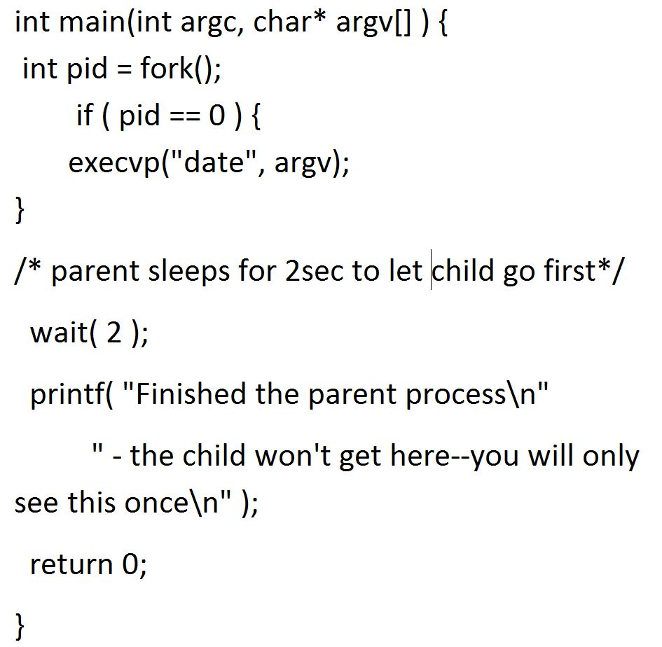
Recap Example 1: Fork and Exec
What would the child print?
What would the parent print?
What would happen if the if (pid == 0) check was removed?

Slide 4
wait: Synchronizing With Children
int wait(int *child_status)
Suspends current process until one of its children terminates
Return value is pid of child process that terminated
If child_status != NULL, then integer it points to will be set to indicate why child terminated

Slide 5
wait: Synchronizing With Children
Void wait_demo() {
int child_status;
if (fork() == 0) {
printf("HC: hello from child\n");
}
else {
printf("HP: hello from parent\n");
wait(&child_status);
printf("CT: child has terminated\n");
}
printf("Bye\n");
exit(0);
}
HC
Bye
HP
CT
Bye

Slide 6
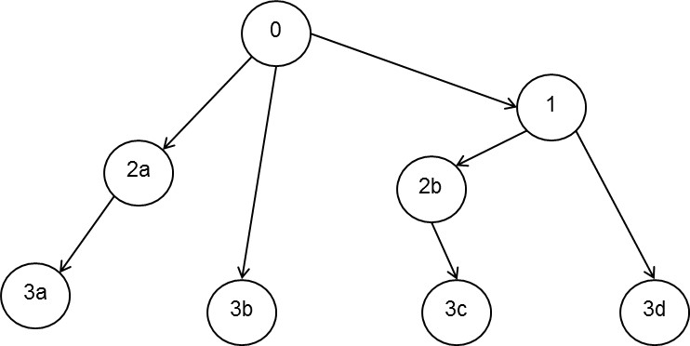
Discussion- Example 2
How would you create the process tree. The numbers
inside the circles simply represent the order of process creation

Slide 7
Discussion – Example 3
How many lines will be printed? Will the output always be the same?

Slide 8
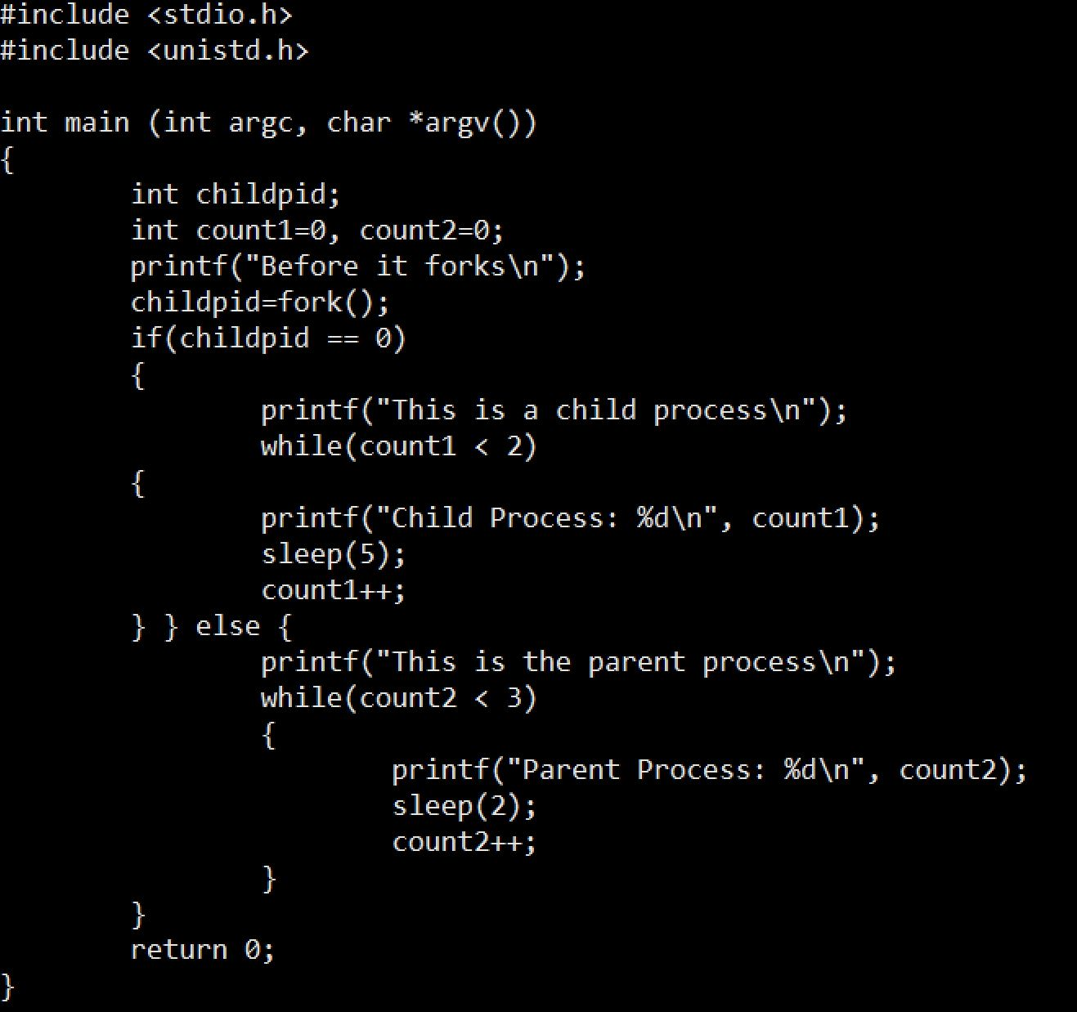
Discussion: Example 4
What is the output of this program?
Will it remain the same?

Slide 9
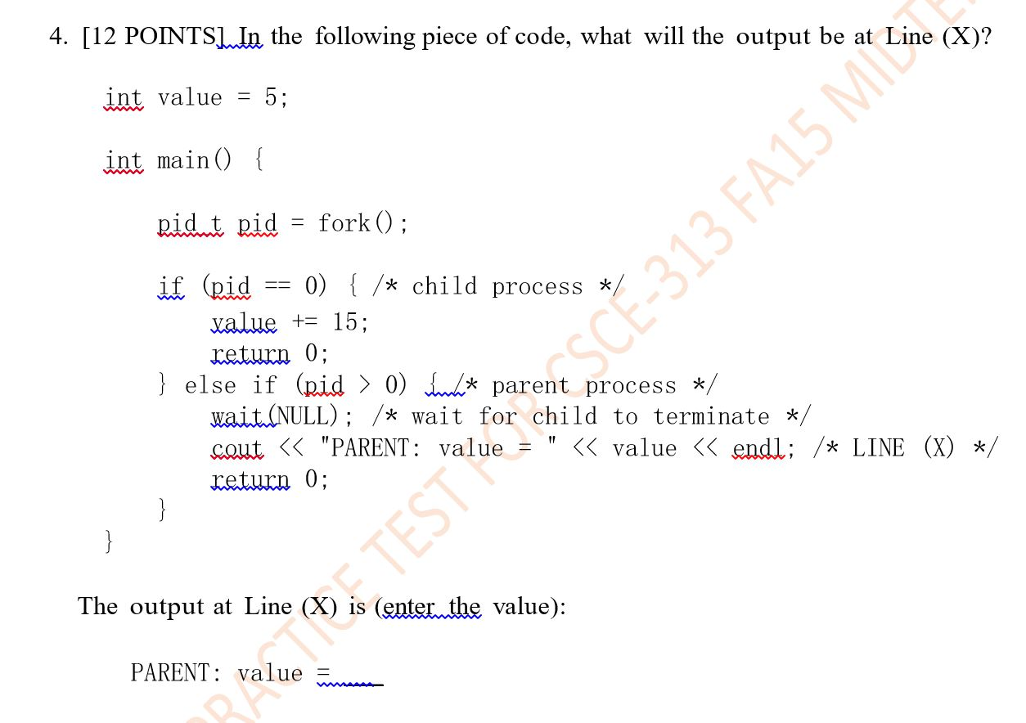
Discussion – Example 5
Notes:
Reference: http://www.makelinux.net/books/lkd2/ch03lev1sec2
Process Creation
Process creation in Unix is unique. Most operating systems implement a spawn mechanism to create a new process in a new address space, read in an executable, and begin executing it. Unix takes the unusual approach of separating these steps into two distinct functions: fork() and exec()^{[8]}. The first, fork(), creates a child process that is a copy of the current task. It differs from the parent only in its PID (which is unique), its PPID (parent's PID, which is set to the original process), and certain resources and statistics, such as pending signals, which are not inherited. The second function, exec(), loads a new executable into the address space and begins executing it. The combination of fork()followed by exec() is similar to the single function most operating systems provide.
^{[8]} By exec() I mean any member of the exec() family of functions. The kernel implements the execve() system call on top of which execlp(),execle(),execv() , and execvp() are implemented.
Copy-on-Write
Traditionally, upon fork() all resources owned by the parent are duplicated and the copy is given to the child. This approach is significantly naïve and inefficient in that it copies much data that might otherwise be shared. Worse still, if the new process were to immediately execute a new image, all that copying would go to waste. In Linux, fork() is implemented through the use of copy-on-write pages. Copy-on-write (or COW) is a technique to delay or altogether prevent copying of the data. Rather than duplicate the process address space, the parent and the child can share a single copy. The data, however, is marked in such a way that if it is written to, a duplicate is made and each process receives a unique copy. Consequently, the duplication of resources occurs only when they are written; until then, they are shared read-only. This technique delays the copying of each page in the address space until it is actually written to. In the case that the pages are never writtenfor example, if exec() is called immediately after fork()they never need to be copied. The only overhead incurred by fork() is the duplication of the parent's page tables and the creation of a unique process descriptor for the child. In the common case that a process executes a new executable image immediately after forking, this optimization prevents the wasted copying of large amounts of data (with the address space, easily tens of megabytes). This is an important optimization because the Unix philosophy encourages quick process execution.
fork()
Linux implements fork() via the clone() system call. This call takes a series of flags that specify which resources, if any, the parent and child process should share (see the section on "The Linux Implementation of Threads" later in this chapter for more about the flags). The fork(), vfork(), and __clone() library calls all invoke the clone() system call with the requisite flags. The clone() system call, in turn, calls do_fork().
The bulk of the work in forking is handled by do_fork(), which is defined in kernel/fork.c. This function calls copy_process(), and then starts the process running. The interesting work is done by copy_process():
It calls dup_task_struct(), which creates a new kernel stack, thread_info structure, and task_struct for the new process. The new values are identical to those of the current task. At this point, the child and parent process descriptors are identical.
It then checks that the new child will not exceed the resource limits on the number of processes for the current user.
Now the child needs to differentiate itself from its parent. Various members of the process descriptor are cleared or set to initial values. Members of the process descriptor that are not inherited are primarily statistically information. The bulk of the data in the process descriptor is shared.
Next, the child's state is set to TASK_UNINTERRUPTIBLE, to ensure that it does not yet run.
Now, copy_process() calls copy_flags() to update the flags member of the task_struct. The PF_SUPERPRIV flag, which denotes whether a task used super-user privileges, is cleared. The PF_FORKNOEXEC flag, which denotes a process that has not called exec(), is set.
Next, it calls get_pid() to assign an available PID to the new task.
Depending on the flags passed to clone(), copy_process() then either duplicates or shares open files, filesystem information, signal handlers, process address space, and namespace. These resources are typically shared between threads in a given process; otherwise they are unique and thus copied here.
Next, the remaining timeslice between the parent and its child is split between the two (this is discussed in Chapter 4).
Finally, copy_process() cleans up and returns to the caller a pointer to the new child.
Back in do_fork(), if copy_process() returns successfully, the new child is woken up and run. Deliberately, the kernel runs the child process first^{[9]}. In the common case of the child simply calling exec() immediately, this eliminates any copy-on-write overhead that would occur if the parent ran first and began writing to the address space.

Slide 10
Questions to ponder about processes – what have we learned so far?
How is a process created?
How is a process deleted?
Is there a user process and kernel process
Where do we keep information about a process
Does a process have to run through completion from start to finish or can it be interrupted?
Do processes have priorities?
What are the relationships between multiple processes in a system?
Can we have multiple processes related to the same program? Would multiple processes of the same program share addresses during execution?
How does a program run a program?
How does a parent wait for a child to exit?

Slide 11
Rest of the Discussion
Process Life-Cycle
What does it take to execute the life-cycle?
Orphan, Zombie Processes

Slide 12

OS Bottom Line: Run Programs
Program Source
Executable
Memory
0x000…
int main()
{ … ;
}
Load & Execute
instructions
compiler
instructions
editor
data
data
heap
foo.c
a.out
Load instruction and data segments of executable file into memory
Create stack and heap
“Transfer control to it”
Provide services to it (network, file connections, IO, etc.)
while protecting OS and it
stack
OS
0xFFF…
PC:
registers
Processor

Slide 13
States of a Process
User view: A process is executing continuously
In reality: Several processes compete for the CPU and other resources
A process may be
Running: it holds the CPU and is executing instructions
Blocked(waiting): it is waiting for some I/O event to occur
Ready: it is waiting to get back on the CPU
preempt
Create
(new)
ready
running
Exit
(terminated)
dispatch
I/O or
Event complete
blocked
I/O or event wait
Notes:
UNIX: ps to get process information

Slide 14
Questions
How many processes can be in the running state simultaneously?
What state do you think a process is in most of the time?
How many processes can a system support? **
Notes:
How many processes can be in the running state simultaneously? - as many as number of cores
What state do you think a process is in most of the time? Ready or waiting (if majority are IO dependent)
How many processes can a system support? **
Check out: /etc/security/limits.conf

Slide 15
The Execution Trace of Processes
...
β
Two processes and a dispatcher
Traces of processes A and B
β+1
β+2
α
β
β+3
α+1
β+1
β+4
α+2
β+2
δ
α+3
β+3
δ+1
program B
α+4
β+4
δ+2
α+5
β+5
δ+3
α+6
β+6
δ+4
β
α+7
β+7
α
α+8
β+8
α+1
α+9
β+9
α+2
program A
α+10
β+10
α+3
α+11
β+11
α+4
δ
α
Trace of dispatcher
δ+1
δ+2
δ
δ+3
dispatcher
δ+1
δ+4
δ+2
β+5
δ
β+6
δ+3
δ+4
β+7
...

Slide 16
Process Data Structures
How does the OS represent a process in the kernel?
At any time, there are many processes in the system, each in its particular state
The OS data structure representing each process is called the Process Control Block (PCB)
The PCB contains all of the info about a process
The PCB also is where the OS keeps all of a process’ hardware execution state (PC, SP, regs, etc.) when the process is not running
This state is everything that is needed to restore the hardware to the same configuration it was in when the process was switched out of the hardware
Notes:
http://unix.stackexchange.com/questions/150734/where-is-pcb-on-linux:
In the Linux kernel, each process is represented by a task_struct in a doubly-linked list, the head of which is init_task (pid 0, not pid 1). This is commonly known as the process table.
In user mode, the process table is visible to normal users under /proc. Taking the headings for your question:
Process identification data is the process ID (which is in the path /proc/<process-id>/...), the command line (cmd), and possibly other attributes depending on your definition of 'identification'.
Process state data includes scheduling data (sched, stat and schedstat), what the process is currently waiting on (wchan), its environment (environ) etc.
Process control data could be said to be its credentials (uid_map) and resource limits (limits).
So it all depends how you define your terms... but in general, all data about a process can be found in /proc.

Slide 17
Process Control Block (PCB)
process identification | process id parent process id user id etc…
processor state information | register set condition codes processor status
process control information | process state scheduling information event (wait-for) memory-mgmt information owned resources (e.g., list of opened files)

Slide 18
Process Context Switch
Mechanism of a process switch:
Process A
Process B
process identification
Preempt Process A and store
all relevant information.
(idle)
Load information about
Process B and continue execution
processor state
information
(idle)
Preempt Process B and store
all relevant information.
process control
information
Load information about
Process A and continue execution
(idle)
Process Control Block
Notes:
Context switch

Slide 19
Context Switch: PCB and the Hardware States
When a process is running, its hardware state (PC, SP, regs, etc.) is in the CPU
The hardware registers contain the current values
When the OS stops running a process, it saves the current values of the registers into the process’ PCB
When the OS is ready to start executing a new process, it loads the hardware registers from the values stored in that process’ PCB
The process of changing the CPU hardware state from one process to another is called a context switch
This can happen 100 or 1000 or more times a second!

Slide 20
Process Scheduling Queues
Job queue – set of all processes in the system
Ready queue – set of all processes residing in main memory, ready and waiting to execute
Device queues – set of processes waiting for an I/O device
Processes migrate among the various queues

Slide 21
Example for the Use of PCBs: Process Queues
ready
running
waiting
ready queue
executing process
disk 1
disk 2
I/O device queues
serial I/O

Slide 22
Schedulers
Long-term scheduler (or job scheduler)
selects which processes should be brought into the ready queue
controls degree of multiprogramming
must select a good process mix of I/O-bound and CPU-bound processes
Short-term scheduler (or CPU scheduler)
selects which process should be executed next and allocates CPU
executes at least every 100ms, therefore must be very fast
Medium-term scheduler (swapper)
in some Oss
sometimes good to temporarily remove processes from memory (suspended)

Slide 23
Schedulers
start
long-term (admission) scheduler
short-term (CPU) scheduler
suspended
ready
ready
running
suspended
blocked
blocked
medium-term (memory) scheduler
Notes:
Long-term scheduler (job scheduler)
controls degree of multiprogramming
must select a good process mix of I/O-bound and CPU-bound processes
Short-term scheduler:
allocates the CPU
executes at least every 100ms, therefore must be very fast
Medium-term scheduler (swapper):
in some OSs
sometimes good to temporarily remove processes from memory

Slide 24
Zombie Process
Idea
When process terminates, still consumes system resources
Various tables maintained by OS (to store exit status)
Called a “zombie”
Living corpse, half alive and half dead
Reaping
Performed by parent on terminated child
Parent is given exit status information
Kernel discards process

Slide 25
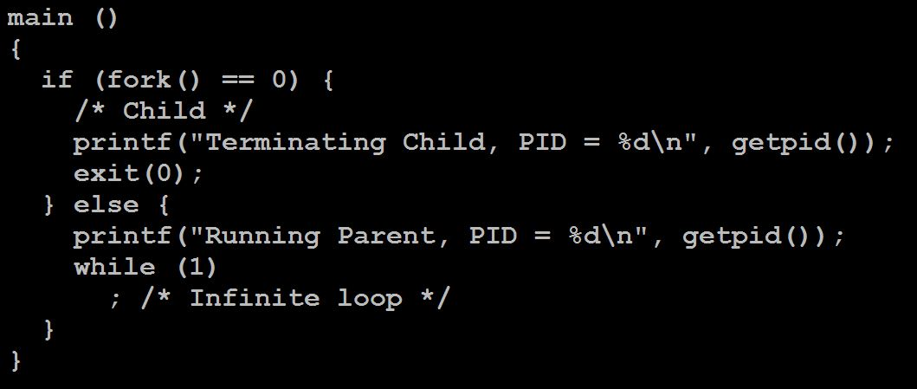
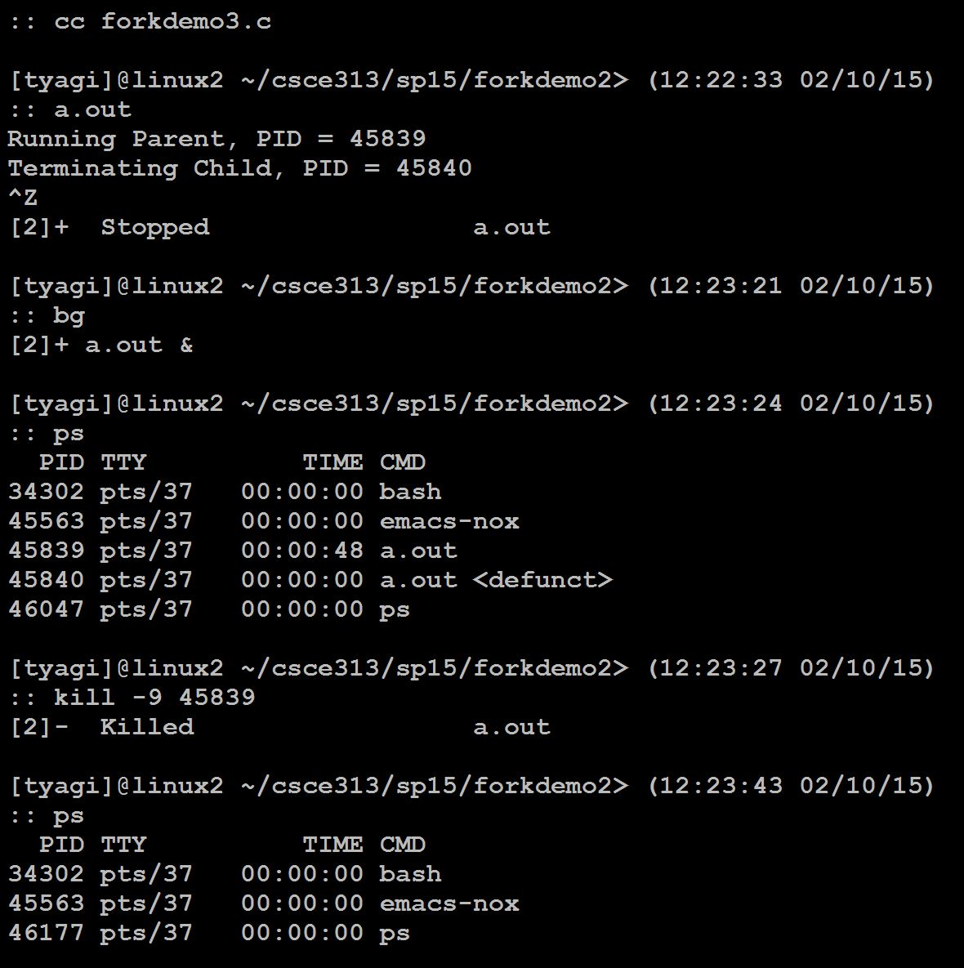
Zombie Example
ps shows child process as “defunct”
Killing parent allows child to be reaped

Slide 26
Orphan Process
Without a parent process
Adopted immediately by the “Init” process
Sometimes orphans are killed with the SIGHUP signal
(it can be overruled with the nohup handler)

Slide 27
Summary
What are the units of execution?
Processes
How are those units of execution represented?
Process Control Blocks (PCBs)
How is work scheduled in the CPU?
Process states, process queues, context switches
What are the possible execution states of a process?
Running, ready, waiting
How does a process move from one state to another?
Scheduling, I/O, creation, termination
How are processes created?
fork/exec (Unix)

Slide 28
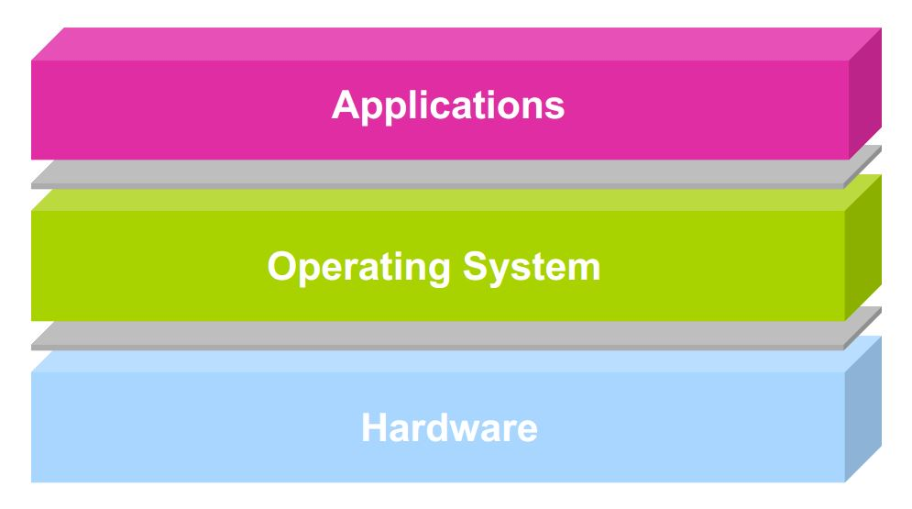
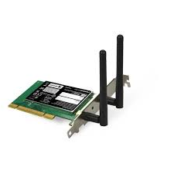



Next Class
Unix I/O
user2
user3
user1
user2
user3
user4
user1
user4
Application Programs/Processes
return
System calls,
Exceptions
Privileged
Operations
Processor
Memory
INT
Character O/P
Bock I/O
storage

