Slide 1
Week 5: UNIX IO
Reference:
Advanced Programming in the UNIX Environment, Third Edition, W. Richard Stevens and
Stephen A. Rago, Addison-Wesley Professional Computing Series, 2013. Chapter 3
Computer Systems: A Programmer's Perspective, Randal E. Bryant and David R. O'Hallaron,
Prentice Hall, 3rd edition, 2016, Chapter 10
Acknowledgment: A number of examples in a box with this color are taken from CSAPP book cited above
Aakash Tyagi CSCE 313 Spring 2017

Slide 2
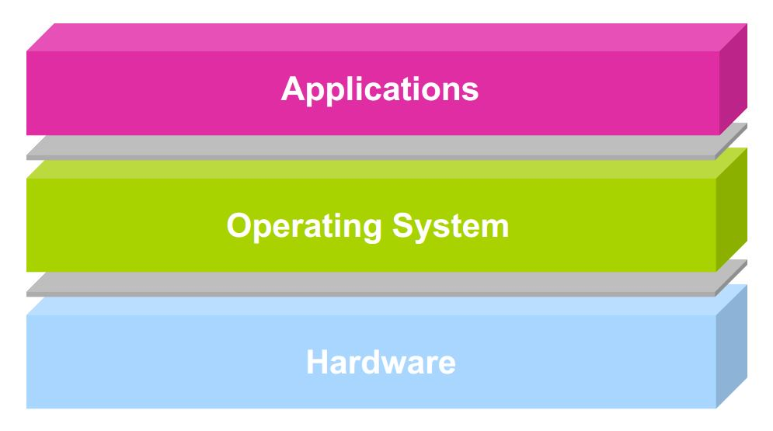
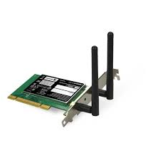



Unix IO
How do we communicate with IO Devices?
user2
user3
user1
user2
user3
user4
user1
user4
Application Programs/Processes
return
System calls,
Exceptions
Privileged
Operations
Processor
Memory
INT
Character O/P
Bock I/O
storage

Slide 3
Motivation
I/O is the process of copying data between main memory and external devices (disk drives, terminals, networks)
Language run-time systems provide higher-level facilities for performing I/O (e.g. printf, scanf)
On Unix systems, these higher-level I/O functions are implemented using System-Level Unix I/O functions provided by the Kernel
Notes:
Most of the time the higher-level I/O functions work fine, so why bother learn Unix I/O?
Understanding Unix I/O will help us with other system concepts
Sometimes you have no choice but to use Unix I/O
File metadata requires Unix I/O.
Standard I/O library also makes it risky for network programming.

Slide 4
Unix Files
A Unix file is a sequence of m bytes:
B₀ , B₁ , .... , B_{k} , .... , B_{m-1}
All I/O devices (networks, disks, terminals) are represented as files:
/dev/sda2 (/usr disk partition; a is the order and #2 is the partition)
/dev/tty2 (terminal)
Even the kernel is represented as a file:
/dev/kmem (kernel memory image)
/proc (kernel data structures)
All I/O is performed by reading and writing the appropriate files

Slide 5
Files are not always “Files”: I/O Devices
graphics
keyboard
mass storage
CPU
mouse
printer
memory
modem
network

Slide 6
Unix File Types
Regular file
File containing user/app data (binary, text, whatever)
Directory file
A file that contains the names and locations of other files
Character special and block special files
Terminals (character special) and disks (block special)
FIFO (named pipe)
A file type used for inter-process communication
Socket
A file type used for network communication between processes

Slide 7
Unix I/O
Key Features
Elegant mapping of files to devices allows kernel a simple interface called Unix I/O
Important idea: All input and output is handled in a consistent and uniform way

Slide 8
Unix I/O
Basic Unix I/O operations (system calls):
Opening and closing files
open()and close()
Reading and writing a file
read() and write()
Changing the current file position (seek)
Kernel maintains a file position (initially 0) for each open file
indicates next (byte) offset into file to read or write
lseek()
B₀
B₁
• • •
B_{k-1}
B_{k}
B_{k+1}
• • •
Current file position = k

Slide 9
Opening Files
Opening a file informs the kernel that you are getting ready to access that file
Returns a small identifying integer file descriptor
fd == -1 indicates that an error occurred
Kernel keeps track of all information about the open file. The application only keeps track of the descriptor
int fd; /* file descriptor */
if ((fd = open("/etc/hosts", O_RDONLY)) < 0) {
perror("open");
exit(1);
}

Slide 10
Opening Files
Each process created by a Unix shell begins life with three open files associated with a terminal:
0: standard input
1: standard output
2: standard error

Slide 11
Closing Files
Closing a file informs the kernel that you are finished accessing that file
The kernel responds by freeing the data structures associated with the file and restoring the descriptor to the available pool of available descriptors
When a process terminates for any reason, the kernel closes all open files and frees their memory resources
int fd; /* file descriptor */
int retval; /* return value */
if ((retval = close(fd)) < 0) {
perror("close");
exit(1);
}
Notes:
Closing an already closed file is a recipe for disaster in threaded programs
Moral: Always check return codes, even for seemingly benign functions such as close()

Slide 12
Example
What is the output of the following program?
Unix processes begin life with open descriptors assigned to stdin (fd=0), stdout (fd=1), and stderr (fd=2). The open function always returns the lowest unopened descriptor so the output will be “fd2=3”
int main ()
{
int fd1, fd2;
fd1 = open(“foo.txt”, O_RDONLY, 0);
close(fd1);
fd2 = open(“baz.txt”, O_RDONLY, 0);
printf(“fd2=%d\n”, fd2);
exit(0);
}

Slide 13
Reading Files
Reading a file copies bytes from the current file position to memory, and then updates file position
char buf[512];
int fd; /* file descriptor */
int nbytes; /* number of bytes read */
/* Open file fd ... */
/* Then read up to 512 bytes from file fd */
if ((nbytes = read(fd, buf, sizeof(buf))) < 0) {
perror("read");
exit(1);
}

Slide 14
Reading Files
char buf[512];
int fd; /* file descriptor */
int nbytes; /* number of bytes read */
/* Open file fd ... */
/* Then read up to 512 bytes from file fd */
if ((nbytes = read(fd, buf, sizeof(buf))) < 0) {
perror("read");
exit(1);
}
Returns number of bytes read from file fd into buf
Return type ssize_t is signed integer
nbytes < 0 indicates that an error occurred
Short counts (nbytes < sizeof(buf) ) are possible and are not errors (eg. EOF, reading text from terminal etc.)

Slide 15
Writing Files
Writing a file copies bytes from memory to the current file position, and then updates current file position
char buf[512];
int fd; /* file descriptor */
int nbytes; /* number of bytes written*/
/* Open the file fd ... */
/* Then write up to 512 bytes from buf to file fd */
if ((nbytes = write(fd, buf, sizeof(buf)) < 0) {
perror("write");
exit(1);
}

Slide 16
Writing Files
char buf[512];
int fd; /* file descriptor */
int nbytes; /* number of bytes written*/
/* Open the file fd ... */
/* Then write up to 512 bytes from buf to file fd */
if ((nbytes = write(fd, buf, sizeof(buf)) < 0) {
perror("write");
exit(1);
}
Returns number of bytes written from buf to file fd
nbytes < 0 indicates that an error occurred
As with reads, short counts are possible and are not errors!

Slide 17
Simple Unix I/O example
Copying standard in to standard out, one byte at a time
int main(void)
{
char c;
while(read(STDIN_FILENO, &c, 1) != 0)
write(STDOUT_FILENO, &c, 1);
exit(0);
}

Slide 18
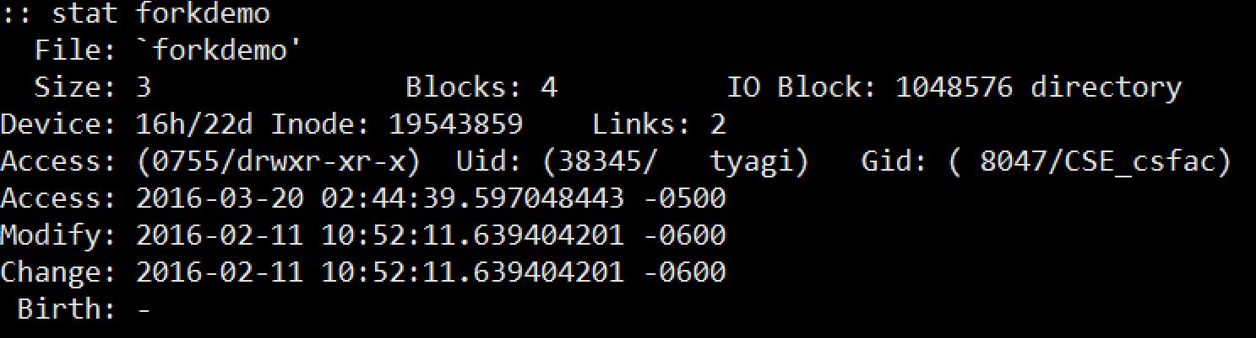
File Metadata
Metadata is data about data, in this case file data
Per-file metadata maintained by kernel
accessed by users with the stat function
/* Metadata returned by the stat function */
struct stat {
dev_t st_dev; /* device */
ino_t st_ino; /* inode */
mode_t st_mode; /* protection and file type */
nlink_t st_nlink; /* number of hard links */
uid_t st_uid; /* user ID of owner */
gid_t st_gid; /* group ID of owner */
dev_t st_rdev; /* device type (if inode device) */
off_t st_size; /* total size, in bytes */
unsigned long st_blksize; /* blocksize for filesystem I/O */
unsigned long st_blocks; /* number of blocks allocated */
time_t st_atime; /* time of last access */
time_t st_mtime; /* time of last modification */
time_t st_ctime; /* time of last change */
};

Slide 19
Example of Accessing File Metadata
unix> ./statcheck statcheck.c
type: regular, read: yes
unix> chmod 000 statcheck.c
unix> ./statcheck statcheck.c
type: regular, read: no
unix> ./statcheck ..
type: directory, read: yes
unix> ./statcheck /dev/kmem
type: other, read: yes
int main (int argc, char **argv)
{
struct stat stat;
char *type, *readok;
Stat(argv[1], &stat);
if (S_ISREG(stat.st_mode))
type = "regular";
else if (S_ISDIR(stat.st_mode))
type = "directory";
else
type = "other";
if ((stat.st_mode & S_IRUSR)) /* OK to read?*/
readok = "yes";
else
readok = "no";
printf("type: %s, read: %s\n", type, readok);
exit(0);
}

Slide 20
Accessing Directories
Reading Directory Entries
dirent structure contains information about a directory entry
DIR structure contains information about directory while stepping through its entries
#include <sys/types.h>
#include <dirent.h>
{
DIR *directory;
struct dirent *de;
...
if (!(directory = opendir(dir_name)))
error("Failed to open directory");
...
while (0 != (de = readdir(directory))) {
printf("Found file: %s\n", de->d_name);
}
...
closedir(directory);
}

Slide 21
File Representation to User
The kernel represents open files using three related data structures
Descriptor Table
Each process has its own separate descriptor table whose entries are indexed by the process’s open file descriptors. Each open descriptor entry points to an entry in the file table.
v-node Table
Each entry (per file) contains information in the stat structure
File Table
Shared by all processes. Each entry consists of the current file position, reference count of # of descriptor entries that point to it, and a ptr to the entry in the v-node table, along with status flags

Slide 22
How the Unix Kernel Represents Open Files
Two descriptors referencing two distinct open disk files. Descriptor 1 (stdout) points to terminal, and descriptor 4 points to open disk file
Descriptor table
[one table per process]
Open file table
[shared by all processes]
v-node table
[shared by all processes]
File A (terminal)
stdin
fd 0
File access
stdout
fd 1
File pos
File size
Info in
stat struct
stderr
fd 2
fd 3
refcnt=1
File type
fd 4
...
...
File B (disk)
Refcnt = # of descriptor entries
pointing to a file
File access
File pos
File size
refcnt=1
File type
...
...

Slide 23
File Sharing
Two distinct descriptors sharing the same disk file through two distinct open file table entries
E.g., calling open twice with the same filename argument
Descriptor table
[one table per process]
Open file table
[shared by all processes]
v-node table
[shared by all processes]
Entry#x File A (disk)
stdin
fd 0
File access
stdout
fd 1
File pos
File size
stderr
fd 2
fd 3
refcnt=1
File type
fd 4
...
...
Entry#y File A (disk)
File pos
refcnt=1
...

Slide 24
Example
Suppose the disk file foobar.txt consists of the six ASCII characters “foobar”. Then what is the output of the following program:
Answer: The descriptors fd1 and fd2 each have their own open file table entry so each descriptor has its own file position for foobar.txt. Thus the read from fd2 reads the first byte of foobar.txt and the output is “c=f” and NOT “c=o”
int main ()
{
int fd1, fd2;
char c;
fd1 = open(“foobar.txt”, O_RDONLY, 0);
fd2 = open(“foobar.txt”, O_RDONLY, 0);
read(fd1, &c, 1);
read(fd2, &c, 1);
printf(“c=%c\n”, c);
exit(0);
}

Slide 25
File Descriptors and fork()
With fork(), child inherits content of parent’s address space, including most of parent’s state:
scheduling parameters
file descriptor table
signal state
environment
etc.
parent’s file desc table
[0]
A(SFT)
[1]
B(SFT)
[2]
C(SFT)
[3]
D(SFT)
system file table (SFT)
[4]
[5]
A
B
C
child’s file desc table
D (“myf.txt”)
[0]
A(SFT)
[1]
B(SFT)
[2]
C(SFT)
[3]
D(SFT)
[4]
[5]

Slide 26
File Descriptors and fork() (II)
parent’s file desc table
[0]
A(SFT)
int main(void) {
char c = ‘!’;
int myfd;
myfd = open(‘myf.txt’, O_RDONLY);
fork();
read(myfd, &c, 1);
printf(‘Process %ld got %c\n’, (long)getpid(), c);
return 0;
}
B(SFT)
[1]
C(SFT)
[2]
D(SFT)
[3]
system file table (SFT)
[4]
[5]
A
B
C
child’s file desc table
D (“myf.txt”)
[0]
A(SFT)
[1]
B(SFT)
[2]
C(SFT)
[3]
D(SFT)
[4]
[5]
Notes:
In this case, the first process to read gets the first character in the file, and the other reads the second character from the file.

Slide 27
File Descriptors and fork() (III)
parent’s file desc table
int main(void) {
char c = ‘!’;
int myfd;
fork();
myfd = open(‘myf.txt’, O_RDONLY);
read(myfd, &c, 1);
printf(‘Process %ld got %c\n’, (long)getpid(), c);
return 0;
}
[0]
A(SFT)
[1]
B(SFT)
system file table (SFT)
[2]
C(SFT)
[3]
D(SFT)
A
[4]
B
[5]
C
D (“myf.txt”)
child’s file desc table
[0]
A(SFT)
E (“myf.txt”)
[1]
B(SFT)
[2]
C(SFT)
[3]
E(SFT)
[4]
[5]

Slide 28
Example
Suppose the disk file foobar.txt consists of the six ASCII characters “foobar”. Then what is the output of the following program:
Answer: The child inherits the parent’s descriptor table and all processes share the same file table. Thus the descriptor fd in both the parent and child points to the same open file table entry. When the child reads the first byte of the file, the file position increments by 1. Thus the parent reads the second byte and output is “c=o”
int main ()
{
int fd;
char c;
fd = open(“foobar.txt”, O_RDONLY, 0);
if (fork() == 0) {
read(fd, &c, 1);
exit(0);
}
wait(NULL)
read(fd, &c, 1);
printf(“c=%c\n”, c);
exit(0);
}

Slide 29
I/O Redirection
Question: How does a shell implement I/O redirection?
unix> ls > foo.txt
Answer: By calling the dup2(oldfd, newfd) function
Copies (per-process) descriptor table entry oldfd to entry newfd
Descriptor table
before dup2(4,1)
Descriptor table
after dup2(4,1)
fd 0
fd 0
fd 1
a
fd 1
b
fd 2
fd 2
fd 3
fd 3
fd 4
b
fd 4
b

Slide 30
I/O Redirection Example
Step #1: open file to which stdout should be redirected
Happens in child executing shell code, before exec
Descriptor table
[one table per process]
Open file table
[shared by all processes]
v-node table
[shared by all processes]
File A
stdin
fd 0
File access
stdout
fd 1
File pos
File size
stderr
fd 2
fd 3
refcnt=1
File type
fd 4
...
...
File B
File access
File pos
File size
refcnt=1
File type
...
...

Slide 31
I/O Redirection Example (cont.)
Step #2: call dup2(4,1)
cause fd=1 (stdout) to refer to disk file pointed at by fd=4
Descriptor table
[one table per process]
Open file table
[shared by all processes]
v-node table
[shared by all processes]
File A
stdin
fd 0
File access
stdout
fd 1
File pos
File size
stderr
fd 2
fd 3
refcnt=0
File type
fd 4
...
...
File B
File access
File pos
File size
refcnt=2
File type
...
...

Slide 32
Example
Assuming that the disk file foobar.txt consists of six ASCII characters “foobar” what is the output?
int main()
{
int fd1, fd2;
char c;
fd1 = Open(fname, O_RDONLY, 0);
fd2 = Open(fname, O_RDONLY, 0);
Read(fd2, &c, 1);
Dup2(fd2, fd1);
Read(fd1, &c, 1);
printf("c = %c\n", c);
return 0;
}
Because we are redirecting fd1 to fd2, the output is c=o

Slide 33
Practice: Fun with File Descriptors (1)
int main(int argc, char *argv[])
{
int fd1, fd2, fd3;
char c1, c2, c3;
char *fname = argv[1];
fd1 = Open(fname, O_RDONLY, 0);
fd2 = Open(fname, O_RDONLY, 0);
fd3 = Open(fname, O_RDONLY, 0);
Dup2(fd2, fd3);
Read(fd1, &c1, 1);
Read(fd2, &c2, 1);
Read(fd3, &c3, 1);
printf("c1 = %c, c2 = %c, c3 = %c\n", c1, c2, c3);
return 0;
}
What would this program print for file containing “abcde”?

Slide 34
Practice: Fun with File Descriptors (2)
#include "csapp.h"
int main(int argc, char *argv[])
{
int fd1;
int s = getpid() & 0x1;
char c1, c2;
char *fname = argv[1];
fd1 = Open(fname, O_RDONLY, 0);
Read(fd1, &c1, 1);
if (fork()) { /* Parent */
sleep(s);
Read(fd1, &c2, 1);
printf("Parent: c1 = %c, c2 = %c\n", c1, c2);
} else { /* Child */
sleep(1-s);
Read(fd1, &c2, 1);
printf("Child: c1 = %c, c2 = %c\n", c1, c2);
}
return 0;
}
What would this program print for file containing “abcde”?

Slide 35
Practice: Fun with File Descriptors (3)
#include "csapp.h"
int main(int argc, char *argv[])
{
int fd1, fd2, fd3;
char *fname = argv[1];
fd1 = Open(fname, O_CREAT|O_TRUNC|O_RDWR, S_IRUSR|S_IWUSR);
Write(fd1, "pqrs", 4);
fd3 = Open(fname, O_APPEND|O_WRONLY, 0);
Write(fd3, "jklmn", 5);
fd2 = dup(fd1); /* Allocates descriptor */
Write(fd2, "wxyz", 4);
Write(fd3, "ef", 2);
return 0;
}
What would be the contents of the resulting file?

Slide 36
Standard I/O Functions
The C standard library (libc.so) contains a collection of higher-level standard I/O functions
Documented in Appendix B of K&R.
Examples of standard I/O functions:
Opening and closing files (fopen and fclose)
Reading and writing bytes (fread and fwrite)
Reading and writing text lines (fgets and fputs)
Formatted reading and writing (fscanf and fprintf)

Slide 37
Standard I/O Streams
Standard I/O models open files as streams
Abstraction for a file descriptor and a buffer in memory.
C programs begin life with three open streams (defined in stdio.h)
stdin (standard input)
stdout (standard output)
stderr (standard error)
#include <stdio.h>
extern FILE *stdin; /* standard input (descriptor 0) */
extern FILE *stdout; /* standard output (descriptor 1) */
extern FILE *stderr; /* standard error (descriptor 2) */
int main() {
fprintf(stdout, "Hello, world\n");
}

Slide 38
Buffering in Standard I/O
Standard I/O functions use buffered I/O
Buffer flushed to output fd on “\n” or fflush() call
printf("h");
printf("e");
printf("l");
printf("l");
printf("o");
buf
printf("\n");
h
e
l
l
o
\n
.
.
fflush(stdout);
write(1, buf, 6);

Slide 39
Unix I/O vs. Standard I/O
Standard I/O is implemented using low-level Unix I/O
Which ones should you use in your programs?
fopen fdopen
fread fwrite fscanf fprintf sscanf sprintf fgets fputs fflush fseek
fclose
C application program
Standard I/O
functions
open read
write lseek
stat close
Unix I/O functions
(accessed via system calls)
Notes:
There are some important cases where using higher-level I/O functions is either impossible or inappropriate. For example, the standard I/O library provides no way to access file metadata such as file size or file creation time. Further, there are problems with the standard I/O library that make it risky to use for network programming.

Slide 40
Pros and Cons of Unix I/O
Pros
Unix I/O is the most general and lowest overhead form of I/O
All other I/O packages are implemented using Unix I/O functions
Unix I/O provides functions for accessing file metadata
Cons
Dealing with short counts is tricky and error prone
Efficient reading of text lines requires some form of buffering, also tricky and error prone
Both of these issues are addressed by standard I/O packages

Slide 41
Pros and Cons of Standard I/O
Pros:
Buffering increases efficiency by decreasing the number of read and write system calls
Short counts are handled automatically
Cons:
Provides no function for accessing file metadata
Standard I/O is not appropriate for input and output on network sockets
There are poorly documented restrictions on streams that interact badly with restrictions on sockets (CS:APP2e, Sec 10.9)

Slide 42
Choosing I/O Functions
General rule: use the highest-level I/O functions you can
Many C programmers are able to do all of their work using the standard I/O functions
When to use standard I/O
When working with disk or terminal files
When to use raw Unix I/O
Inside signal handlers, because Unix I/O is async-signal-safe
In rare cases when you need absolute highest performance

Slide 43
For Further Information
The Unix bible:
W. Richard Stevens & Stephen A. Rago, Advanced Programming in the Unix Environment, 3nd Edition, Addison Wesley, 2013
Computer Systems: A Programmer's Perspective, Randal E. Bryant and David R. O'Hallaron,
Prentice Hall, 3rd edition, 2016, Chapter 10

