Slide 1
Week 3 – Unix process
Reading Reference
Textbook Chapters 2 and 3
Molay Reference Text: Chapter 8
CSCE 313 Spring 2017

Slide 2
Key Learnings from Week 2
DUAL MODE
“Referee” Role of an OS comes with significant responsibilities and capabilities
Enforcing Fairness, Efficiency, and Correctness are perhaps the most critical of the bunch
OS is also a piece of software residing in the same memory so it is the CPU that wears the “referee” hat when it runs the OS Kernel code and wears the “player” hat when running user code
This is called Dual Mode operation

Slide 3
Key Learnings from Week 2
Architectural support for user and kernel modes in CPU execution implies hardware features provided to accomplish dual modes transition, especially
Privileged Instructions
Memory Protection
Timer, etc.

Slide 4
A Real-Life Analogy (Approximate)
A Typical Coffee Shop | Computer System
Store | System
Customer | Process or Program or User Application
Barista/Cashier | Operating System Kernel, Privileged Code
Coffee Machine | CPU
Customer Order | System Call
Order item not on Menu | Exception
Telephone Call | Interrupt
Fire Alarm | Signal
>1 Customers being served | Process Scheduling
Customer realizing at the counter that he needs to go to ATM to get money | Process Context Switching
Notes:
Remember to not take this analogy too far in assuming complete parallel between a computer system and a shop ☺ These analogies are simply given so we can better relate to some high level concepts.

Slide 5
Key Asides
System Call Handling (Ch. 2.6)
How do we execute traps safely and return back cleanly to resume user code?
Interrupt handling (Ch. 2.5)
How do we service an exception that occurs in the middle of running user code and return back cleanly (safely) to resume user code?
How do we boot an OS Kernel? (Ch. 2.9)

Slide 6
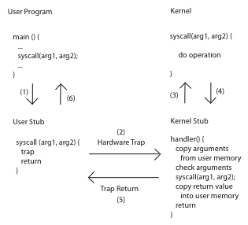
Aside1: Handling System Calls

Slide 7
Aside2: Handling an Interrupt
CPU checks for interrupts after each instruction
Save critical registers on Kernel stack and get in Kernel Mode
Disable Interrupts
Refer to Interrupt Descriptor Table for handler location
Execute handler
save process context
service INT
Enable Interrupts. If no other INT, restore control to interrupted process
Continue on normal program execution

Slide 8
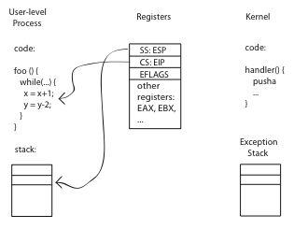
Aside2: Handling an Interrupt (Before)

Slide 9
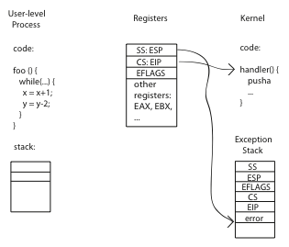
Aside2: Handling an Interrupt (During)

Slide 10
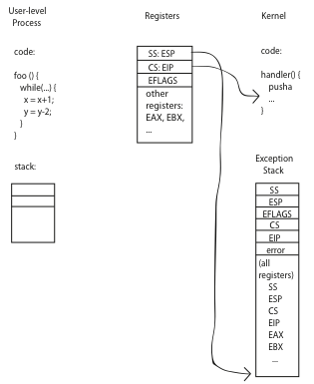
Aside2: Handling an Interrupt (After)

Slide 11
Aside2: At the end of handler
Handler restores saved registers
Atomically return to interrupted process/thread
Restore program counter
Restore program stack
Restore processor status word/condition codes
Switch to user mode

Slide 12
Aside3: PC Booting

Slide 13
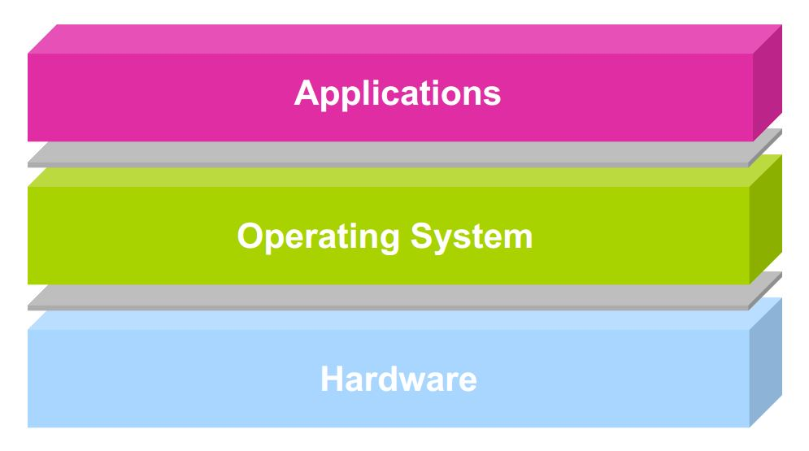
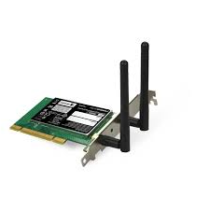



Theme of the rest of Week 3
Unix Process concept and definitions
user2
user3
user1
user2
user3
user4
user1
user4
Application Programs/Processes
return
System calls,
Exceptions
Privileged
Operations
Processor
Memory
INT
Character O/P
Bock I/O
storage

Slide 14
Outline
Process – Program in Action
Address Spaces
Learning about Process with ‘ps’
Miscellaneous questions about Process
Concurrent Processes
Context Switching

Slide 15
Prologue* with Questions
“How does Unix run programs? It looks easy enough: you log in, your shell prints a prompt, you type a command and press Enter. Soon a program runs.
When the program finishes, your shell prints a new prompt. How does that work?
What is the shell? What does a shell do? What does the kernel do? What is a program and what does it mean to run a program?”
* Understanding Linux/Unix Programming, by Bruce Molay

Slide 16
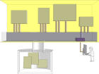
Process is Program in Action
processes
ps
ps –a
ps -l
ls
ls –a
ls -l
files
In Unix terminology
an executable program is a list of machine language instructions and data
a process is the memory space and settings with which the program runs
Data and programs are stored in files on the disk: programs run in processes

Slide 17
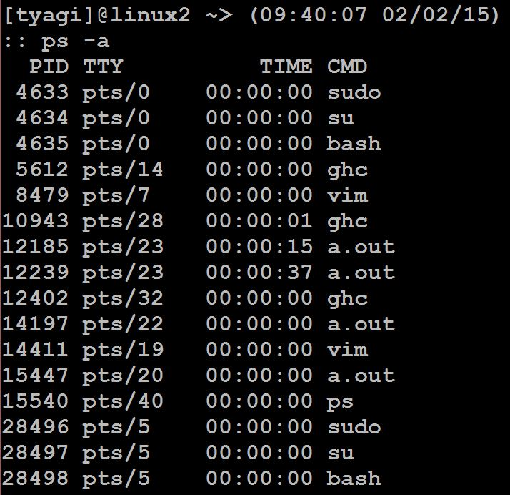
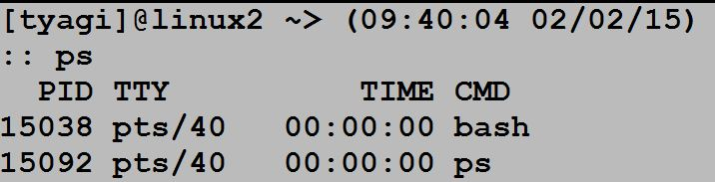
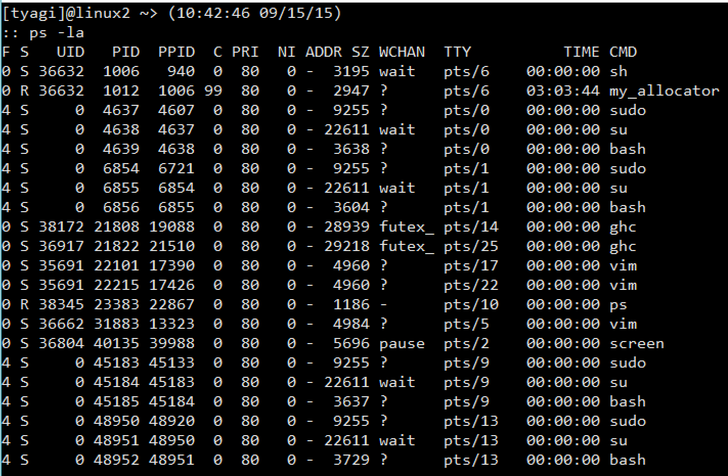
Learning about Processes with ‘ps’
Run these commands in your linux/unix system and then also read the ‘man’ pages
Notes:
For full details about ps output fields, do “man ps” in linux shell
F: flags (4 is super-user)
S: Process State (R is Running or Runnable (on run queue), S is waiting for an event to complete, T is stopped)
C: % of CPU
PRI: Priority
NI: Nice Value
ADDR: Memory address - not used
SZ: Size virtual memory usage in pages (default page size is 4K)
Wchan: Memory address of the event the process is waiting for

Slide 18
Processes
Definition: A process is an instance of a ‘running’ program
Process provides each program with two key abstractions:
Logical control flow
Each program seems to have exclusive use of the CPU
Private address space
Each program seems to have exclusive use of main memory
How are these illusions maintained?
Process executions interleaved (multitasking)
Address spaces managed by virtual memory system

Slide 19
Logical Control Flows
Each process has its own logical control flow
Process A
Process B
Process C
Time

Slide 20
Private Address Spaces
Each process has its own private address space
0xffffffff
user stack
(created at runtime)
%esp (stack pointer)
memory mapped region for
shared libraries
0x40000000
run-time heap
(managed by malloc)
brk
read/write segment
(.data, .bss)
loaded from the
executable file
read-only segment
(.init, .text, .rodata)
0x08048000
0
unused

Slide 21
Process Management and File Management
‘ps’ shows that processes have many attributes
‘ls’ does something similar but for files
The kernel stores several processes in the memory just like it stores files on the disk

Slide 22

Computer Memory and Programs
Memory can be viewed as an expanse of space containing the kernel and user applications (processes)
Memory as an array of pages and split processes into one or more pages
The array of pages may be stored physically in solid state chips
kernel
process A
process B

Slide 23
Concurrent Processes
Two processes run concurrently (are concurrent) if their flows overlap in time
Otherwise, they are sequential
Examples:
Concurrent: A & B, A & C
Sequential: B & C
Process A
Process B
Process C
Time

Slide 24
User View: Concurrent Processes
Control flows for concurrent processes are physically disjoint in time (except on multi-core machines)
However, we can think of concurrent processes as running in ‘parallel’ with each other
Process A
Process B
Process C
Time

Slide 25
Context Switching
Processes are managed by the kernel
Important: the kernel runs as part of (or on behalf of) user processes
Control flow passes from one process to another via a context switch
Process A
code
Process B
code
user code
kernel code
context switch
Time
user code
kernel code
context switch
user code

Slide 26
Some questions to ponder about processes
How is a process created?
How is a process deleted?
Is there a user process and kernel process
Where do we keep information about a process
Does a process have to run through completion from start to finish or can it be interrupted?

Slide 27
Some questions to ponder about processes
Do processes have priorities?
What are the relationships between multiple processes in a system?
Can we have multiple processes related to the same program? Would multiple processes of the same program share addresses during execution?
How does a program create and run a program?
How does a parent wait for a child to exit?

Slide 28
OK, so what have we learnt so far…
Concept and Definition of a Process
Example viewed through UNIX ‘ps’
Outlined some questions about processes for forthcoming discussions
Process concurrency and context switching
Process A
code
Process B
code
Process A
Process B
Process C
user code
kernel code
context switch
Time
Time
user code
kernel code
context switch
user code

Slide 29
What’s coming up next?
Process Operations and Programming Interface (Chapter 3)
We will also start answering some of the questions posed earlier about a process
Executing a program from within a program. How does a shell work?
Creating a new process
Introducing Wait dependencies between parent and child processes

Slide 30
What is a Shell?
Shell is a program which
Runs programs
Manages inputs and outputs
Can be programmed

Slide 31
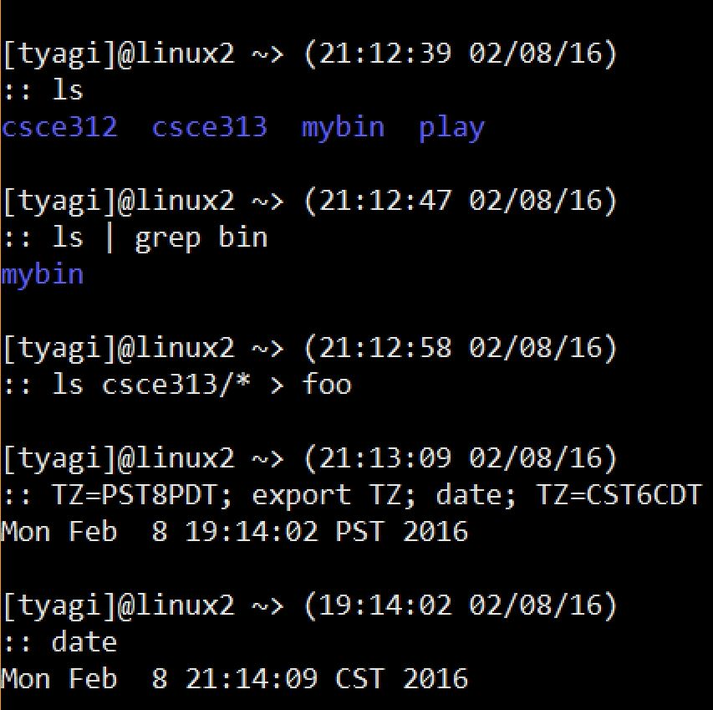
Shell – Running Programs
The commands ls, grep, date, etc. are regular programs. The shell loads these programs into memory and runs them.

Slide 32
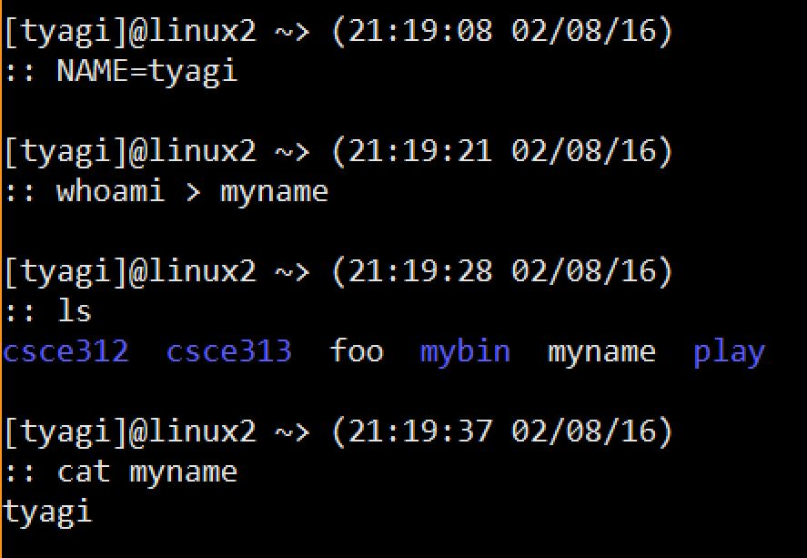
Shell – Managing I/O
Using ‘>’, ‘|’ etc. the user tells the shell to attach the output to a file on disk, or to another process, etc.

Slide 33
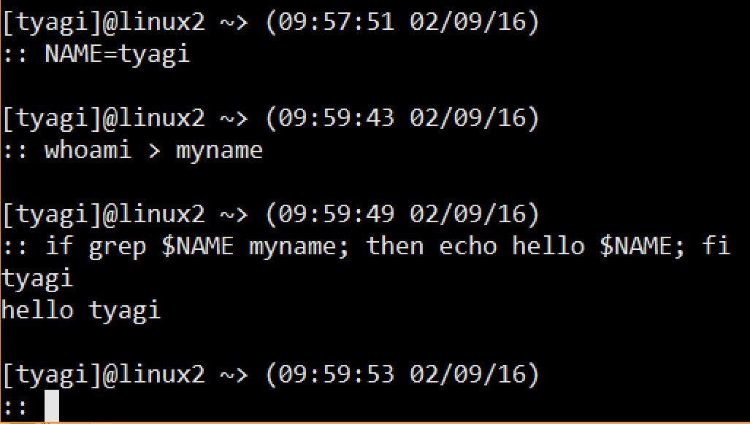
Shell - Programming
Shell is also a programming language with variables and flow control

Slide 34
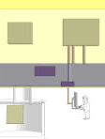
How does the Shell Run Programs?
A. The user types a.out in the shell
D
B
$ a.out
New process
Shell
B. The shell creates a new process to run the program
C. The shell load the program
from the disk into the memory
process mgmt.
system
C
D. The program runs in its process until it is done
A
program
User
Ref: Understanding Unix/Linux Programming by Bruce Molay

Slide 35
The Main Loop of a Shell
The shell consists of the following loop:
while (! end_of_input)
get command
execute command
wait for command to finish
Ref: Understanding Unix/Linux Programming by Bruce Molay

Slide 36
To Write a Shell, we need to…
Run a Program
Create a Process
Wait for Exit

Slide 37
How do we get a new process?
A process calls FORK to replicate itself
Usage: fork (); /* takes no arguments*/
After a process invokes fork, control passes to the KERNEL. The Kernel does this:
Allocates address space and data structures
Copies the original process into the new process
Adds the new process to the set of running processes
Returns control back to both processes
User
Parent process
Child process
User
Before
fork()
After
Before
fork()
After
Before
fork()
After
Kernel
fork
fork
Kernel
Before Fork
After Fork

Slide 38
How do we get a new process?
A process calls FORK to replicate itself
Usage: fork (); /* takes no arguments*/
After a process invokes fork, control passes to the KERNEL. The Kernel does this:
Allocates address space and data structures
Copies the original process into the new process
Adds the new process to the set of running processes
Returns control back to both processes
Parent process
Child process
User
Before
fork()
After
Before
fork()
After
fork
Kernel
After Fork

Slide 39
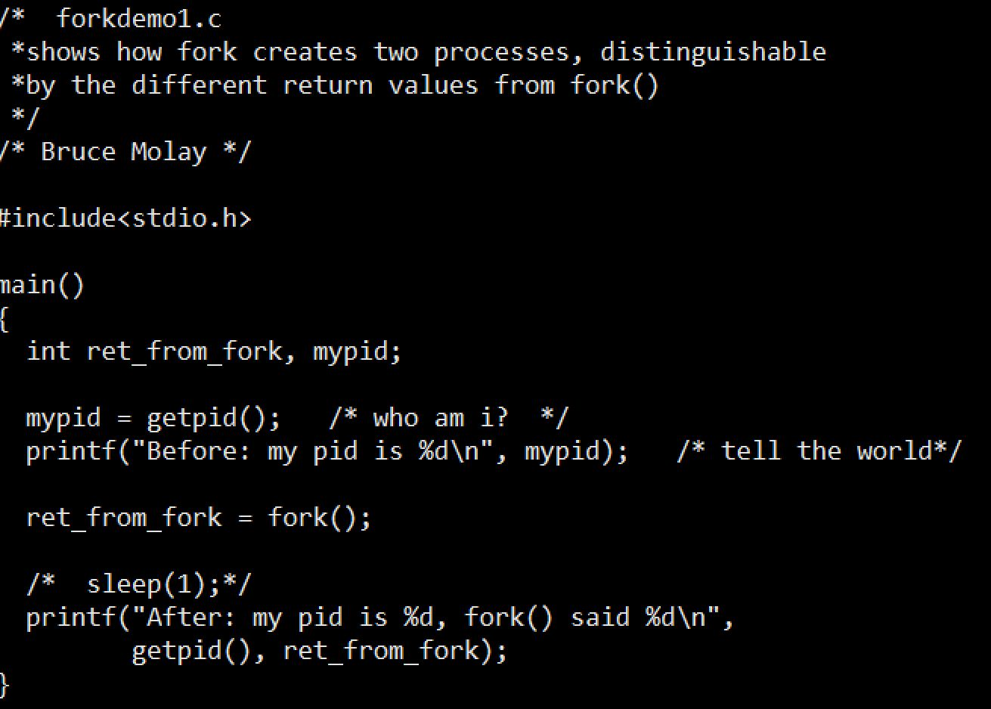
Example: Fork

Slide 40
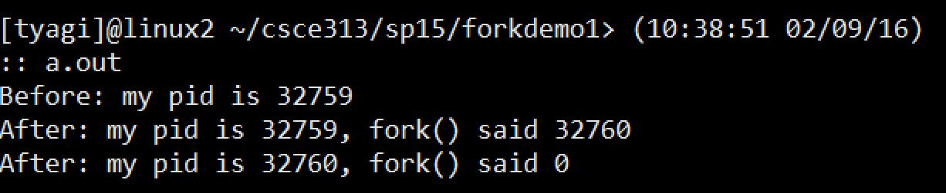
Example: Fork
Why is the “After” message printed twice but “Before” message only once?
Because Fork created a child process and both parent and child execute the rest of the code following the fork

Slide 41
Example: Fork
Why is the “After” message printed twice but “Before” message only once?
Parent process
Child process
Before
fork()
After
Before
fork()
After
Before
fork()
After
fork
fork
Before Fork
After Fork

Slide 42
An Observation and A Question
Observation
Fork does a wonderful job of creating a copy of the process that goes on to execute the same code as the parent
Question
If that is the case, how in the world do we get a process to create a child process that does something different than the parent?

Slide 43
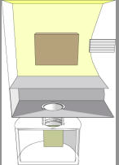
How does a Program run a Program?
Process (Program) calls “execvp”
Kernel loads program from disk into the process
Kernel copies arglist into the process
Kernel calls main(argc, argv)
process
1
3
array of strings
2
program to run

Slide 44
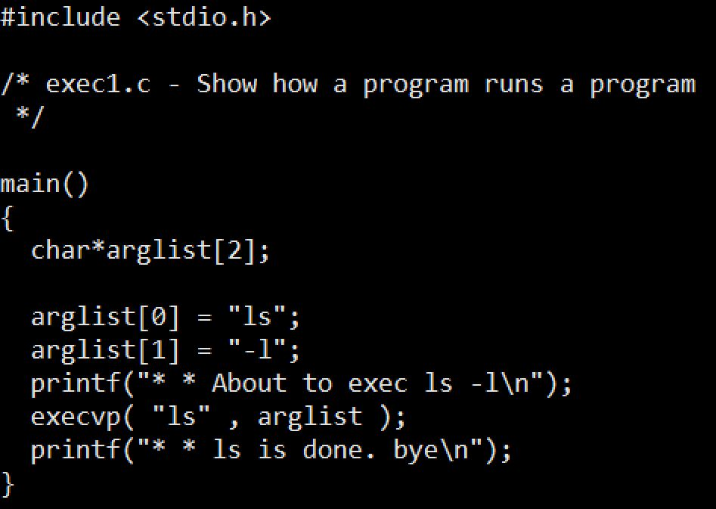
Example: Program running a program

Slide 45
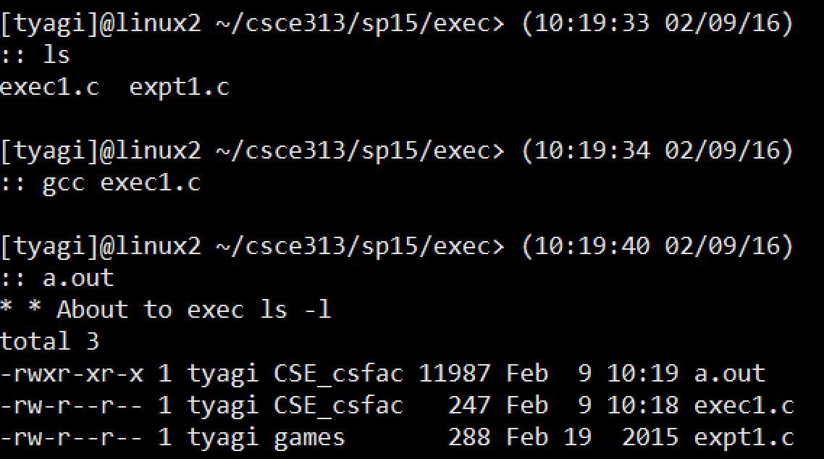
Example: contd.

Slide 46
Example: contd.
Where is the second message?
The exec system call clears out the machine language code of the current program from the current process and then in the now empty process puts the code of the program named in the exec call and then runs the new program
execvp does not return if it succeeds
execvp is like a brain transplant
Notes:
Reference: http://linux.about.com/library/cmd/blcmdl3_execvp.htm
Linux / Unix Command: execvp Command LibraryNAME
execl, execlp, execle, execv, execvp - execute a file SYNOPSIS
#include <unistd.h>extern char **environ;
int execl(const char *path, const char *arg, ...); int execlp(const char *file, const char *arg, ...); int execle(const char *path, const char *arg , ..., char * const envp[]); int execv(const char *path, char *const argv[]); int execvp(const char *file, char *const argv[]);
DESCRIPTION
The exec family of functions replaces the current process image with a new process image. The functions described in this manual page are front-ends for the function execve(2). (See the manual page for execve for detailed information about the replacement of the current process.)The initial argument for these functions is the pathname of a file which is to be executed.
The const char *arg and subsequent ellipses in the execl, execlp, and execle functions can be thought of as arg0, arg1, ..., argn. Together they describe a list of one or more pointers to null-terminated strings that represent the argument list available to the executed program. The first argument, by convention, should point to the file name associated with the file being executed. The list of arguments must be terminated by a NULL pointer.
The execv and execvp functions provide an array of pointers to null-terminated strings that represent the argument list available to the new program. The first argument, by convention, should point to the file name associated with the file being executed. The array of pointers mustbe terminated by a NULL pointer.
The execle function also specifies the environment of the executed process by following theNULL pointer that terminates the list of arguments in the parameter list or the pointer to the argv array with an additional parameter. This additional parameter is an array of pointers to null-terminated strings and must be terminated by a NULL pointer. The other functions take the environment for the new process image from the external variable environ in the current process.
Some of these functions have special semantics.
The functions execlp and execvp will duplicate the actions of the shell in searching for an executable file if the specified file name does not contain a slash (/) character. The search path is the path specified in the environment by the PATH variable. If this variable isn't specified, the default path ``:/bin:/usr/bin'' is used. In addition, certain errors are treated specially.
If permission is denied for a file (the attempted execve returned EACCES), these functions will continue searching the rest of the search path. If no other file is found, however, they will return with the global variable errno set to EACCES.
If the header of a file isn't recognized (the attempted execve returned ENOEXEC), these functions will execute the shell with the path of the file as its first argument. (If this attempt fails, no further searching is done.)
RETURN VALUE
If any of the exec functions returns, an error will have occurred. The return value is -1, and the global variable errno will be set to indicate the error.

Slide 47
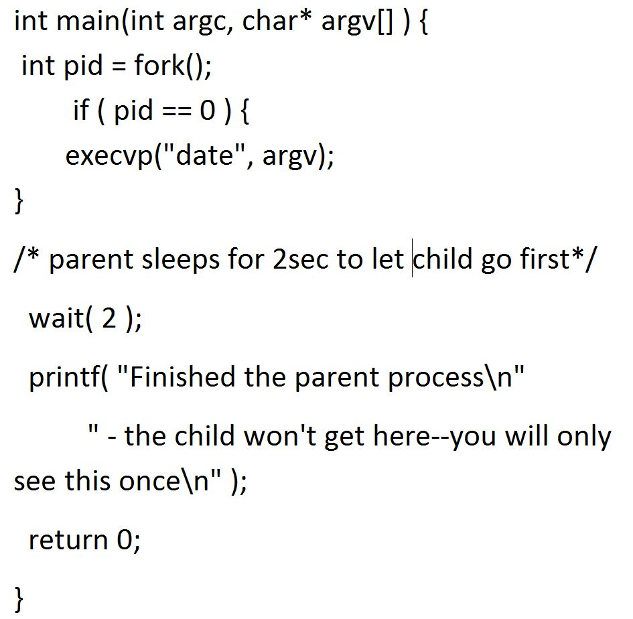
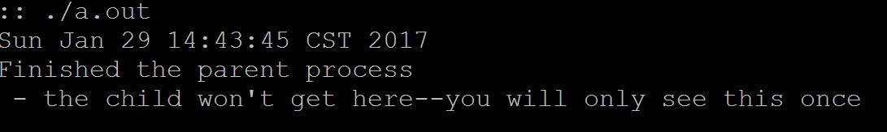
Fork and Exec

Slide 48
wait: Synchronizing With Children
int wait(int *child_status)
Suspends current process until one of its children terminates
Return value is pid of child process that terminated
If child_status != NULL, then integer it points to will be set to indicate why child terminated

Slide 49
wait: Synchronizing With Children
Void wait_demo() {
int child_status;
if (fork() == 0) {
printf("HC: hello from child\n");
}
else {
printf("HP: hello from parent\n");
wait(&child_status);
printf("CT: child has terminated\n");
}
printf("Bye\n");
exit(0);
}
HC
Bye
HP
CT
Bye

Slide 50
Some questions to ponder about processes
How is a process created?
How is a process deleted?
Is there a user process and kernel process
Where do we keep information about a process
Does a process have to run through completion from start to finish or can it be interrupted?
Do processes have priorities?
What are the relationships between multiple processes in a system?
Can we have multiple processes related to the same program? Would multiple processes of the same program share addresses during execution?
How does a program run a program?
How does a parent wait for a child to exit?

Slide 51
Key Learnings
Shell Basics
Replacing Program Executed by Process
Call execv (or variant)
One call, (normally) no return
Spawning Processes
Call to fork
One call, two returns
Reaping Processes
Call wait

Slide 52
What’s coming up in Week 4?
More about process fork, exec, and new functions related to process data and control
Process Life-Cycle
What does it take to execute the life-cycle?
Orphan, Zombie Processes
Problem Solving related to Process Execution

