Slide 1
CSCE 313 Introduction
CSCE 313 Spring 2017

Slide 2
Main Points (for today)
Part1
Introduction to Computer Systems
Part2
Course Objectives and Outcome
Logistics

Slide 3
Learnings from CSCE-312: Hardware and Software Hierarchy
algorithm
abstract interface
Software
hierarchy
High Level Language
Compiler
abstract interface
Virtual
VM Translator
Machine
abstract interface
Assembly
Language
Assembler
abstract interface
Computer
Machine
Architecture
Language
abstract interface
Hardware
Gate Logic
Platform
abstract interface
Electrical
Hardware
Chips &
Engineering
hierarchy
Logic Gates
Physics
Notes:
This picture shows a clean translation of a human thought to the physics of executing that thought on a machine. Abstractions are used at every level of hierarchy to expand or obfuscate details to the next level of hierarchy. For example, a gate level representation of an adder need not understand the physics of how transistor switching will take place to implement the adder function. At gate level we are satisfied with Boolean logic description of addition. Similarly, a program written in a high level language is agnostic of the architectural details of a given machine on which the program will be executed. This picture shows how eventually binary code executes on a processor architecture.

Slide 4
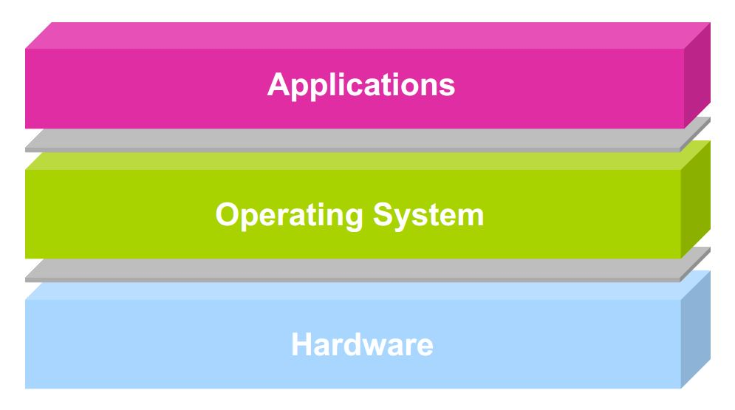
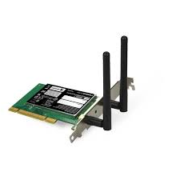
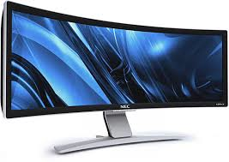
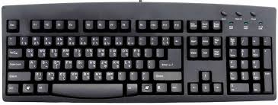

A Modern Computer System
user2
user3
user1
user2
user3
user4
user1
user4
Application Programs/Processes
return
System calls,
Exceptions
Privileged
Operations
Processor
Memory
INT
INT
Character O/P
Block I/O
Packet I/O
storage
Notes:
This picture shows a broader generalized view of hardware and software stack in a modern computer system. Users write application programs. When many programs are running on a concurrent system, a system software known as the operating system is needed to play the role of a referee, illusionist, and glue. We will learn the specifics in coming lectures. But for now, it suffices to say that a modern computer system with multiple interacting hardware devices and software needs a controlling system software to keep things running efficiently and correctly.

Slide 5
First Generation Computer Systems (1949-1956)
Single user: writes program, operates computer through console or card reader / printer
Absolute machine language
I/O devices
Development of libraries; device drivers
Compilers, linkers, loaders
Relocatable code

Slide 6
Second-Generation Computers (1956-1963)
Automation of Load/Translate/Load/Execute
Batch systems
Monitor programs
Job Control Language
Advent of operators: computers as input/output box
Problem: Resource management and I/O still under control of programmer. Issues??
Memory protection
Timers
Privileged instructions
Monitor
user program area
device drivers
control card interpreter
job sequencer / loader

Slide 7
Third-Generation Computer Systems (1964-1975)
Problem with batching: one-job-at-a-time
Solution: Multiprogramming
Job pools: have several programs ready to execute
Keep several programs in memory
New issues:
Job scheduling, Memory management, Protection
sequential:
CPU
I/O
Job1
CPU
Job2
better:
Job3
I/O
Monitor
Job1
Job2
JobN

Slide 8
Time Sharing (mid 1960s on)
Remote interactive access to computer: “Computing as Utility”
OS interleaves execution of multiple user programs with time quantum, e.g. CTSS (1961): time quantum 0.2 sec
User returns to own the machine
New aspects and issues:
On-line file systems
resource protection
virtual memory
sophisticated process scheduling

Slide 9
Modern Computer Systems
A modern computer system can be divided into the following three key components
Application programs – define the ways in which the system resources are used to solve the computing problems of the users
Word processors, compilers, web browsers, database systems, video games
Hardware – provides basic computing resources
CPU, memory, I/O devices
Operating system - controls and coordinates use of hardware among various applications and users
Notes:
This is just a summary of previous picture.

Slide 10
What is an operating system?
Special layer of software that provides application software access to hardware resources
Convenient abstraction of complex hardware devices
Protected access to shared resources
Security and authentication
Communication amongst logical entities
appln
appln
appln
OS
Hardware

Slide 11
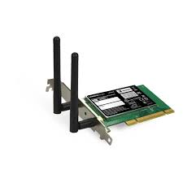

OS Basics: “Virtual Machine” Boundary
Courtesy: Prof Culler, Berkley
Address Spaces
Threads
Processes
Files
Sockets
Software
OS Hardware Virtualization
Hardware
ISA
Memory
Processor
Networks
storage
Displays
Inputs

Slide 12
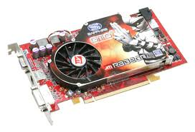
OS Basics: Program => Process
Address Spaces
Threads
Processes
Files
Sockets
Software
OS Hardware Virtualization
Hardware
ISA
Memory
Processor
OS
storage
Networks
Inputs
Displays

Slide 13
OS Basics: Context Switch
Address Spaces
Threads
Processes
Files
Sockets
Software
OS Hardware Virtualization
Hardware
ISA
Memory
Processor
OS
storage
Networks
Inputs
Displays

Slide 14
OS Basics: Scheduling, Protection
Address Spaces
Threads
Processes
Files
Sockets
Software
OS Hardware Virtualization
Hardware
ISA
Memory
Processor
Protection Boundary
OS
storage
Networks
Inputs
Displays

Slide 15
OS Basics: I/O
Address Spaces
Threads
Processes
Files
Sockets
Software
OS Hardware Virtualization
Hardware
ISA
Memory
Processor
Protection Boundary
OS
Ctrlr
storage
Networks
Inputs
Displays

Slide 16
OS Basics: Loading
Address Spaces
Threads
Processes
Files
Sockets
Software
OS Hardware Virtualization
Hardware
ISA
Memory
Processor
Protection Boundary
OS
Ctrlr
storage
Networks
Displays
Inputs

Slide 17
Main Points (for today)
Part1
Introduction to Computer Systems
Part2
Course Objectives and Outcome
Logistics

Slide 18
Why take CSCE 313?
Some of you will actually design and build operating systems or components of them
Perhaps more now than ever
Many of you will create systems that utilize the core concepts in operating systems
The concept of “hierarchy” and “abstraction” are all too important
Whether you build software or hardware
The concepts and design patterns appear at many levels
All of you will build applications, etc. that utilize operating systems
The better you understand their design and implementation, the better use you’ll make of them.

Slide 19
CSCE-313 Course Outcome
In this course, you will learn
What is an operating system; its components; system calls
Execution of a program; function calls; interrupts
OS application interface; file system; process control
Concurrency, process and thread synchronization, inter-process communication
Network Programming
Security threats in centralized and distributed systems; authentication, authorization, confidentiality; security mechanisms

Slide 20
CSCE-313 Course Structure Spiral
Asynchronous Events
Concurrency
File Systems
OS and System Concepts
Network Programming
Computer and Network Security
Intro

Slide 21
Textbook, Reference Books
Text: Operating Systems: Principles and Practice, Second Edition, Thomas Anderson and Michael Dahlin, Recursive Books, 2014.
Reference:
Main: Advanced Programming in the UNIX Environment, Third Edition, W. Richard Stevens and Stephen A. Rago, Addison-Wesley Professional Computing Series, 2013.
Secondary: Understanding Unix/Linux Programming A Guide to Theory and Practice, Bruce Molay, Pearson Education Inc., 2003
Other Interesting Readings
Computer Systems
Computer Systems: A Programmer's Perspective, Randal E. Bryant and David R. O'Hallaron, Prentice Hall, 2011

Slide 22
How Success will be Measured
The course will have two exams, a series of machine problems and quizzes. The grade allocation is as follows:
Total = 200 points
Exams = 90 points (45 points each)
Announced Quizzes (several) = 10 points
Machine Problems (approx. 8) = 100 points
The grading scale is as follows:
180 – 200: A
160 - 179: B
140 – 159: C
110 – 139: D
109 and below: F

Slide 23
Exams
Two exams – Midterm and Final
Exams are closed book
Final Exam will be based on material covered after the midterm
Exams will be tough but success is guaranteed if you have understood the concepts

Slide 24
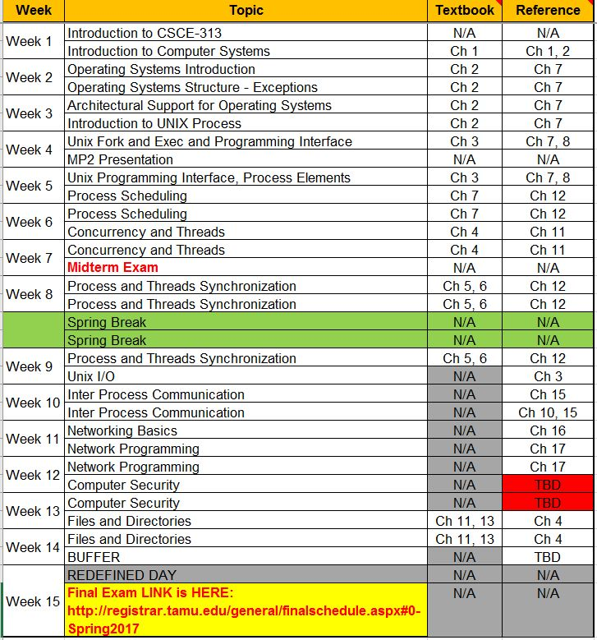
Quizzes
There will be several announced in-class quizzes
These will be aligned with major topics
These are intended to encourage class participation and incremental concepts refresh

Slide 25
Machine Problems
There will be 8-9 Machine Problems assigned weekly or bi-weekly basis. Students will form teams of two to work on machine problems
Typically, machine problems will be described in lab on week ‘x’ and will be graded in lab during week ‘x+1’ or ‘x+2’
Lab attendance is necessary to ensure you understand the problem, actively hash the problem out with your teammate, and clarify with lab instructors.
We are deploying a new platform for MP submission. More on this in the next class

Slide 26
Late Policy for Machine Problems
Quizzes: 0 marks for late submissions.
Machine Problems Penalty: (Relative to due date and time)
1 day late: 5%
2 days late: 15%
3 days late: 20%
4 days late: 50%
4 days – 30 days late: The maximum possible grade will be capped to a 50% ceiling.
> 30 days late: 100% penalty i.e. 0 marks in the assignment

