Slide 1
L2 - A conversation on success in this course and beyond
CSCE-313 Spring 2017

Slide 2
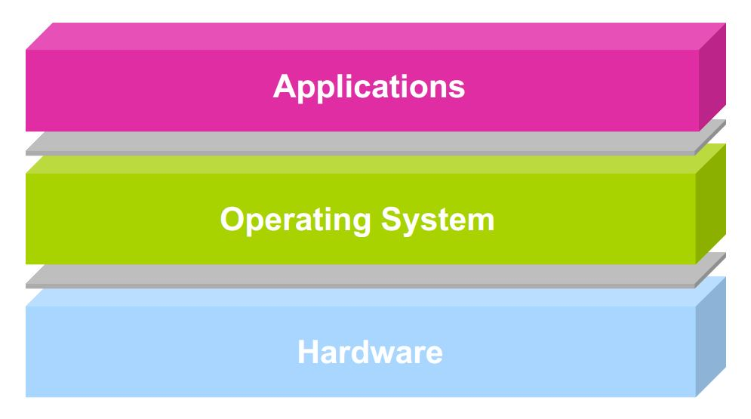
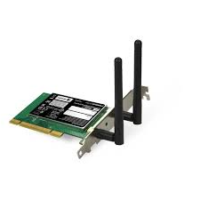

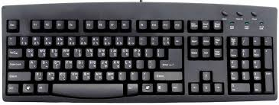

A Quick Recap from our earlier discussion
user2
user3
user1
user2
user3
user4
user1
user4
Application Programs/Processes
return
System calls,
Exceptions
Privileged
Operations
Processor
Memory
INT
INT
Character O/P
Block I/O
Packet I/O
storage
Notes:
This picture shows a broader generalized view of hardware and software stack in a modern computer system. Users write application programs. When many programs are running on a concurrent system, a system software known as the operating system is needed to play the role of a referee, illusionist, and glue. We will learn the specifics in coming lectures. But for now, it suffices to say that a modern computer system with multiple interacting hardware devices and software needs a controlling system software to keep things running efficiently and correctly.

Slide 3
Operating System is at the heart of it all!
For the hardware, OS is:
Driver (knows how to use h/w, apps do not know)
Manager (when to run what … scheduling)
Protector (stops malicious ones)
Illusionist (tells each app “the h/w is all yours”)
….
Why H/W needs managing/protecting?
Processor
Memory
Capacity
Protection
Display

Slide 4
Theme of Today’s Discussion
What does success in this course look like?
Tangibles
Non-Tangibles
Tips for success

Slide 5
Evolution of this course in the last 2 years
 | FA’14 (Tyagi) | SP’15 (Tyagi) | FA’15 (Tyagi) | SP’16 (Tyagi) | FA’16 (Ahmed) | SP’17 (Tyagi) | FA’17 (Planed)
Textbook | Previously used Text | New – Anderson & Dahlin | No Change | No Change | No Change | No Change | Free Online Text?
Lecture Material | Minor-Mid Refresh | Major Overhaul | No Change | Delta Change | Delta Change | Delta Change | Modern Topics
HW/Quiz | HW | HW | In class quizzes | In class quizzes | In class quizzes | Take-home quizzes | TBD
Machine Problems | Previously used MP | No Change | 1 new MP | No Change | Major Overhaul | Delta w/ feedback | Delta w/ feedback
Grading Platform | CSNET | CSNET | E-campus | Vocareum | Vocareum | Vocareum++ | No Change
DEV Platform | Dept. Linux Server | Dept. Linux Server | Dept. Linux Server | Dept. Linux Server | Dept. Linux Server | Dept. Linux Server | R-PI?

Slide 6
Some Observations from Past Semesters - Exams
Exams are mostly problem centric with few sprinkles of objective T/F, Multiple Choice questions
Midterm – Content is relatively easier so class tends to do better compared to the Finals
Finals – Content is difficult primarily attributed to threaded code synchronization and inter-process communication. Also, we end up competing with multiple course priorities at the end

Slide 7
Some Observations from Past Semesters – Machine Problems
Machine Problems are now more or less synced with classroom content
With good teamwork and proper planning, it is fairly easy to earn maximum allocated points
We continue to struggle in facilitating productive and rewarding teamwork mostly due to large classroom size
Move to Vocareum platform should help steer TA and peer teacher time to assisting with execution and quality
Department Server based instruction acts as a constraint to unfettered learning
Long term vision is to migrate to a platform which is extremely forgiving to experimentation ☺

Slide 8
Success in CSCE-313 - Tangibles
Overall grade of B or better
80% or better overall score in exams – typically means that student ‘got’ the key concepts right
90% or better overall score in machine problems – translates to a demonstrated ability to write quality system programs and understanding of system programming concepts
90% or better in quizzes – translates to demonstrated ability to absorb classroom discussion

Slide 9
Tips for Succeeding in Exams
Target no more than 10% missed days of attendance.
Offline ‘catching up’ is tempting but not productive.
Take notes.
There’s more said on each slide than what is written. Concepts are inter-woven so offline reading of slides carries the risk of missing key linkages.
Practice problem solving for each topic.
Provided quizzes will help.
Make sure that concepts are clear.
With that, you will be assured of solving any problem with a correct approach.

Slide 10
Machine Problems
ID | Machine Problem | Key Learnings | Complexity
MP1 | High Performance Linked List | C++ refresh, cost of system calls | LOW
MP2 | Memory Allocator | Memory Management | MED-HIGH
MP3 | System Calls and Critical OS Functions | Inner workings of some key system commands | LOW
MP4 | UNIX Process | Anatomy and Attributes of a UNIX process | LOW
MP5 | UNIX Shell | Creation and Execution of a Unix Shell, basic functions | MED

Slide 11
Machine Problems (contd.)
ID | Machine Problem | Key Learnings | Complexity
MP6 | Threaded Client-Server | Threading | LOW
MP7 | Advanced Client-Server | Threading, Synchronization | MED
MP8 | IPC Mechanisms | Threading, Synchronization, IPC Mechanisms | MED
MP9 | Networking | Sockets | LOW

Slide 12
Some additional comments on Machine Problems (MP’s)
MP’s have three main components
Scenario understanding and system/algorithm development
Coding, debugging, debugging, and debugging (gdb)
Performance analysis
MP’s are closely aligned to subject matter covered in class with one exception:
MP1,2 are primarily constructed to act as a refresher for C++ coding and Pointer Arithmetic. MP2 is a build over MP1. MP2 is perhaps the most intense of the MP’s.
Starting with MP6, the remaining MP’s incrementally build on top of the previous one to seamlessly tie concepts learned in class.

Slide 13
Tips for Succeeding in Machine Problems
On the day of MP release: Independently Review and build a 1st cut understanding.
Don’t defer this, because many MPs have only 1-wk deadline
By the 2nd day of MP release: Meet with your partner and create a micro-schedule (key phases and timelines) of how you plan to develop and execute the solution. Take each other’s schedule and commitments into account.
Resist the rush to start coding. Spend adequate time understanding the problem and building your plan (algo, structure). Tie it all the way to the end game.
Lookout for postings (questions, clarifications, announcements) on Piazza. Set your alerts appropriately.

Slide 14
Tips for Succeeding in Machine Problems
Engage me, your TAs, and peer teachers to seek timely clarifications
Set your own deadline at least 2 days ahead of the published deadline.
Inevitably you will find issues (compilation, inability to run across all test cases, poor code performance, etc.) that may take up the final days to recover and still meet deadline.
Enjoy the problem while you work on it.
The problems are designed to mimic (somewhat) what you will encounter in a professional environment.

Slide 15
Teamwork
Observation: The best functioning teams are those where each partner contributes equal amount and brings complementary skills (technical and organizational) to the table
Avoid shortcuts and over-reliance on your teammate.
On our side, we will be looking for indicators to verify equity of effort.
On your side, pitch in equal amount of effort just because solving these problems will infuse strong credibility in your resume!

Slide 16
Collaboration Guidelines
A
B
C
D
LETTER | DESCRIPTION
A | (OKAY) – Completely Independent Original Work
B | (OKAY) – Collaborate across teams on ideas and architecture
C | (NOT-OKAY) – Submitting portions of someone else’s code/detailed pseudo code
D | (NOT-OKAY) – Submitting someone else’s code as yours

Slide 17
Open QnA

