Slide 1
Topic 01 - Introduction
August 30, 2016

Slide 2
CSCE 312 Instruction Team
Instructor: Aakash Tyagi
Professor of Practice at TAMU-CSE (Fall 2014 +)
Teaching Assistant (Graduate Student)
Jerry Yiu (Ph.D. Student in CSCE Department); TA’d csce-312 in Fall 2015
Peer Teachers (Undergraduate Peer Students)
Austin Hamilton (peer taught csce-312 in spring’16)
Joseph Sapp (took csce-312 in spring’16)
Aman Goyal
Ling Chen
Honorary Member: Yang Yang – took csce312 in spring’16 and created several meaningful extensions for course projects during summer’16

Slide 3
Instructor Background
Ph.D. in Design for Manufacturability, Univ. of Louisiana,1993
Served as a University Professor in UL ‘93-’94. Courses Taught: Computer Architecture, Logic Design, Microprocessor Design
20 years at Intel Corporation designing computer chips
Joined Texas A&M in ‘14 as a Professor of Practice Courses Taught: Computer Organization (CSCE-312), Introduction to Computer Systems (CSCE-313), Undergraduate Seminar (CSCE-481), Introduction to Computing (CSCE-181), Chip Design Verification (CSCE-489 and 689)

Slide 4
Instructor Contact Information
Aakash Tyagi (tyagi@tamu.edu)
Office Location and Hours
HRBB-515A
TR 11am – 12pm, rest by appointment

Slide 5
Before we discuss course logistics…..
Let’s reflect on some of the things of the recent past from our daily lives and seek the underpinnings of the technology driving the changes.

Slide 6
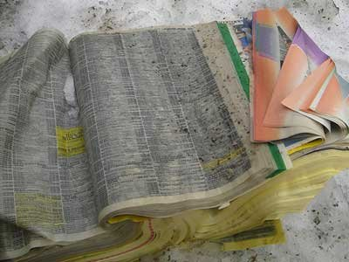

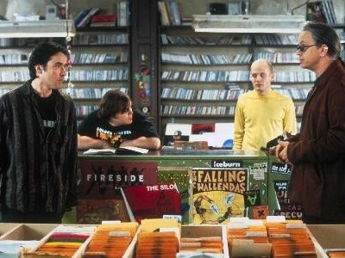
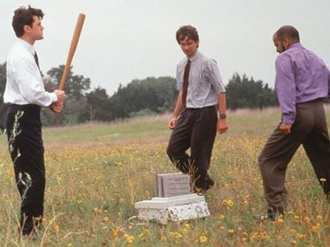
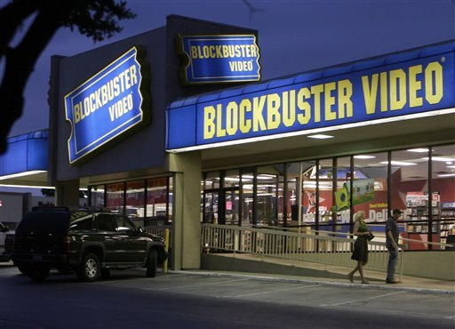
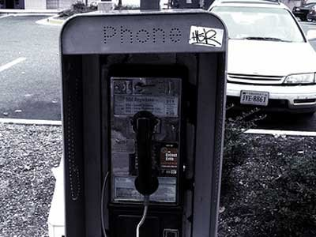
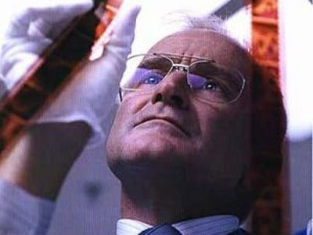
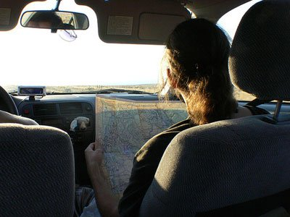
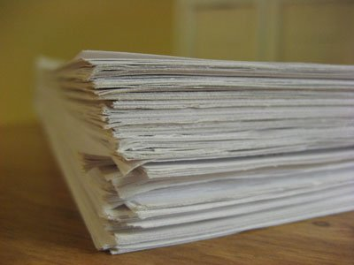
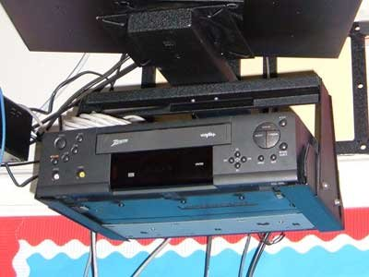
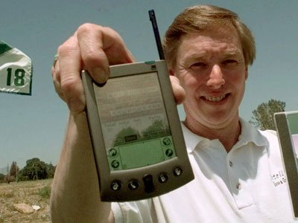

What happened to these ☺
Notes:
Robin Williams Movie – One Hour Photo
Jack Black and John Cussack – High Fidelity (Vinyl Records)
Office Space

Slide 7
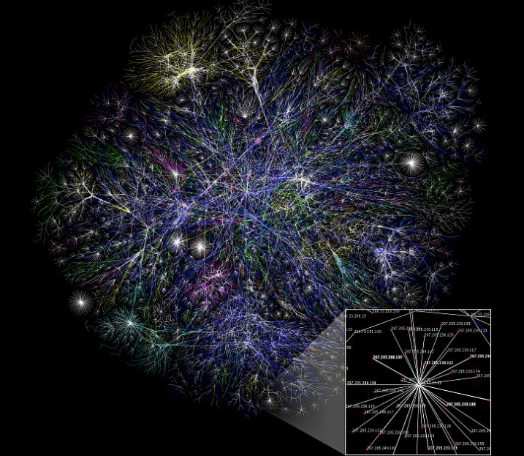
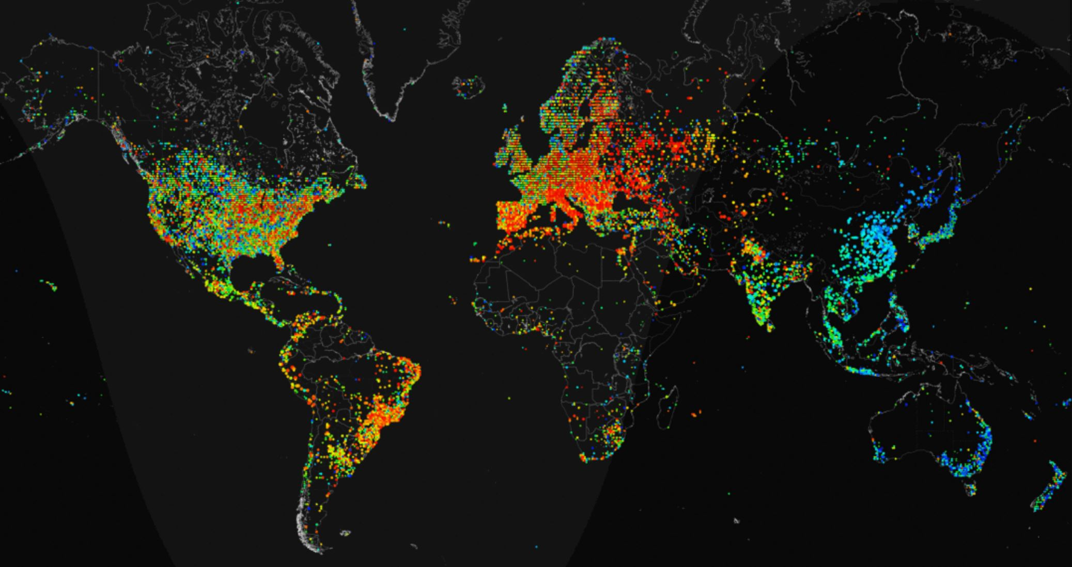
Growth of the internet
There were ZERO Internet users in 1988!
There are over 3 BILLION Internet users today!!
Partial map of the Internet Jan 2005
Internet Usage SNAPSHOT (2012)
Notes:
http://internetcensus2012.bitbucket.org/paper.html
An anonymous researcher with a lot of time on his hands apparently shares the sentiment. In a newly published research paper, this unnamed data junkie explains how he used some stupid simple hacking techniques to build a 420,000-node botnet that helped him draw the most detailed map of the Internet known to man. Not only does it show where people are logging in, it also shows changes in traffic patterns over time with an impressive amount of precision. This is all possible, of course, because the researcher hacked into nearly half a million computers so that he could ping each one, charting the resulting paths in order to make such a complex and detailed map. Along those lines, the project has as much to do with hacking as it does with mapping.

Slide 8

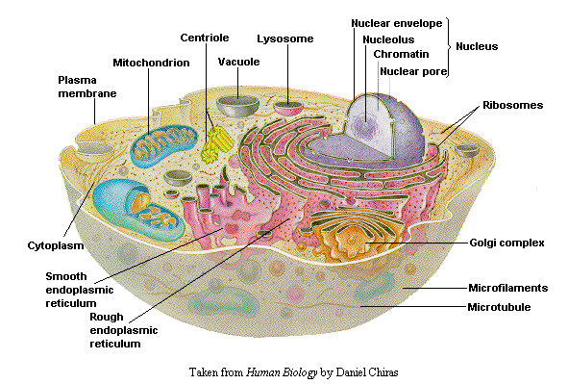
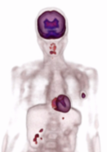
High Performance Computing (HPC)
Weather Prediction
1 ZFlops
100 EFlops
10 EFlops
Genomics Research
1 EFlops
100 PFlops
10 PFlops
Medical Imaging
1 PFlops
100 TFlops
USD 30B+ Market growing at 8%+ CAGR
Performance scaling at 10x every 4 years
10 TFlops
1 TFlops
100 GFlops
10 GFlops
1 GFlops
Forecast
100 MFlops
1993
1993
1999
1999
2005
2005
2011
2011
2017
2017
2023
2029
Source: Avinash Sodani, IEEE Micro-2011 Keynote, “Race to Exascale: Opportunities and Challenges”
HPC has become the Essential Tool for a Knowledge Economy*
Discovery & Insight: Tool for unlocking the mysteries of our universe
Business Transformation: Better and Faster, Design without prototypes
Data Driven Science: Transforming Data to Knowledge
*As noted by Raj Hazra, GM of Intel HPC Business in his report to Investors July 2013
Notes:
1 Kiloflop/s = 1000 FP OP/s
1 Megaflop/s = 1 Million FP OP/s = 1000 Kilo FP OP/s
1 Gigaflop/s = 1 Billion FP OP/s = 1000 Million FP OP/s
1 Teraflop/s = 1 Trillion FP OP/s = 1000 Billion FP OP/s
1 Petaflop/s = 1 Quadrillion FP OP/s = 1000 Trillion FP OP/s
1 Exaflop/s = 1000 Quadrillion FP OP/s

Slide 9
So what’s going on?
Computing Devices
Internet
Notes:
Moore’s Law and Usage Models are driving the proliferation of computing devices
Proliferation of computing devices is enriching our Internet experience
Connected and Empowered Society is generating BIG Data
More Powerful computing devices are enabling doing more with less or doing much more with more

Slide 10
Computing Devices
Moore’s Law is promoting increasing number of transistors on the chip (2x every 18mths)
Systems are getting built on a chip (SOC). More and more functionality per given area.
Computing Systems are now in ALL facets of our lives

Slide 11
Building a tapestry of the way we live (and used to)!
Drive
Work
Communicate
Travel
Entertain
Study
Educate
Form Relationships
Play
Bank
Manufacture
Wear
……..
Computing Devices are pervasive

Slide 12
An Example from the field of Education
‘80’s
‘90’s
‘00’s
‘10’s
Classroom
ROOM
ROOM
‘OFFLINE’ ROOM
‘LIVE’ ROOM
MOOC
Discussion Forums
Equipment
NONE
LAMP
Transparencies
VGA
DVI, Internet
Method
Blackboard
Whiteboard
Whiteboard
CBT
Enabling Motivators: Needs, Wants, Technology, Opportunity, Feasibility…….

Slide 13
The Heart of a Computing Device
The heart of every computing device is the PROCESSOR (also called the CPU or the Central Processing Unit).
This course dives deep into the organization and interfaces of a computing device with emphasis on the processor.

Slide 14
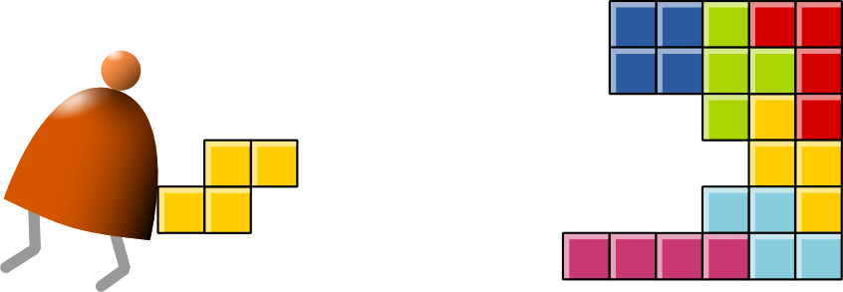
In this course, we are going to build a computer and run a game on It ☺
THANK YOU NOAM NISSAN & SHIMON SCHOKEN!

Slide 15
Course Map
Human
Abstract design
Software
Thought
abstract interface
hierarchy
Chapters 9, 12
H.L. Language
Compiler
&
abstract interface
Operating Sys.
Ch 10, 11
Virtual
VM Translator
Machine
abstract interface
Chapters 7 - 8
Assembly
Course overview:
Building this world, from the ground up
Language
Assembler
Chapter 6
abstract interface
Computer
Machine
Architecture
Language
abstract interface
Chapters 4 - 5
Gate Logic
Hardware
abstract interface
Platform
Chapters 1 - 3
Electrical
Hardware
Chips &
Engineering
Logic Gates
Physics
hierarchy
Notes:
This picture shows a clean translation of a human thought to the physics of executing that thought on a machine. Abstractions are used at every level of hierarchy to expand or obfuscate details to the next level of hierarchy. For example, a gate level representation of an adder need not understand the physics of how transistor switching will take place to implement the adder function. At gate level we are satisfied with Boolean logic description of addition. Similarly, a program written in a high level language is agnostic of the architectural details of a given machine on which the program will be executed. This picture shows how eventually binary code executes on a processor architecture.

Slide 16
CSCE-312 at a glance - Objectives
Understand how hardware and software systems are built, and how they work together
Learn how to break complex problems into simpler ones
Learn how large scale development projects are planned and executed

Slide 17
CSCE-312 at a glance - Methodology
Build a complete, general-purpose, and working computer system
Play and experiment with this computer, at any level of interest

Slide 18
Some course details - Projects
9 lab projects to be done individually
Hardware projects are done and simulated in HDL (Hardware Description Language)
Software projects can be done in any language of your choice (Java, Python, C++…)
Tools: simulators, tutorials, test scripts
Link to download software: http://www.nand2tetris.org/software.php
More on this in your lab sections Project 0

Slide 19
Some course details – Books
Text Book: The Elements of Computing Systems: Building a Modern Computer from First Principles by Noam Nisan, Shimon Schocken, MIT Press
First half of the book is available as free online pdf chapters: http://www.nand2tetris.org/course.php
Reference Books:
Computer Systems: A Programmer's Perspective, Randal E. Bryant and David R. O'Hallaron, Prentice Hall, 2015.
Digital Design, 2nd Ed, by Frank Vahid, Wiley publication, 2010

Slide 20
Some Course details – Exams and Grading
Likely order of coverage will be as follows:
Exam1: Combinational and Sequential Logic: Chapters 1-3
Exam2: Assembly Language, CPU, Assembler: Chapters 4-6
Exam3: Pipelining and Memory Hierarchy: Prescribed Reference Material
Exam4: Virtual Machine and Compilers: Chapters 7-11
Dates of the Exams and Projects will be made available separately on Course Schedule posted on Course Piazza Page HERE.
Course Grade
A: 90+, B: 80-89, C: 70-79, D: 60-69, F: 59-
40% lab assignments (9 lab projects), 40% exams (4 x 10% each), 20% quizzes (several in-class quizzes).

Slide 21
Some Course details – Late Submissions
Unless stated otherwise, lateness is penalized as a simple linear function of minutes late. You lose a percentage point of the score for every hour you are late. Roughly speaking, if you are 4 days late you end up losing all the points for that assignment. Penalty for missing demo is 10% for the assignment.

Slide 22
Course Interaction
Website: https://piazza.com/tamu/fall2016/csce312/home
Lecture presentations will be posted on the Piazza Resource page before the start of class
Note: Projects and Quizzes will be deployed on eCampus

Slide 23
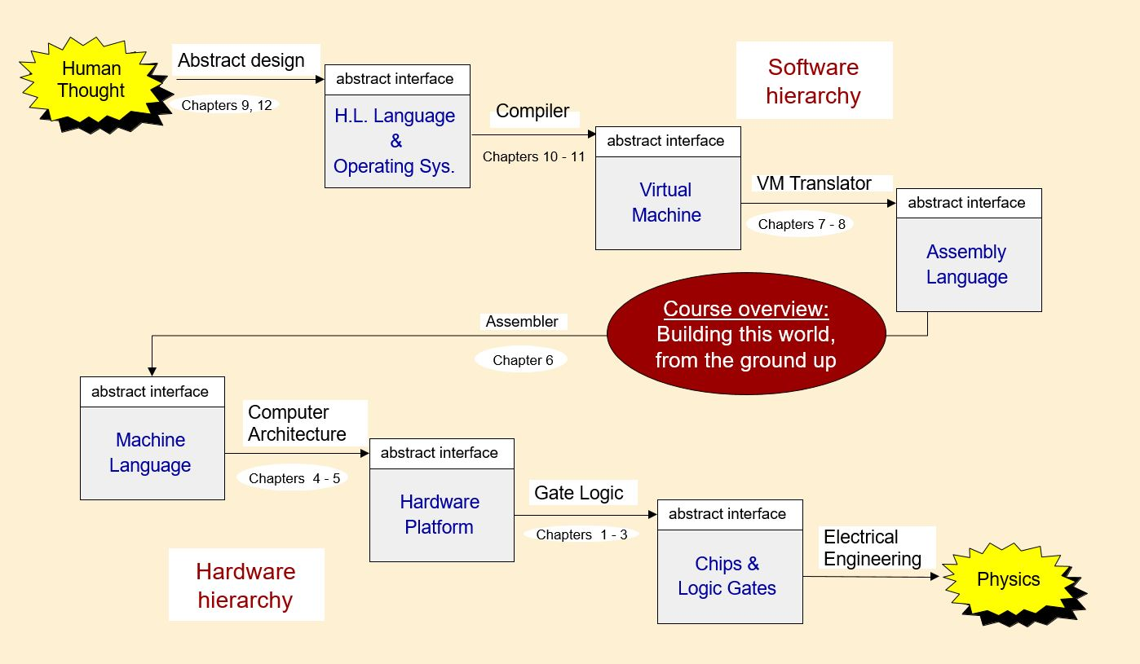
So let’s start on our journey
See you all on THU Sep 1 to explore how the cross-sectional view of this course is laid out

