Slide 1
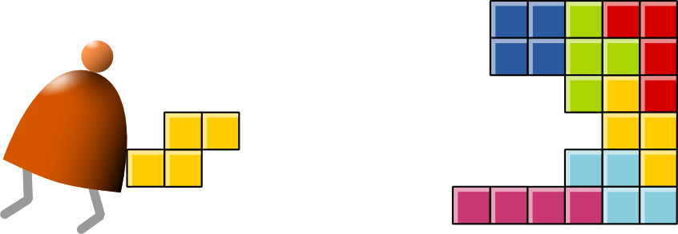
Machine Language
Building a Modern Computer From First Principles
www.nand2tetris.org

Slide 2
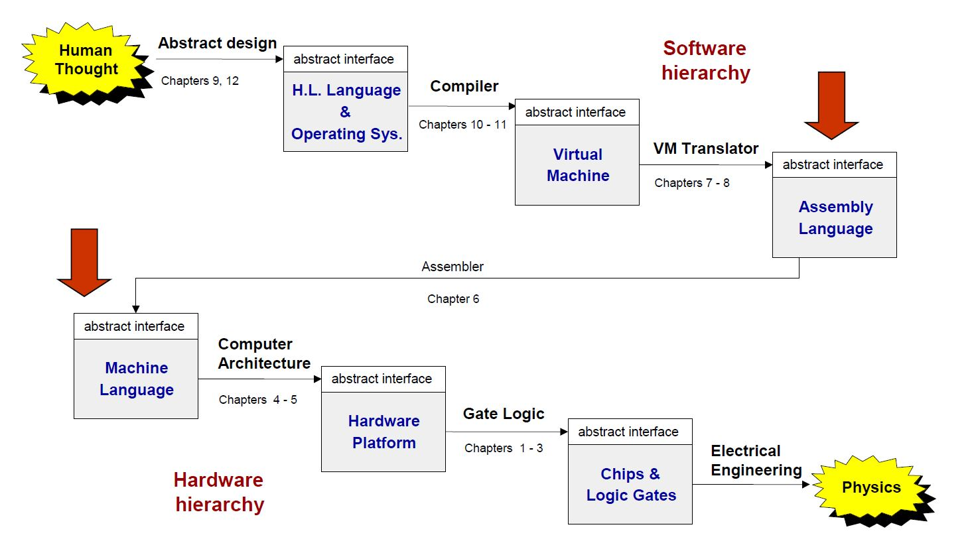
Where are we at?
FOCUS
FOCUS

Slide 3
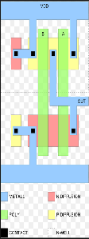
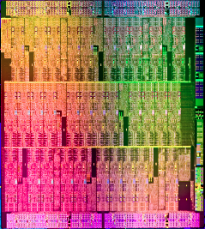
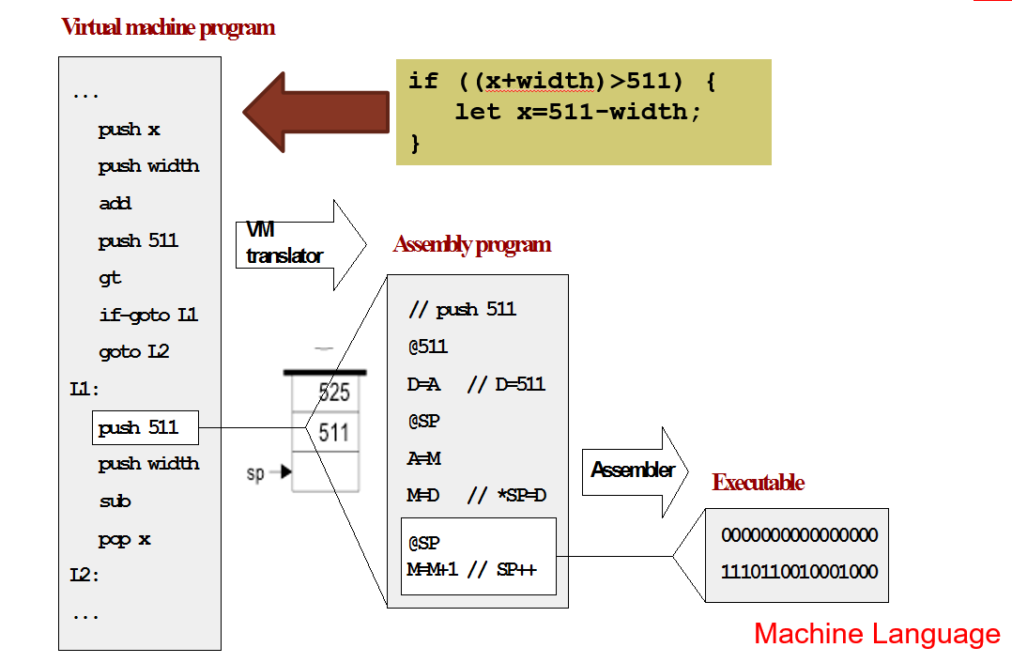
How do we communicate with a computer
(Hardware) We can describe a computer using underlying physical components
OR
(Binary) We can also describe a computer by the abstraction that specifies its machine language capabilities in sequences of 1’s and 0’s
OR
(Assembly) We can also raise the abstraction one level higher with specifications in some mnemonic language

Slide 4
Machine Language versus High Level Programming Language
Machine (and Assembly) Language exposes us to programming to the “Metal” i.e. real hardware
High Level Language gives us the generalities of capabilities and power of expression

Slide 5
So to look back and look ahead
Chapters 1..3 exposed us to the low level components that are used to build our computer (logic gates, arithmetic and datapath components, memory, etc.)
Chapter 4 shows us how to program our computer
Chapter 5 will give a preview of computer architecture
Chapter 6 will teach us about how to construct an assembler

Slide 6
Outline of our discussion
[Machine Language] Discuss the concept of stored program computer and the abstractions of machine language
[Addressing Modes] Discuss ways to address content for performing operations
[Typical Examples] Examples of typical assembly language commands

Slide 7
Stored program computer

Slide 8
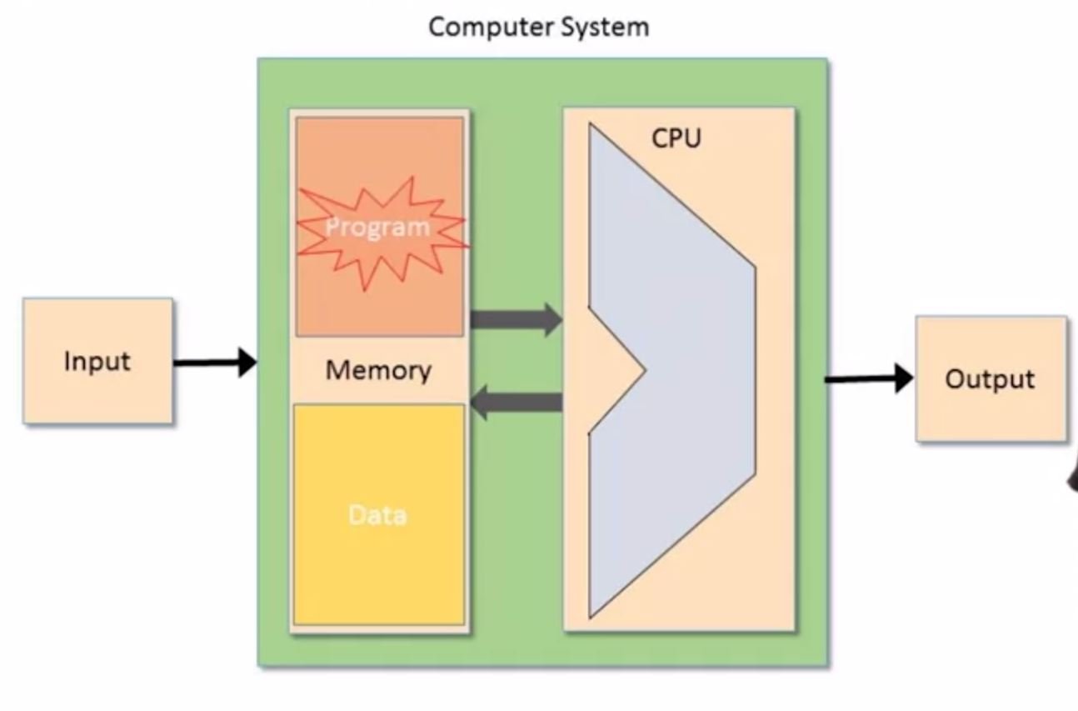
Stored Program Computer

Slide 9
View from the Programmer’s Perspective
The Programmer sees
Memory
CPU
Registers
Goal: Manipulate Memory using processor and Set of Registers
View
Memory: Addresses and Content
CPU: fixed set of elementary operations
Registers: Single Word values (quick access)

Slide 10
Types of Operations on a computer
Arithmetic and Logic Operations
Fetch and Store Values from and to the memory
Move values from and to the registers
Test Boolean conditions
Etc.

Slide 11
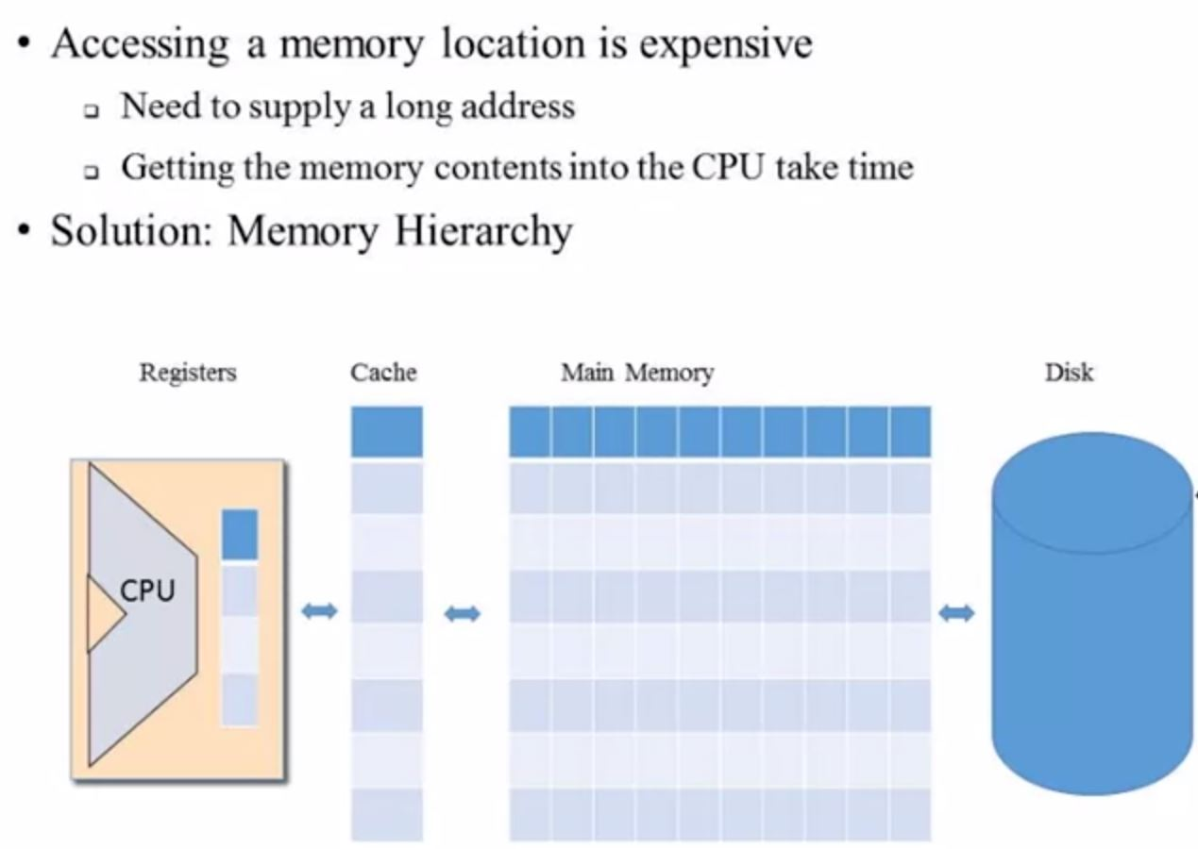
Memory Hierarchy

Slide 12
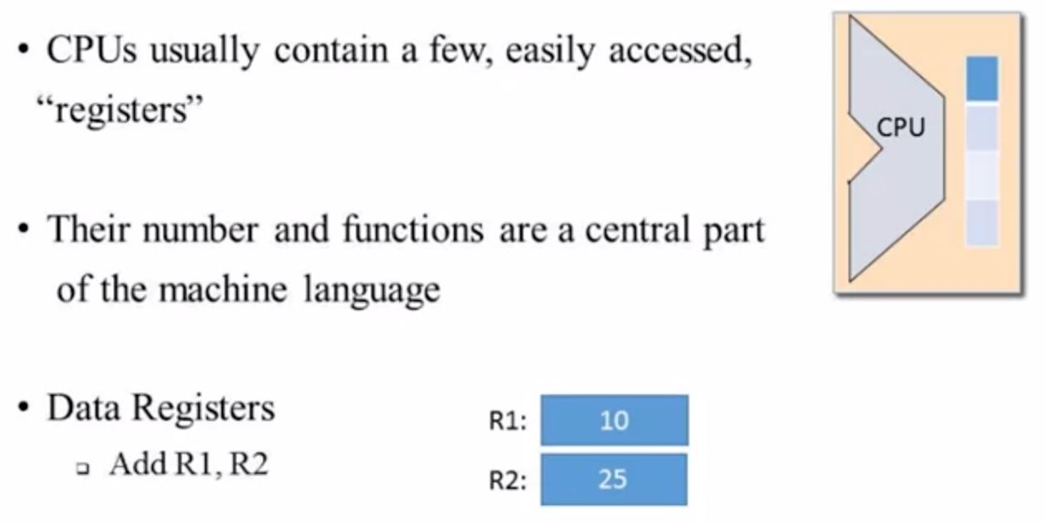
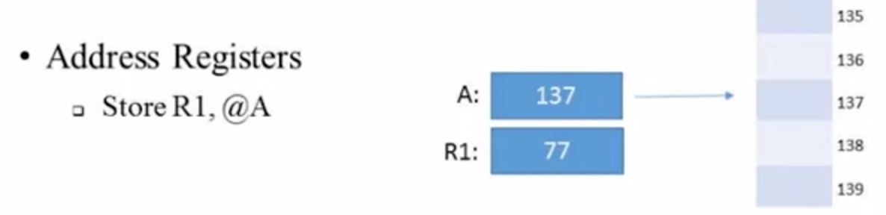
Registers

Slide 13
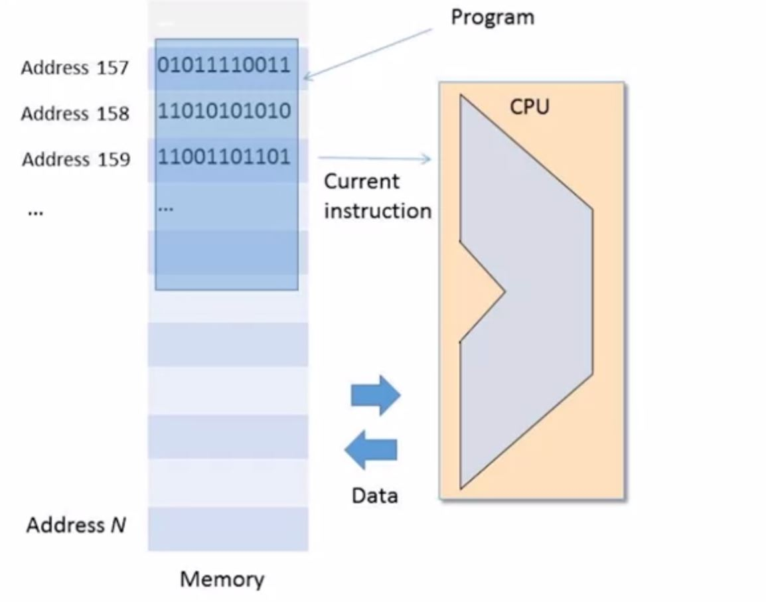
Machine Language
Three elements
- Instructions
- Sequence (Program Counter)
- Addressing

Slide 14
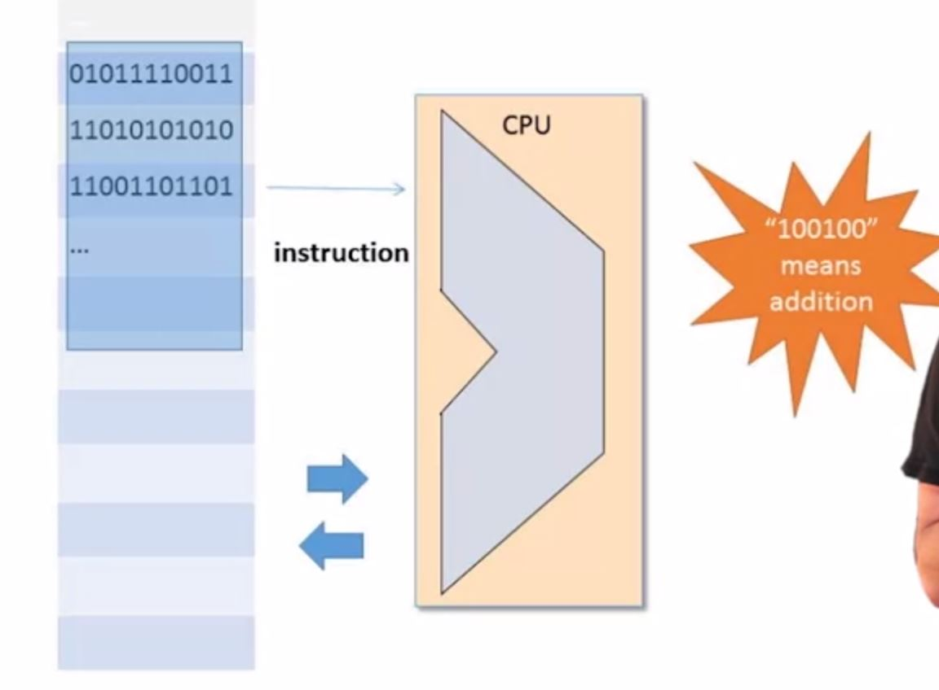
Machine Language: Instructions

Slide 15
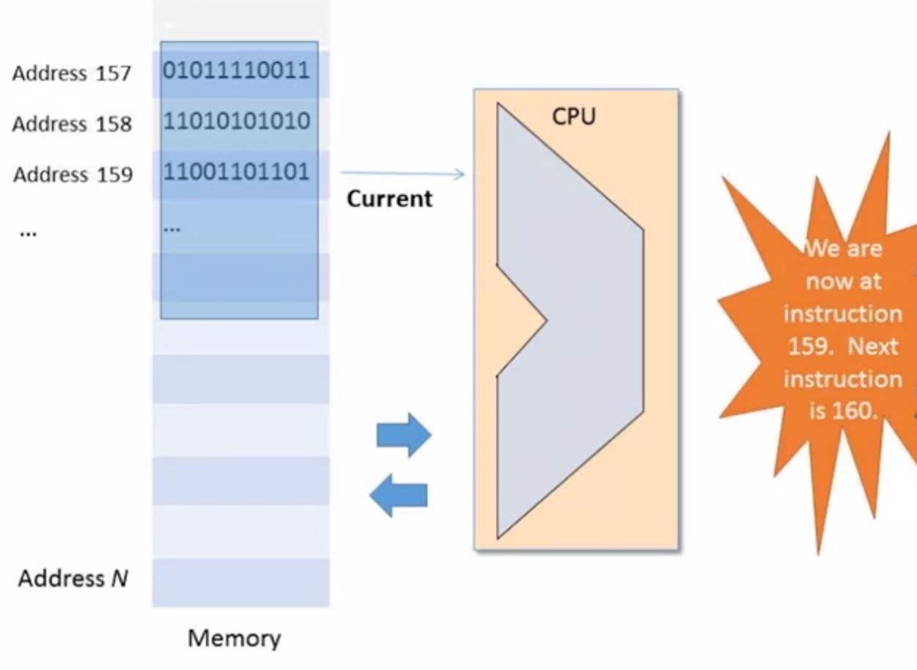
Machine Language: sequence via Program Counter

Slide 16
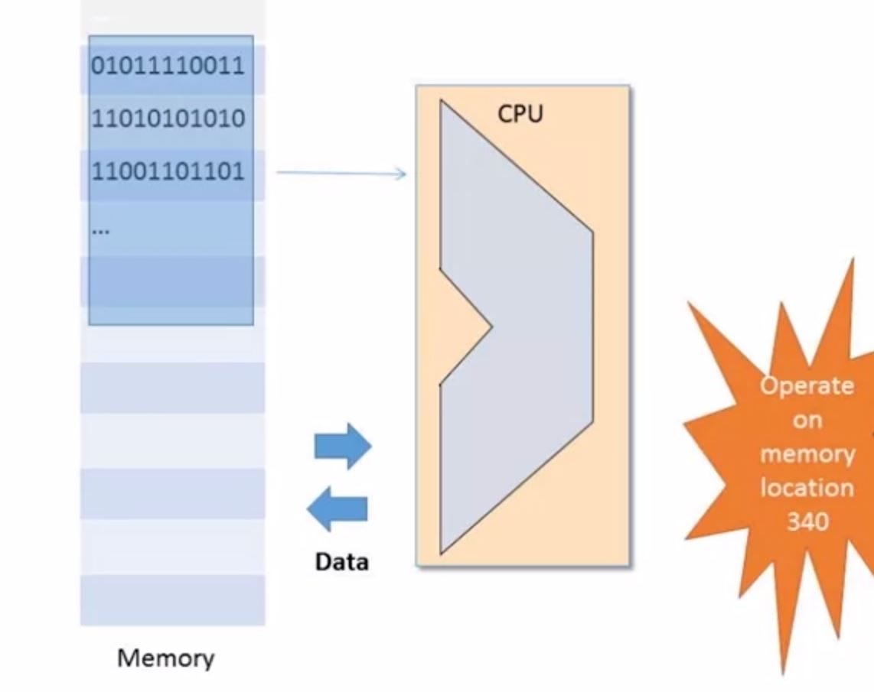
Machine Language: Addressing

Slide 17
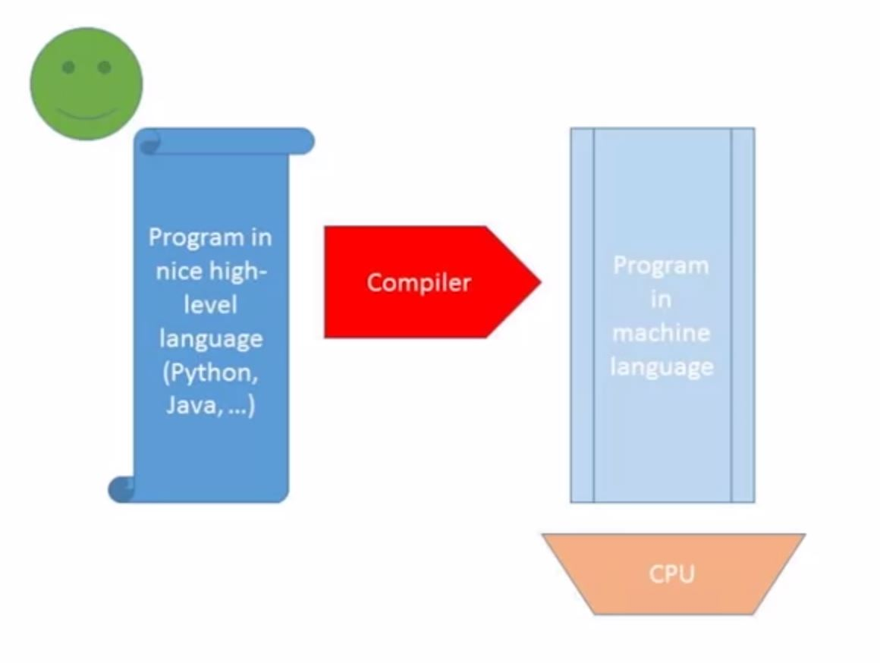
Compilation
Ways to ease the machine language use
- create mnemonics and then “assemble” to true machine language

Slide 18
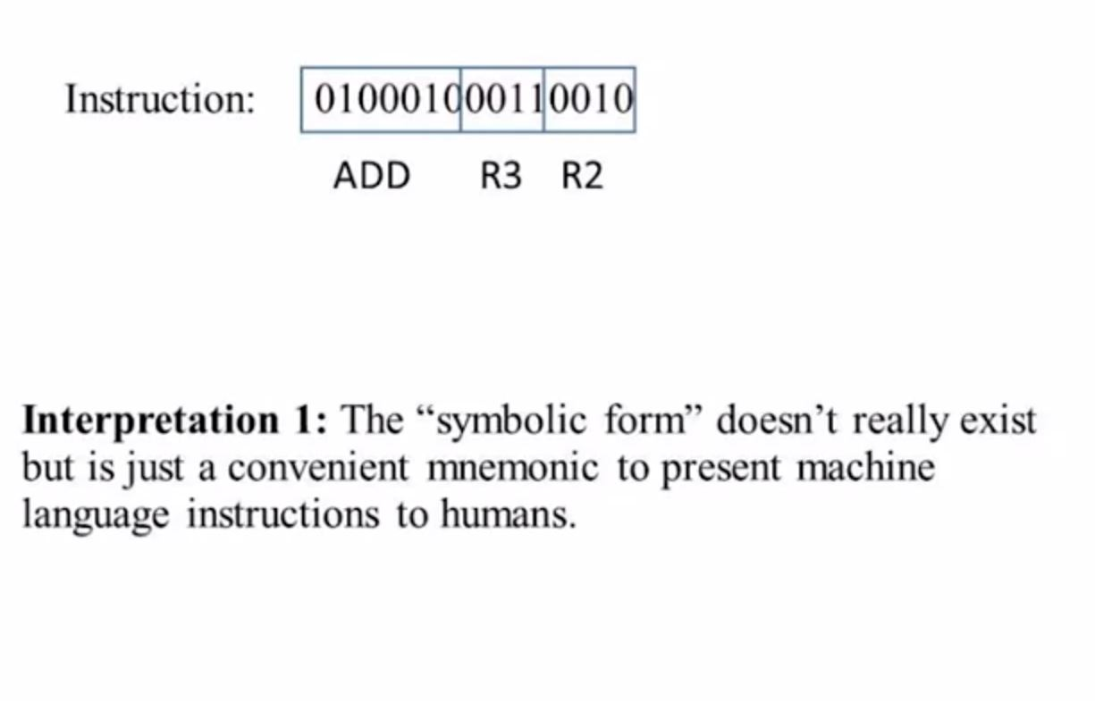
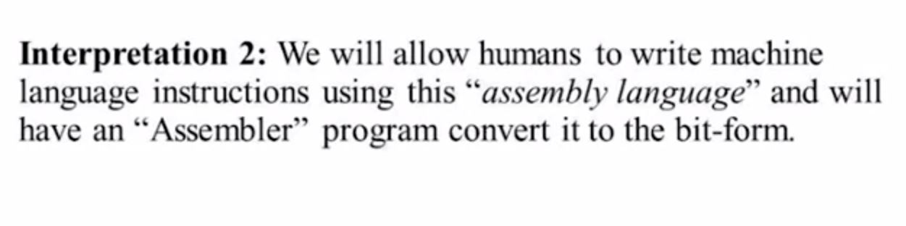
Mnemonics (assembly language)

Slide 19
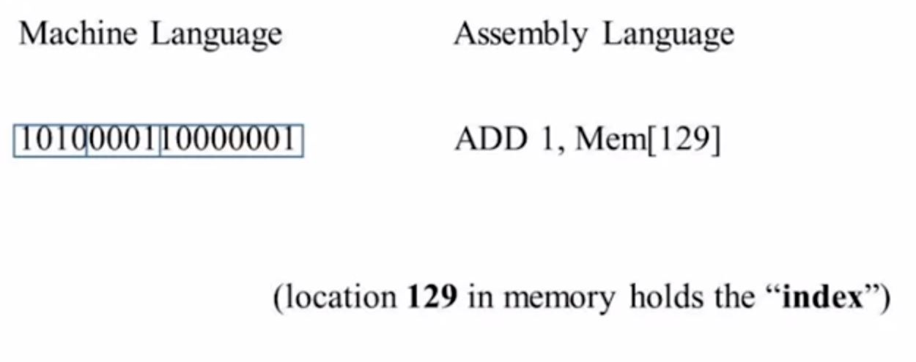
Symbols

Slide 20
addressing

Slide 21
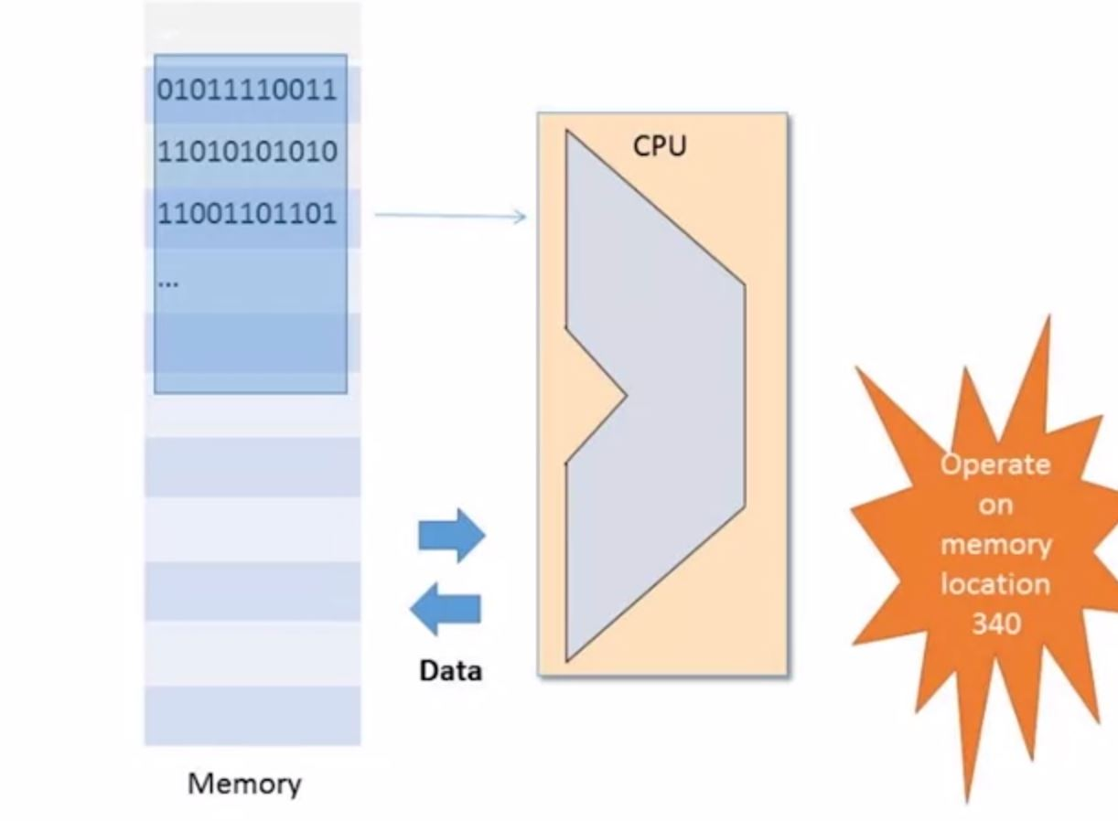
Addressing

Slide 22
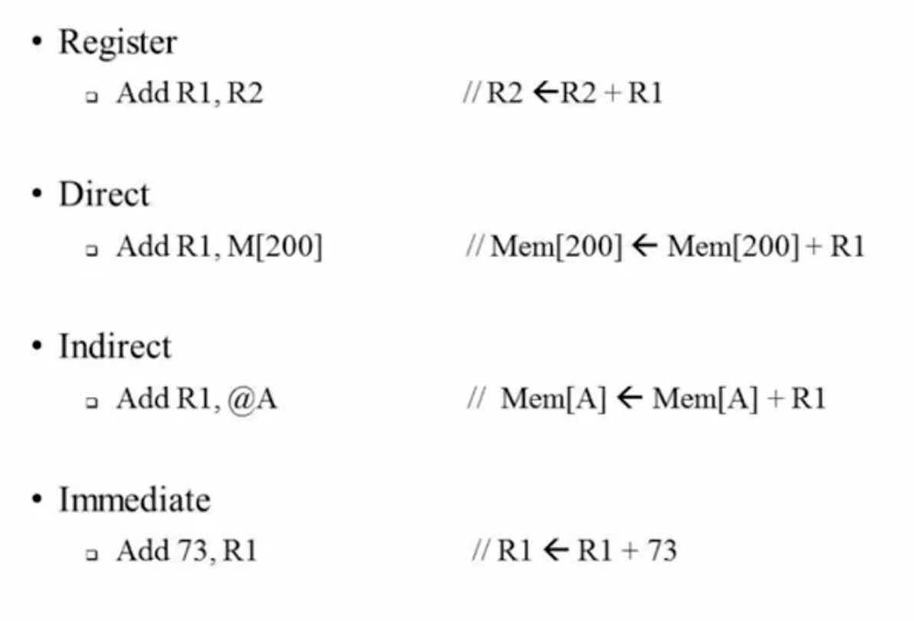
Addressing Modes (Examples)

Slide 23
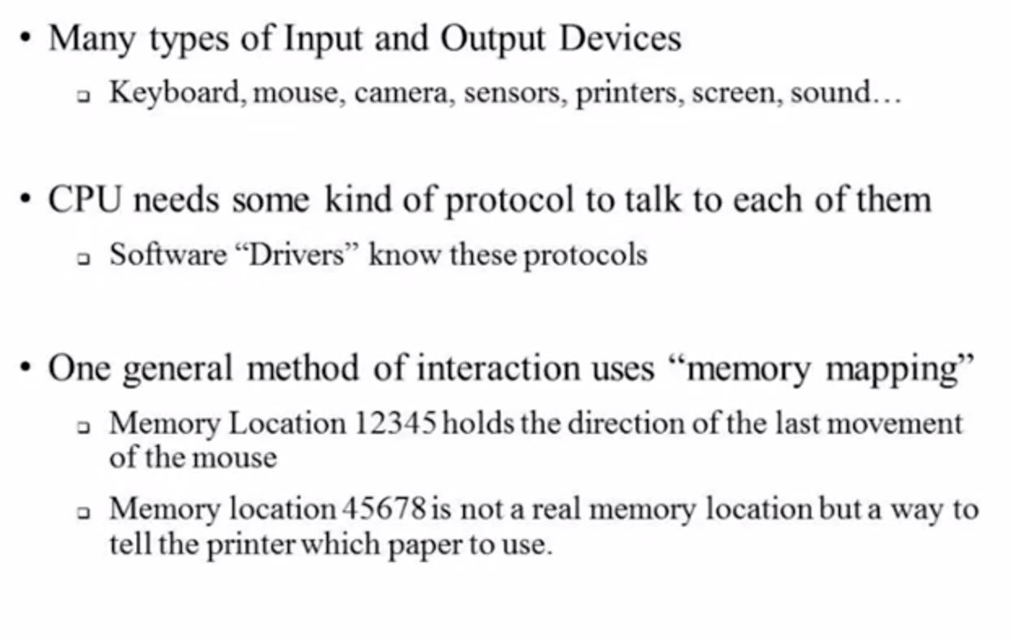
Input/Output

Slide 24
Flow Control

Slide 25
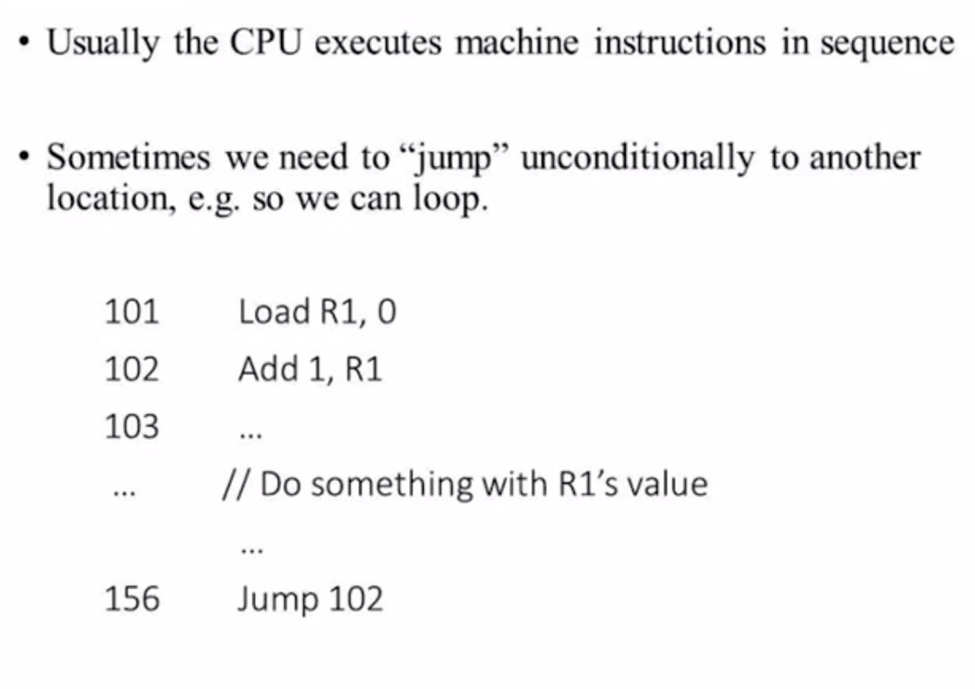
Flow Control - Unconditional
loop
loop

Slide 26
Flow Control – Conditional Jump
Sometimes we need to jump only if certain condition(s) is(are) met
JGT R1, 0, LABEL //Jump if R1 > 0
// do something with negative R1
LABEL:
// do something with positive R1

Slide 27
Typical assembly Commands

Slide 28
Typical Commands – arithmetic & logic
Add R1, R2, R3 (add R2 and R3 and put result in R1)
AND R1, R2, R3 (bitwise AND R2 and R3 and put result in R1)
ADD R1, R2, Mem(x) (Add R2 and contents of Memory location x and put result in R1)

Slide 29
Typical Commands - Memory Access
Operations
Load R1, Mem(x): Load Contents of Mem(x) into R1
Store Mem(x), R2: Store Contents of R2 into location Mem(x)
Addressing
Direct: Load R1, MEM[67] (Load contents of memory location 67 into R1)
Immediate: Load R1, 67 (Load immediate constant 67 into R1)
Indirect: Load R1, MEM[@R2] (Load contents of Memory location pointed to by R2 into R1]

Slide 30
Typical Commands - branches
Unconditional
Conditional e.g. Jump to certain address if a condition is met

Slide 31
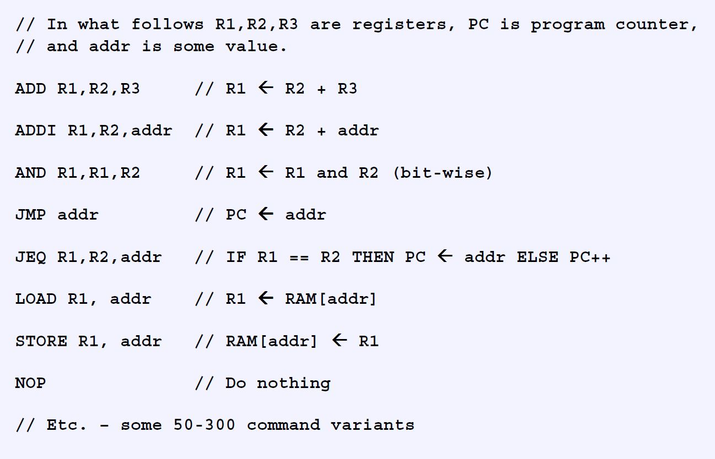
Typical Machine Language Commands

Slide 32
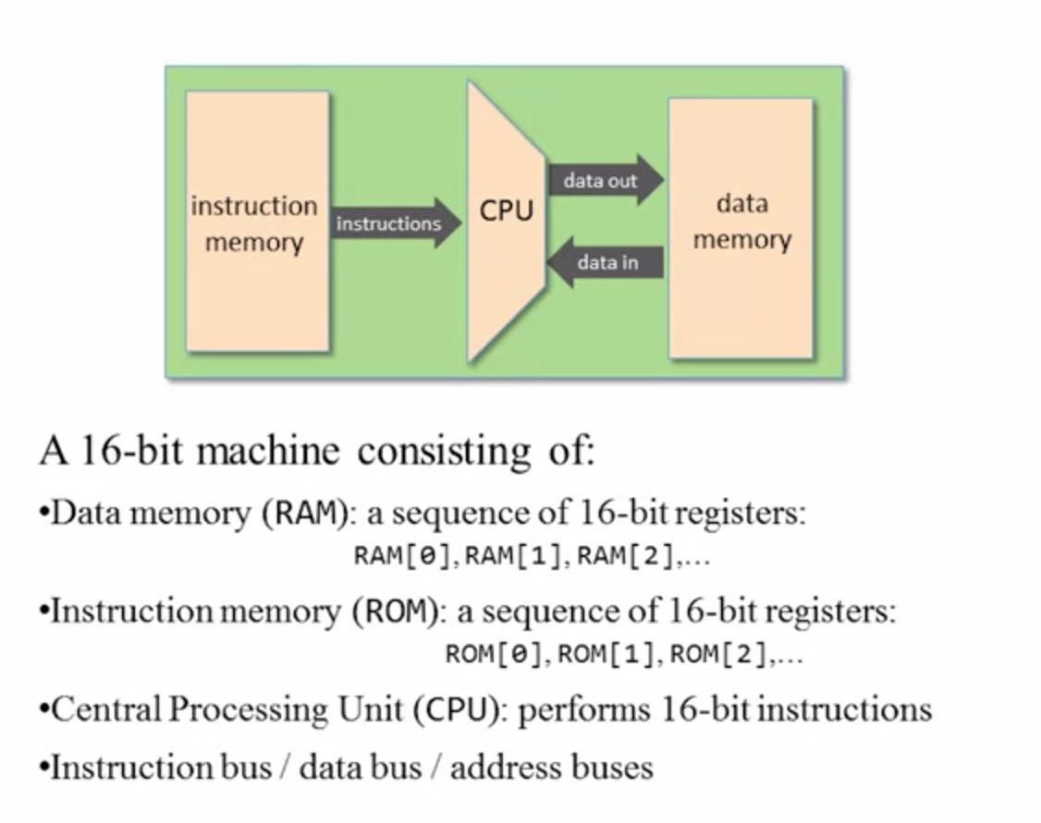
Hack Computer: Hardware

Slide 33
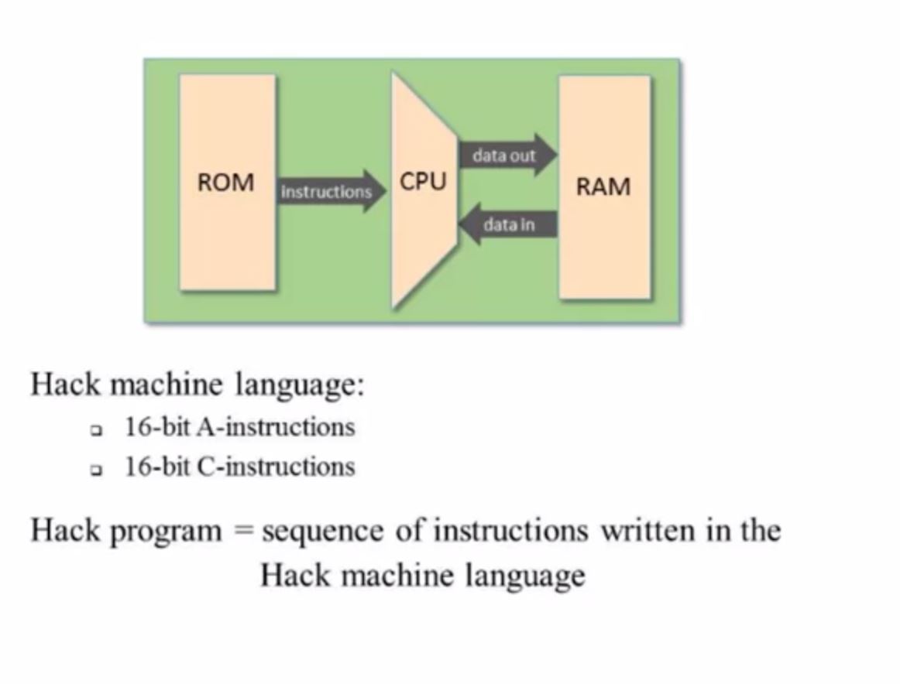
Hack Computer - Software

Slide 34
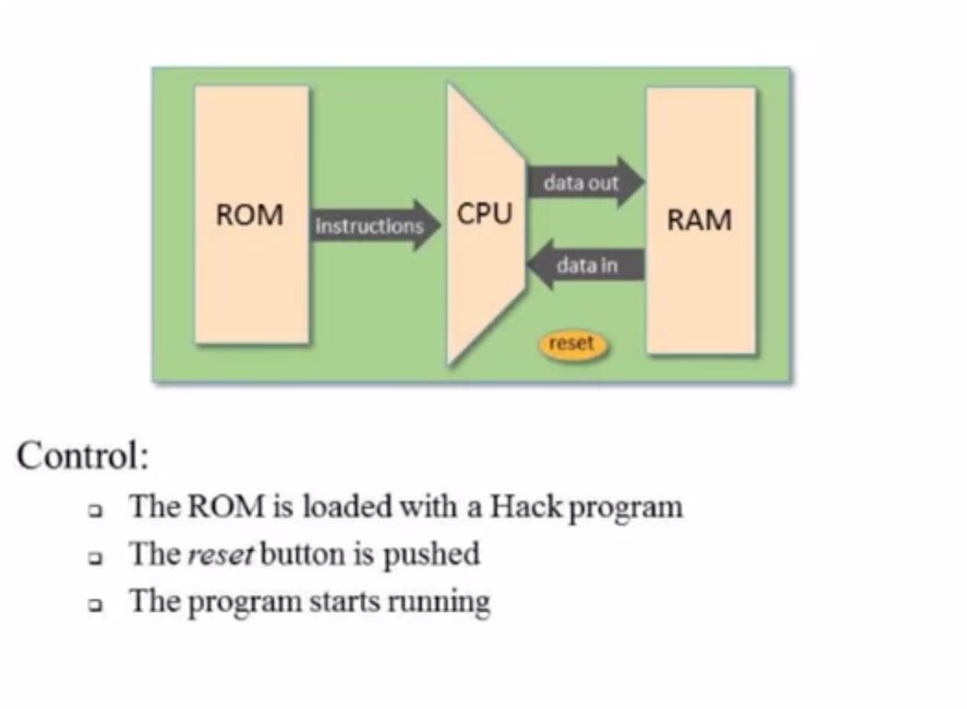
Hack Computer - Control

Slide 35
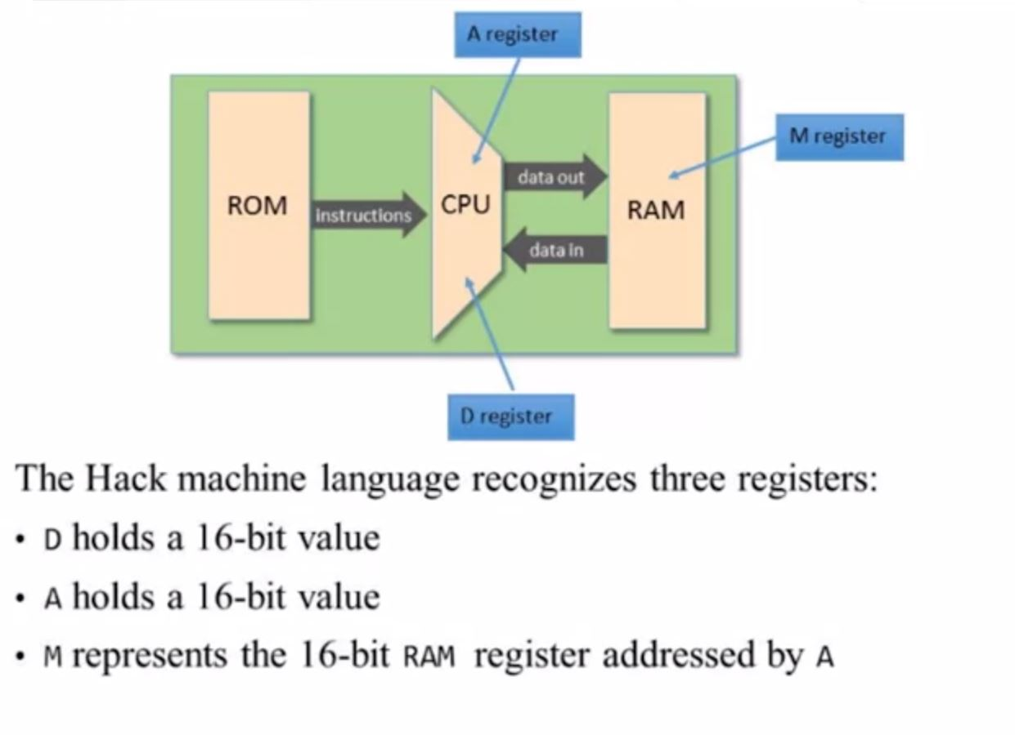
Hack Computer - Registers

Slide 36
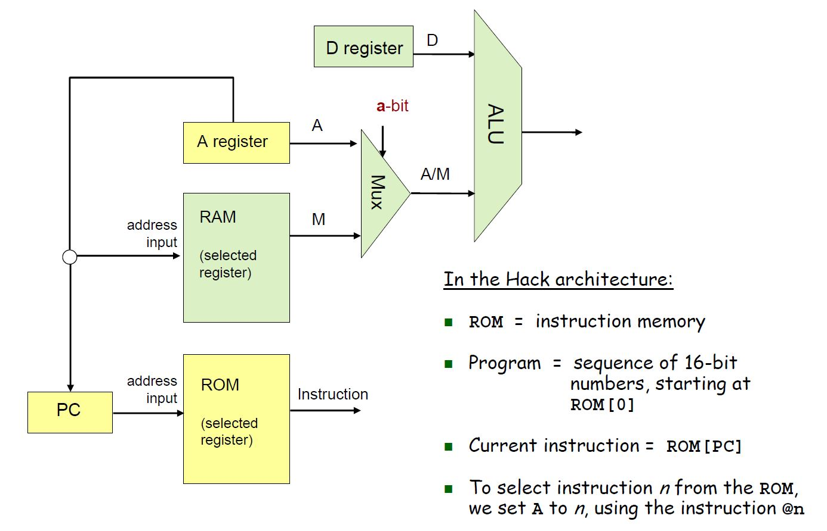
HACK Computer (preview)

Slide 37
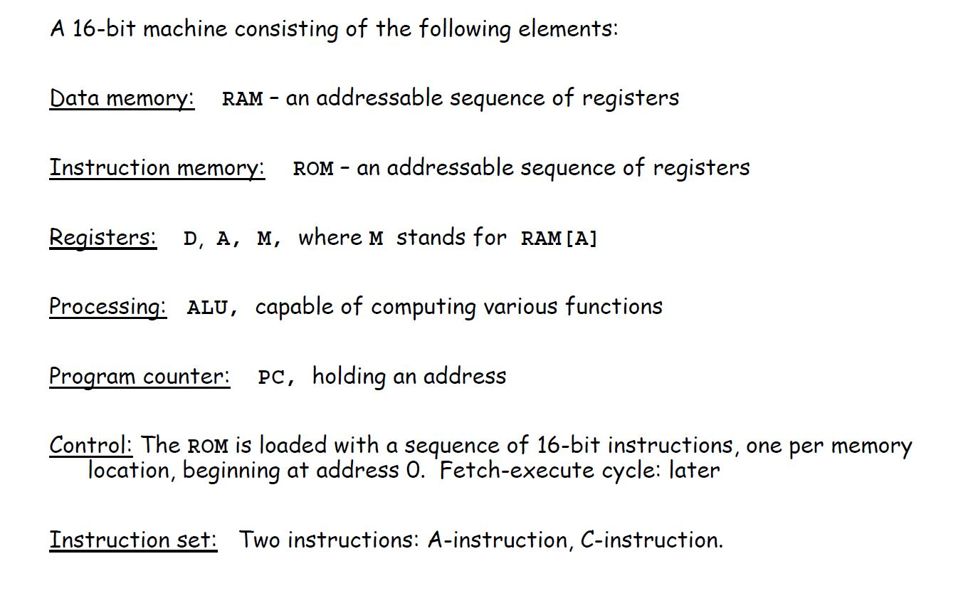
The Hack Computer

Slide 38
More on Hack Computer
Two Instructions
A (Address): Fix the address on which to operate
C (Compute): Specify and Perform Operation
CPU runs program that are resident in instruction memory (ROM)
Registers and Memory Data are all 16 bits wide
Addresses are 15 bits for both Instruction and Data Memory
ie. 32K words
Memory is always accessed by referencing the contents of the A register
For example: D = M[516] -1 would imply setting A to 516 and then doing a read to memory location 516 via A and subtracting 1 from the read content to write the result to A

Slide 39
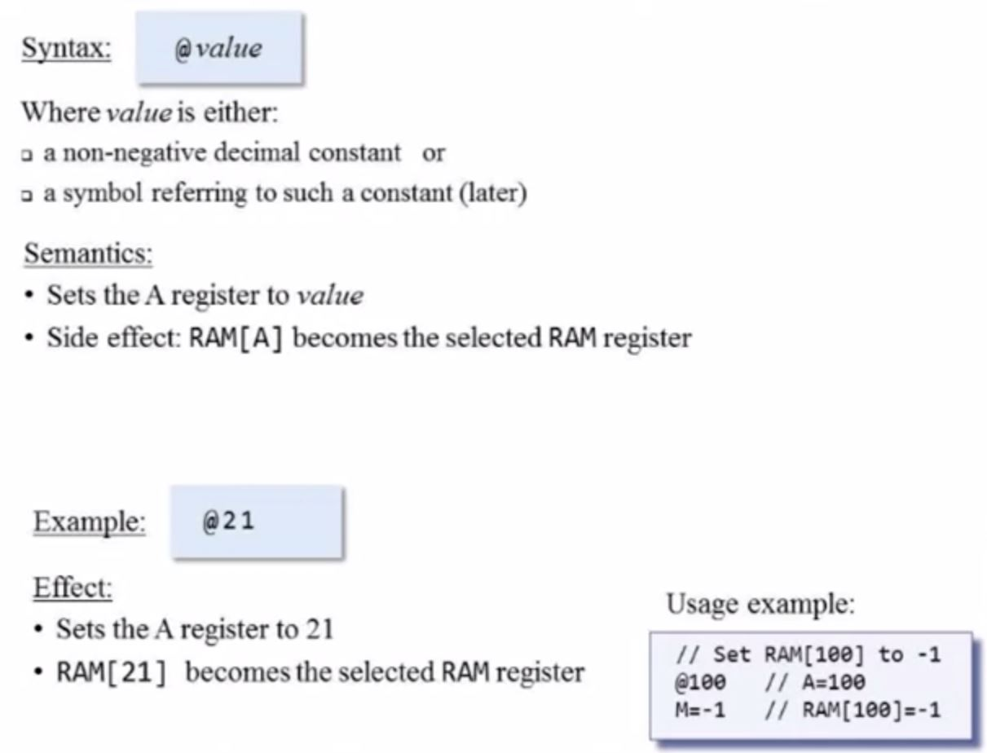
A-Instruction

Slide 40
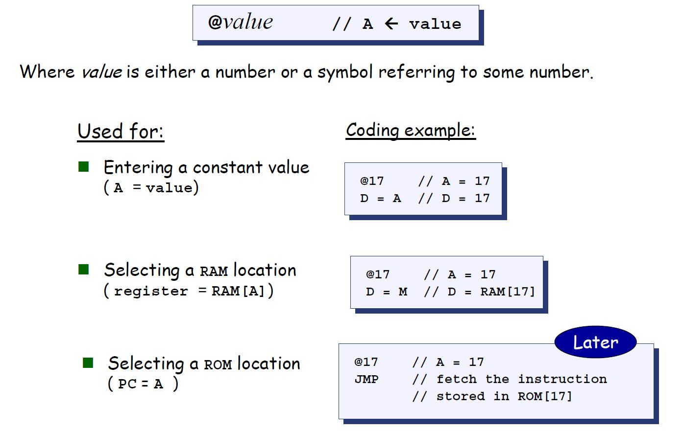
The A-Instruction

Slide 41
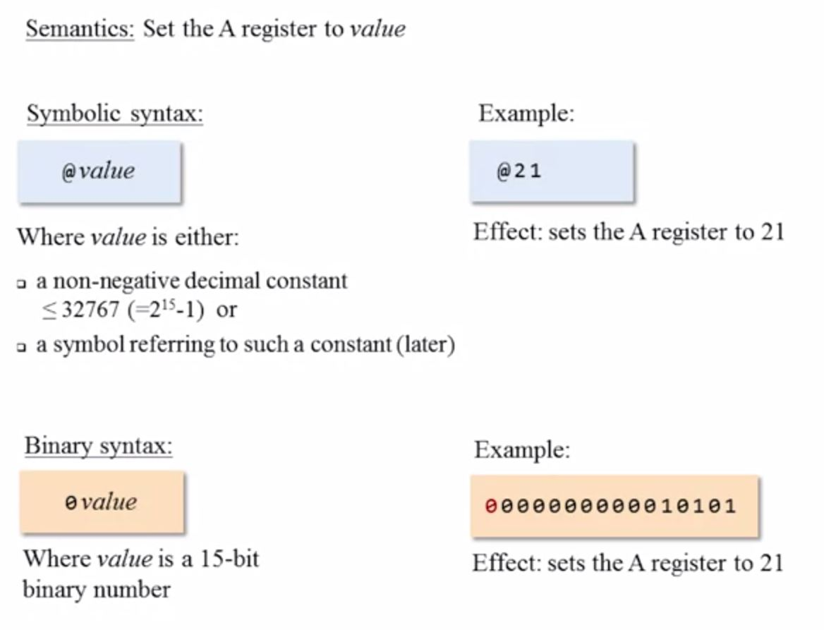
A-Instruction: Symbolic and Binary Syntax

Slide 42
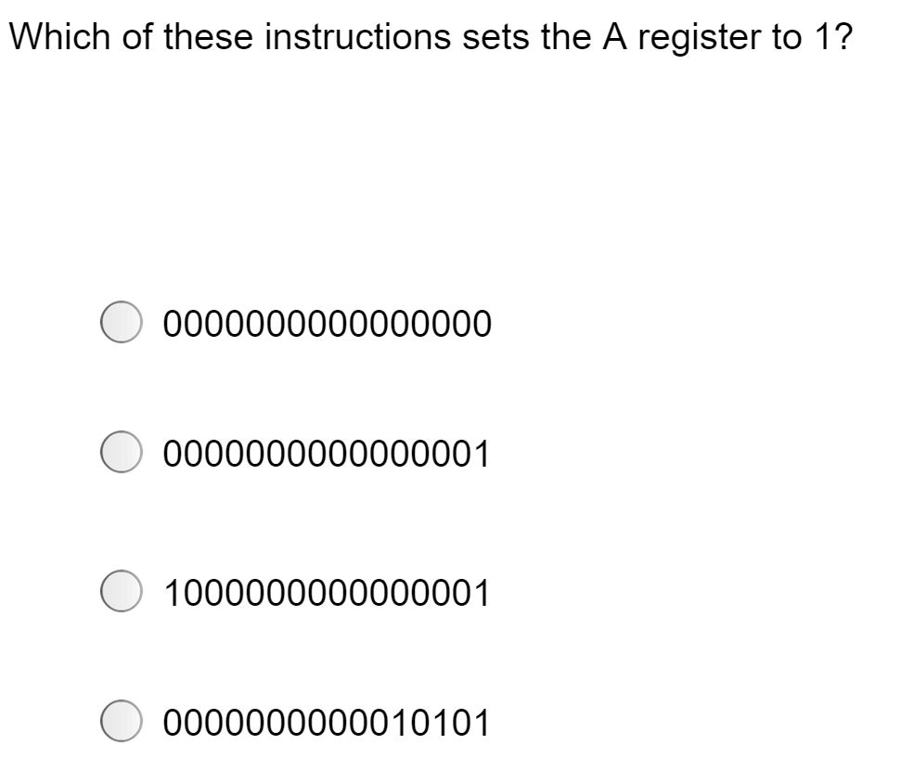
A-Instruction Quiz

Slide 43
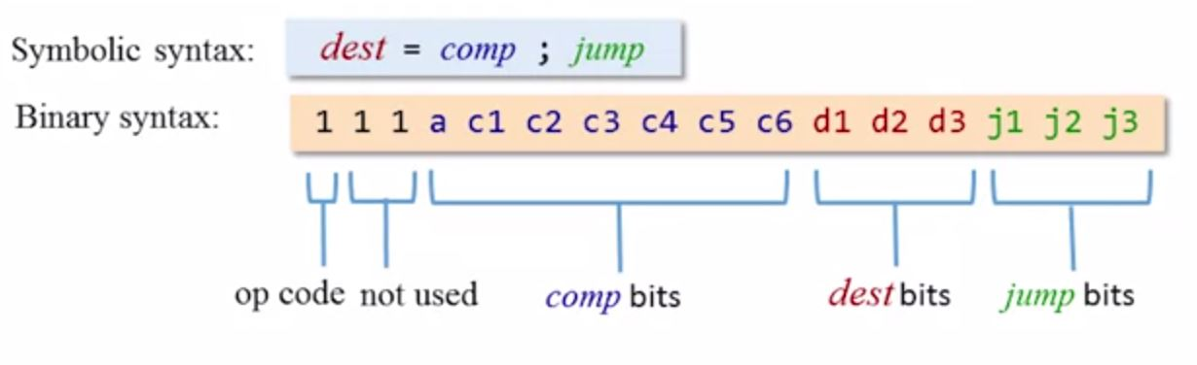
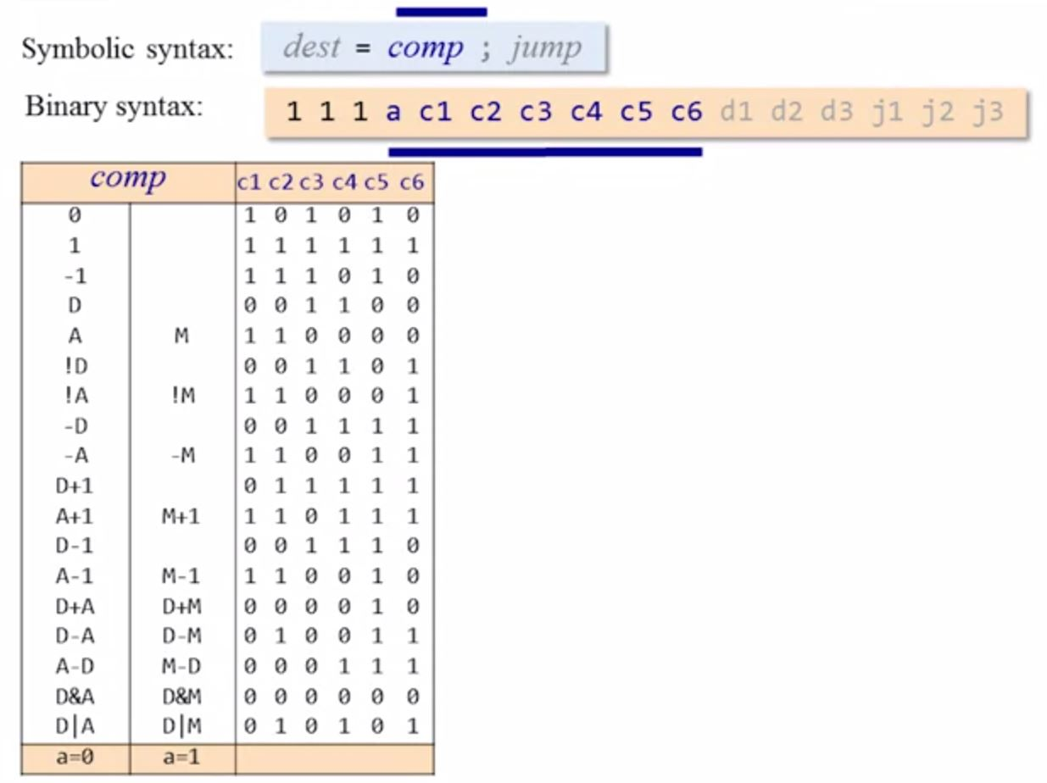
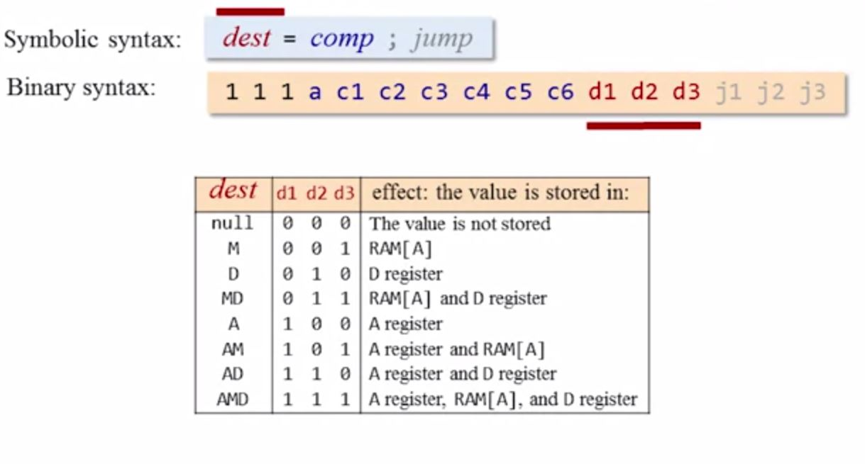
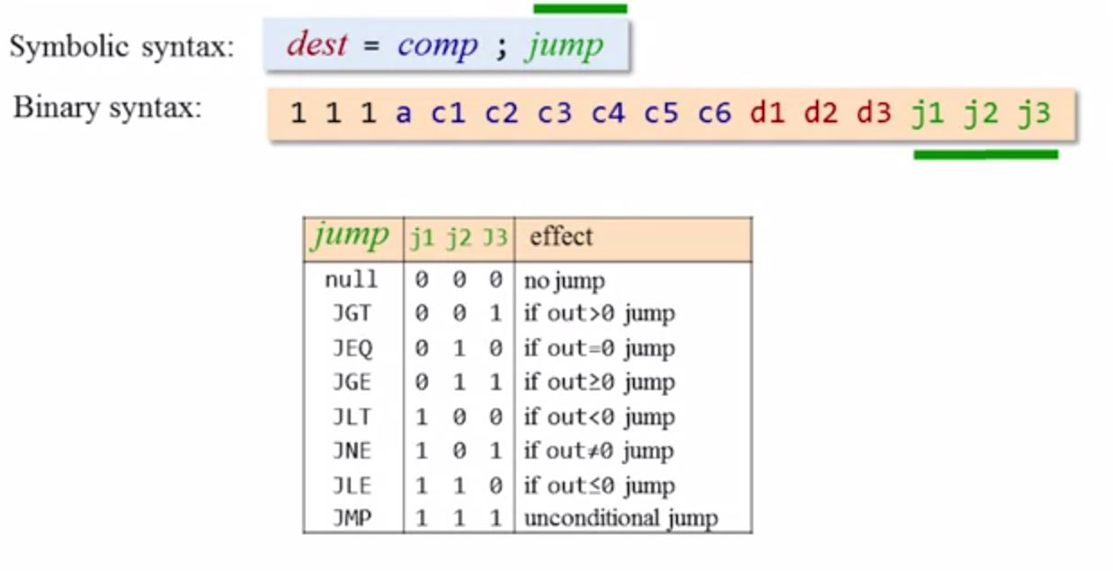
The C-Instruction: Symbolic and Binary Syntax
READ THIS IN SLIDESHOW

Slide 44
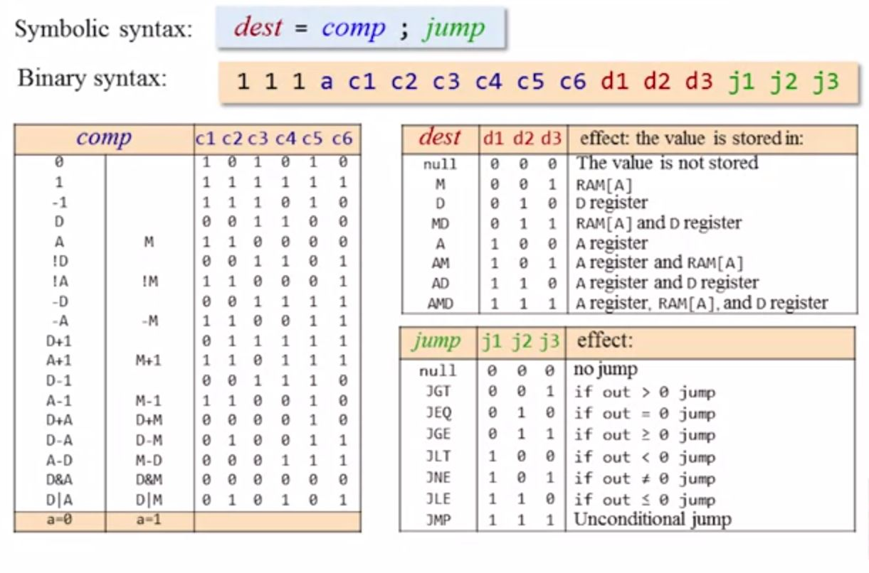
C-Instruction in Entirety

Slide 45
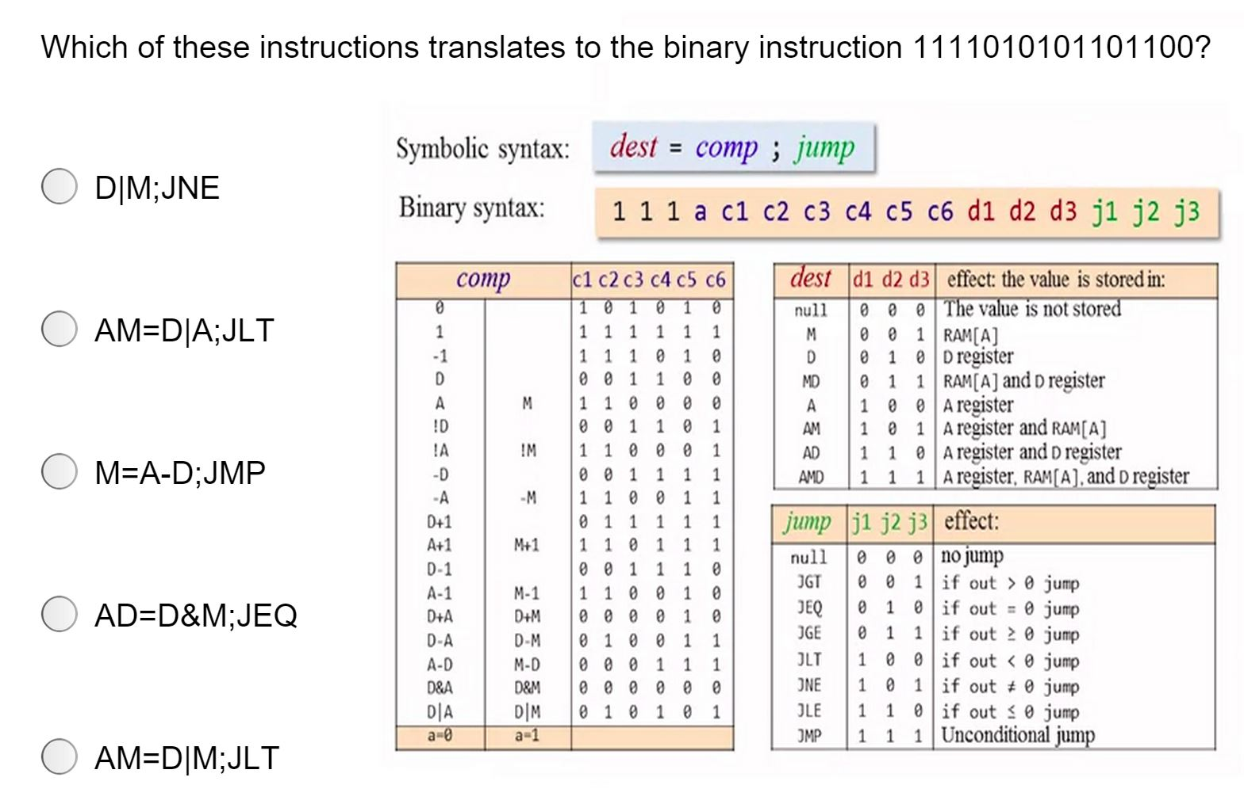
Quiz

Slide 46
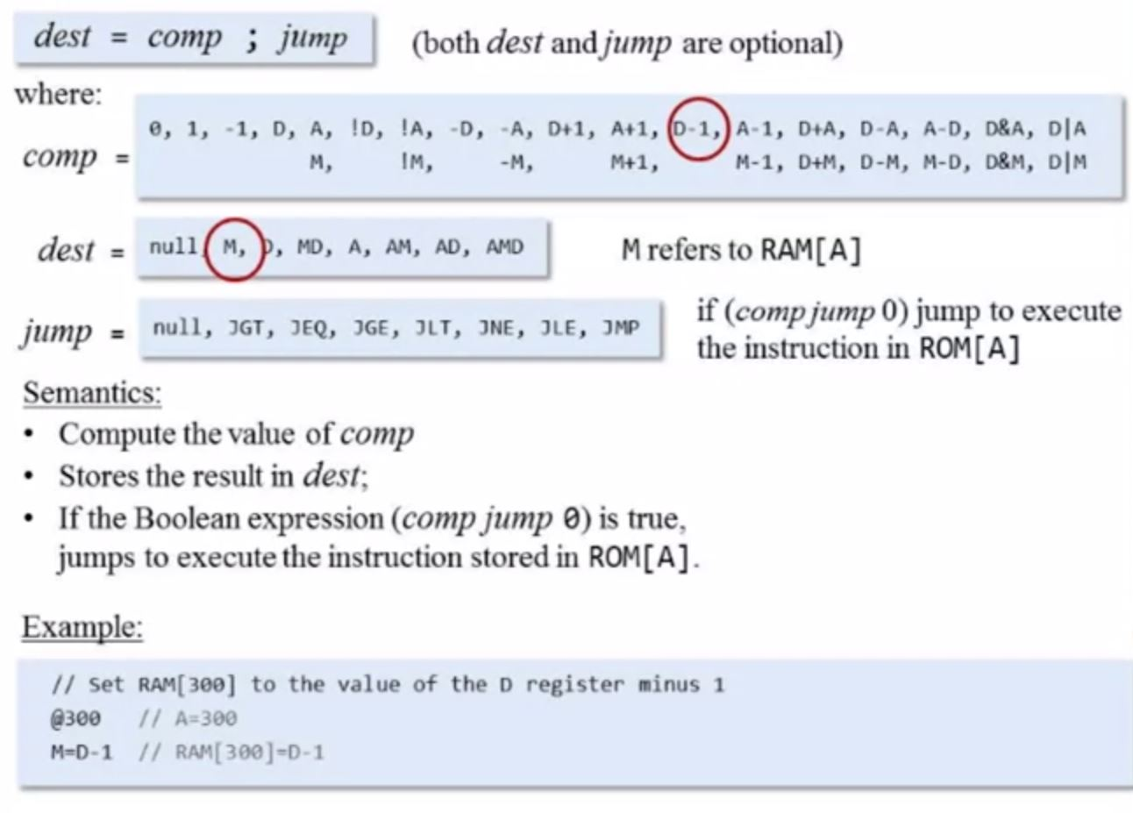
The C-Instruction

Slide 47
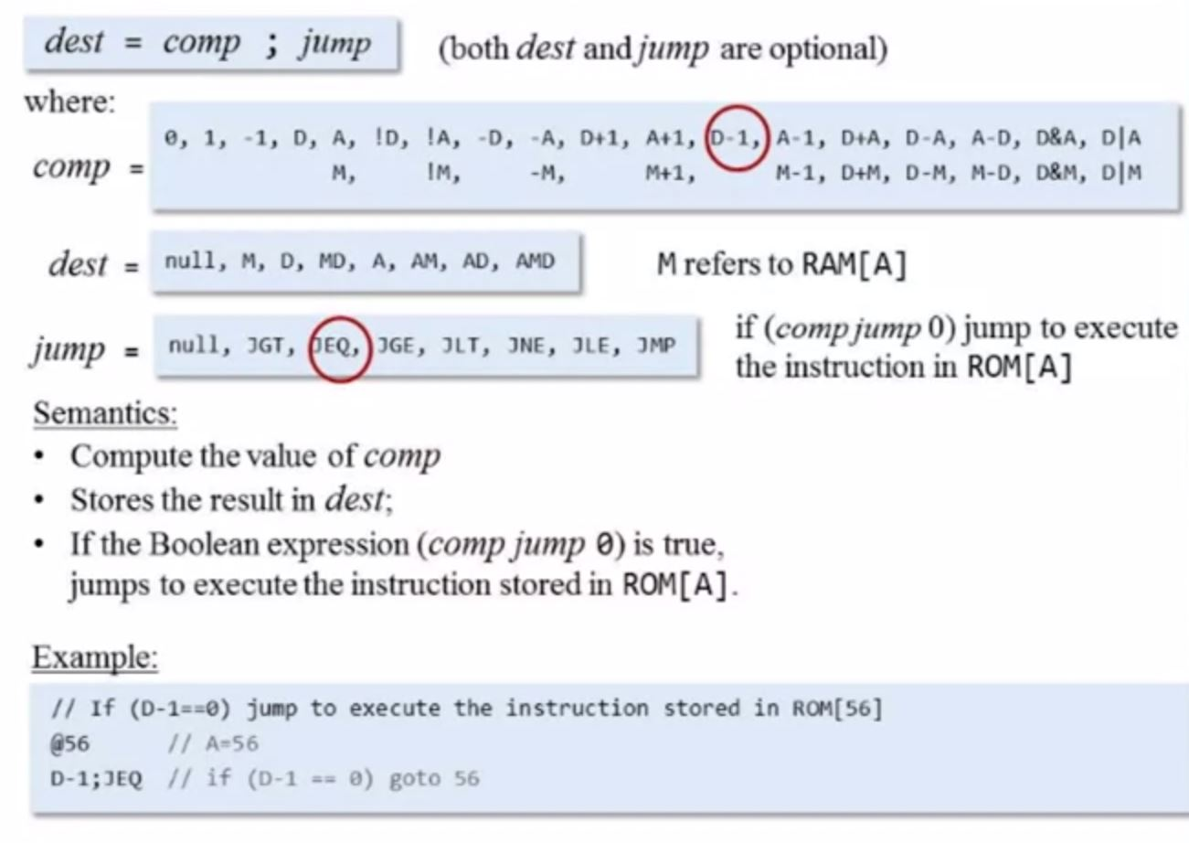
The C-Instruction (JMP)

Slide 48
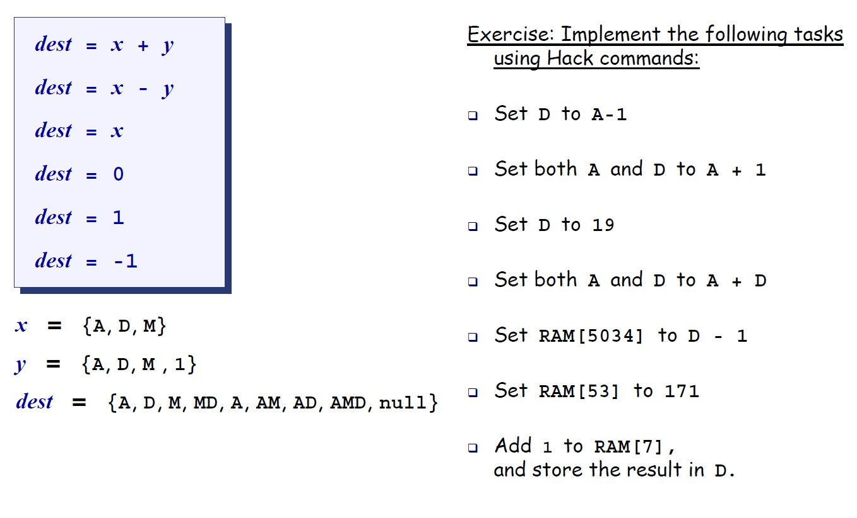
The C-Instruction – More Examples
D = A -1
AD = A+1
@19, D=A
AD = A+D
@5034, M=D-1
@171, D=A; @53, M=D
@7, M=M+1, D=M

Slide 49
The C-instruction (first approximation)
Exercise: Implement the following tasks using Hack commands:
sum = 0
j = j + 1
q = sum + 12 – j
arr[3] = -1
arr[j] = 0
arr[j] = 17
etc.
dest = x + y
dest = x - y
dest = x
dest = 0
dest = 1
dest = -1
x = {A, D, M}
y = {A, D, M , 1}
dest = {A, D, M, MD, A, AM, AD, AMD, null}
Symbol table:
j 3012
sum 4500
q 3812
arr 20561
(All symbols and values are arbitrary examples)

Slide 50
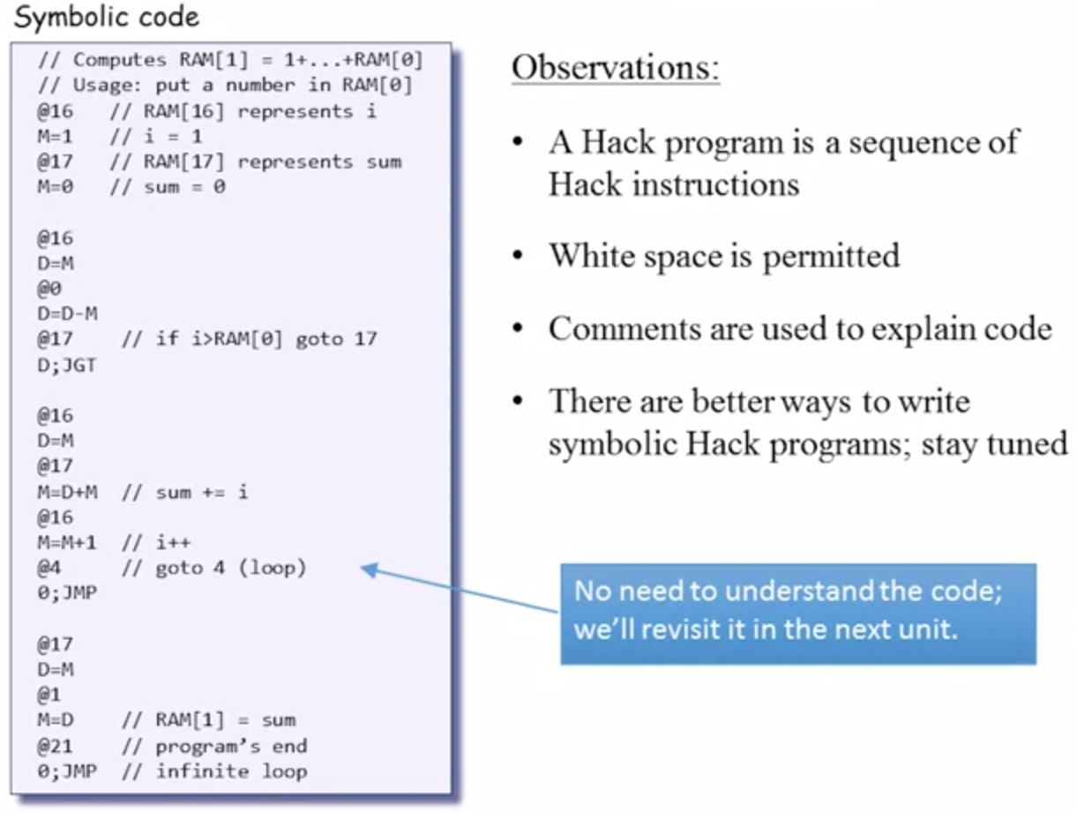
Hack Program

Slide 51
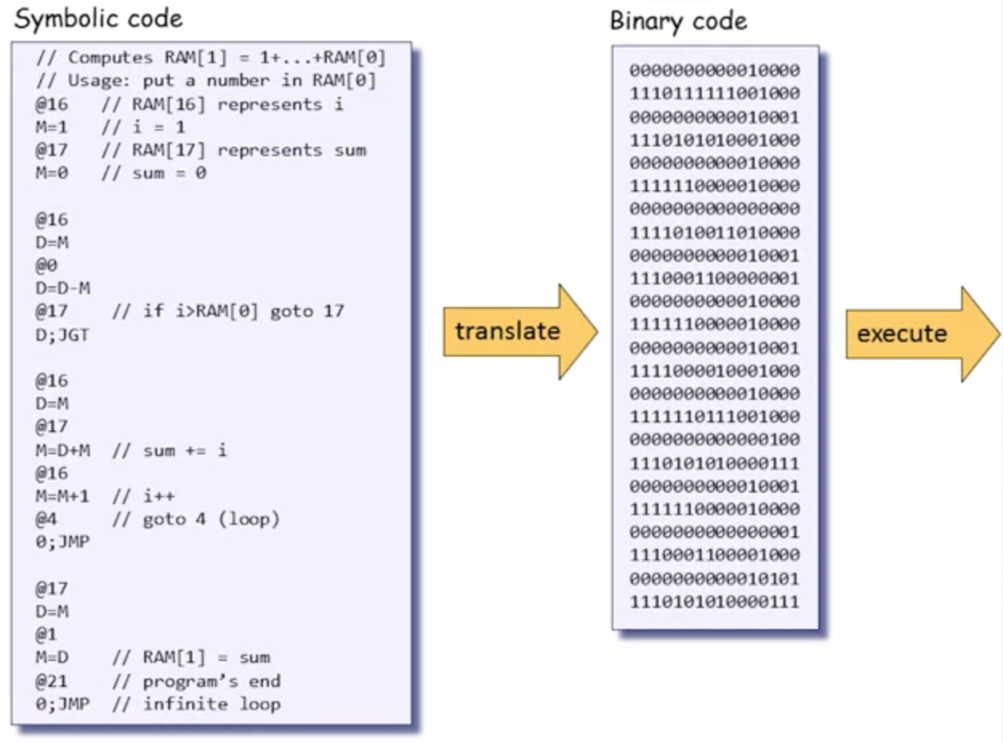
Hack Program: Symbolic and Binary

Slide 52
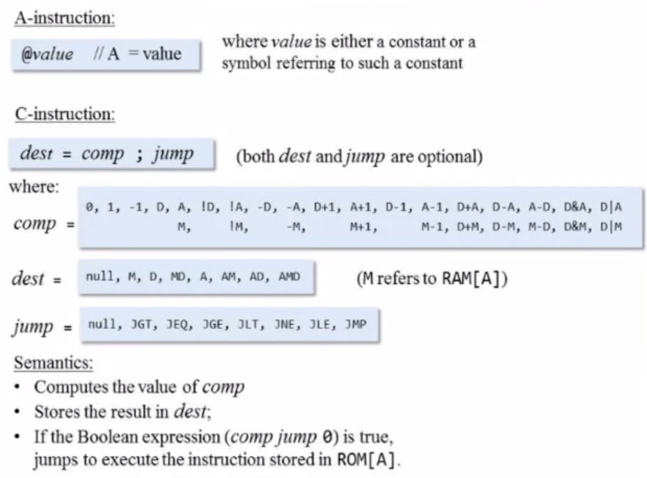
Summary – Hack Assembly Instructions

Slide 53
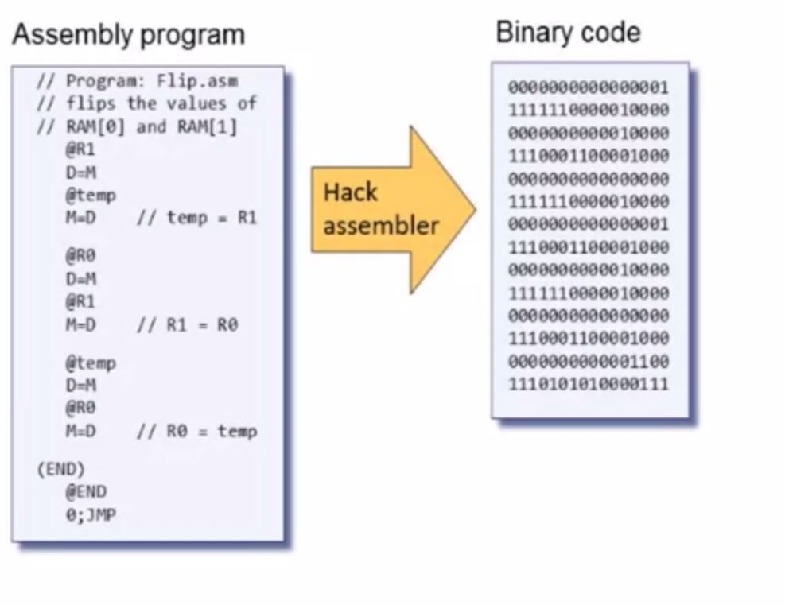
Hack Assembler

Slide 54
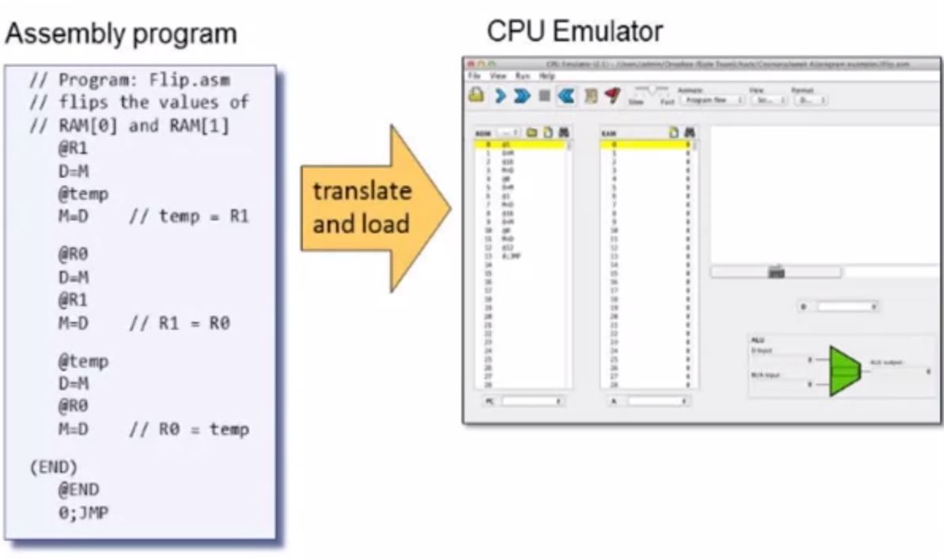
Hack CPU Emulator

Slide 55
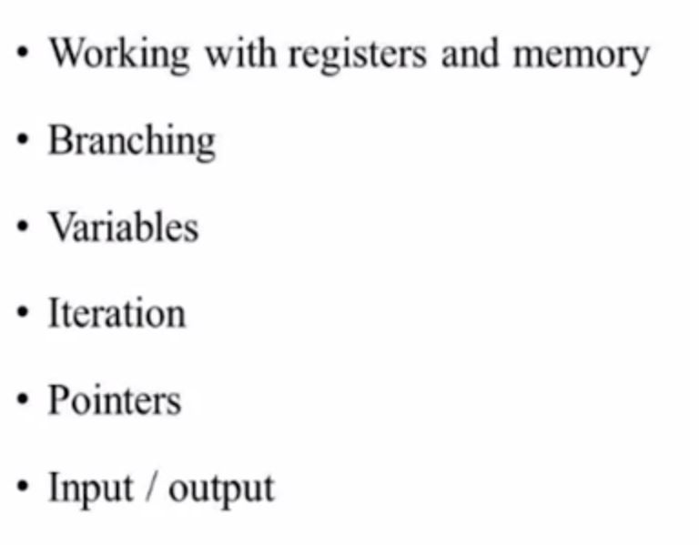
Hack Programming

Slide 56
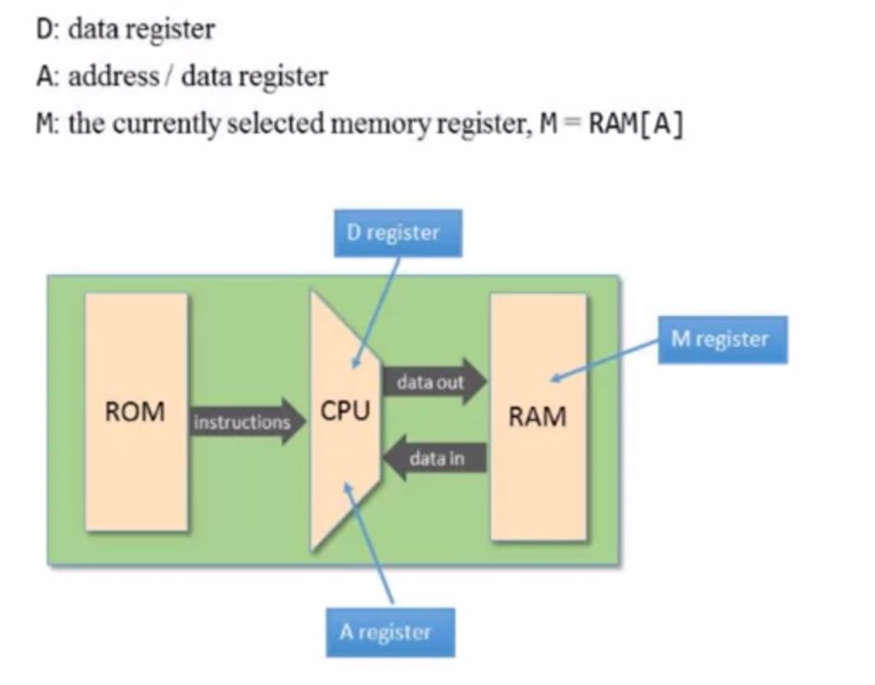
Working with Registers and Memory

Slide 57
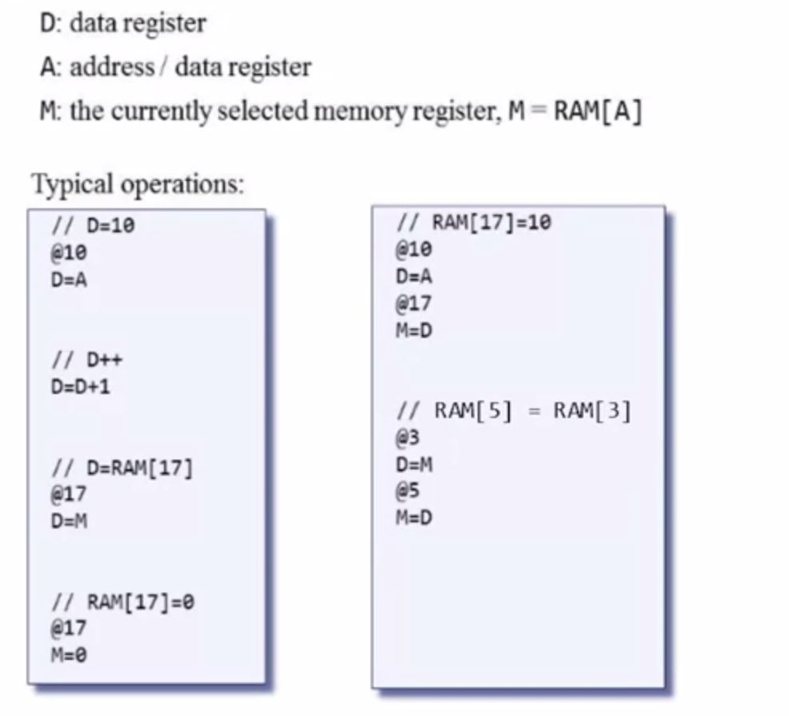
Working with Registers and Memory

Slide 58
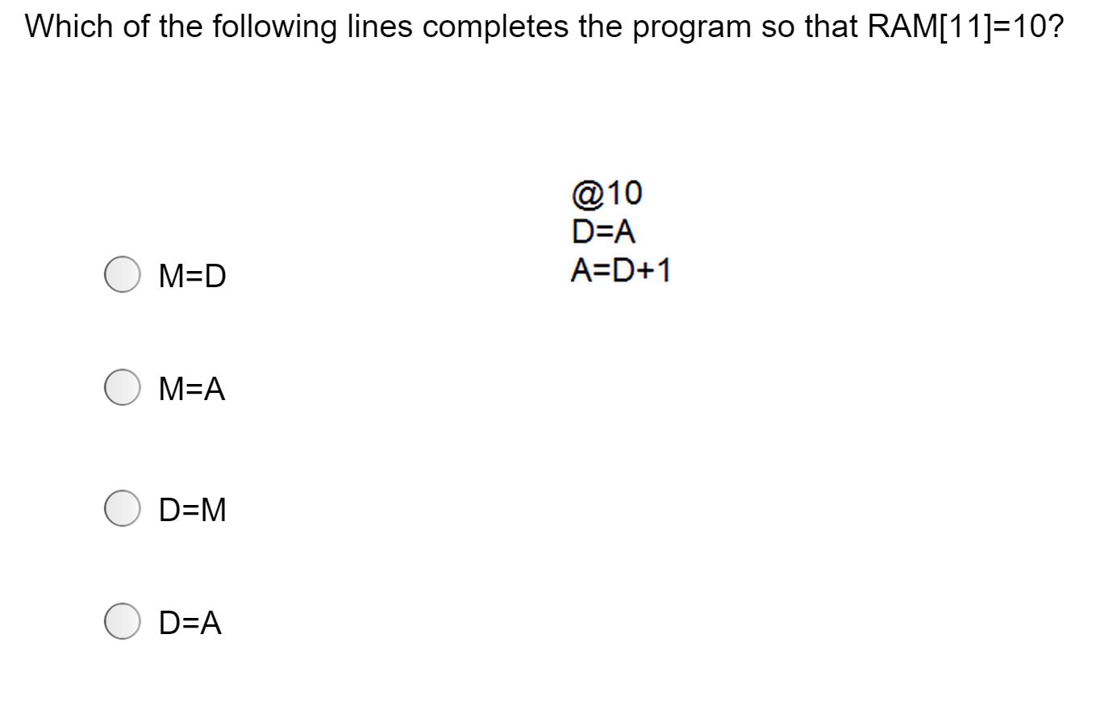
Registers - Quiz

Slide 59


Hack Program Example: Adding Two Numbers

Slide 60

Terminating a Program Correctly

Slide 61

Hack: Built-In Symbols

Slide 62

Hack: Other built-in symbols

Slide 63
Control (focus on the yellow chips only)
D register
D
a-bit
A
ALU
A register
A/M
Mux
address input
RAM
(selected register)
M
In the Hack architecture:
ROM = instruction memory
Program = sequence of 16-bit numbers, starting at ROM[0]
Current instruction = ROM[PC]
To select instruction n from the ROM, we set A to n, using the instruction @n
address input
ROM
(selected register)
Instruction
PC

Slide 64
Coding examples (practice)
Hack commands:
A-command: @value // set A to value
C-command: dest = comp ; jump // dest = and ;jump // are optional
Where:
comp = 0 , 1 , -1 , D , A , !D , !A , -D , -A , D+1 , A+1 , D-1, A-1 , D+A , D-A , A-D , D&A , D|A , M , !M , -M ,M+1, M-1 , D+M , D-M , M-D , D&M , D|M
dest = M , D , MD , A , AM , AD , AMD, or null
jump = JGT , JEQ , JGE , JLT , JNE , JLE , JMP, or null
In the command dest = comp; jump, the jump materialzes if (comp jump 0) is true. For example, in D=D+1,JLT, we jump if D+1 < 0.
Exercise: Implement the following tasks using Hack commands:
goto 50
if D==0 goto 112
if D<9 goto 507
if RAM[12] > 0 goto 50
if sum>0 goto END
if x[i]<=0 goto NEXT.
Symbol table:
sum 2200
x 4000
i 6151
END 50
NEXT 120
Hack convention:
True is represented by -1
False is represented by 0
(All symbols and values in are arbitrary examples)

Slide 65
IF logic – Hack style
High level:
Hack:
if condition {
code block 1}
else {
code block 2}
code block 3
D ← not condition
@IF_TRUE
D;JEQ
code block 2
@END
0;JMP
(IF_TRUE)
code block 1
(END)
code block 3
Hack convention:
True is represented by -1
False is represented by 0

Slide 66
WHILE logic – Hack style
High level:
Hack:
while condition {
code block 1
}
Code block 2
(LOOP)
D ← not condition
@END
D;JEQ
code block 1
@LOOP
0;JMP
(END)
code block 2
Hack convention:
True is represented by -1
False is represented by 0

Slide 67
Side note (focus on the yellow chip parts only)
D register
D
a-bit
A
ALU
A register
A/M
Mux
address input
RAM
(selected register)
M
In the Hack architecture, the A register addresses both the RAM and the ROM, simultaneously. Therefore:
Command pairs like @addr followed by D=M;someJumpDirective make no sense
Best practice: in well-written Hack programs, a C-instruction should contain
either a reference to M, or
a jump directive,
but not both.
address input
ROM
(selected register)
Instruction
PC
Notes:
67

Slide 68
Complete program example
C language code:
Hack assembly code:
// Adds 1+...+100.
into i = 1;
into sum = 0;
while (i <= 100){
sum += i;
i++;
}
// Adds 1+...+100.
@i // i refers to some RAM location
M=1 // i=1
@sum // sum refers to some RAM location
M=0 // sum=0
(LOOP)
@i
D=M // D = i
@100
D=D-A // D = i - 100
@END
D;JGT // If (i-100) > 0 goto END
@i
D=M // D = i
@sum
M=D+M // sum += i
@i
M=M+1 // i++
@LOOP
0;JMP // Got LOOP
(END)
@END
0;JMP // Infinite loop
Hack assembly convention:
Variables: lower-case
Labels: upper-case
Commands: upper-case

Slide 69
Symbols in Hack assembly programs
// Typical symbolic
// Hack code, meaning
// not important
@R0
D=M
@INFINITE_LOOP
D;JLE
@counter
M=D
@SCREEN
D=A
@addr
M=D
(LOOP)
@addr
A=M
M=-1
@addr
D=M
@32
D=D+A
@addr
M=D
@counter
MD=M-1
@LOOP
D;JGT
(INFINITE_LOOP)
@INFINITE_LOOP
0;JMP
Symbols created by Hack programmers and code generators:
Label symbols: Used to label destinations of goto commands. Declared by the pseudo command (XXX). This directive defines the symbol XXX to refer to the instruction memory location holding the next command in the program (within the program, XXX is called “label”)
Variable symbols: Any user-defined symbol xxx appearing in an assembly program that is not defined elsewhere using the (xxx) directive is treated as a variable, and is “automatically” assigned a unique RAM address, starting at RAM address 16
By convention, Hack programmers use lower-case and upper-case letters for variable names and labels, respectively.
Predefined symbols:
I/O pointers: The symbols SCREEN and KBD are “automatically” predefined to refer to RAM addresses 16384 and 24576, respectively (base addresses of the Hack platform’s screen and keyboard memory maps)
Virtual registers: covered in future lectures.
VM control registers: covered in future lectures.
Q: Who does all the “automatic” assignments of symbols to RAM addresses?
A: The assembler, which is the program that translates symbolic Hack programs into binary Hack program. As part of the translation process, the symbols are resolved to RAM addresses. (more about this in future lectures)
Notes:
69

Slide 70
Perspective
Hack is a simple machine language
User friendly syntax: D=D+A instead of ADD D,D,A
Hack is a “½-address machine”: any operation that needs to operate on the RAM must be specified using two commands: an A-command to address the RAM, and a subsequent C-command to operate on it
A Macro-language can be easily developed
A Hack assembler is needed and will be discusses and developed later in the course.

