Slide 1
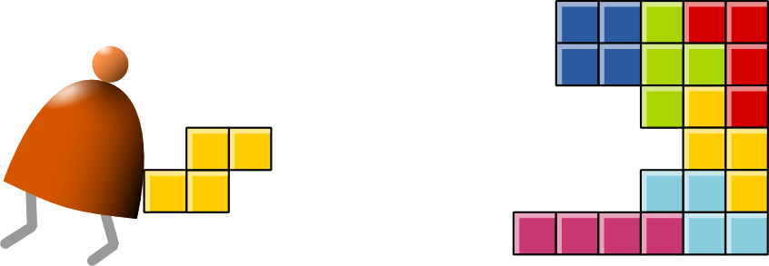
Assembler
Building a Modern Computer From First Principles

Slide 2
The big picture
Human
Abstract design
Software
Thought
abstract interface
hierarchy
Chapters 9, 12
H.L. Language
Compiler
&
abstract interface
Operating Sys.
Chapters 10 - 11
Virtual
VM Translator
Machine
abstract interface
Chapters 7 - 8
Assembly
Language
Assembler
Chapter 6
abstract interface
Computer
Machine
Architecture
Language
abstract interface
Chapters 4 - 5
Gate Logic
Hardware
abstract interface
Platform
Chapters 1 - 3
Electrical
Hardware
Chips &
Engineering
Logic Gates
Physics
hierarchy

Slide 3
Why care about assemblers?
Assemblers are the first rung up the software hierarchy ladder
An assembler is a translator of a simple language
Writing an assembler = low-impact practice for writing compilers.

Slide 4
Assembly example
For now, ignore all details!
Source code (example)
Target code
// Computes 1+...+RAM[0]
// And stored the sum in RAM[1]
@i
M=1 // i = 1
@sum
M=0 // sum = 0
(LOOP)
@i // if i>RAM[0] goto WRITE
D=M
@R0
D=D-M
@WRITE
D;JGT
... // Etc.
0000000000010000
1110111111001000
0000000000010001
1110101010001000
0000000000010000
1111110000010000
0000000000000000
1111010011010000
0000000000010010
1110001100000001
0000000000010000
1111110000010000
0000000000010001
...
assemble
execute

Slide 5
Assembly example
@ 4
D = 55
M = D
000 0000000 000 100
?????????????????????????????
111 1001100 001 000
The program translation challenge
Extract the program’s semantics from the source program, using the syntax rules of the source language
Re-express the program’s semantics in the target language, using the syntax rules of the target language
Notes:
In the example shown in green box, an assembler will extract the program semantics starting with the first line @sum which will bring the variable sum location (address) into A register. The instruction is syntactically correct and has a semantic meaning as aforementioned. However, the next statement D=55 (even though it appears semantically correct i.e. assign 55 to Register D is not syntactically correct since HACK assembly language requires any non0, non-+1 number to be indirectly coming from register A.

Slide 6
@ sum
D = M
@ foo
M = D
Assembly example
Assembler = simple translator
Translates each assembly command into binary machine instructions
Handles symbols (e.g. i, sum, LOOP, …)
Handles Whitespace and Comments
Notes:
In the example shown in green box, an assembler will extract the program semantics starting with the first line @sum which will bring the variable sum location (address) into A register. The instruction is syntactically correct and has a semantic meaning as aforementioned. However, the next statement D=55 (even though it appears semantically correct i.e. assign 55 to Register D is not syntactically correct since HACK assembly language requires any non0, non-+1 number to be indirectly coming from register A.

Slide 7
Basic Assembler Logic
Repeat
Read the next assembly language command
Break it into its different fields
Lookup the binary code for every field
Combine these codes into a single machine language command
Output the machine language command
Until EOF reached
A: @<number or variable>
C: dest = comp ; jump
@4
D = 0
M = D
000 0000000 000 100
111 0101010 010 000
111 1001100 001 000

Slide 8
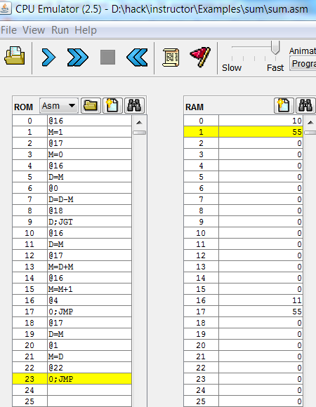
Hack low-level programming: example
Assembly program (sum.asm)
CPU emulator screen shot after running this program
// Computes 1+...+RAM[0]
// And stores the sum in RAM[1].
@i
M=1 // i = 1
@sum
M=0 // sum = 0
(LOOP)
@i // if i>RAM[0] goto WRITE
D=M
@0
D=D-M
@WRITE
D;JGT
@i // sum += i
D=M
@sum
M=D+M
@i // i++
M=M+1
@LOOP // goto LOOP
0;JMP
(WRITE)
@sum
D=M
@1
M=D // RAM[1] = the sum
(END)
@END
0;JMP
user supplied input
program generated output
The CPU emulator allows loading and executing symbolic Hack code. It resolves all the symbolic symbols to memory locations, and executes the code.

Slide 9
The assembler’s view of an assembly program
// Computes 1+...+RAM[0]
// And stores the sum in RAM[1].
@i
M=1 // i = 1
@sum
M=0 // sum = 0
(LOOP)
@i // if i>RAM[0] goto WRITE
D=M
@0
D=D-M
@WRITE
D;JGT
@i // sum += i
D=M
@sum
M=D+M
@i // i++
M=M+1
@LOOP // goto LOOP
0;JMP
(WRITE)
@sum
D=M
@1
M=D // RAM[1] = the sum
(END)
@END
0;JMP
Assembly program = a stream of text lines, each being one of the following:
A-instruction
C-instruction
Symbol declaration: (SYMBOL)
Comment or white space: // comment
The challenge:
Translate the program into a sequence of 16-bit instructions that can be executed by the target hardware platform.
Notes:
9

Slide 10
Translating / assembling A-instructions
Translation to binary:
If value is a non-negative decimal number, simple
If value is a symbol, refer to the symbol table (more on this later)

Slide 11
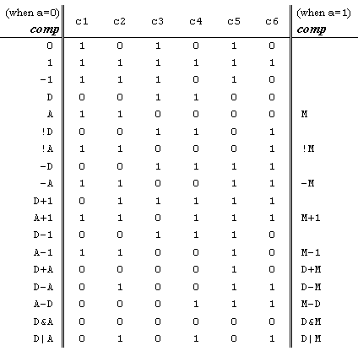
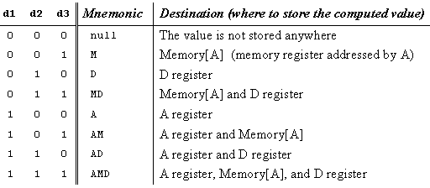
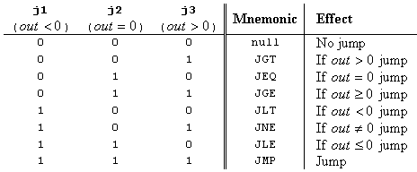

Translating / assembling C-instructions

Slide 12
The overall assembly logic
Assembly program
For each (real) command
Parse the command, i.e. break it into its underlying fields
A-instruction: replace the symbolic reference (if any) with the corresponding memory address, where the variable resides
C-instruction: for each field in the instruction, generate the corresponding binary code
Assemble the translated binary codes into a complete 16-bit machine instruction
Write the 16-bit instruction to the output file.
// Computes 1+...+RAM[0]
// And stores the sum in RAM[1].
@i
M=1 // i = 1
@sum
M=0 // sum = 0
(LOOP)
@i // if i>RAM[0] goto WRITE
D=M
@0
D=D-M
@WRITE
D;JGT
@i // sum += i
D=M
@sum
M=D+M
@i // i++
M=M+1
@LOOP // goto LOOP
0;JMP
(WRITE)
@sum
D=M
@1
M=D // RAM[1] = the sum
(END)
@END
0;JMP

Slide 13
Typical symbolic Hack assembly code:
Handling symbols (aka symbol resolution)
@R0
D=M
@END
D;JLE
@counter
M=D
@SCREEN
D=A
@x
M=D
(LOOP)
@x
A=M
M=-1
@x
D=M
@32
D=D+A
@x
M=D
@counter
MD=M-1
@LOOP
D;JGT
(END)
@END
0;JMP
Assembly programs typically have many symbols:
Labels that mark special memory locations
Labels that mark destinations of Jump commands
Variables
These symbols fall into two categories:
User–defined symbols (created by programmers)
Pre-defined symbols (used by the Hack platform).
Notes:
13

Slide 14
Typical symbolic Hack assembly code:
Handling symbols: user-defined symbols
@R0
D=M
@END
D;JLE
@counter
M=D
@SCREEN
D=A
@x
M=D
(LOOP)
@x
A=M
M=-1
@x
D=M
@32
D=D+A
@x
M=D
@counter
MD=M-1
@LOOP
D;JGT
(END)
@END
0;JMP
Label symbols: Used to label destinations of Jump commands. Declared by the pseudo-command (ABC). This directive defines the symbol ABC to refer to the instruction memory location holding the next command in the program
Variable symbols: Any user-defined symbol xyz appearing in an assembly program that is not defined elsewhere using the (xyz) directive is treated as a variable, and is automatically assigned a unique RAM address, starting at RAM address 16
By convention, Hack programmers use lower-case and upper-case to represent variable and label names, respectively
As part of the program translation process, the assembler resolves all the symbols into RAM addresses.
Notes:
14

Slide 15
Typical symbolic Hack assembly code:
Handling symbols: pre-defined symbols (23)
@R0
D=M
@END
D;JLE
@counter
M=D
@SCREEN
D=A
@x
M=D
(LOOP)
@x
A=M
M=-1
@x
D=M
@32
D=D+A
@x
M=D
@counter
MD=M-1
@LOOP
D;JGT
(END)
@END
0;JMP
Virtual registers: The symbols R0,…, R15 are automatically predefined to refer to RAM addresses 0,…,15
I/O pointers: The symbols SCREEN and KBD are automatically predefined to refer to RAM addresses 16384 and 24576, respectively (base addresses of the screen and keyboard memory maps)
VM control pointers: these are the virtual machine pointers that are assigned to R0..R4 but we will study them later in Chapters 7-8
Notes:
15

Slide 16
Handling symbols: symbol table
Source code (example)
Symbol table
// Computes 1+...+RAM[0]
// And stored the sum in RAM[1]
@i
M=1 // i = 1
@sum
M=0 // sum = 0
(LOOP)
@i // if i>RAM[0] goto WRITE
D=M
@R0
D=D-M
@WRITE
D;JGT
@i // sum += i
D=M
@sum
M=D+M
@i // i++
M=M+1
@LOOP // goto LOOP
0;JMP
(WRITE)
@sum
D=M
@R1
M=D // RAM[1] = the sum
(END)
@END
0;JMP
R0 0
R1 1
R2 2
... ...
R15 15
SCREEN 16384
KBD 24576
SP 0
LCL 1
ARG 2
THIS 3
THAT 4
LOOP 4
WRITE 18
END 22
i 16
sum 17
This symbol table is generated by the assembler, and used to translate the symbolic code into binary code.

Slide 17
Handling symbols: constructing the symbol table
Source code (example)
R0 0
R1 1
R2 2
...
R15 15
SCREEN 16384
KBD 24576
SP 0
LCL 1
ARG 2
THIS 3
THAT 4
LOOP 4
WRITE 18
END 22
i 16
sum 17
// Computes 1+...+RAM[0]
// And stored the sum in RAM[1]
@i
M=1 // i = 1
@sum
M=0 // sum = 0
(LOOP)
@i // if i>RAM[0] goto WRITE
D=M
@R0
D=D-M
@WRITE
D;JGT
@i // sum += i
D=M
@sum
M=D+M
@i // i++
M=M+1
@LOOP // goto LOOP
0;JMP
(WRITE)
@sum
D=M
@R1
M=D // RAM[1] = the sum
(END)
@END
0;JMP
Initialization: create an empty symbol table and populate it with all the pre-defined symbols
First pass: go through the entire source code, and add all the user-defined label symbols to the symbol table (without generating any code)
Second pass: go again through the source code, and use the symbol table to translate all the commands. In the process, handle all the user-defined variable symbols.
Symbol table

Slide 18
The assembly process (detailed)
Initialization: create the symbol table and initialize it with the pre-defined symbols
First pass: march through the source code without generating any code. For each label declaration (LABEL) that appears in the source code, add the pair <LABEL , n > to the symbol table
Second pass: march again through the source code, and process each line:
If the line is a C-instruction, simple
If the line is @xyz where xyz is a number, simple
If the line is @xyz and xyz is a symbol, look it up in the symbol table and proceed as:
If the symbol is found, replace it with its numeric value and complete the command’s translation
If the symbol is not found, then it must represent a new variable: add the pair <xyz, n > to the symbol table, where n is the next available RAM address, and complete the command’s translation.

Slide 19
The result ...
Source code (example)
Target code
// Computes 1+...+RAM[0]
// And stored the sum in RAM[1]
@i
M=1 // i = 1
@sum
M=0 // sum = 0
(LOOP)
@i // if i>RAM[0] goto WRITE
D=M
@R0
D=D-M
@WRITE
D;JGT
@i // sum += i
D=M
@sum
M=D+M
@i // i++
M=M+1
@LOOP // goto LOOP
0;JMP
(WRITE)
@sum
D=M
@R1
M=D // RAM[1] = the sum
(END)
@END
0;JMP
0000000000010000
1110111111001000
0000000000010001
1110101010001000
0000000000010000
1111110000010000
0000000000000000
1111010011010000
0000000000010010
1110001100000001
0000000000010000
1111110000010000
0000000000010001
1111000010001000
0000000000010000
1111110111001000
0000000000000100
1110101010000111
0000000000010001
1111110000010000
0000000000000001
1110001100001000
0000000000010110
1110101010000111
assemble
Note that comment lines and pseudo-commands (label declarations) generate no code.

Slide 20
Proposed assembler implementation
An assembler program can be written in any high-level language.
We propose a language-independent design, as follows.
Software modules:
Parser: Unpacks each command into its underlying fields
Code: Translates each field into its corresponding binary value, and assembles the resulting values
SymbolTable: Manages the symbol table
Main: Initializes I/O files and drives the show.

Slide 21
Proposed assembler implementation
Proposed implementation stages
Stage I: Build a basic assembler for programs with no symbols
Stage II: Extend the basic assembler with symbol handling capabilities.

Slide 22
Perspective
Simple machine language, simple assembler
Most assemblers are not stand-alone, but rather encapsulated in a translator of a higher order
High-Level Language programmers that understand the code generated by its compiler can improve their code considerably
C++ programming (e.g. for real-time systems) may involve re-writing critical segments in assembly, for optimization
Writing an assembler is an excellent practice for writing more challenging translators, e.g. a VM Translator and a compiler, as we will do later.

Slide 23
BACKUP REFERENCE

Slide 24
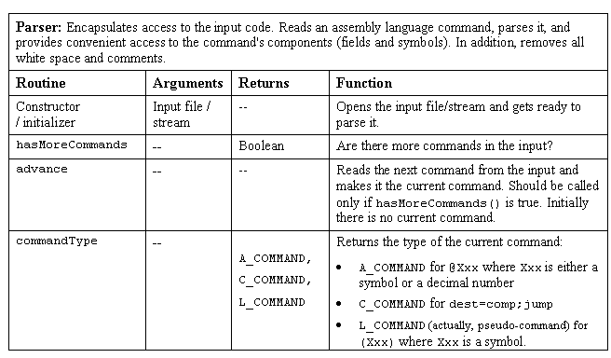
Parser (a software module in the assembler program)

Slide 25
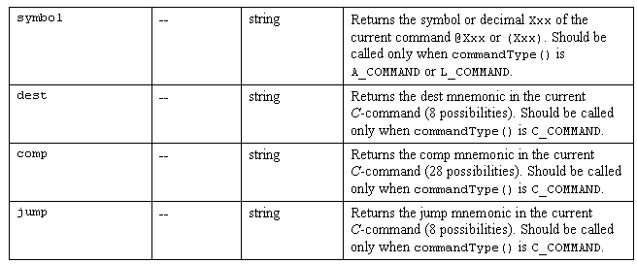
Parser (a software module in the assembler program) / continued

Slide 26
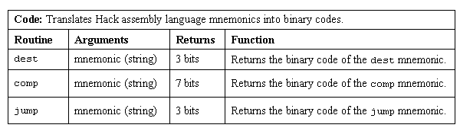
Code (a software module in the assembler program)

Slide 27
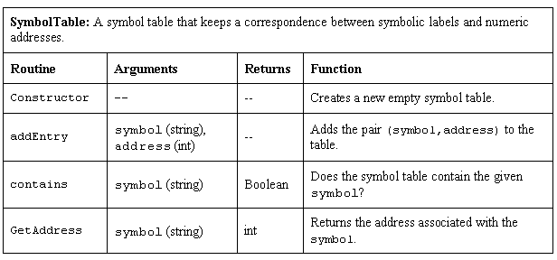
SymbolTable (a software module in the assembler program)

