Slide 1
Topic 08 – great ideas in computer architecture
Credit: Professors Nicholas Weaver and Vladimir Stojanovic at University of California, Berkeley for much of the content material

Slide 2
Anatomy of Computing Devices and Interactions

Slide 3
Conventional Machine Structures
Application (ex: browser)
Operating
Compiler
System
(ex: Mac OSX)
Software
Assembler
Instruction Set
Architecture
Hardware
Processor
Memory
I/O system
Datapath & Control
Digital Design
Circuit Design
Transistors

Slide 4




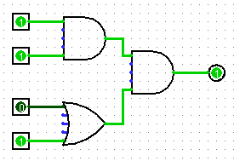
Modern Machine Structures (It’s a bit more complicated!)
Parallel Requests
Assigned to computers/cores
e.g., Search “bears”
Parallel Threads
Assigned to cores/hw threads
e.g., lookup, ads
Parallel Instructions
>1 instruction @ one time
e.g., 5 pipelined instructions
Parallel Data
>1 data item @ one time
e.g., Add of 4 pairs of words or coloring many pixels of a picture
Software Hardware
Harness Parallelism &
Achieve High Performance
Warehouse-Scale Computer
Smart Phone
Computer
Core
…
Core
Memory (Cache)
Input/Output
Core
Instruction Unit(s)
Functional
Unit(s)
A₀+B₀
A₁+B₁
A₂+B₂
A₃+B₃
Main Memory
Logic Gates
Notes:
There is also a subtle but important difference between parallelism and concurrency. The latter is an illusion of parallelism but is inherently sequential. The illusion is created by the system software layer called the operating system which ‘juggles’ the different tasks ‘behind the scenes’ leaving the user with the impression that multiple things are happening ‘at once’

Slide 5
FIVE Great Ideas in Computer Architecture
Abstraction (Layers of Representation/Interpretation)
Moore’s Law (Designing through Trends)
Principle of Locality (Memory Hierarchy)
Parallelism (Multiple things at once)
Dependability (via Redundancy)

Slide 6
Great Idea #1: Abstractions

Slide 7
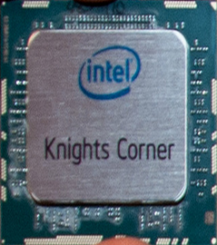
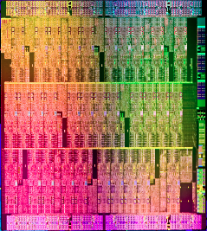
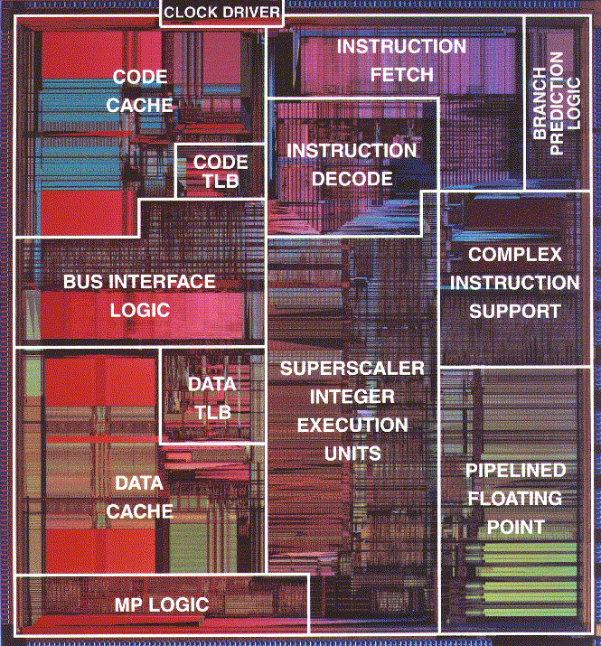
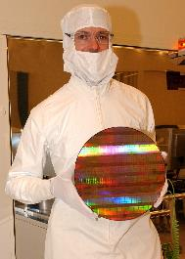

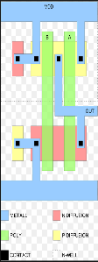
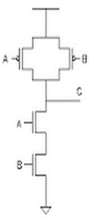

What does a processor really look like
Single Core
Wafer
Core is made of millions
of gates like these
And this is what a NAND gate
looks when sent to the MASK
shop to get fabricated!
This is what a NAND gate
looks like inside at switch level

Slide 8
Abstractions from Human Thought to Physics
Human
Abstract design
Software
Thought
abstract interface
hierarchy
H.L. Language
Compiler
&
abstract interface
Operating Sys.
Virtual
VM Translator
Machine
abstract interface
(Abstraction–implementation paradigm)
Assembly
Language
Assembler
abstract interface
Computer
Machine
Architecture
Language
abstract interface
Hardware
Gate Logic
Platform
abstract interface
Electrical
Hardware
Chips &
Engineering
Logic Gates
Physics
hierarchy
Notes:
This picture shows a clean translation of a human thought to the physics of executing that thought on a machine. Abstractions are used at every level of hierarchy to expand or obfuscate details to the next level of hierarchy. For example, a gate level representation of an adder need not understand the physics of how transistor switching will take place to implement the adder function. At gate level we are satisfied with Boolean logic description of addition. Similarly, a program written in a high level language is agnostic of the architectural details of a given machine on which the program will be executed. This picture shows how eventually binary code executes on a processor architecture.

Slide 9


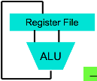
Levels of Abstraction
High Level Language Program
// Computes 1+...+RAM[0]
// And stored the sum in RAM[1]
Compiler
// Computes 1+...+RAM[0]
// And stored the sum in RAM[1]
@i
M=1 // i = 1
@sum
M=0 // sum = 0
(LOOP)
@i // if i>RAM[0] goto WRITE
D=M
@R0
D=D-M
@WRITE
D;JGT
@i // sum += i
D=M
@sum
M=D+M
@i // i++
M=M+1
@LOOP // goto LOOP
0;JMP
(WRITE)
@sum
D=M
@R1
M=D // RAM[1] = the sum
(END)
@END
0;JMP
Assembly Language Program
0000000000010000
1110111111001000
0000000000010001
1110101010001000
0000000000010000
1111110000010000
0000000000000000
1111010011010000
0000000000010010
1110001100000001
0000000000010000
1111110000010000
0000000000010001
1111000010001000
0000000000010000
1111110111001000
0000000000000100
1110101010000111
0000000000010001
1111110000010000
0000000000000001
1110001100001000
0000000000010110
1110101010000111
Assembler
Machine Language Program
Machine Interpretation
Hardware Architecture Description (e.g., block diagrams)
Architecture Implementation
Logic Circuit Description (Circuit Schematic Diagrams)

Slide 10
Great Idea #2: Moore’s Law

Slide 11
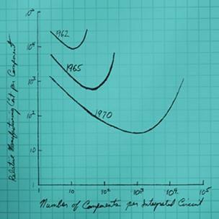
Moore’s law The sweet spot for cost
The Sweet Spot: Economics was at the core of Moore’s 1965 paper. He argued that for any particular generation of manufacturing technology, there is a cost curve. The cost of making a component declines the more you pack onto an integrated circuit, but past a certain point, yields decline and costs rise. The sweet spot, where the cost per component is at a minimum, moves to more and more complex integrated circuits over time.
Source: http://spectrum.ieee.org/semiconductors/processors/the-multiple-lives-of-moores-law
Notes:
When Gordon Moore, then at Fairchild Semiconductor, was asked in 1965 to theorize about the future of the newly developed integrated circuit, he had one in his lab with a then-amazing 64 transistors on it — double the 32 that was state of the art only a year earlier. Connecting those dots on a graph with the single component planar transistor invented in 1959, Moore noticed that the number of components was roughly doubling every year. In an article he contributed to a special issue of Electronics magazine published that spring, he speculated that it could continue to do so for at least a decade. It wasn’t until that decade had passed, and Moore’s friend Carver Mead noticed that the trend had held up, that the term Moore’s Law was coined

Slide 12
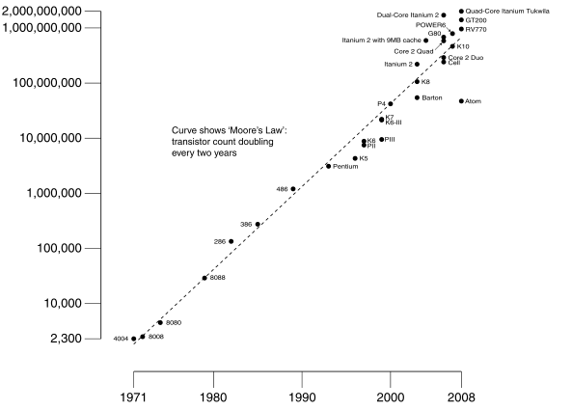
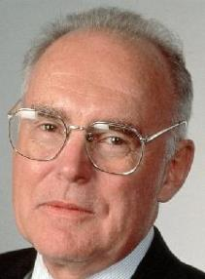
Moore’s Law: Continuous Miniaturization
Gordon Moore Intel Cofounder

Slide 13
Great Idea #3: Memory Hierarchy – The illusion of fastest infinite memory!

Slide 14

Jim Gray’s Storage Latency Analogy: How Far Away is the Data?
Andromeda
10
9
Tape /Optical
2,000 Years
Robot
Jim Gray Turing Award
10
6
Disk
Pluto
2 Years
Houston
1.5 hr
100
Main Memory
10
On Board Cache
This Campus
10 min
2
On Chip Cache
This Room
1
Register
Registers
My Head
1 min
(ns)
BIT

Slide 15
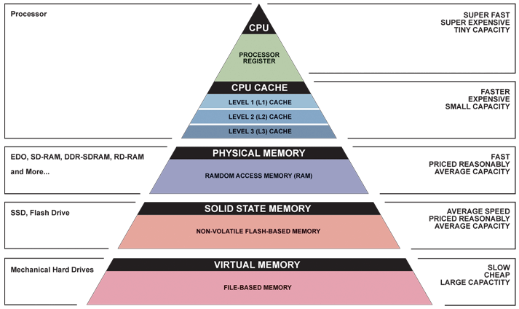
Memory Hierarchy – A case for Locality
If your computer doesn’t have an SSD, get one!

Slide 16
The Power of Locality
Temporal Locality: If an address has been accessed recently, it will likely be accessed again.
Spatial Locality: If an address has been accessed, it is likely addresses close to it will be accessed.

Slide 17
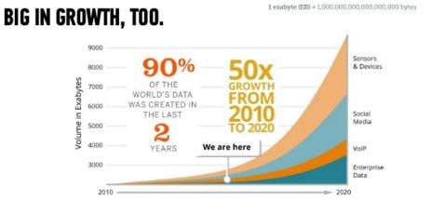
ASIDE – DNA Storage for big data
Big Data is here, it is here to stay and grow BIGGER
Latest Microsoft and Univ of Washington Initiative showcases 200 MB of data on a synthetic DNA strands
Addresses data density, reliability
Is slow so best suited for long-term storage at the bottom of memory hierarchy
44 Trillion GB by 2020!!!
Notes:
By some accounts all 700 Exabytes of today’s data could fit in a shoebox containing DNA
(FROM: http://www.gizmag.com/dna-data-storage-record/44273/) You could then tuck that shoebox away in a vault for thousands of years, and the DNA-stored data would remain intact. As evidenced by fossilized remains of woolly mammoths, which have been found to still contain traces of the animals' genetic code thousands of years after they died out, DNA is incredibly hardy and capable of storing information for millennia under the right conditions.

Slide 18
Great Idea #4: Parallelism

Slide 19
Parallelism
Many Cores, Many Threads (HW and SW)
Pipelining
Vectorization (multiple lanes of compute)

Slide 20
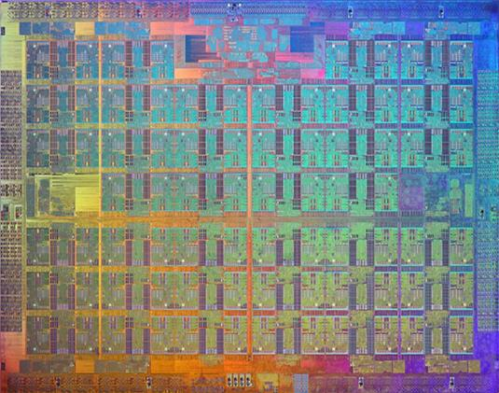

Many Cores
Computer
Core
…
Core
Memory (Cache)
Input/Output
Core
Instruction Unit(s)
Functional
Unit(s)
A₀+B₀
A₁+B₁
A₂+B₂
A₃+B₃
Main Memory
Logic Gates
8

Slide 21
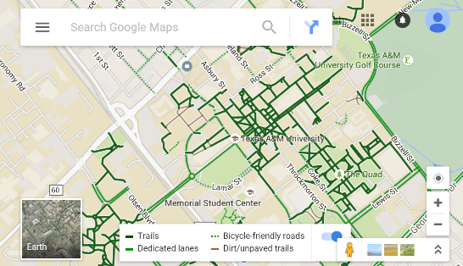


Many Threads
Thread 1
DrawScene()
Thread 2
DrawScene()
Thread 3
DrawWidgets()
Thread 4
GetData()

Slide 22
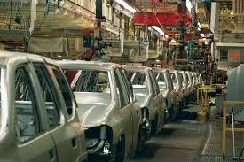
Pipelining
Computer
Core
…
Core
Memory (Cache)
Input/Output
Core
Instruction Unit(s)
Functional
Unit(s)
A₀+B₀
A₁+B₁
A₂+B₂
A₃+B₃
Main Memory
Logic Gates
8
7

Slide 23
Real Life Example - Gotta Do Laundry
Ann, Brian, Cathy, Dave each have one load of clothes to wash, dry, fold, and put away
Washer takes 30 minutes
Dryer takes 30 minutes
“Folder” takes 30 minutes
“Stasher” takes 30 minutes to put clothes into drawers
A
B
C
D

Slide 24
Sequential Laundry
Sequential laundry takes 8 hours for 4 loads
6 PM
7
8
9
10
11
12
1
2 AM
T
a
s
k
O
r
d
e
r
30
30
30
30
30
30
30
30
30
30
30
30
30
30
30
30
Time
A
B
C
D

Slide 25
Pipelined Laundry
6 PM
7
8
9
10
11
12
1
2 AM
30
30
30
30
30
30
30
Time
T
a
s
k
O
r
d
e
r
A full laundry load gets done every 30 minutes
Pipelined laundry takes 3.5 hours for 4 loads!
A
B
C
D

Slide 26
Pipelining in Computers
PC
instruction
memory
registers
Data
memory
ALU
+4
imm
1. Instruction
Fetch
2. Operand Fetch
3. Execute
4. Memory

Slide 27
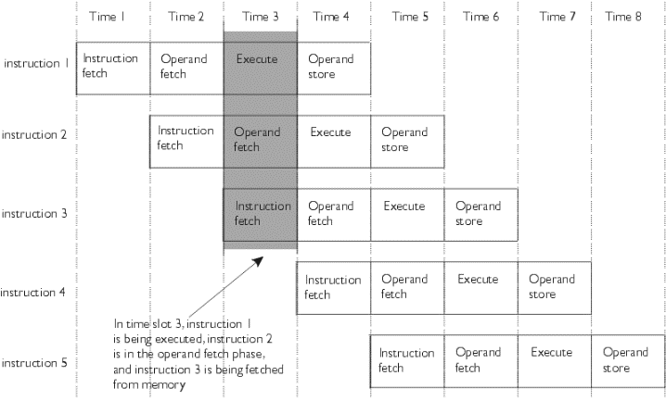
Pipelining

Slide 28
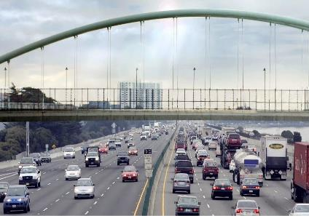
Vectorization (Multiple Lanes)
Computer
Core
…
Core
Memory (Cache)
Input/Output
Core
Instruction Unit(s)
Functional
Unit(s)
A₀+B₀
A₁+B₁
A₂+B₂
A₃+B₃
Main Memory
Logic Gates
8

Slide 29
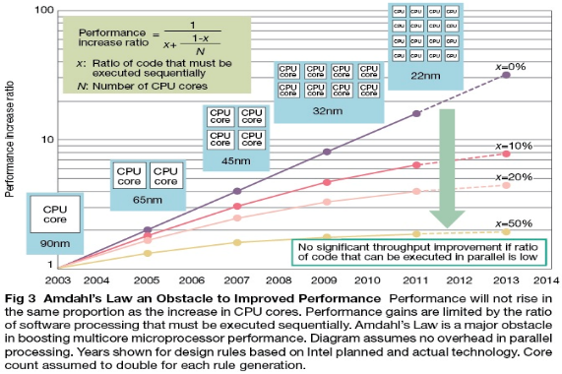
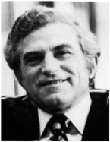
Caveat (Is Multicore the solution to performance?): Amdahl’s Law
Gene Amdahl
Computer Pioneer

Slide 30
Great Idea #5: Redundancy

Slide 31
Coping with Failures
4 disks/server, 50,000 servers
Failure rate of disks: 2% to 10% / year
Assume 4% annual failure rate
On average, how often does a disk fail?
1 / month
1 / week
1 / day
1 / hour
50,000 x 4 = 200,000 disks
200,000 x 4% = 8000 disks fail
365 days x 24 hours = 8760 hours

Slide 32
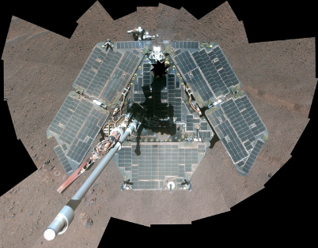
NASA Fixing Rover’s Flash Memory
Opportunity still active on Mars after >10 years
But flash memory worn out
New software update to avoid using worn out memory banks
http://www.engadget.com/2014/12/30/nasa-opportunity-rover-flash-fix/

Slide 33
Dependability via Redundancy
Redundancy so that a failing piece doesn’t make the whole system fail
1+1=2
2 of 3 agree
1+1=2
1+1=2
1+1=1
FAIL!
Increasing transistor density reduces the cost of redundancy

Slide 34
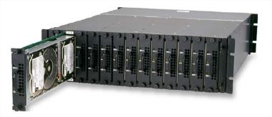

Dependability via Redundancy
Applies to everything from datacenters to storage to memory to instructors
Redundant datacenters so that can lose 1 datacenter but Internet service stays online
Redundant computers was Google’s original internal innovation
Redundant disks so that we can lose 1 disk but not lose data (Redundant Arrays of Independent Disks/RAID)
Redundant memory bits of so that can lose 1 bit but no data (Error Correcting Code/ECC Memory)

Slide 35
SUMMARY: FIVE Great Ideas in Computer Architecture
Abstraction (Layers of Representation/Interpretation)
Moore’s Law (Designing through Trends)
Principle of Locality (Memory Hierarchy)
Parallelism (Multiple things at once)
Dependability (via Redundancy)

Slide 36
What to expect from this slide set in Exam 3?
Be able to name the top-5 great ideas in computer architecture
Be able to annotate a description to particular idea
Answer some general True/False statements limited to material presented in this slide set

Slide 37
Further Reading
http://spectrum.ieee.org/computing/software/the-trouble-with-multicore
http://web.eng.fiu.edu/npala/eee6397ex/gordon_moore_1965_article.pdf
http://www.economist.com/blogs/economist-explains/2015/04/economist-explains-17
http://www.extremetech.com/extreme/203031-moores-law-at-50-its-past-and-its-future
https://homes.cs.washington.edu/~luisceze/publications/dnastorage-asplos16.pdf
http://www.gizmag.com/dna-data-storage-record/44273/
http://www.slideshare.net/sfamilian/working-with-big-data-jan-2016-part-1/7-CONTEXT_WHATS_BIG_DATABIG_IN

