Slide 1
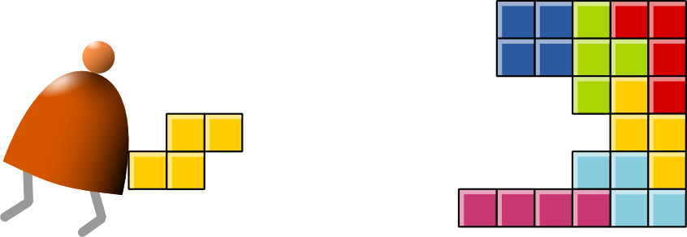
Computer Architecture
Building a Modern Computer From First Principles

Slide 2
The big picture
Human
Abstract design
Software
Thought
abstract interface
hierarchy
Chapters 9, 12
H.L. Language
Compiler
&
abstract interface
Operating Sys.
Chapters 10 - 11
Virtual
VM Translator
Machine
abstract interface
Chapters 7 - 8
Assembly
Language
Assembler
Chapter 6
abstract interface
Computer
Machine
Architecture
Language
abstract interface
Chapters 4 - 5
Gate Logic
Hardware
abstract interface
Platform
Chapters 1 - 3
Electrical
Hardware
Chips &
Engineering
Logic Gates
Physics
hierarchy

Slide 3
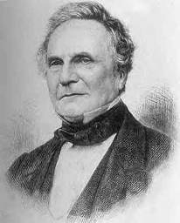
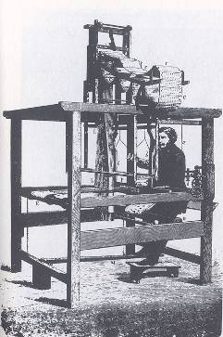
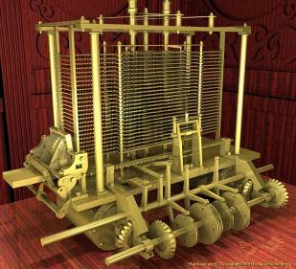

Babbage’s Analytical Engine (1835)
“We may say most aptly that the Analytical Engine weaves algebraic patterns just as the Jacquard-loom weaves flowers and leaves” (Ada Lovelace)
Charles Babbage (1791-1871)

Slide 4
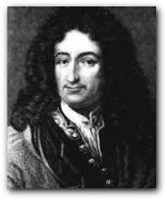

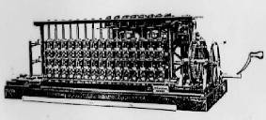
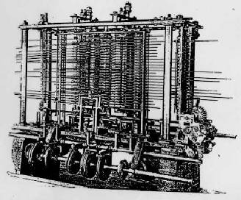
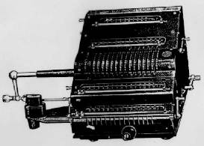
Some early computers and computer scientists
Blaise Pascal 1623-1662
Gottfried Leibniz 1646-1716

Slide 5
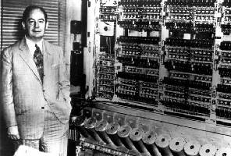
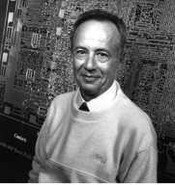
Stored Program Concept
John Von Neumann (and others) ... made it possible (circa 1940)
Andy Grove (and others) ... made it small and fast.

Slide 6
Processing logic: fetch-execute cycle
Executing the current instruction involves one or more of the following micro-tasks:
Have the ALU compute some function out = f (values of register and/or memory)
Write the ALU output to selected register and/or memory location
As a side-effect of this computation, figure out which instruction to fetch and execute next.

Slide 7
The Hack chip-set and hardware platform
Elementary logic gates
Nand
Not
And
Or
Xor
Mux
Dmux
Not16
And16
Or16
Mux16
Or8Way
Mux4Way16
Mux8Way16
DMux4Way
DMux8Way
Combinational chips
HalfAdder
FullAdder
Add16
Inc16
ALU
Sequential chips
DFF
Bit
Register
RAM8
RAM64
RAM512
RAM4K
RAM16K
PC
done
Computer Architecture
Memory
CPU
Computer
this lecture
done
done

Slide 8
The Hack computer
A 16-bit Von Neumann platform
The instruction memory and the data memory are physically separate
Screen: 256 rows by 512 columns, black and white
Keyboard: standard
Designed to execute programs written in the Hack machine language
Can be easily built from the chip-set that we built so far in the course

Slide 9
The Hack computer
D register
D
Main parts of the Hack computer:
Instruction memory (ROM)
Memory (RAM):
Data memory
Screen (memory map)
Keyboard (memory map)
CPU
Control logic that holds everything together
a-bit
A
ALU
A register
A/M
Mux
address input
RAM
(selected register)
M
address input
ROM
(selected register)
Instruction
PC

Slide 10
Lecture / construction plan
Instruction memory
Memory:
Data memory
Screen
Keyboard
CPU
Computer

Slide 11
Instruction memory
Function:
The ROM is pre-loaded with a program written in the Hack machine language
The ROM chip always emits a 16-bit number: out = ROM32K[address]
‘out’ is interpreted as the current instruction
‘address’ is provided by the Program Counter

Slide 12
Data memory
load
Low-level (hardware) read/write logic:
To read RAM[k]: set address to k, probe out
To write RAM[k]=x: set address to k, set in to x, set load to 1, run the clock

Slide 13
Lecture / construction plan

Instruction memory
Memory:
Data memory
Screen
Keyboard
CPU
Computer


Slide 14
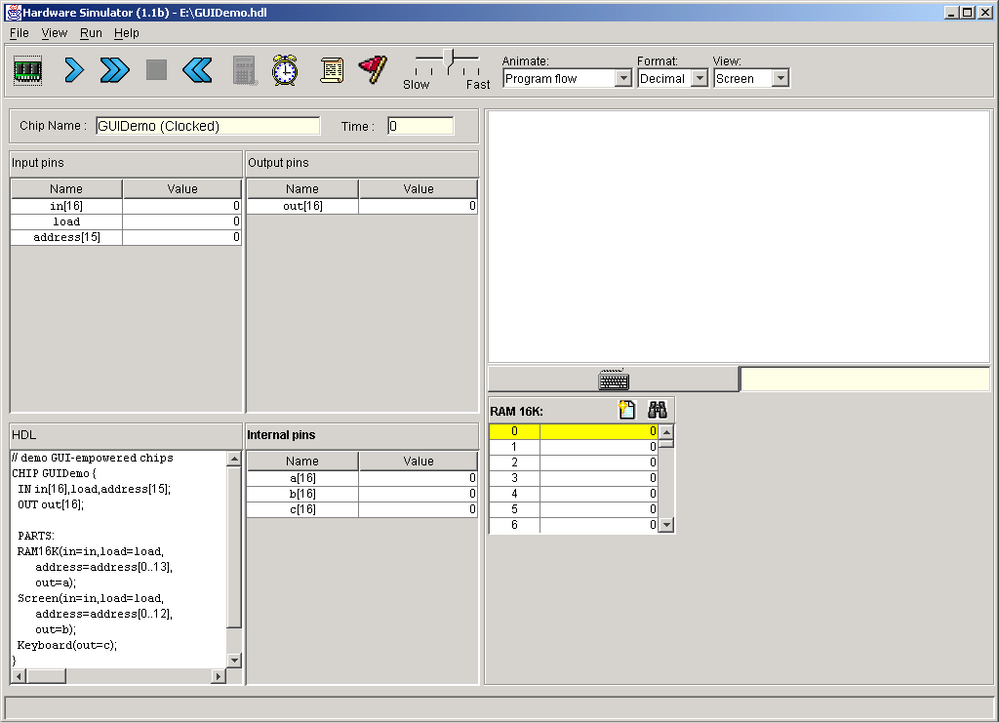
Screen
The bit contents of the Screen chip is called the “screen memory map”
Simulated screen:
The Screen chip has a basic RAM chip functionality:
read logic: out = Screen[address]
write logic: if load then Screen[address] = in
Side effect:
Continuously refreshes a 256x512 black-and-white screen device
The simulated 256 by 512 B&W screen
When loaded into the hardware simulator, the built-in Screen.hdl chip opens up a screen window; the simulator then refreshes this window from the screen memory map several times each second.

Slide 15
Screen memory map
In the Hack platform, the screen is implemented as an 8K 16-bit RAM chip.
How to set the (row,col) pixel of the screen to black or to white:
Low-level (machine language): Set the col%16 bit of the word found at Screen[row*32+col/16] to 1 or to 0 (col/16 is integer division)
Notes:
15

Slide 16
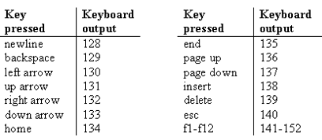
Keyboard
Simulated keyboard:
Keyboard chip: a single 16-bit register
Input: scan-code (16-bit value) of the currently pressed key, or 0 if no key is pressed
Output: same
The simulated keyboard enabler button
The keyboard is implemented as a built-in Keyboard.hdl chip. When this java chip is loaded into the simulator, it connects to the regular keyboard and pipes the scan-code of the currently pressed key to the keyboard memory map.
Special keys:
How to read the keyboard:
Low-level (hardware): probe the contents of the Keyboard chip

Slide 17
Lecture / construction plan

Instruction memory
Memory:
Data memory
Screen
Keyboard
CPU
Computer



Notes:
17

Slide 18
Memory: conceptual / programmer’s view
Memory
Using the memory:
To record or recall values (e.g. variables, objects, arrays), use the first 16K words of the memory
To write to the screen (or read the screen), use the next 8K words of the memory
To read which key is currently pressed, use the next word of the memory.
Data
Screen memory map
Screen
Keyboard map
Keyboard
Notes:
18

Slide 19
Memory: physical implementation
load
The Memory chip is essentially a package that integrates the three chip-parts RAM16K, Screen, and Keyboard into a single, contiguous address space.
This packaging effects the programmer’s view of the memory, as well as the necessary I/O side-effects.
Memory
0
in
16
RAM16K
(16K mem. chip)
out
16383
16
address
16384
Screen
(8K mem. chip)
15
24575
Screen
24576
Keyboard
(one register)
Keyboard
Access logic:
Access to any address from 0 to 16,383 results in accessing the RAM16K chip-part
Access to any address from 16,384 to 24,575 results in accessing the Screen chip-part
Access to address 24,576 results in accessing the keyboard chip-part
Access to any other address is invalid.
Notes:
19

Slide 20
Lecture / construction plan

Instruction memory
Memory:
Data memory
Screen
Keyboard
CPU
Computer



Notes:
20

Slide 21
CPU-FETCH
a Hack machine language instruction like M=D+M, stated as a 16-bit value
CPU internal components (invisible in this chip diagram): ALU and 3 registers: A, D, PC
CPU fetch logic:
Recall that:
the instruction may include a jump directive (expressed as non-zero jump bits)
the ALU emits two control bits, indicating if the ALU output is zero or less than zero
If reset==0: the CPU uses this information (the jump bits and the ALU control bits) as follows:
If there should be a jump, the PC is set to the value of A; else, PC is set to PC+1
If reset==1: the PC is set to 0. (restarting the computer)
Notes:
21

Slide 22
CPU-EXECUTE
a Hack machine language instruction like M=D+M, stated as a 16-bit value
CPU internal components (invisible in this chip diagram): ALU and 3 registers: A, D, PC
CPU execute logic:
The CPU executes the instruction according to the Hack language specification:
The D and A values, if they appear in the instruction, are read from (or written to) the respective CPU-resident registers
The M value, if there is one in the instruction’s RHS, is read from inM
If the instruction’s LHS includes M, then the ALU output is placed in outM, the value of the CPU-resident A register is placed in addressM, and writeM is asserted.

Slide 23
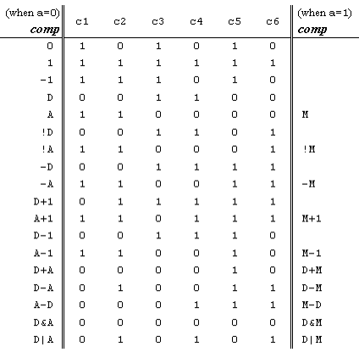
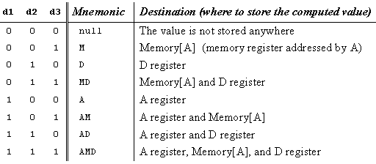
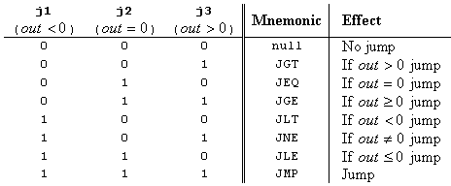
The C-instruction revisited

Slide 24
CPU implementation
Chip diagram:
Includes most of the CPU’s execution logic
The CPU’s control logic is hinted: each circled “c” represents one or more control bits, taken from the instruction
The “decode” bar does not represent a chip, but rather indicates that the instruction bits are decoded somehow.
Execute logic:
Decode
Execute
Fetch logic:
If there should be a jump, set PC to A else set PC to PC+1
Resetting the computer:
Set reset to 1, then set it to 0.
Cycle:
Fetch
Execute

Slide 25
Lecture / construction plan

Instruction memory
Memory:
Data memory
Screen
Keyboard
CPU
Computer




Notes:
25

Slide 26
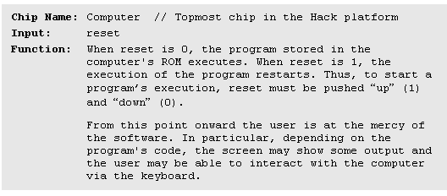
Computer-on-a-chip interface

Slide 27
Computer-on-a-chip implementation
CHIP Computer {
IN reset;
PARTS:
// implementation missing
}
Implementation: Simple, the chip-parts do all the hard work.

Slide 29
Perspective: from here to a “Traditional” computer
Caching
Pipelining/Super-Scalar
More I/O units
Special-purpose processors (I/O, graphics, communications, …)

Slide 30
Perspective: from here to a “Traditional” computer
Multi-core / parallelism/
Efficiency
Energy consumption considerations

Slide 31
Perspective: some issues we haven’t discussed (among many)
Hardware diversity: desktop, laptop, hand-held, game machines, …
General-purpose vs. embedded computers
Silicon compilers
And more ...

