Slide 1
CPU Pipelining
ACKNOWLEDGMENTS
Vladimir Stojanovic and Nicholas Weaver
http://inst.eecs.Berkeley.edu/~cs61c/sp16

Slide 2
Gotta Do Laundry
Ann, Brian, Cathy, Dave each have one load of clothes to wash, dry, fold, and put away
Washer takes 30 minutes
Dryer takes 30 minutes
“Folder” takes 30 minutes
“Stasher” takes 30 minutes to put clothes into drawers
A
B
C
D

Slide 3
Sequential Laundry
Sequential laundry takes 8 hours for 4 loads
6 PM
7
8
9
10
11
12
1
2 AM
T
a
s
k
O
r
d
e
r
30
30
30
30
30
30
30
30
30
30
30
30
30
30
30
30
Time
A
B
C
D

Slide 4
Pipelined Laundry
Pipelined laundry takes 3.5 hours for 4 loads!
6 PM
7
8
9
10
11
12
1
2 AM
30
30
30
30
30
Time
T
a
s
k
O
r
d
e
r
30
30
A
B
C
D

Slide 5
Pipelining Lessons (1/2)
Pipelining doesn’t help latency of single task, it helps throughput of entire workload
Multiple tasks operating simultaneously using different resources
Potential speedup = Number pipe stages
Time to “fill” pipeline and time to “drain” it reduces speedup: 2.3x (8/3.5) v. 4x (8/2) in this example
6 PM
7
8
9
T
a
s
k
O
r
d
e
r
Time
30
30
30
30
30
30
30
A
B
C
D

Slide 6
Pipelining Lessons (2/2)
6 PM
7
8
9
Suppose new Washer takes 20 minutes, new Stasher takes 20 minutes. How much faster is pipeline?
Pipeline rate limited by slowest pipeline stage
Unbalanced lengths of pipe stages reduces speedup
Dependencies between stages???
T
a
s
k
O
r
d
e
r
Time
30
30
30
30
30
30
30
A
B
C
D

Slide 7
Execution Steps in Typical Processor Datapath
1) FETCH: Instruction Fetch, Increment PC
2) DECODE: Instruction Decode, Read Registers
3) EXECUTE: Mem-ref: Calculate Address Arith-log: Perform Operation
4) Memory: Load: Read Data from Memory Store: Write Data to Memory
5) Writeback: Write Data Back to Register

Slide 8
Single Cycle Datapath
PC
instruction
memory
registers
Data
memory
ALU
+4
imm
2. Decode/
Register Read
1. Instruction
Fetch
5. Write Back
3. Execute
4. Memory

Slide 9
Pipeline registers
PC
instruction
memory
registers
Data
memory
ALU
+4
imm
2. Decode/
Register Read
1. Instruction
Fetch
5. Write Back
3. Execute
4. Memory
Need registers between stages
To hold information produced in previous cycle

Slide 10
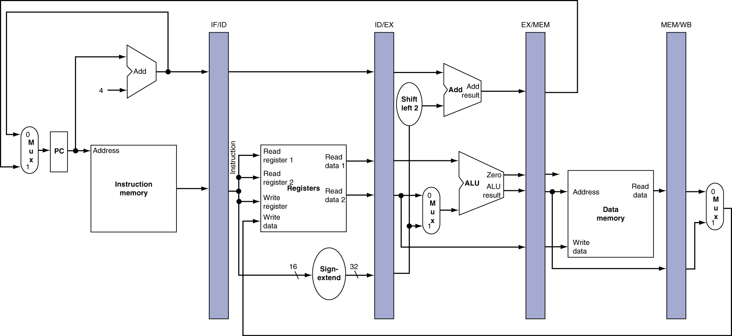
More Detailed Pipeline

Slide 11
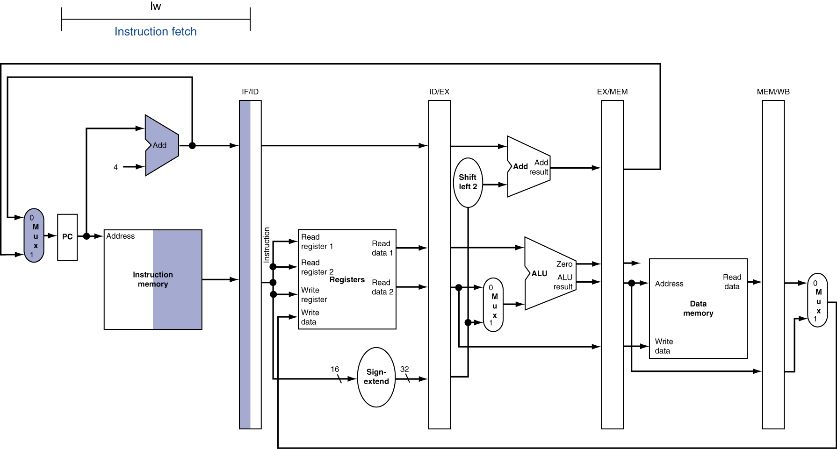
Example: IF for Load, Store, …

Slide 12
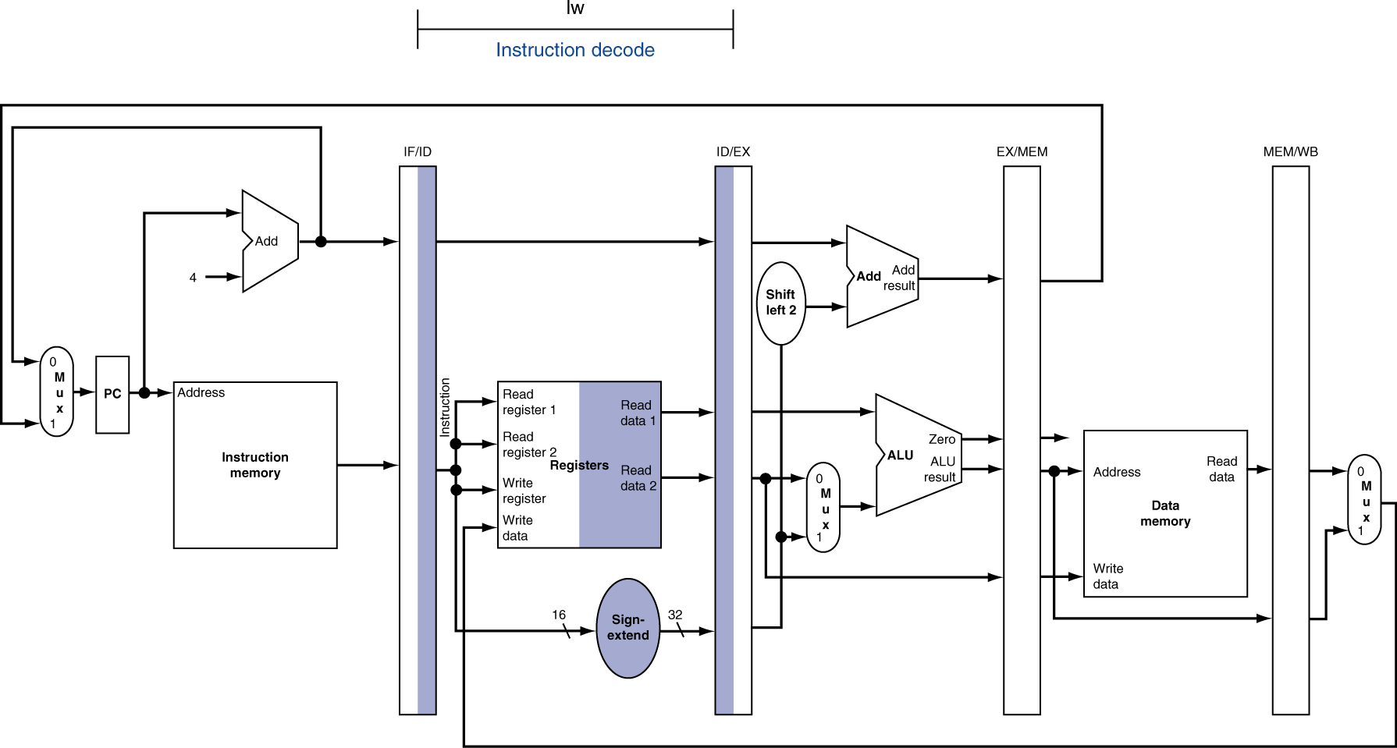
ID for Load, Store, …

Slide 13
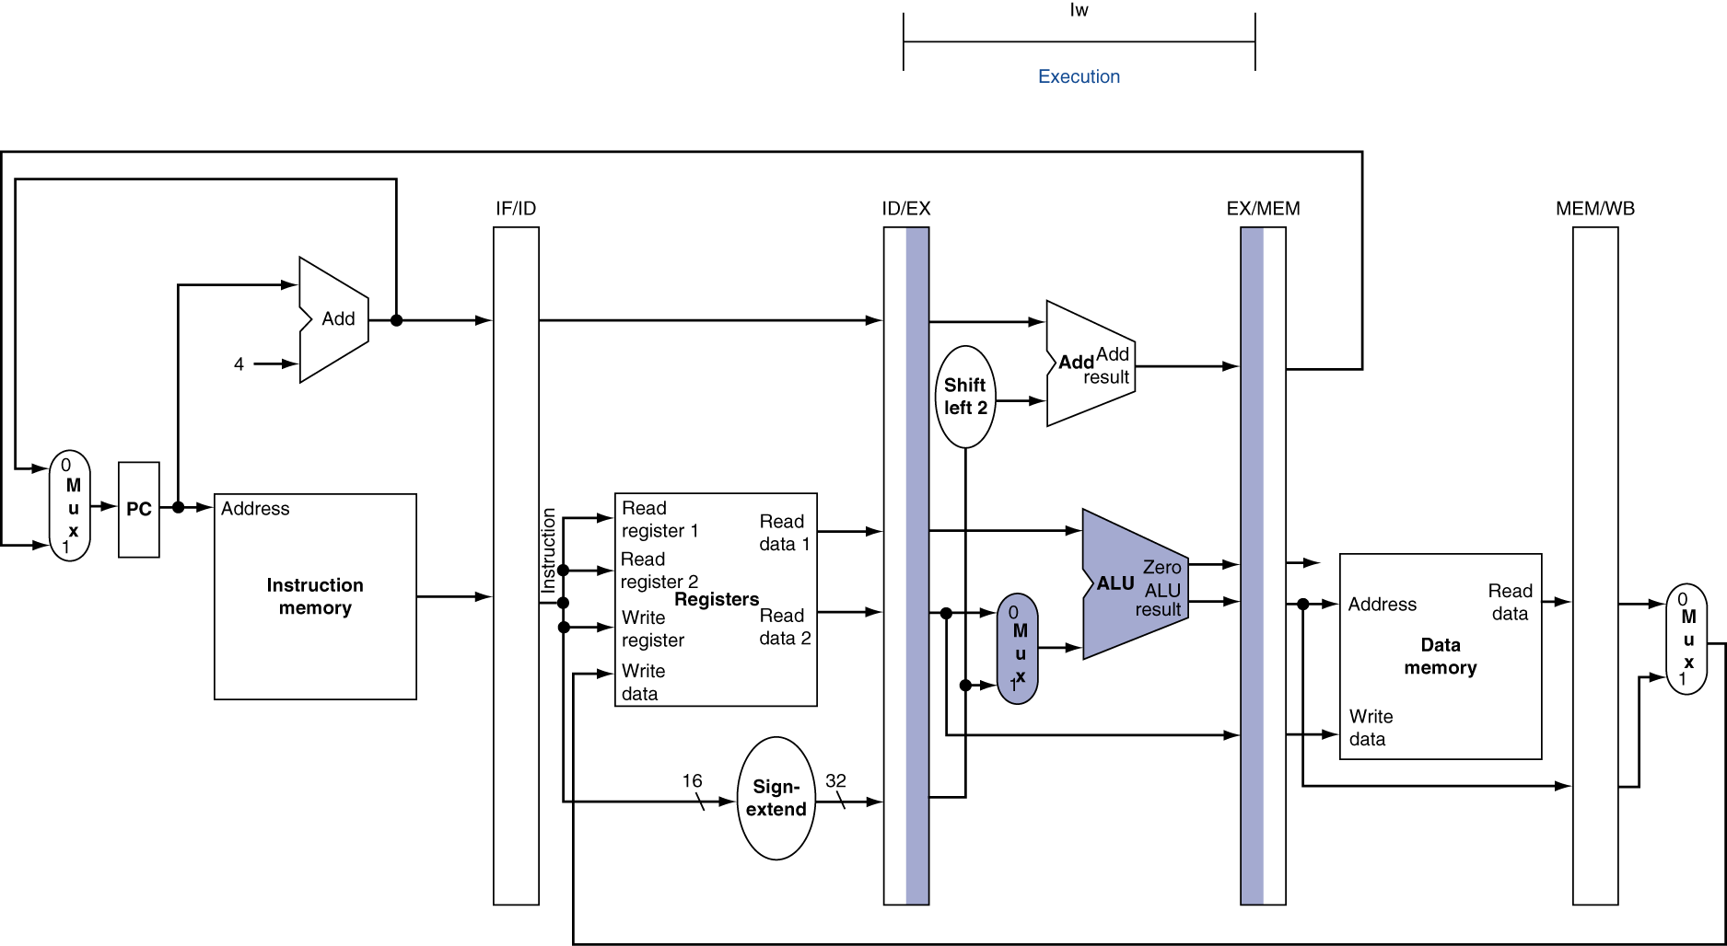
EX for Load

Slide 14
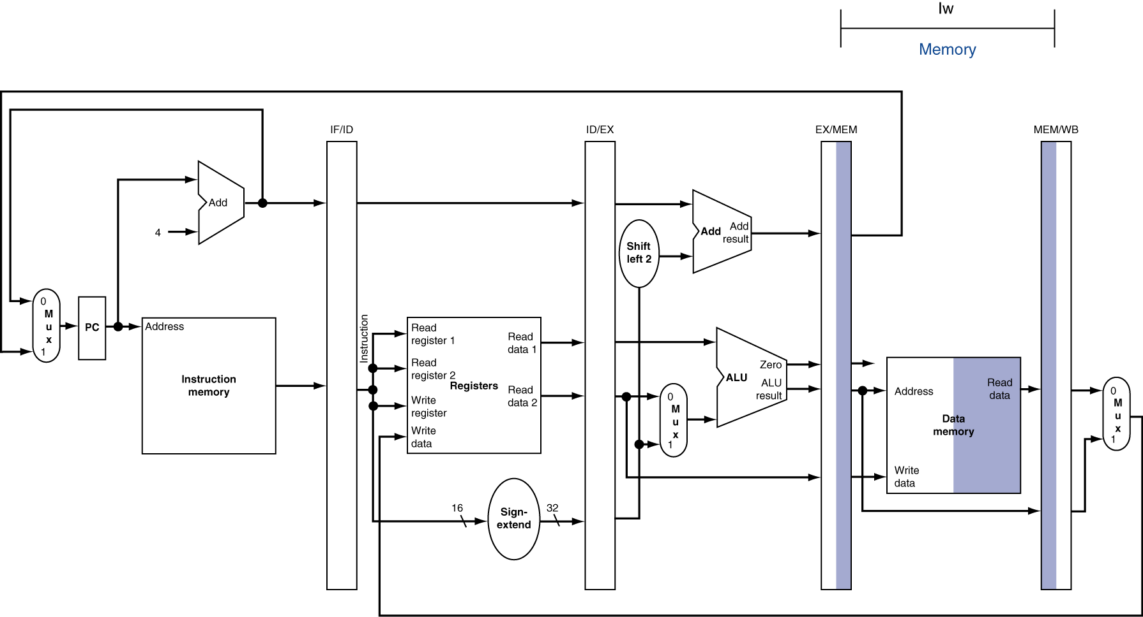
MEM for Load

Slide 15
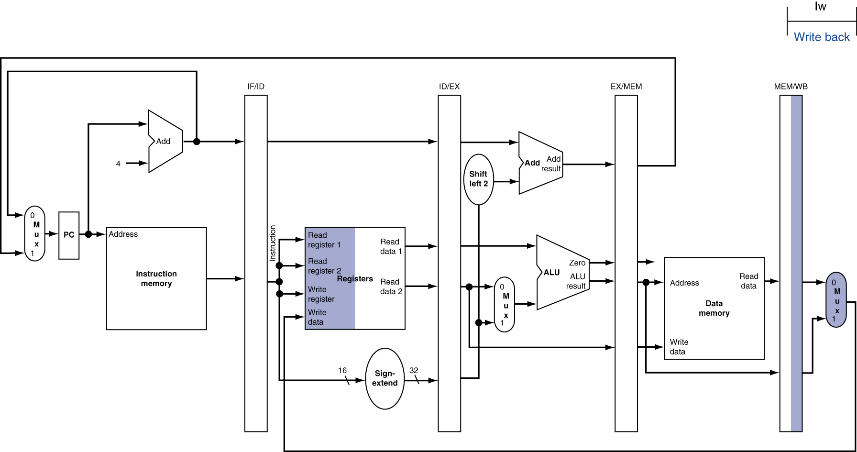
WB for Load – Oops!
Wrong register number!

Slide 16
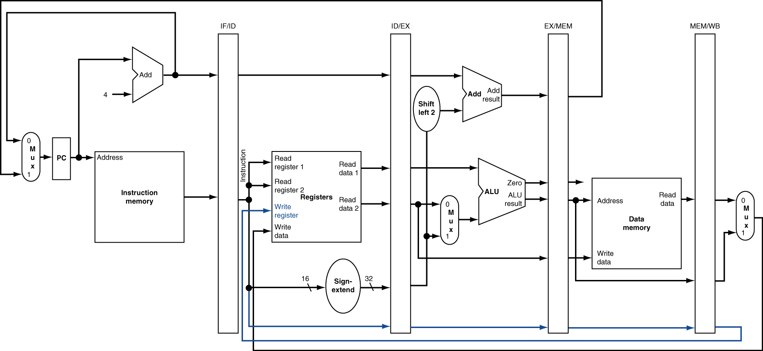
Corrected Datapath for Load

Slide 17
Pipelined Execution Representation
Time
IF
ID
EX
MEM
WB
IF
ID
EX
MEM
WB
IF
ID
EX
MEM
WB
IF
ID
EX
MEM
WB
IF
ID
EX
MEM
WB
IF
ID
EX
MEM
WB
Every instruction must take same number of steps, so some stages will idle
e.g. MEM stage for any arithmetic instruction
Notes:
Each instruction has identical latency!

Slide 18
Graphical Pipeline Diagrams
Register
File
ALU
PC
instruction
memory
Data
memory
+4
MUX
imm
2. Decode/
Register Read
1. Instruction
Fetch
3. Execute
4. Memory
5. Write
Back
Use datapath figure below to represent pipeline:
IF
ID
EX
Mem
WB
I$
Reg
ALU
D$
Reg
Note: I$ is another way of referring to instruction memory, and D$ refers to Data Memory

Slide 19
Graphical Pipeline Representation
Reg: left half is write, right half is read
Time (clock cycles)
I
n
s
t
r
O
r
d
e
r
Load
I$
Reg
ALU
D$
Reg
Add
I$
Reg
ALU
D$
Reg
Store
I$
Reg
ALU
D$
Reg
Sub
I$
Reg
ALU
D$
Reg
Or
I$
Reg
ALU
D$
Reg

Slide 20
Pipelining Performance (1/2)
Assume time for stages is
100ps for register read or write
200ps for other stages
What is pipelined clock rate?
Compare pipelined datapath with single-cycle datapath
Instr | Instr fetch | Register read | ALU op | Memory access | Register write | Total time
lw | 200ps | 100 ps | 200ps | 200ps | 100 ps | 800ps
sw | 200ps | 100 ps | 200ps | 200ps |  | 700ps
add (reg) | 200ps | 100 ps | 200ps |  | 100 ps | 600ps
jeq (reg) | 200ps | 100 ps | 200ps |  |  | 500ps

Slide 21
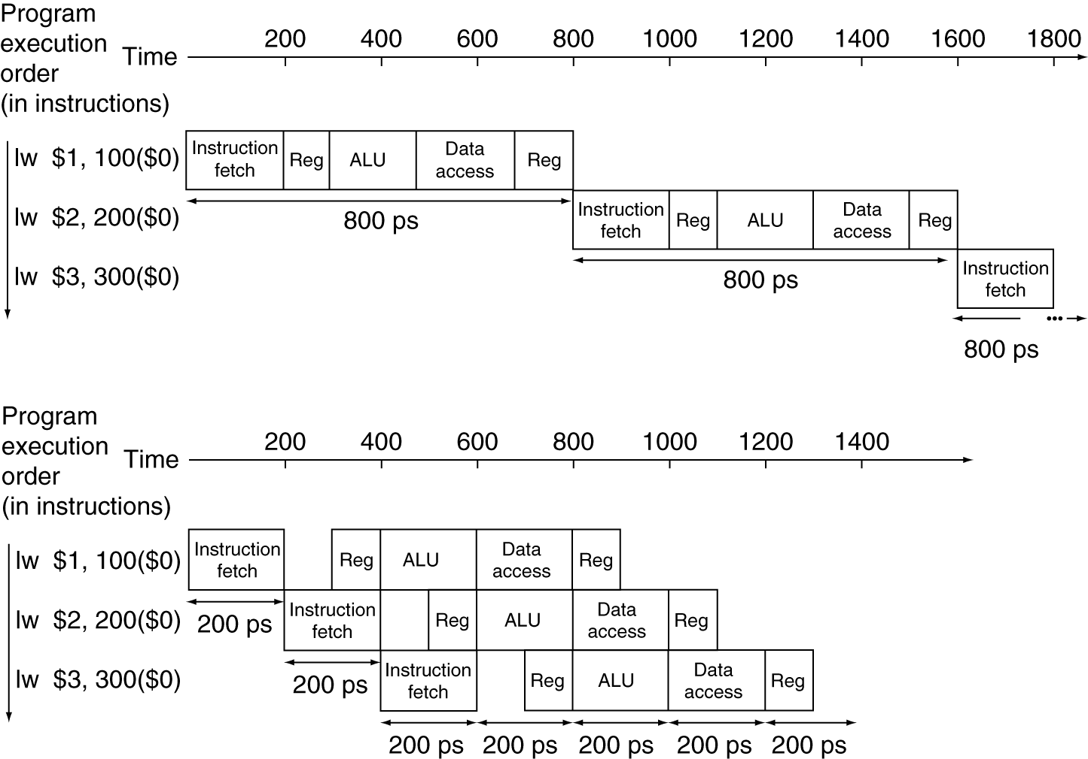
Pipelining Performance (2/2)
Single-cycle
T_{c} = 800 ps
f = 1.25GHz
Here using T_{c} as “time between completion of instructions.”
Pipelined
T_{c} = 200 ps
f = 5GHz
Notes:
Here using T_{c} as “time between completion of instructions.”

Slide 22
Single Cycle Performance
Assume time for actions are
100ps for register read or write; 200ps for other events
Clock period is?
Instr | Instr fetch | Register read | ALU op | Memory access | Register write | Total time
lw | 200ps | 100 ps | 200ps | 200ps | 100 ps | 800ps
sw | 200ps | 100 ps | 200ps | 200ps |  | 700ps
R-format | 200ps | 100 ps | 200ps |  | 100 ps | 600ps
beq | 200ps | 100 ps | 200ps |  |  | 500ps
Clock rate (cycles/second = Hz) = 1/Period (seconds/cycle)
Notes:
1.25 GHz

Slide 23
Single Cycle Performance
Assume time for actions are
100ps for register read or write; 200ps for other events
Clock period is?
Instr | Instr fetch | Register read | ALU op | Memory access | Register write | Total time
lw | 200ps | 100 ps | 200ps | 200ps | 100 ps | 800ps
sw | 200ps | 100 ps | 200ps | 200ps |  | 700ps
R-format | 200ps | 100 ps | 200ps |  | 100 ps | 600ps
beq | 200ps | 100 ps | 200ps |  |  | 500ps
What can we do to improve clock rate?
We can do deeper pipelines and/or break slowest stages
Will this improve performance as well?
Normally yes, because throughput will improve. But deeper pipelines can incur higher penalty for pipeline flushes for control dependencies
Notes:
1.25 GHz

Slide 24
Pipelining – Bringing Realism
Register storage overhead between every pipeline stage
Stalls (waiting for data that is not there yet)
Flushes (loaded ‘wrong’ instructions)

Slide 25

CPU implementation
Chip diagram:
Includes most of the CPU’s execution logic
The CPU’s control logic is hinted: each circled “c” represents one or more control bits, taken from the instruction
The “decode” bar does not represent a chip, but rather indicates that the instruction bits are decoded somehow.
Cycle:
Execute
Fetch
Execute logic:
Decode
Execute
Fetch logic:
If there should be a jump, set PC to A else set PC to PC+1
Resetting the computer:
Set reset to 1, then set it to 0.

Slide 26
Register Overhead

Slide 27
Pipeline Overhead
Logic in some stages takes 200ps and in some 100ps. Clk-Q delay is 30ps and setup-time is 20ps. What is the maximum clock frequency at which a pipelined design can operate?
A: 10GHz
B: 5GHz
C: 6.7GHz
D: 4.35GHz
E: 4GHz
Notes:
Frequency is 4 GHZ as it is inverse of the cycle time of 250ps

Slide 28
Practice question
The 5 stages of the processor have the following latencies:
Fetch Decode Execute Memory Writeback
a. 300ps 400ps 350ps 550ps 100ps
b. 200ps 150ps 100ps 190ps 140ps
Assume that when pipelining, each stage costs 20ps extra for the registers between pipeline stages.
CASE1: Non-pipelined processor: what is the cycle time? What is the latency of an instruction? What is the throughput?
Because there is no pipelining, the cycle time must allow an instruction to go through all stages in one cycle. The latency is the same as cycle time since it takes the instruction one cycle to go from the beginning of fetch to the end of write back. The throughput is defined as 1/CT inst/s.
a. CT = 300 + 400 + 350 + 550 + 100 = 1700ps …….Latency = 1700ps……Throughput = 1/1700 inst/ps
b. CT = 200 + 150 + 100 + 190 + 140 = 780ps…….Latency = 780ps…….Throughput = 1/780 inst/ps

Slide 29
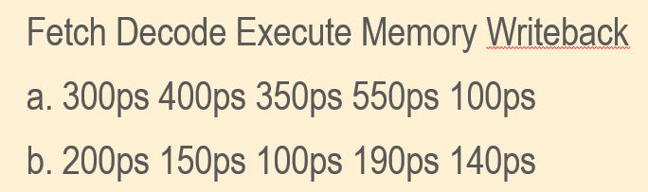
Practice example: Pipelined case
Case2: Pipelining reduces the cycle time to the length of the longest stage plus the register delay. Latency becomes CT*N where N is the number of stages as one instruction will need to go through each of the stages and each stage takes one cycle. The throughput formula remains the same.
a. CT = 550 + 20 = 570 ps
Latency = 5 * 570 = 2850ps
Throughput = 1/570 inst/ps
b. CT = 200 + 20 = 220 ps
Latency = 5 * 220 = 1100ps
Throughput = 1/220 inst/ps

Slide 30
Practice question: what if?
If you could split one of the pipeline stages into 2 equal halves, which one would you choose? What is the new cycle time? What is the new latency? What is the new throughput?
Answer: We would want to choose the longest stage to split in half. The new cycle time becomes the originally 2nd longest stage length. Calculate latency and throughput correspondingly, but remember there are now 6 stages instead of 5.
a. CT = 400 + 20 = 420 ps
Latency = 6 * 420 = 2520 ps
Throughput = 1/420 inst/ps
b. CT = 190 + 20 = 210 ps
Latency = 6 * 210 = 1260 ps
Throughput = 1/210 inst/ps

Slide 31
Pipelining – Bringing Realism
Register storage overhead between every pipeline stage
Stalls (waiting for data that is not there yet)
Flushes (loaded ‘wrong’ instructions)

Slide 32
Data dependencies
Look at these 2 HACK instructions
I1: A = D + M
I2: AD = M
What data dependencies do you see in the above simple instruction stream?
Hint: I2 is trying to write into a register which was written to by I1.
What other dependencies do you see?

Slide 33
Data dependencies
Look at these 2 HACK instructions
A = D + M
AD = M
In HACK CPU, we simply execute one instruction at a time
IF
ID
EX
MEM
WB
C1
I1
C2
I2
I1
C3
I2
I1
C4
I2
I1
But what if HACK was pipelined in 5 stages?
C5
I2
I1
C6
I2
Problem with this implementation:
I1 updates register A in cycle C5. I2 needs it in cycle C3!!
So I2 should not be allowed to proceed in the pipe

Slide 34
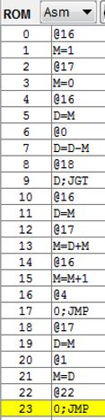
Data dependencies
Read After Write (RAW)
Memory or Register is read after being written to by a prior instruction
Example: I13 is reading the contents of D that were updated by prior instruction I11
Write After Read (WAR)
Memory or Register is written to after being read by a prior instruction
Example: I11 updates register D which was read by prior instruction I9
Write After Write (WAW)
Memory or Register is written to after being written to by a prior instruction
Example: I7 updates register D which was updated by prior instruction I5

Slide 35
do dependencies matter?
Dependencies are immaterial in a non-pipelined CPU implementation (e.g HACK Computer) because we are processing only ONE instruction at a time
However, in a pipelined CPU, more than one instruction can be in the pipeline in a given cycle (at most n instructions in a n-stage pipeline)
The correct values must be read at ALL times
The possibility of an incorrect value being read is called a HAZARD
Not ALL DEPENDENCIES constitute a HAZARD

Slide 36
Discussion: True and False Dependencies
RAW are true dependencies
WAR and WAW are false dependencies i.e. they are dependencies in name only
RAR are not dependencies since the “RAR dependent” instructions could be swapped without impacting program output unlike WAR or WAW where the program output could be different.

Slide 37
When does a RAW dependency constitute a hazard?
Read After Write (RAW)
Memory or Register is read after being written to by a prior instruction
RAW HAZARD: Example: I13 is reading the contents of D that were updated by prior instruction I11
This dependency will be a hazard because I13 is reading register D in C4 even though the new value of D will not become available until C5!!
IF
ID
EX
MEM
WB
Ci
I11
Ci+1
I12
I11
Ci+2
I13
I12
I11
Ci+3
I13
I12
I11
Ci+4
I13
I12
I11
Ci+5
I13
I12
Ci+6
I13

Slide 38
How do we fix a RAW Hazard?
We use a technique call “STALL” by not advancing the impacted instruction in the pipeline so as to resolve the RAW hazard
 | IF | ID | EXE | MEM | WB
Ci | I11
Ci+1 | I12 | I11
Ci+2 | I13 | I12 | I11
Ci+3 | I13 | STALL | I12 | I11
Ci+4 | I13 | STALL |  | I12 | I11
Ci+5 |  | I13 |  |  | I12
Ci+6 |  |  | I13
Ci+7 |  |  |  | I13
I13 reads the correct value of D written by I11

Slide 39
When does a RAW dependency NOT constitute a hazard?
Read After Write (RAW)
Memory or Register is read after being written to by a prior instruction
RAW Dependency: Example: I13 is reading the contents of D that were updated by prior instruction I5
This dependency will NOT be a hazard because I5 completes execution well in advance of I13

Slide 40
More discussion on dep and haz
Identify dependencies and hazards in the instruction stream executed in a 5-stage pipelined CPU
RAW |  | WAR |  | WAW
I0 → I5
I5→ I7 * |  |  |  | I5 → I7
I7 → I9 *
I7 → I11* |  | I9→ I11; I7→ I11 |  | I7 –I 11
Complete the rest of the
table as exercise
Note: * implies a HAZARD

Slide 41
Generic Example - dependencies
IF
ID
EX
MEM
WB
INSTRUCTION DEST, SRC1, SRC2
I1: MUL R1, R2, R3
I2: ADD R6, R1, R6
I3: MUL R1, R5, R6
I4: SUB R4, R1, R2
 | RAW | WAR | WAW
I1 → I2 | YES | N/A | N/A
I1 → I3 | N/A | N/A | YES
I1 → I4 | YES | N/A | N/A
I2 → I3 | YES | YES | N/A

Slide 42
To Summarize: Dependencies and Hazards
A Dependency is property of program alone
A Hazard is a situation when Dependence results in incorrect program execution
Hazard is a property of program as well as pipeline

Slide 43
Example
INSTRUCTION DEST, SRC1, SRC2
ADD R1, R1, R2
MUL R2, R2, R4
SUB R6, R2, R6
DIV R10, R6, R10
XOR R11, R11,R1
By the time XOR reads R1, ADD has already completed
and is therefore not a hazard to XOR
IF | ID | EX | MEM | WB
XOR | DIV | SUB | MUL | ADD
 | XOR | DIV | SUB | MUL
What if DIV and XOR were swapped?

Slide 44
Pipelining – Bringing Realism
Register storage overhead between every pipeline stage
Stalls (waiting for data that is not there yet)
Flushes (loaded ‘wrong’ instructions)

Slide 45
Example – Conditional Jump
 | IF | ID | EXE | MEM | WB
Ci | I7
Ci+1 | I8 | I7
Ci+2 | I9 | I8 | I7
Ci+3 | I10 | I9 | I8 | I7
Ci+4 | I11 | I10 | I9 | I8 | I7
Ci+5 | I12 | I11 | I10 | I9 | I8
Ci+6 | I18 |  |  |  | I9
Ci+7 |  | I18
When I9 executes a Jump, I10, I11, and I12 are already in the pipeline!!
These need to be FLUSHED and I18 needs to be loaded

Slide 46
Example: unconditional jump
IF | ID | EX | MEM | WB
JMP | ADD R1, R1,R2 | SUB R6, R6, R7
XOR R10, R10, R11 | JMP | ADD R1, R1, R2 | SUB R6, R6, R7
MUL R8, R8, R9 | XOR R10, R10, R11 | JMP | ADD R1, R1, R2 | SUB R6, R6, R7
DIV R4, R4, R5 | MUL R8, R8, R9 | XOR R10, R10, R11 | JMP | ADD R1, R1, R2
Once unconditional JMP executes, it causes MUL and XOR to
Be flushed from the pipe. New Instruction DIV is brought into the PIPE

Slide 47
Pipelining Topics out of Scope for this offering of 312
Instruction Reordering: Role of Compiler in reducing hazards (LINK)
Restructure program to eliminate RAW hazards
Forwarding (http://www.cs.utexas.edu/users/mckinley/352/lectures/12.pdf Slide 14 and onwards)
Forward the results (after EXE) to instructions waiting for the data instead of waiting all the way till the instruction retires (2 cycle gain!)
Register Renaming (LINK)
Out of Order execution (LINK)
These topics can be learnt in CSCE-350

Slide 48
What to expect from the preceding slide set in the Final Exam?
Be able to name the 5 stages in a simple pipeline and match them to descriptions
Be able to calculate latency, throughput, and clock period for hypothetical examples
Be able to draw pipestage execution for given instruction stream
Answer some general True/False statements limited to material presented in this slide set

Slide 49
What to expect from the preceding slide set in the Final Exam (contd.)?
Be able to name key overheads in pipeline execution
Calculate pipeline frequency with specified overheads
Identify data dependencies between instructions
Draw pipeline execution diagram for an instruction stream with stalls and flushes

