Slide 1
Topic 11 – memory hierarchy and cache memory

Slide 2
Memory addressing
Memory of capacity “X Bytes” can be addressed using log₂ X bits
Example: Any unique byte location in a 4 MB (2²² Bytes) memory can be identified by its 22-bit address

Slide 3
Memory organization
Memory can be organized as Blocks (rows) of BYTES or a 2D matrix with BLOCKS in rows and Bytes in columns
For example: An 8 Byte memory can be organized in any of these forms:
4 Bytes
1 Byte
4 Blocks
2 Blocks
8 Bytes
8 Bytes
2 Bytes
1 Block

Slide 4
Addressing
Show two different schemes of organizing and addressing a 4MB memory
Version 1: 4M blocks, each block being 1B
ADDRESS
BLOCK # (22 bits)
21
0
Version 1: 4M blocks, each block being 1B
BLOCK # (20 bits)
Byte
offset
ADDRESS
21
2
1
0

Slide 5
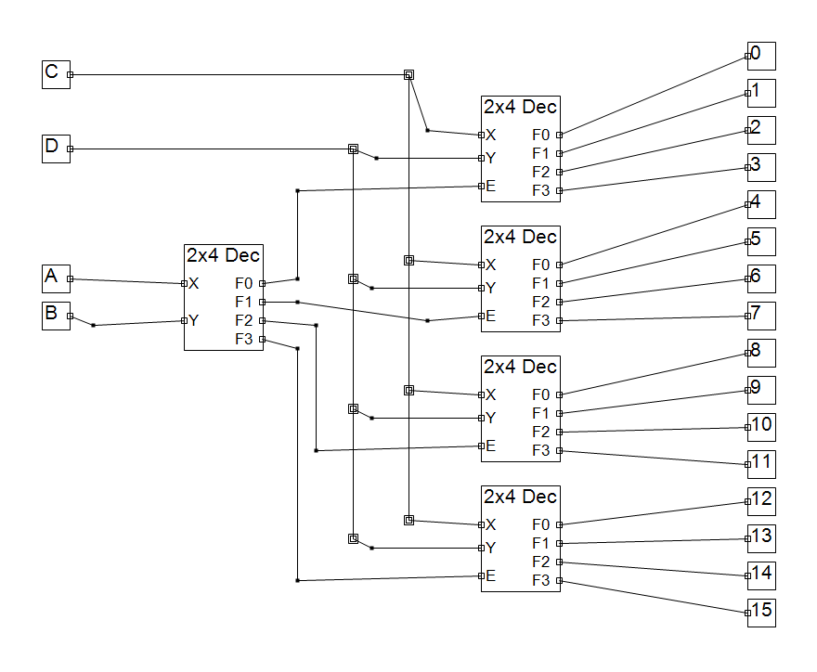
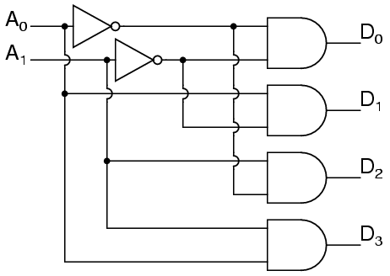
The larger the memory, the slower it is to access….why?
The larger the memory, the longer its address and therefore the wider (and slower) the decoder circuit
2 to 4 decoder for a 4 Block Memory
4 to 16 decoder for a 16 Block Memory
Notes:
The decoder pictures are for illustration only – they illustrate that the larger the memory gets, the deeper the levels of decoding to address a specific location in the memory. There are other reasons for a large memory to have slower access time, but this is just one example to illustrate why access gets slower for larger memory structures.

Slide 6
The larger the memory, the slower it is to access….why?
The larger the memory, the higher its likelihood of being further away from the CPU and therefore longer to access
CPU CHIP
MEMORY CHIP
These cross-chip
wires have long
delays

Slide 7
Smaller memory on chip?
We look for hosting some memory on the same chip as the CPU since it will be faster
both because of the size and also because of its co-location with the CPU)
Such a memory is called “Cache Memory” or simply “Cache”
By definition, a cache can only store a subset of memory during program execution

Slide 8
Example
Bytes
3
2
1
0
63
256 Byte memory organized as 64 BLOCKS and 4 Bytes per BLOCK
16 Byte cache organized as 4 LINES and 4 Bytes per LINE
Bytes
62
3
2
1
0
3
48
CPU
2
Lines
1
Blocks
0
31
CACHE
26
1
0
MEMORY

Slide 9
How does a cache help?
Principles of locality come to the rescue
Temporal Locality: If a memory address has been accessed recently, it will likely be accessed again.
Spatial Locality: If a memory address has been accessed, it is likely addresses close to it will be accessed.
Notes:
int sum = 0;
for (int j = 0; j<1000; j++)
sum = sum + arr[j];
What portion of this code shows temporal locality? Answer: variables j and sum
What portion of this code shows spatial locality? Answer: variable arr array

Slide 10
How does cache access work?
By definition, a cache stores a subset of memory during program execution
When a program generates access to a memory location, the CPU first looks in the cache
If it finds the location is ‘cached’, we call it a ‘cache hit’
Otherwise, we call it a ‘cache miss’ and the CPU goes to the memory to access the location

Slide 11
Illusion from locality
Cache memory facilitates the illusion of the fastest, infinite memory
This illusion is a reality ‘most of the time’
i.e. the principles of locality imply that what we are looking for will be found in the cache most of the time

Slide 12
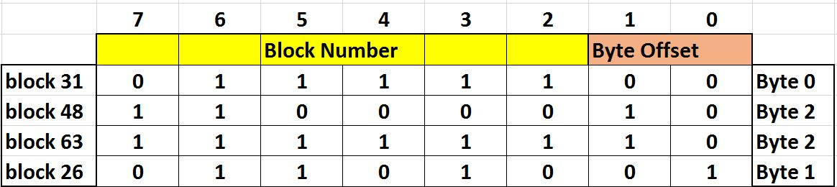
Example
Let’s assume a 256 Byte memory organized as 64 blocks and 4 Bytes per block
3
2
1
0
63
62
MEMORY ADDRESS
48
31
26
1
0
MEMORY
MEMORY ADDRESS EXAMPLES

Slide 13
Example (contd.)
Now let’s assume a 16 Byte cache organized as 4 Lines and 4 Bytes per line
3
2
1
0
Now, let’s say we access blocks 26, 31, 48, and 63 in the memory
3
2
1
0
3
63
2
62
1
0
48
CACHE
31
How do we decide which block in memory gets ‘placed’ in which line in the cache?
26
1
0
MEMORY

Slide 14
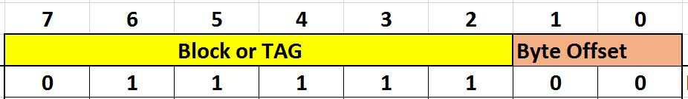
Fully Associative
Any to Any: Any block in memory can go to any line in the cache
Bytes
3
2
1
0
To capture and remember the mapping, we attach TAGS to every line in the cache
63
62
48
Bytes
3
2
1
0
Blocks
3
26
Block 31, Byte 0
31
2
63
Lines
26
1
31
0
48
CACHE
TAG (6 bits)
1
0
MEMORY

Slide 15
example
Let’s say a program generates access to memory addresses as follows:
01111100, 01111110, 11111100, 11000000, 01101011, 10101000
Bytes
Bytes
3
2
1
0
3
2
1
0
3
26
??
63
2
63
62
Lines
1
31
0
48
48
CACHE
TAG (6 bits)
Blocks
31
26
The 1st 5 addresses get assigned or matched just fine
The 6th address (Block 42) does not result in a MATCH!
For every address, it is clear that we ‘check’ the block bits against every line’s TAG bits and that is costly
1
0
MEMORY

Slide 16
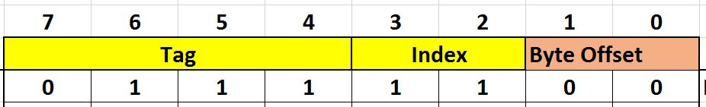
Direct mapped
Fixed location: A block in memory can only be ‘cached’ in one location in the cache
Bytes
3
2
1
0
To capture the mapping, we split the block # into TAG and index bits
63
62
48
Bytes
3
2
1
0
Blocks
3
0 1 1 1
31
3
2
2
Lines
26
1
1
0
0
Index=11 &
TAG=0111
CACHE
TAG (4 bits)
1
0
MEMORY

Slide 17
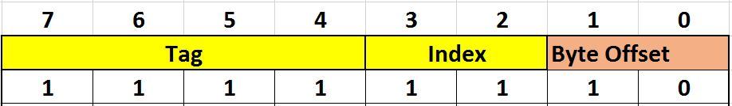
Direct mapped - example
Assuming block 31 is placed in line 3, now what happens if we access block 63?
Bytes
3
2
1
0
Bytes
63
3
2
1
0
62
3
3
0 1 1 1
2
2
Lines
48
1
1
0
0
Index=11 &
TAG=1111
Blocks
CACHE
TAG (4 bits)
31
26
1
OOPS!! Houston we have a problem….both block 31
and 63 want to go to the same location in the cache!!
But we also realize that we had to go looking at only one location
(defined by index bits) unlike fully associative with “any to any” flexibility
0
MEMORY

Slide 18
To summarize….
Fully associative cache gives maximum flexibility for block placement but is also the most expensive to require comparison against every stored tag to find match
Direct mapped cache is simpler since index bits tell us exactly where to look, but it is also the most rigid since there is only one place that a block could reside

Slide 19
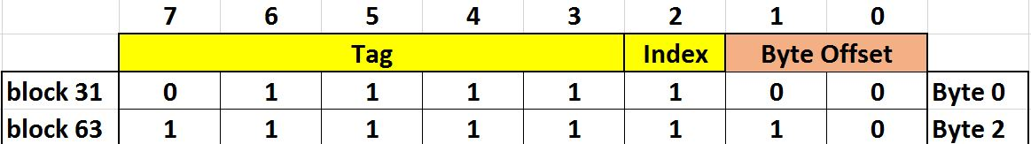
Middle ground: set associative
Bytes
3
2
1
0
Main points
Compile the cache as a collection of sets
Each set has ≥ 1 lines
Sets are assigned in direct mapped scheme
But implement fully associative within a set
63
62
48
Blocks
31
Bytes
3
2
1
0
26
Set1
Set1
0 1 1 1 1
1 1 1 1 1
Index=1 &
TAG=01111
Set0
Set0
Index=1 &
TAG=11111
1
0
CACHE
TAG(5 bits)
MEMORY
Notes:
Most caches are implemented as set associative caches (ranging from 2-way SA to 16-way SA). The tradeoff is always including the key parameters like access time, hit rate and area complexity

Slide 20
Remember this example for FA cache?
Let’s say a program generates access to memory addresses as follows:
01111100, 01111110, 11111100, 11000000, 01101011, 10101000
Bytes
Bytes
3
2
1
0
3
2
1
0
3
26
??
63
2
63
62
Lines
1
31
0
48
48
CACHE
TAG (6 bits)
Blocks
31
26
The 1st 5 addresses get assigned or matched just fine
The 6th address (Block 42) does not result in a MATCH!
How do we respond to the 6th address which is not in the cache and the cache is full?
1
0
SOMETHING’s GOTTA GIVE
MEMORY

Slide 21
Cache Line Replacement
Let’s say a Set is full and a new address request goes to the Set resulting in a Miss
Miss → Need to bring a new block in the Cache
Which line in the set do we kick out?
Common techniques are
Random
First in First out
Least Recently Used (LRU)

Slide 22
LRU Implementation
Basic Idea is to look for the oldest accessed line to kick out? Why?
Implementation: Attach a counter to each line. Line with the lowest count is the eviction candidate.
Notes:
The reason for looking to kick out the oldest line is because it shows the least probability of access based on the principle of temporal locality

Slide 23
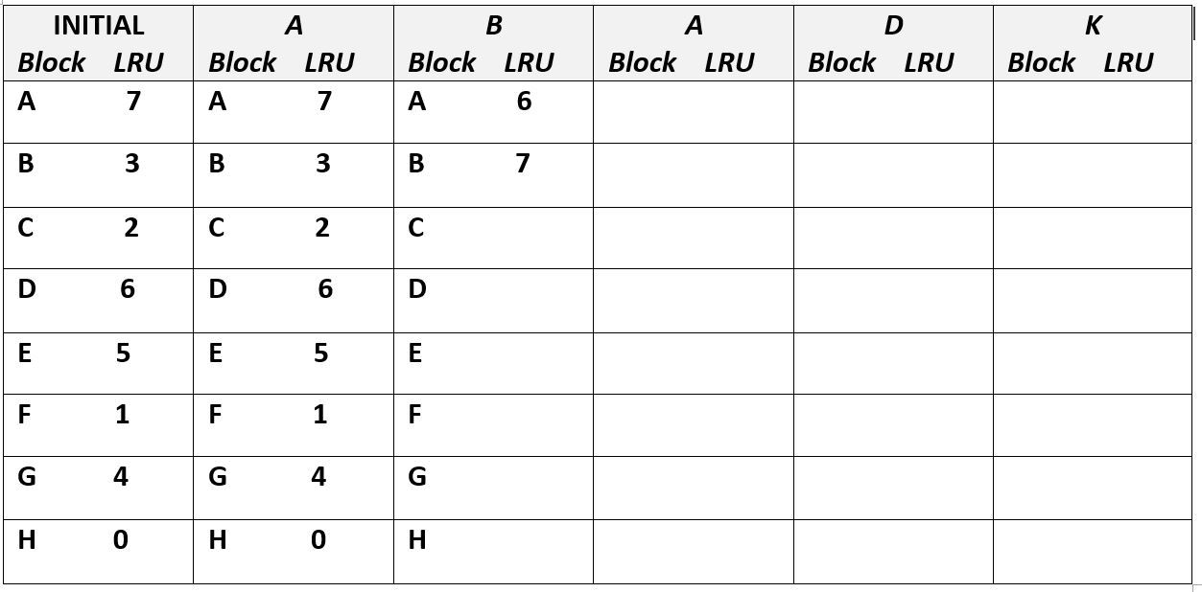
Example: How does LRU work?
Suppose we have an 8-way set. Initial tags and access patterns are shown in the table below
Notes:
NOTE: When updating LRU counter values, only update the count value of the ways that are higher than the one accessed

Slide 24
discussion
What determines the bit-width of the LRU counter?
Does it make sense to implement LRU mechanism for a direct-mapped cache?
Also remember,
1-way set associative cache is really a direct-mapped cache
N-way cache where N is also equal to the number of lines in the cache implies a fully-associative cache
Notes:
Bit width of LRU counters is determined by the number of ways in a set (so an 8-way would require a 3-bit counter)
It does not make sense to implement LRU mechanism for direct-mapped cache because there is only 1 fixed location for a given address

Slide 25
Case for a valid bit
Bytes
tags
3
2
1
0
lru
valid
3
2
Set1
Set1
Lines
1
0
Set0
Set0
Why Valid bit?
Because when a chip is powered up, any readout from caches must be trustworthy. To distinguish and prevent stale bits and/or un-initialized bits in the cache from being read, we install a valid bit for every line in the cache

Slide 26
What about writes to a cache?
how should we handle write MISS?
How should we handle write HIT?

Slide 27
Write Policy for Write Miss
Do we cache the blocks we write?
No-Write-Allocate: On write miss, just write to the memory and not cache the block.
Write Allocate: Every time there is a write miss, bring the block to the cache as well. Why?
To take advantage of locality between writes and read i.e. cache the block with the expectation that it will be read again soon

Slide 28
Write Policy for Write Hits
Do we write just to the cache or also to memory?
Write-Through: Update memory every time a write to cache occurs
Write-Back: Update memory only when a written entry (line) in cache is getting evicted or replaced

Slide 29
Write-Back Cache
To implement this, we append a “Dirty” bit to every cache line
Dirty Bit =1 indicates the line was written to and therefore needs to be updated in the main memory at replacement
Dirty Bit = 0 indicates the line was not written to and can be simply replaced without any updates to the main memory

Slide 30
Cache topographical elements
Bytes
tags
3
2
1
0
lru
valid
dirty
3
2
Set1
Set1
Lines
1
0
Set0
Set0
Example: a 16B 2-way set associative cache
There are some other arrays as well for modern caches but
the ones above are the primary ones

Slide 31
Write-back practice question
Consider a single-line cache initialized as follows
A
0
1
ACCESS PATTERN
TAG
Valid
Dirty
What are the final values of V, D, TAG?
How many misses occurred in total?
How many write-backs occurred in total?
READ A
READ B
WRITE B
READ C
READ D
WRITE D
Notes:
READ A → TAG = A, Valid=1, D=0, Miss = 1 (since V=0 initially), WB = 0
READ B → TAG = B, Valid = 1, D = 0, Miss = 2, WB = 0
WRITE B → TAG = B, Valid = 1, D=1 (since write occurred), Miss = 2, WB = 0
READ C → TAG = C, Valid = 1, D=0, Miss = 3, WB=1
READ D → TAG = D, Valid = 1, D=0, Miss = 4, WB =1
WRITE D → TAG = D, VALID = 1, D=1, Miss = 4, WB=1

Slide 32
Summary
Memory Hierarchy is needed to assist in the creation and maintenance of the illusion of infinite and fastest storage
Caching is the most critical concept behind this illusion and relies on principles of locality
Caches are organized as direct mapped or fully associative or set associative

Slide 33
Summary
Handling misses are time consuming therefore miss rate must be minimized
The size of cache, number of ways and line size are important parameters designed to maximize the chances of finding the address i.e. ‘hit rate’
LRU is a popular algorithm used to determine which cache line to evict in the event of an address conflict
Cache write policies can be ‘write back’ or ‘write through’ depending on traffic

