Slide 1
Memory Hierarchy
Acknowledgment: Professor Milos Prvulovic, GATECH

Slide 5
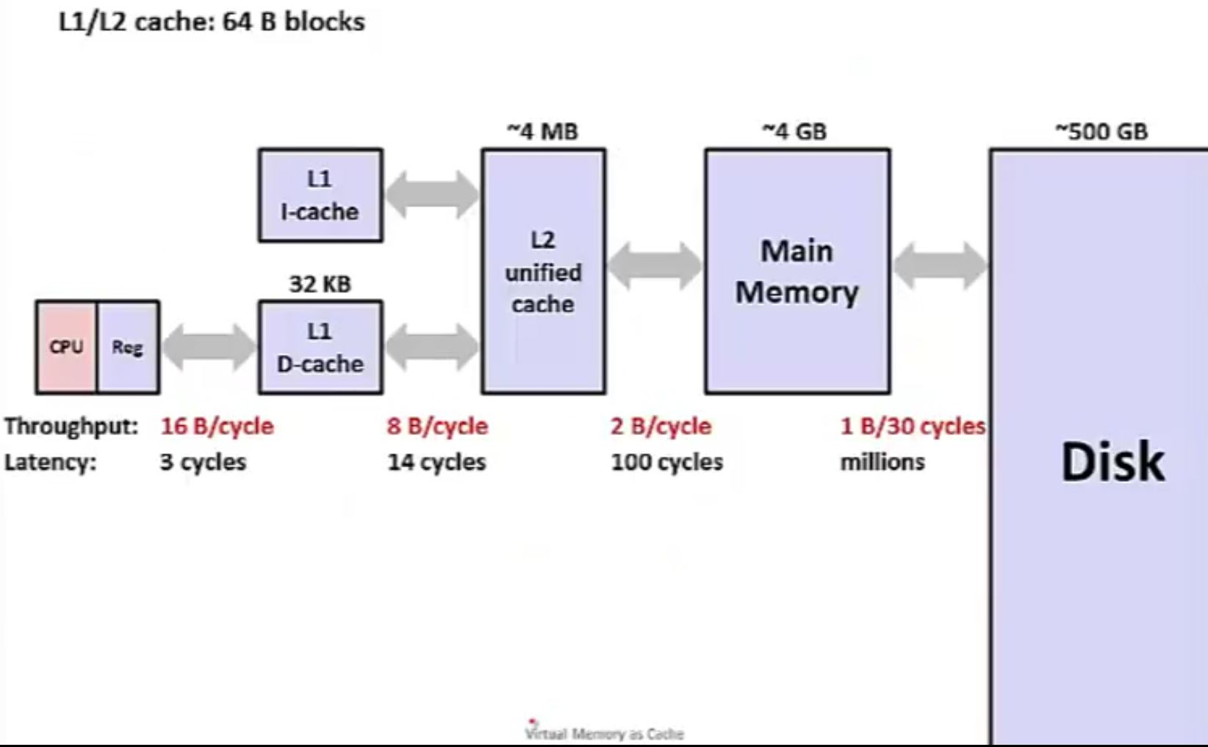
Memory Hierarchy: Core 2 Duo (not drawn to scale)
Source: UW Course in HW/SW Interface (Coursera)

Slide 6
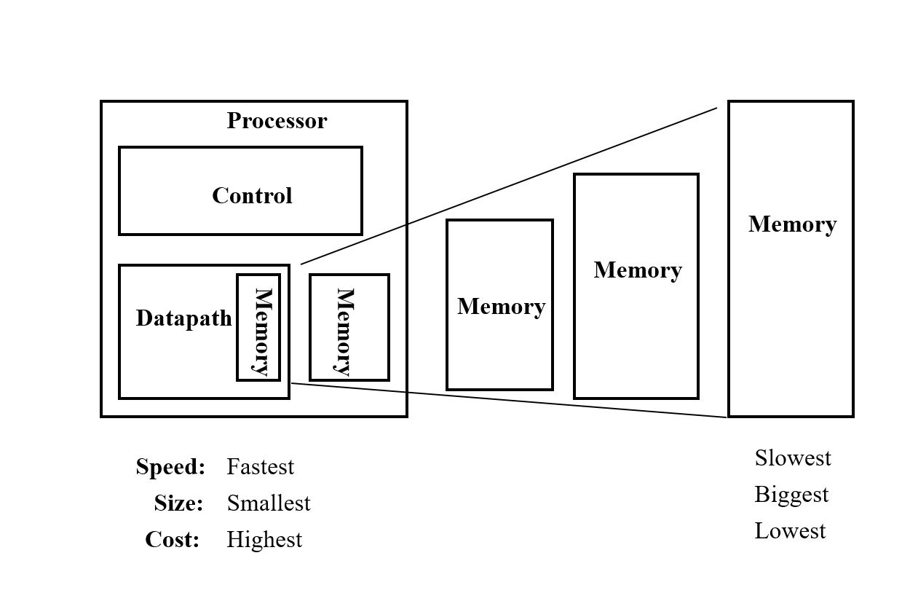
The Case for Memory Hierarchy
Part of memory hierarchy that starts with Registers at the Lowest Level closest to the CPU and ends with the Disk Drive that is furthest from the CPU.
Memory Hierarchy works because it harnesses the two principles of locality
Temporal Locality
Spatial Locality
Facilitates the vision of realizing the “fastest” “infinite” memory

Slide 7
Principles of Locality
Temporal Locality: If an address has been accessed recently, it will likely be accessed again.
Spatial Locality: If an address has been accessed, it is likely addresses close to it will be accessed.

Slide 8
Temporal and spatial locality
int sum = 0;
for (int j = 0; j<1000; j++)
sum = sum + arr[j];
What portion of this code shows temporal locality?
What portion of this code shows spatial locality?

Slide 9
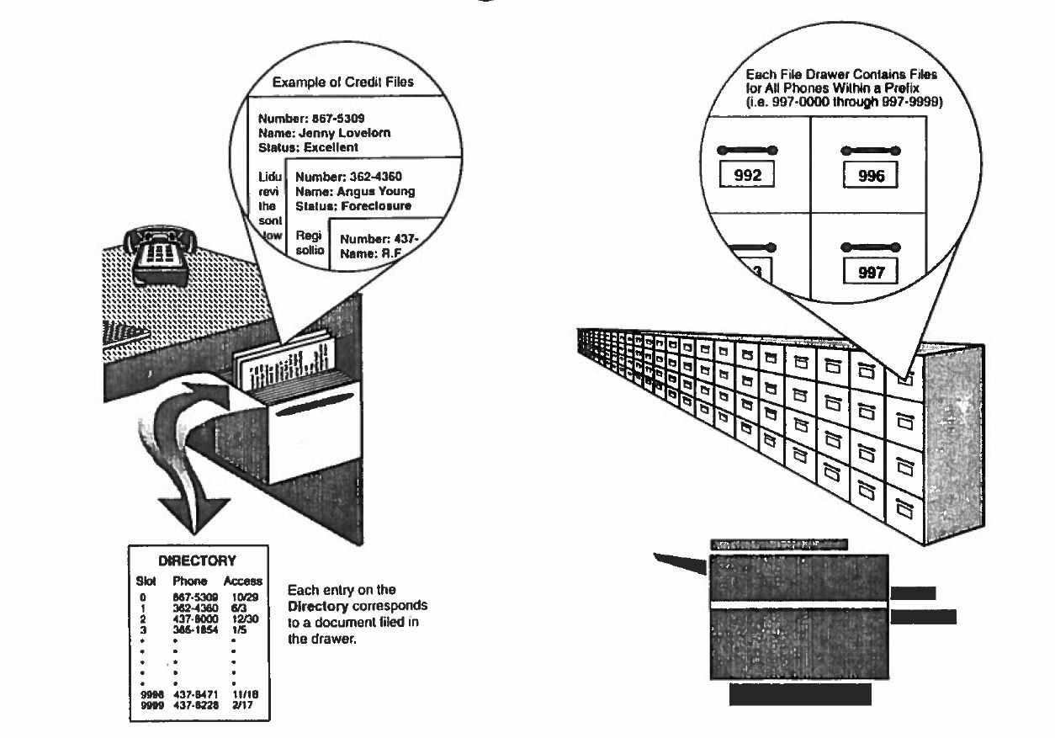
Workings of a Cache Memory
Source: Jim Handy, The Cache Book

