Slide 1
CSCE-313 Spring 2017 Final exam Study Guide
Aakash Tyagi
CSCE 313 Spring 2017

Slide 2
Final Exam Discussion Outline
Format
Study Guide
  Reading Material
  Key Concepts
  Summary Recap

Slide 3
CSCE 313 SP’17 Final Exam Format
Dates:
  Monday May 8 3:30pm-5:30pm (504-506)
  Tuesday May 9 8am-10am (507-509)
Venue: Classroom
  ETB 2005 (504-506)
  ETB 1020 (507-509)
Duration = 120 minutes
Format: Handwritten answers on exam paper. Answers must be legible and written in the space provided below each question.
Total 90 points distributed over 5-6 questions. The score will be scaled down to actual allocation for the final grade (45 points)

Slide 4
CSCE 313 SP’17 Final Exam Format
Types of Questions (roughly equally divided among the following categories)
  Objective/Multiple-Choice
  Problem Solving
Coverage
  Process and Thread Synchronization
  Inter-Process Communication
  Signals
  Networking, Socket Programming
  Virtual Memory

Slide 5
Finals Study Guide - Reading Material Review
Classroom Material: Piazza Resource Section (LINK)
Textbook (Anderson and Dahlin)
  Concurrency and Threads: Chapter4: Sections 4.1-4.6
  Synchronization: Chapter 5: Sections 5.1-5.3
  Virtual Memory: Chapter 8
Reference Textbook (Advanced Programming in the UNIX Environment; use as needed to buttress material from Slides)
  Signals: Chapter 10 (only the topics covered in class)
  Inter-Process Communication: Chapter 15
  Network IPC: Chapter 16

Slide 6
Finals Study Guide – Key Concepts
Please make sure you have a firm grasp over these concepts. Past exams are good representation of questions.
  Threads: TCB, Thread Operations, Multi-core/Multi-thread Pitfalls
  Synchronization: Starvation, Mutex, Critical Section, Atomic Operation, Interrupt Disable, Busy-Wait, Atomic Instructions, Semaphores
  Inter-Process Communication: All discussed mechanisms: concept, implementation, pros and cons
  SIgnals: Catching, ignoring, defaulting signals
  Network Programming: OSI, TCP, UDP, Terminology, Socket Programming concepts, System Calls
  Virtual Memory: Virtual memory concepts, Paging, Address Translation, Translation Lookaside Buffer

Slide 7
Concept Recap and Practice Questions
Key slides from class material are selected for quick recap
Does not mean that the exam will be limited to this material!!

Slide 8
Process and Thread
(Unix) Process
A(int tmp) {
if (tmp<2)
B();
printf(tmp);
}
B() {
C();
}
C() {
A(2);
}
A(1);
…
Process
Memory
threads
Mem.
I/O State
(e.g., file, socket contexts)
…
IO
state
CPU
state
CPU
state
CPU state (PC, SP, registers..)

Slide 9
Thread Execution – Advisory
Cannot make any assumptions about relative speed at which the threads operate (i.e. interleaving is a given)
Program execution can be non-deterministic (scheduler, processor frequencies, etc.)
Compilers can reorder instructions

Slide 10
Key things necessary to make threading work
Sharing of address space is hallmark of threaded code
Need protection mechanism for shared objects
Need to make these protection mechanism “race proof”
Two requirements
  Need mechanism to lock shared objects
  The lock mechanism itself must be atomically executed
Synchronization: using atomic operations to ensure cooperation between threads
Critical Section: piece of code that only one thread can execute at once
Mutual Exclusion: ensuring that only one thread executes critical section
Lock: prevents someone from doing something
  Lock before entering critical section and before accessing shared data
  Unlock when leaving, after accessing shared data
  Wait if locked

Slide 11
Synchronization – Solutions Palette
Programs
Shared Programs
Higher-level
API
Locks Semaphores Monitors Send/Receive
Hardware
Load/Store Disable Ints Test&Set Comp&Swap
Need Synchronization Primitives to avoid race conditions involving shared objects

Slide 12
Practice Question
Cooperating Threads are advantageous because they allow
  a. Facilitate sharing of resources
  b. Allow speedup of execution
  c. Introduce program modularity
  d. All of the above

Slide 13
Practice Question
Consider the following code segment:
pid_t pid;
pid = fork();
if (pid == 0) { /*child process
fork();
threadcreate( . . .);
}
fork();
  How many unique processes are created?
    Total 6 unique processes are created.
  How many unique threads are created?
    Total 2 unique threads are created one each by the child and its fork process.
P0
P4
P1
P2
P3
T1
T2
P5

Slide 14
Practice Question
A system with two dual-core processors has four processors available for scheduling. A CPU-intensive application is running on this system. All input is performed at program start-up, when a single ﬁle must be opened. Similarly, all output is performed just before the program terminates, when the program results must be written to a single ﬁle. Between startup and termination, the program is entirely CPUbound. Your task is to improve the performance of this application by multithreading it. The application runs on a system that uses the one-to-one threading model (each user thread maps to a kernel thread).
How many threads will you create to perform the input and output? Explain.
  We will create 2 threads to perform input and output respectively since a single file is involved in read and write.
How many threads will you create for the CPU-intensive portion of the application? Explain.
  For the CPU intensive operation all cores can be employed simultaneously for a fully parallel operation. Therefore the application must be 4-threaded for 4-way parallel execution.

Slide 15
Practice Question
A concurrent program contains a few updates to a shared variable x, which occur inside critical sections. Variable x is also used in the following portion of code, which is not enclosed in a critical section:
    if (x < c)
      y = x;
    else
      y = x + 10;
    cout << "x = " << x << " y = " << y << endl;
Does this program have a race condition? If yes, illustrate an example, otherwise explain why not.

Slide 16
Practice Question
Otherwise the control may disappear from this thread and never wake up threads waiting on the condition
Which sequence of steps is correct and why?
  Lock a mutex
  Change the condition protected by the mutex
  Signal threads waiting on the condition
  Unlock the mutex
OR
  Lock a mutex
  Change the condition protected by the mutex
  Unlock the mutex
  Signal threads waiting on the condition

Slide 17
Inter-Process Communication
OS provides generic mechanisms to communicate
  Pipes and Named Pipes (FIFO)
  Shared Memory: multiple processes can read/write same physical portion of memory; implicit channel
  Message Passing: explicit communication channel provided through send()/receive() system calls
      » A system call is required
IPC is, in general, expensive due to the need for system calls

Slide 18
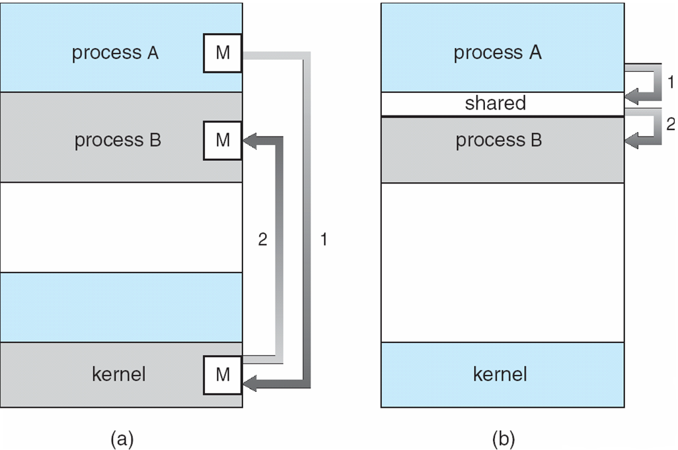
IPC Fundamental Communication Models
Example: pipe, fifo, message, signal
Example: shared memory, memory mapped file

Slide 19


Pipe Creation
int pipe(int filedes[2]);
BEFORE pipe
AFTER pipe
Process has some usual files open
Kernel creates a pipe and sets file descriptors
BEFORE
  Shows standard set of file descriptors
AFTER
  Shows newly created pipe in the kernel and the two connections to that pipe in the process

Slide 20
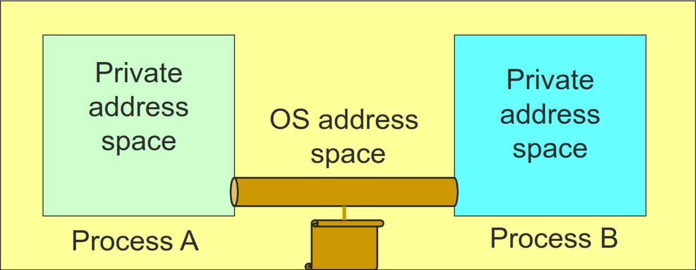
FIFO
A pipe disappears when no process has it open
FIFOS (also called named pipes) are a mechanism that allow for IPC that's similar to using regular files, except that the kernel takes care of synchronizing reads and writes, and
Data is never actually written to disk (instead it is stored in buffers in memory) so the overhead of disk I/O (which is huge!) is avoided.

Slide 21
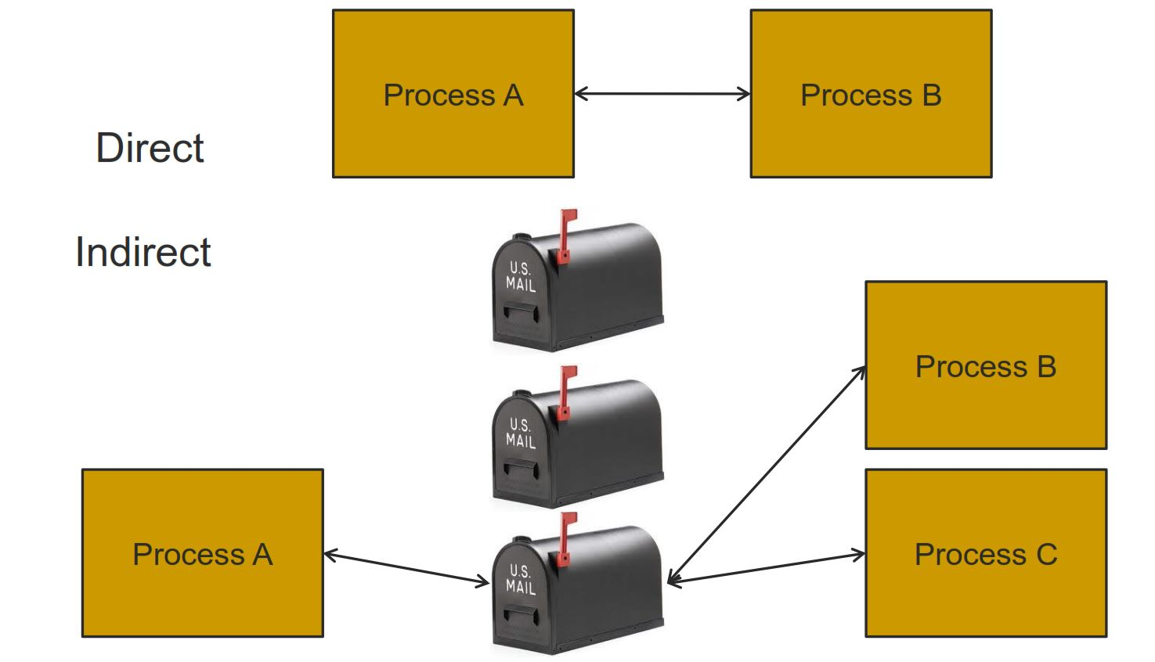
Message Passing

Slide 22
Shared Memory
Process A
Process B
OS Address Space
Processes request the segment
OS maintains the segment
Processes can attach/detach the segment

Slide 23
Practice Questions
When setting up a pipe to a child, the order of system calls is
  the parent calls pipe then calls fork
  the parent calls fork, then both processes call pipe
Connections to a pipe remain in effect after exec because
  the array of open files is part of the process, not the program
  the parent adds the pipe to the environment
A pipe can connect two children of the same process if
  the parent creates the pipe before creating both children
  the parent creates two pipes and connects them
OK
OK
OK

Slide 24
Practice Questions
If two different processes read from the same FIFO,
  one will get some data, the other will get the rest
  both will read the same data
If two different processes write to the same pipe,
  data from one writer may overwrite data from the other one
  both sets of messages will get to the reader
Shared memory is faster for communication than pipes because
  the kernel stores shared memory segments in the CPU cache
  data does not have to be copied from one process to another
OK
OK
OK

Slide 25
Signal
A Signal is a one-word message
  A Green Light is a signal, A Referee’s whistle is a signal
  These items and events do not contain messages, they are messages!
Each Signal has a numerical code
So when we press CTRL-C key we ask the Kernel to send the interrupt signal to the currently running process
Signals mean to user mode execution what interrupts/exceptions mean to the protected mode execution

Slide 26
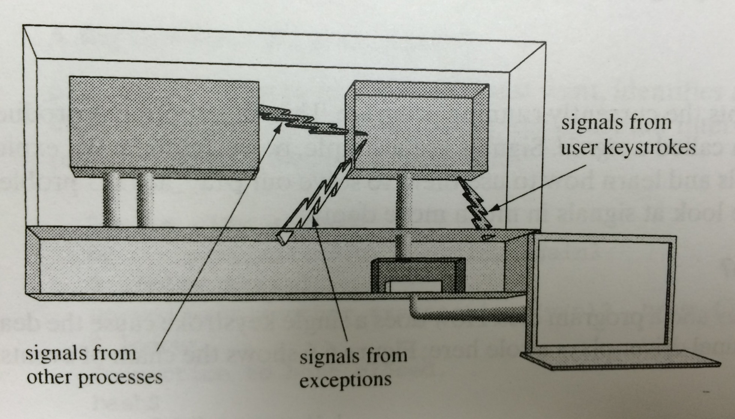
Where do Signals come from?
Taken from: Chapter 6 of “Understanding Unix/Linux Programming” by Bruce Molay

Slide 27
Actions Pertaining to Signals
What can a process tell the Kernel to do about a Signal?
  Accept Default, Ignore, Catch
A Signal is “Generated” when ……
  event that causes the signal occurs
A Signal is “Delivered” when ……
  action for signal is taken

Slide 28
Signals Concept Refresh
A Signal is “Blocked” when …..
  it is not allowed to be delivered
signal mask can be used to control ……
  set of signals that are prevented from delivery
When the Kernel calls a signal handler on a process, that type of signal is ……
  automatically blocked
When a signal handler returns, the blocked signal type is …….
  automatically unblocked

Slide 29

Multiple Signals Handling….Process
A Process receives multiple signals
  Does the handler stay in effect after a signal arrives?
  What happens if a SIGY arrives while the process is in SIGX handler?
  What happens if a second SIGX arrives while the process is still in SIGX handler? Or a third SIGX?
  What happens if a signal arrives while the program is blocking on input?
SIGINT
SIGINT Handler
SIGALRM
SIGQUIT Handler
SIGQUIT
SIGALRM Handler

Slide 30

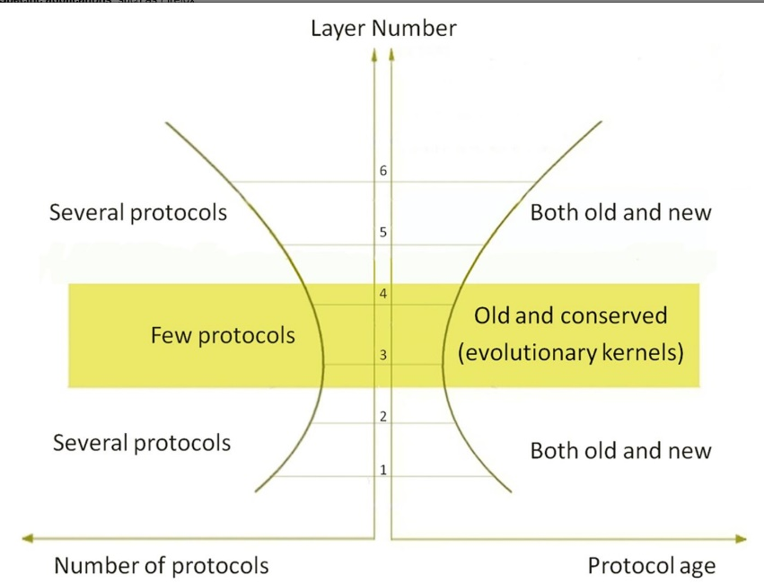
Internet Hourglass Architecture
Email, Web, ssh,...
TCP, UDP, …
IP
Source: GATECH Internet Hourglass Architecture
From top to bottom, the Internet architecture consists of six layers:
Specific applications, such as Firefox;
Application protocols, such as Hypertext Transfer Protocol (HTTP);
Transport protocols, such as Transmission Control Protocol (TCP);
Network protocols, such as Internet Protocol (IP);
Data-link protocols, such as Ethernet; and
Physical layer protocols, such as DSL.
Layers near the top and bottom contain many items, called protocols.
The central transport layer contains two protocols
and the network layer contains only one, creating an hourglass architecture.
Ethernet, WiFi,
3G, bluetooth,...
30

Slide 31
Transferring Data Over an internet
Host A
Host B
client
server
(1)
data
(8)
data
protocol
software
protocol
software
internet packet
(2)
data
PH
FH1
(7)
data
PH
FH2
LAN1 frame
LAN1
adapter
LAN2
adapter
Router
(3)
data
PH
FH1
(6)
data
PH
FH2
LAN1
adapter
LAN2
adapter
LAN1
LAN2 frame
LAN2
(4)
data
PH
FH1
(5)
data
PH
FH2
protocol
software
Cox
Networking
31

Slide 32
Organization of an Internet Application
Internet client
Internet server
Client
User code
Server
Sockets interface
(system calls)
TCP/IP
Kernel code
TCP/IP
Hardware interface
(interrupts)
Network
adapter
Hardware
and firmware
Network
adapter
Global IP Internet
Cox
Networking
32

Slide 33
Putting it all Together:
Anatomy of an Internet Connection
Client socket address
128.2.194.242:51213
Server socket address
208.216.181.15:80
Client
Server
(port 80)
Connection socket pair
(128.2.194.242:51213, 208.216.181.15:80)
Client host address
128.2.194.242
Server host address
208.216.181.15
Cox
Networking
33

Slide 34
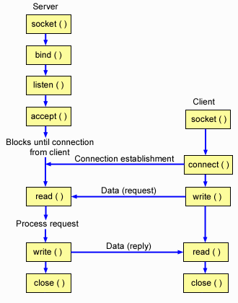
A TCP Client-Server Interaction

Slide 35
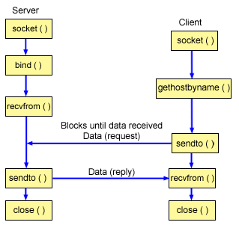
A UDP Client-Server Interaction

Slide 36
Miscellaneous Questions
From the last slide of the signal powerpoint:
¨When the Kernel calls a signal handler on a process, that type of signal is ……
¤ automatically blocked
¨When a signal handler returns, the blocked signal type is …….
¤automatically unblocked
So a signal handler is called when a signal is sent (if it is set up correctly). But if something is blocked and then unblocked, the signal is not lost, and then would again when it is unblocked. Basically how does the blocking work (it hangs on to the signal) and why it is necessary when dealing handlers?

Slide 37
Hot off the Press on Piazza
Going through the lecture slides for FIFOs and pipes, I had a few questions:
1. In a Unix pipe, is it bi-directional? I dont see why it would not be, since it is just writing to the file descriptors and the file descriptor table is copied over at fork.
2. For pipes and fifos, and message passing, are all bytes only read once, even if multiple programs have the pipe open/queue for reading? Or, is it like with file descriptors where each connection has its own offset and can read every message passed in? (For example, if I made a FIFO, and connected one writer and two readers, and the writer wrote "Cake" and the first reader read one character and the second reader read a character, would the second reader read "C" or "a"?
3. In message passing, messages are stored in a buffer. Is this buffer stored in the kernel?
4. Is this proposed order of speed correct:
Fifos and pipes are tied for slowest, along with message passing. Both have to copy the info into a kernel buffer and into the next process. Sending messages directly and indirectly is equally fast as each other and fifos and pipes, because it also just copies data into a buffer, although it must wait for the other program to ask for it.
Shared memory is fastest, because it is akin to using global variables so thus no extra coping is needed for sending data. Even though this memory is outside the process memory space, it is mapped to memory that is inside the process memory space (main memory) so the access is super quick. Is mapping different than caching.

