Slide 1
W8 – Concurrency and threads
Reading Reference: Textbook: Chapter 4
Aakash Tyagi CSCE 313 Spring 2017

Slide 2
This Week’s Conversation
Threads
A bit complex topic but central to our understanding of modern computer systems (HW and SW)
We will build concepts incrementally and tie the picture together at the end
We will continue the crux of discussion on threading after the spring break
Adapted from contemporary courses in OS/Systems taught at Berkeley, UW, TAMU,
UIUC, and Rice. Some slides are from Anderson and Dahlin Text.
Special acknowledgment to Profs Gu/Bettati at TAMU, Culler and Joseph at Berkeley

Slide 3
Why Processes & Threads?
Goals:
Multiprogramming: Run multiple applications concurrently
Protection: Don’t want a bad application to crash system!
Solution:
Virtual Machine abstraction: give process illusion it owns machine (i.e., CPU, Memory, and IO device multiplexing)
Process: unit of execution and allocation
Challenge:
Process creation & switching expensive
Need concurrency within same app (e.g., web server)
Solution:
Thread: Decouple allocation and execution
Run multiple threads within same process
Notes:
Multiprogramming: Older idea than multi-tasking, run jobs concurrently (load several into memory), but not necessarily “interactively”.

Slide 4
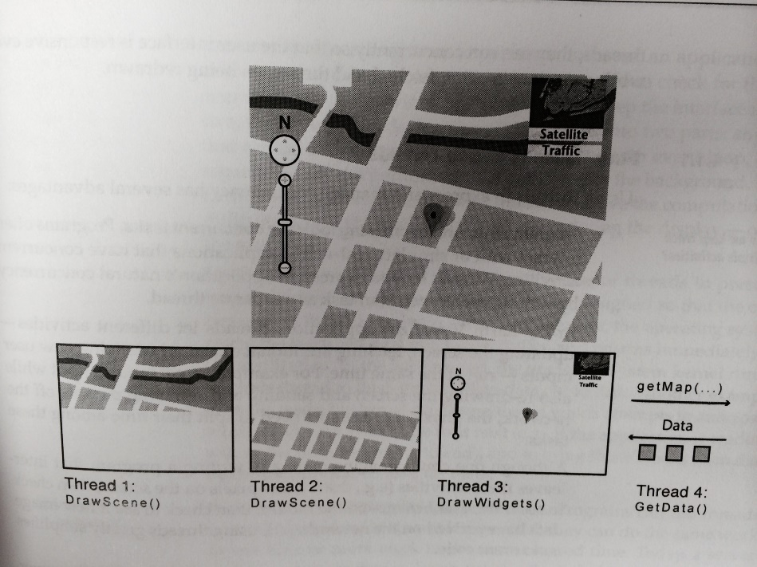
Let’s picture this scenario
Processes
thread
thread
thread
thread
Multiple programs (processes) doing their individual functions
PAYING THE COST OF CONTEXT SWITCHING
WHAT IF WE COULD REDUCE THE COST
AT THE EXPENSE OF SOMETHING
SO THE NET PERFORMANCE IS STILL BETTER
Credit – NASA Earth Observatory
Two ‘threads’ each draw parts of the scene, a third ‘thread’ manages the user interface widgets, and a fourth ‘thread’ fetches new data from the remote server
In a ‘traditional program’ these will be sequenced
Key differentiation is “facilitated concurrency”.
A traditional program is a single ‘thread’
Inside a program, we can represent each concurrent task as “Thread”

Slide 5
Motivation for SW Threads
Operating systems need to be able to handle multiple things at once (MTAO)
processes, interrupts, background system maintenance
Servers need to handle MTAO
Multiple connections handled simultaneously
Parallel programs need to handle MTAO
To achieve better performance
Programs with user interfaces often need to handle MTAO
To achieve user responsiveness while doing computation
Network and disk bound programs need to handle MTAO
To hide network/disk latency

Slide 6
Motivation for HW Threads
MTAO for performance
Assists for SW threads

Slide 7
Motto for Threading
Multiple Things at Once
MTAO

Slide 8
Programs, Process, Threads, MultiCore, Multithreads…
Scenario: Warehouse Accountant needs to
look at the invoice list
verify it against the purchase order list and
then issue a check for valid purchases.
There are multiple sheets of purchase orders and invoices.
More than one accountant are qualified and allowed to work on this assignment. Constraint is that an accountant can only work on his assigned list.
An accountant must have a TAG before he can work on his list.
There is only one tag to go around.

Slide 9
Scenario Build
Scenario1: No accountant: Analogous to a “Program”

Slide 10
Scenario Build
Scenario2: Accountant present in Room1 with a TAG, along with all lists and a checkbook: Akin to a Process in execution

Slide 11
Scenario Build
Scenario3: Accountant2 shows up in Room2. At some point Accountant1 goes on lunch break
His stopping point and local records are saved (aka PCB).
Tag and Global lists (invoice and PO) are walked over to Room2 so Accountant 2 can take over.
When Accountant 2 takes a break, the tag and lists are walked over to Room1 again…..Akin to 2 processes and context switch from Process1 to Process2.

Slide 12
Scenario Build
Scenario4: Now picture Accountants 1 and 2 are sitting in the same room with global lists visible to both.
Whoever gets the TAG recalls his previous stopping point and resumes.
There’s no walking across the rooms, carrying lists etc.
They just have to be careful not to clobber over each other’s lists. This is akin to Threads.

Slide 13
Putting it together: Process
(Unix) Process
A(int tmp) {
if (tmp<2)
B();
printf(tmp);
}
B() {
C();
}
C() {
A(2);
}
A(1);
…
Process
Memory
threads
Mem.
I/O State
(e.g., file, socket contexts)
…
IO
state
CPU
state
CPU
state
CPU state (PC, SP, registers..)

Slide 14
Putting it together: Processes
Process 1
Process 2
Process N
Process Switch overhead: high
CPU state: low
Memory/IO state: high
Process creation: high
Protection
CPU: yes
Memory/IO: yes
Sharing overhead: high (involves at least a context switch)
Mem.
Mem.
Mem.
IO
state
IO
state
…
IO
state
CPU
state
CPU
state
CPU
state
CPU sched.
OS
1 process at a time
CPU
(1 core)

Slide 15
Putting it together: Threads
Process 1
Process N
threads
threads
Thread Switch overhead: low (only CPU state)
Thread creation: low
Protection
CPU: yes
Memory/IO: No
Sharing overhead: low
Mem.
Mem.
…
IO
state
…
…
IO
state
CPU
state
CPU
state
CPU
state
CPU
state
CPU sched.
OS
1 thread at a time
CPU
(1 core)

Slide 16
Putting it together: Multi-Cores
Process 1
Process N
threads
threads
Switch overhead: low (only CPU state)
Thread creation: low
Protection
CPU: yes
Memory/IO: No
Sharing overhead: low (thread switch overhead low)
Mem.
Mem.
…
IO
state
…
…
IO
state
CPU
state
CPU
state
CPU
state
CPU
state
CPU sched.
OS
4 threads/process at a time
core 1
Core 2
Core 3
Core 4
CPU

Slide 17
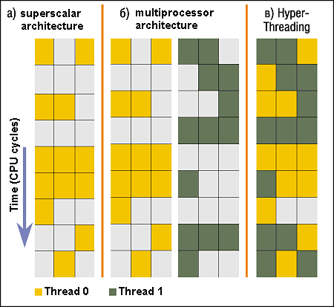
Hardware Parallelism (only for reference)
Triple issue SS arch
Hardware technique
Superscalar processors can execute multiple instructions that are independent.
Hyper-threading duplicates register state to make a second “thread,” allowing more instructions to run.
Can schedule each thread as if were separate CPU
But, sub-linear speedup!
Original technique called “Simultaneous Multithreading”
See http://www.cs.washington.edu/research/smt/index.html
SPARC, Pentium 4/Xeon (“Hyperthreading”), Power 5
P0
P1
Colored blocks show instructions executed

Slide 18
Putting it together: Hyper-Threading
Process 1
Process N
threads
threads
Switch overhead between hardware-threads: very-low (done in hardware)
Contention for ALUs/FPUs may hurt performance
Mem.
Mem.
…
IO
state
…
…
IO
state
CPU
state
CPU
state
CPU
state
CPU
state
CPU sched.
OS
hardware-threads
(hyperthreading)
8 threads at a time
core 1
core 2
core 3
core 4
CPU

Slide 19
Thread Abstraction
Infinite number of processors
Threads execute with variable speed
Programs must be designed to work with any schedule
Notes:
Execution model: each thread runs on a dedicated virtual processor with unpredictable and variable speed.

Slide 20
Programmer vs. Processor View

Slide 21
Possible Executions

Slide 22
ATM Bank Server
ATM server problem:
Service a set of requests
Do so without corrupting database
Don’t hand out too much money

Slide 23
ATM bank server example
Suppose we wanted to implement a server process to handle requests from an ATM network:
BankServer() { while (TRUE) { ReceiveRequest(&op, &acctId, &amount); ProcessRequest(op, acctId, amount); } }
ProcessRequest(op, acctId, amount) { if (op == deposit) Deposit(acctId, amount); else if … }
Deposit(acctId, amount) { acct = GetAccount(acctId); /* may use disk I/O */ acct->balance += amount; StoreAccount(acct); /* Involves disk I/O */ }
How could we speed this up?
More than one request being processed at once
Multiple threads (multi-proc, or overlap comp and I/O)

Slide 24
Can Threads Help?
One thread per request!
Requests proceed to completion, blocking as required:
Deposit(acctId, amount) { acct = GetAccount(actId); /* May use disk I/O */ acct->balance += amount; StoreAccount(acct); /* Involves disk I/O */ }

Slide 25
Can Threads Help?
Unfortunately, shared state can get corrupted: Thread 1 Thread 2 load r1, acct->balance load r1, acct->balance add r1, amount2 store r1,acct->balance add r1, amount1 store r1, acct->balance

Slide 26
Problem is at the lowest level
Most of the time, threads are working on separate data, so scheduling doesn’t matter:
Thread A Thread B
x = 1; y = 2;
However, What about (Initially, y = 12):
Thread A Thread B
x = 1; y = 2;
x = y+1; y = y*2;
What are the possible values of x?
Thread A Thread B
x = 1;
x = y+1;
y = 2;
y = y*2
x=13
Notes:
X could be (13, 5, 3)

Slide 27
Problem is at the lowest level
Most of the time, threads are working on separate data, so scheduling doesn’t matter:
Thread A Thread B
x = 1; y = 2;
However, What about (Initially, y = 12):
Thread A Thread B
x = 1; y = 2;
x = y+1; y = y*2;
What are the possible values of x?
Thread A Thread B
y = 2;
y = y*2;
x = 1;
x = y+1;
x=5
Notes:
X could be (13, 5, 3)

Slide 28
Problem is at the lowest level
Most of the time, threads are working on separate data, so scheduling doesn’t matter:
Thread A Thread B
x = 1; y = 2;
However, What about (Initially, y = 12):
Thread A Thread B
x = 1; y = 2;
x = y+1; y = y*2;
What are the possible values of x?
Thread A Thread B
y = 2;
x = 1;
x = y+1;
y= y*2;
x=3
Notes:
X could be (13, 5, 3)

Slide 29
Thread Operations API
thread_create(thread, func, args)
Create a new thread to run func(args)
Analogous to UNIX process fork and exec
thread_yield()
Relinquish processor voluntarily
thread_join(thread)
In parent, wait for forked thread to exit, then return
Analogous to UNIX process wait
thread_exit
Quit thread and clean up, wake up joiner if any
Notes:
Thread API is based on the POSIX standard Pthreads API
Thread API provides a way to invoke an asynchronous procedure call. A synchronous procedure call will pass a set of arguments to a function, run the function immediately on the caller’s stack and then return control back to the caller when the function is complete. An asynchronous procedure call separates the call from the return: with thread_create, the caller starts the function, but unlike the synchronous procedure call, the caller will go on to execute concurrently with the called function. Later the caller can wait for the function completion.

Slide 30
Example: threadhello
#define NTHREADS 10
thread_t threads[NTHREADS];
main() {
for (i = 0; i < NTHREADS; i++) thread_create(&threads[i], &go, i);
for (i = 0; i < NTHREADS; i++) {
exitValue = thread_join(threads[i]);
printf("Thread %d returned with %ld\n", i, exitValue);
}
printf("Main thread done.\n");
}
void go (int n) {
printf("Hello from thread %d\n", n);
thread_exit(100 + n);
// REACHED?
}

Slide 31
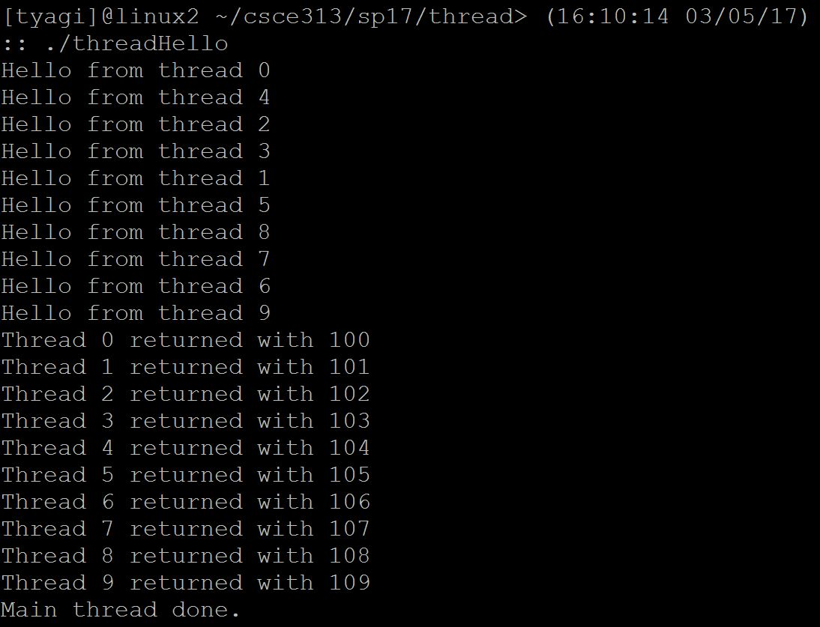
threadhello – Example Output

Slide 32
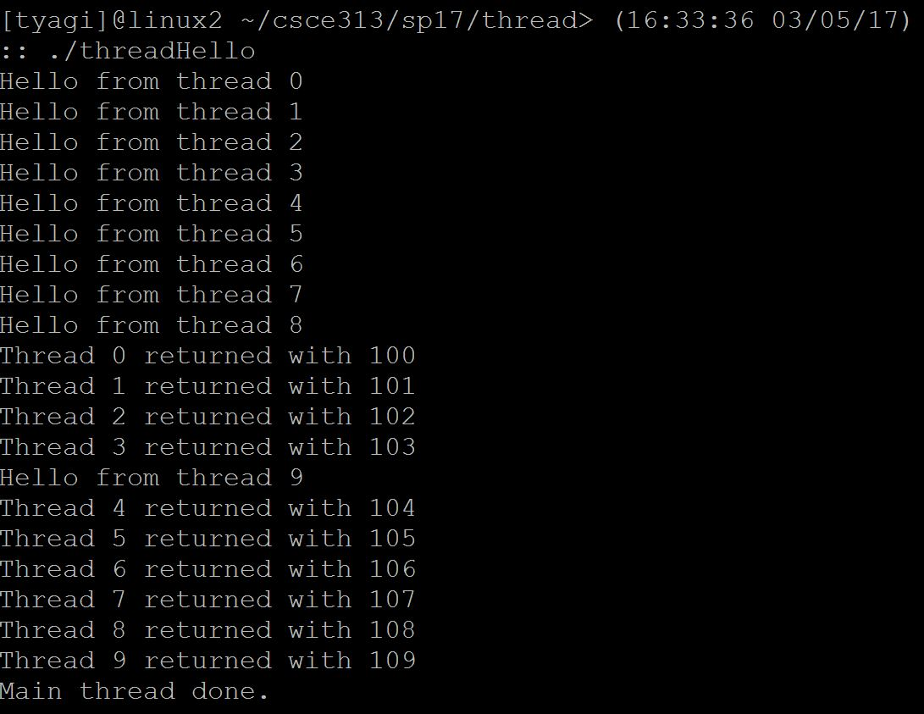
threadhello – Example Output

Slide 33
threadhello: Example Output
Why might the “Hello” message from thread 2 print after the “Hello” message from thread 5 even though thread 5 was created after thread 2?
Why must “thread returned” print in order?
What is maximum # of threads that could exist when thread 5 prints hello?
Minimum?
Notes:
Why might the “Hello” message from thread 2 print after the “Hello” message from thread 5 even though thread 5 was created after thread 2?
Answer: Because the creation of thread is independent from scheduling
Why must “thread returned” print in order?
Answer: Because the main thread checks for thread completion in the order they were created. It calls thread_join for thread i+1 only after thread_join for i has returned
What is maximum # of threads that could exist when thread 5 prints hello?
Answer: 11 (main + 10)
Minimum?
Answer: 2. Because all the created threads could have run and completed before thread 5 prints “Hello”

Slide 34
Fork/Join Concurrency
Threads can create children, and wait for their completion
Data only shared before fork (from parent) and after join (from child)
Examples:
Web server: fork a new thread for every new connection
As long as the threads are completely independent
Merge sort
Parallel memory copy

Slide 35
bzero with fork/join concurrency
void blockzero (unsigned char *p, int length) {
int i, j;
thread_t threads[NTHREADS];
struct bzeroparams params[NTHREADS];
// For simplicity, assumes length is divisible by NTHREADS.
for (i = 0, j = 0; i < NTHREADS; i++, j += length/NTHREADS) {
params[i].buffer = p + i * length/NTHREADS;
params[i].length = length/NTHREADS;
thread_create_p(&(threads[i]), &go, &params[i]);
}
for (i = 0; i < NTHREADS; i++) {
thread_join(threads[i]);
}
}
Notes:
This example shows a procedure to zero a contiguous block of memory. To prevent unintentional data leakage, whenever a process exits, the operating system must zero the memory that had been allocated to the existing process. Otherwise a new process may be re-assigned that memory enabling it to read potentially sensitive data. For example, an OS’s remote login procedure could temporarily store a user password in memory, but the next process to use the same physical memory might be a memory scanning program launched by a malicious user.
Parallelizing a memory zeroing program makes sense and we can do so with threads. (1GB of memory zero can take 50 milisec whereas creating and starting a new thread can take tens of micro seconds).
In the block zero code, we can spawn off threads assigned to zero contiguous blocks of memory. The region is empty when all threads have completed their work. In practice, a block zero thread can be run in the background and when the specific memory region is needed it can be executed with a join to the block zero thread so it will be allowed to proceed only when the block zero is accomplished.

Slide 36
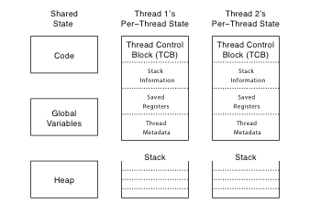
Thread Data Structures
Notes:
Thread Stack stores information needed by the nested procedures the thread is currently running. The registers can be stored in the TCB or in thread stack.
Thread metadata – eg. Threadid, scheduling priority and status.
How large should a stack be allocated to each thread? Kernel threads are all managed in memory therefore the memory there is in premium; typically 8KB for kernel thread stacks.
Shared State: program code although each thread may be executing at a different place. Additionally statically created global variables and dynamically allocated heap variables can store information that is accessible to all threads.

Slide 37
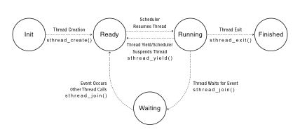
Thread Lifecycle
Notes:
Labels should be thread_create() not sthread_create, etc.

Slide 38
Location of per thread state for different life cycle
State of Thread | Location of TCB | Location of Thread Registers
INIT | Being created | TCB
READY | Ready Queue | TCB
RUNNING | Running Queue (may be single or multiple) | CPU
WAITING | Synch Variable Waiting List | TCB
FINISHED | Finished Queue and then deleted | TCB or deleted

Slide 39
Discussion
Question1: For the threadhello program, when thread_join returns for thread i, what is thread i’s thread state?
Question2: For the threadhello program, what is the minimum and maximum number of times that the main thread enters the READY state on a Uniprocessor?
Notes:
Answer1: Finished State
Answer2:
Minimum: the main thread must first be in ready state at creation. On a uniprocessor, it must also give up the CPU at least once for its kids to finish. So the minimum number is 2
Maximum: Can be infinite (practically) since it can be context switched in or out between itself and its kids

Slide 40
Implementing Threads
Kernel-level threads
Thread abstraction only available to kernel
To the kernel, a kernel thread and a single threaded user process look quite similar
Multithreaded processes using kernel threads (Linux, MacOS)
Kernel thread operations available via syscall
User-level threads
Thread operations without system calls (for efficiency purposes, the common cases can be offered as a library which can then be operated without kernel’s help)

Slide 41
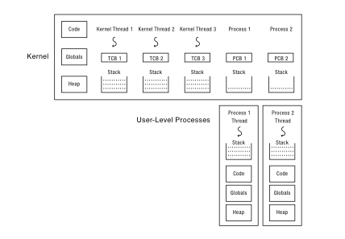
Multithreaded OS Kernel
Notes:
Each user process has a stack at the uder-level for executing user code and a kernel interrupt stack for executing interrupts and system calls

Slide 42
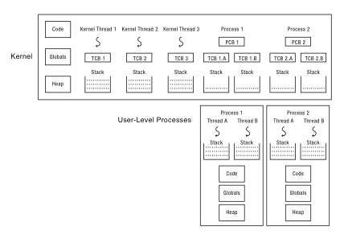
Multithreaded User Processes

Slide 43
Implementing threads
Thread_create(func, args)
Allocate thread control block
Allocate stack
Build stack frame for base of stack (stub)
Put func, args on stack
Put thread on ready list
Will run sometime later (maybe right away!)
stub(func, args):
Call (*func)(args)
If return, call thread_exit()

Slide 44
Thread Stack
What if a thread puts too many procedures on its stack?
What happens in Java?
What happens in the Linux kernel?
What should happen?

Slide 45
Thread Context Switch
Voluntary
Thread_yield
Thread_join (if child is not done yet)
Involuntary
Interrupt or exception
Some other thread is higher priority

Slide 46
Multithreaded User Processes (Take 1)
User thread = kernel thread (Linux, MacOS)
System calls for thread fork, join, exit (and lock, unlock,…)
Kernel does context switch
Simple, but a lot of transitions between user and kernel mode

Slide 47
Multithreaded User Processes (Take 2)
Green threads (early Java)
User-level library, within a single-threaded process
Library does thread context switch
Preemption via upcall/UNIX signal on timer interrupt

Slide 48
Multithreaded User Processes (Take 3)
Scheduler activations (Windows 8)
Kernel allocates processors to user-level library
Thread library implements context switch
Thread library decides what thread to run next
Upcall whenever kernel needs a user-level scheduling decision
Process assigned a new processor
Processor removed from process
System call blocks in kernel

Slide 49
Summary
Threading is great for performance
Threading is tricky and carry hazards!
After Spring Break – we will dive into hazard scenarios and prevention mechanisms
MP 6, 7, 8 will all build upon coding with threads

