Slide 1

AI-Assisted
Quantum Simulation & Modelling using Agentic AI
School of Computer Science and Engineering
Department of Computer Science and Engineering
Submitted By:
Shriya Desai
2427030171
Supervised By:
Dr. Ankit Shrivastava

Slide 2
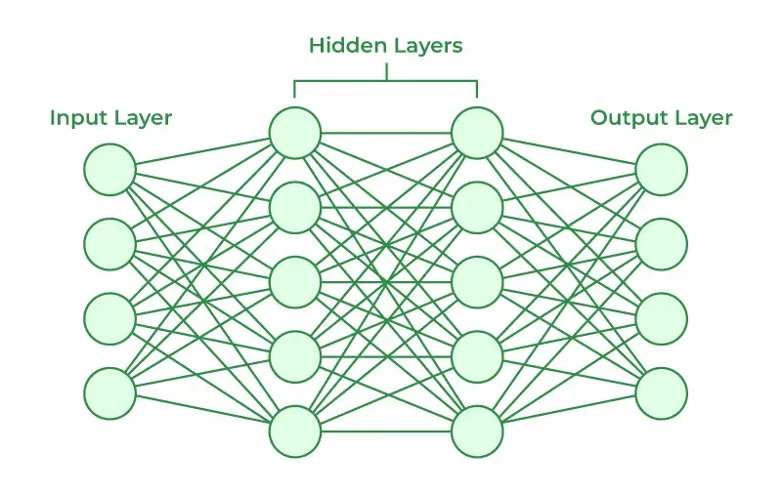
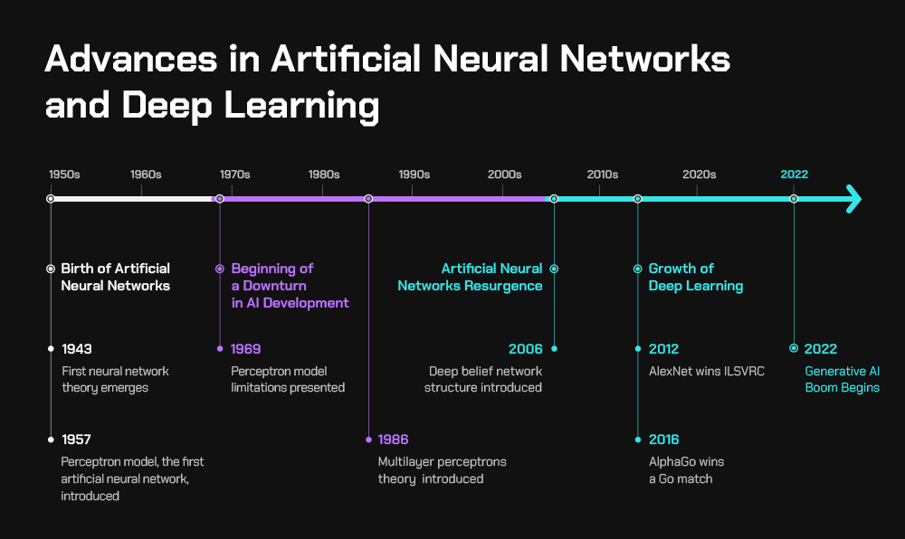
Introduction
*
*
A neural network is like our brain. It has neurons that are connected to each other.
NNs are trained on some existing data and are used to further make predictions based on their learnings.
80% of the data is used for training and 20% of data is used for testing
*1
*2

Slide 3
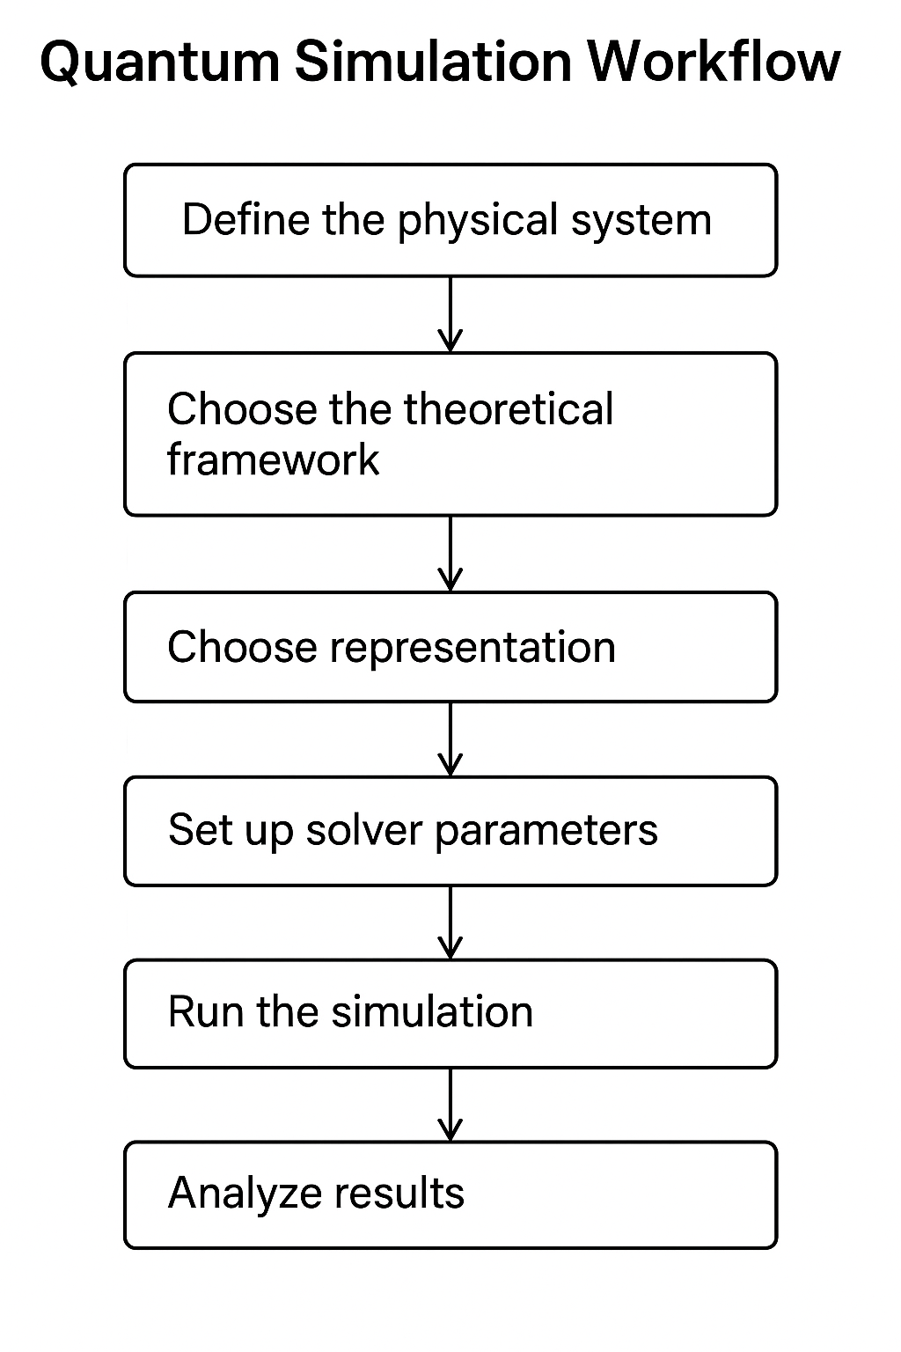
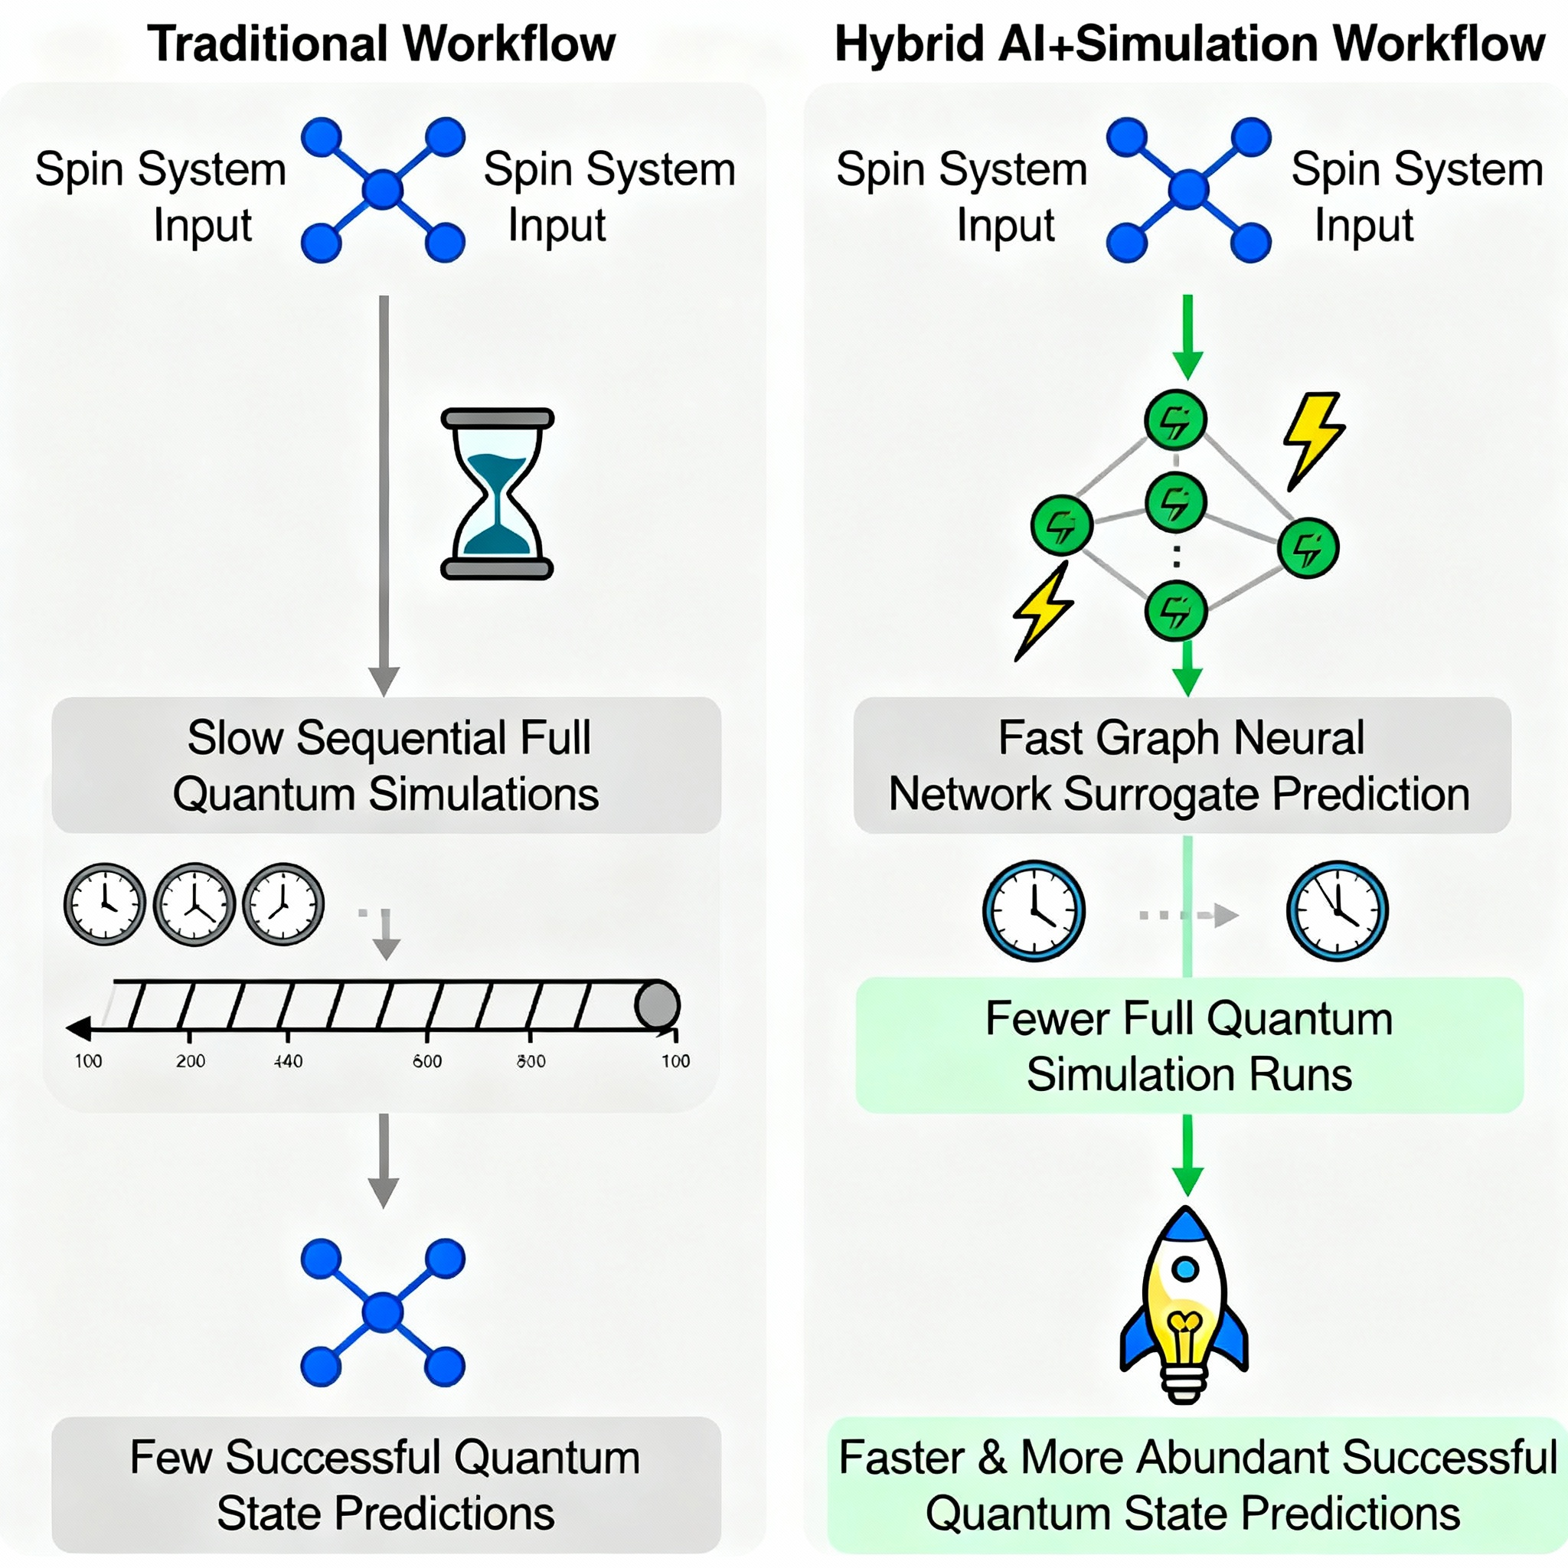
Notes:
Workflow:
What are you simulating?
Which approximation are you using?
How do you want to represent the states/wavefunctions?
How accurate or fast do you want the simulation?
Where?
How?

Slide 4
Research my model builds on
In quantum mechanics, the wavefunction(Ψ) tells us the complete characteristics and behaviour of a quantum system. For a large system containing many particles, this wavefunction is very difficult to computationally calculate.
This is where NNQS comes in. Neural Network Quantum State is an ML surrogate that becomes the model of the quantum state. Instead of calculating Ψ, our NN learns to approximate it.
The first paper that introduced this idea is the *Carleo & Troyer (2017): “Solving the Quantum Many-Body Problem with Artificial Neural Networks”
Another paper describing how Agentic AI helps optimize scientific workflows is the *“Müller et al. (2020): "Revolution of Scientific Workflows in the Agentic AI Era”. It shows how Agentic AI reduces manual effort and hence accelerates discovery.
My model applies both NN surrogates and agentic workflows directly to practical quantum simulation tasks(parameter selection, interpreting outputs, estimating results)
*3
*4

Slide 5
Literature Review
Project/Approach | Pros(carried forward) | Cons(minimized) | My Project's Improvements
El Agente Q(LLM agent), 2025* | Powerful automation via natural language Tool orchestration | LLMs can hallucinate Complex for non-experts | Uses Agentic AI, has simplified guidance
ML Surrogates (Nature 2019) | Fast, accurate predictions of quantum properties ML generalizability | Not integrated with workflows Less user-facing | Integrated into workflow, instant feedback
Design Agents (RL, Innsbruck)* | Adaptive learning | Narrow use case (experiment setup) Not an accessible UI | Broader workflow, interactive UI
SpinQ Quantum AI Lab* | Cutting-edge algorithms | Research/hardware focus Not designed for accessible interaction | Software-first, user-focused
*5,6 *7 *8
Notes:
El Agente Q (LLM agent, 2025):Leveraged large language models to automate quantum chemistry workflows via conversational interaction.
ML Surrogates (Nature 2019):Introduced machine learning-based surrogates for rapid prediction of quantum properties.
Design Agents (RL, Innsbruck):Developed reinforcement learning agents for autonomous quantum experiment design.
SpinQ Quantum AI Lab:Focused on advancing quantum machine learning algorithms and hardware-software integration.

Slide 6
Problem Statement
Choosing correct solver parameters like basis sets, cutoff energies, and time steps is hard and time consuming.
Simulation outputs (logs, energies, spectra) are difficult to interpret.
ML surrogate models are not integrated into scientific workflows.

Slide 7
Proposed Solution
My solution aims to create an Agentic AI solution that guides users through complex quantum simulations by recommending optimal parameters, interpreting simulation outputs in simple language, and providing fast predictions using machine learning surrogates.
This is integrated with a quantum simulation tool and presented via a web dashboard for enhanced user experience.
Notes:
Agentic AI does the following:
Orchestrates the workflow
Decides whether surrogate result is worth simulating
Explains outputs in simple language

Slide 8
Proposed Solution-Phases
Phase 1: Parameter Guidance
  Build agent flows to recommend simulation settings based on user inputs.
Phase 2: ML Surrogate Integration
  Train and deploy surrogate ML models for rapid prediction of key quantum results.
  Connect surrogate predictions seamlessly with ongoing simulations for real-time feedback.
Phase 3: Simulation Toolkit Connectivity
  Enable backend connection to major quantum simulation packages like QuTiP
  Ensure smooth data exchange and workflow orchestration across tools.
Phase 4: User Interface & Experience
  Parse simulation outputs and present plain-language summaries.
  Build a user-friendly web dashboard displaying simulation status, outputs, and surrogate insights.
Notes:
Prospective Agentic AI:
Salesforce Agentforce
AWS Strands
Databricks Agentbricks
CrewAI
Beam AI

Slide 9
Objectives
Develop foundational skills in AI & ML through hands-on model building, deployment, and testing.
Gain practical exposure to quantum simulation techniques and learn how modern AI models (especially neural networks) can accelerate quantum research.
Learn how to integrate agentic AI tools (such as Salesforce Agentforce) into complex scientific workflows.
Acquire end-to-end project execution skills, from research and design to technology selection and implementation.

Slide 10
Comparitive Study
Reference / Approach | Automation | Accessibility | Surrogate ML | Parameter Guidance | Output Interpretation | Workflow Integration | Scalability
El Agente Q (LLM agent, 2025) | Yes | Moderate | No | Partial | Yes | Multi-tool | Yes
ML Surrogates (Nature 2019) | No | Low | Yes | No | No | Poor | Yes
Design Agents (RL, Innsbruck) | Partial | Low | No | No | No | Narrow | Yes
SpinQ Quantum AI Lab | No | Low | Yes | No | No | Poor | Yes
PySCF, ESPRESSO, Qiskit, QuTiP | No | Moderate | Limited | No | No | Strong (core only) | Moderate
SmartChem | Yes | High | Yes | Yes | Partial | Moderate | Yes
Google Ferminet | No | Low | Yes | No | No | Poor | Yes
Quantum Surrogate Benchmarks | No | Low | Yes | No | No | Poor | Yes
Proposed Solution | Yes | High | Yes | Yes | Yes | Full | Yes

Slide 11
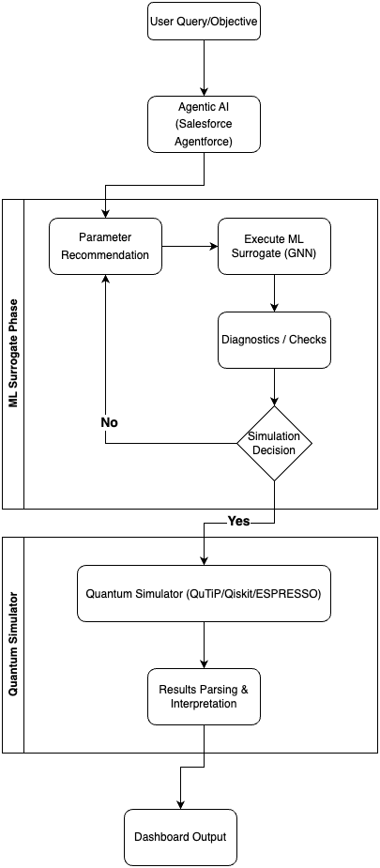
Project Workflow

Slide 12
Technology Selection
Component | Options Evaluated | Final Choice | Reasoning
Quantum Simulation | QuTiP, Qiskit, ESPRESSO | QuTiP & Qiskit | Python-integrated, flexible, scalable
ML Framework | PyTorch, Tensorflow, scikit-learn | PyTorch Geometric | GNN support, community, performance
Agentic Platform | Salesforce, Rasa, Botpress | Salesforce Agentforce | Enterprise-grade, easy UI integration
Database | PostgreSQL, MySQL, MongoDB | PostgreSQL | Structured modeling, reliability
API/Backend | Flask, FastAPI | Flask | Lightweight, easy setup
Dashboard | Salesforce Lightning, React | Salesforce Lightning | Seamless with Agentforce

Slide 13

ML Selection Rationale
Graph Representation of Quantum Systems:
Each quantum system (e.g., molecule, spin chain) encoded as a graph:
  Nodes: Atoms (features: element type, charge, quantum state)
  Edges: Bonds/interactions (features: bond type, distance, coupling constant)
So, while simpler models (Linear, MLP, SVM) provide rapid prototyping and interpretability, they are fundamentally limited in capturing the highly-interconnected, non-linear relationships present in quantum systems, especially molecules, crystals, or spin networks, which are naturally represented as graphs. GNNs, with their ability to process node and edge features, update representations via message passing, and perform efficient pooling/readout for graph-level prediction, have proven superior for this scientific context.
Training & Evaluation:
Data: Used publicly available quantum datasets (e.g., QM9) representing molecular graphs with labeled properties.
Metrics: Evaluated mean absolute error (MAE), root mean squared error (RMSE), and calibration of uncertainty estimates.
Iteration: Compared results with baseline MLPs, confirming substantial improvements for GNNs on graph-structured quantum data.
Deployment:
Integrated trained GNN model into Flask backend as /surrogate_predict endpoint.
Enabled real-time predictions for user-defined quantum systems/scenarios, displayed on dashboard and agentic interface.

Slide 14
Surrogate Model Training using public Quantum Datasets
Dataset Name | Size | Features / Properties | Quantum Use Cases
QM9 | ~134,000 molecules | 19 quantum properties (energy, HOMO/LUMO, dipole, polarizability, etc.) | Small molecule property prediction, screening, generative modeling, quantum chemistry GNN benchmarking
QM7 & QM7b | ~7,000 molecules (QM7), ~7,200 (QM7b) | Atomization energies, geometric and electronic properties | Fast regression/prototype studies, benchmarking ML architectures
QMugs | ~665,000 molecules | Quantum mechanical descriptors for pharmacologically relevant compounds | Drug discovery, property prediction in bio-chemistry
QM40 | ~163,000 compounds | Quantum properties from ZINC database | High-throughput materials screening
QCDGE | ~450,000 molecules | Ground and excited state properties | Excited state ML, spectroscopy modelling
BDE-db | ~200,000 radicals | Bond dissociation energies, quantum descriptors | Radical chemistry, reaction modeling
tmQM | ~86,000 transition metal complexes | Quantum properties, coordination geometries | Transition metal and catalyst modeling
QCML | ~14.7 billion entries (semi-empirical), 33.5 million DFT | Energies, forces, multipole moments, wavefunctions | General quantum property ML, force field generation, molecular dynamics
QDataSet | 52 one-/two-qubit systems, 10,000 samples per set | State vectors, Hamiltonians, measurement distributions, noise/pulse data | Quantum control, quantum tomography, noise spectroscopy, gate errors

Slide 15
Implementation in the Prototype
By selecting a dataset, our GNN model is trained to predict a wide range of molecular quantum properties. The training process involves:
Step 1: Loading the dataset
Step 2: Constructing graph representations for each molecule (nodes = atoms with features; edges = bonds/interactions).
Step 3: Building and training the GNN, validating accuracy on held-out molecular structures.
Step 4: Deploying the trained surrogate model as a backend API, enabling instant property prediction as a part of the conversational agent workflow.
Step 5: If possible, testing the model’s capability for other for broader use cases, and benchmarking against traditional simulation outputs.

Slide 16
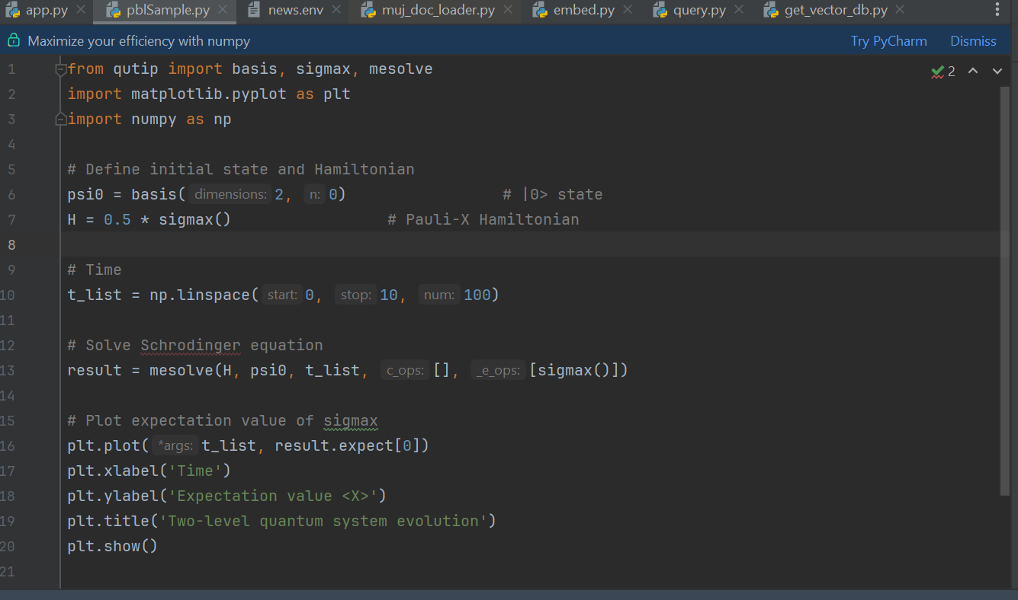
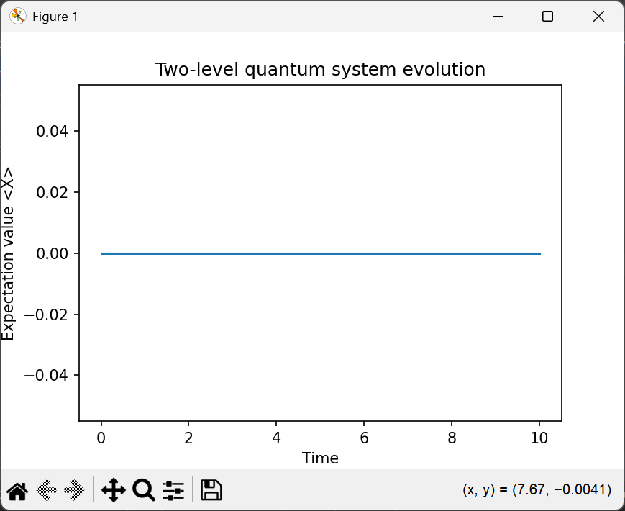
Screenshot of sample code

Slide 17
References
https://www.geeksforgeeks.org/machine-learning/neural-networks-a-beginners-guide/
https://news.skhynix.com/all-about-ai-the-origins-evolution-future-of-ai/
Carleo, G., & Troyer, M. (2017). Solving the quantum many-body problem with artificial neural networks. Science, 355(6325), 602-606.
https://doi.org/10.48550/arXiv.2509.09915
https://elagente.ca/
https://www.cell.com/matter/fulltext/S2590-2385(25)00306-6
https://www.uibk.ac.at/en/th-physik/qic-group/research/ai-and-science/
https://www.spinquanta.com/news-detail/spinq-quantum-artificial-intelligence-lab-research-project-overview
https://medium.com/@mihir473/simulating-quantum-systems-with-qutip-a-deep-dive-c3daf829b05f

Slide 18
Thank You

