Slide 1
Group - 4
Moniruzzaman Joy
ID – 17.02.04.067
Sadman Jahin
ID – 17.02.04.115
Arman Sharker
ID – 17.02.04.116

Slide 2

Story Line :
A "Feluda" story based on the novel of Satyajit Roy by the same name, where still amateur detective Feluda attempts to solve the mysterious disappearance of a very costly and historic artifact and in the process reveals a series of crimes...
exit
Start game
about
score
menu
instruction

Slide 3

feluda
Start game
Instruction
exit
score
Start game
score
about
instruction
menu
about
exit

Slide 4


feluda
125
exit
Start game
about
score
menu
instruction

Slide 5
Control movement
jump
f
punch
exit
Start game
about
score
instruction
menu
g
fire

Slide 6
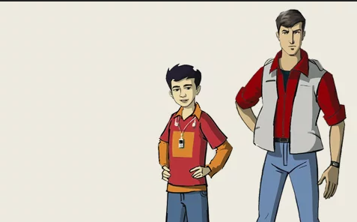
feluda
Name
score
kashem
125
abul
10
exit
Start game
about
score
menu
instruction

Slide 7

feluda
Our story……………
exit
about
Start game
score
menu
instruction

Slide 8

exit
Start game
about
score
menu
instruction

Slide 9


17.02.04.067
A
Menu, Score, Movement
17.02.04.115
B
Work distributions
Control, Movement, Collision
C
Illustration, Control
17.02.04.116

Slide 10

Structure
A
Character
File operations
B
Store Score, High Score
scope
C
Menu, Score, Picture, Character, Level
Header file

