Slide 1
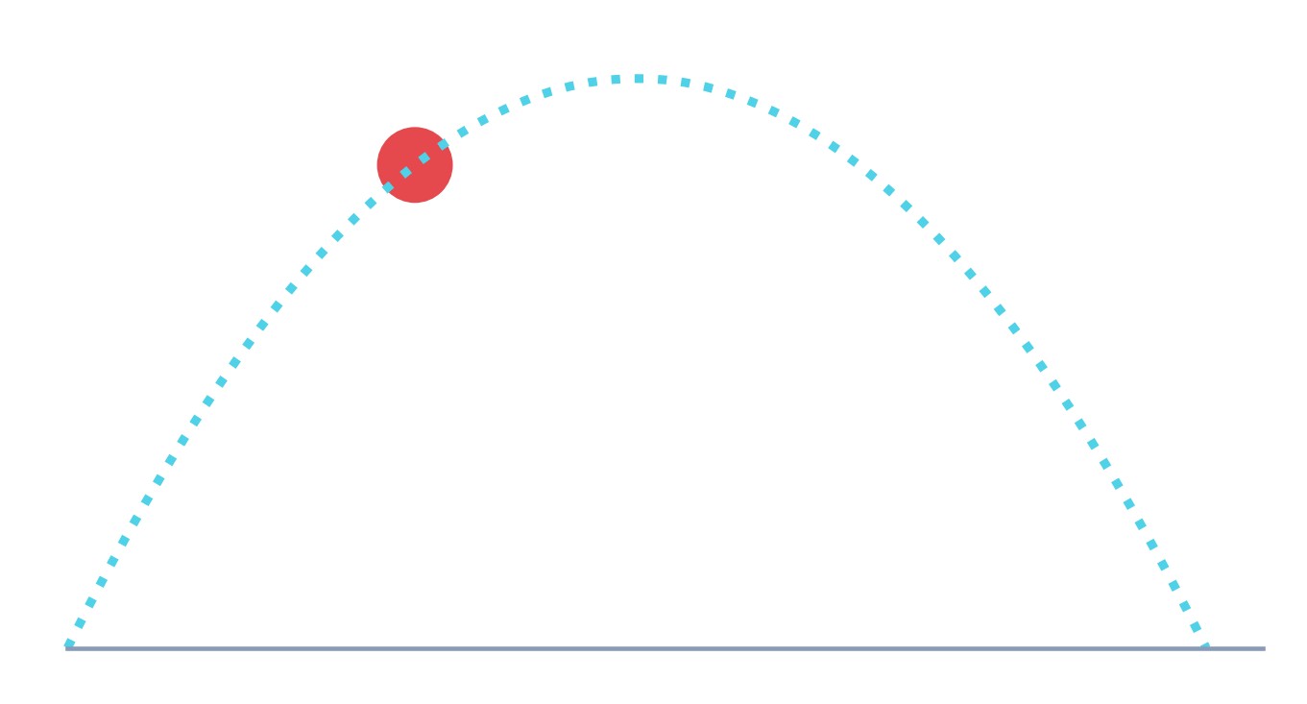
SIET · Guest lecture
From Equation to World Models
AI and the Simulation of Physics
Balaji Muthusubramanian
Notes:
Today we will follow one simple question from Isaac Newton all the way to the AI 'world models' being built in 2025 and 2026. Along the way we'll see that the mathematics hardly changes: vectors, tensors and calculus.

Slide 2
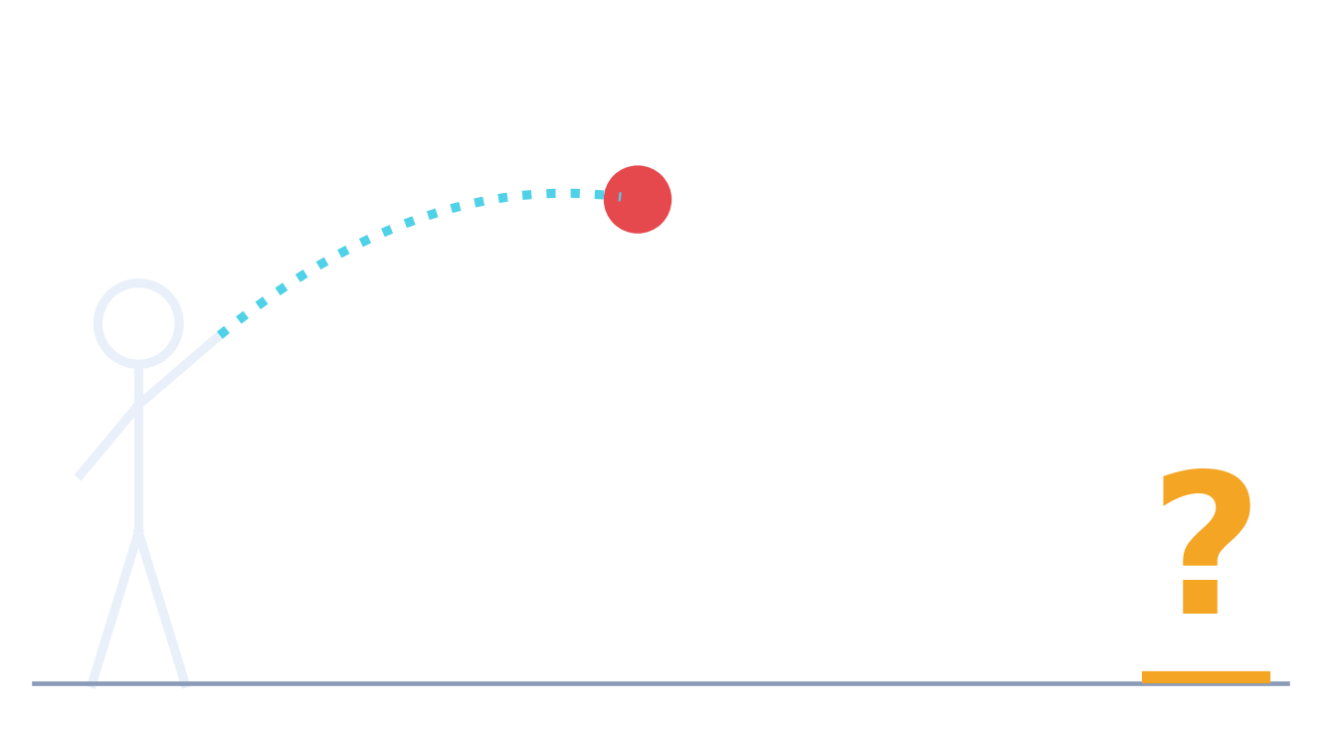
LET'S START WITH A QUESTION
Where will this ball land?
Notes:
Ask the audience and take a few answers. Everyone can answer it roughly, and a child can catch a ball without knowing a single equation. Keep that child in mind; we will come back to them at the end.

Slide 3
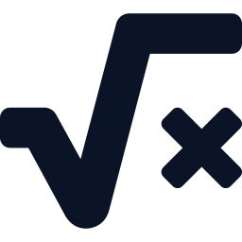


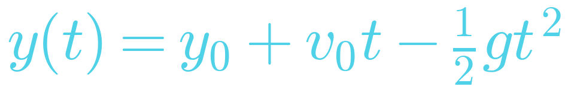
THE ROADMAP
Three ways to answer it
1 · Write the law
2 · Learn from data
3 · Learn by watching
Newton, 1687
Machine learning
World models, 2025
Watch 1,000 throws.
Fit a pattern.
Watch video of the world.
Build intuition.
This talk moves from 1 to 3, and shows where they meet.
Notes:
Physics has lived in column 1 for over 300 years: find the law, then calculate. AI started in column 2: find patterns in data. The most exciting work today mixes the two, and world models aim for column 3, which is how a child catches the ball. This is the map for the rest of the talk.

Slide 4
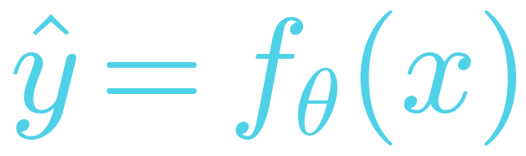
PART 1 · WHAT IS AI, MATHEMATICALLY?
AI is a function learned from data
f θ
x
state now
ŷ
state later
x what you know: the ball's position now
ŷ what you want: its position later
θ the adjustable numbers the machine learns
Notes:
Forget the hype. An AI model is a function with adjustable knobs, called theta. Large language models have hundreds of billions of knobs; the network in our first demo has about two thousand. Learning means turning those knobs.

Slide 5
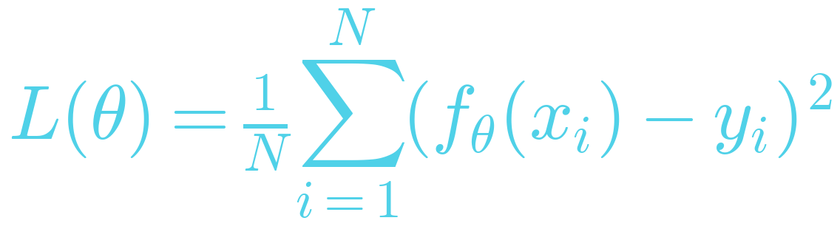
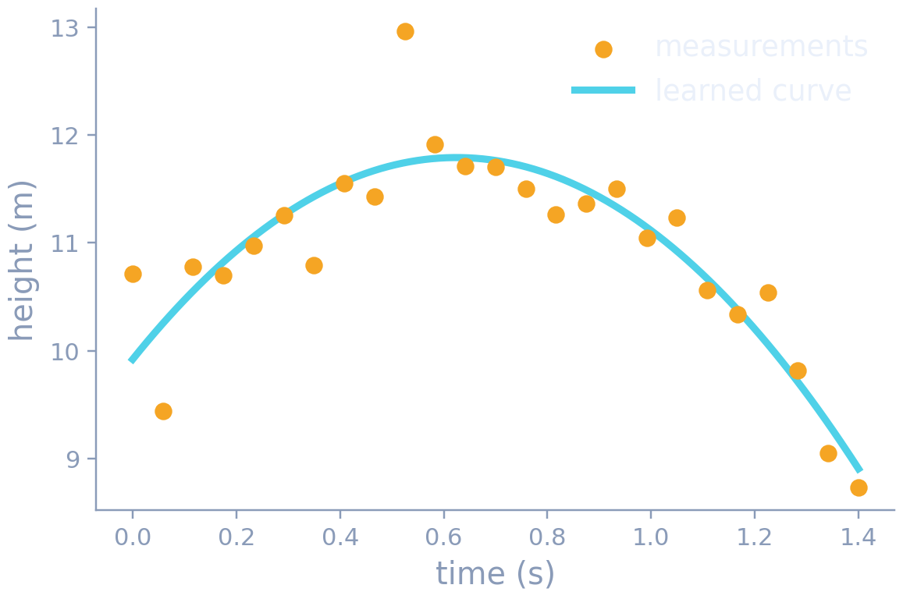
PART 1 · WHAT IS AI, MATHEMATICALLY?
Learning is statistics
Find the θ that makes the average squared error as small as possible: least squares.
Linear regression is the simplest AI.
Notes:
Here are noisy measurements of a ball's height. Fitting a curve through them is exactly what a neural network does, just with far more parameters and far more complicated curves. It is the same least-squares idea from a first statistics course.

Slide 6
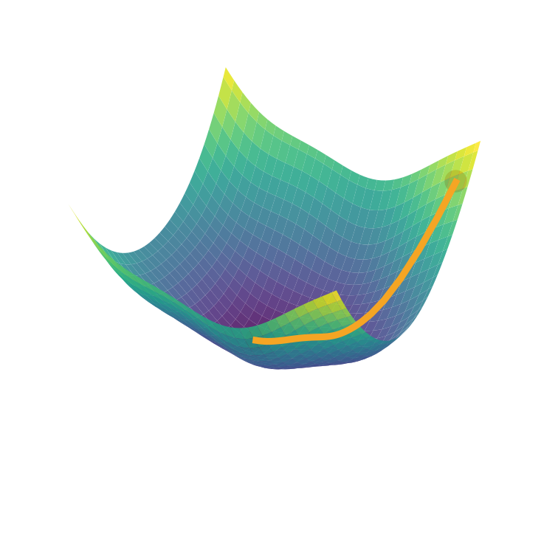
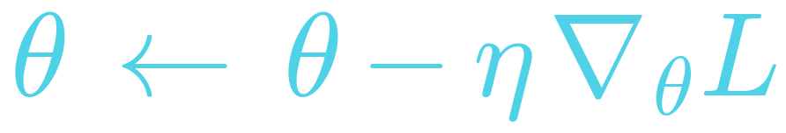
PART 1 · WHAT IS AI, MATHEMATICALLY?
Learning is calculus
Take a small step downhill on the error surface.
The slope ∇L for billions of parameters comes from the chain rule: backpropagation.
PyTorch does it automatically (autograd).
Notes:
To improve, we go downhill on the error surface. Working out which way is downhill for billions of parameters is just the chain rule applied over and over, which is called backpropagation. We will use this same automatic differentiation in Demo 1 to take derivatives with respect to time.

Slide 7
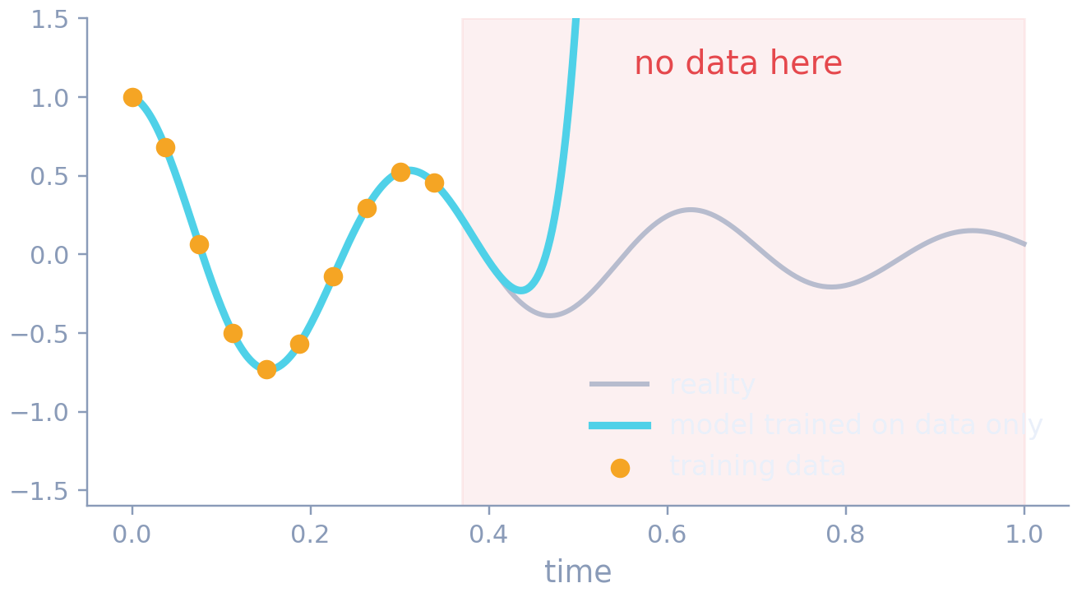
PART 1 · WHAT IS AI, MATHEMATICALLY?
The catch
Data alone doesn't know the laws of nature.
A model can fit every data point perfectly and still predict nonsense where it has no data.
Notes:
This is the central weakness of pure machine learning. Outside the data it has seen, the network can do anything. Hold on to this; putting physics back into the model is how we will fix it.

Slide 8
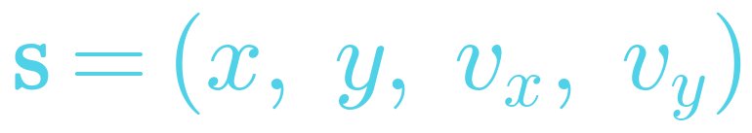
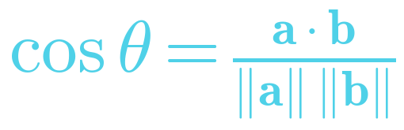
PART 2 · THE LANGUAGE: VECTORS AND TENSORS
Everything becomes a vector
PHYSICS: the state of the ball
AI: an embedding
A word, a pixel patch, a sensor reading → a list of ~1,000 numbers
Similarity is a dot product
Vectors that point the same way mean similar things.
Notes:
Physicists already describe a system by its state vector: position and velocity. AI does the same for everything, even words and images. Once things are vectors, 'how similar are these two?' becomes a dot product, the same one you learned in school.

Slide 9
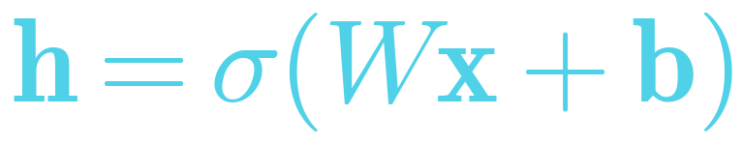
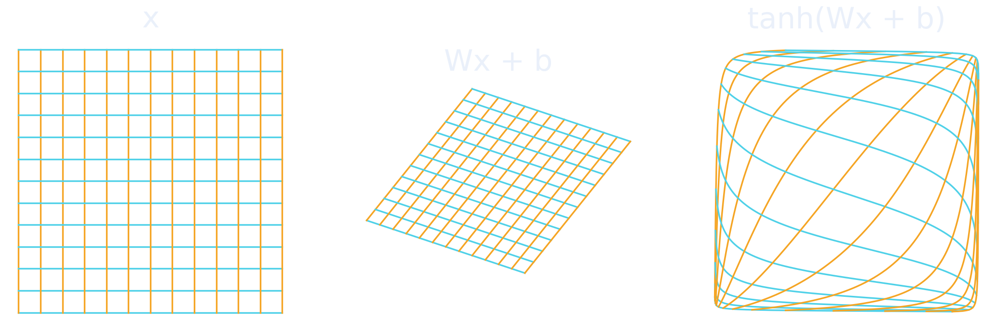
PART 2 · THE LANGUAGE: VECTORS AND TENSORS
A neural layer = a matrix + a bend
W rotates, stretches and shears space. σ bends it. Stack layers → bend space into any shape you need.
Notes:
Left: a square grid. Middle: after multiplying by a matrix W and adding b, the grid is sheared and rotated, but the lines are still straight. Right: after the tanh nonlinearity, space is bent. A deep network is many of these bends stacked together. That's all it is.

Slide 10
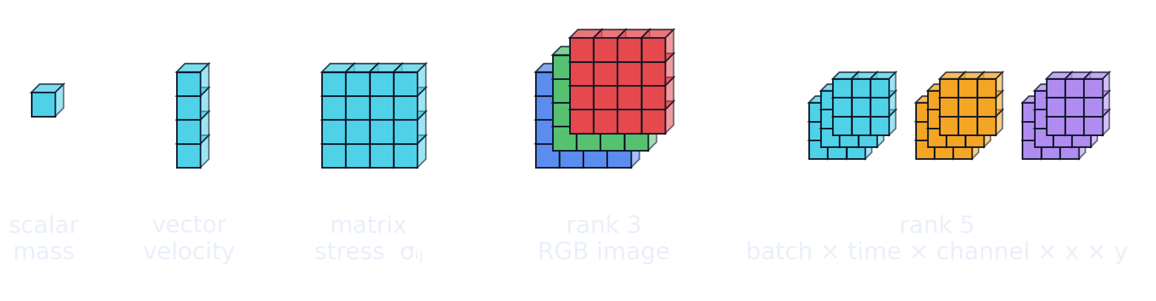
PART 2 · THE LANGUAGE: VECTORS AND TENSORS
Tensors: from a scalar to a video
A 16-frame video clip = a tensor of shape 16 × 3 × 256 × 256 ≈ 3.1 million numbers
Notes:
A tensor is just an array with more indices. Mass is a scalar, velocity a vector, stress a matrix, a colour image a rank-3 tensor, and a batch of fluid simulations a rank-5 tensor. The world model in Demo 3 eats a 16 by 3 by 256 by 256 tensor.

Slide 11
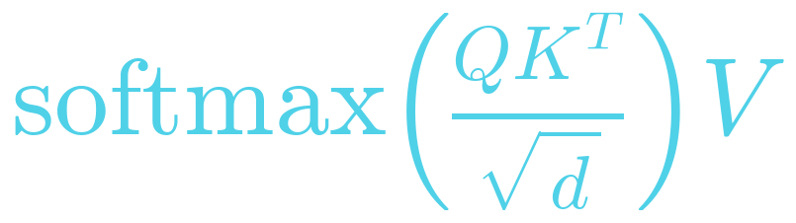
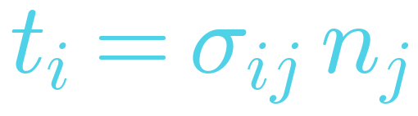
PART 2 · THE LANGUAGE: VECTORS AND TENSORS
Same mathematics for physics and AI
PHYSICS: stress to force
AI: attention in transformers
Einstein summation over j
Who interacts with whom, like forces
Both are tensor contractions. GPUs exist to do them fast.
▶ LIVE DEMO · 1a Tensors in PyTorch
Notes:
The same einsum line computes the traction on a surface and the attention inside ChatGPT or Claude. This is why physicists feel at home in AI. Switch to notebook 1, Part 1: vectors, the grid warp, stress, inertia and attention.

Slide 12
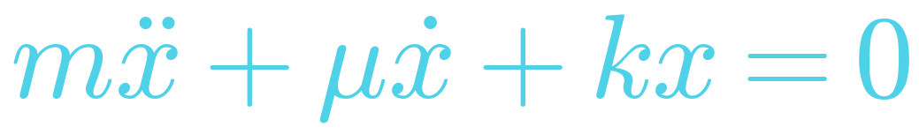
PART 3 · PUTTING PHYSICS INSIDE THE NETWORK
The classical way: simulate the equation
A mass on a spring with friction (Newton's second law)
Discretise time and space into small steps
Solve step by step, very accurately
But large problems (weather, turbulence, plasmas) take hours to days on supercomputers
t0
t1
t2
t3
t4
t5
x(t + Δt) = x(t) + Δt · … repeated millions of times
Notes:
This is column 1 on our map: we know the law, and we crunch numbers. It's accurate and trustworthy, but slow. A single high-resolution weather or turbulence simulation can occupy a supercomputer for hours.

Slide 13
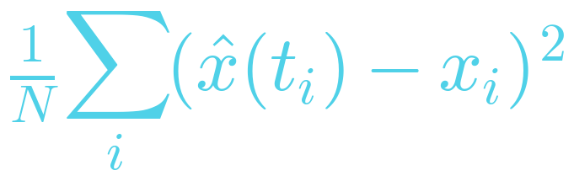
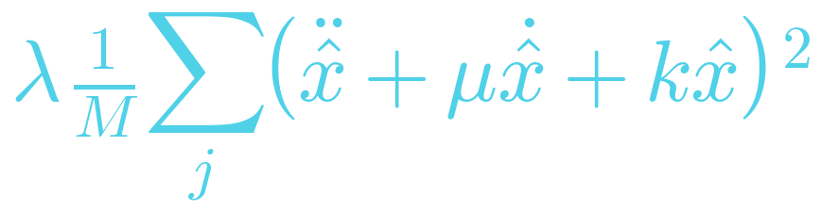
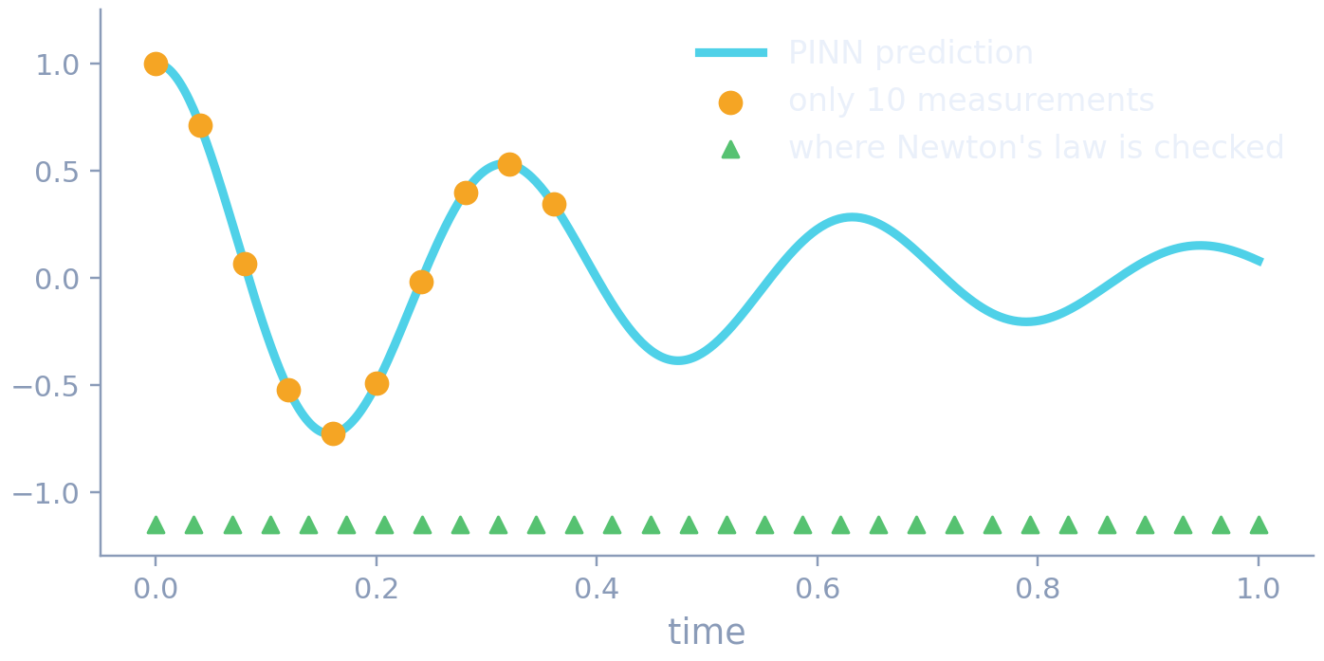
PART 3 · PUTTING PHYSICS INSIDE THE NETWORK
Physics-informed neural networks (PINNs)
L =
+
fit the 10 data points
obey Newton's law everywhere
Autograd gives ẋ and ẍ exactly
10 points → the whole motion
Make μ learnable → it discovers the friction coefficient
▶ LIVE DEMO · 1b PINN + discovering μ
Notes:
We put the law directly into the loss function. The network is punished both for missing the data and for breaking Newton's law. With only ten measurements from the first third of the motion, it predicts the entire oscillation. Then we flip it around: we don't know the friction, we make it a learnable parameter, and gradient descent finds it. Switch to notebook 1, Parts 2 and 3.

Slide 14

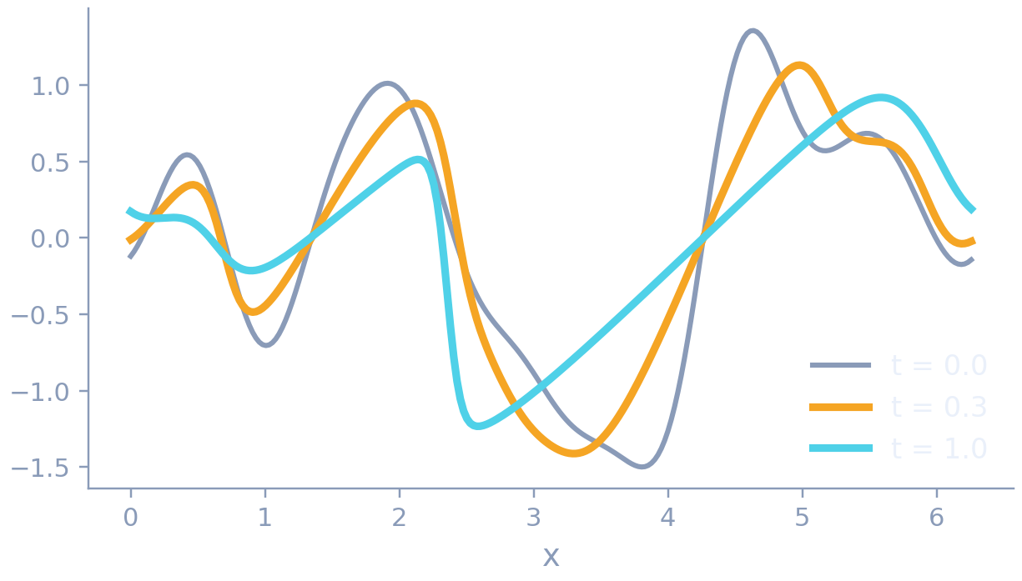
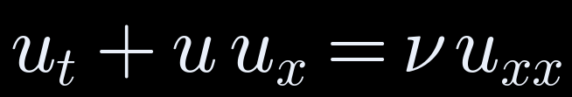
PART 3 · PUTTING PHYSICS INSIDE THE NETWORK
Neural operators: learn the solver itself
u(x, 0)
FFT
× R (learned tensor)
inverse FFT
u(x, T)
Burgers equation: a 1-D cousin of Navier–Stokes
Train once, then predict in milliseconds.
▶ LIVE DEMO · 2 Fourier Neural Operator
Notes:
A PINN solves one problem. A neural operator learns the map from any starting condition to the answer. The Fourier Neural Operator does its learning in frequency space: FFT, multiply the low modes by a learned complex tensor, then transform back. It even works on a finer grid than it was trained on. Switch to notebook 2.

Slide 15
PART 4 · WORLD MODELS
Back to the child catching the ball
No equations.
Just millions of observations.
Can a machine learn physics just by watching video, the way a child does?
Notes:
Column 3. A child has never solved a differential equation, yet predicts where the ball will land. Can we build a machine that learns an internal simulator of the world just by watching?

Slide 16
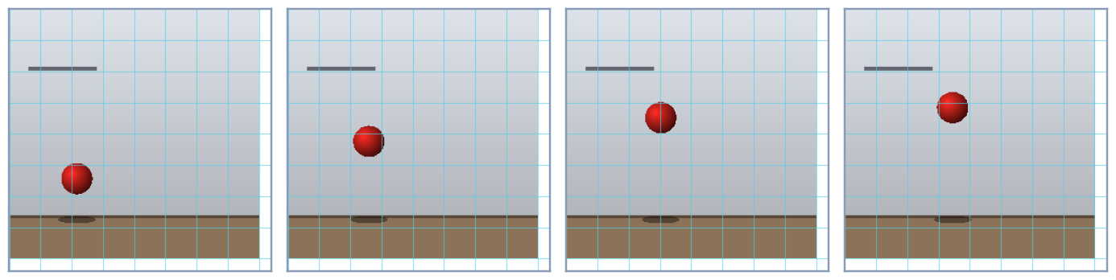
PART 4 · WORLD MODELS · META V-JEPA 2 (2025)
How a world model learns
Encoder
(sees the past)
Predictor
(imagines the future)
video → 16 × 16-pixel patches
Hide the future. Predict its meaning, not its pixels.
16
2,048
1,024
300 M
frames
tokens
numbers per token
parameters
Notes:
V-JEPA 2 was pre-trained by Meta on over a million hours of internet video. The game: hide part of the video and predict the abstract representation of what is hidden, not the pixels. That makes it focus on objects and motion rather than on every leaf and shadow. Under the hood it is the same tensor algebra: patches become vectors, attention mixes them, and the predictor outputs vectors.

Slide 17
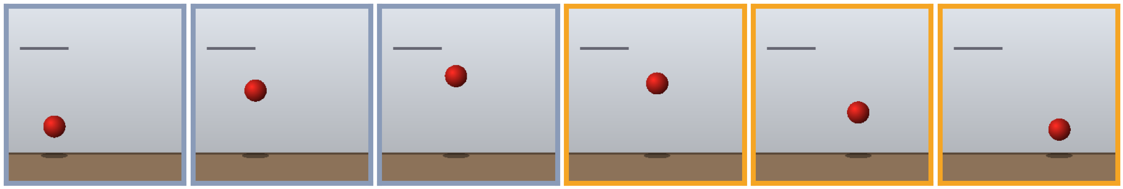


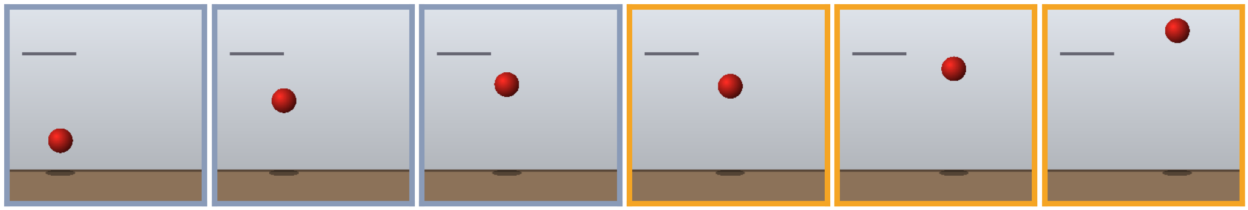
PART 4 · WORLD MODELS
Testing its intuition: surprise
Normal
Surprise = prediction error
Infants stare longer at impossible events.
If the model has learned physics, impossible videos should surprise it more.
Result: live from the notebook →
Teleports
Vanishes
Falls upward
past (grey) → future (amber)
▶ LIVE DEMO · 3 V-JEPA 2 from Hugging Face
Notes:
Developmental psychologists test babies by showing them impossible events; babies look longer when their expectations are broken. We do the same: the encoder sees the first eight frames, the predictor imagines the next eight, and we measure how wrong it was. Switch to notebook 3. If you recorded a video with the audience, run the last cell.

Slide 18
SUMMARY
The journey
1
2
3
4
5
6
Equation
Data
Tensors
PINNs
Operators
World models
Newton
Statistics
The language
Physics + data
Learned solvers
Learned intuition
Each step keeps the mathematics of the one before.
Notes:
We started with a law written by hand and ended with a model that learns intuition from video. The vectors, tensors and calculus stayed the same all the way through.

Slide 19
FRONTIER
Open questions
?
Understanding or imitation?
?
Conservation laws
Does it know physics, or has it memorised what videos look like?
Does it conserve energy and momentum over long predictions?
?
Extrapolation
?
Back to equations
Can it handle situations it has never seen?
Can we extract readable laws from a trained network (symbolic regression)?
Notes:
These are open research problems, and very good ones for the students in this room. Each one is a potential thesis.

Slide 20
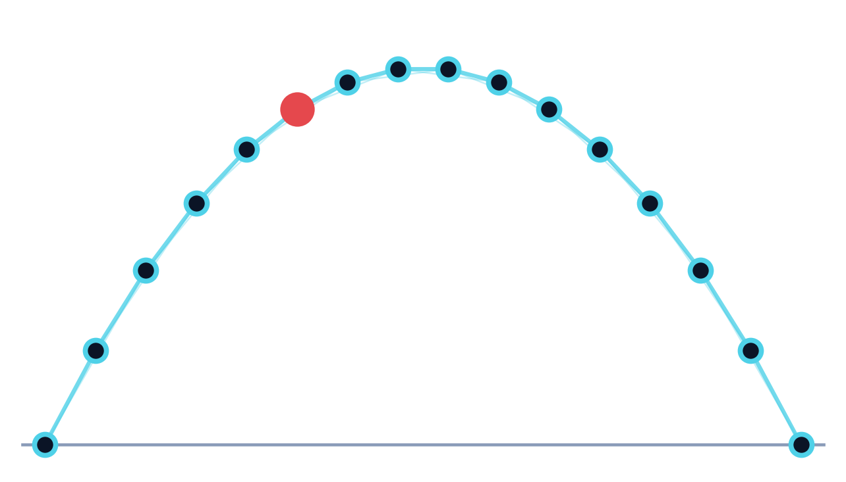
AI doesn't replace physics.
It's a new instrument for exploring it.
Thank you · Questions?
PyTorch · pytorch.org
Hugging Face · facebook/vjepa2-vitl-fpc64-256
Neural operators · neuraloperator.github.io
Polymathic AI · polymathic-ai.org
Balaji Muthusubramanian
Notes:
The ball's path from the first slide, now drawn as a network. Thank the audience and point them to the notebooks and resources.

