Slide 1
Weighing galaxies and finding dark matter
28 Sept 2013
University of Texas at Austin
Brian W. Mulligan

Slide 2
Goals
Why do we think dark matter exists?
Some ideas about what is dark matter.

Slide 3
Rotation Curves
Planetary data from Zeilik & Gregory, Introductory Astronomy & Astrophysics, 4th Ed.

Slide 4
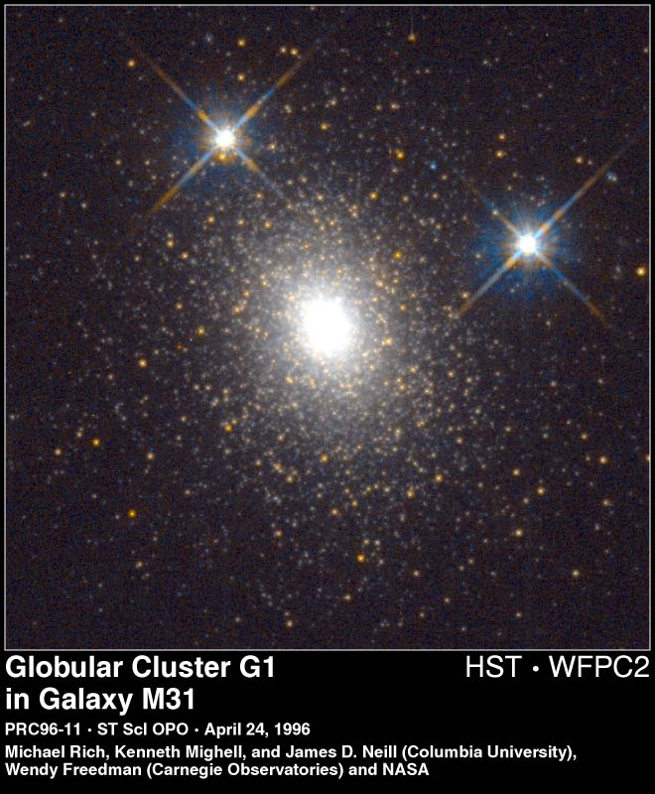
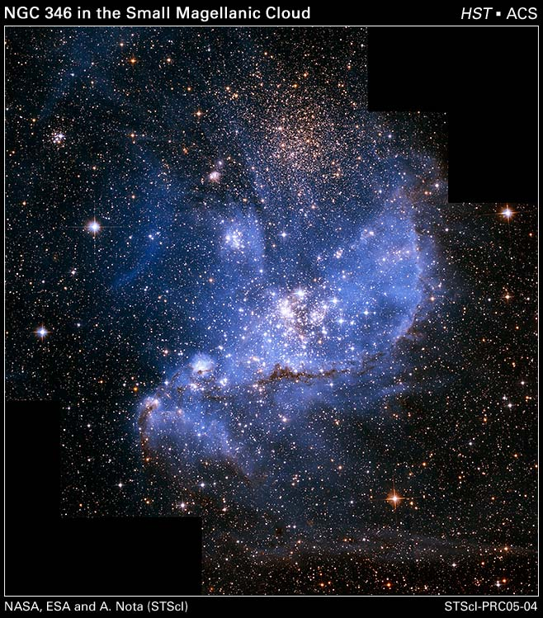
Weigh a cluster of stars

Slide 5
Star clusters: mass, and mass to light ratio
Cluster |  | σ (km/s) | Radius (pc) | Mass (thousands of Suns) | M/L (compared to sun)
NGC 5139 | ω Cen | 20 | 4 | 2600 | 2.5
NGC 104 | 47 Tuc | 11 | 0.5 | 800 | 1.5
NGC 7078 | M15 | 12 | <0.1 | 900 | 2
NGC 6341 | M92 | 5 | 0.5 | 200 | 1
NGC 6121 | M4 | 4 | 0.5 | 60 | 1
 | Pal 13 | ~0.8 | 1.7 | 3 | 3-7
NGC 1049 | Fornax 3 | 9 | 1.6 | 400 | ~3
 | Pleiades | 0.5 | 3 | 0.8 | 0.2
From “Galaxies in the Universe”, 2nd Ed., Sparke & Gallagher

Slide 6
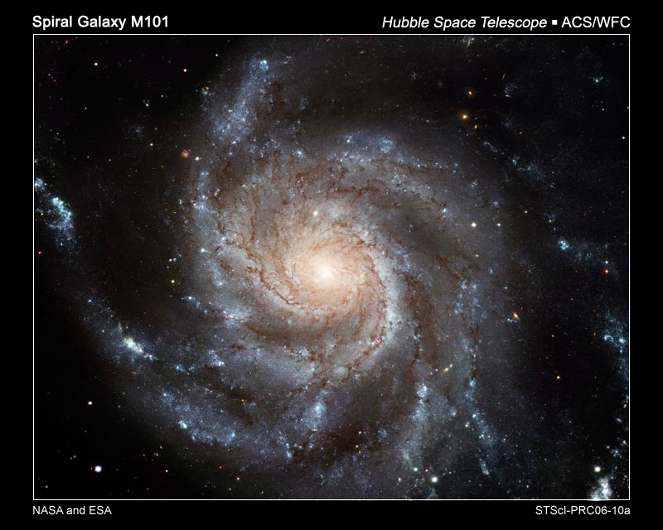
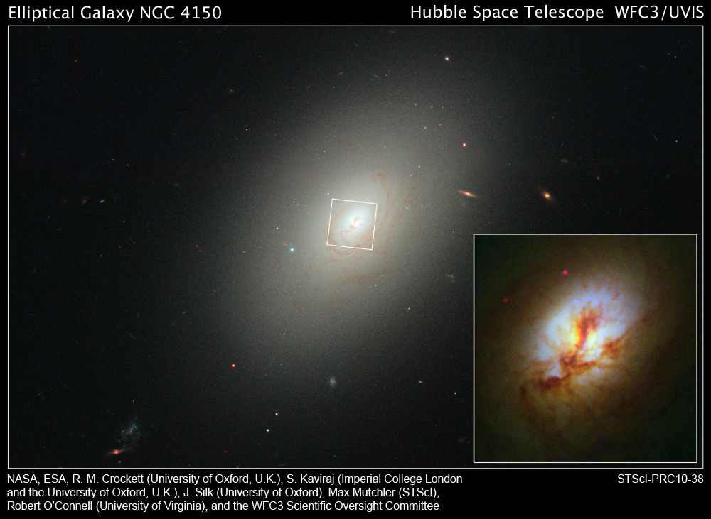
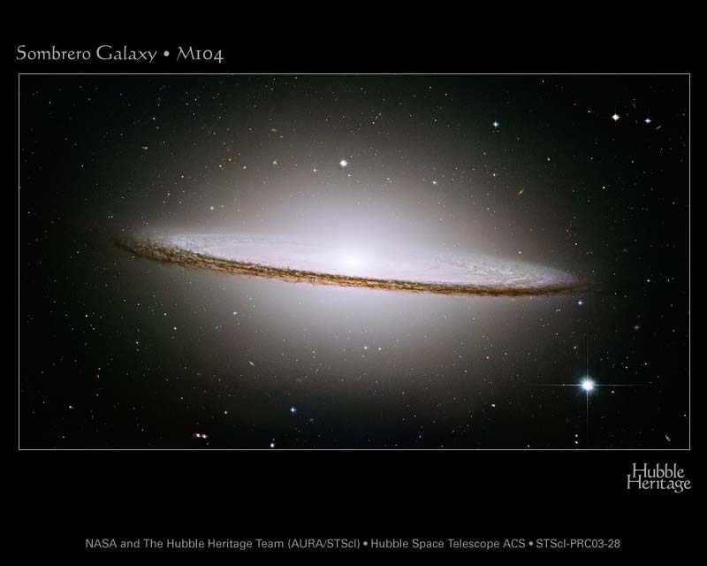
Weighing galaxies?

Slide 7
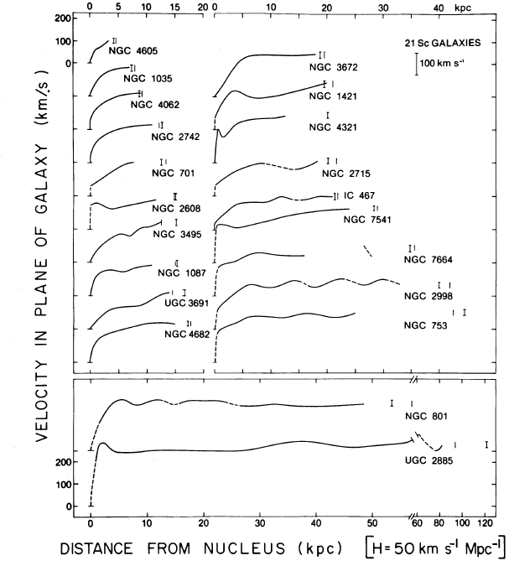
How to stars in galaxies move?
Rotation curves of 21 spiral galaxies, as measured through optical spectra. Note that for each one, the peak is around 200 km/s, and the curve is relatively flat beyond 10 kpc.
From Rubin, Ford, Thonnard 1980

Slide 8
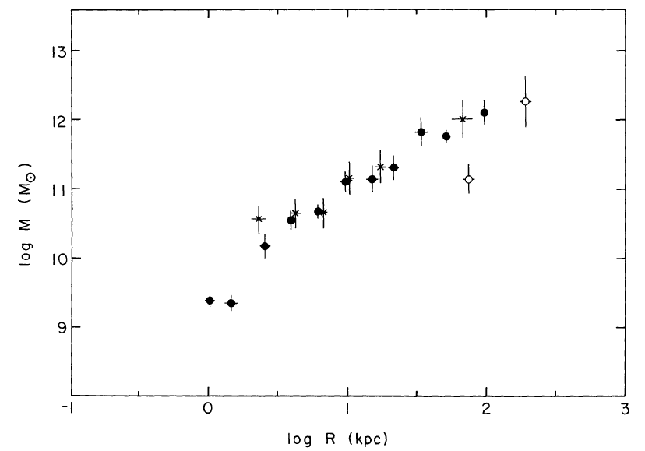
Where is the stuff?
The rotation curve is flat: Mass keeps increasing the further out you get
Mass-to-light ratio increases the further out you get (can get up to 10-100)
Where is the edge of the galaxy?
Mass as a function of radius for the Milky Way, based on observations of globular clusters and satellite galaxies.
From Faber & Gallagher 1979

Slide 9
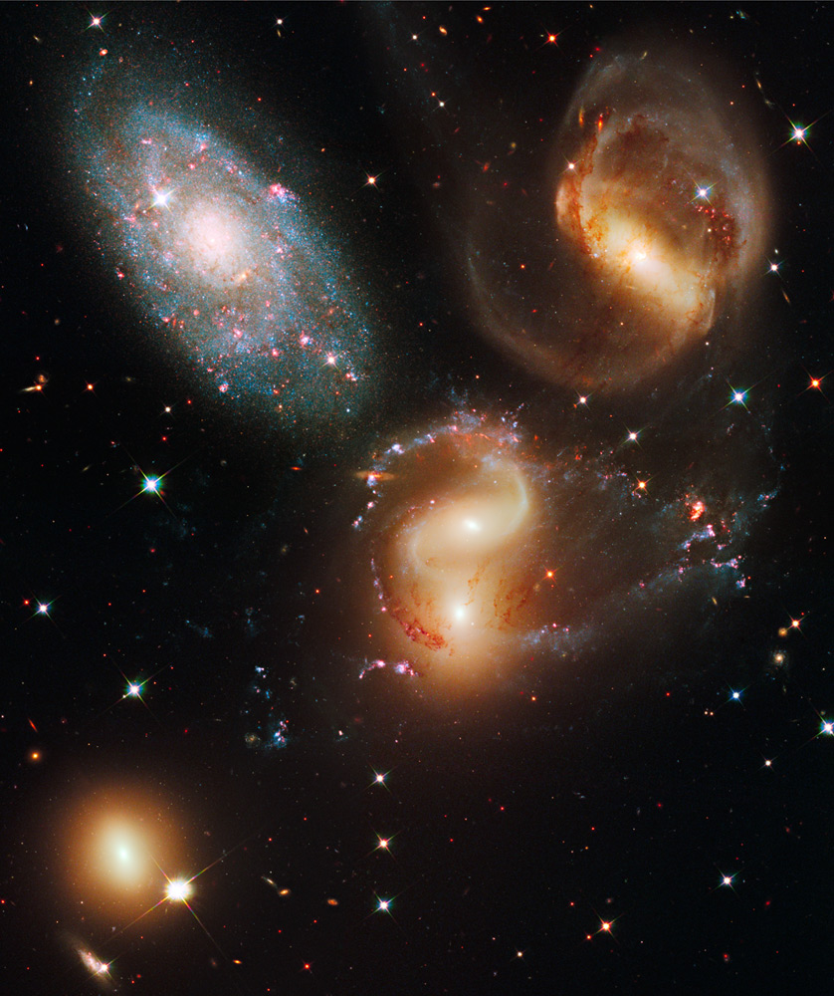
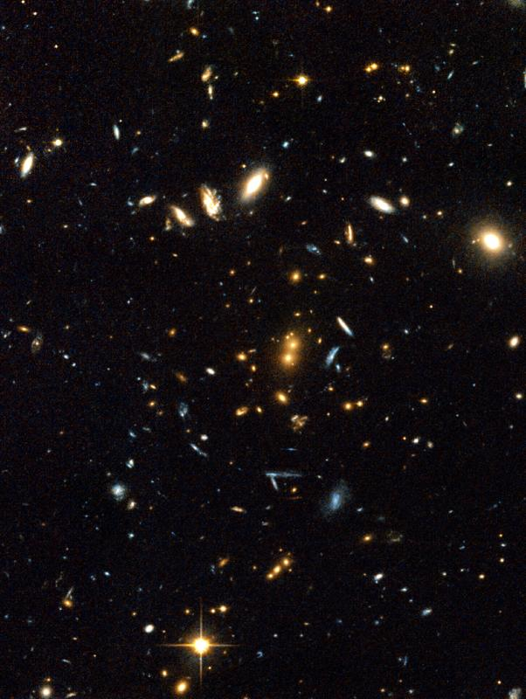
Bigger: clusters of galaxies
RDCS 1252.9-2927
Image credit: NASA, ESA, J. Blakeslee, M. Postman, P. Rosati
Stephan’s Quintet
Image credit: NASA, ESA, and the Hubble SM4 ERO Team

Slide 10
Heavy clusters
Cluster | σ (kms/s) | M/L | M/Mx
Virgo | 700-800 | 150 | 10
Fornax | 350 | 250 | 80
Coma | 1000 | 80 | 6
Perseus | 1300 -> 600 | 180 | 7
RDCS 1252.9-2927 | 800 | ~200 | 10
Stephan's Quintet | 350 | 14 | >1000
Heavy!
From “Galaxies in the Universe”, 2nd Ed., Sparke & Gallagher

Slide 11
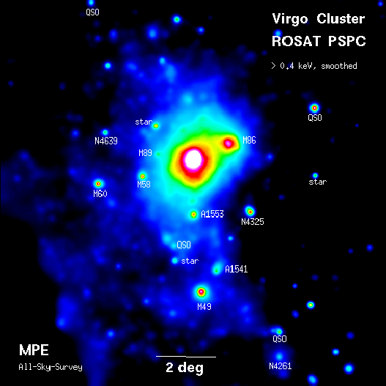
Taking X-rays from clusters
10,000,000 degrees!
Particles in the gas crashing into each other
Gravity vs. temperature
Böhringer et al 1994

Slide 12
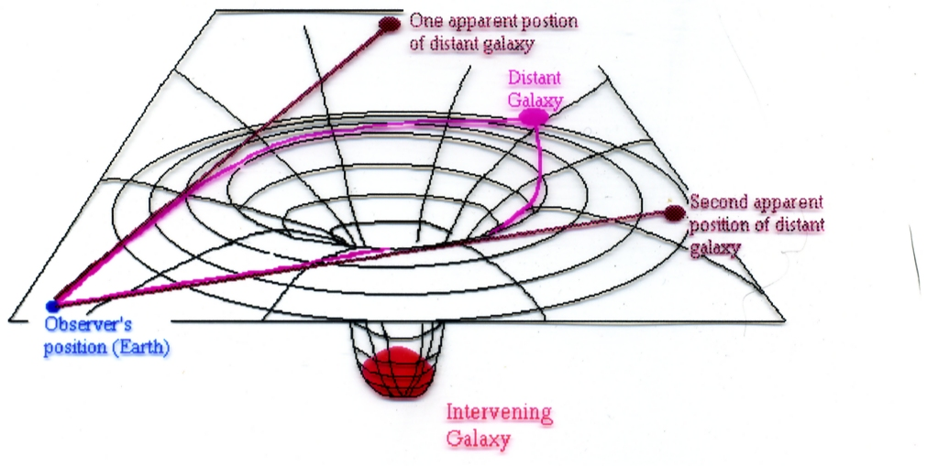
How about another method: gravitational lensing
Source: http://epsc.wustl.edu/classwork/classwork_210a/transparencies/bernard/gravitational_lens001.jpg

Slide 13
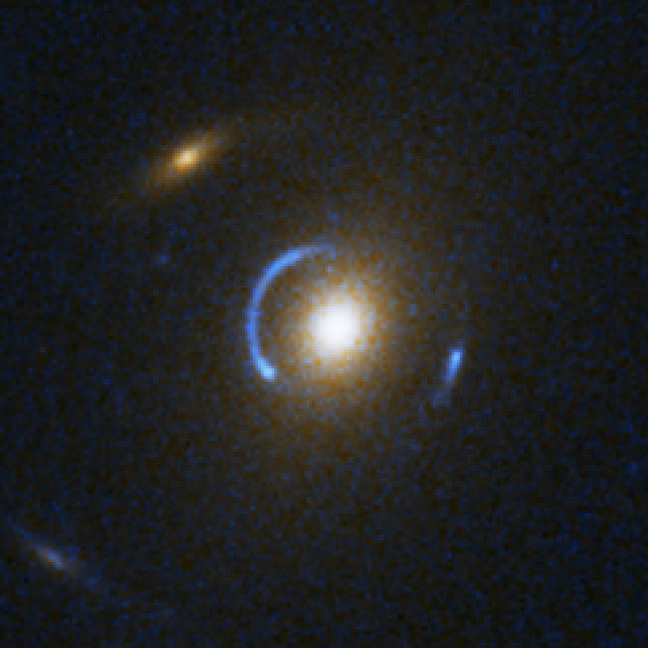
Do we really see gravitational lensing happen?
SDSS J120540.43+491029.3
Credit: NASA, ESA, A. Bolton (Harvard-Smithsonian CfA) and the SLACS Team

Slide 14
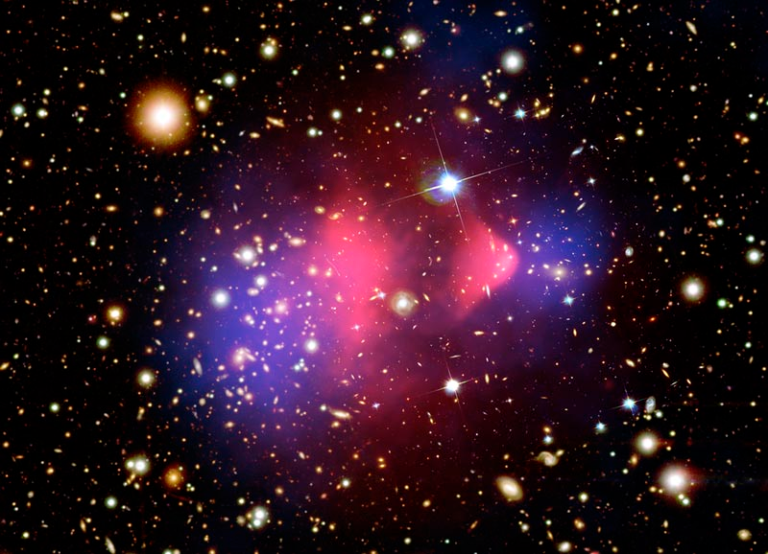
X-rays, lenses, and dark-matter, oh my!
The “Bullet” Cluster. Blue shading represents mass as measured by gravitational lensing. Red represents hot x-ray gas.
Image credit: NASA/STScI, ESO WFI, Magella/U.Arizona/D.Clowe et al.

Slide 15
Dark matter: OK, we’re convinced, now what is it?
~85% of the universe
Dust / Gas?
Black holes, planets, etc?
Is our theory of gravity wrong?
Exotic particles?

Slide 16
Dark matter: how about dust?
Dust / Gas?
  Dust and gas in galaxies would cause more stars to form: we would be able to see those stars
  More dust and gas in galaxy clusters would cause the dust and gas to become part of the galaxies, leading to more stars
  Bullet cluster strongly suggests that it is not gas, otherwise

Slide 17
Dark matter: MACHOs
Black holes, neutron stars, brown dwarfts, rogue planets?
Planets: heaviest in solar system: Jupiter = 0.001x mass of sun
Can watch for them using gravitational lensing events
Extensive search in the 1990s
Best case: ~20% of missing mass

Slide 18
Dark matter: Gravity?
Is our theory of gravity wrong?
  Modified Newtonian Dynamics (MOND)
  Modification of gravity and general relativity.
  No theory yet that both fixes the dark matter problem and supports cosmological effects

Slide 19
Dark matter: WIMPs and exotic particles
Four fources: Strong, Weak, Gravity, Electromagnetism
Neutrinos? Too light
Weakly Interacting Massive Particle (WIMP)
“Cold dark matter”: 1 particle ~ 10-100x mass of hydrogen atom
Looking for evidence:
  Large Hadron Collider (LHC) – Can we make dark matter?
    Nothing found so far
  Many other searches (CDMS, CoGeNt, DAMA, EDELWEISS,…) – If a dark matter particle collides with an atom, could we detect it?
    Some claims to have detected the collisions, but controversial

Slide 20
Dark Matter: Other exotic particles
Standard model of physics: the particles we know of
  Protons, neutrons, electrons, neutrinos, quarks
  Candidate: ‘glueballs’
LHC in Switzerland suggesting that our “standard model” is correct, which suggests that we can't make special particles

Slide 21
Summary:
How do we weigh a galaxy?
  Measure it’s rotation curve, calculate the gravitational mass.
How do we weigh a cluster of galaxies?
  Measure velocities of clusters in the galaxy
  Measure hot gas (x-rays)
  Look for gravitational lensing
Why do we think dark matter exists?
  Mass-to-light ratio is very large for galaxies and clusters compared to star clusters, or the solar system
  Galaxies have mass beyond the visible edge
What is dark matter?
  Makes up 60-80% of the matter in the universe
  Not gas/dust
  Not MACHOs
  WIMPs?
  Something even more exotic?

