Slide 1


Time, Calendars, and the Stars
A little history of time and calendars
Brian W. Mulligan
University of Texas at Austin
13 Nov 2013

Slide 2
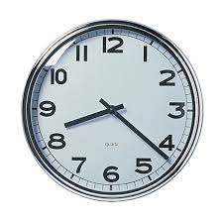
What is time?

Slide 3
What is time?
Determines the order of events
  Relativity
    The interval between light being at point A and point B
  The direction in which entropy is increasing
How to measure time?
  Atomic clocks
  Clocks [mechanics, engineering]
  Sun & stars

Slide 4
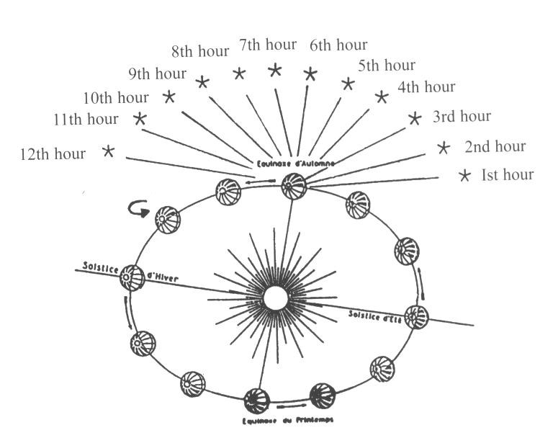
12 “Hours”in a Night

Slide 5
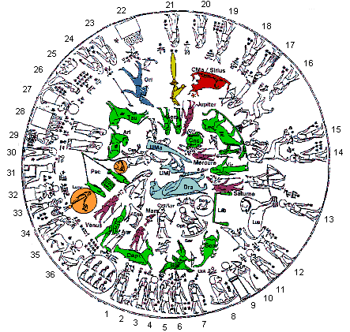
Timekeeping
Divisions in the night sky: The Egyptian Decan stars (outer ring), compared to other constellations
http://www.mazzaroth.com/ChapterOne/TranslateDenderah.htm

Slide 6
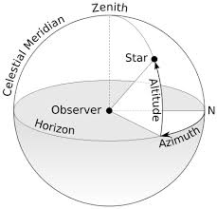
Measuring things in the sky
http://en.wikipedia.org/wiki/File:Azimuth-Altitude_schematic.svg

Slide 7
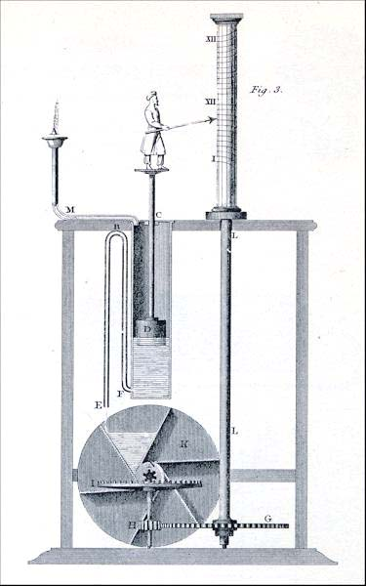
Clocks: tracking time mechanically
Illustration of Greek water clock (clepsydra) from 3rd century BCE.
http://en.wikipedia.org/wiki/File:Clepsydra-Diagram-Fancy.jpeg

Slide 8
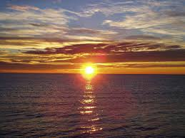
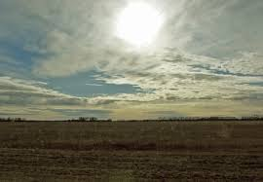
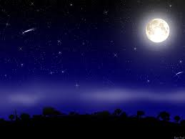
Starting the clock
Sunrise or sunset?
Noon?
Midnight?
http://www.sunriseproperties.net/
http://debtorby.typepad.com/connections/2006/12/north_dakota_pr.html
http://customize.org/wallpapers/7145

Slide 9
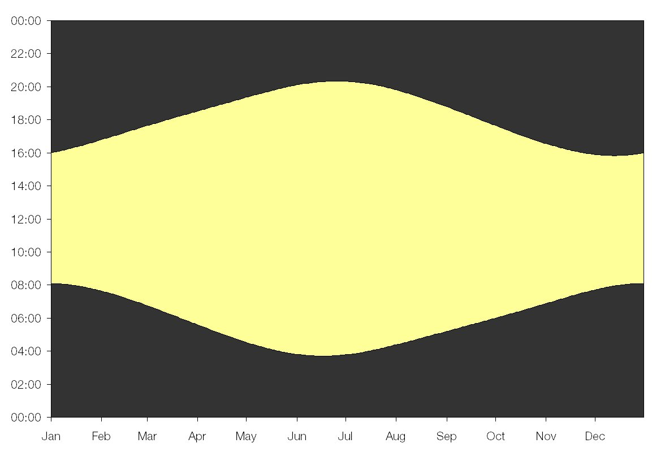
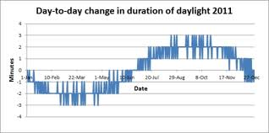
Sunrise / Sunset
Daily change in daylight
Length of Day in London
http://www.sydneyobservatory.com.au/2011/how-does-the-length-of-the-day-vary-from-one-day-to-the-next-throughout-the-year/
http://wordpress.mrreid.org/2010/10/

Slide 10
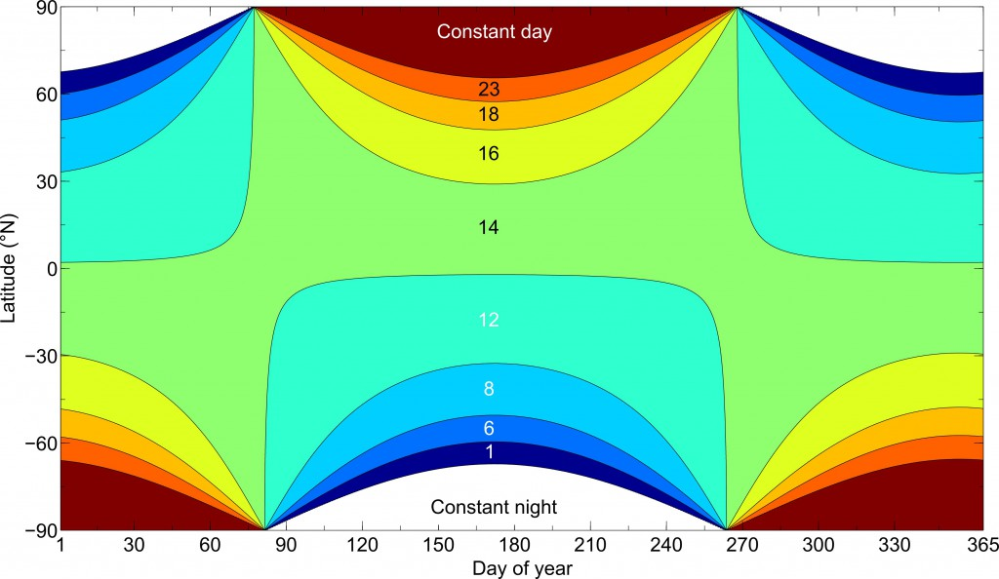
Length of day
Length of Day at any latitude
http://wordpress.mrreid.org/2010/10/

Slide 11
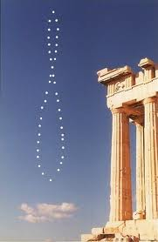
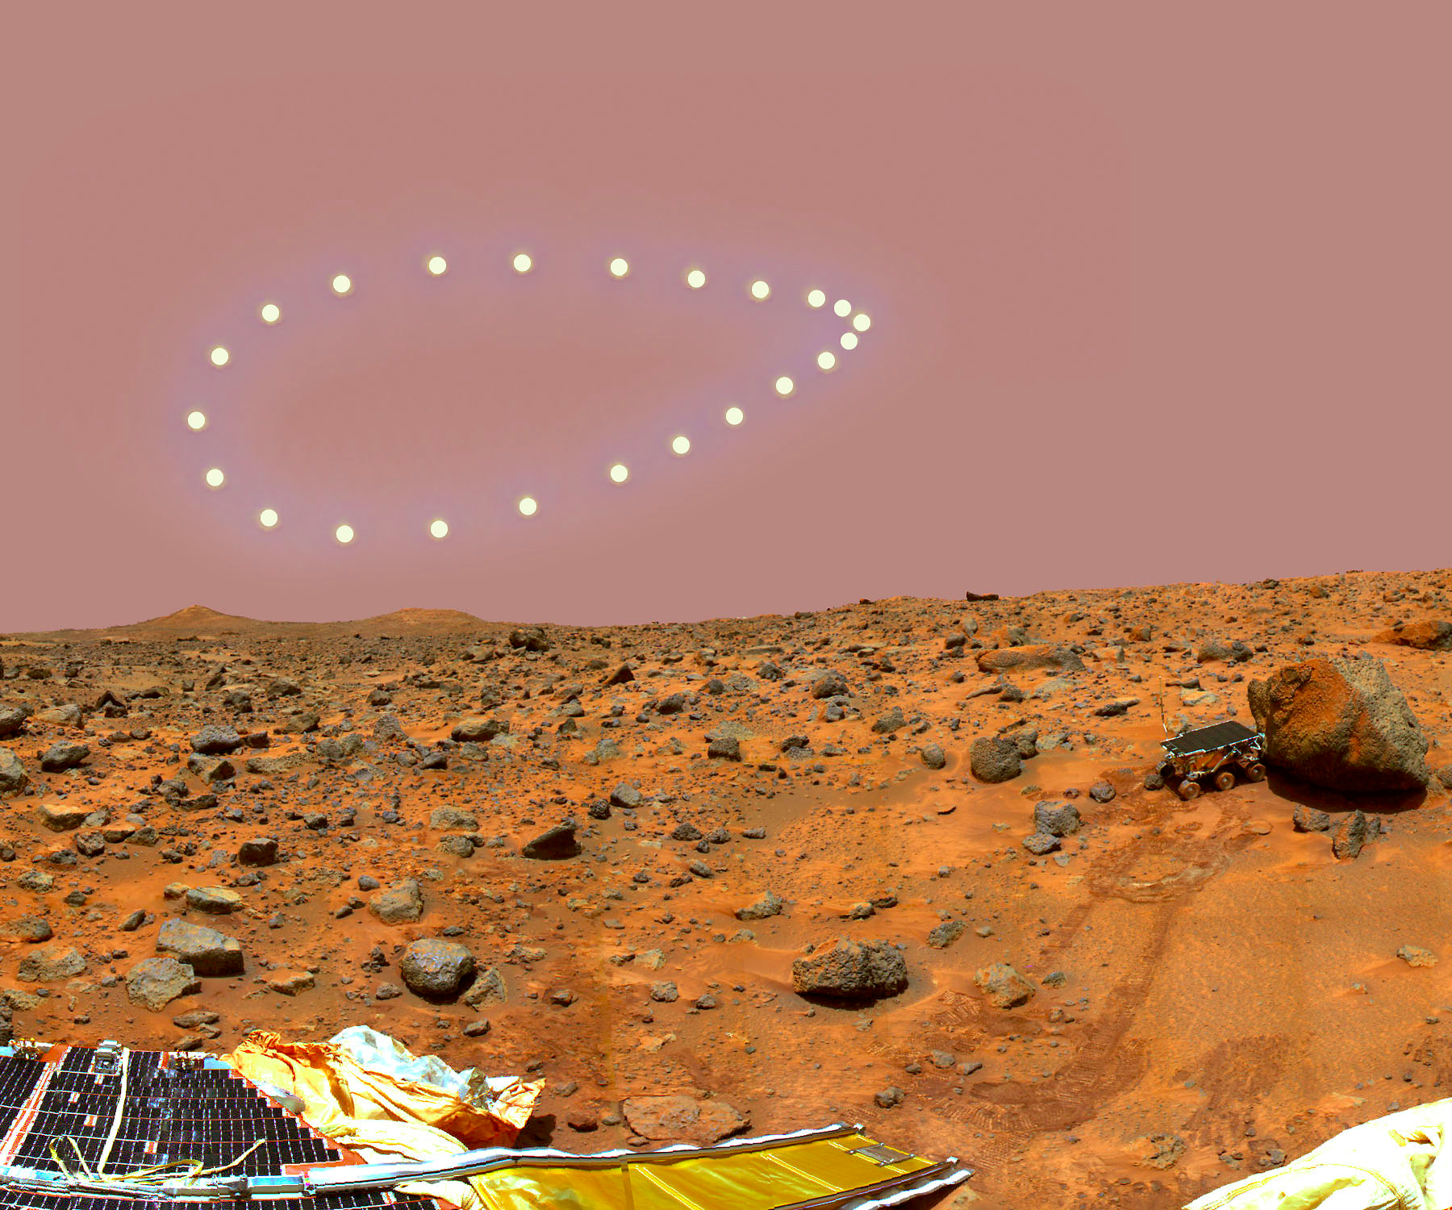
The analemma
Analemma on Mars
Analemma on Earth
http://www.perseus.gr/Astro-Solar-Analemma.htm
http://apod.nasa.gov/apod/ap061230.html

Slide 12
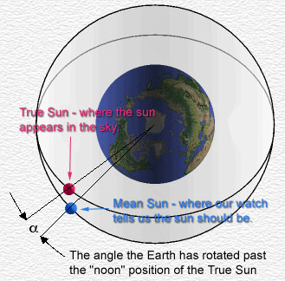
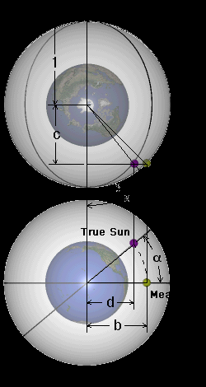
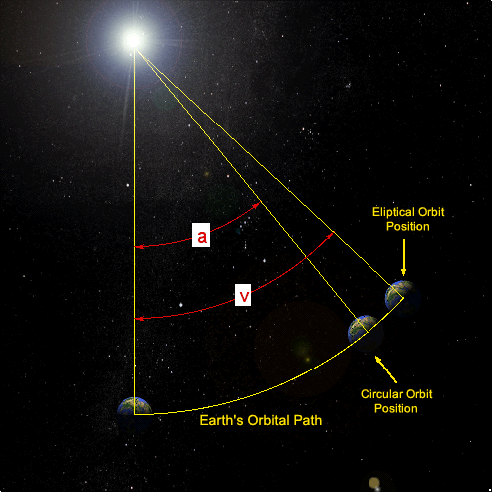
What's happening?
Earth's orbit
The “Mean” sun (clock time) vs. The “True” sun (sundial time)
Earth's Tilt
http://www.analemma.com/Pages/framesPage.html
http://www.markpine.us/?p=4716

Slide 13
Local noon
Noon in Austin isn't the same time as it is in Europe
Points on Earth experience local noon based on longitude
Longitude prize [England, 1714]: up to 20,000 B.P. [several million today]
Noon in Austin isn't the same as in Houston
Noon in Austin isn't the same as in Pflugerville

Slide 14
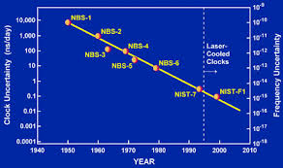
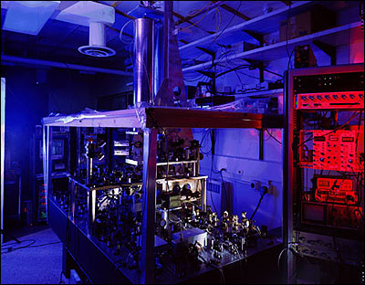
Time today
Atomic clock at NIST
Accuracy of clocks
http://www.nist.gov

Slide 15
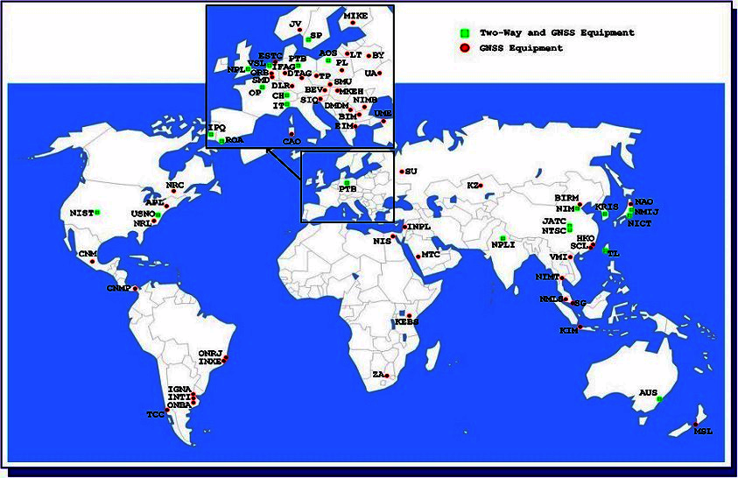
International Atomic Time
http://www.bipm.org/en/scientific/tai/tai.html

Slide 16
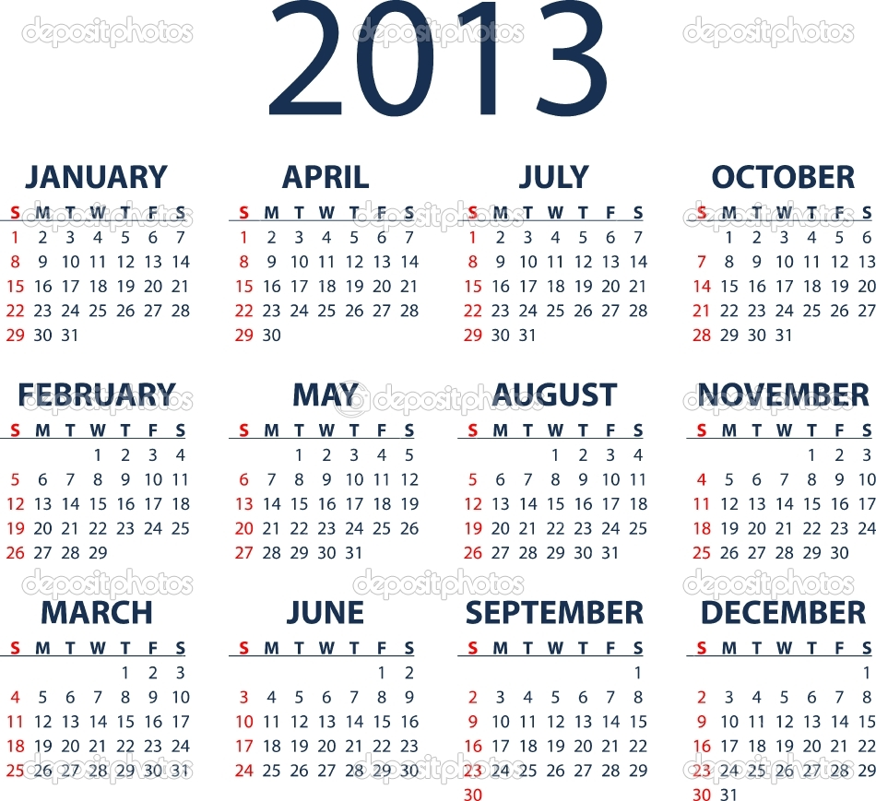
The calendar

Slide 17
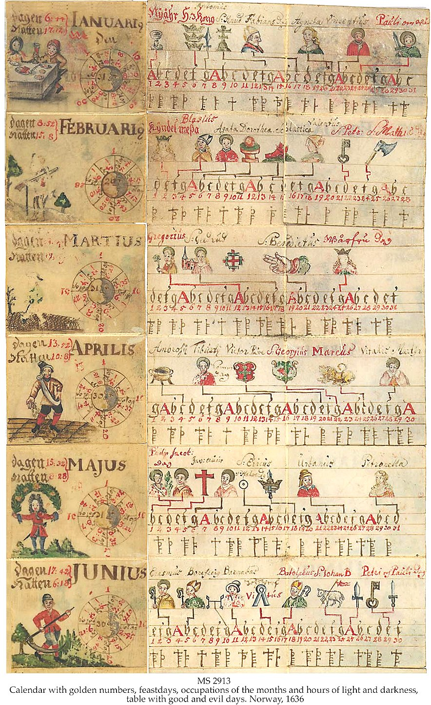
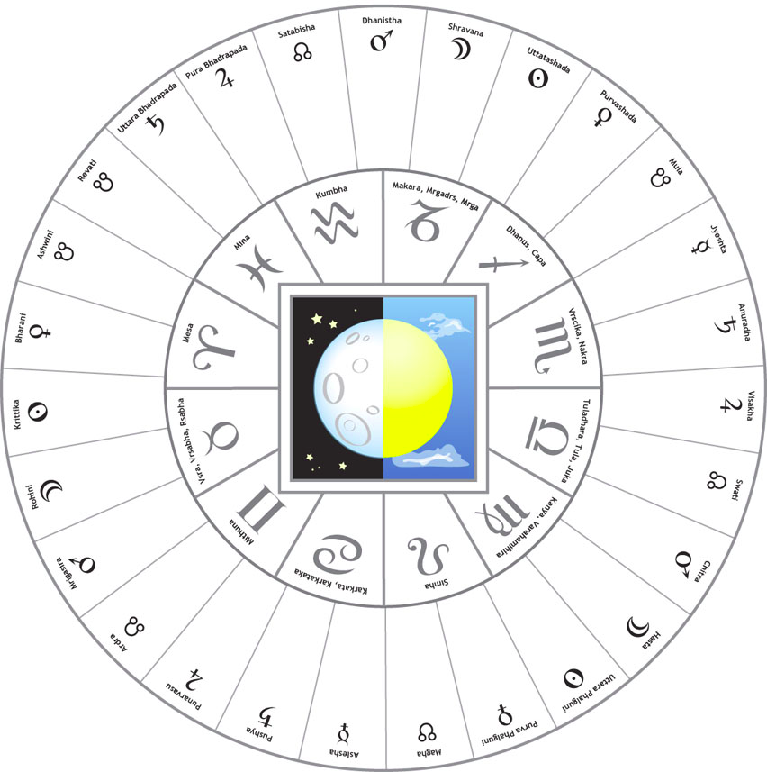
The calendar, agriculture, and fortune telling?
http://horoscopicastrologyblog.com/2008/12/11/the-transmission-of-hellenistic-astrology-to-india/
http://growingtheglow.blogspot.com/2010/10/herbal-monographs.html

Slide 18
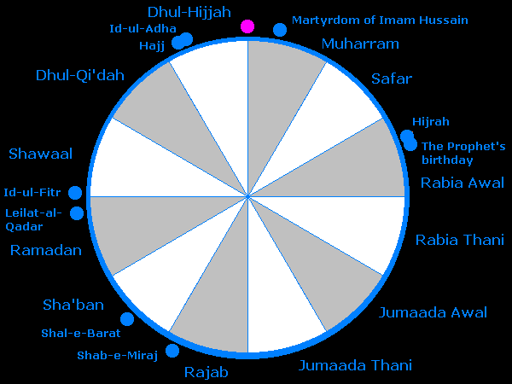
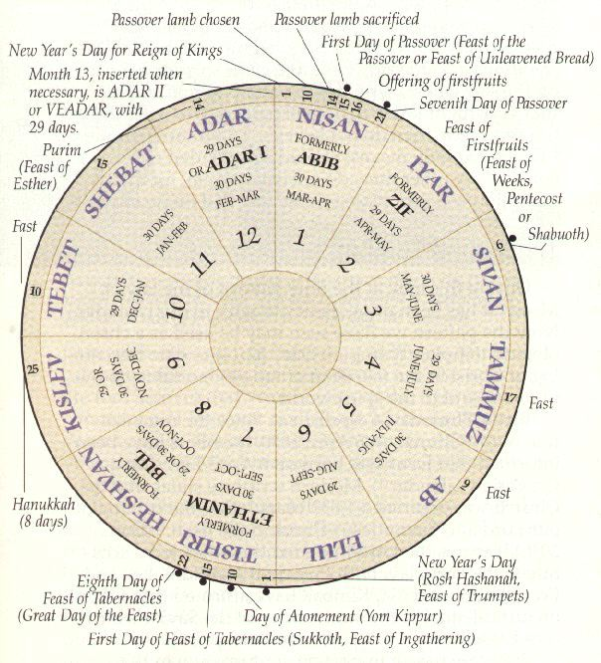
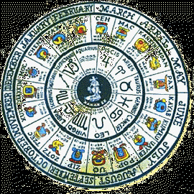
Types of calendar
Lunar (ex: Islam)
Lunisolar (ex: Jewish,Chinese)
Solar (ex: Mayan, Gregorian)
http://www.change.freeuk.com/learning/relthink/muslimyear.html
http://www.yucatanadventure.com.mx/mayacalendar.htm
http://www.johnpratt.com/items/calendar/hebrew/

Slide 19
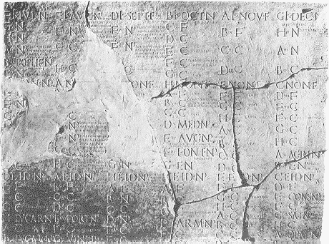
Early Roman Calendar
10 months, 304 days
  March (Mars)
  April (???)
  May (Maia, growth)
  June (Juno, youth)
  Quintilius
  Sextilis
  September
  October
  November
  December
Lunar: months about 30 days to follow the moon.

Slide 20
Early Roman Calendar
Kalends = new moon
Nones = half moon (2x per month)
Ides = full moon

Slide 21
Calendar of Nuna
Add January & February
Change # of days in months
Extra month added occasionally by decree of government
Julius Caesar's 3rd term (1 'year') as council was 445 days long

Slide 22
Julian Calendar
First Roman solar calendar
Started around 46 BC
365 days + leap day / 4 years
Quintilian = Juli (Julius)
Sextilis = August (Augustus)

Slide 23
The Influence of the Church
Easter
  First Sunday after full moon after the March Equinox
Date of equinox: March 21
Year isn't really 365.25 days
  By 1582, “Official” equiniox and real equinox differ by 10 days

Slide 24
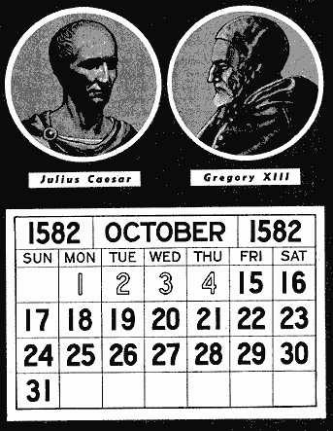
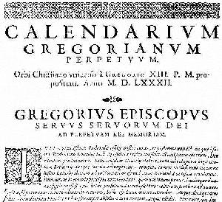
The Gregorian Reform
http://macquirelatory.com/Gregorian%20Calendar.htm

Slide 25
Time, Calendars, and the Stars
Day
  24 equal hours
  Clock time = solar time only for a perfectly circular orbit
  Analemma: correction for Earth's motion and tilt
Year
  365.24219 days
  Position of sun relative to the Earth and stars
  Roman (Julian) calendar, corrected in 1582
  Gregorian calendar since 1582

Slide 26
Thank you for coming!
Questions?

