Slide 1
Software Design for Astronomers
Brian W. Mulligan
University of Texas at Austin
Grad Student – Post-Doc Seminar
University of Texas at Austin
15 Sept. 2017

Slide 2
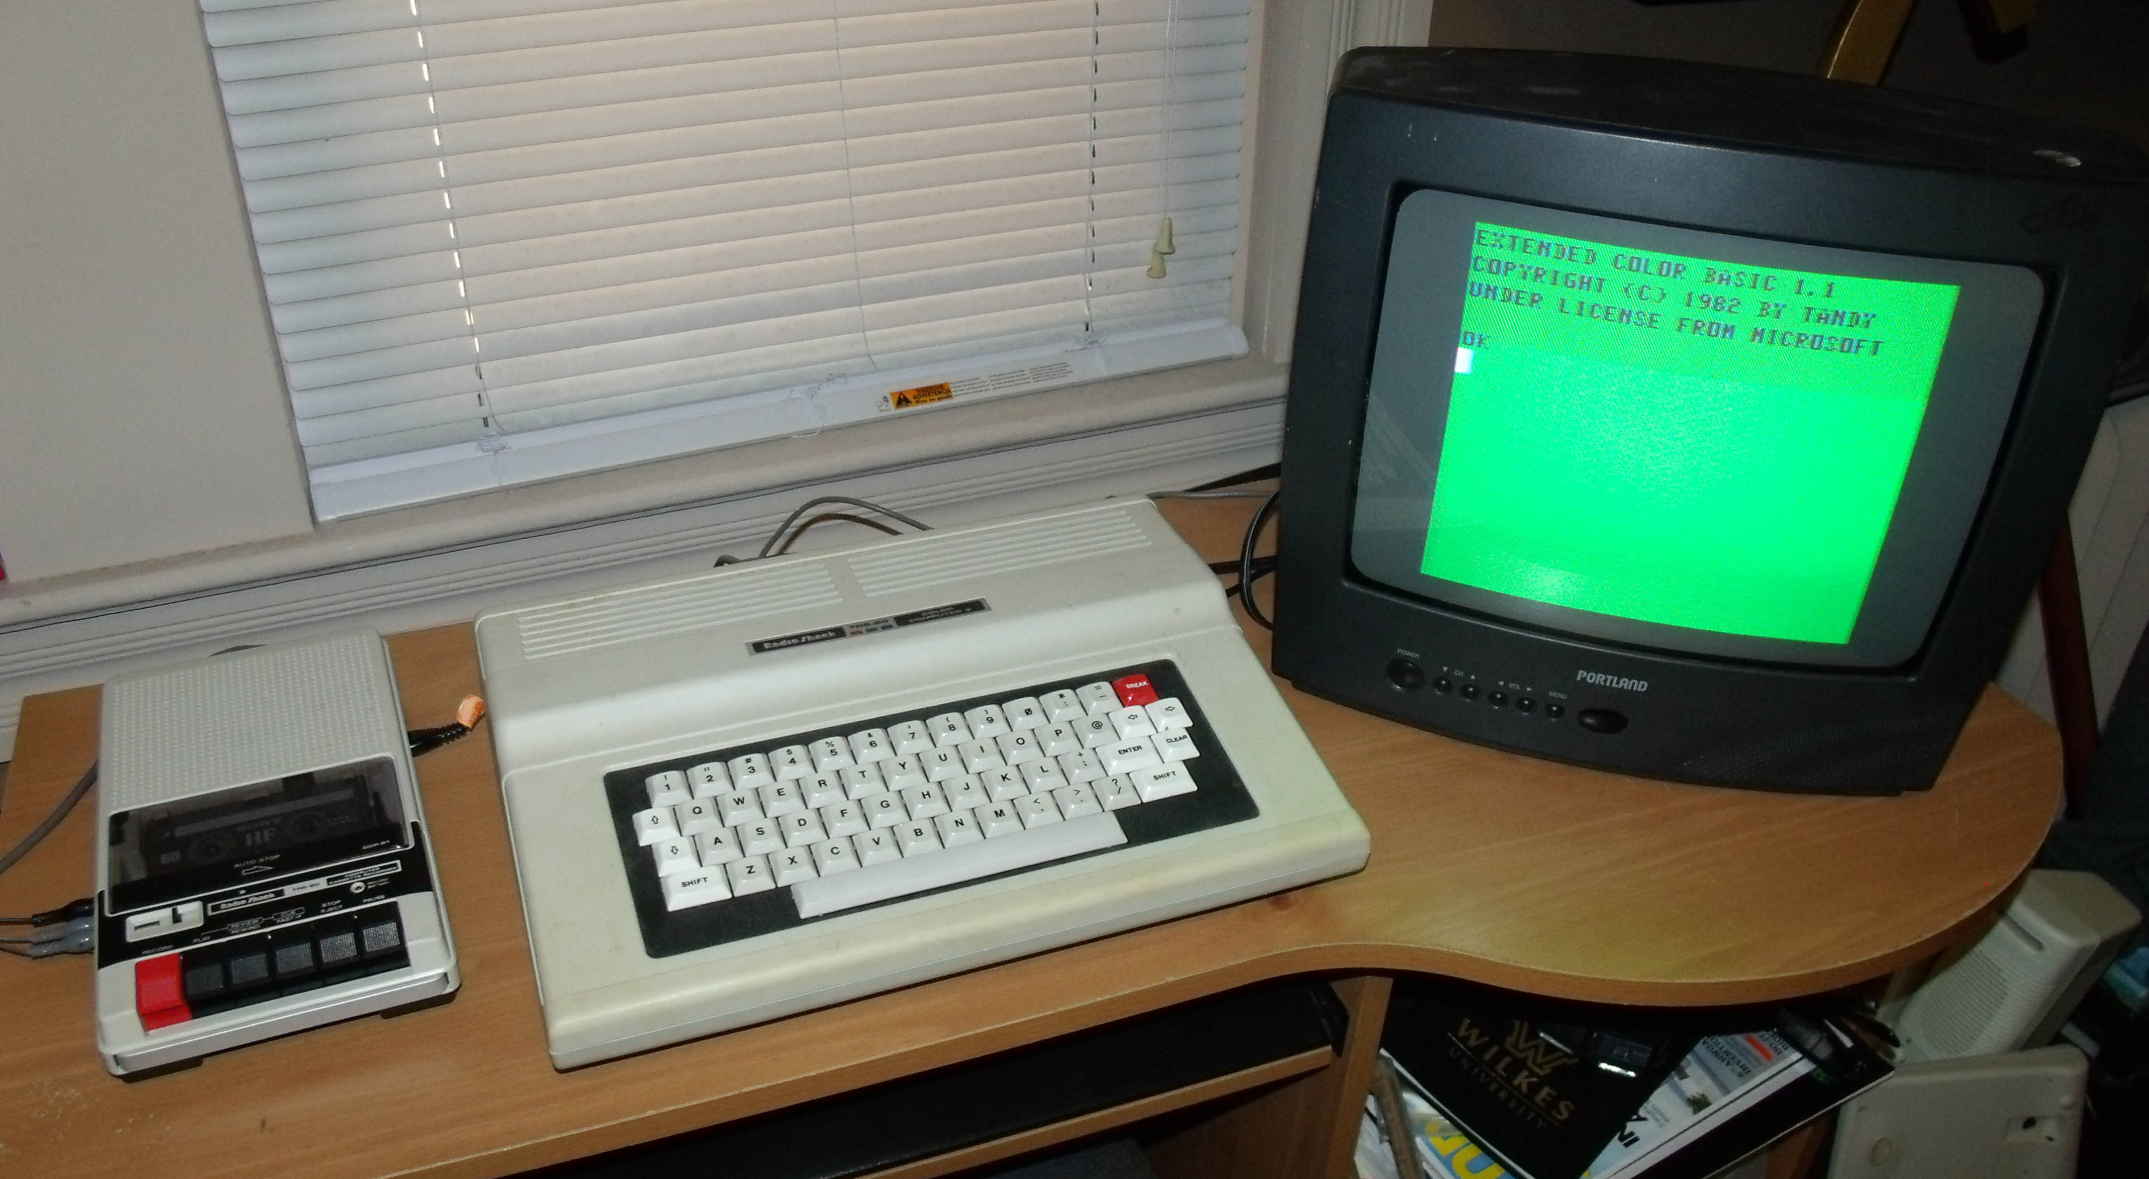

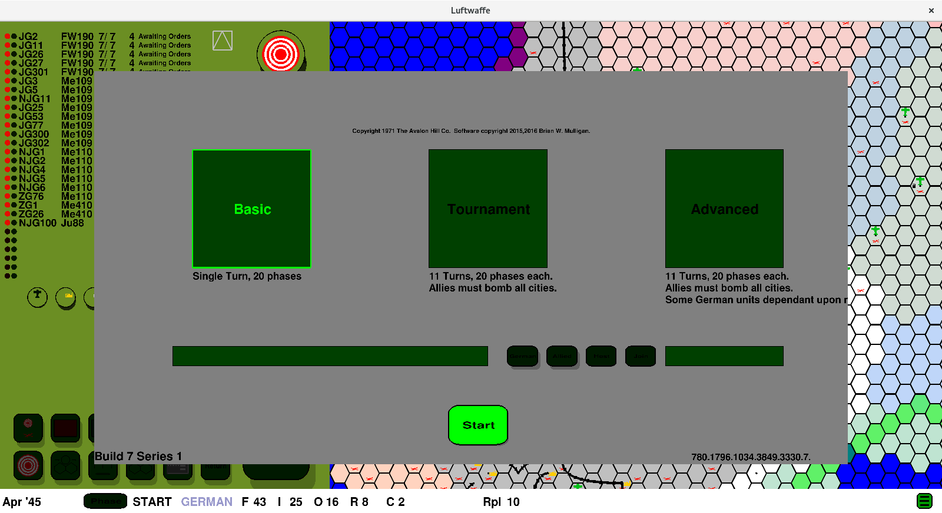

My Bio

Slide 3
Plan for this talk
Source control & github
Purpose
Input
Output
Packages / Modules / Libraries

Slide 4
Plan for this talk
Source control & github
Purpose
Input
Output
Packages / Modules / Libraries

Slide 5


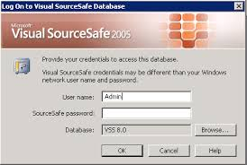

Source Control & github
Source Control
Backs up changes to the code over time
Allows tracking changes and the purpose for the changes
Allows reversion to previous versions
Source control & github 1/2

Slide 6
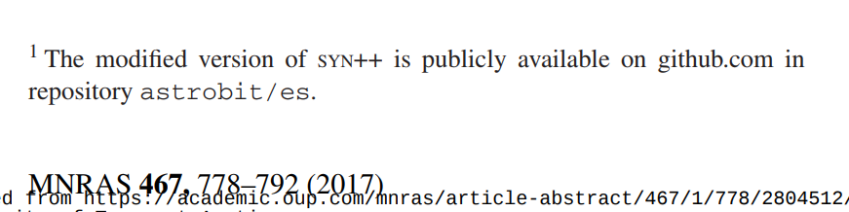
Github: sharing your code
Generally free
As a student, eligible for free private repositories
Share your code with collaborators
Repository for your code used in papers
Source control & github 2/2

Slide 7
Plan for this talk
Source control & github
Purpose
Input
Output
Packages / Modules / Libraries

Slide 8
Questions to ask
Does software to do this already exist?
  If it does, how complicated is it to make it do what you want to do?
How often do I need to do this task?
Will I need to do it again in the future?
How complex is the task?
How time-consuming is coding, debugging, and processing vs. manual operation?
Purpose 1/4

Slide 9
Graphing
IDL
just don’t
Python – pyplot
Useful for one-off code, a handful of plots, or something that can be done in a short time
C – pgplot
Basis of pyplot, going to run a lot faster than python. Useful for a large number of plots or large datasets
FORTRAN – pgplot
basically the same as C
Other
Postscript – skip the intermediary and write your own .ps files; can be done from any language – this is all that pyplot / pgplot does.
gnuplot, other utilities – probably similar to using python.
Purpose 2/4

Slide 10
Fundamental models
Translation
Welcome
Добро пожаловать!
Software
Manipulation
Welcome
Hello
Software
Purpose 3/4

Slide 11

Purpose / complexity
Generate simple plots or tables?
(Translation model)
Convert data from one format to another?
(Translation model)
Perform calculations on data
(Manipulation model)
Design 4/4

Slide 12
Plan for this talk
Source control & github
Purpose
Input
Output
Packages / Modules / Libraries

Slide 13
How to access your data
Assume: data in (set of) files
Avoid hard coding inputs unless they never change
User inputs via:
  command line / typed user input
  graphical user interface
  Parameter files
Input 1/5

Slide 14
Command line
Provide parameters to command when running the code
  g++ -c source.cpp -o source.o –std=c++11
Highly flexible and allows user to specify only parameters that are needed.
Requires string processing in code to translate potentially obscure command line options to meaningful information.
Very suitable for scripting
Useful when there is only a handful of parameters
Input 2/5

Slide 15
stdin
Provide parameters via stdin
  imstat
  List of input images (HIP62157_firstpointing-0001_V.fit):
Useful for code that is run a few times manually
Can make use of redirecting stdin so all parameters can be stored in one or more files.
Using stdin means unformatted parameter files – not particularly user friendly
Input 3/5

Slide 16
Parameter files
Store parameter information in a formatted file
Parameter file with fixed filename (don’t do this!) or via command line
Formats:
  xml: broadly used standard, lots of code available for processing
  json: starting to come into broad use; features similar to xml, but not as verbose
  yaml: similar to json or xml, but a little more limited; not as widely used
  Parameter list:
    parameter_a = 1
    parameter_b = whats up?
    Requires more intensive string processing in your code, but pretty easy to read
Input 4/5

Slide 17
Data input
What storage format is the data in?
What format do you need it in your code?
  These two questions should guide you to appropriate data structures and libraries / packages for reading the data.
Do you need all of it all the time?
  For large datasets, you’ll probably only want to load what you need when you need it.
  Reading from disk is really slow.
How much memory / space is required for the data?
What order will you access the data?
  For large datasets, be aware of access order – you want to make sure that access is ordered the same as storage.
Input 5/5

Slide 18
Plan for this talk
Source control & github
Purpose
Input
Output
Packages / Modules / Libraries

Slide 19
Final products
Human readable?
Machine readable?
Both?
Graphs?
LaTeX tables?
Output 1/3

Slide 20
Machine Readable files
Xml, json, .csv, others
Maintain precision of floating point data?
  Single precision: 8 digits
  Double precision: 17 digits
Binary machine readable?
  Most compact format
  Can cause problems if data is transferred from one computer to another
Output 2/3

Slide 21
Intermediate products?
Storage of intermediate state of processed data
  Useful if processing is intensive
  Allows restart in case of crash
  Usually machine readable format
  Format is highly dependent on usage
  Consider SQL
Other intermediate data
  Information regarding the analysis results
  Effectively an output product
Output 3/3

Slide 22
Plan for this talk
Source control & github
Purpose
Input
Output
Packages / Modules / Libraries

Slide 23
Modules & Libraries
What components of your code do you expect to re-use?
Do you find yourself regularly re-using a piece of code with small changes?
Can those components be written in a way to be usable in different contexts?
Functional or object oriented programming
Helps prevent errors and allows fixing bugs in a global manner.
  Find bug in a piece of code, if it’s in a library, fix it once, otherwise fix it 10 times.
Libraries 1/X

Slide 24
Interface design
What parameters are required?
What parameters are optional?
Many modern languages allow optional paramters to have a default value
  void thisfunction(int a, int &b, int c = 10)
Consider grouping parameters into a container
  Highly flexible method of supplying paramters
  class params
  {
  public:
  int a;
  int b;
  int c;
  params(void) {c = 10;}
  };
  void thisfunction (params Params);

Slide 25
Github!
Place your modules / libraries / packages on github – other people can now use them!
Remember to provide some documentation to users so they know how to use the code (and you remember when you come back to it a year later)
Github.com/astrobit/xlibs

Slide 26
Summary
Consider usage and scope of task
Set up inputs to be easy to control, avoid hard-coding (fixed) inputs
Outputs as needed – consider language
Create libraries / modules to avoid errors and copy / paste
Use github and share your work!

