Slide 1
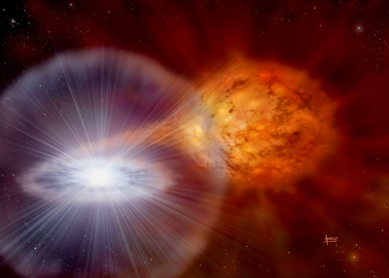
Simulation of compact circumstellar shells around Type Ia supernovae and the resulting high-velocity features
Credit: David A. Hardy
Brian W. Mulligan & J. Craig Wheeler
University of Texas at Austin
AAS 229th Meeting (Grapevine, TX)
6 Jan 2017

Slide 2
Acknowledgements
J. Craig Wheeler (Advisor)
Jeffrey Silverman
G. “Howie” Marion
Joszef Vinko
E. “Rob” Robinson
Milos Milosavljevic
Volker Bromm
Harriet Dinerstein
Anil Pradhan
Mark McCormick
Referees
Friends

Slide 3
Overview
Type Ia supernovae
Early observations: high velocity features
Interaction between supernova and circumstellar medium
Our 1-D simulations & results to date

Slide 4
Type Ia Supernovae
Standardizable candles, used for measurements of Hubble flow
Chemical enrichment (Fe) of galaxies
C/O white dwarf (SN2011fe)
Chandrasehkar limit via accretion or merger
Rapid burning of C,O to Ni
Credit: David A. Hardy

Slide 5
Outstanding Questions
Configuration of the progenitor system?
  White dwarf with MS or RG stellar companion
    “Single Degenerate”
  Two white dwarfs
    “Double Degenerate”
Explosion Mechanism?
  Central deflagration followed by detonation?
  Surface shell detonation cent. def. Det?
Several methods to probe
  Early spectra

Slide 6
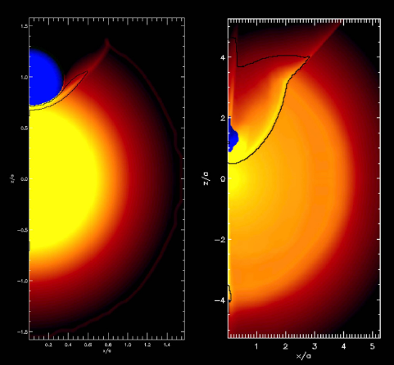
Type Ia supernova
Double degenerate (DD)
  Gravitational waves
Single Degenerate (SD)
  Surviving remnant
Both:
  Early light curve
  Early spectra
“Early” ~= pre-maximum light, first days-weeks after explosion
Maximum light ~18-20 days after explosion
Kasen 2010

Slide 7
Early spectra available
Count of SNe included in Silverman et al. 2015 with spectra available at or after X days

Slide 8
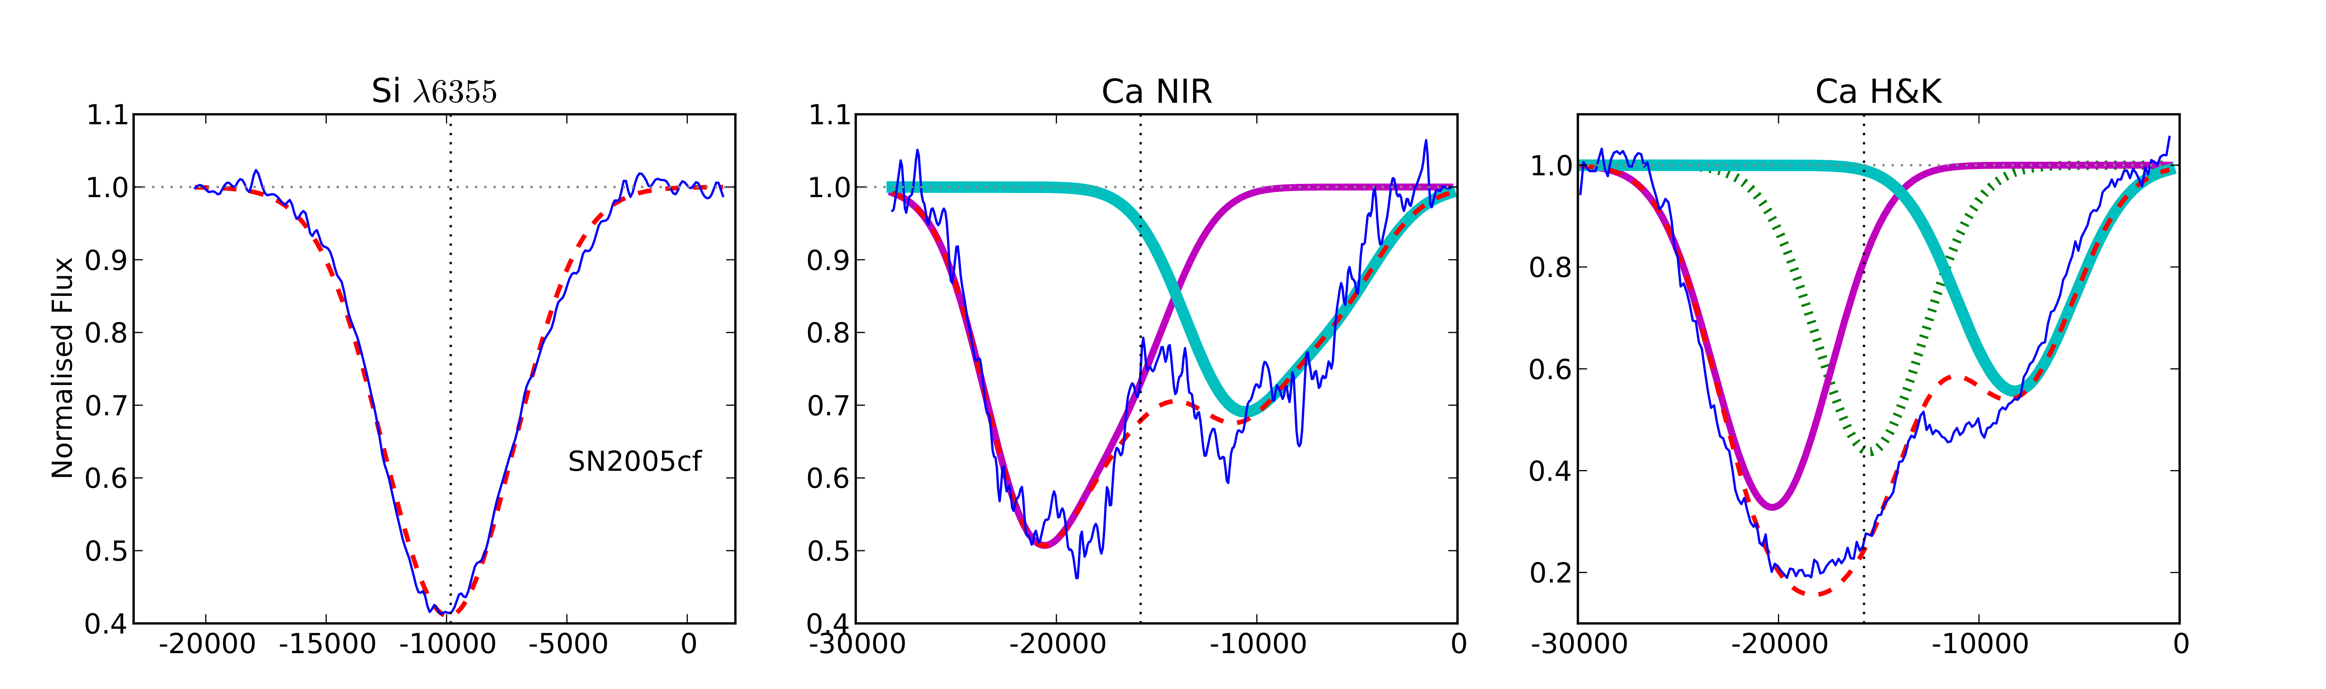
Outermost layers – high velocity features (HVF)
SN 2005cf Bmax -1.8d
(Childress et al. 2014)
High velocity feature (>~20,000 km/s)
“Typical” Ejecta (~10,000 km/s)

Slide 9
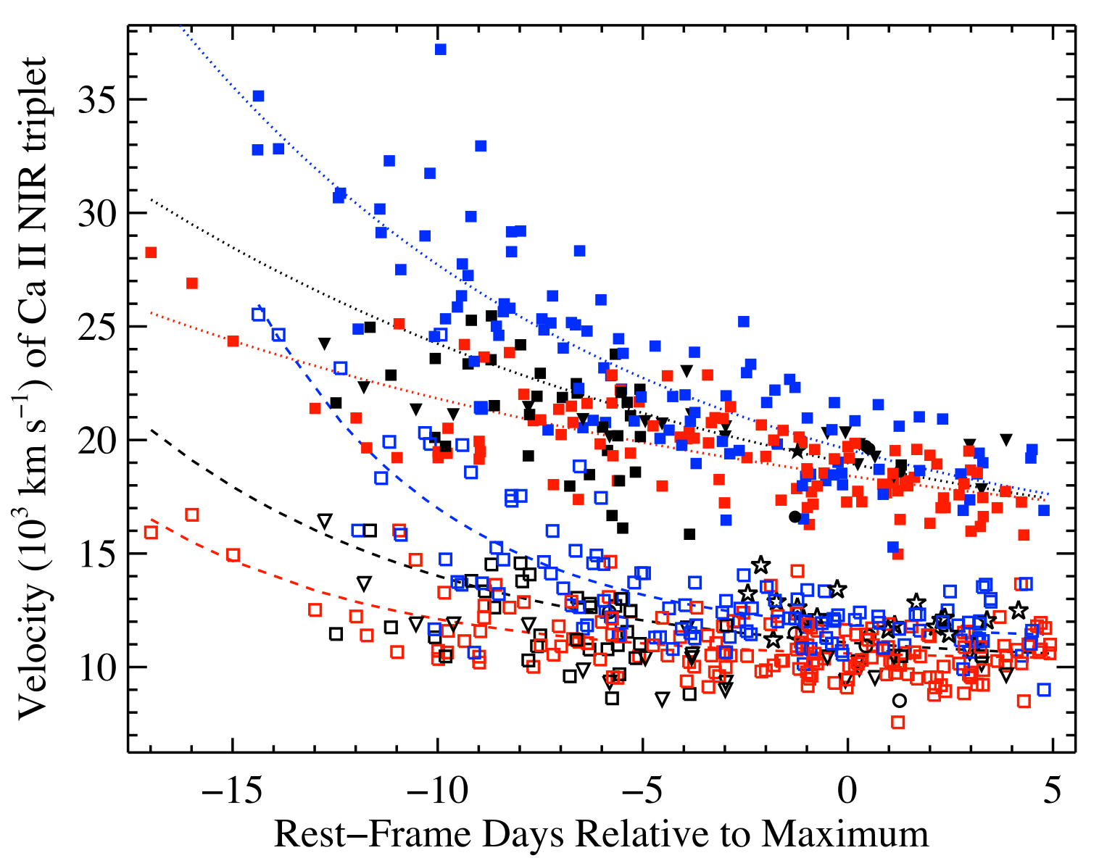
HVF Evolution (Velocity)
(Silverman et al. 2015)

Slide 10
Ca II NIR triplet feature evolution
(Mulligan & Wheeler 2017, data from Silverman et al. 2015)

Slide 11
Observational information about HVF
Velocity >~ 30,000 km/s @ 1-2 days
Consistently >~ 8,000 km/s faster than ejecta
Fade over time (gone by ~1 week after Bmax)
Polarized clumpy (Wang et al. 2003, Kazen et al. 2003)
Observed in ~90% of SNe.
Calcium (most SNe), Silicon (few SNe, Wang HV)
~ 0.01 Msun of material (Tanaka et al 2008)
Unlikely to be related to pre-explosion wind or extended CSM interation (blue and synchrotron emission)

Slide 12
Questions
What is required to make high velocity features?
What is the source of the material?
(Accretion? Merger? Surface detonation?)
What is the composition of the material?

Slide 13
SN structure (with HVF)
Unburned C/O
O, Mg, Ne
Ca, Si, S
Fe, Co, Ni
HV material

Slide 14
Sources of HVF
Density enhancement? (Tanaka et al. 2005)
Ionization? (Blondin et al. 2013)
Wind or CSM? (Gerardy et al. 2004)
Energetic clumps from ejecta? (Wang 2003)
Focus on times near max. light
No evidence that velocity and pEW will evolve

Slide 15
Compact Circumstellar Shell
R < R_{sun}
Mass: 0.003 – 0.02 M_{sun}
Velocity: 0 km/s
  Broadly consistent with any compact shell / atmosphere with velocity << eject velocity
Density structure
𝜌
r

Slide 16
Simulation & Spectral generation
Hydrodynamics: FLASH 4.1 (1-D spherical)
𝜌(v) 𝜏_{Sobolev}(v)
Synthetic Spectra: syn++ (modified)
  Ca II NIR triplet (uncontaminated)
  github.com/astrobit/es
  github.com/astrobit/analysis_tools

Slide 17
syn++ & the Optical depth profile
α = time dependance of optical depth; α = 2 (Sobolev, free exp.)
S = scalar factor
g(v) = normalized profile generated from hydrodynamic data
Free parameters:
Photosphere velocity
Photosphere temperature
S(shell)
S(ejecta)
ejecta
shell

Slide 18
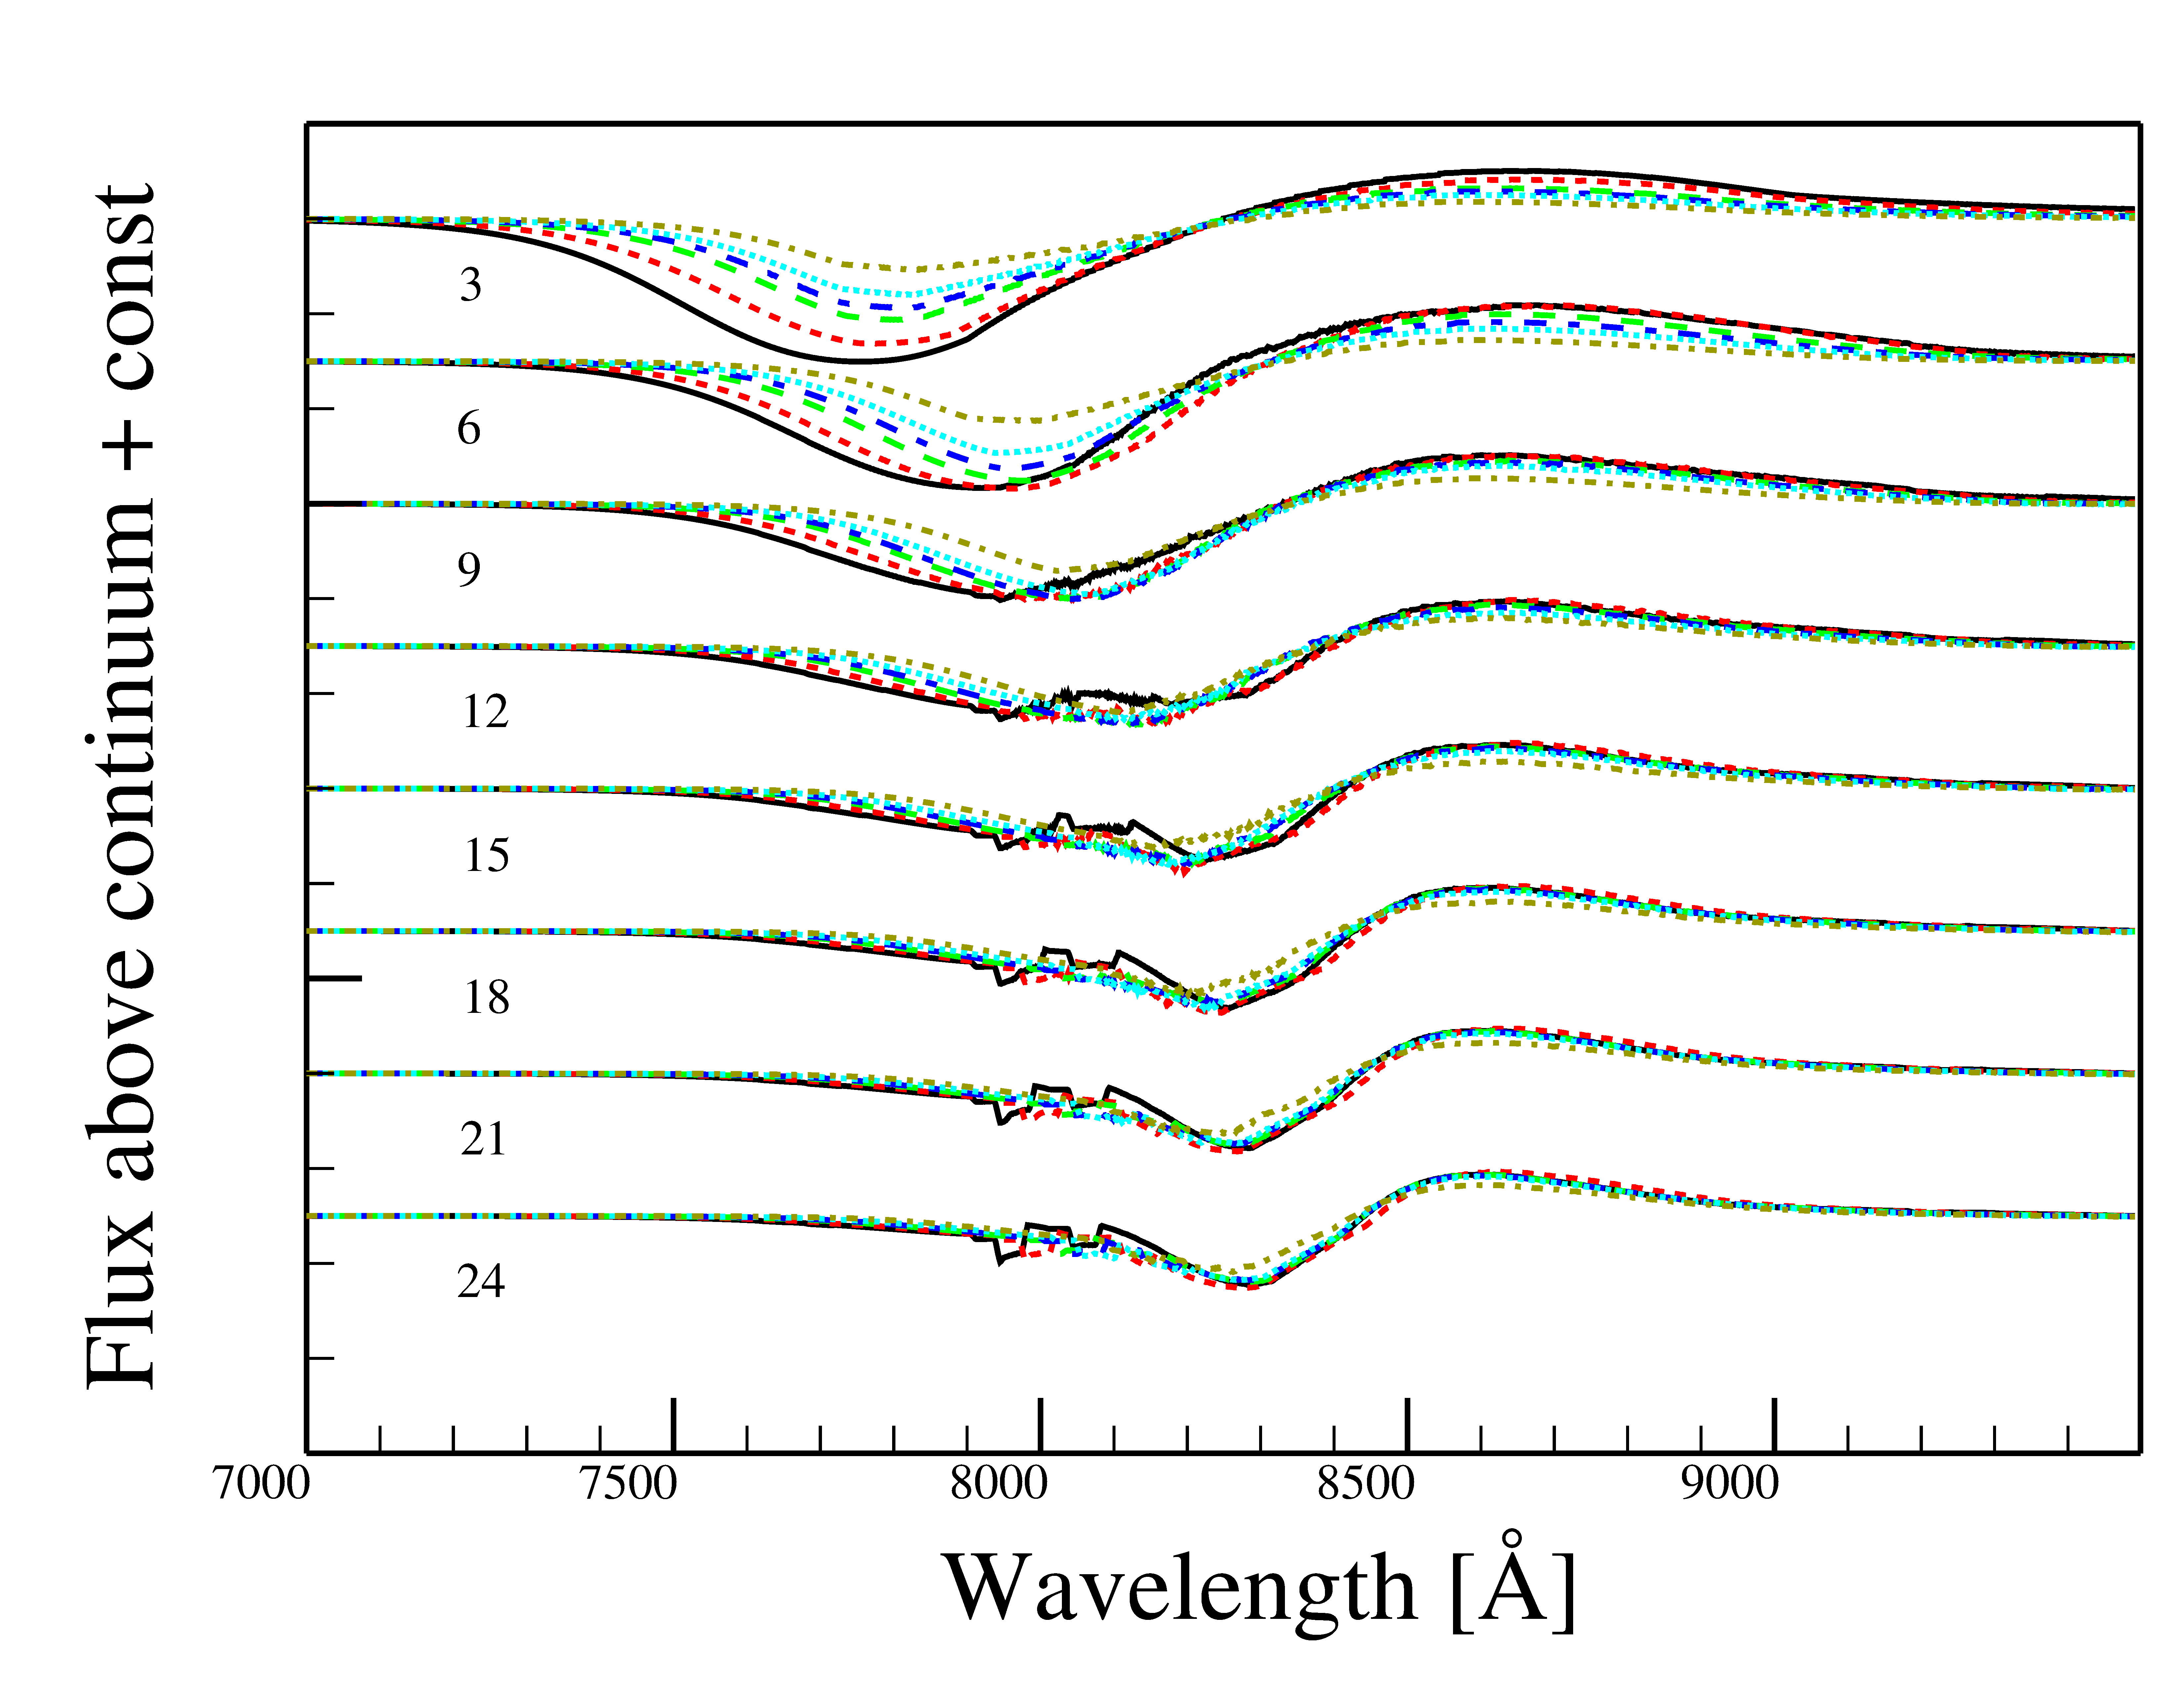
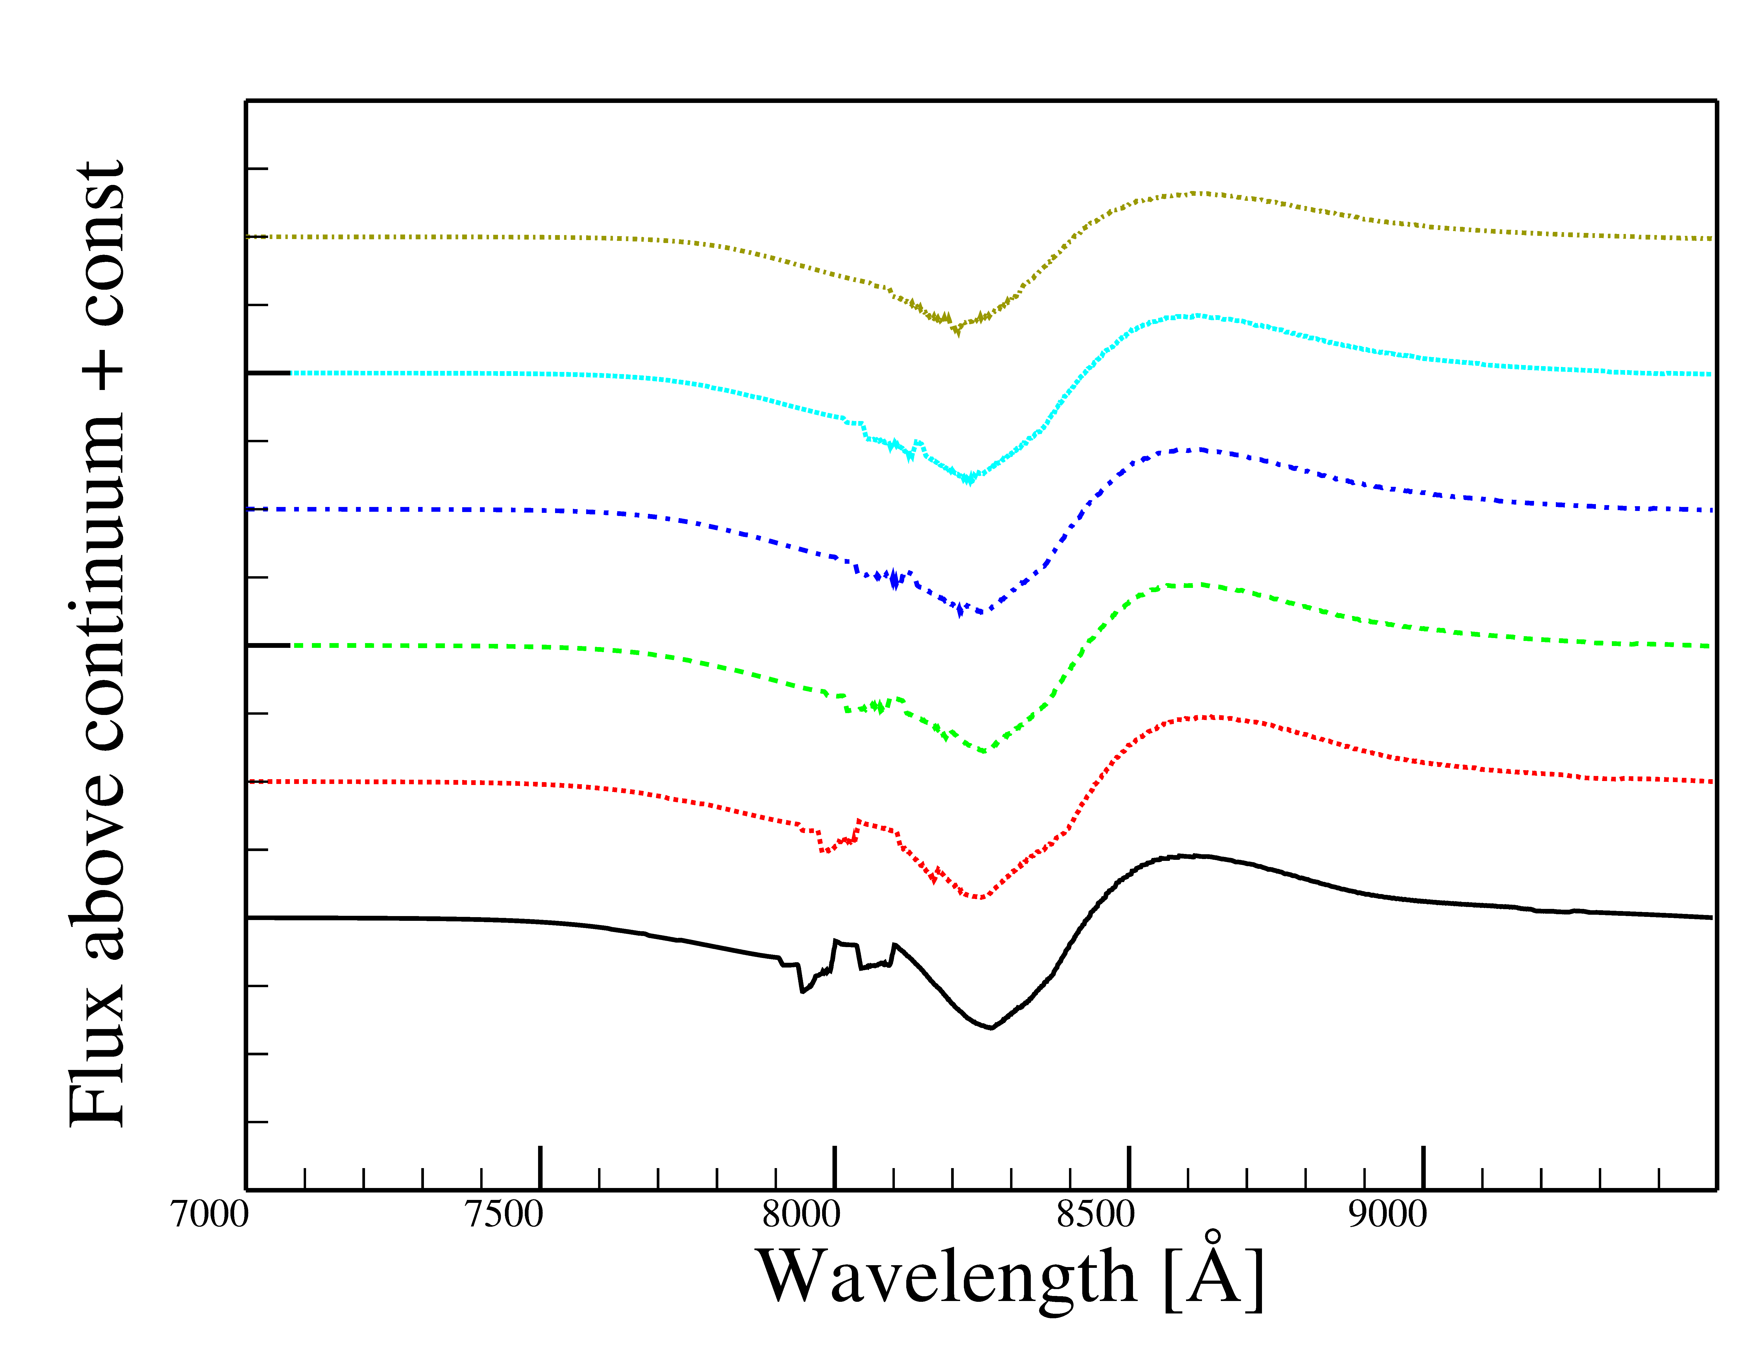
Synthetic Spectra
0.02 M_{sun}
0.003 M_{sun}
Mulligan & Wheeler 2017

Slide 19
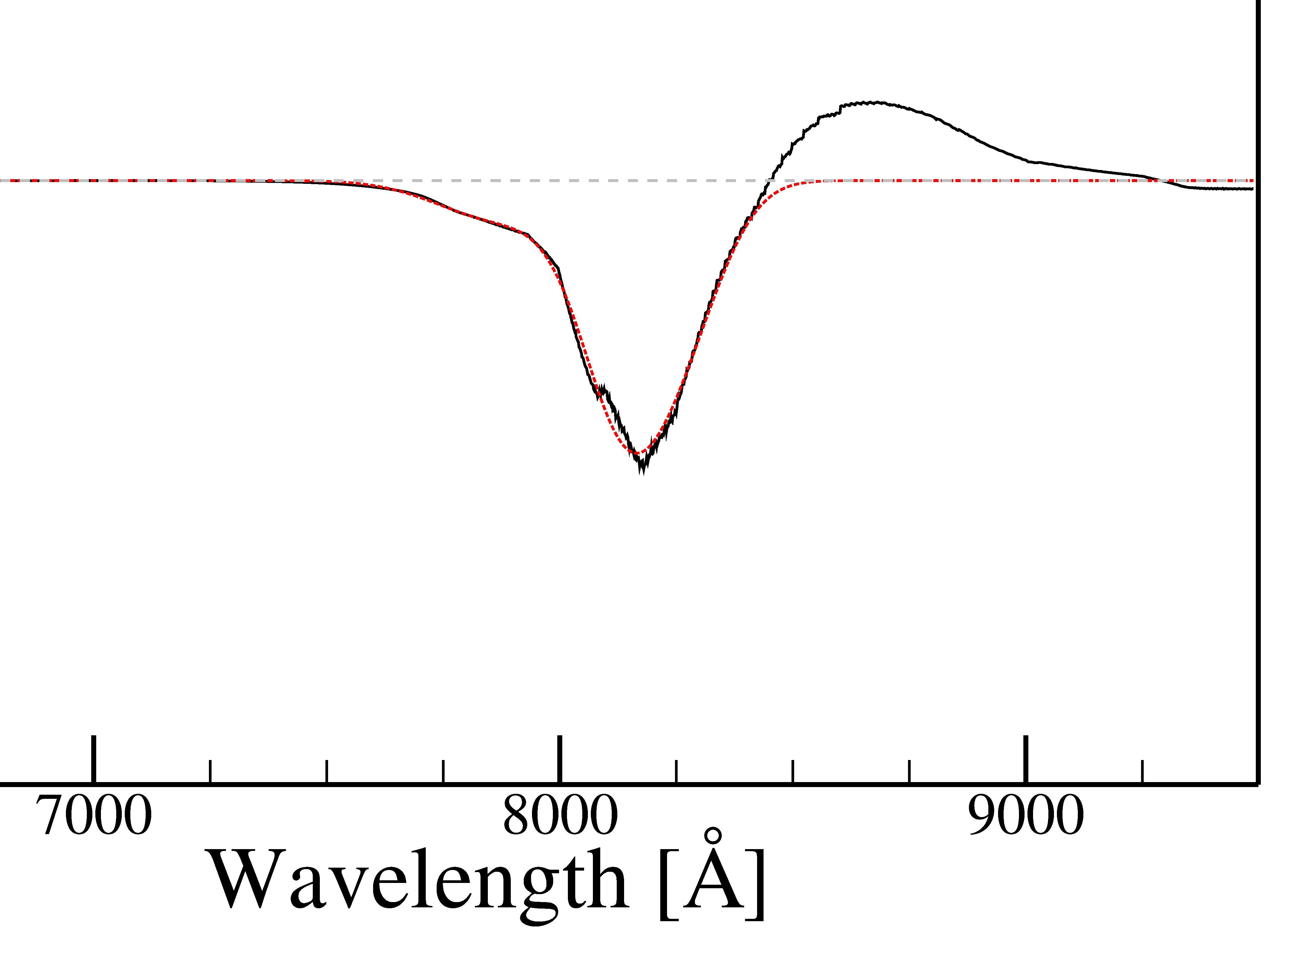
Gaussian fitting for pEW & Velocity
P Cygni method
Absorption method

Slide 20
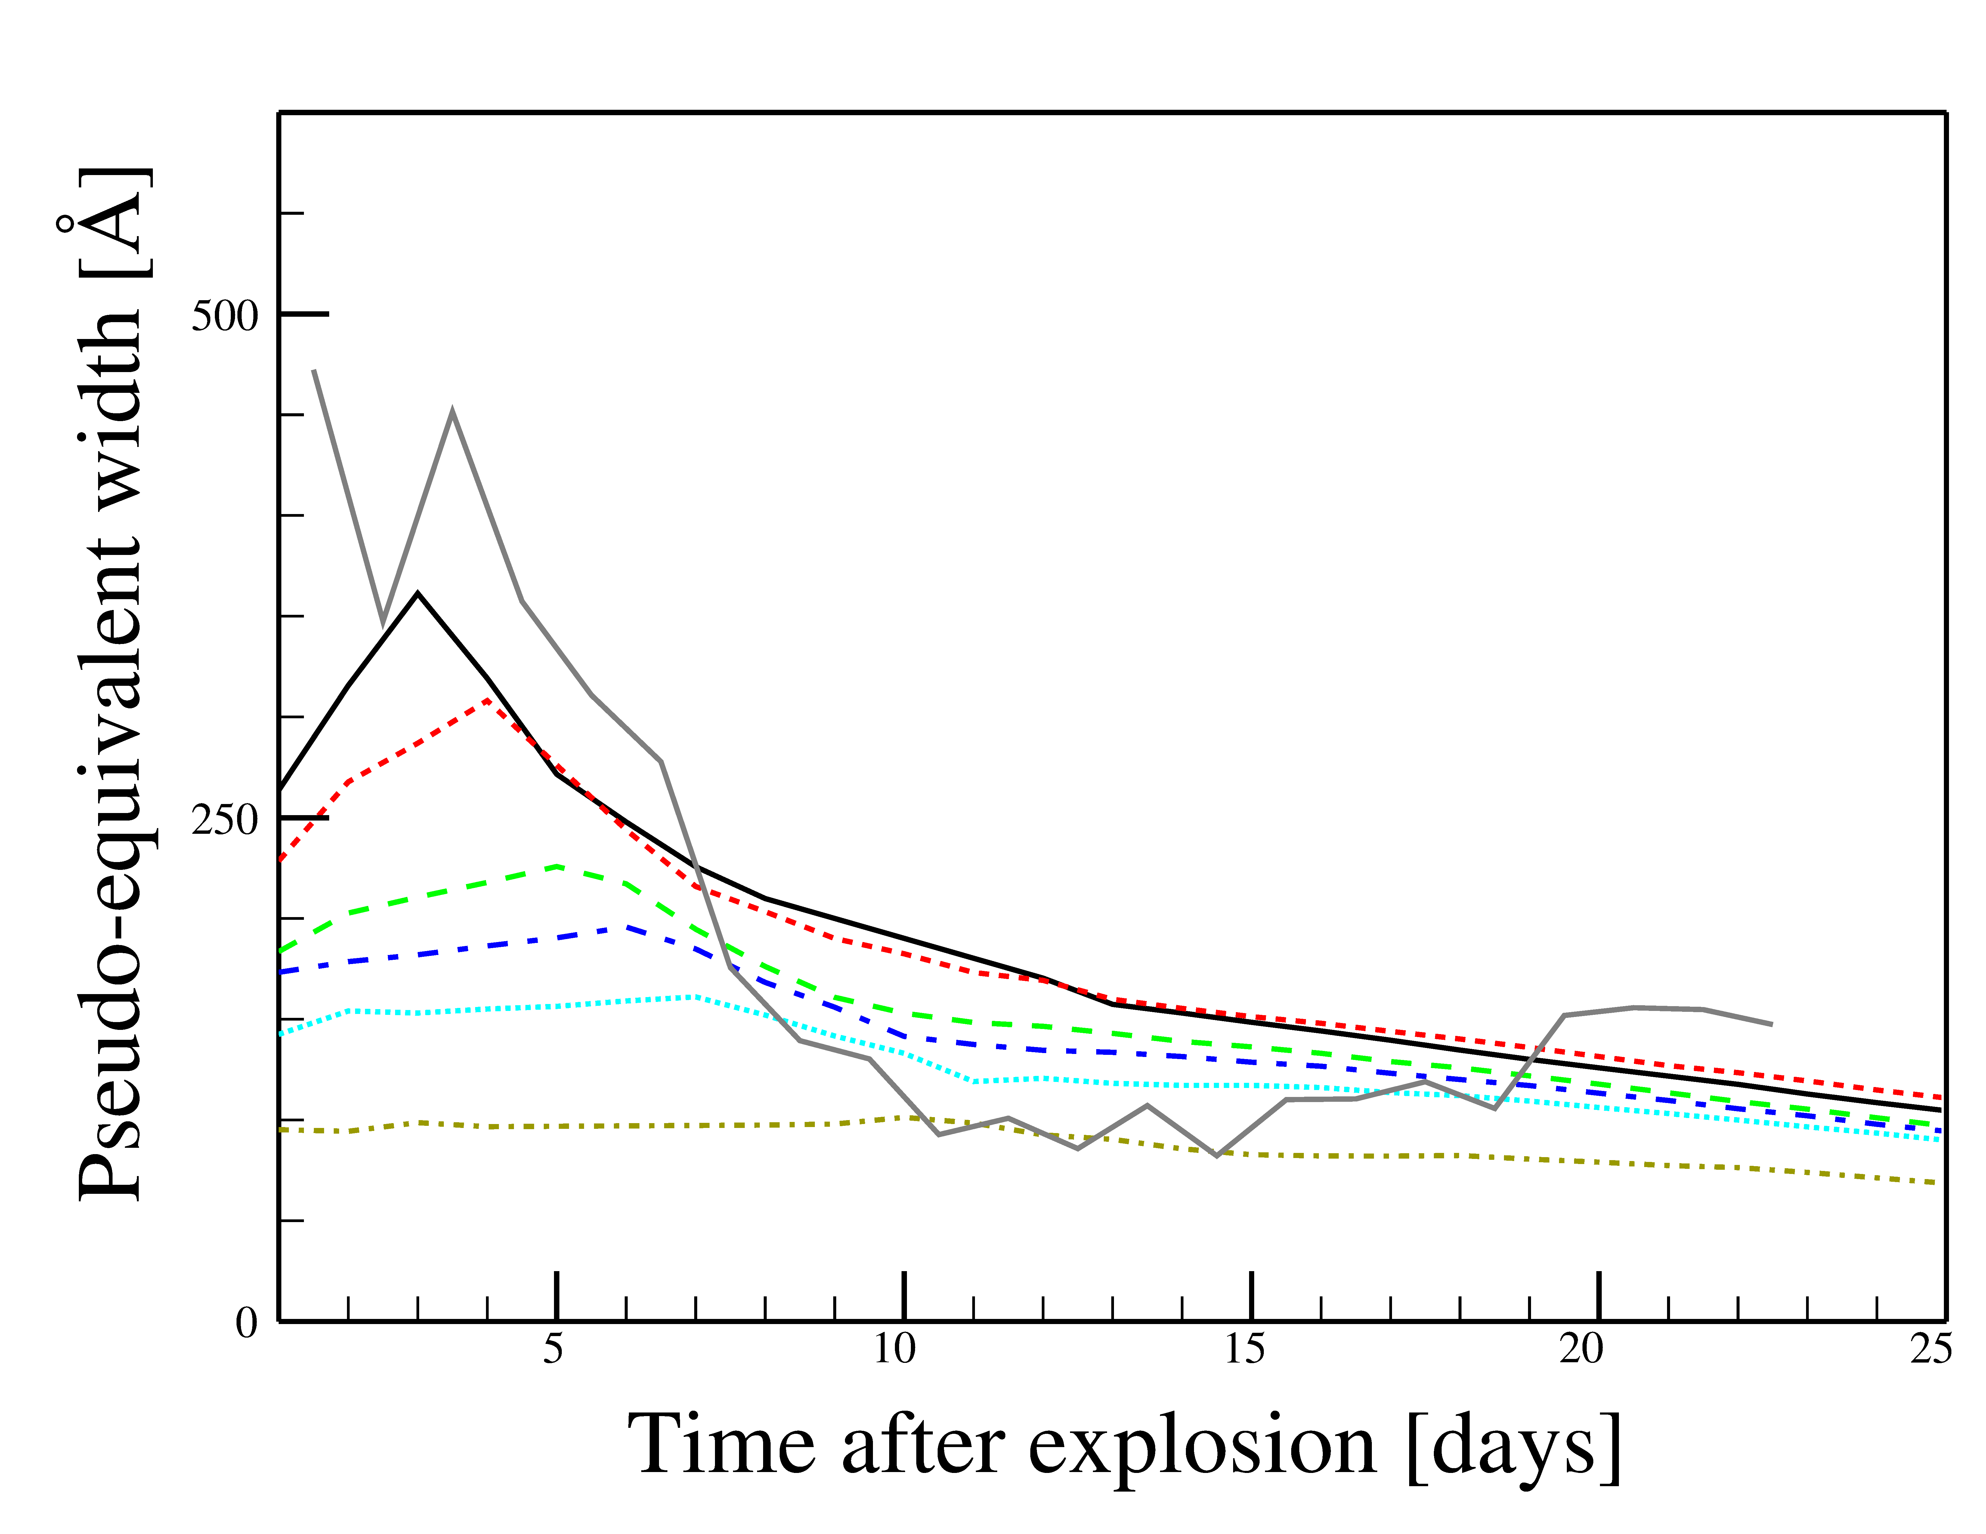
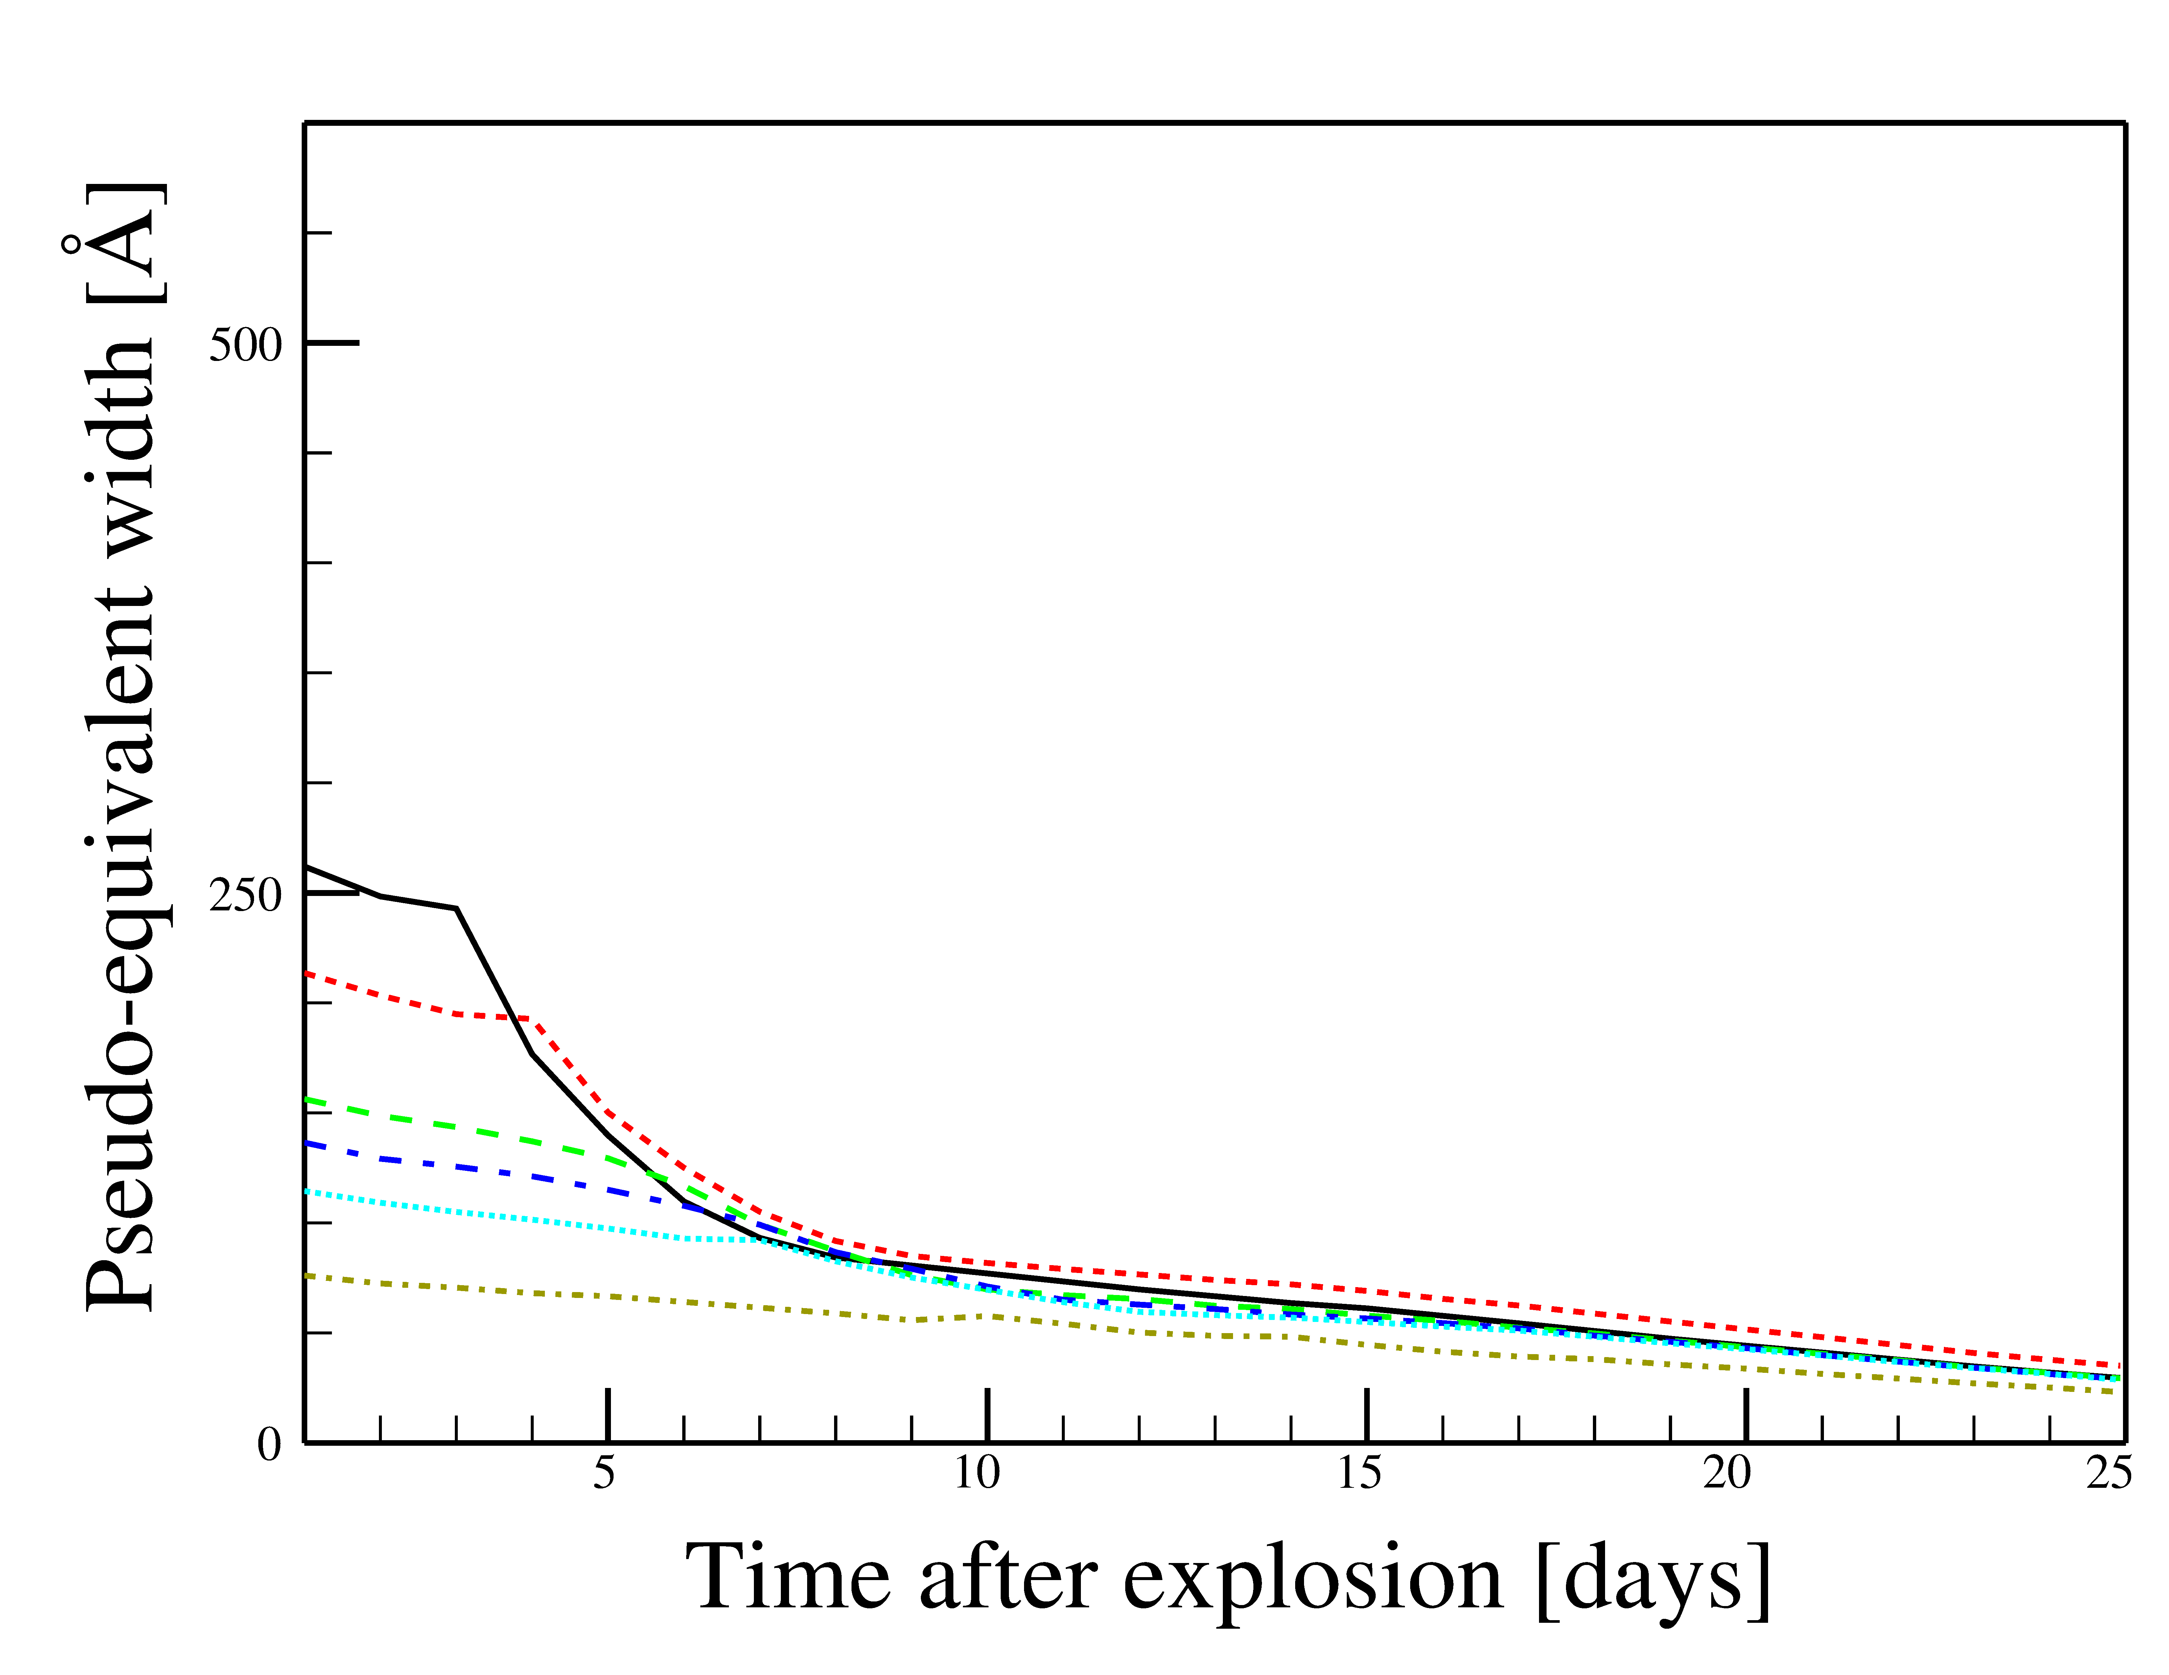
Evolution of pEW
Mass
Mean Observed SN
P cygni method
Absorption method
Mulligan & Wheeler 2017, MNRAS
Mass: 0.003 – 0.02 M_{sun}

Slide 21
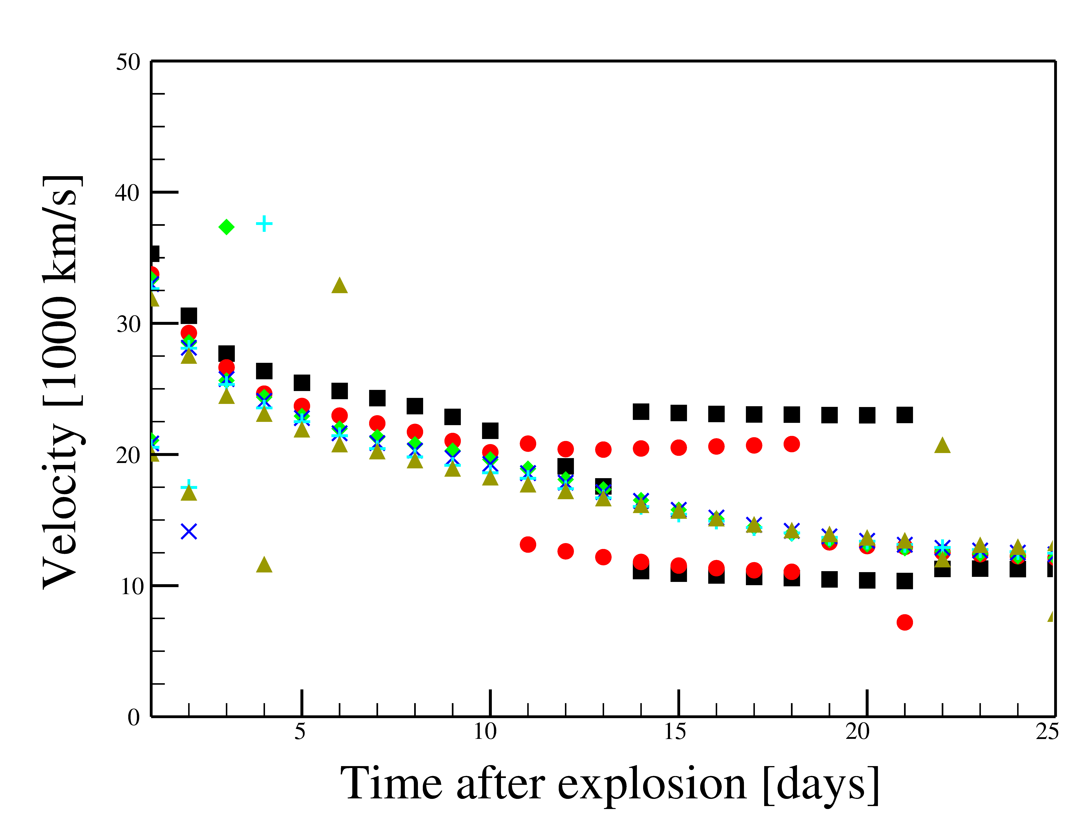
Evolution of Velocity
Black(Square)=0.003 M_{sun}
Red(Circle) = 0,005 M_{sun}
Others=0.008 – 0.02 M_{sun}
(Mulligan & Wheeler 2017)

Slide 22
Fitting to SN 2011fe
PRELIMINARY
Red = model (0.005 Msun)
Black = Pereira et al. (2013)
MJD 55801.2
B-max – 13.3d
t_{exp} + ~6d
O II
Wavelength [Angstroms]

Slide 23
Shell composition
α = time dependance of optical depth; α = 2 (Sobolev, free exp.)
S = scalar factor
G(v) = normalized profile generated from hydrodynamic data
t~ 1d: n(contact discontinuity) ~ 10¹³ cm⁻³
χ=line specific paramters (oscillator strength, wavelength, etc.)
g = statistical weights
f = fraction of elements in lower and upper states of transition
Computed assuming
X = abundance
X_{Ca} >~ O(10⁻⁴) for τ ~ 1
PRELIMINARY

Slide 24
Summary
High velocity features in Type Ia SNe
  90% of SNe
  ~10,000 km/s faster that ejecta
  Ca, occasionally Si
Compact shell as source
  Excess heat radiates away before observation
  Velocity & pEW evolution
  Mass <~ 0.012+/- 0.004 M_{sun}
  May be highly Ca enriched
Ongoing:
  Fitting to SN 2011fe & other interesting SNe

