Slide 1
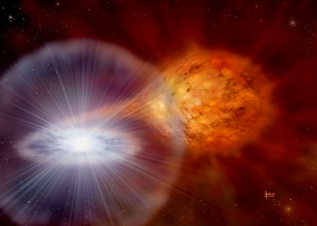
Type Ia SNe - CSM interaction
Credit: David A. Hardy
Brian W. Mulligan
Committee:
Volker Bromm
Milos Milosavlevic
Rob Robinson
Jozsef Vinko
Advisor: J. Craig Wheeler
Collaborators:
G. Howie Marion
Jeffrey Silverman
Jozsef Vinko
31 Jan 2017
University of Texas at Austin

Slide 2
Overview
Overview of my work
Update since Fall 2015
Projected timeline

Slide 3
High velocity features
Type Ia supernova (~90%)
Revealed by spectroscopy within ~3 weeks of explosion
>~ 10,000 km/s faster than “typical” ejecta
Ca, sometimes Si

Slide 4
My work
Explore HVF in Type Ia due to SN-CSM interaction
Hydrodynamic simulation (FLASH)
  Type Ia supernova model (Gamezo et al. 2005)
  Circumstellar shell models
Synthetic spectra (syn++, customized)
Estimate Ca abundance in models

Slide 5
Update from Fall 2015
Last meeting: 1 Dec 2015
Spring 2016
  TA: AST 309 (Craig)
  Completed work on first paper focused on methods of hydrodynamics and synthetic spectra generation.
  Submitted paper 11 May 2016
    Initial referee report vauge
    Responses to referee: 17 Aug, 10 Oct, 21 Dec.
  Paper accepted 30 Dec
  Now in proof stage (submitted today)

Slide 6
Update from Fall 2015
Summer 2016
  Ref. response
  Beginning work on re-fitting models to 2011fe
    Use complete data set available from new Open Supernova Catalog (Ref of 2015 paper noted that we used only used a limited data from one paper).
  Initial estimates for ionization and excitation states of Ca in purely radiative environment
    Based on comment from ref of paper I.
    Deem sufficiently involved to remove from paper I and develop as separate project

Slide 7
Update from Fall 2015
Fall 2016
  TA: Signature Course (Karl)
  Began computational project to estimate ion. And excit. States of Ca in radiative environment (presented method in Theory seminar, Oct 2016) with goal of estimating Ca abundance in HVF
  Ref response.

Slide 8
Update from Fall 2015
Winter 2016/17
  Back injury & father passed
  Ongoing work on computational project
    Completed initial computational component for estimating states; numerical limitations allow only lower bound
  Ongoing work on fitting to 2011fe
    Use equivalent width and wavelength (velocity) of minimum of feature for fitting instead of variance.
  Presented dissertation talk at AAS
    Presented preliminary results of fitting to 2011fe & estimate for Ca abundance
    Seemed well received. Rob & Craig in attendance.

Slide 9
Plans this semester
Spring 2017:
  TA: AST 301 (Rob)
  Complete comp. Project for estimating Ca abundance
    Some analysis left, but bulk of work complete
    Paper in progress
  Complete 2011fe fitting project
    Still trying to improve quality of fits
    Paper will be recycled from 2015 version, with references to recent MNRAS paper
  Dissertation and defense late spring?

Slide 10
Post-graduate
Political and science funding climate
Software &/| data science
Adjunct teaching
  Build teaching resume for eventual position at undergrad only institution or community college.
Still would like to do some astronomy related research

