Slide 1
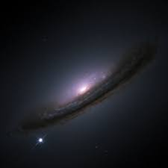
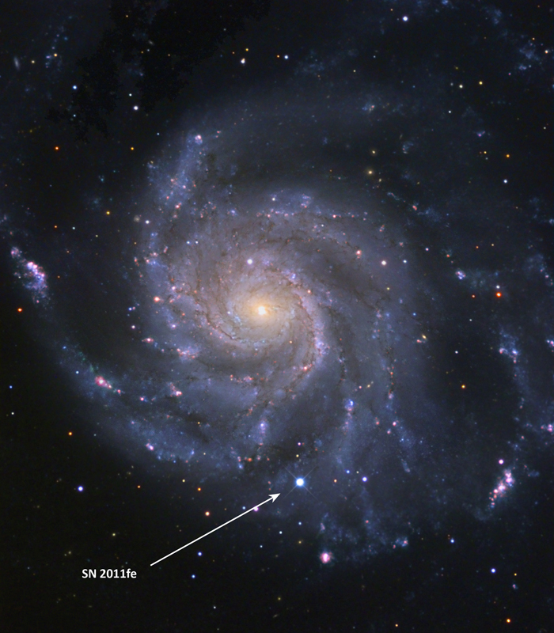
Type Ia supernovae
Brian W. Mulligan
University of Texas at Austin
Astronomy Students Association
University of Texas at Austin
30 Nov 2016

Slide 2
History of Supernovae
“In the second year of the Zhongping reign period, the tenth month, on a Guihai day (December 7, 185 [CE]), a ‘guest star’ emerged within the Southern Gate (Nanmen, an ancient Chinese asterism, near α Cen).It seemed to be as large as half a yan, with scintillating, variegated colors, and it then grew smaller, until in the sixth month of the hou-year (hou-nian, 24 July to 23 August 187 [CE]), it disappeared.”
  (Zhao, Strom & Jiang 2006)
Later: 393 CE
Also maybe: 369 CE, 386 CE, 437 CE, 827 CE, 902 CE
Notes:
Zhao FY; Strom RG; Jiang SY (2006). "The Guest Star of AD185 Must Have Been a Supernova". Chinese J Astron Astrophys. 6 (5): 635–40.

Slide 3
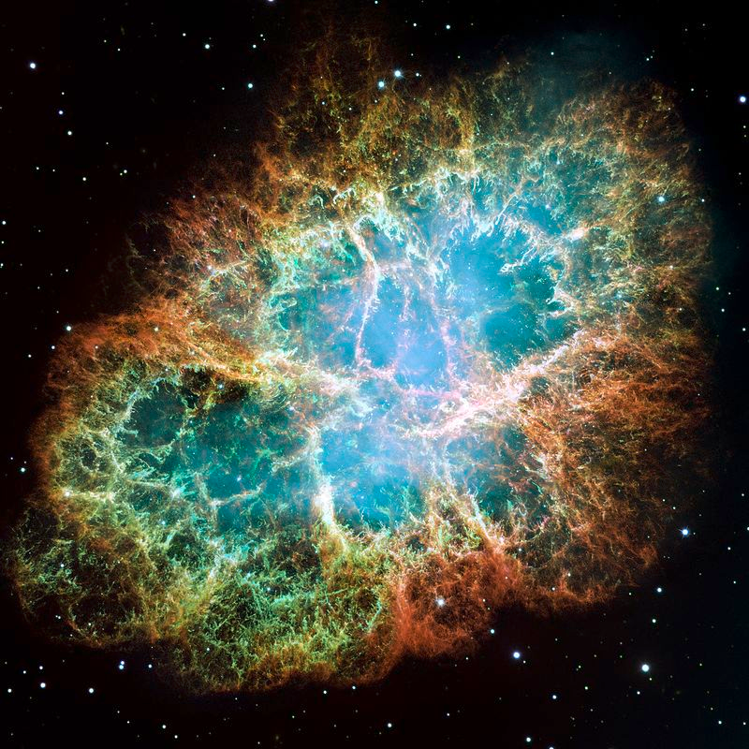
History of Supernovae
1006 CE: China, Egypt, Iraq, Italy, Japan, Switzerland
1054 CE: China, Japan, Middle East, Anasazi

Slide 4
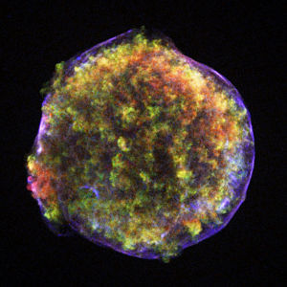
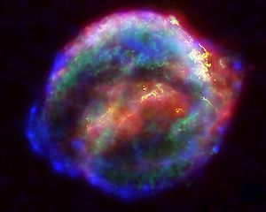
History of Supernovae
1572 CE: Europe, China
“Tycho’s supernova”
1604 CE: Europe, China, Japan
“Kepler’s supernova”

Slide 5
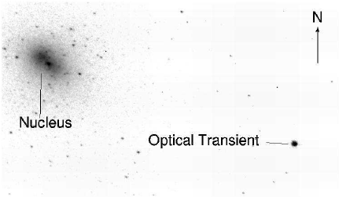
History of Supernovae
  Modern astronomy! (We have telescopes)
1800s: Bursting stars, ordinary novae
1885: Ludovic Gully – bright star in Andromeda
(Fesen et al. 1999)

Slide 6
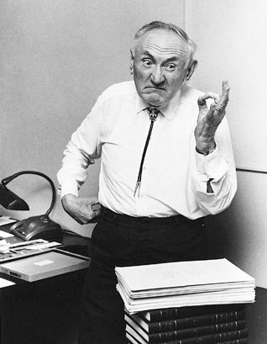
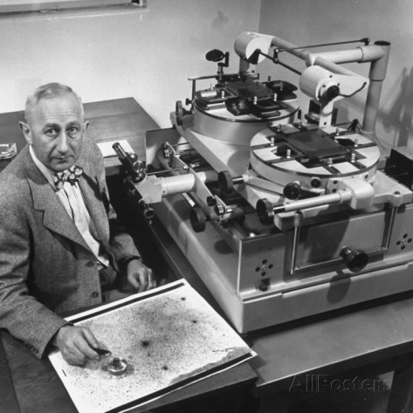
History of Supernovae
1930s: Fritz Zwicky and Walter Baade
  Supernova: a star that suddenly brightens to be as bright as an entire galaxy

Slide 7
History of Supernovae
SN 1054: The Crab Nebula
1938: Walter Baade
Crab Nebula
Expanding Rapidly
Exploded ~900 years prior

Slide 8
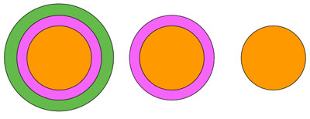
History of Supernovae
1941: Rudolph Minkowski
  Type I (no H) and Type II (H)
1970s: Type I → Type Ia, Ib, Ic
H
He
He
C,O
Si,Ca
Fe
C,O
Si,Ca
Fe
C,O
Si,Ca
Fe
II
Strong H
I (a,b,c)
Ib
He
Ic
No He
Ia
Si
No He

Slide 9
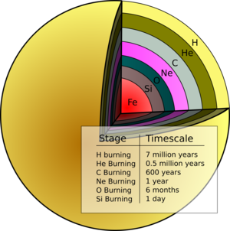
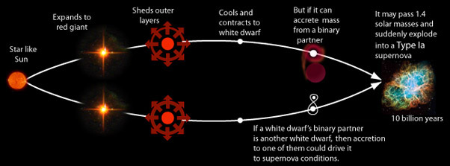
Supernova Types
Type II, Ib, Ic: Massive Stars
Type Ia: Binary Sun-Like Stars

Slide 10
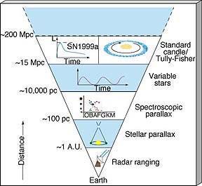
Type Ia Supernovae
1.44 x Mass of the Sun
Always the same brightness
1998: High-Z Supernova Team (Schmidt, Reiss, et al.)
1999: Supernova Cosmology Project (Perlmutter et al.)
Dark Energy – Accelerating expansion of the universe

Slide 11
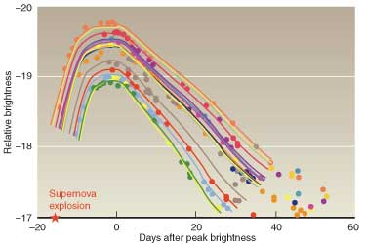
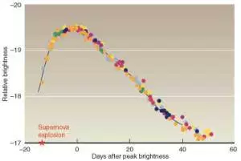
Type Ia Supernovae
Always(ish) the same brightness
9
5
Brightness (billions of suns)
3
1
0.5
0 20 40 60
0 20 40 60
Time (days)

Slide 12
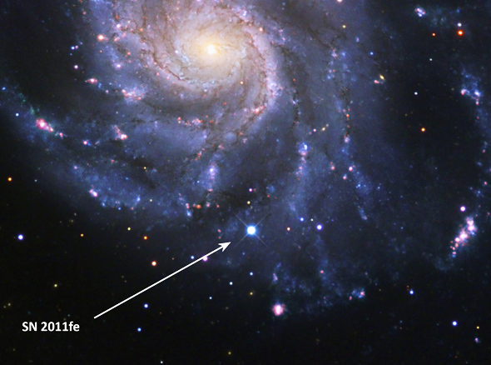
What are SN Ia?
Pinwheel Galaxy (M101)

Slide 13
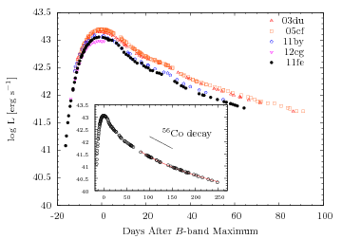
SN 2011fe light curve
10
Brightness (billions of suns)
1
0.1
0.01
(Zheng et al. 2016)

Slide 14
SN 2011fe as a white dwarf
10
23 August 2011 10:59 pm (CDT)
Brightness (billions of suns)
Explosion (est.):
23 August 2011 10:29 am (CDT)
1
0.1
Bloom et al.:
No detection
23 August 2011 ~2 pm (CDT)
0.01
(Zheng et al. 2016)
SN 2011fe must be very small (R < Rsun)

Slide 15
Type Ia supernova physics
Pressure
White dwarf
Carbon & Oxygen
Very dense
~ mass of sun
but the size of Earth
Quantum pressure
electrons refuse to get
too close together
Gravity

Slide 16

Type Ia supernova physics
White Dwarf
Carbon & Oxygen
Pressure
Gravity
Magic mass:
1.44x mass of Sun
Chandrasekhar Limit
Gravity beats electron pressure

Slide 17
Type Ia supernova physics
Unburned C/O
O, Mg, Ne
Ca, Si, S
Fe, Co, Ni

Slide 18
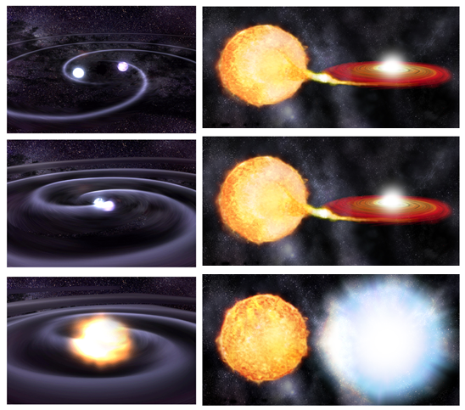
How does it gain mass?

Slide 19
Can we tell these apart?
Statistics:
Observe binary white dwarfs
Need: right mass (1.44x mass of sun or more)
merges sometime within the age of the universe
Observe binary stars
Need: right mass (1.44x mass of sun or more)
close enough to transfer material
can’t be a normal nova

Slide 20
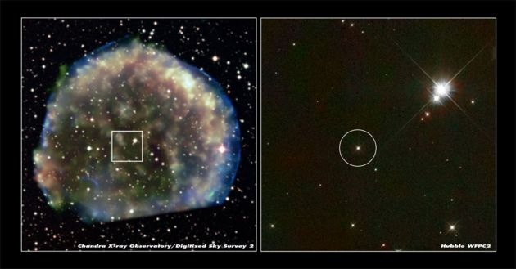


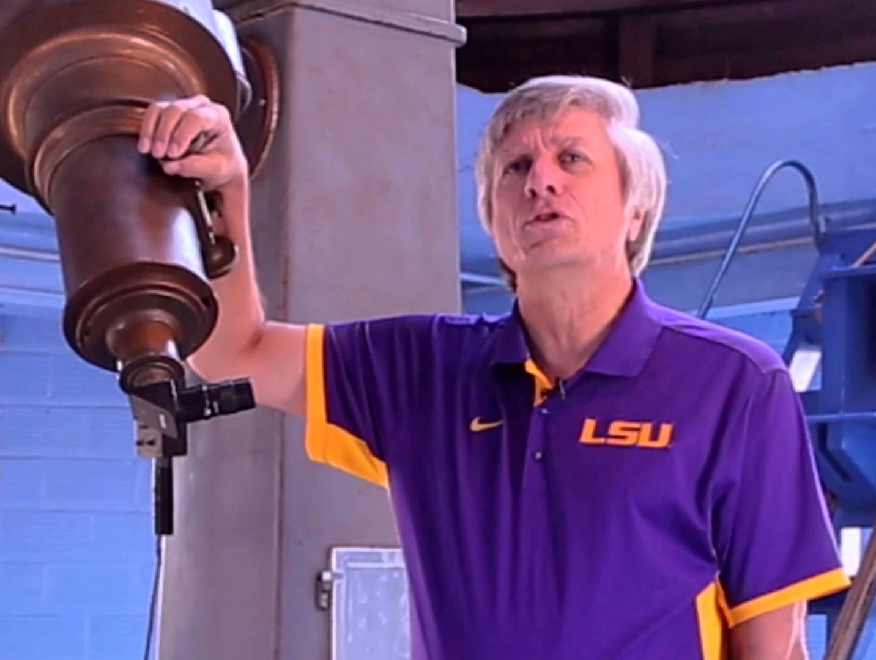
Can we tell these apart?
Search for normal star left behind?
Pilar Ruiz-Lapuente
Bradley Schaefer
Ashley Pagnotta

Slide 21
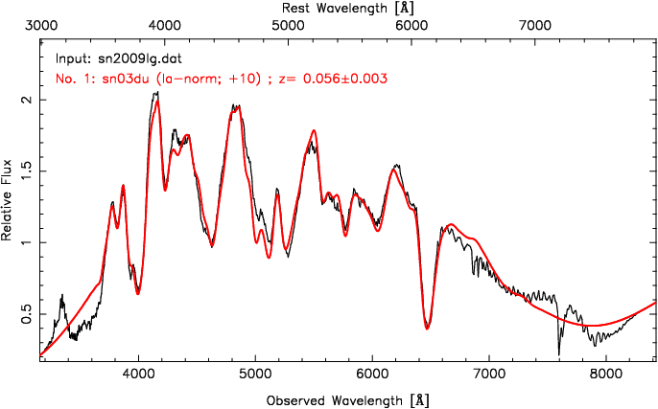
Can we tell these apart?
Look for clues in the material of the explosion
H?
He?
C/O?
Other stuff?
Mg
Si
S
Ca
Si
Fe
Fe
O
Ca

Slide 22
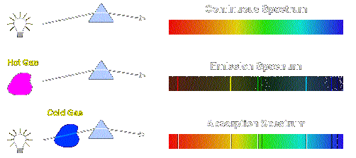
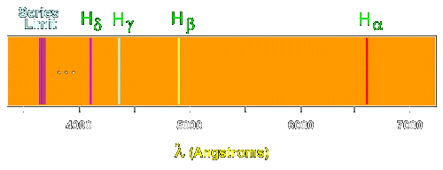
Interpreting Spectra

Slide 23

Redshift / Blueshift

Slide 24
Velocity of material
Unburned C/O
O, Mg, Ne
Ca, Si, S
Fe, Co, Ni
10-15,000 km/s
20,000 km/s
Velocity
-20,000 km/s

Slide 25
The times they are a-changin’
1st week: outermost layers
2-4 weeks: middle layers
Months – years: inner layers

Slide 26
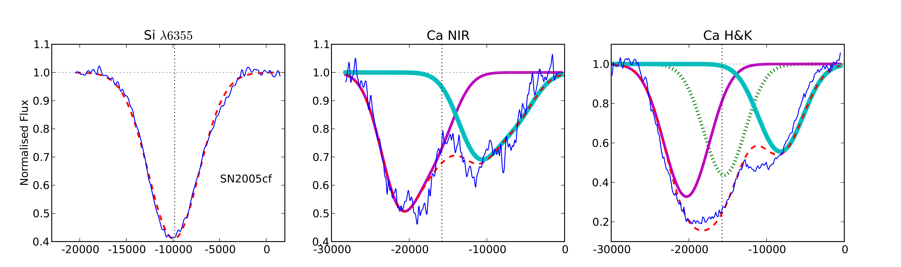
Outermost layers – high velocity
(Childress et al. 2014)
Fast moving stuff (>~20,000 km/s)
Regular stuff (~10,000 km/s)

Slide 27
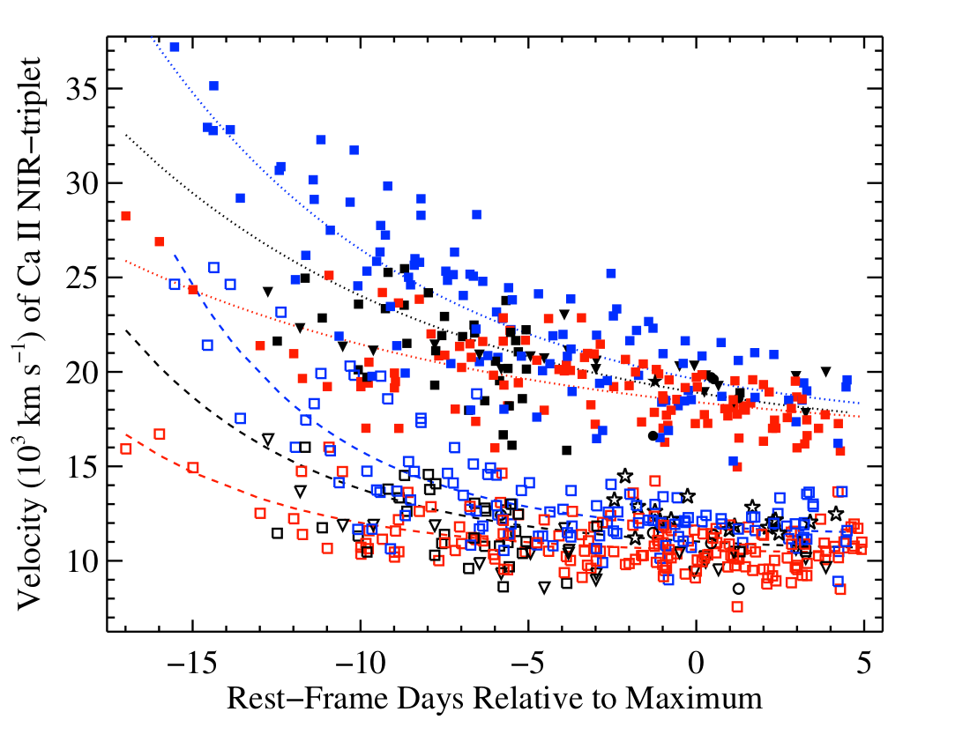
High velocity stuff vs normal stuff
(Silverman et al. 2015)

Slide 28
Unburned C/O
O, Mg, Ne
Ca, Si, S
Fe, Co, Ni
HV material

Slide 29
High velocity bullets?
C/O/Mg/S/Si, etc
Drag some stuff on the way out

Slide 30
Stuff from companion
1: similar to sun
2: He or C/O, with small mix of other stuff

Slide 31
Surface explosion
He shell
He, Ca, sometimes Si

Slide 32
The effect of the shell
Mass:
0.003 M_{sun}
0.005 M_{sun}
0.008 M_{sun}
0.010 M_{sun}
0.012 M_{sun}
0.020 M_{sun}

Slide 33
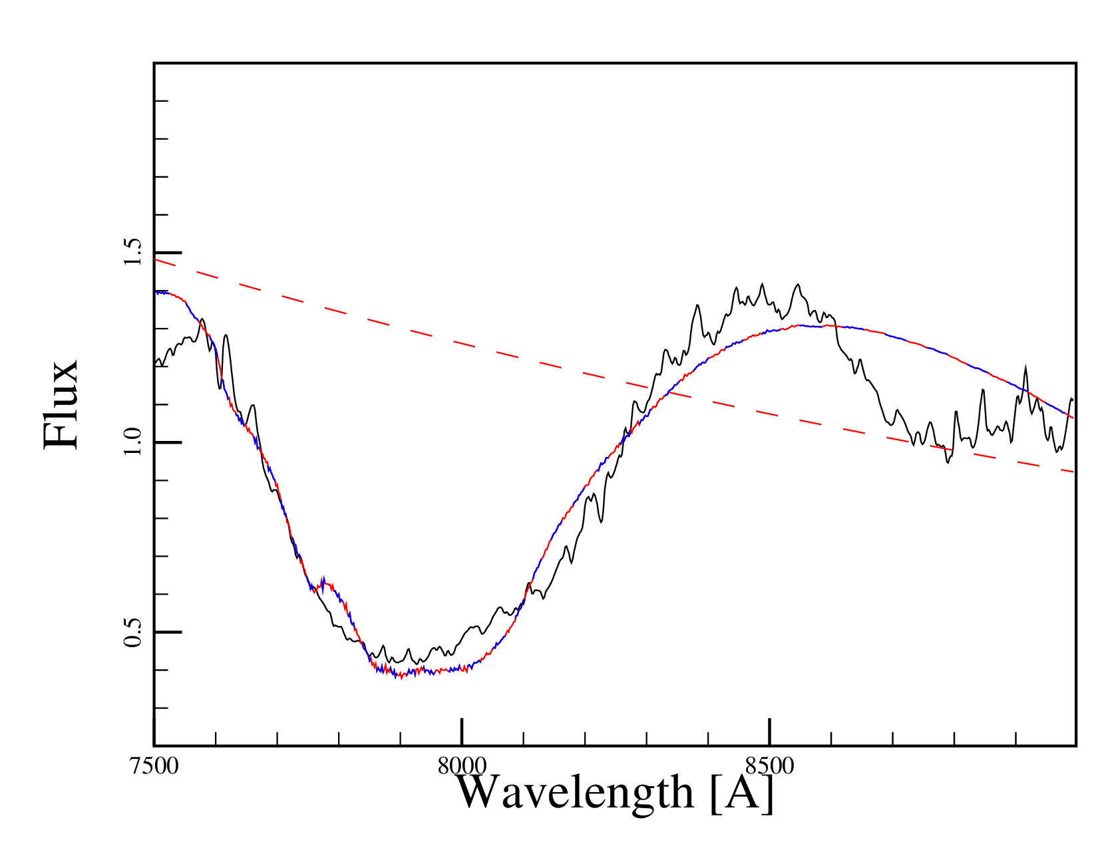
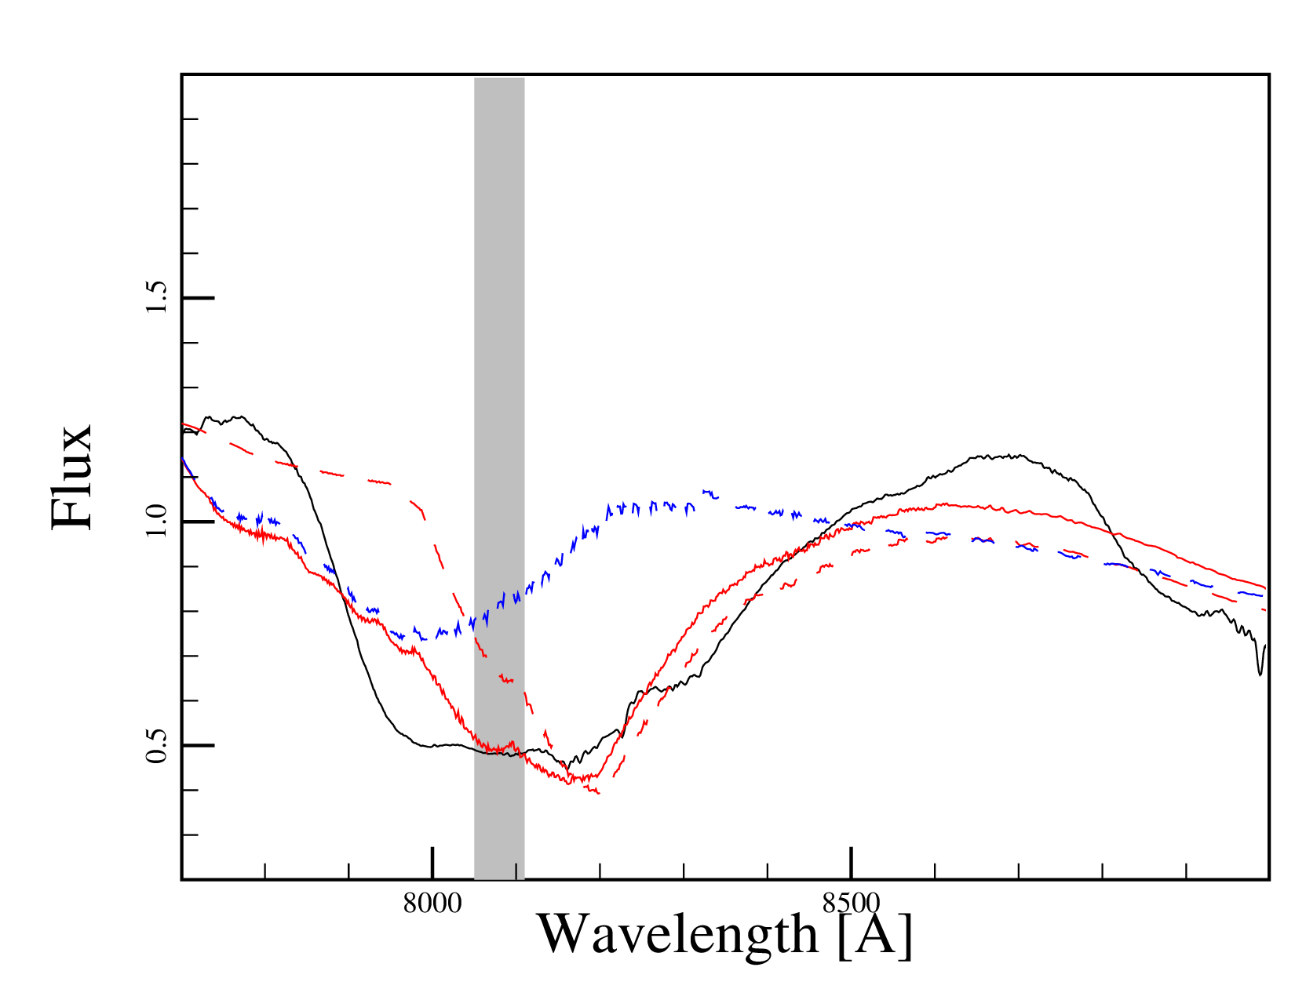
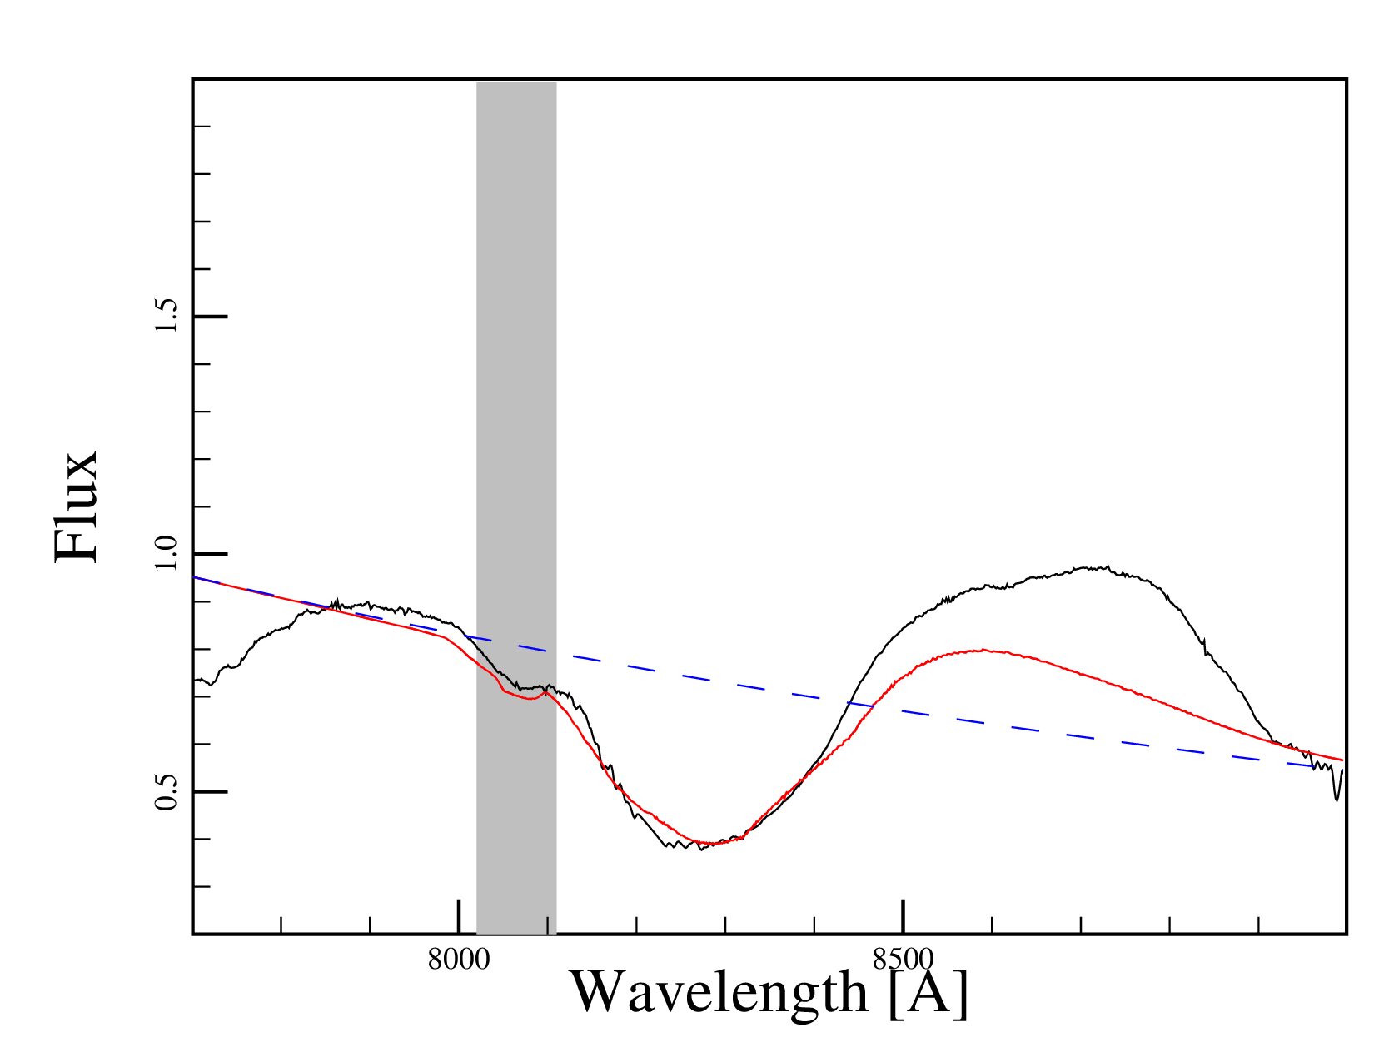
~2 days after explsion
~6 days after explosion
Red, solid:
Fit
Blue, dashed:
Shell
Red, dashed:
Ejecta
SN2011fe data:
Parrent+ 2012
~20 days after explosion
Mulligan & Wheeler, in prep

Slide 34
Surface explosion?
He shell
Mass of shell, Calcium abundance consistent (?) with this model
(Hoping to have specific results by January)

Slide 35
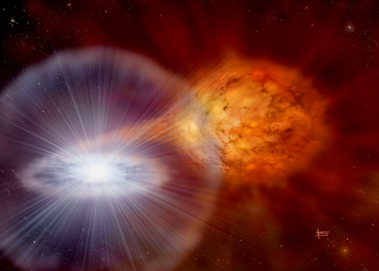
Summary
Supernovae: exploding stars
Type Ia supernova: exploding white dwarfs
  Very useful for cosmology
  Don’t know what causes them to explode
  Hints in light and spectra soon after explosion
  Ca enrichment in outermost layers?
    May point to surface explosion model

