Slide 1
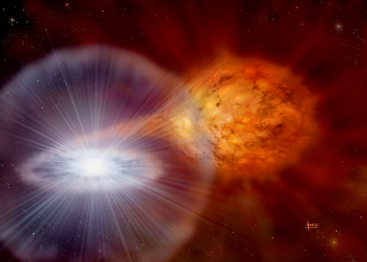
Type Ia supernovae, circumstellar shells, and high velocity lines: 1-D simulation
Credit: David A. Hardy
Brian W. Mulligan
Feat. J. Craig Wheeler, Jeffrey Silverman, G. Howie Marion, and Jozsef Vinko
6 Oct 2014
University of Texas at Austin

Slide 2
Overview
Type Ia supernovae
Early observations: high velocity lines
Interaction between supernova and circumstellar medium
Our 1-D simulations & results to date

Slide 3
Type Ia Supernovae
Standardizable candles, used for measurements of Hubble flow
Chemical enrichment (Fe) of the universe
C/O white dwarf (SN2011fe)
Chandrasehkar limit via accretion or merger
Rapid burning of C,O to Ni
Credit: David A. Hardy

Slide 4
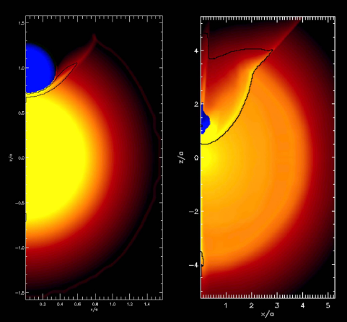
Type Ia supernova
Evidence for companions?
Double degenerate (DD)
  Gravitational waves
Single Degenerate (SD)
  Surviving remnant
Both:
  Early light curve
  Early spectra
“Early” ~= pre-maximum light, first days-weeks after explosion
Maximum light ~18-20 days after explosion
Kasen 2010

Slide 5
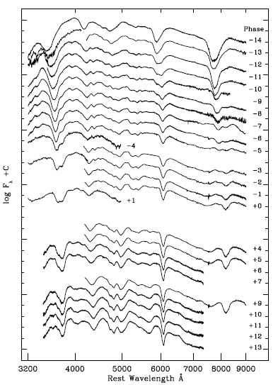
Early spectra (2009ig)
Marion et al. 2013

Slide 6
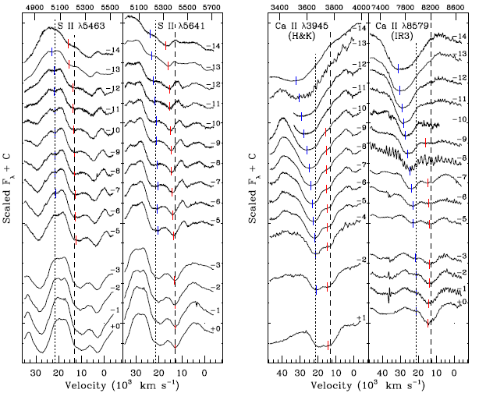
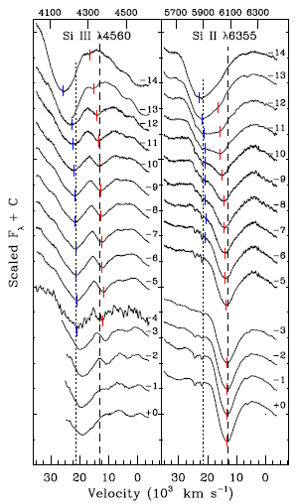
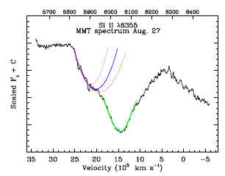
Individual lines in early spectra
Marion et al 2013

Slide 7
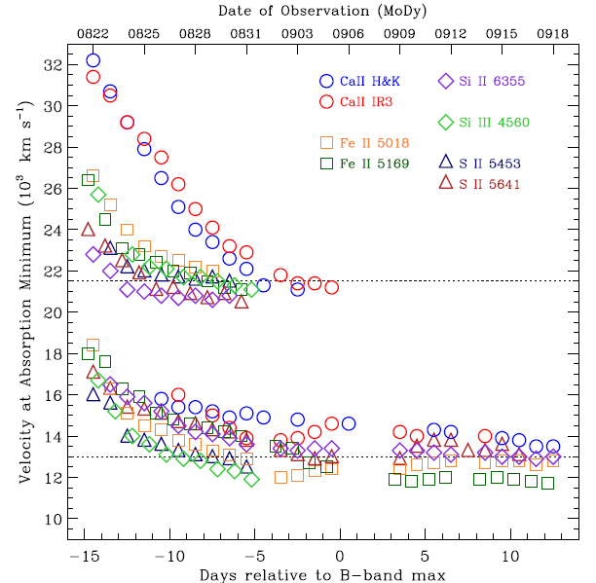
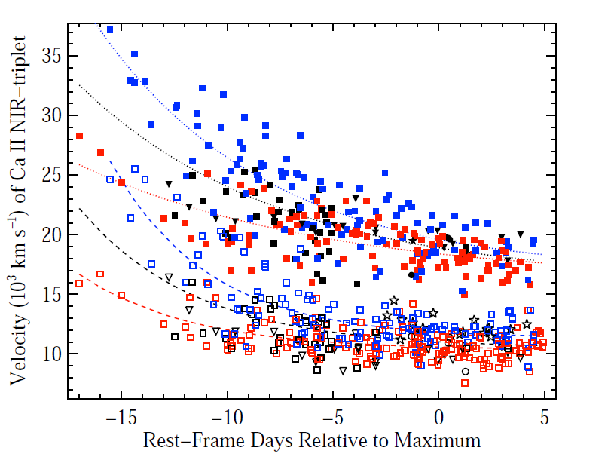
High velocity features
SN 2009ig: Marion et al. 2013
Silverman et al. (in prep)

Slide 8
Questions
What is required to make high velocity features?
What is the source of the material?
(Accretion? Merger? Surface detonation?)
What is the makeup of the material?

Slide 9
Questions
What is required to make high velocity features?
What is the source of the material?
(Accretion? Merger? Surface detonation?)
What is the makeup of the material?
(makeup may point to source)

Slide 10
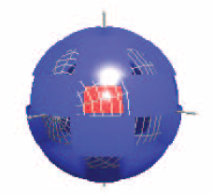
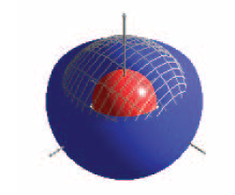
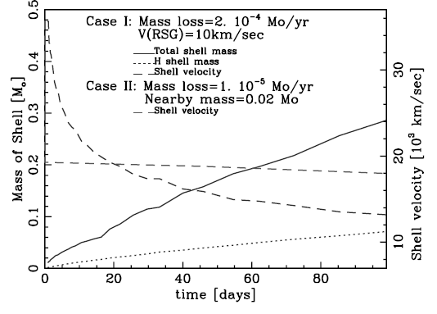
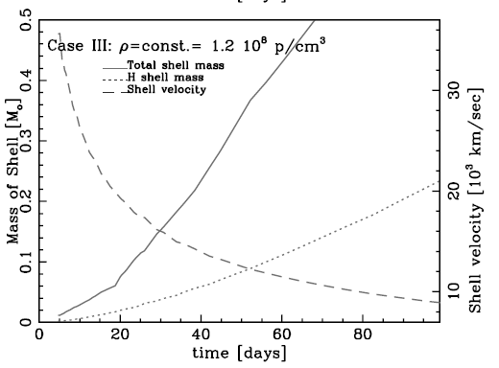
Modeling HV features
(Thick) Toroid or patchy?
  Tanaka 2006
Wind or circumstellar medium?
  Gerardy et al. 2004

Slide 11
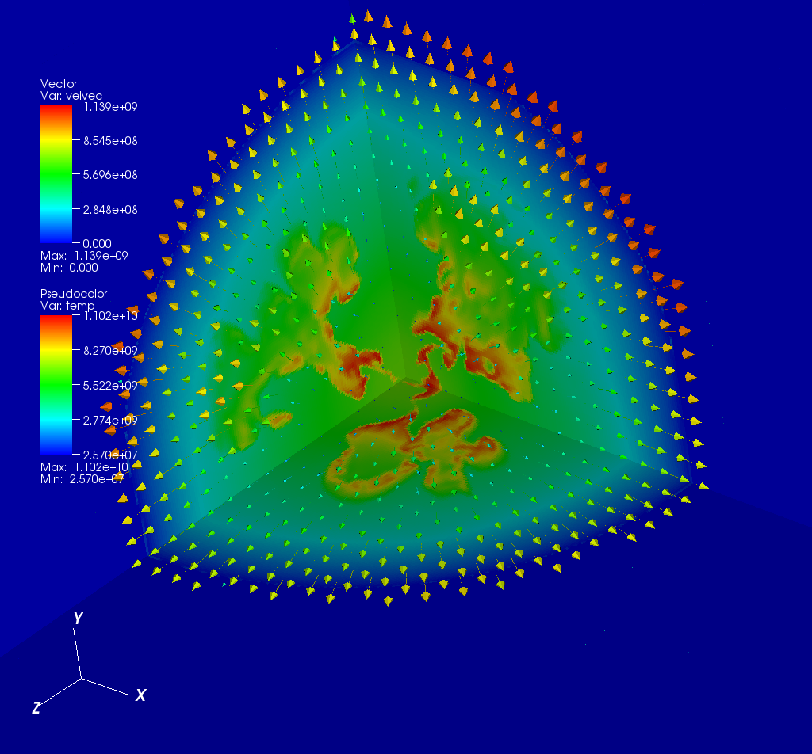
Simulation:
Hydrodynamics
FLASH 4.1
Hydro only, split PPM
AMR
EOS: Helmholtz, Ideal (Gamma law)
Multipole gravity
Multispecies (H,He,α-elements up to Ni-56)
1-D (spherically averaged from model)
tmax = 50s (Constrained by low density limit in Helmholtz EOS)
  Received extended helm table from Frank Timmes (Sept 2014)

Slide 12
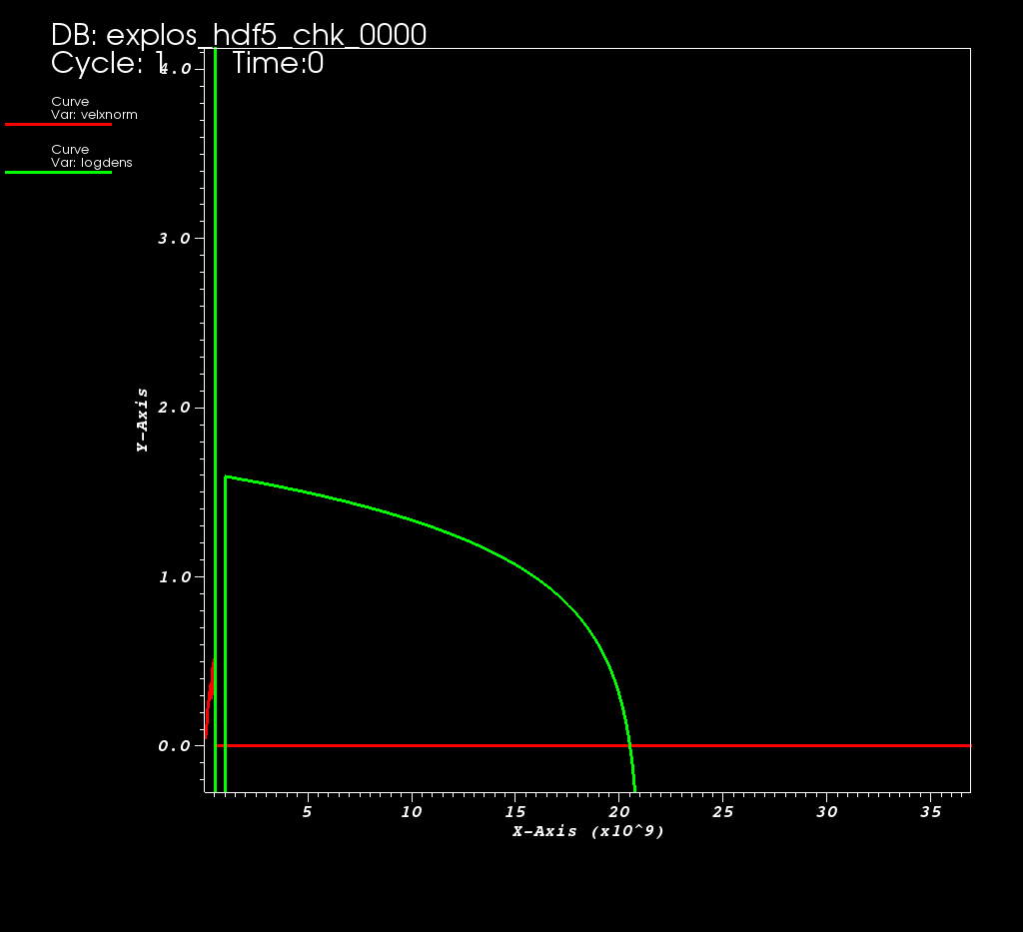
Circumstellar Shell and Medium
Spherically symmetric shell
Free parameters (shell):
  Total shell mass
  Density profile
  Shell initial temperature
  Distance from progenitor WD
  Shell width
  Abundance [solar]
Free parameters (CSM):
  Density
  Temperature
  Abundance [solar]

Slide 13
Shell Geometry

Slide 14
Synthetic spectra
Sobolev Approximation
Optical Depth
Density

Slide 15
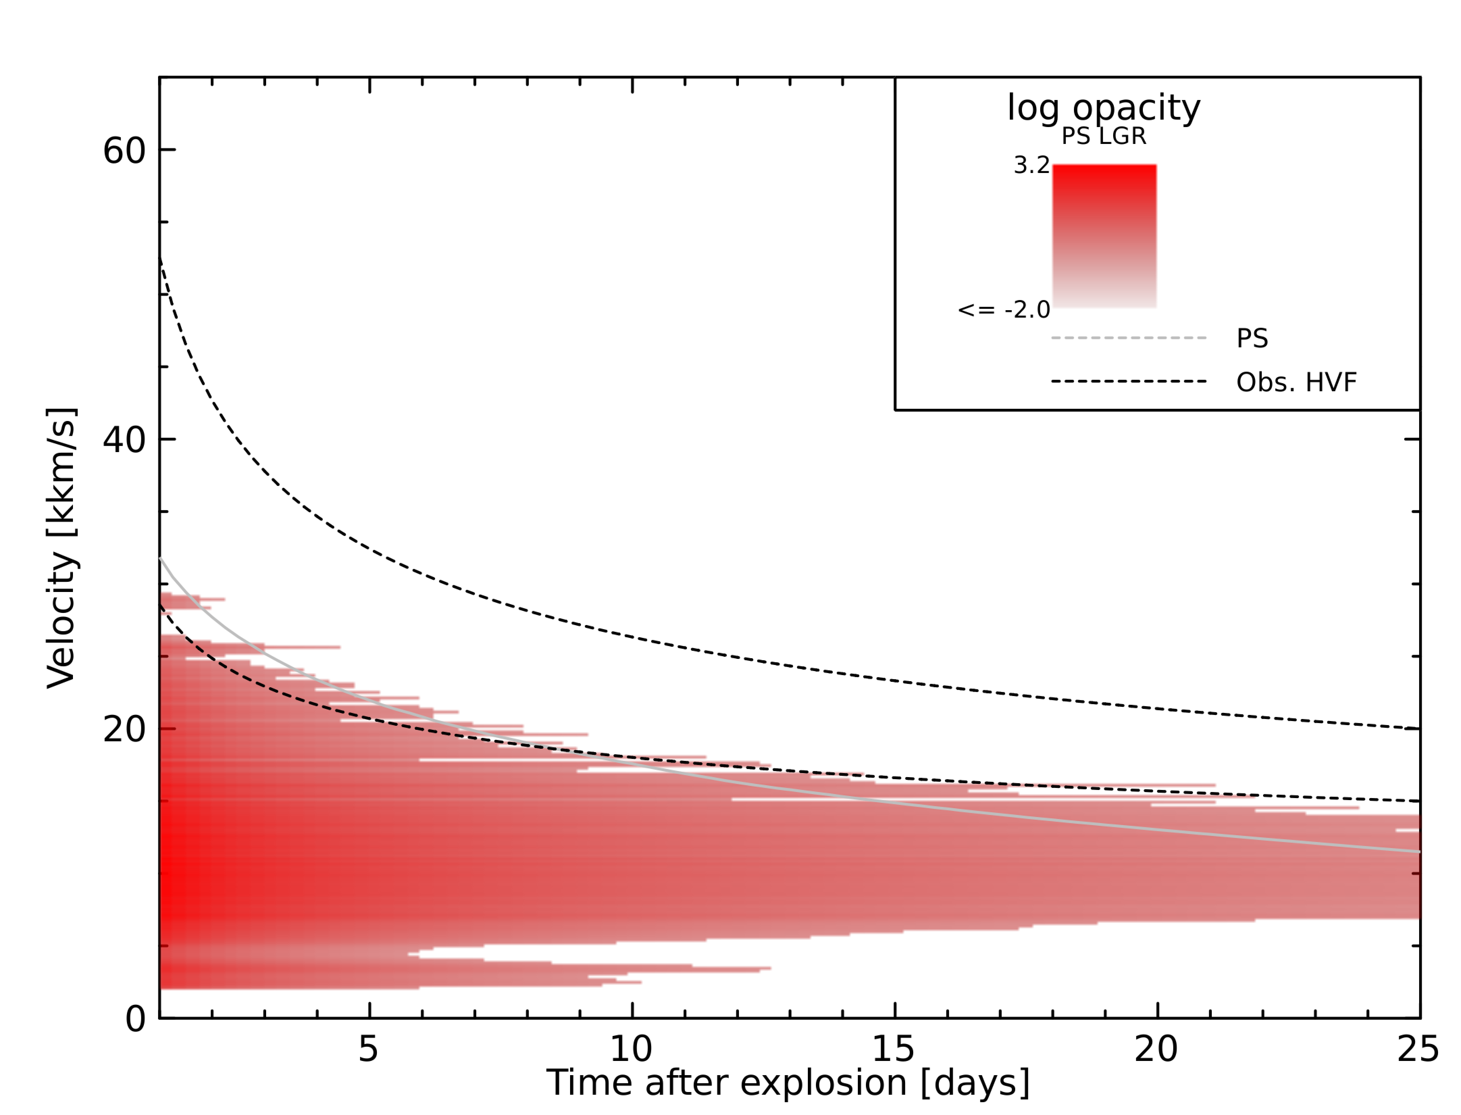
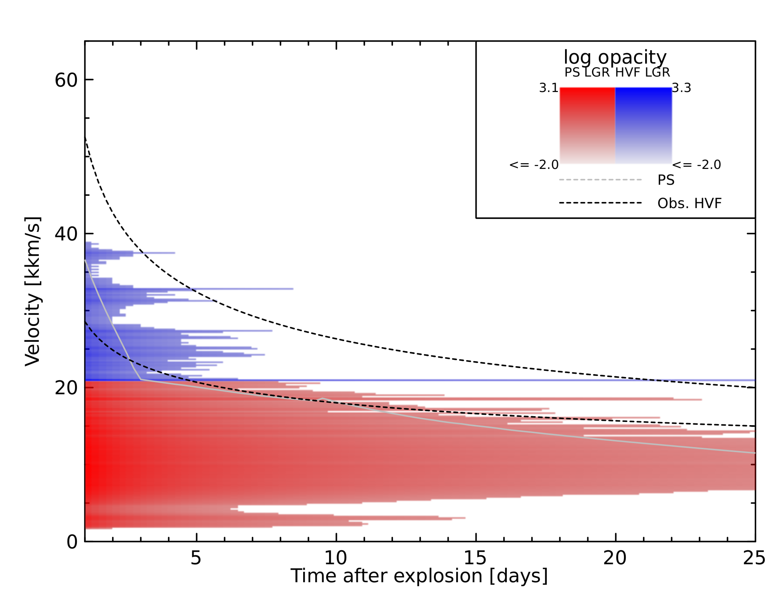
(Ca) Optical Depth
With shell (0.005 Msun)
Normalized to τ = 1
Shell: v = 18.5 kkm/s on d25
Ejecta: v = 11.5 kkm/s on d25
No shell
Normalized to τ = 1
@ 11.5 kkm/s on Day 25

Slide 16
Synthetic spectra
syn++: synthetic spectra tool for supernovae
  Modified to allow arbitrary optical depth profile
Free parameters
  # of days after explosion
  PS velocity – sets minimum velocity for ion
  PS temp – continuum temp
  Ejecta ionization * Ca/Si abundance
  HVF ionization * Ca abundance
Assume ion (state) temp = PS temp

Slide 17
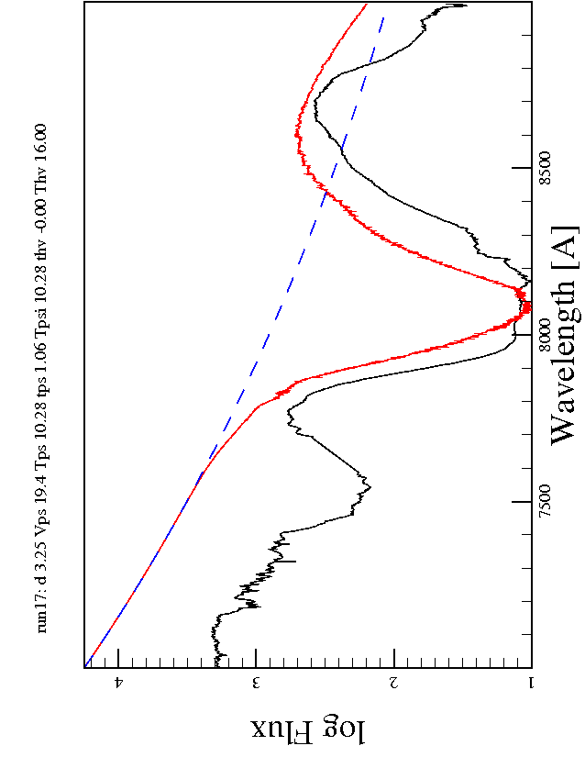
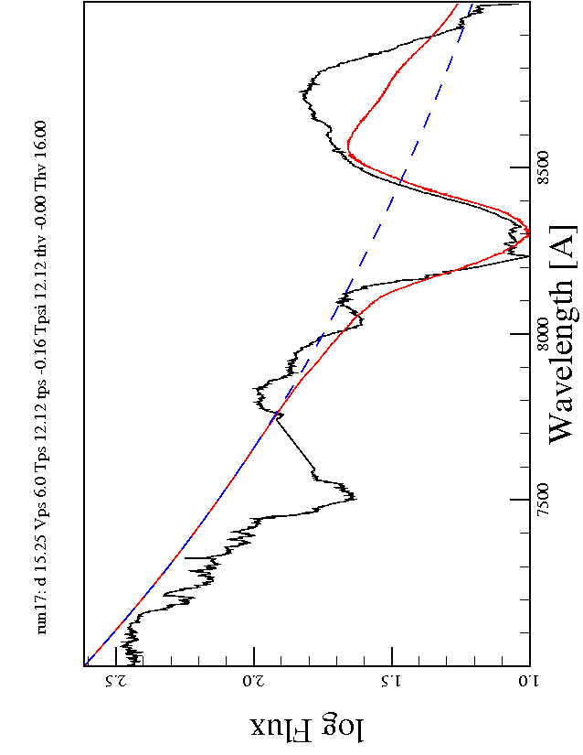
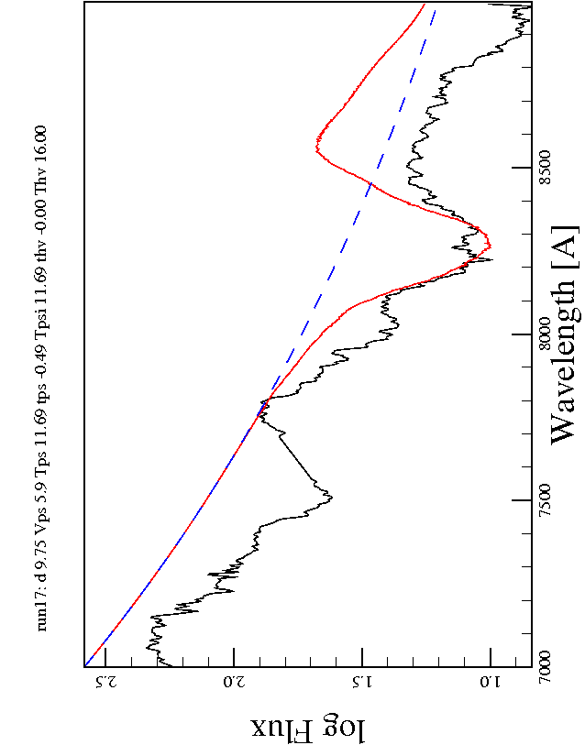
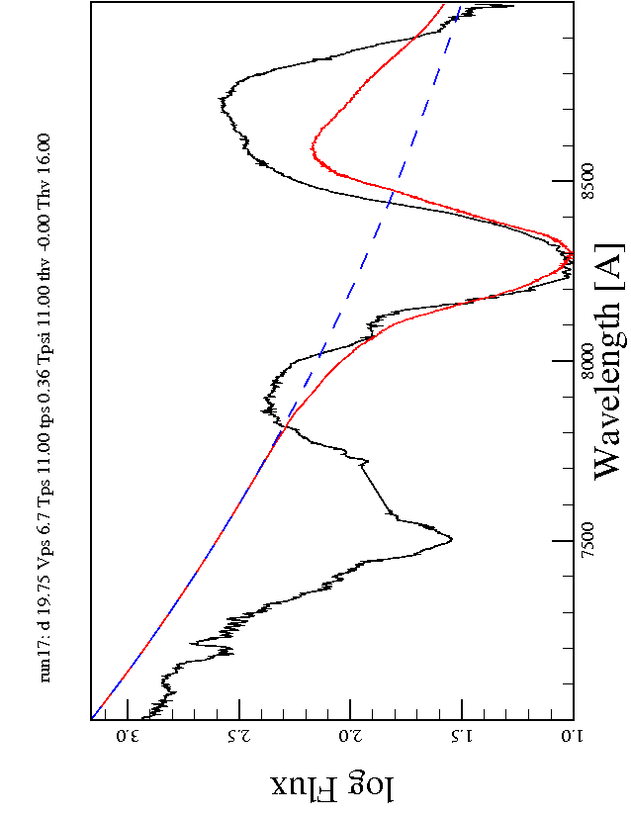
Spectra: No shell
PS
Bmax - 15d
Bmax - 5d
Shell
SN2011fe
Combined
Bmax - 10d
Bmax - 0d
Ca II
OII

Slide 18
Consistency of Parameters:
No shell

Slide 19
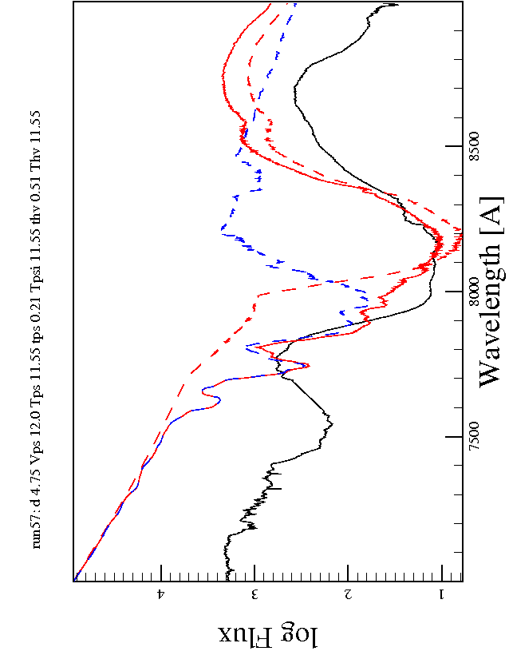
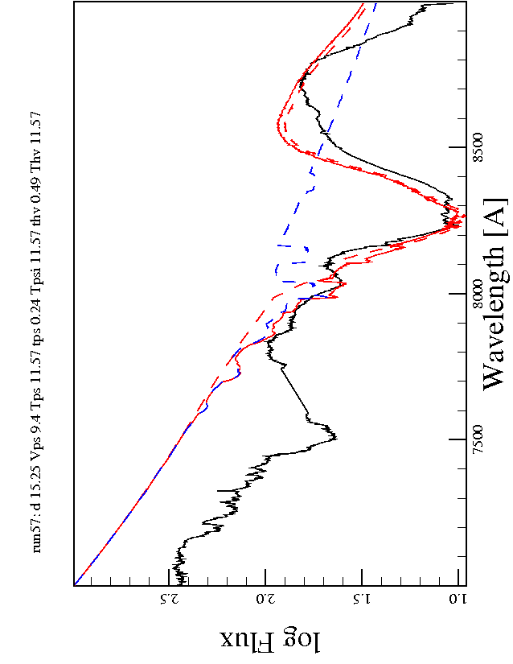
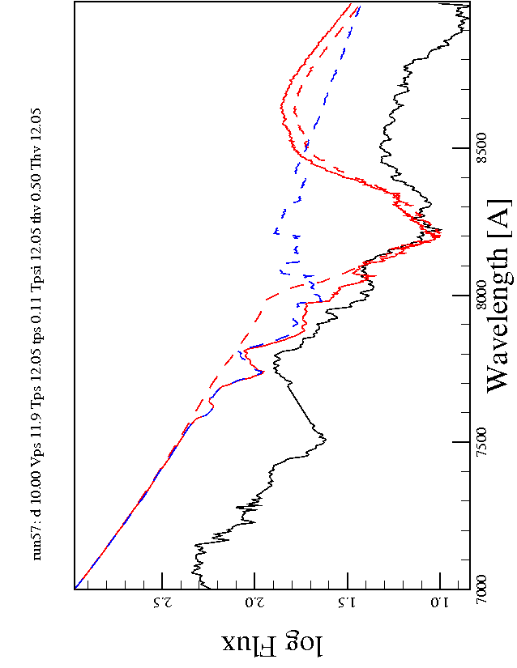
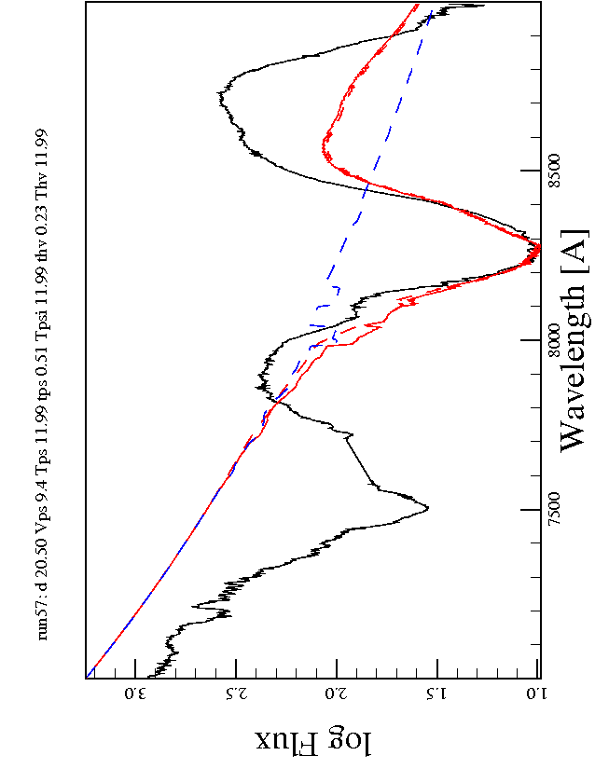
Spectra: 0.005 Msun shell (reverse sawtooth)
PS
Bmax - 15d
Bmax - 5d
SN2011fe
Shell
Combined
Bmax - 10d
Bmax - 0d
Ca II
OII

Slide 20
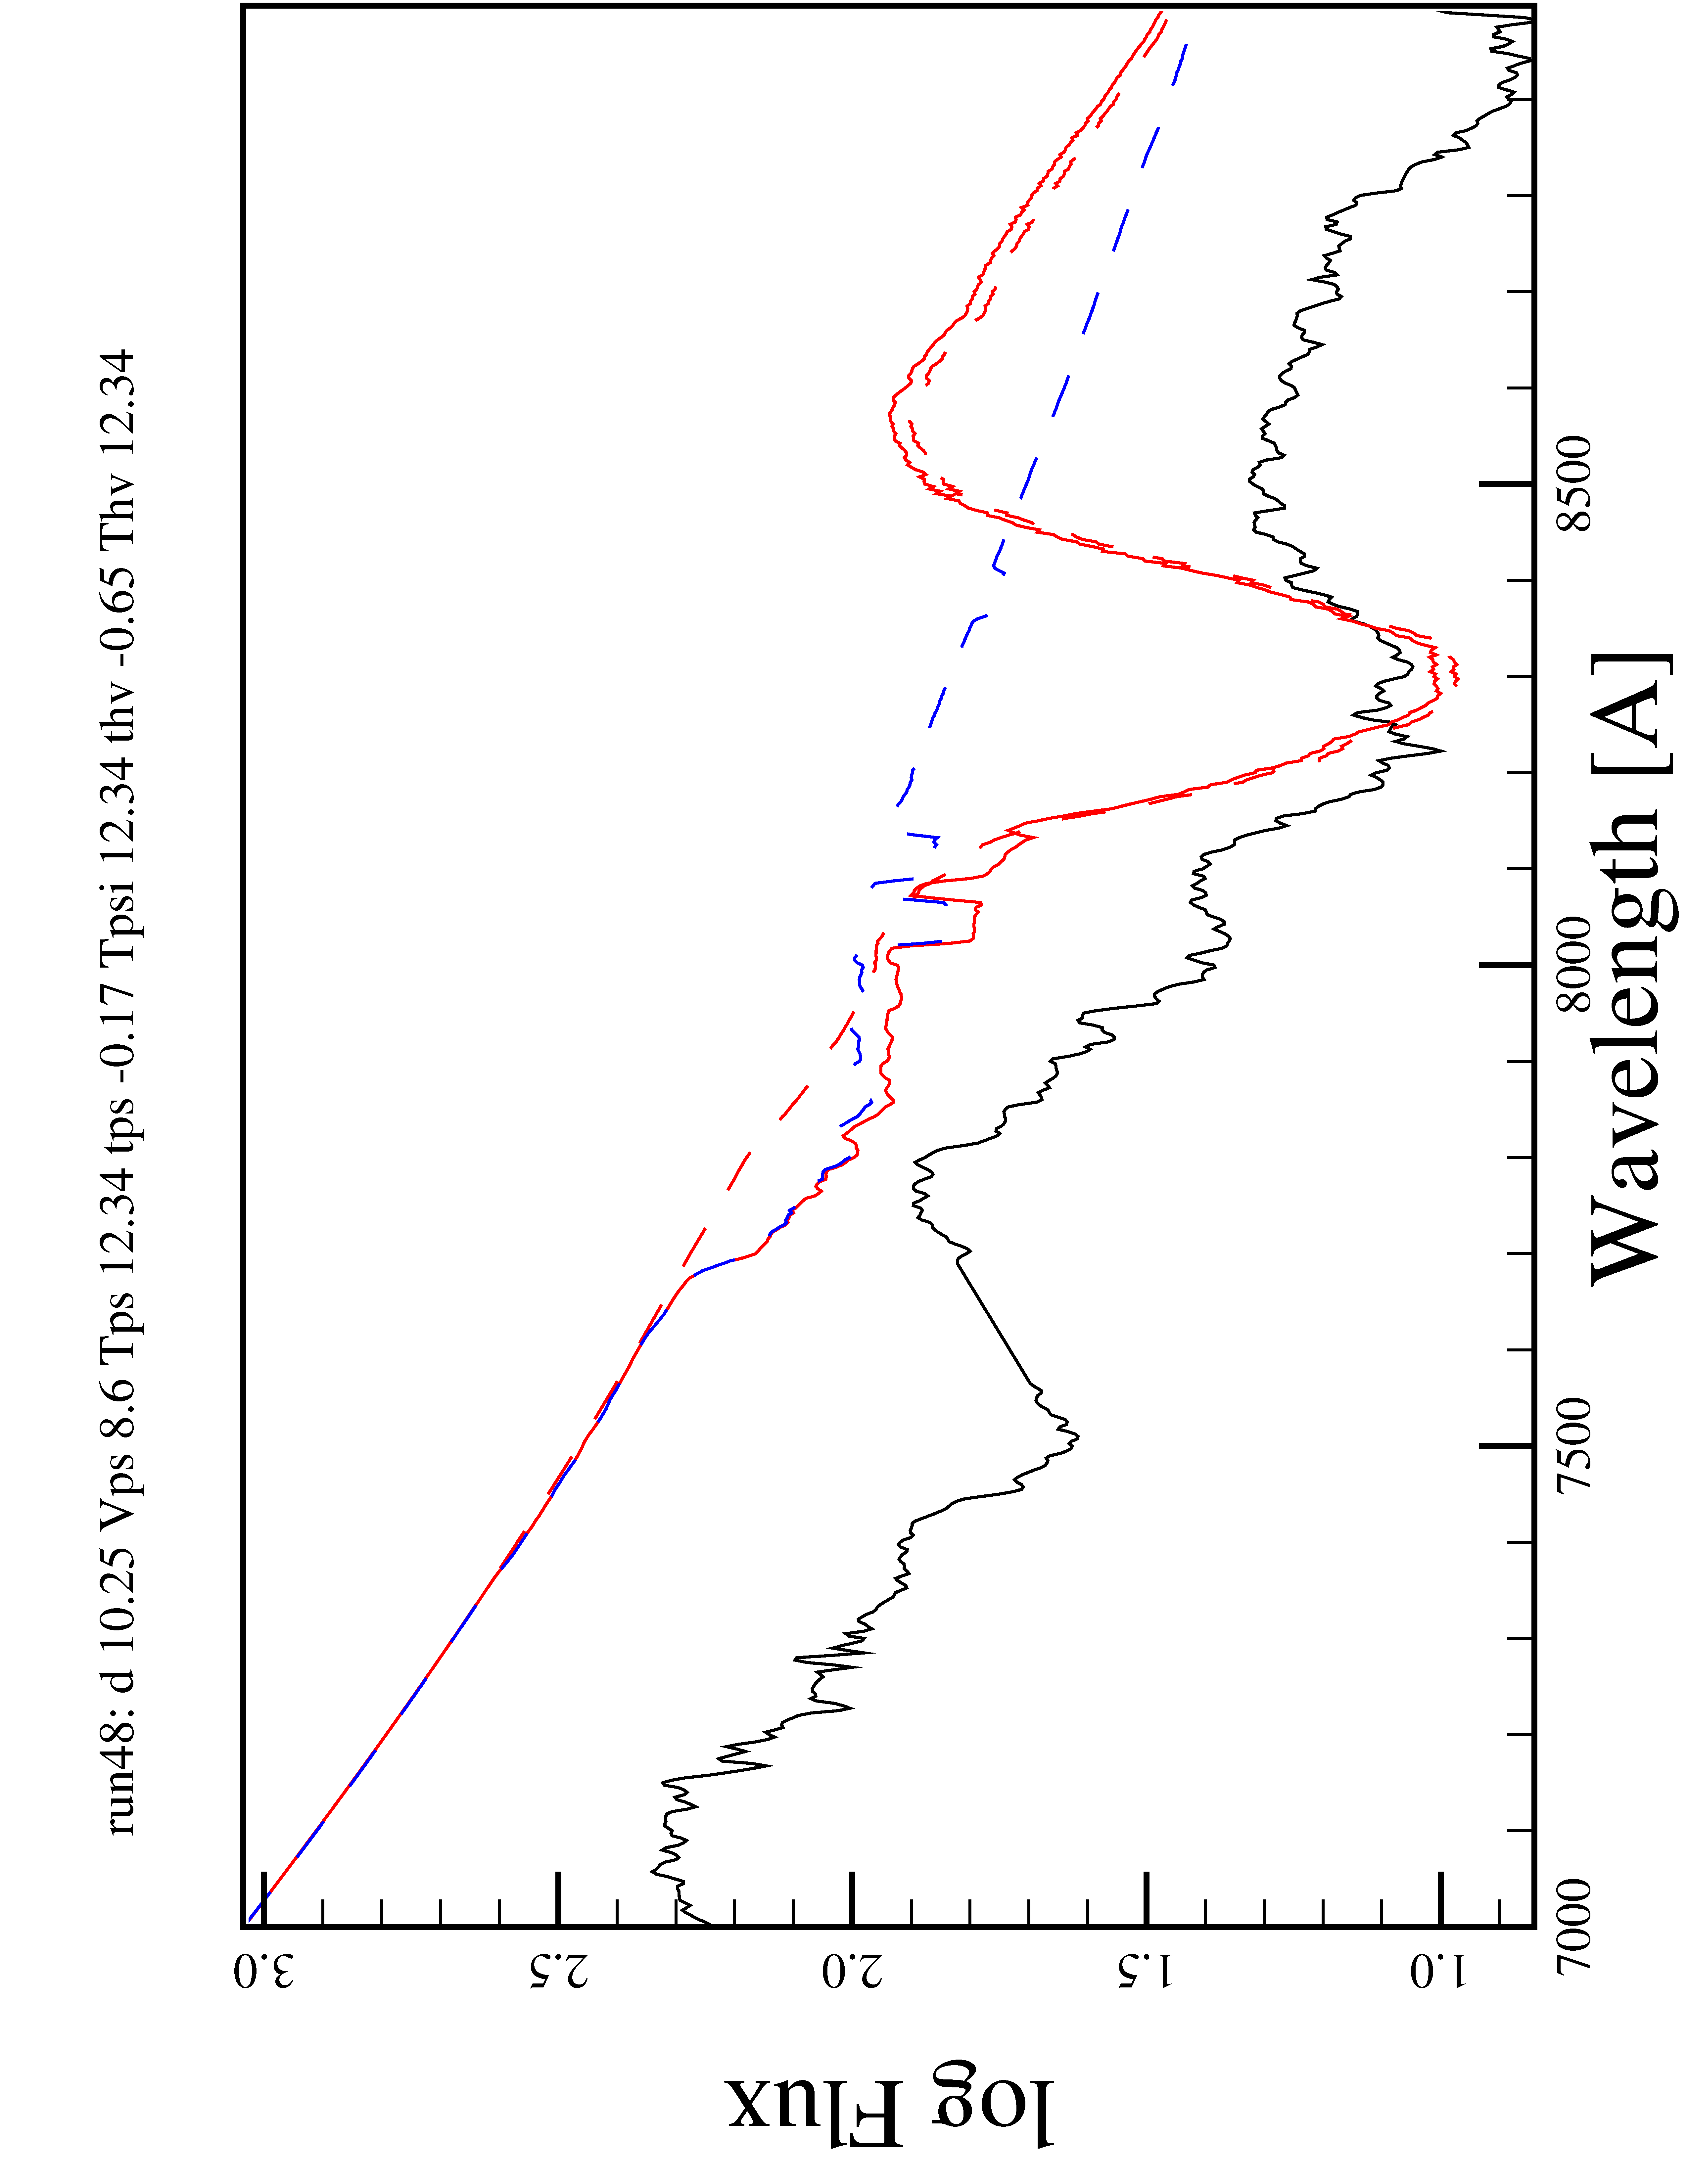
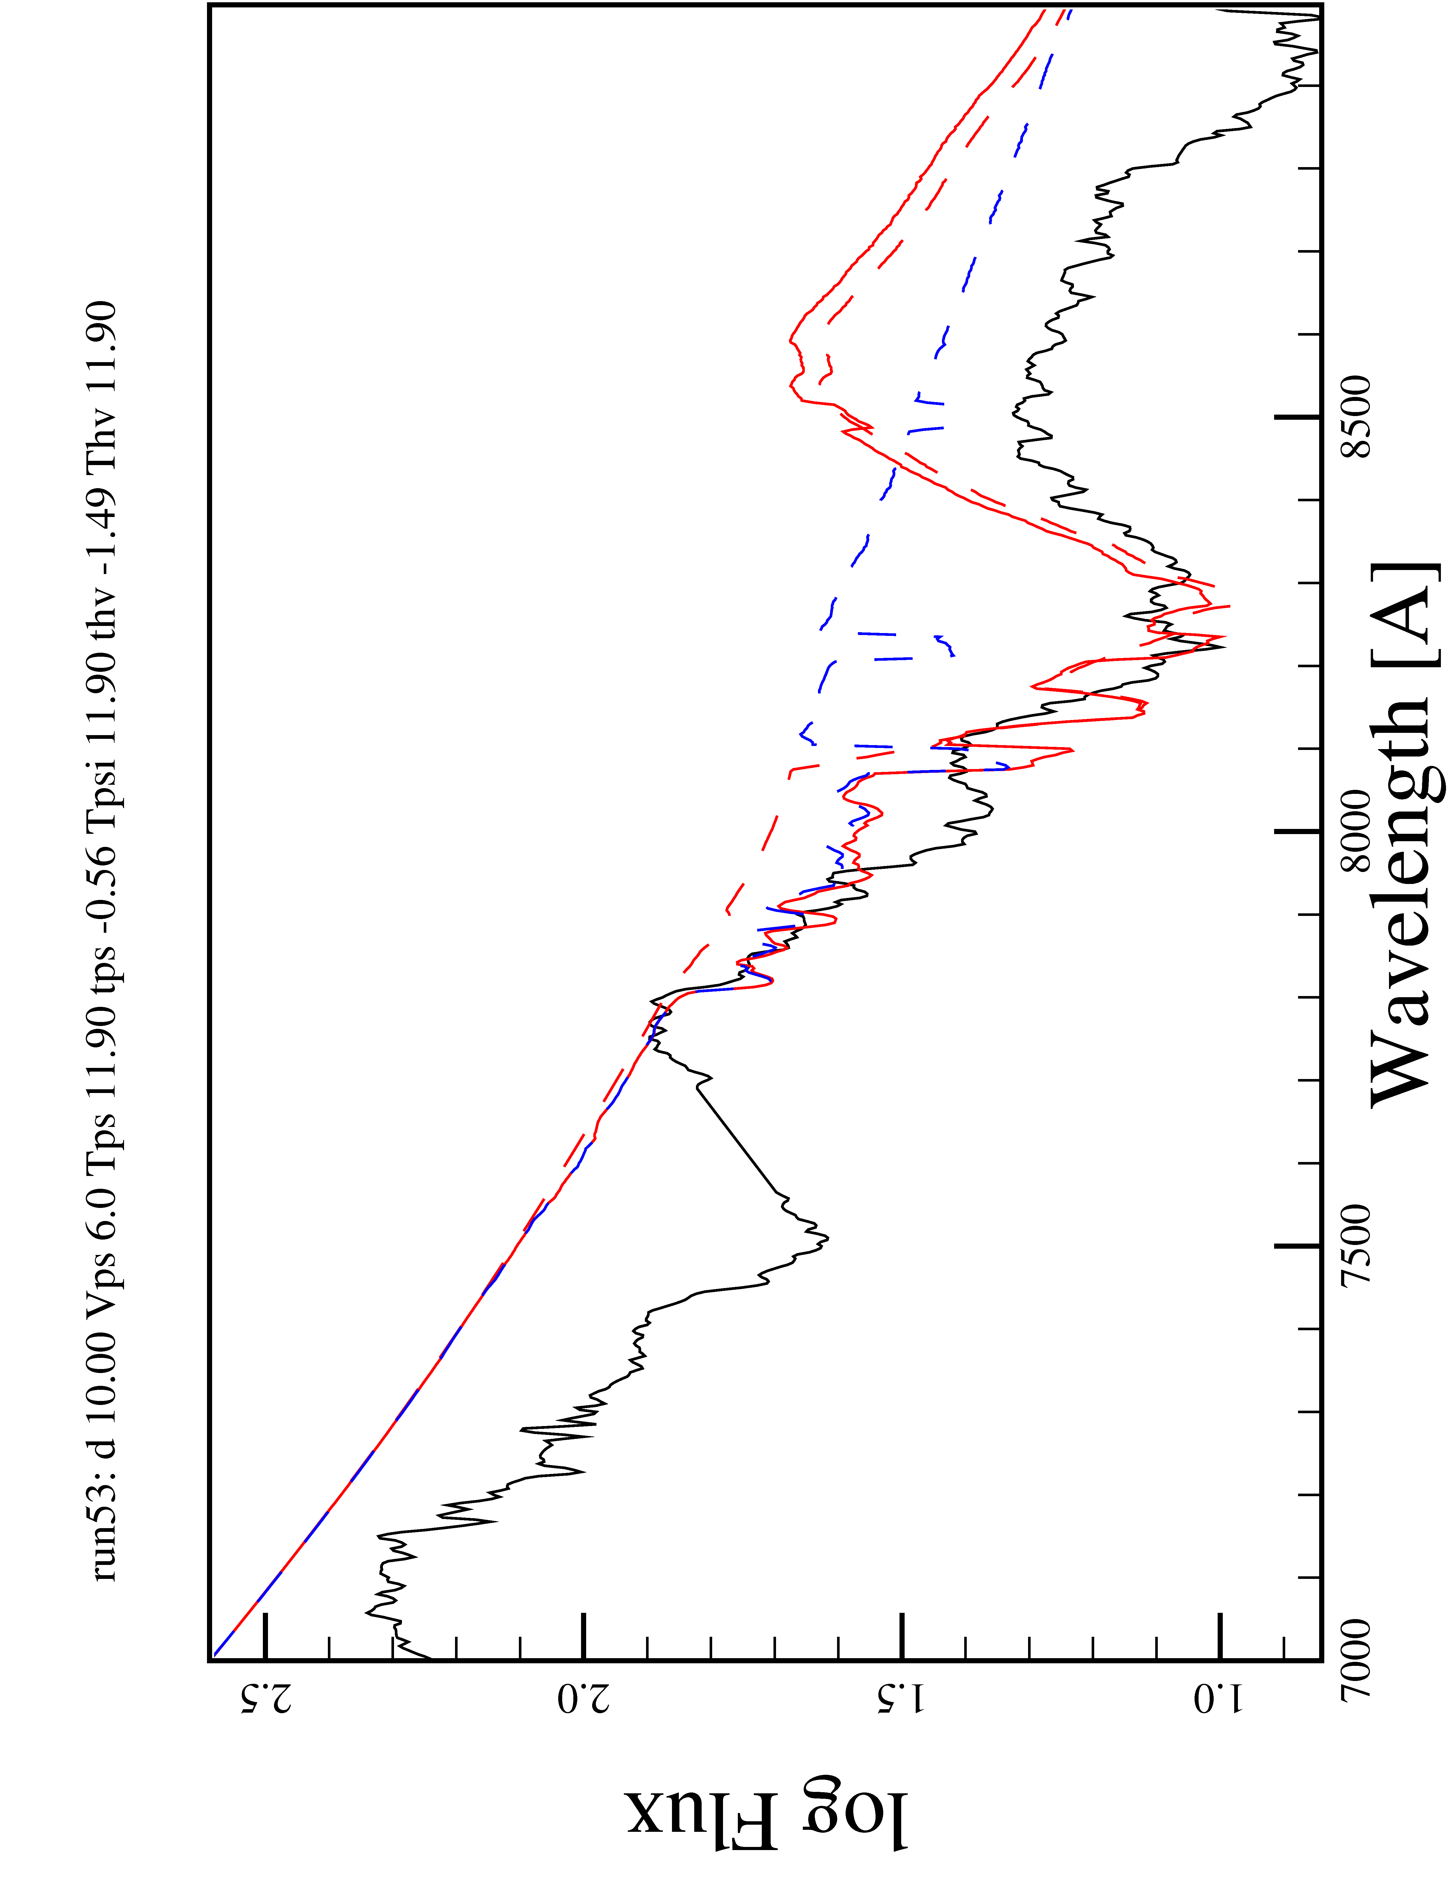
Comparison to other shell masses
Reverse Sawtooth, Bmax – 10d, Same Shell radius, width
0.005 Msun
0.01 Msun
0.02 Msun

Slide 21
Consistency of Parameters:
0.005 Msun shell.

Slide 22
Outstanding Questions
Does ion effective temp = photospheric temp?
  Ca H&K vs. Ca NIR
Does Ca/Si ratio in shell match ejecta?
  Si 6355 features
Possible sources of shell?
  MS/RG Companion: H, He
  WD Companion: He, C, O
  Surface detonation: He, C, O

Slide 23
Summary
Future work
  Fit Ca H&K feature – better constraint on Ca ion temp.
  Si features – does shell Ca/Si abundance match that of the SN?
  H, He, C, O limits
High velocity features in Type Ia SNe
  Features identifiable only within ~2 weeks after explosion
  Requires non-supernova material
  0.005 Msun shell interaction seems consistent with SN2011fe

Slide 24
Thank you

Slide 25
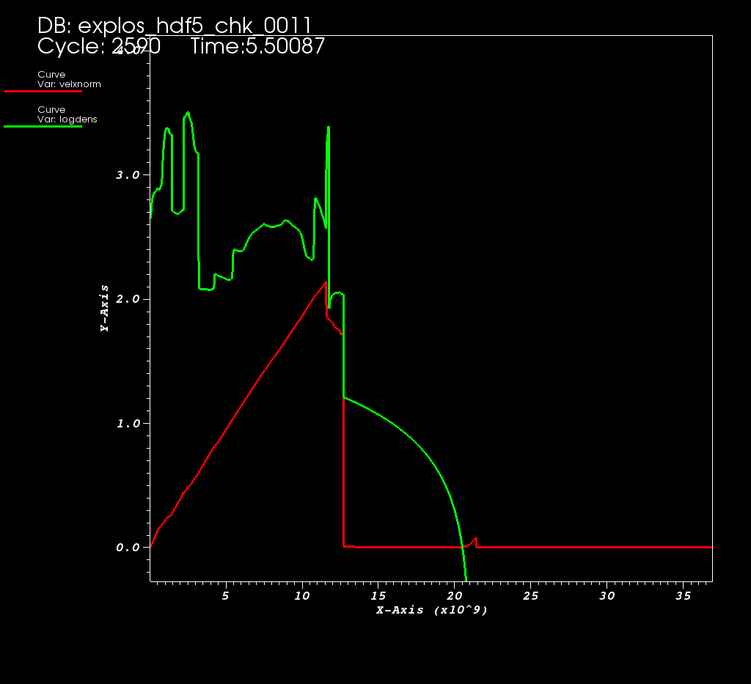
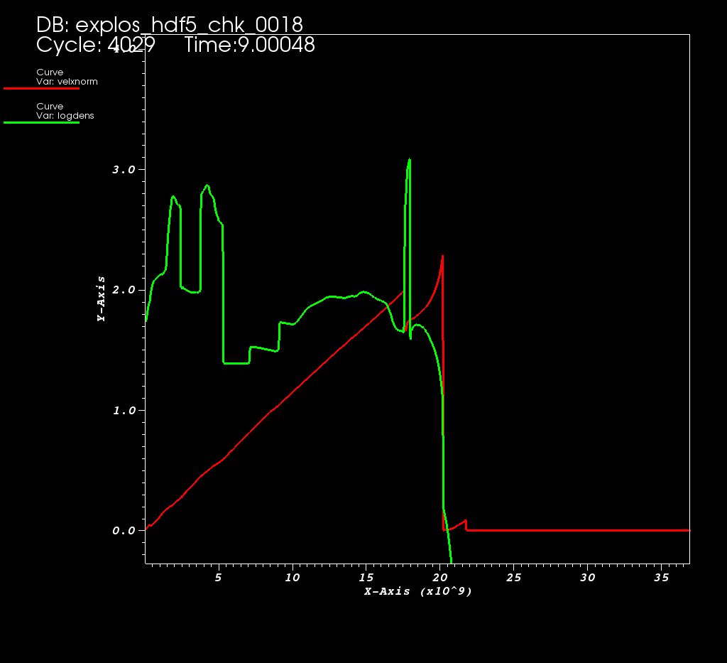
SN-shell interaction

Slide 26
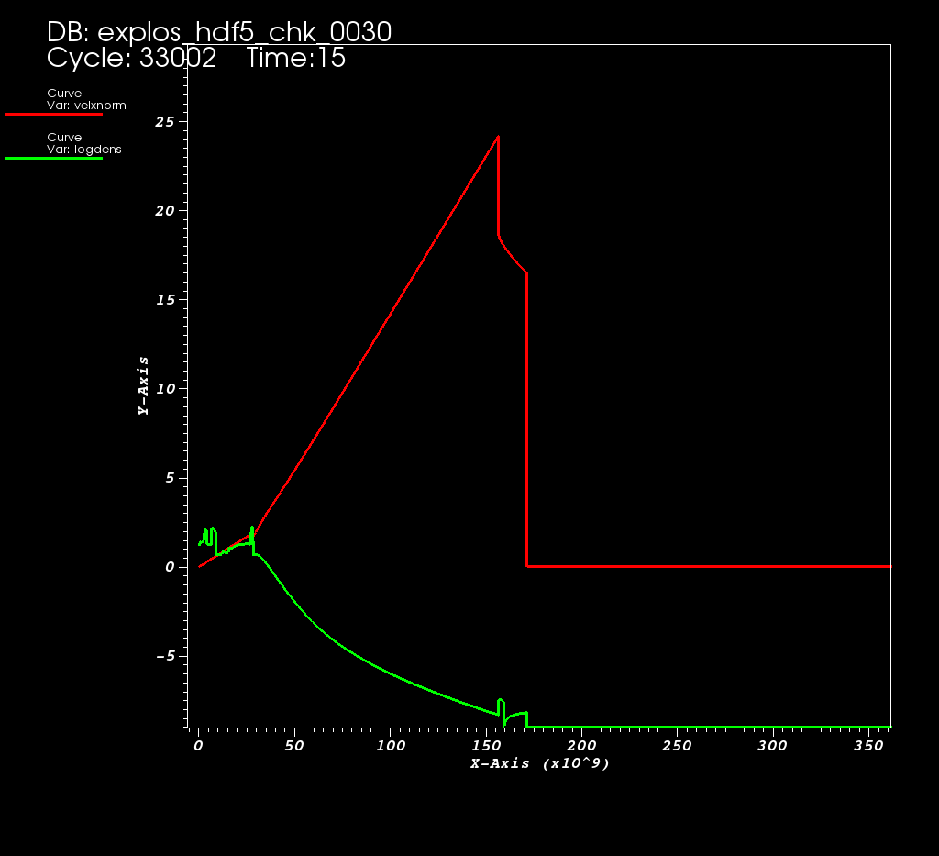
SN-shell: breakout

