Slide 1
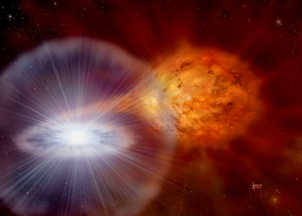
On determining the composition of high velocity material in Type Ia supernova
Credit: David A. Hardy
Brian W. Mulligan
J. Craig Wheeler
27 Nov 2017
University of Texas at Austin

Slide 2
Overview
High Velocity Features in Type Ia supernovae
Our prior work in HVF
Finding state populations in a radiation dominated environment

Slide 3
High Velocity Features in Type Ia SNe
????
With e.g. calcium
~15,000 km/s
~22,000 km/s
Newly
synthesized e.g. calcium

Slide 4
Circumstellar shell as source of HVF
Mulligan & Wheeler 2017
No Shell
(3 models)
High density, high velocity
Shell
Relative Density
Relative Density
Ejecta

Slide 5
Fitting SN 2011fe
SN 2011fe (Nugent et al. 2011)
Result of fit
Ejecta only
Ca II near-infrared triplet
Shell only
Mulligan & Wheeler, submitted

Slide 6
Line Optical Depth (using syn++)
Simulation
Fitting
Mulligan & Wheeler, submitted.

Slide 7
Sobolev Approximation
Constant density, composition, temperature gas in uniform expansion
Photon Energy
Velocity of material increases with distance from emitting surface

Slide 8
Line Optical Depth in Supernovae
Sobolev Optical Depth

Slide 9
Composition?
Total density, optical depth, time, wavelength, absorption coefficient, and statistical weights known from simulation, fitting of SN 2011fe, and details of the line.
Need relative state populations and ion fraction

Slide 10
Detailed Balance (Radiative)
Two state atom (purely radiative transitions)
Many state atom

Slide 11
Detailed Balance (Radiative)
Local state populations are dependent only on the local radiation field
Local relative state populations are independent of total density.
The relative populations can be found as an eigenvector of the matrix [G] with eigenvalue 1.

Slide 12
The ionization term

Slide 13
Including ionization

Slide 14
Radiative Absorption and Emission
Kurucz & Bell (1995)
Transition data for many elements up to uranium
Coverage for ion states I and II for most elements in the set
Extended ion state coverage for most elements up to Ni
Provides wavelength, oscillator strength, damping constant, upper and lower electron state

Slide 15
Photo-Ionization Data
The Opacity Project
H – Fe
Photo-ionization cross-section as function of photon energy
Does not include relativistic corrections or fine or hyperfine structure
Currently being superseded by The Iron Project
  For Ca, data available up to Ca XV

Slide 16
Limitations
Opacity Project level data do not necessarily match Kurucz level data.
  Difference in wavelength / level energies
  Mismatch in levels for a given transition
OP data include only a small subset of known levels
  Need to assume cross-section for levels not included in OP
Numerical precision when computing eigenvector of large matrices
  Using “long double”: 2⁻⁶³ significand, 15 bit exponent (2^{+/-14})
  Future: would like to implement n-bit extended precision floating point

Slide 17
Summary
Results Pending (suggest Ca enrichment)
Using Kurucz line data and Opacity Project ion cross sections
Detailed balance of many states of a single element when purely radiation driven
Simultaneous solutions for ion states and excitation states without resorting to LTE assumptions.

