Slide 1
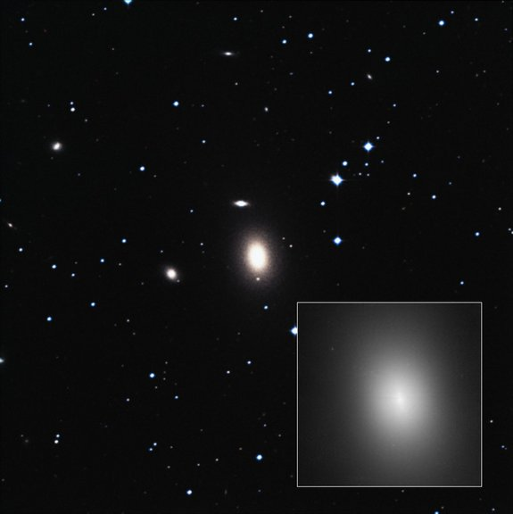
Friday, April 6, 2016
Exam back Wednesday, key posted.
Exam 4, Skywatch 4, Friday, April 15.
Chapter 8 Neutron Stars - Sections 8.1, 8.2, 8.5, 8.6, 8.10
Chapter 9 Theory of Black Holes: 9.1 to 9.5 (update at end of week)
Astronomy in the news
Largest black hole discovered to date
In the galaxy NGC 1600
BH is 17 billion times the mass of the sun
Supernova near Earth ~2 & ~8 million years ago
Fe-60 found on bottom of ocean
Fe-60 formed in core-collapse supernova, radioactively decays with half-life of 2.6 million years
Any Fe-60 on the surface of the Earth must be recent! SN ~ 300 light years distant
Prof. Wheeler out for today,
Brian will hold office hours in his place
RLM 16.216
NGC 1600
Image credit NASA, ESA, Digital Sky Survy 2

Slide 2
Skywatch
Black hole candidates in the directions of Sagittarius, Ursa Majoris, Perseus, Scorpius, Ophiuchus, Vulpecula, Monoceros, Lupus (tough), Cygnus (2) (Find and observe the constellations for sky watch)
Cygnus X-1
AO620-00 = Nova Mon 1975 = V616 Monocerotis - one of the first and best studied with a small mass companion, black hole about 5 solar masses.
V404 Cygni - somewhat evolved companion, but one of the best cases for a black hole with “dark” mass of about 12 solar masses.
Two candidates in the Large Magellanic Cloud:
LMC X-1, LMC X-3 (Not visible from Austin)

Slide 3
Goal:
To understand how time works in curved space and near black holes.

Slide 4




Gravity and Time
Predictions of Einstein:
For an object moving away from an observer, all frequencies, including the rate of aging are lower (Doppler red shift).
Clock on ship, viewed from Earth moves slowly
Clock on Earth, viewed from Earth
Moves “normally”
Clock on ship, viewed from ship
Moves “normally”
Clock on Earth, viewed from ship
Moves slowly

Slide 5
Gravity and Time
Predictions of Einstein:
If a clock is deep in a gravity well (the curved space around a gravitating object) it ticks more slowly according to an observer at large distance where gravity is absent (flat 3D space). Gravitational red shift.
Get both effects if you drop a “clock” into a gravity well and watch it fall in from a safe distance where gravity is weak (flat 3D space).
A distant observer will see every aspect of time slow down for an object falling into a gravity well, including the aging of a volunteer, and the rate at which they are falling.
“Flat”
3 D
space
far from
BH
> Distant
observer
(
Event
horizon

Slide 6
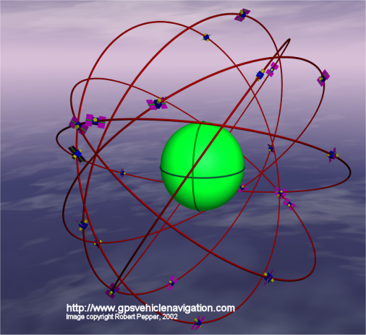
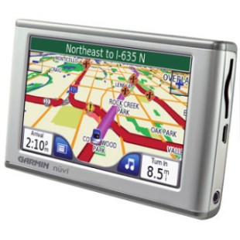
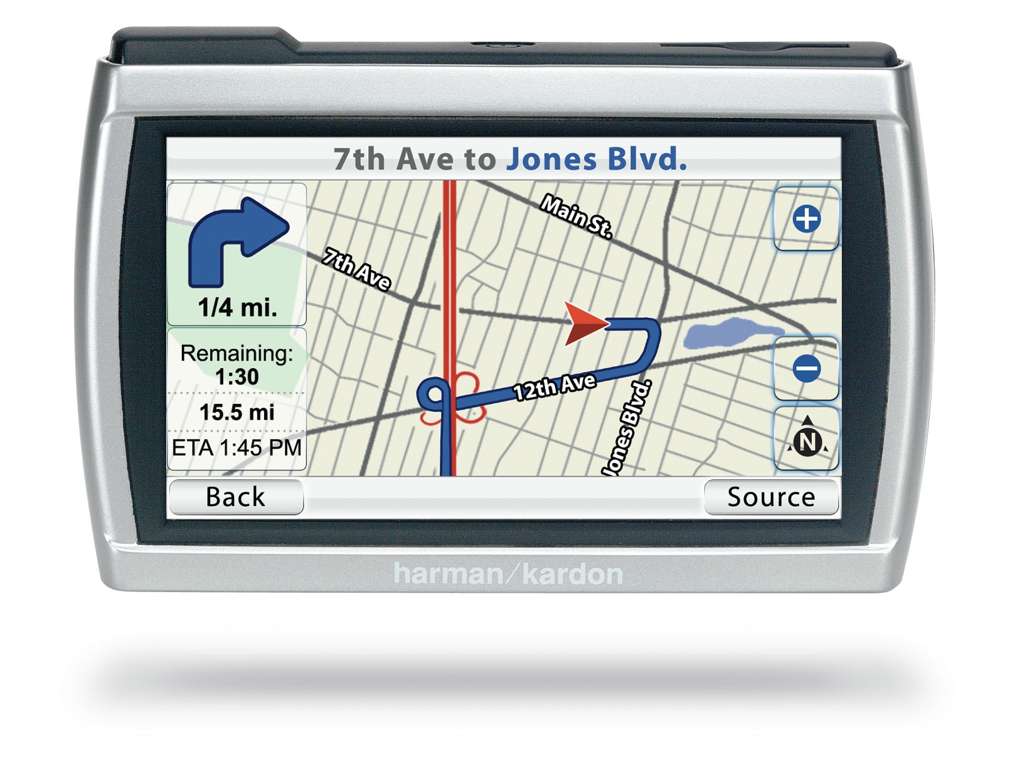
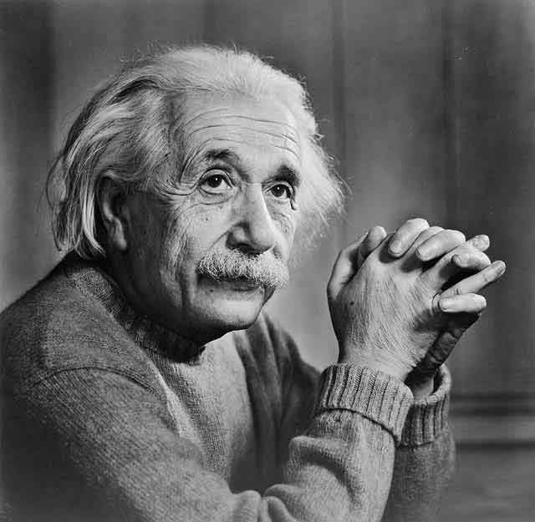
One especially fascinating application: the Global Positioning System
GPS depends not only on an array of satellites in orbit, but must be programmed to understand Einstein’s theory of warped space and time to function properly.

Slide 7
Specifically for Black Holes
Photons out
singularity
“Flat”
3 D
space
far from
BH
> Distant
observer
(
Event
horizon
Volunteer
falls in
Volunteer finds herself rapidly falling through event horizon, she is noodleized, and dies
Distant observer sees Doppler and gravitational redshifts
Received photons get longer, longer wavelength
Time between photons gets longer and longer
Infinite time for last photon emitted just as volunteer reaches the event horizon; space is moving inward at the speed of light compared to distant observer
Distant observer never sees volunteer cross the horizon
Photons get undetectable, very long wavelength, most of the time is between photons - absolutely black - why black holes are black.

Slide 8
A distant observer watching an object falling into a black hole will see it getting dimmer and dimmer and aging more and more slowly.
A distant observer will perceive an object to turn black, stop aging, and stop falling and never see the object fall inside the event horizon.
An observer within a gravity well will see a clock, or a human, far away (in less-gravitating, less curved space) aging more rapidly.

Slide 9
One Minute Exam
From the point of view of a distant observer, a volunteer who falls into a black hole
Will be noodleized and die
Will fade and stop aging before arriving at the event horizon
Will age more rapidly
Will shrink to a point

Slide 10
End of Material for Exam 4

Slide 11
Goal:
To understand the nature of time-like space inside a black hole.

Slide 12
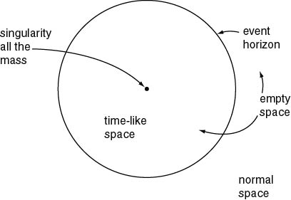
Figure 9.1
Basic properties of a (non-rotating) black hole

Slide 13
Goal:
To understand the full space-time associated with non-rotating black holes.

Slide 14

Non-rotating Schwarzschild Black Hole
Mass, but no spin, no electrical charge
Assume all mass is in the singularity, no mass anywhere else (assumption necessary to solve equations)
Find two Universes, each of infinite space, connected at one instant by the singularity.
Cannot pass from one to the other if travel at less than the speed of light.
Event horizon is also surface of infinite redshift
Universe #1
Slice of embedding diagram
Somewhere else in hyperspace
Universe #2

