Slide 1
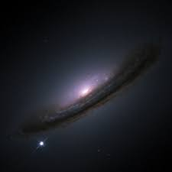
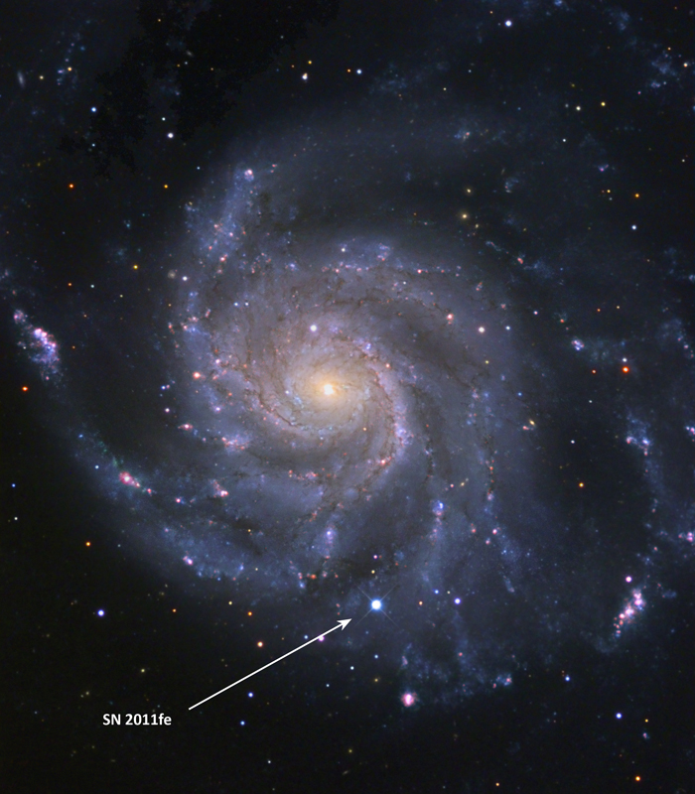
Simulation of compact circumstellar shells around Type Ia supernovae and the resulting high-velocity features
Brian W. Mulligan & J. Craig Wheeler
University of Texas at Austin
AAS 229th Meeting
Grapevine, TX
6 Jan 2017

Slide 2
Type Ia supernova physics
Unburned C/O
O, Mg, Ne
Ca, Si, S
Fe, Co, Ni

Slide 3
Typical Picture of Type Ia SN
Unburned C/O
O, Mg, Ne
Ca, Si, S
Fe, Co, Ni
10-15,000 km/s
20,000 km/s
Velocity
-20,000 km/s

Slide 4
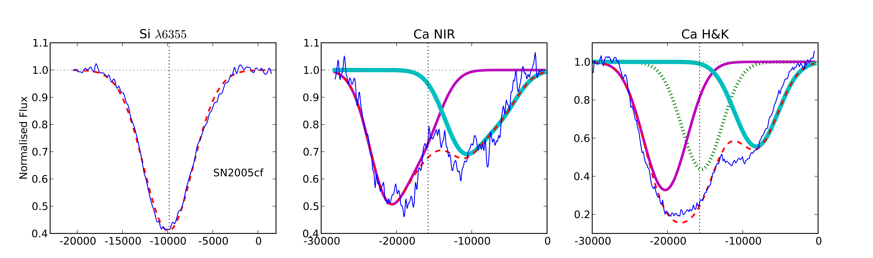
Outermost layers – high velocity
(Childress et al. 2014)
High Velocity Feature (>~20,000 km/s)
SN Ejecta (~10,000 km/s)

Slide 5
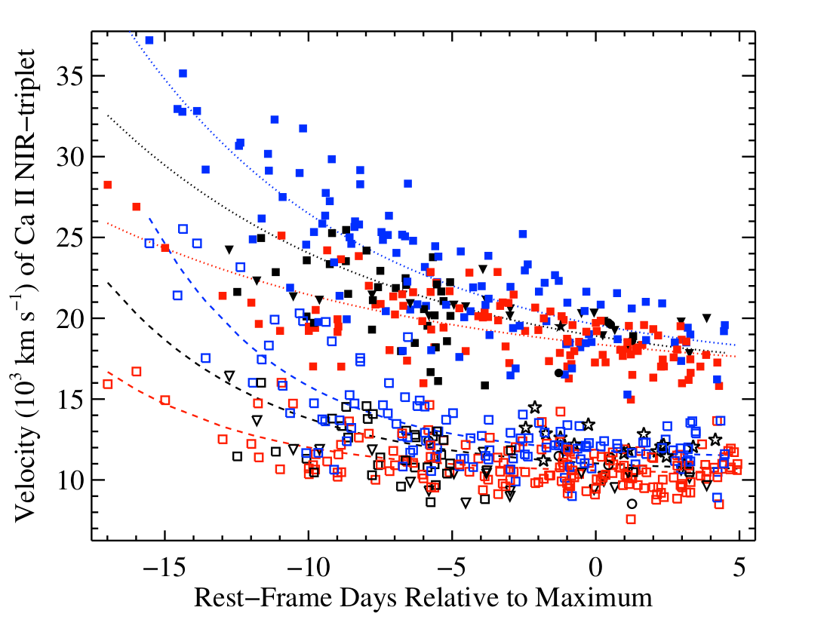
High velocity stuff vs normal stuff
(Silverman et al. 2015)

Slide 6
Unburned C/O
O, Mg, Ne
Ca, Si, S
Fe, Co, Ni
HV material

Slide 7
High velocity bullets?
C/O/Mg/S/Si, etc
Drag some stuff on the way out

Slide 8
Stuff from companion
1: similar to sun
2: He or C/O, with small mix of other stuff

Slide 9
Surface explosion
He shell
He, Ca, sometimes Si

Slide 10
The effect of the shell
Mass:
0.003 M_{sun}
0.005 M_{sun}
0.008 M_{sun}
0.010 M_{sun}
0.012 M_{sun}
0.020 M_{sun}

Slide 11
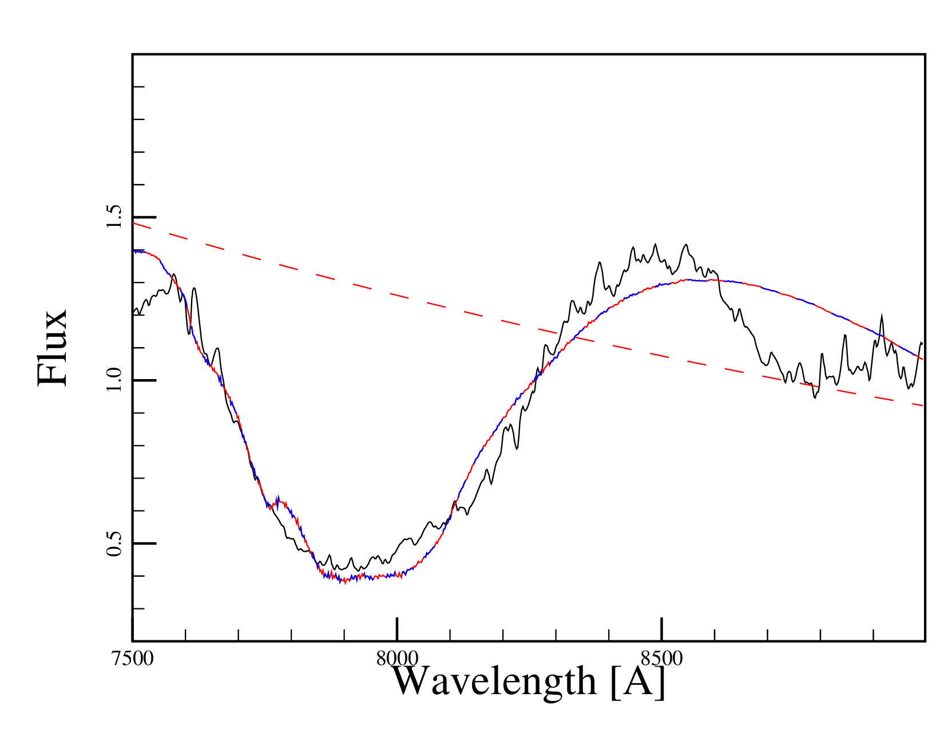
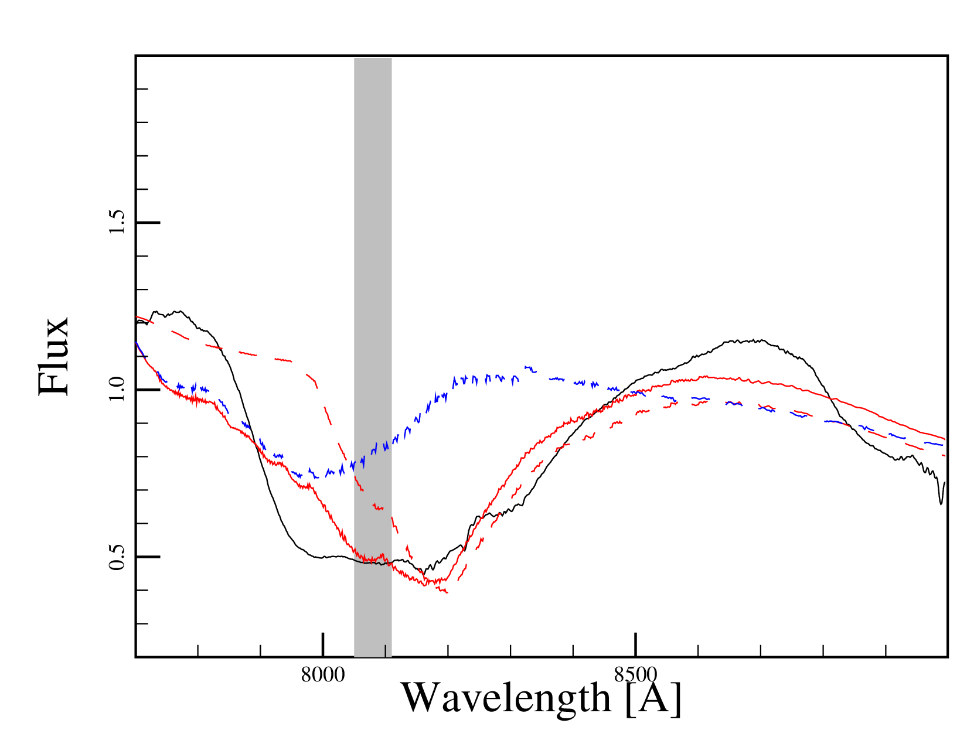
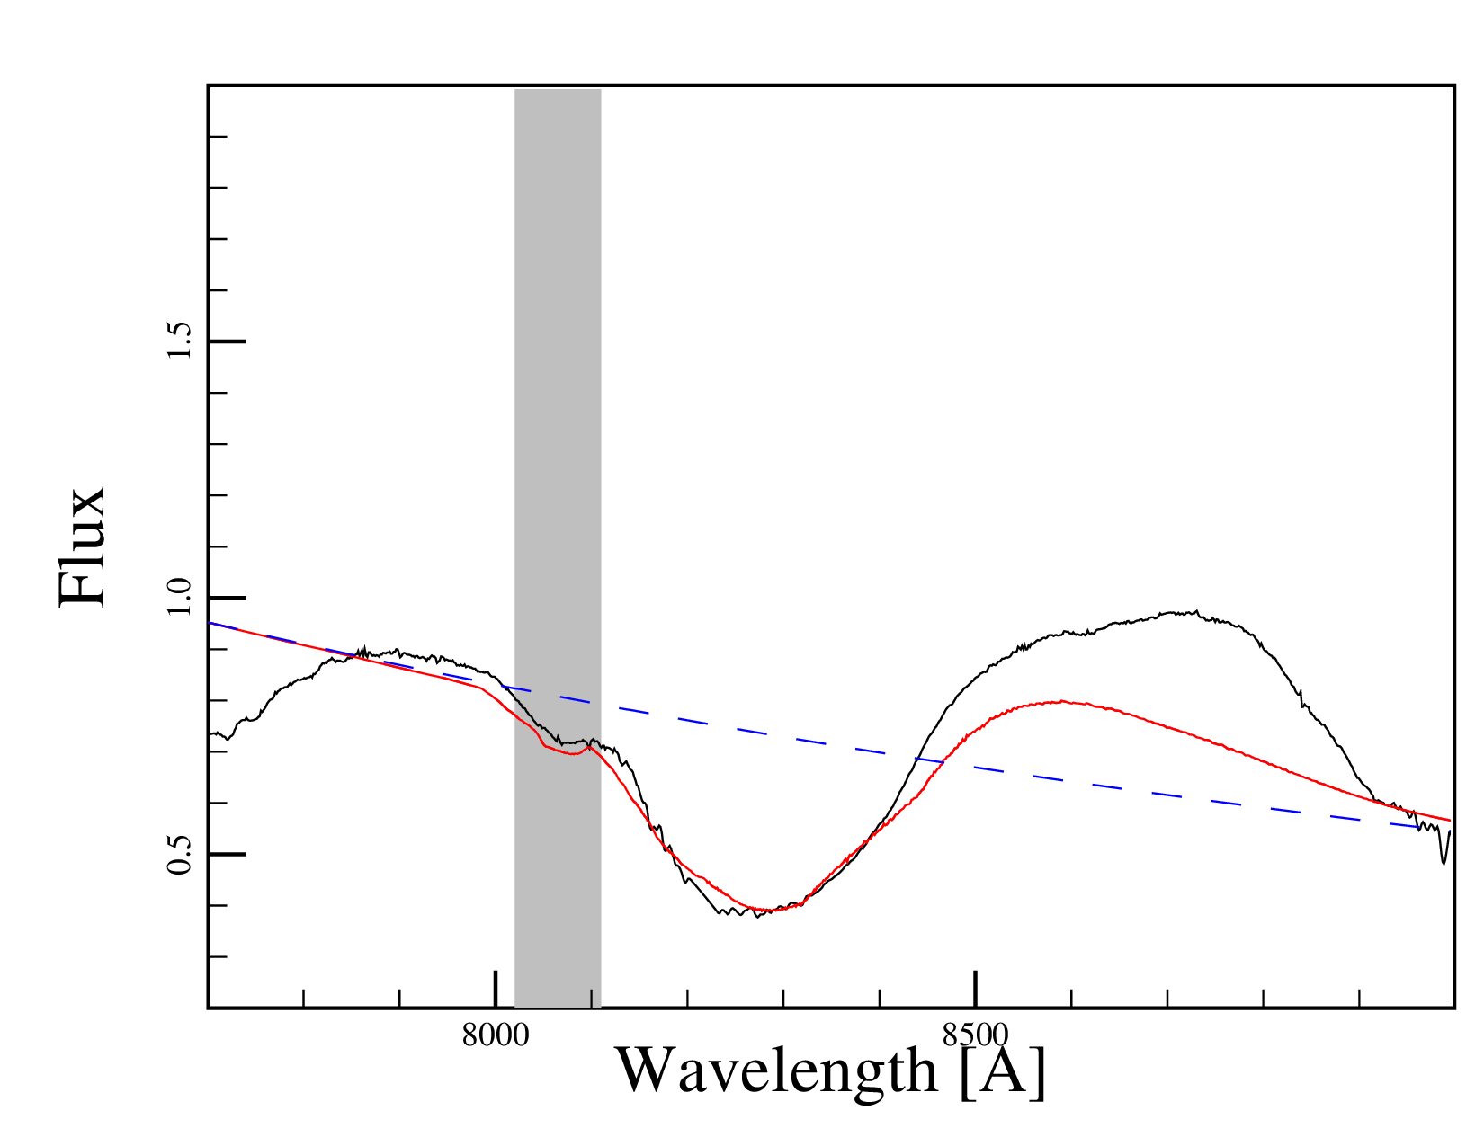
~2 days after explsion
~6 days after explosion
Red, solid:
Fit
Blue, dashed:
Shell
Red, dashed:
Ejecta
SN2011fe data:
Parrent+ 2012
~20 days after explosion
Mulligan & Wheeler, in prep

Slide 12
Surface explosion?
He shell
Mass of shell, Calcium abundance consistent (?) with this model
(Hoping to have specific results by January)

Slide 13
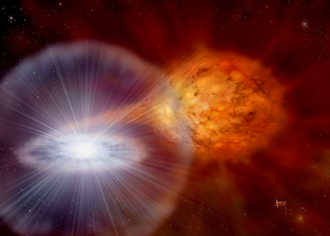
Summary
Supernovae: exploding stars
Type Ia supernova: exploding white dwarfs
  Very useful for cosmology
  Don’t know what causes them to explode
  Hints in light and spectra soon after explosion
  Ca enrichment in outermost layers?
    May point to surface explosion model

