Slide 1
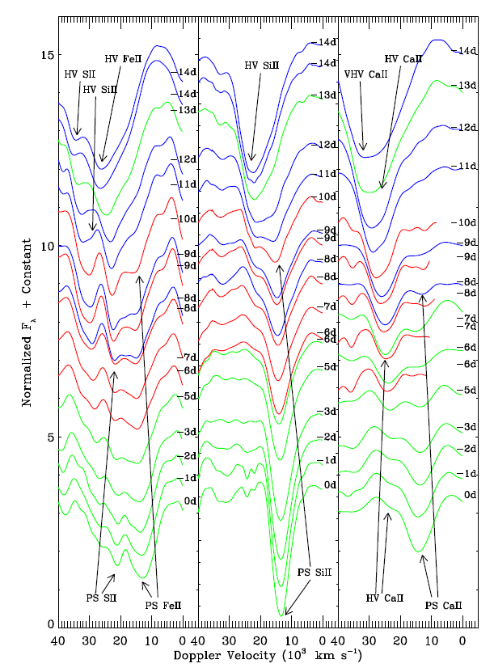
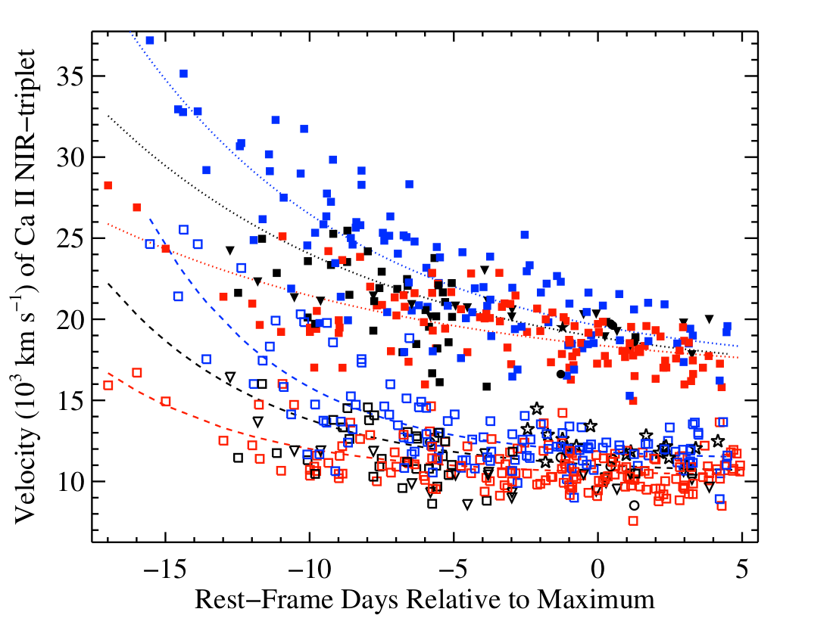
SN 2009ig
Silverman+ 2015
Marion+ 2013

Slide 2
Unburned C/O
O, Mg, Ne
Ca, Si, S
Fe, Co, Ni
HV material

Slide 3
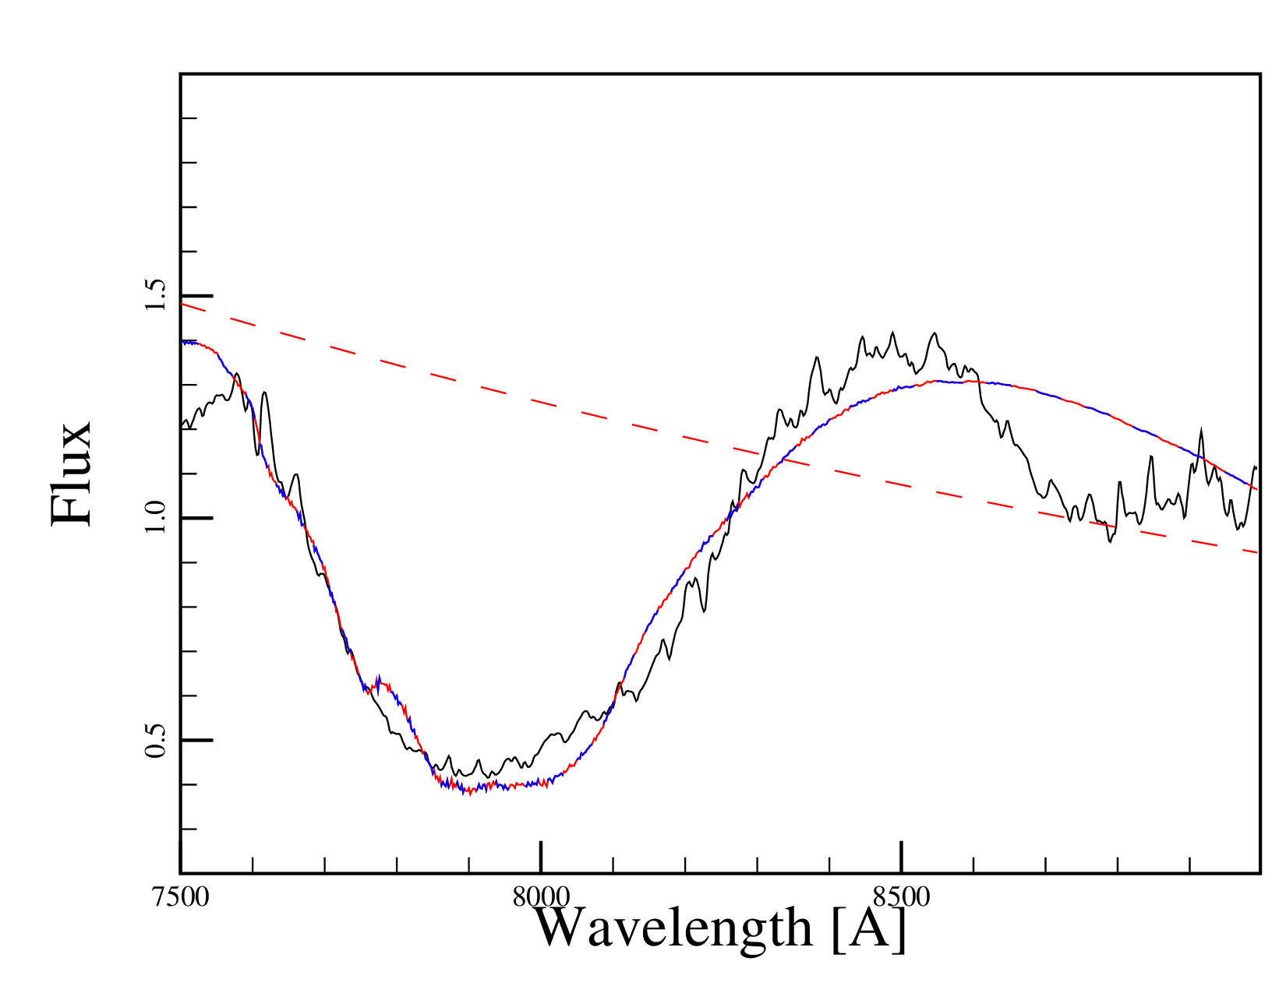
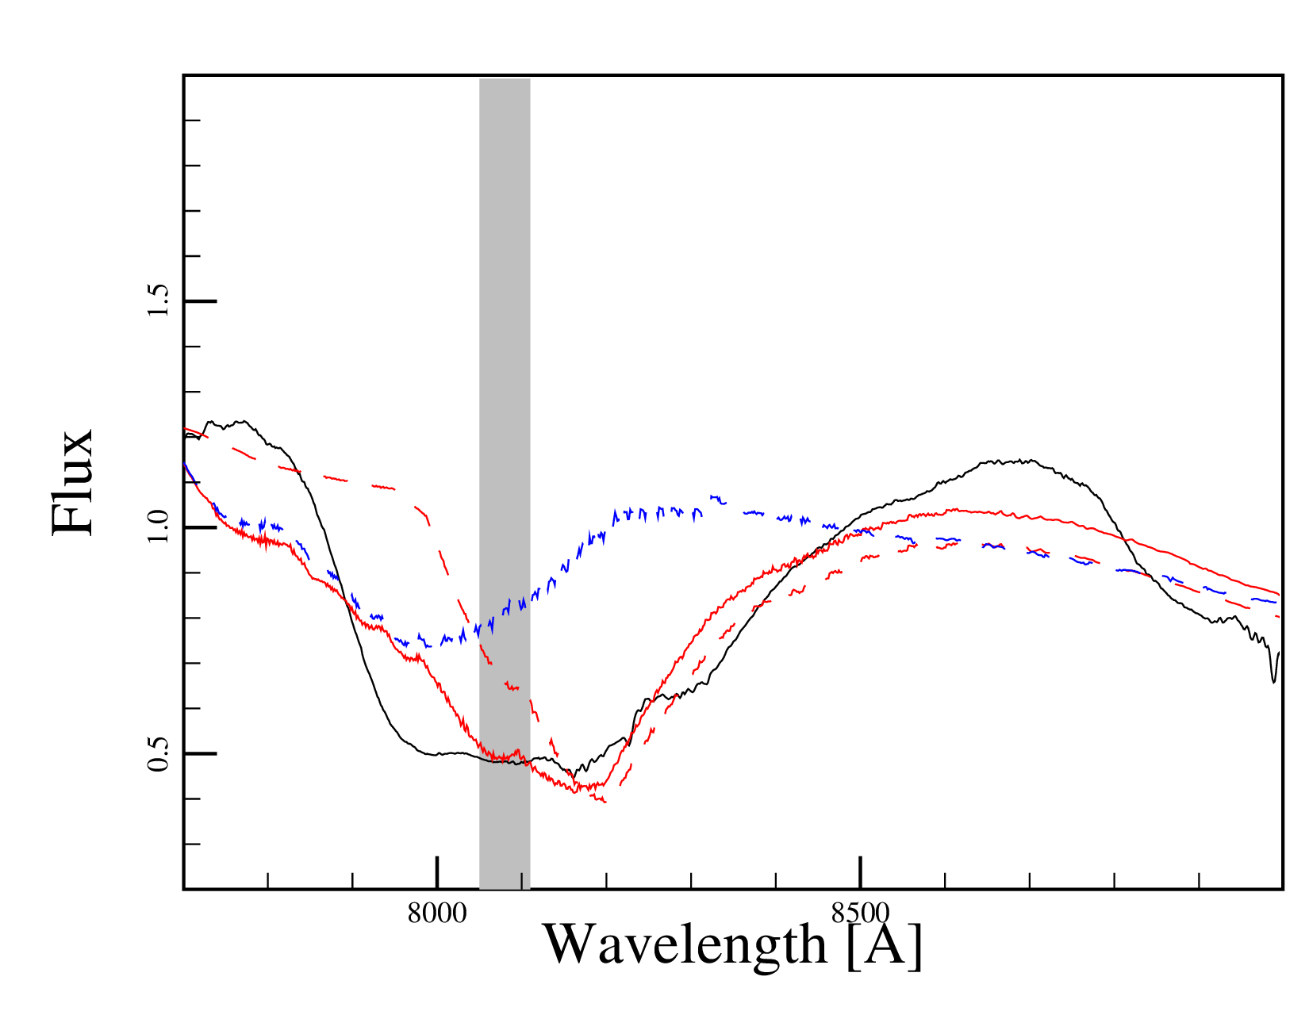
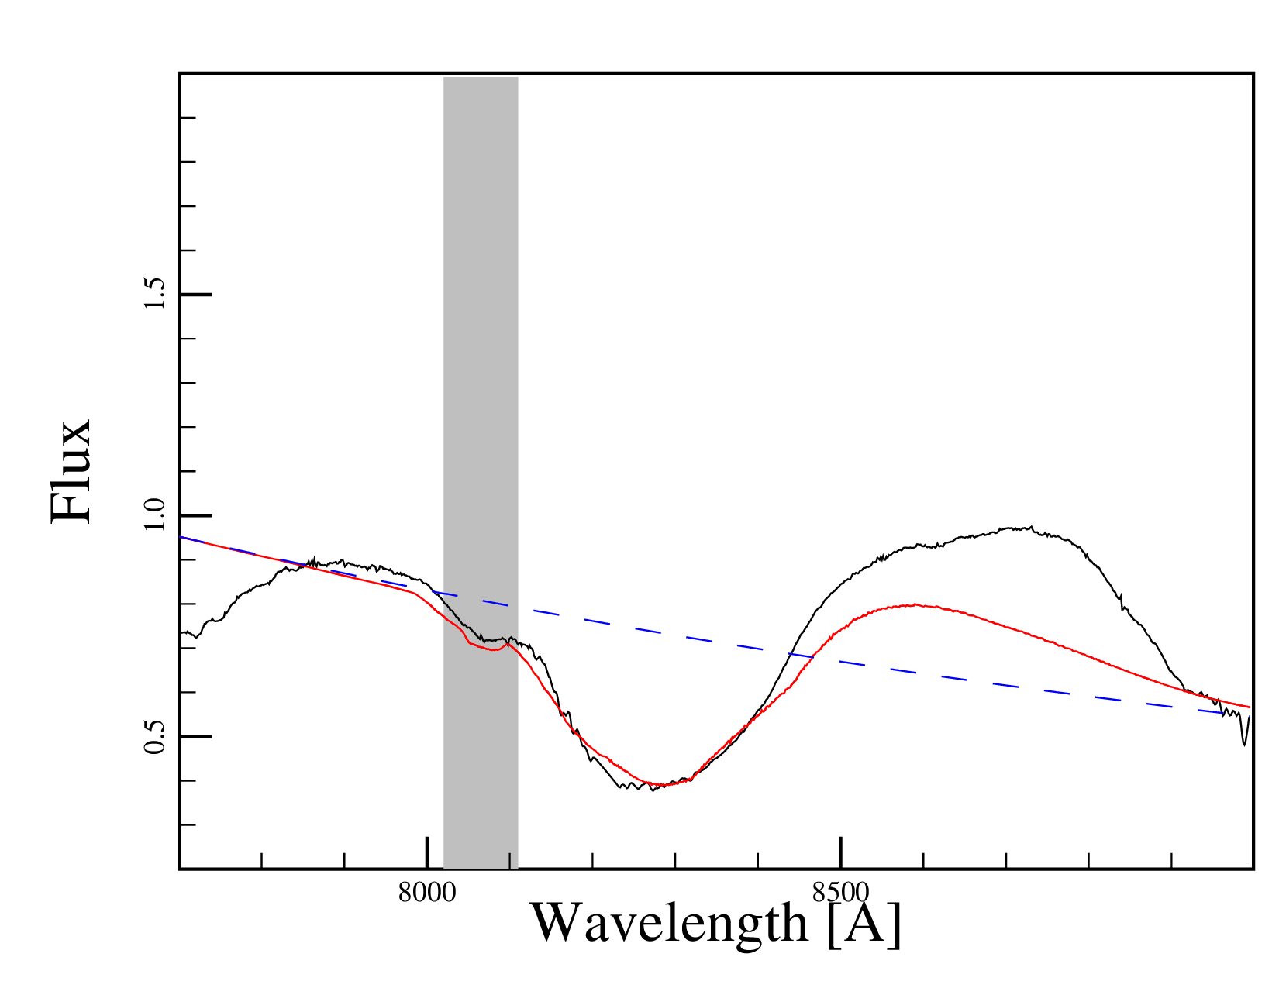
Bmax – 16.54d
Bmax – 12.66d
Red, solid:
Fit
Blue, dashed:
Shell
Red, dashed:
Ejecta
SN2011fe data:
Parrent+ 2012
Bmax + 2.87d

Slide 4
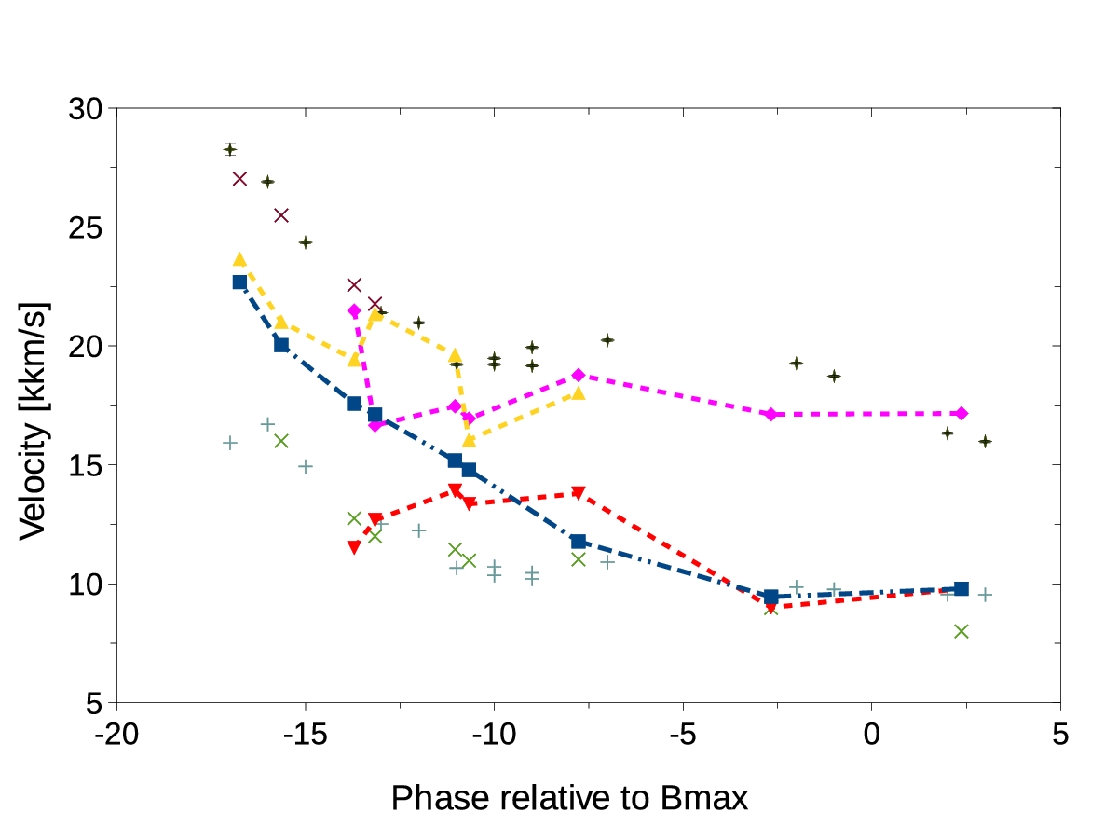
Observed SN2011fe HVF (symb.)
Shell + “Interaction Feature”
SNO
Observed SN2011fe PVF (symb.) Ejecta (line)

Slide 5
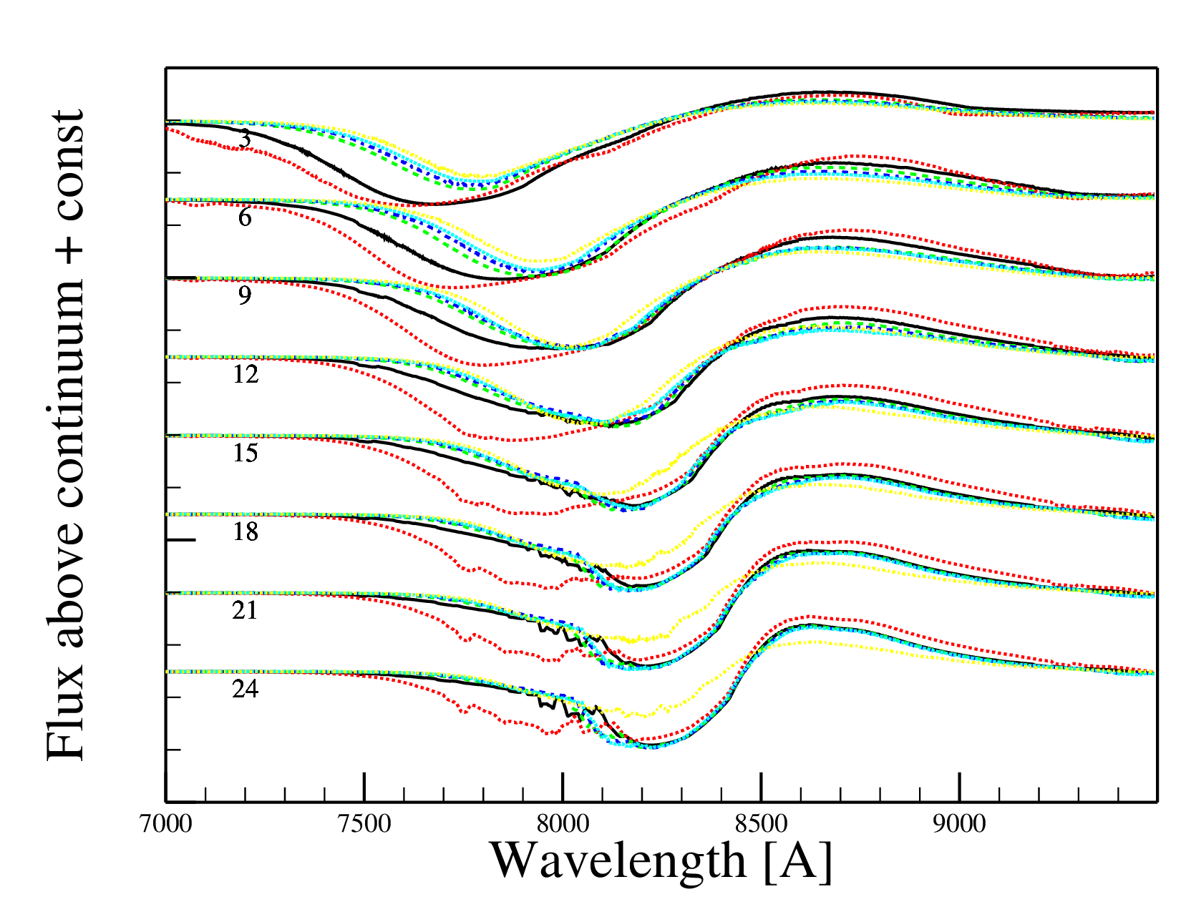
Mass:
0.003 M_{sun}
0.005 M_{sun}
0.008 M_{sun}
0.010 M_{sun}
0.012 M_{sun}
0.020 M_{sun}

Slide 6
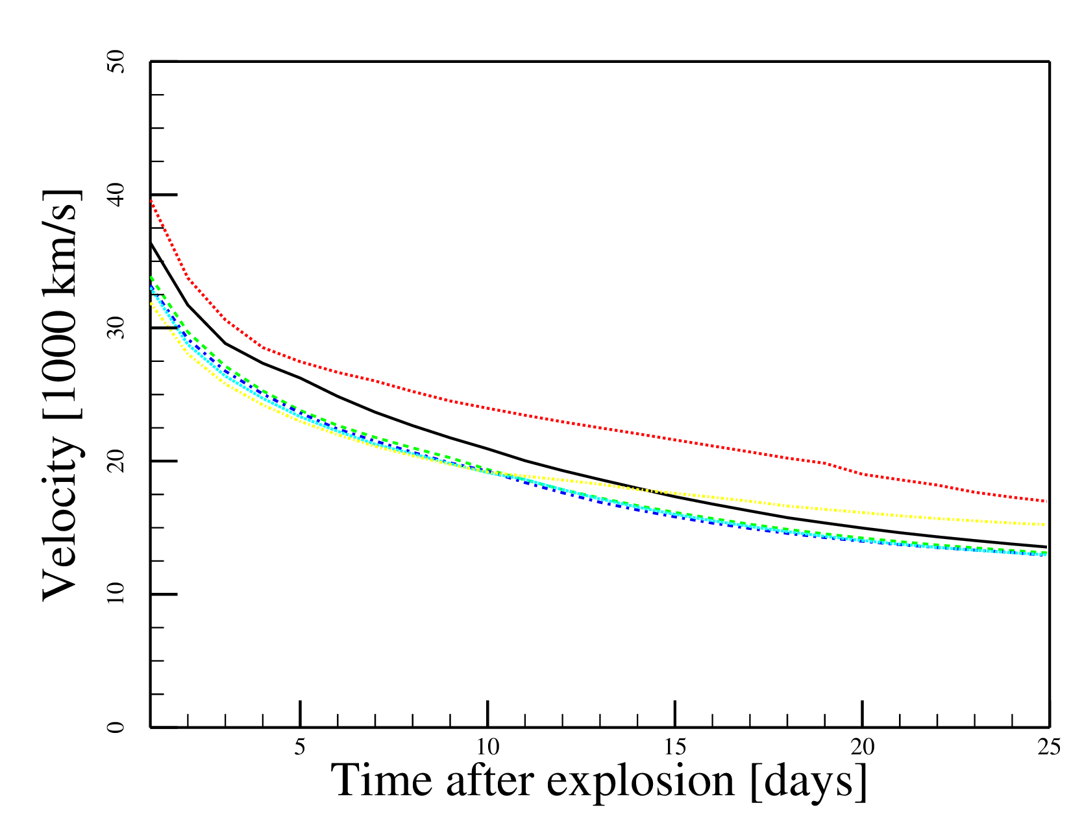
Velocity Evolution (by Mass)
Mass:
0.003 M_{sun}
0.005 M_{sun}
0.008 M_{sun}
0.010 M_{sun}
0.012 M_{sun}
0.020 M_{sun}

Slide 7
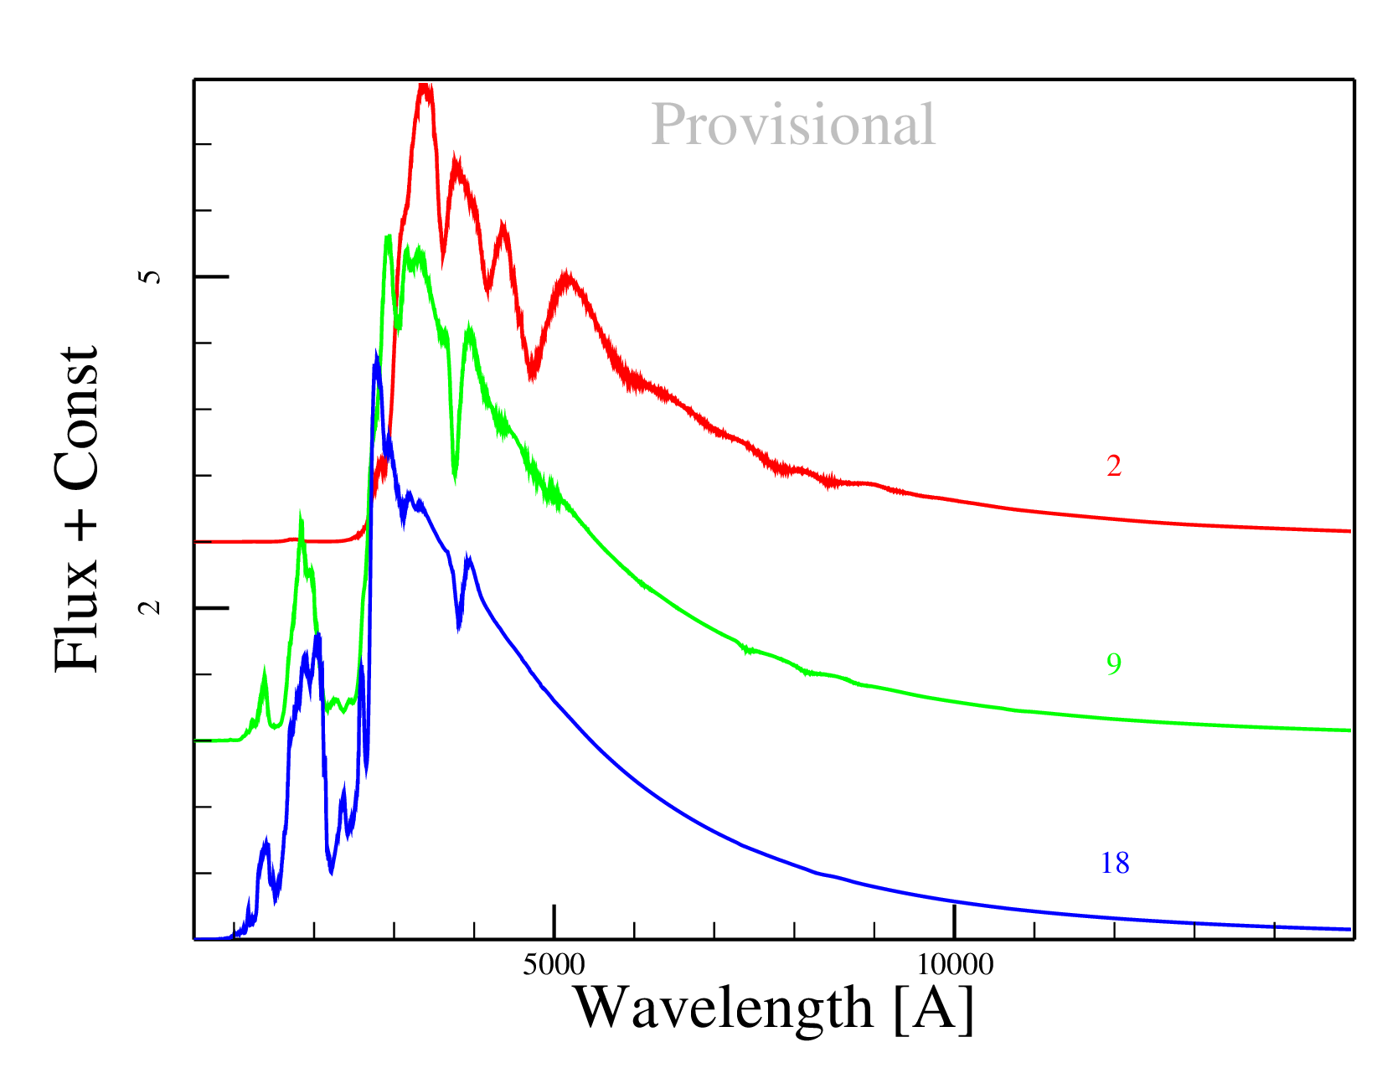
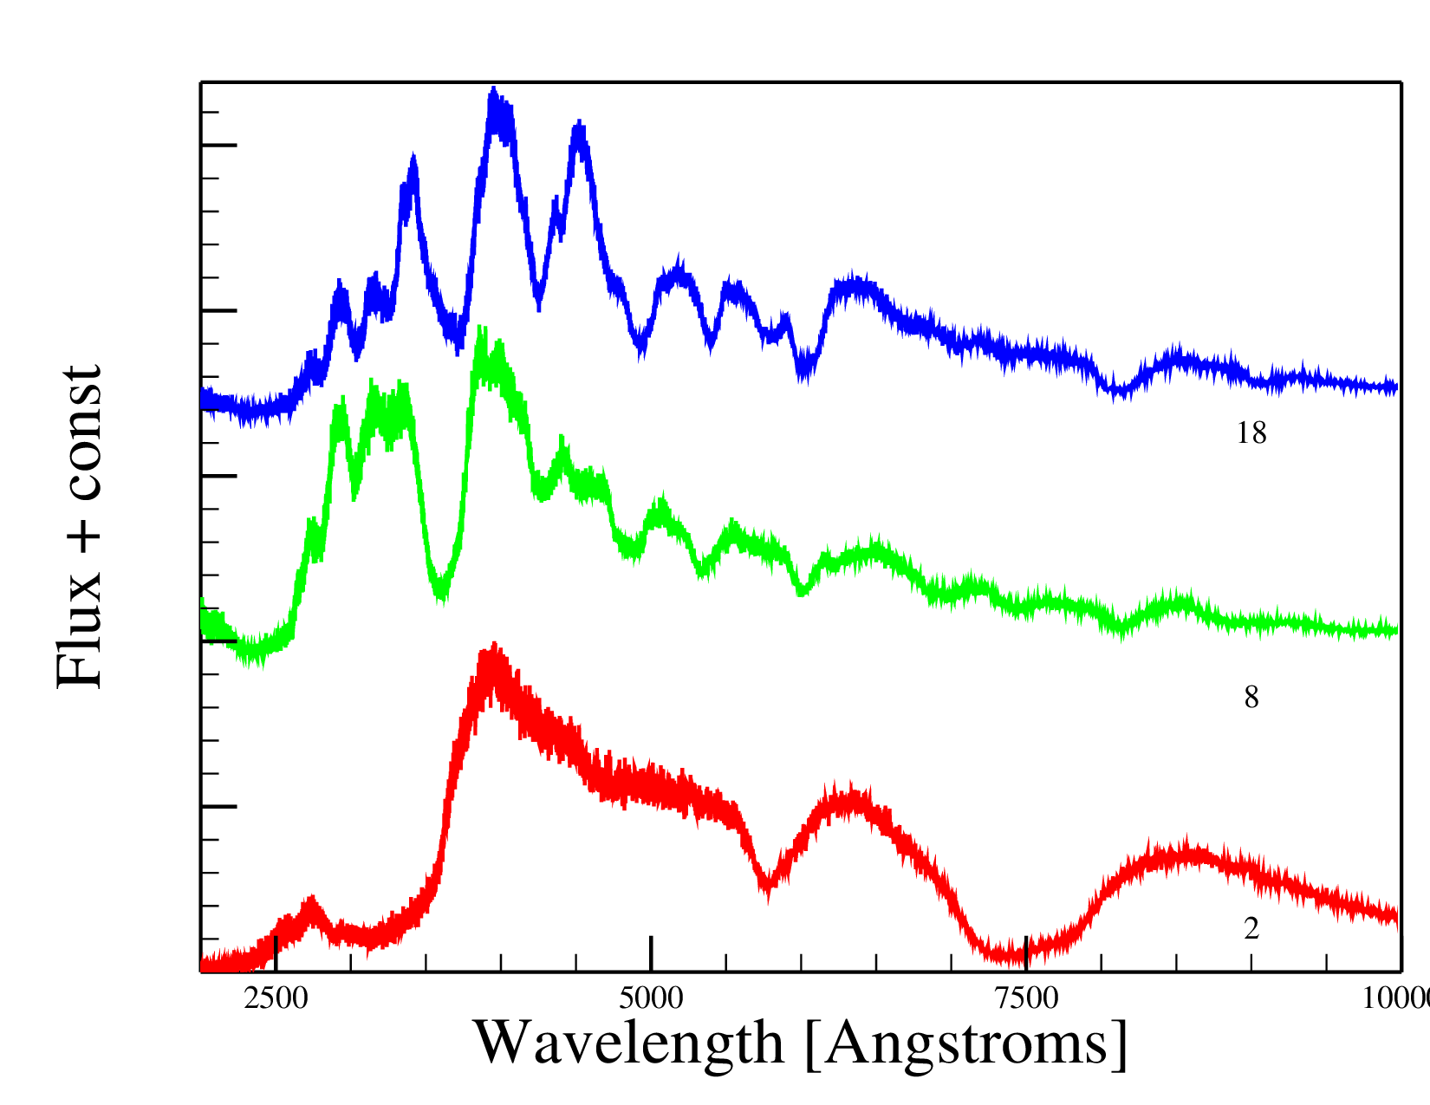
Multi-ion spectra
Syn++
[Ca rich, weak]
Tardis
[Solar abundance]

Slide 8
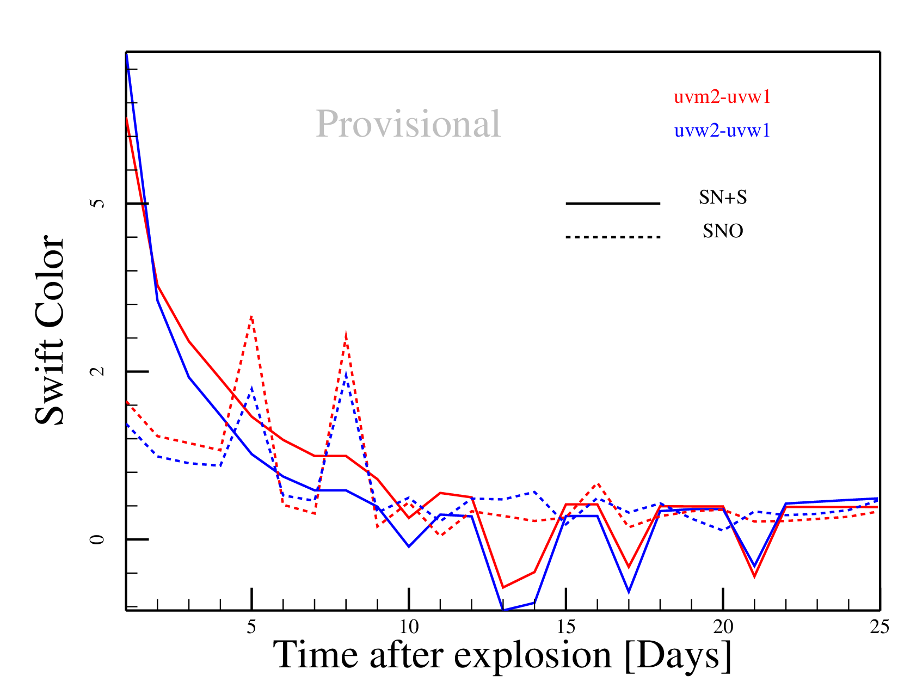
Swift Light curve

Slide 9
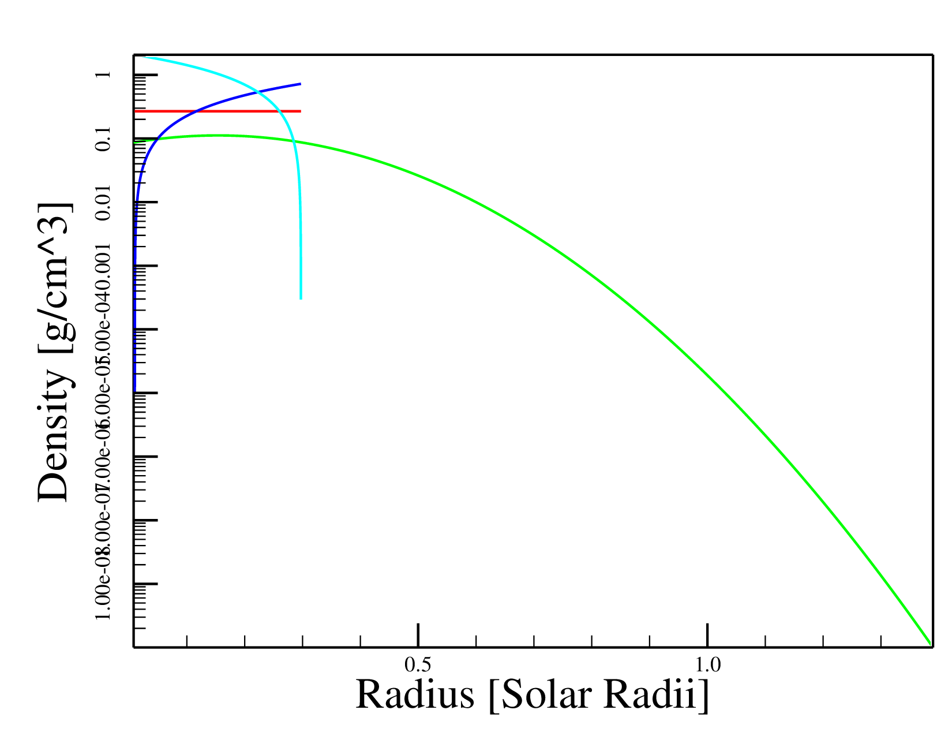
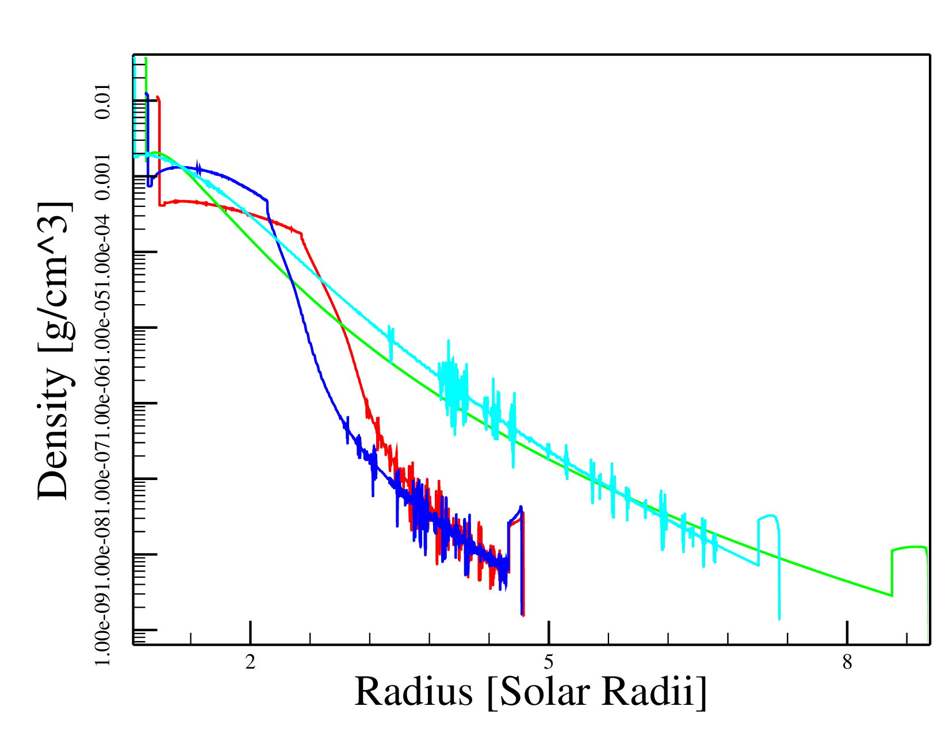
Left: at initialization Right: after interaction (50s)
Tophat Gaussian Sawtooth Rev. Sawtooth

Slide 10
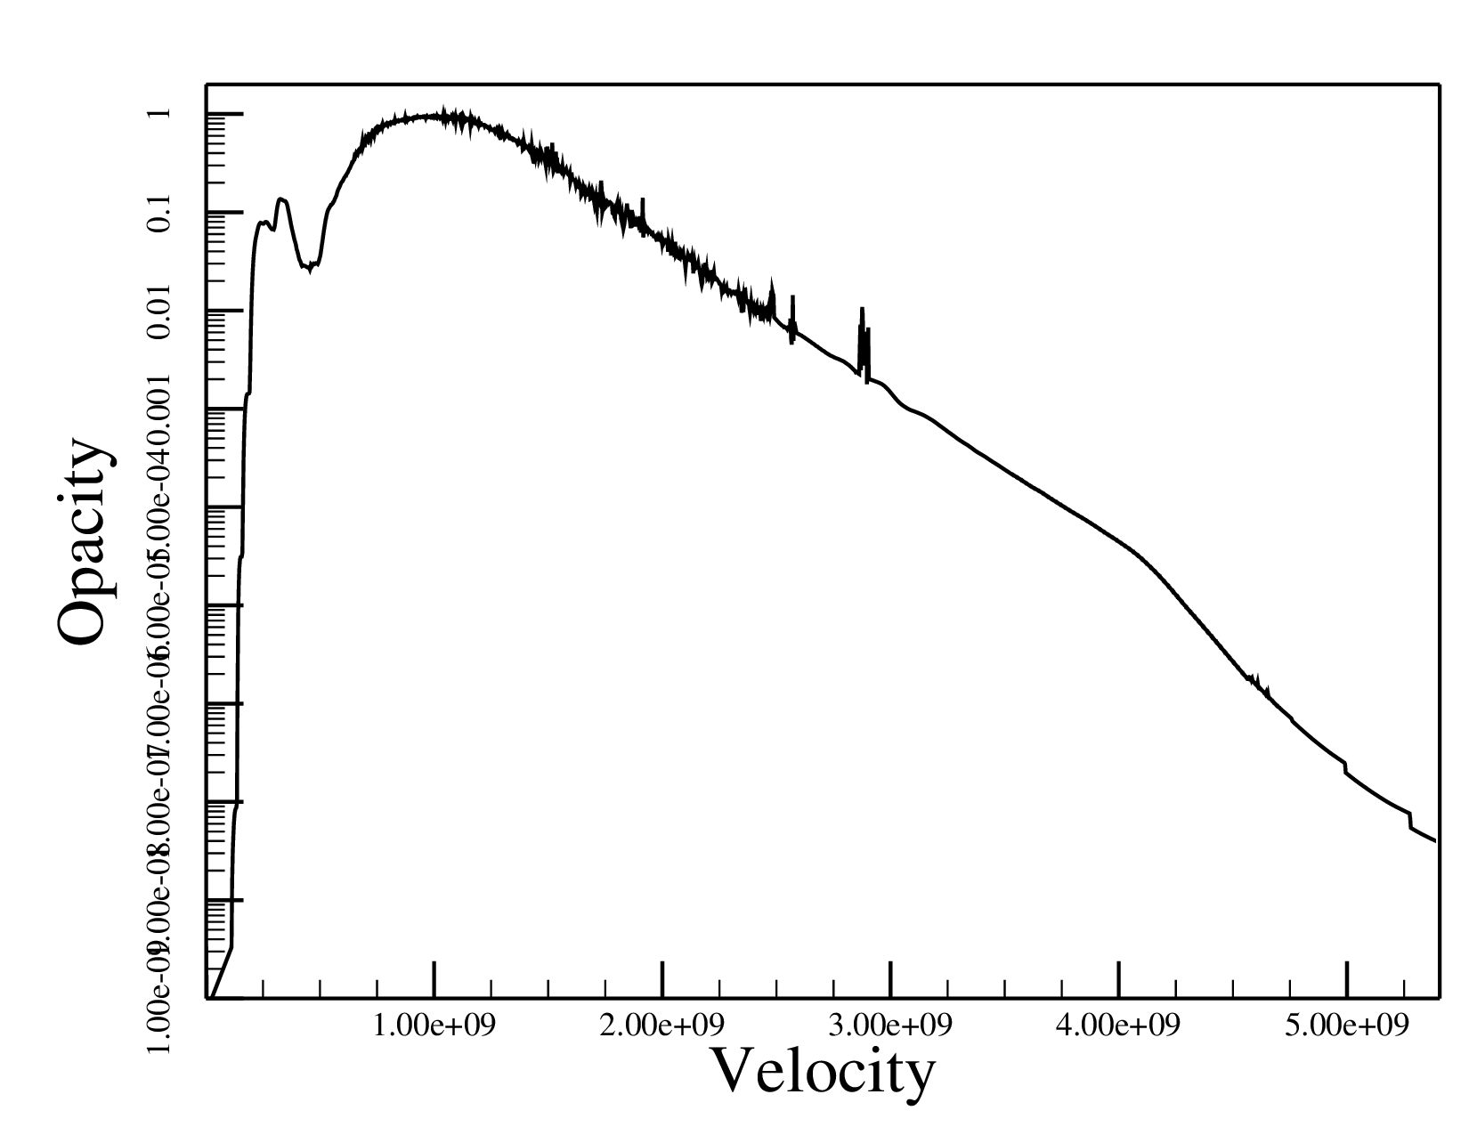
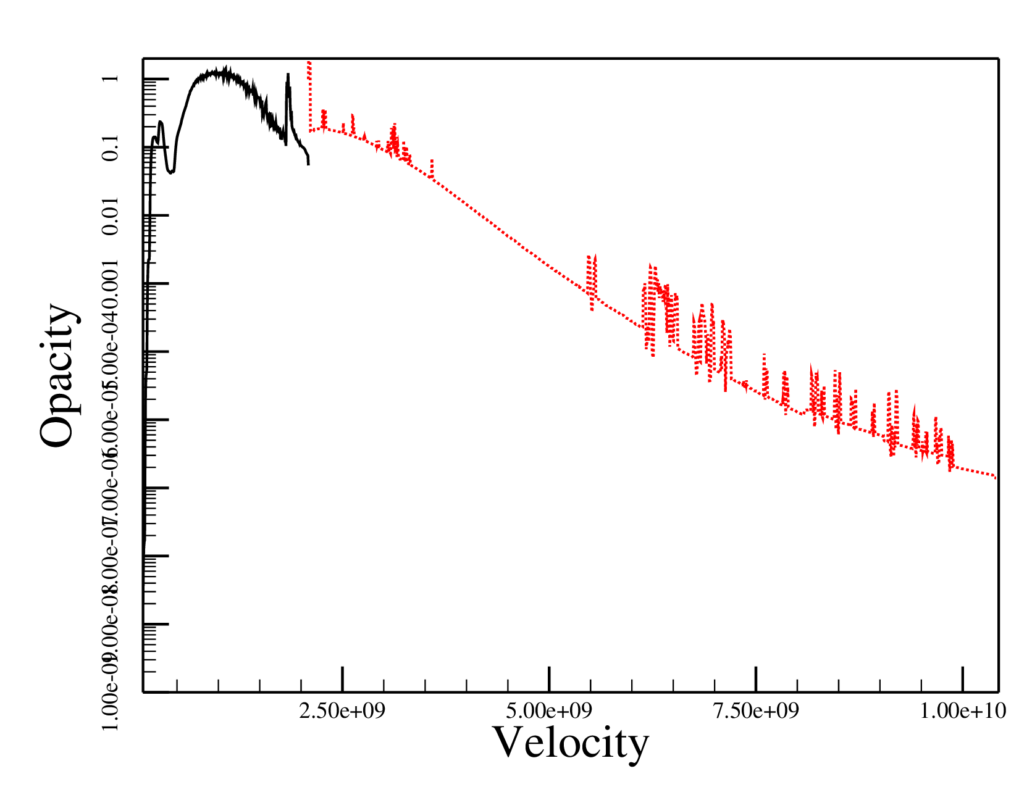
No shell
With shell (0.005 Msun)

