Slide 1
Baseball Scoring & Statistics
An Introduction
Brian W. Mulligan
University of Texas at Austin
Grad Student – Post-Doc Seminar
University of Texas at Austin
12 May 2017

Slide 2
Plan for this talk
The Score Sheet
Making it to base
Fielding Positions
Outs
Batting Statistics

Slide 3
Plan for this talk
The Score Sheet
Making it to Base
Fielding Positions
Outs
Batting Statistics

Slide 4
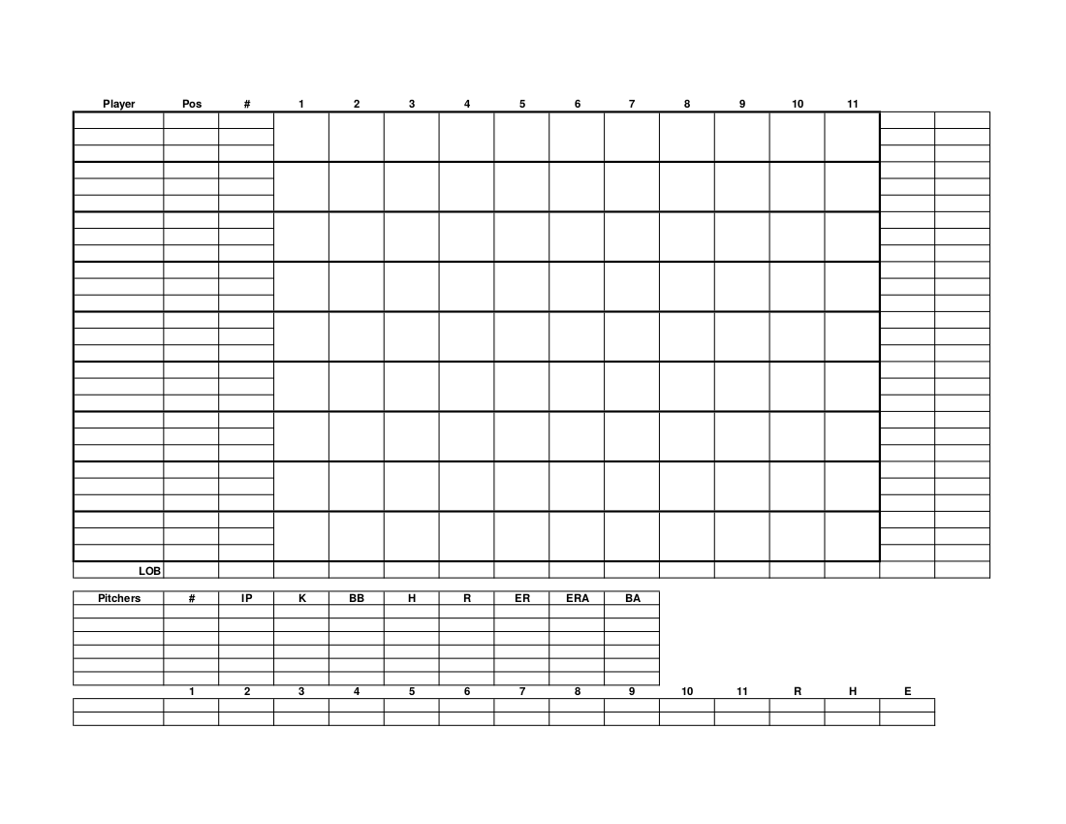
Most basic
Scoresheet 1/9

Slide 5
Most basic
Players
Scoresheet 2/9

Slide 6
Most basic
Hit / out results by player by inning
Players
Scoresheet 3/9

Slide 7
Most basic
Hit / out results by player by inning
Players
Player stats
Scoresheet 4/9

Slide 8
Most basic
Hit / out results by player by inning
Players
Player stats
Game scoring
Scoresheet 5/9

Slide 9
Most basic
Hit / out results by player by inning
Players
Player stats
Pitching stats
(not covered today)
Game scoring
Scoresheet 6/9

Slide 10
Most basic
Hit / out results by player by inning
Players
Player stats
Pitching stats
(not covered today)
Game scoring
Scoresheet 7/9

Slide 11
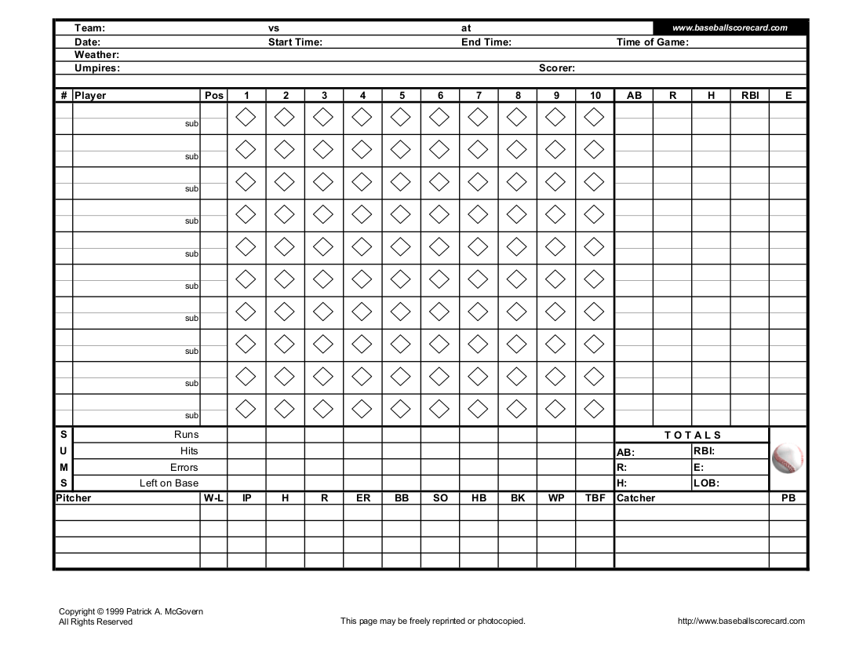
Better sheet
Scoresheet 8/9

Slide 12
Useful markings
End of a half inning (indicate last batter of prior inning, first batter of next inning)
Player Substitution (indicate inning / at bat between when player was substituted
Pitching Change (indicate batters between which the pitcher changed)
Scoresheet 9/9

Slide 13
Plan for this talk
The Score Sheet
Making it to Base
Fielding Positions
Outs
Batting Statistics

Slide 14
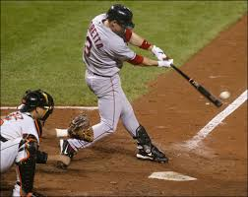
A Hit!
Single [1B]
1B
1B
2B
2B
Double [2B]
3B
3B
Triple [3B]
Home Run [HR]
HR
HR
Tracking the hit
Most useful for opposing team
Indicate direction of hit with thin line
Single toward left field
1B
Hits 1/6

Slide 15
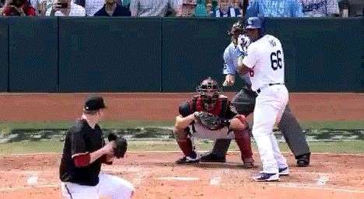
Pitching choices and mistakes
Base on balls (Walk) [BB]
BB
Intentional Walk
[IBB or IW]
IBB
Hit by Pitch [HBP]
HBP
Dropped third strike: wild pitch [K WP]
K
WP
Dropped third strike:
Passed ball [K PB]
K
PB
Hits 2/6

Slide 16
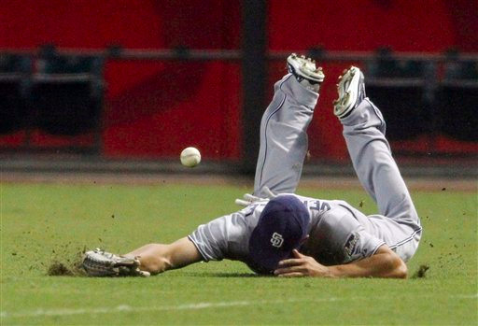
Not so good a hit...
Fielding Error
(by the first baseman)
E4
Fielders Choice
Batter makes it to base, but another runner is forced or tagged out
Ex: Runner on 1st; Grounder to 2nd, 2nd baseman tosses to SS, force runner out at 2nd. Batter makes it to 1st.
FC
Hits 3/6

Slide 17
Advancing the runners
A runner advances on a hit by another batter.
Note who advanced the runner to each base.
First base runner who had a single
1B
3
Advances on a single by batter #3
1B
4
3
Advances again on a single by batter #4
1B
4
3
Gets a run by batter #6
6
1B
Hits 4/6

Slide 18
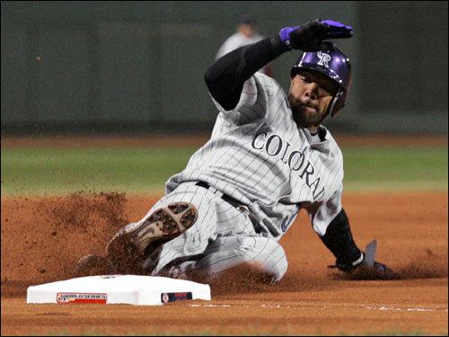
Stolen bases and errors
Make note of when the runner advanced by who was batting
First base runner who had a single
1B
SB3
Steals a base [SB] during batter #3 at bat
1B
Advances on an error [E] by the shortstop
(more details on this later)
E6
SB3
1B
E6
SB3
Pitcher hits the mascot
(Wild Pitch [WP])
WP2
1B
Pitcher Balks [BLK]
Catcher drops the ball
(Passed Ball [PB])
Interference by player or spectator [I or INT]
Hits 5/6

Slide 19
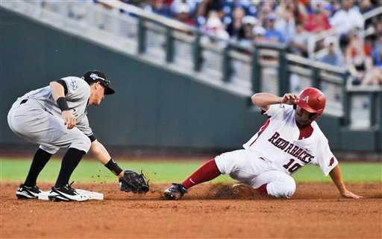
Runner doesn’t advance
When a runner fails to advance due to being tagged or forced out, terminate their path
First base runner who had a single
1B
Forced out by batter #2
2
1B
Caught stealing [CS]
2
CS
1B
Runner Interferes with fielder [INT]
Left Base Early [LBE]
(tries to advance on fly, reaches next base but ball is caught)
Runner left base-path
[LBP]
Picked Off [PO]
Hits 6/6

Slide 20
Plan for this talk
The Score Sheet
Making it to Base
Fielding Positions
Outs
Batting Statistics

Slide 21
Fielding Positions
1
Pitcher
Fielding 1/10

Slide 22
Fielding Positions
1
Catcher
2
Fielding 2/10

Slide 23
Fielding Positions
3
1
1st Base
2
Fielding 3/10

Slide 24
Fielding Positions
4
3
1
2nd Base
2
Fielding 4/10

Slide 25
Fielding Positions
4
5
3
1
3rd Base
2
Fielding 5/10

Slide 26
Fielding Positions
6
4
5
3
1
Short stop
2
Fielding 6/10

Slide 27
Fielding Positions
7
6
4
5
3
1
Left Field
2
Fielding 7/10

Slide 28
Fielding Positions
8
7
6
4
5
3
1
Center Field
2
Fielding 8/10

Slide 29
Fielding Positions
8
7
9
6
4
5
3
1
Right Field
2
Fielding 9/10

Slide 30
Fielding Positions
8
7
9
10
6
4
5
3
1
Rover
(Softball)
2
Fielding 10/10

Slide 31
Plan for this talk
The Score Sheet
Making it to Base
Fielding Positions
Outs
Batting Statistics

Slide 32
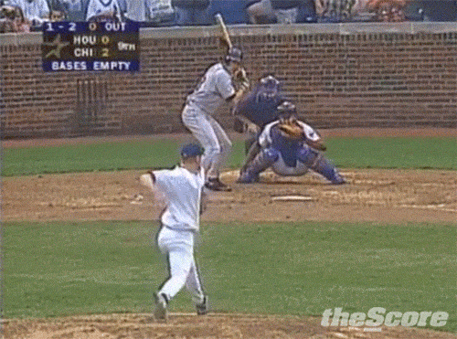
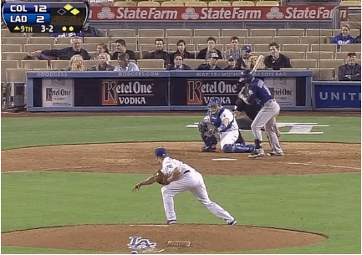
Strikeouts (K)
Strikeout swinging
K
Strikeout called
(looking / watching)
8
(Backwards K)
7
9
10
6
4
5
1
3
2
Outs 1/11

Slide 33
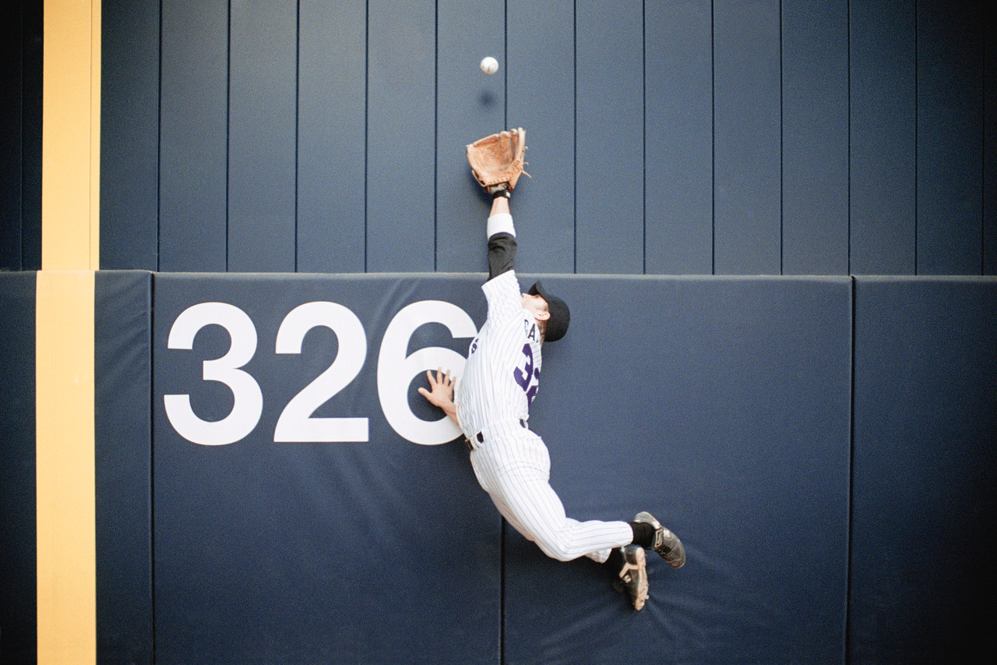
Fly balls (F) and Foul Outs (FO)
Fly Ball to Left Field
F7
Fly Ball to Short Stop
F6
Fly Ball to 1st Base
F3
8
7
9
10
Fly Ball in Foul Territory to Catcher
6
4
FO2
5
1
3
2
Outs 2/11

Slide 34
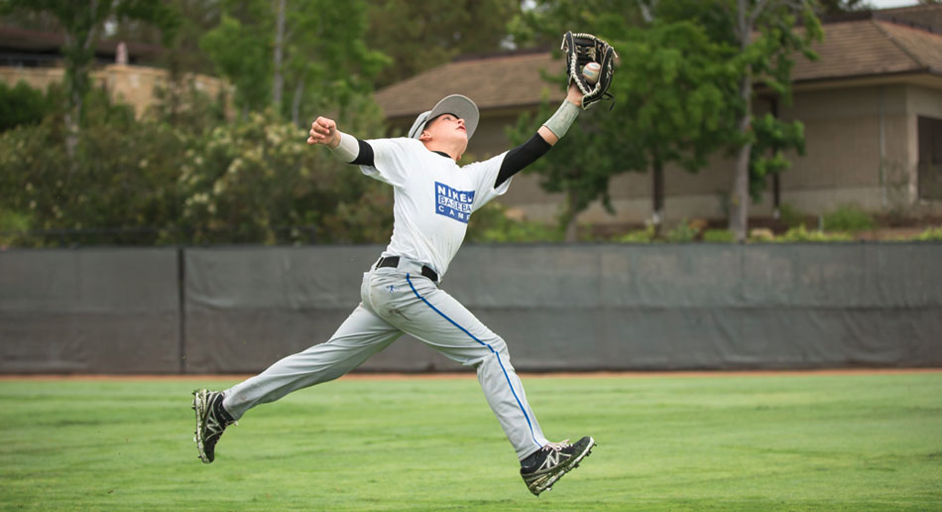
Line Drives (L)
Line to short stop
L6
Line Drive
To 1st Base
L3
8
7
9
10
6
4
5
1
3
2
Outs 3/11

Slide 35
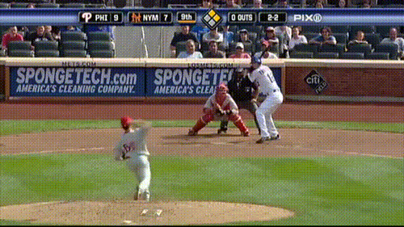
Unassisted (U)
Ground ball to 1st Base
U3
Ground ball to pitcher
U1
8
7
9
10
6
4
5
1
3
2
Outs 4/11

Slide 36
Assisted plays (batter out)
Ground to 2nd, throw (out) at 1st
4-3
Ground to shortstop, throw to 1st
6-3
8
7
9
10
6
4
5
1
3
2
Outs 5/11

Slide 37
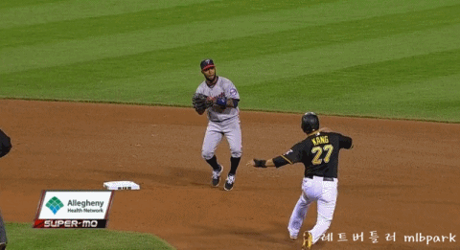
Back to fielders choice (FC)
Ground to 2nd, toss to SS, forceout at 2nd, batter reaches 1st on fielders choice
2
1B
4-6
FC
Show runner that was forced out by terminating their baserunning and indicate who was responsible
8
7
9
10
6
4
5
1
3
2
Outs 6/11

Slide 38
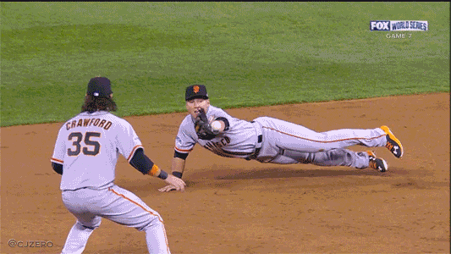
Multiple Outs with assist
Double plays (DP)
Ground to 2nd, toss to SS, forceout at 2nd, throw to 1st, forceout at 1st
2
1B
DP
4-6-3
Show runner that was forced out by terminating their baserunning and indicate who was responsible
8
7
9
10
6
4
5
1
3
2
Outs 7/11

Slide 39
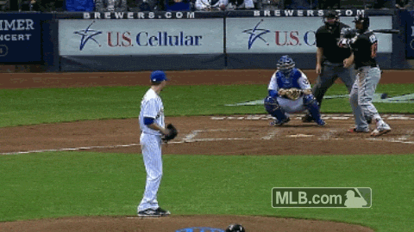
Multiple Outs with assist
Triple plays (TP)
Ground to 3rd, forceout at 3nd, throw to 2nd, forceout at 2nd, throw to 1st, forceout at 1st
3
2
1B
3
1B
TP
5-4-3
8
7
9
10
6
4
5
1
3
2
Outs 8/11

Slide 40
Infield Fly Rule [IFR]
  When there is a fly ball that can reasonably be caught by an infield player, there is less than two outs, and there are runners on 1st and 2nd (and optionally 3rd).
  Decided by umpire. Batter is out, runners don’t advance
IFR
Outs 9/11

Slide 41
Sacrifices
Sacrifice play
  Batter intentionally hits in such a way that they are out but runners advance
  Sacrifice Fly: SF
  Sacrifice Bunt: SH or SB or SAC
2
1B
SAC
2-3
Outs 10/11

Slide 42
Summary of Outs
Indicate all fielders involved in each play.
Indicate batter who is responsible for advancing or eliminating runners.
Caught Stealing (CS)
Picked off (PO)
Fly (F)
Foul Out (FO)
Line Drive (L)
Strikeout (K) or ( )
Unassisted (U)
Double Play (DP)
Triple Play (TP)
Infield Fly Rule (IFR)
Outs 11/11

Slide 43
Plan for this talk
The Score Sheet
Making it to Base
Fielding Positions
Outs
Batting Statistics

Slide 44
Batting Raw Statistics
At-Bats [AB]: Number of times a batter hit the ball leading to an out or one or more bases. Excludes walks and hit by pitch. Includes dropped 3rd strike.
Hits [H]: Number of times a batter reached any base via a hit, including dropped 3rd strike.
Walks [BB]: Number of times a batter reached first base due to being pitched 4 balls, including intentional walks
Hit By Pitch [HBP]: Number of times a batter was hit by a pitch.
Strikeouts [K or SO]: Number of times batter struck out
Runs batted in [RBI]: Number of runners batter advanced to a run.
Total Bases [TB]: Number of bases a batter achieved from at-bats (i.e. a single = 1 base, a double = 2 bases, etc.)
Doubles [2B]: Number of times batter got a double
Triples [3B]: Number of times batter got a triple
Home Runs [HR]: Number of times batter got a home run
Statistics 1/5

Slide 45
Batting calculated statistics
Batting Average [BA or AVG]:
fraction of the time batter gets to base via a hit
  AVG = H / AB
On Base Percentage [OBP]:
Fraction of the time the batter gets to base by any means
  OBP = (H + HBP + BB) / (AB + HBP + BB)
Slugging Percentage [SLG]:
Average number of bases a batter achieves in an at-bat
SLG = TB / AB or (1B + 2*2B + 3*3B + 4*HR)/AB
Statistics 2/5

Slide 46
Other stats
Baseball is a stats game
  Waaay too many individual stats to cover here.
  Wikipedia lists about 40 batting stats, a similar number of pitching stats, and about 20 additional other stats. You can probably find dozens more.
  Probably some data science jobs available for analysis – contact your favorite MLB team or fivethirtyeight
Pitching stats
  Frequency of giving up hits, HR, runs, etc. etc.
Fielding stats
  Tracking who makes the outs allows some degree of fielding capabilities
Statistics 3/5

Slide 47
Score sheets usually have columns for AB and H, sometimes for R, RBI,
And sometimes for other stats
Usually all other stats are kept separately
Statistics 4/5

Slide 48
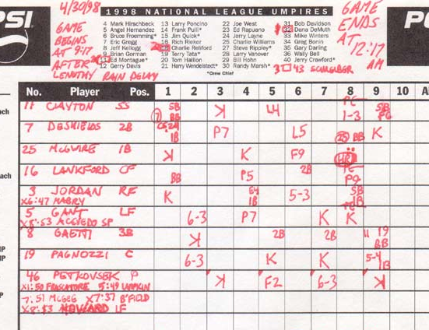
Cards – Cubs April 30, 1998
AB H BB TB RBI AVG OBP SLG
4 0 1 1 0 .000 .200 .000
4 1 1 2 1 .250 .400 .250
4 1 0 4 2 .250 .250 1.000
3 1 1 2 0 .333 .500 .666
4 2 0 2 0 .500 .500 .500
4 0 0 0 0 .000 .000 .000
3 2 1 4 0 .666 .750 1.333
4 1 0 0 0 .250 .250 .250
1 0 0 0 0 .000 .000 .000
1 0 0 0 0 .000 .000 .000
1 0 0 0 0 .000 .000 .000
1 0 0 0 0 .000 .000 .000
Statistics 5/5

Slide 49
Summary
Hits & walks
  1B / 2B / 3B / HR / BB / IBB or IW
  Show advancing runners and indicate credit for advance
Outs
  Indicate all fielders involved in the play.
  Fielders order: Pitcher, Catcher, infield (1st→3rd), SS, OF (left→ right)
  Mark line drives (L), flys (F), foul outs (FO), double (DP) and triple (TP) plays
Stats
  Raw: AB, BB, H, RBI
  Calculated: AVG, OBP, SLG

Slide 50
Extras: Pitching Statistics
Innings Pitched [IP]: the total number of outs during which the pitcher was pitching, divided by 3. Special note: when written in decimal rather than as a fraction, 1/3 inning is written as 0.1, and 2/3 as 0.2. Yes, this is wrong.
Hits [H]: the total number times that a batter reached 1st base or more through hitting the ball, excluding fielders choice or errors
Walks [BB]: the total number of walks that the pitcher gave up.
Strikeouts [K]: the total number of strikeouts that the pitcher gets.
Home Runs [H]: the total number of home runs that the pitcher gives up.
Runs [R]: the total number of runs that the pitcher gave up.
Earned Runs [ER]: the total number of runs that the pitcher gave up and was responsible for. This acknowledges that errors or other situations allow runs to occur that a pitcher has little to no control over.
Extras: Pitching 1/3

Slide 51
Extras: Pitching Calculated Statistics
Earned Run Average [ERA]: An estimate of how many runs an opposing team will get in a game for a pitcher.
  ERA = ER / IP * 9
Note: Use decimal IP – so 5 1/3 innings is 5.1, not 5.33333.
Walks & Hits per inning pitched [WHIP]: Pretty much what is says
  WHIP = (BB + H) / IP
Extras: Pitching 2/3

Slide 52
Extras: Pitching Game Statistics
Wins [W]: Pitcher was pitching when the team took the lead, then eventually won the game.
Loss [L]: Pitcher who gave up the runs that lead to loss of game.
Save Opportunities [SO]: A pitcher enters the game with
  A lead of three or fewer runs and pitches one inning
  Enters the game with the potential tying run on base, at back, or on deck
  Pitches 3 or more innings and is credited with a save by the scorer
Save [SV]: A pitcher enters the game in which their team is winning with a lead of 3 runs or less, and there was a save opportunity, and they are not the winning pitcher.
Extras: Pitching 3/3

Slide 53
Extras: Fielding Stats
Assists [A]: # of times a player is involved in a play, but does not physically tag or force out a runner.
Put Out [PO]: Number of times a player tags or forces out a player or catches a foul out, fly ball or line drive, or appeals a runner.
Errors [E]: # of time a player was responsible for allowing a runner to reach a base due to mishandling the ball.
Total Changes [TC]: # of times fielder was involved in a play
  TC = A + PO + E
Innings Played [INN]: # of innings the fielder plays
Range Factor [RF]: Average number of plays the fielder is involved in per game. Estimate of how much field the player can cover.
  RF = (A + PO) / INN * 9
Fielding Percentage [FP]: How many times a player is involved in a play and doesn’t fuck it up.
  FP = (A + PO) / TC
Extras: Fielding 1/1

