Slide 1
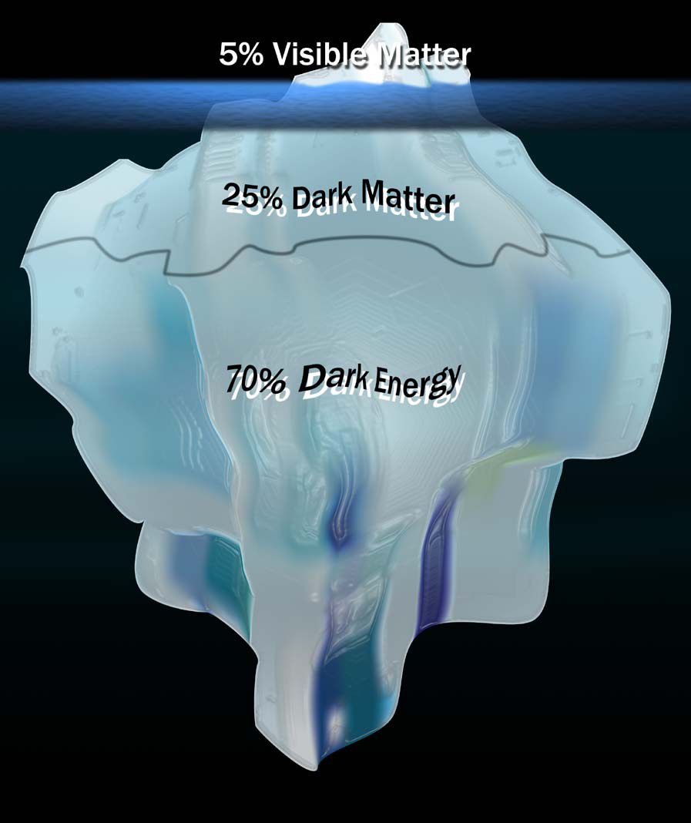
Searching for the rest of the Universe: Dark Matter

Slide 2
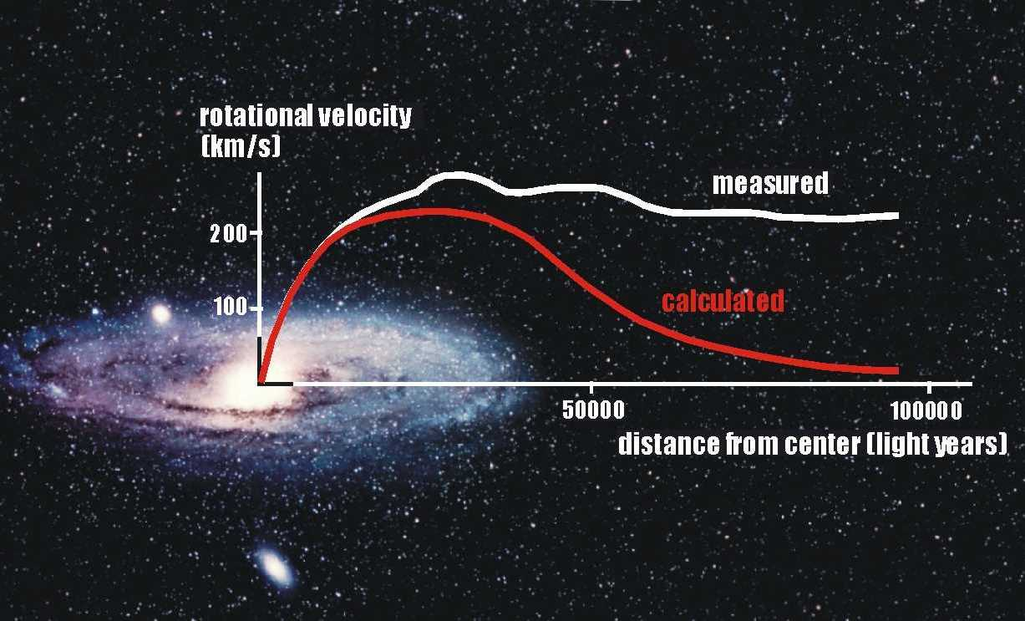
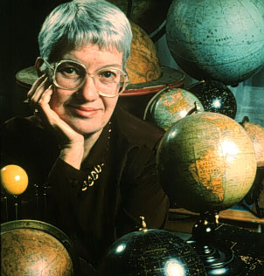
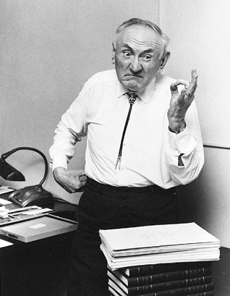
Dark Matter’s Gravitational Effects

Slide 3
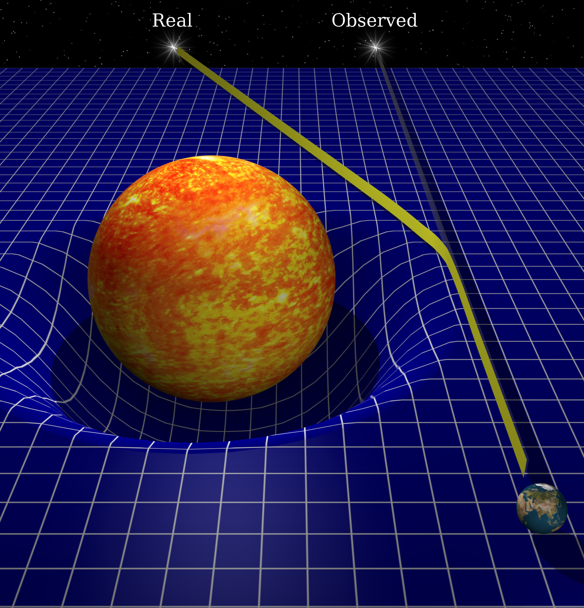
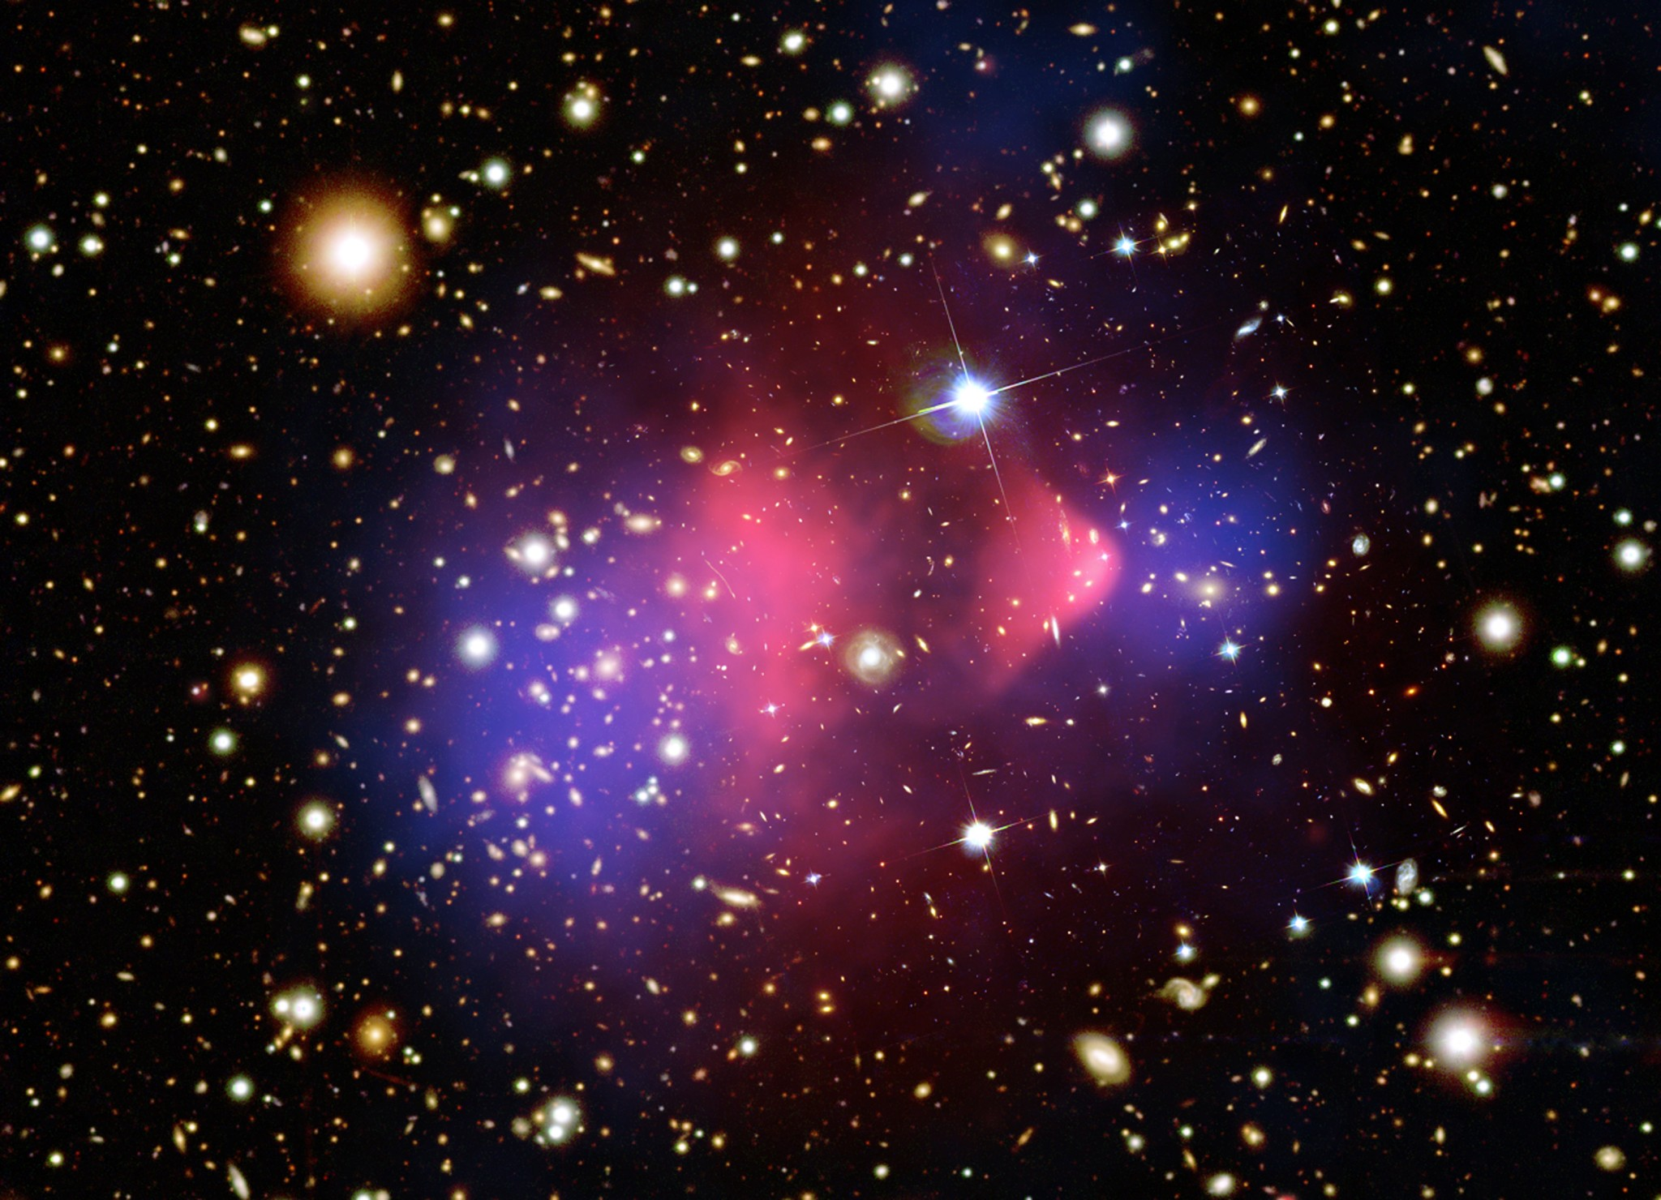
Lensing & the Bullet Cluster
dark = doesn’t interact with light
(except via gravity)
Blue = Gravitating Mass
Red = Hot Gas

Slide 4
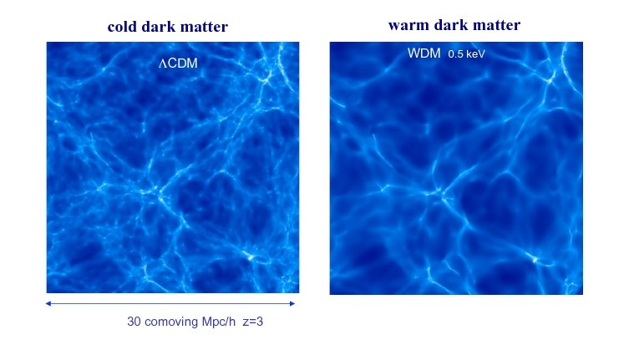
Cosmological Simulations
cold (or warm)
=
moves slowly
=
very massive particles
Bright = Lots of Galaxies

Slide 5
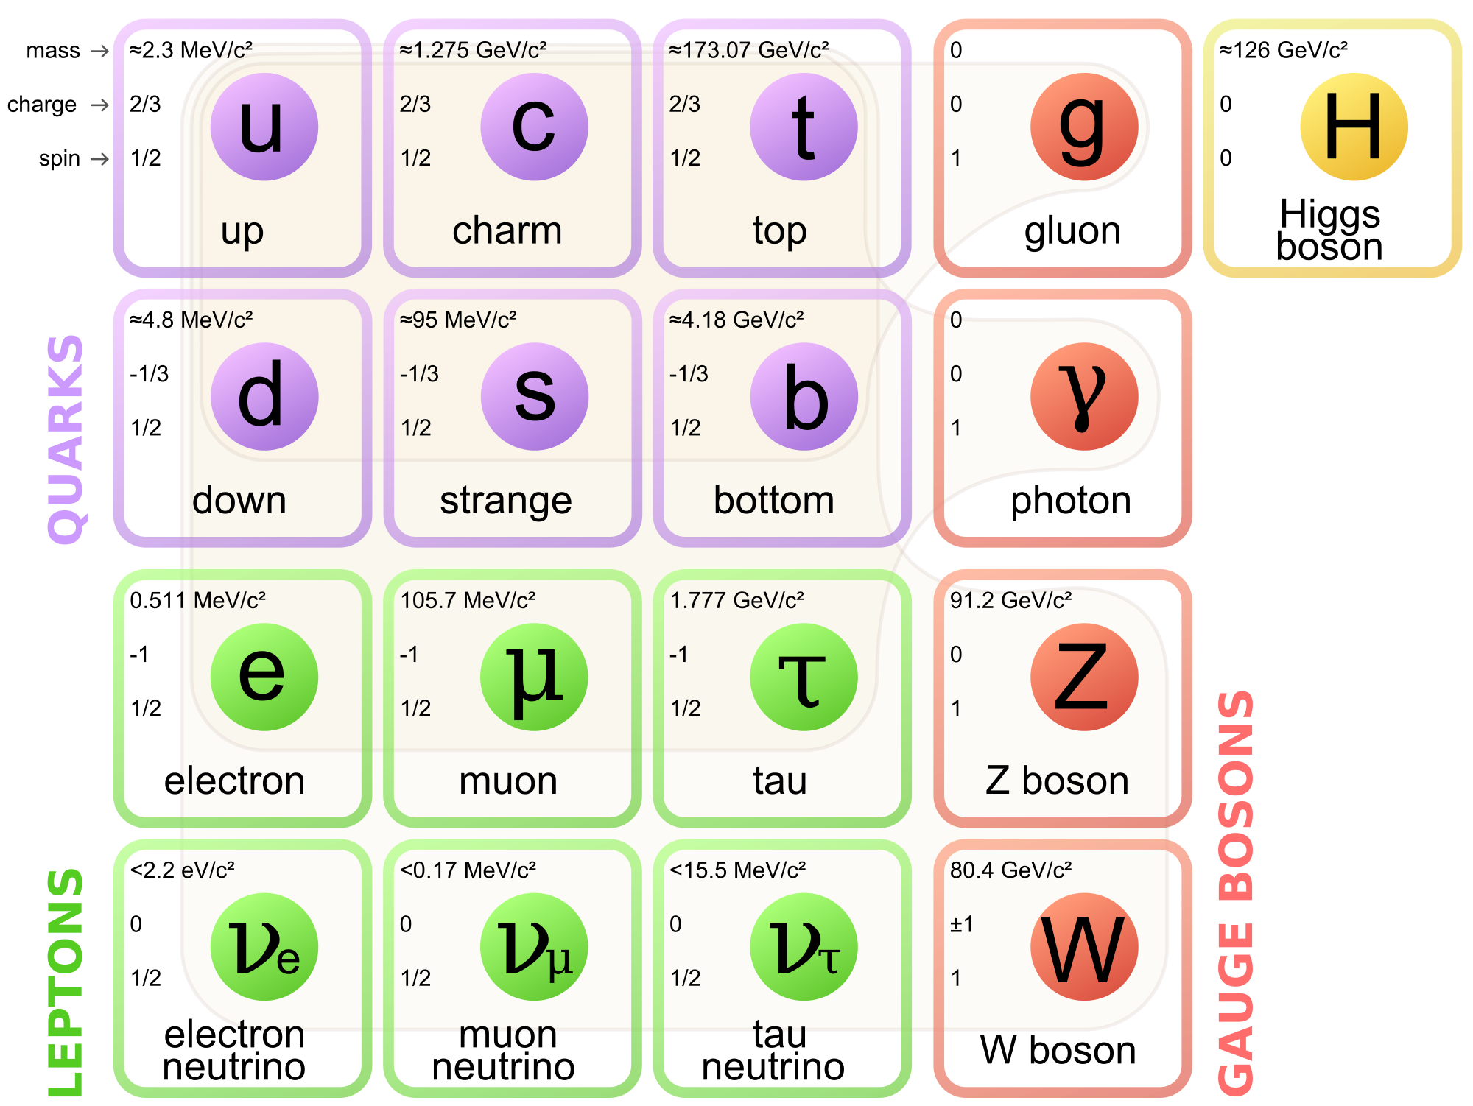
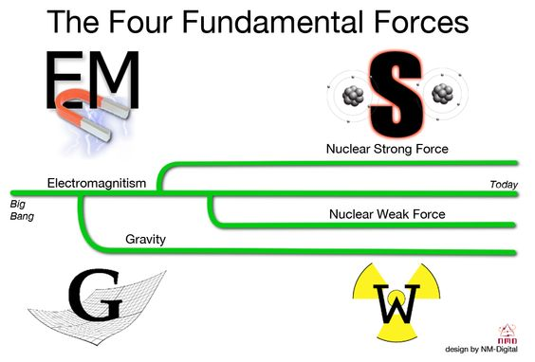
Forces & Particles
Most Normal Matter (atoms)
G
Graviton

Slide 6
Interactions?
?
?

Slide 7
Strong Force
u
d
u
u
u
u
d
u
u
u

Slide 8
Weak Force
u
u
d
u
d
d
ν⁰
e⁻

Slide 9
Direct Detection Experiments
LUX
CDMS
DM
Fancy
Electronics
Germanium Crystal
Xenon Gas
Heat,
Light
Superconductor
Light Detectors

Slide 10
Direct Search Results

Slide 11
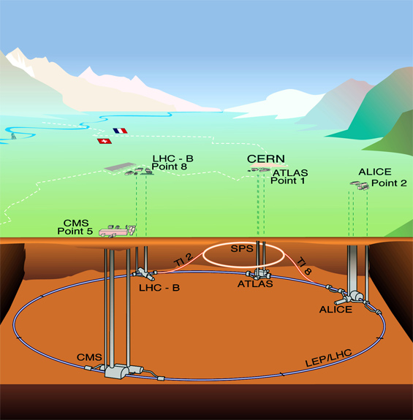
Indirect Searches
DM

Slide 12

Indirect Search Results

Slide 13
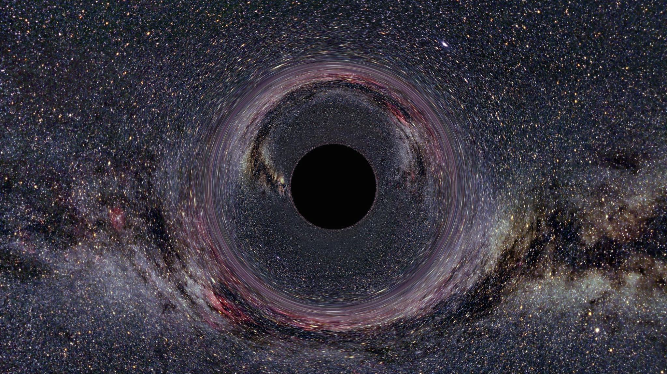
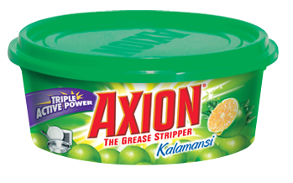
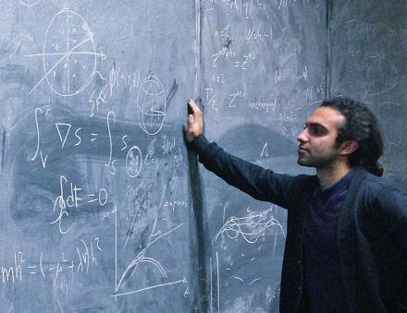
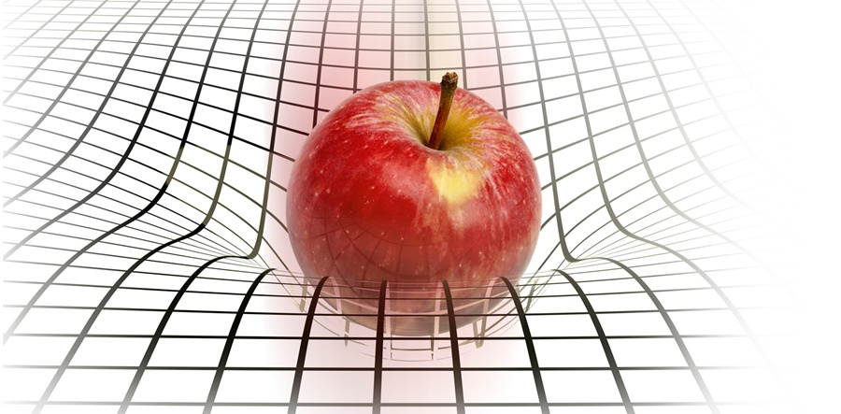

Other possibilities?

