Slide 1
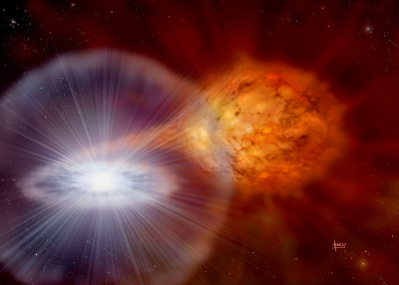
Type Ia SNe - CSM interaction
Credit: David A. Hardy
Brian W. Mulligan
Committee:
Volker Bromm
Milos Milosavlevic
Rob Robinson
Jozsef Vinko
Advisor: J. Craig Wheeler
Collaborators:
G. Howie Marion
Jeffrey Silverman
Jozsef Vinko
3 Oct 2014
University of Texas at Austin

Slide 2
Overview
Background & Motivation
  High velocity features (HVF) in Type Ia SNe
Overview of my work
Update since Spring 2014
Projected timeline
Future work

Slide 3
Type Ia Supernova
Standardizable candles, used for measurements of Hubble flow
Chemical enrichment of galaxies
Open Questions:
  Single or double degenerate?
  Mechanism to initiate detonation and burning
  Mass transfer
Early spectra (0-15d post explosion)
  High velocity Ca, Si
Credit: David A. Hardy

Slide 4
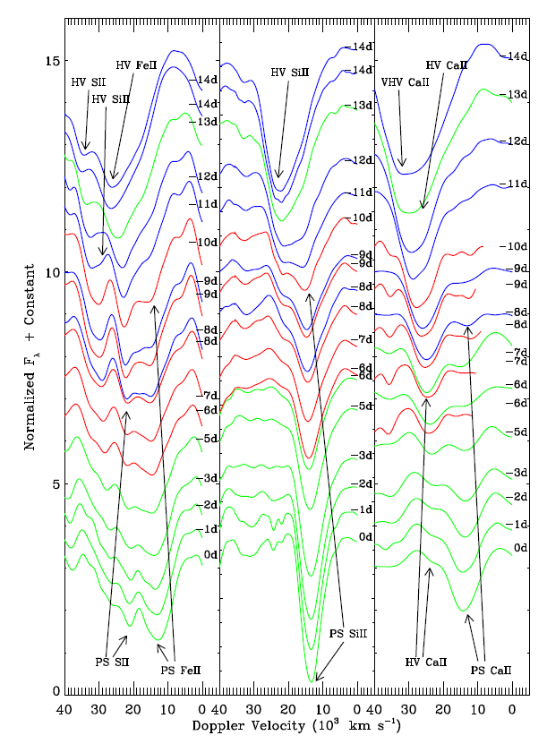
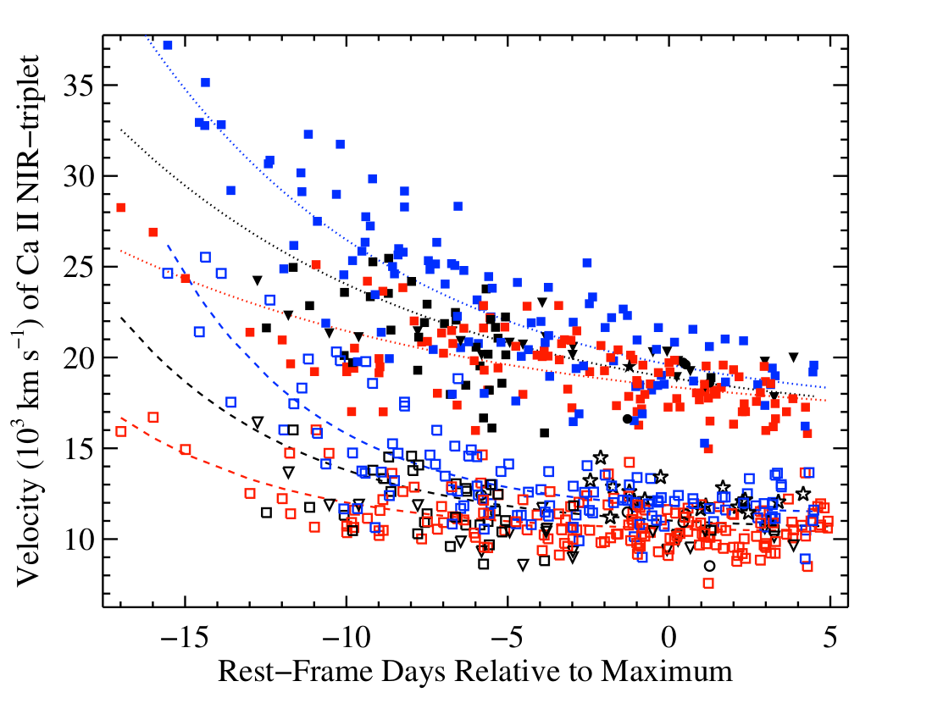
High velocity features
Marion et al 2013
Silverman et al., in prep

Slide 5
High Velocity Features
SN photosphere (PS): 8-12,000 km/s
HVF: 20-30,000 km/s; well separated from PS in velocity
Features visible only in ~ first 2-3 weeks after explosion (< -5d from maximum light)
Velocity of HVF minima slow, asymptote, fade over time
Velocity of PS minima slow, asymptote, grow over time
Ca II , Si II,III, occasionally S, Fe ions
~91% of normal-luminous Type Ia supernovae (Silverman)
HVF show polarization of spectral features
  Blobs of material?

Slide 6
My work
Explore HVF due to SN-CSM interaction (Gerardy et al. 2004)
Hydrodynamic simulation (FLASH)
  Type Ia supernova model (Gamezo et al. 2005)
  Circumstellar material models
Synthetic spectra (syn++, customized)
Theory Seminar, Next Monday (6 Oct) [Sorry, Jozsef]

Slide 7
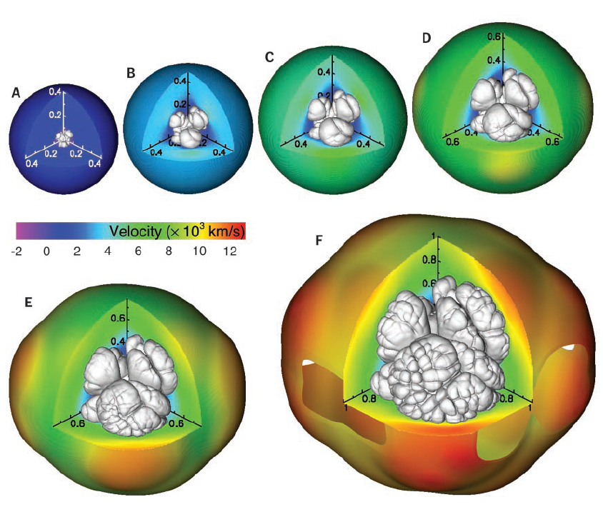
Explosion Model
Gamzeo et al 2005
3-d model
  Single octant
  128³
  (5.3x10⁸ cm)³
  1.4 Msun
Provides ρ, ε, v, Xi [C,O,”Mg”,”Si”, “Ni”]
Spherically average

Slide 8
Overview of my work:
Hydrodynamics
FLASH 4.1
Hydro only, split PPM
AMR
EOS: Helmholtz, Ideal (Gamma law)
Multipole gravity
Multispecies (H,He,α-elements up to Ni-56)
1-D (spherically averaged from model)
tmax = 50s (Constrained by low density limit in Helmholtz EOS)
  Received extended helm table from Frank Timmes (Sept 2014)

Slide 9
Overview of my work
Shell model
Thin (~10¹⁰ cm) circumstellar shell
  Free parameters: mass, width, inner radius
    Mass ~ 10⁻¹ – 10⁻³ Msun
    Width ~ 10¹⁰ – 10¹¹ cm (Rsun - AU)
    Radius ~ 10¹⁰ – 10¹² cm
    Density structure
      Gaussian
      Top hat
      Sawtooth
    Abundance

Slide 10
Shell Geometry

Slide 11
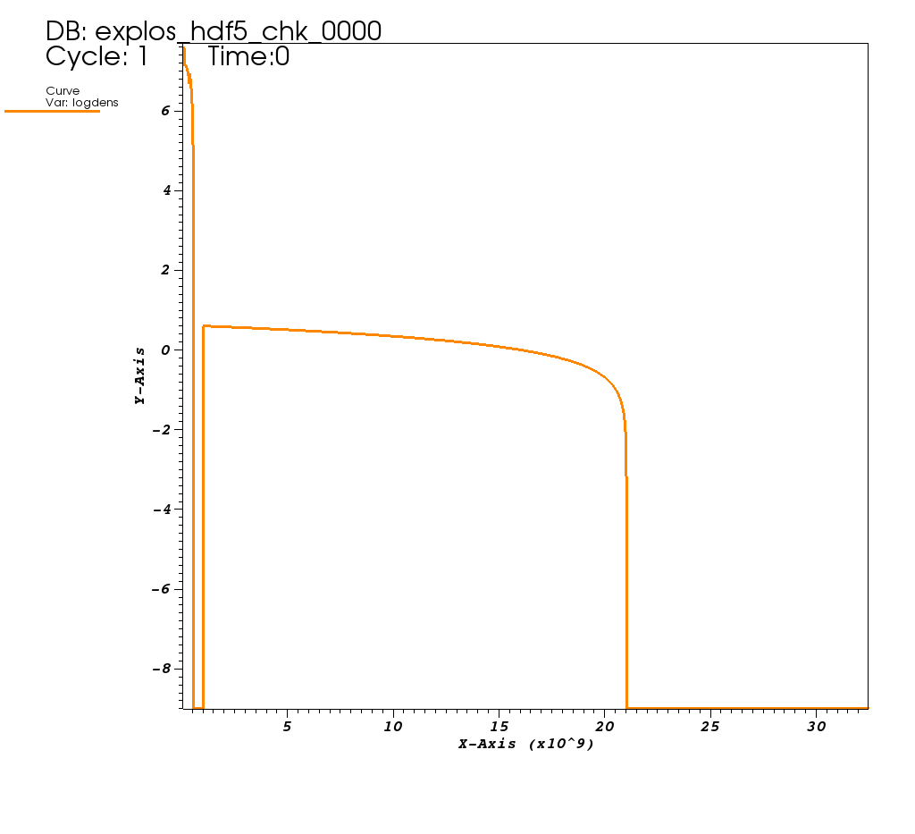
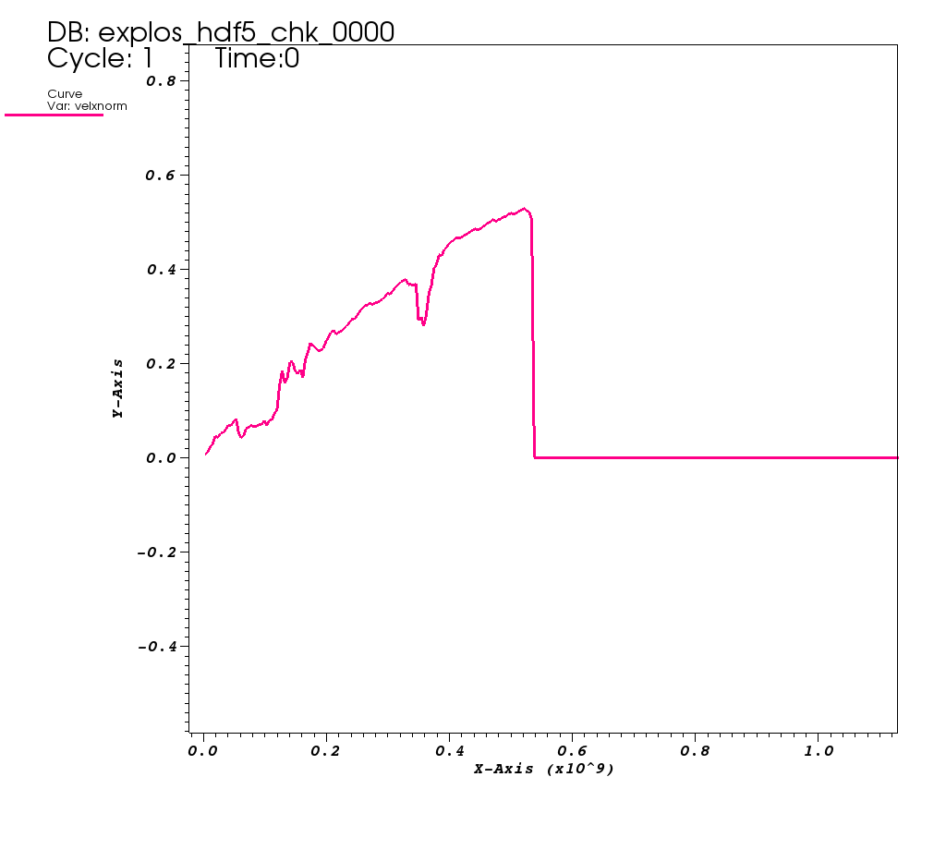
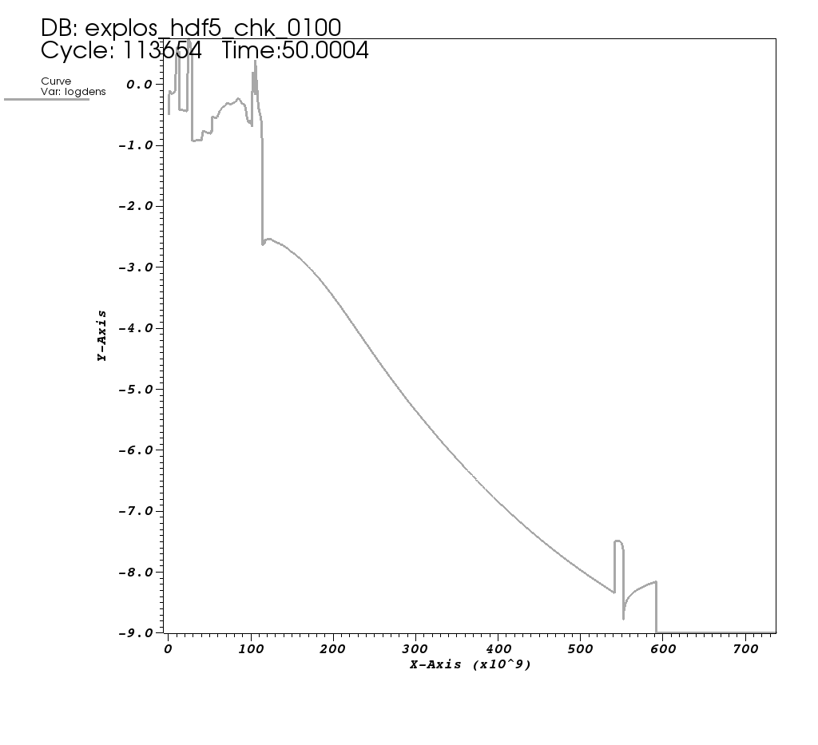
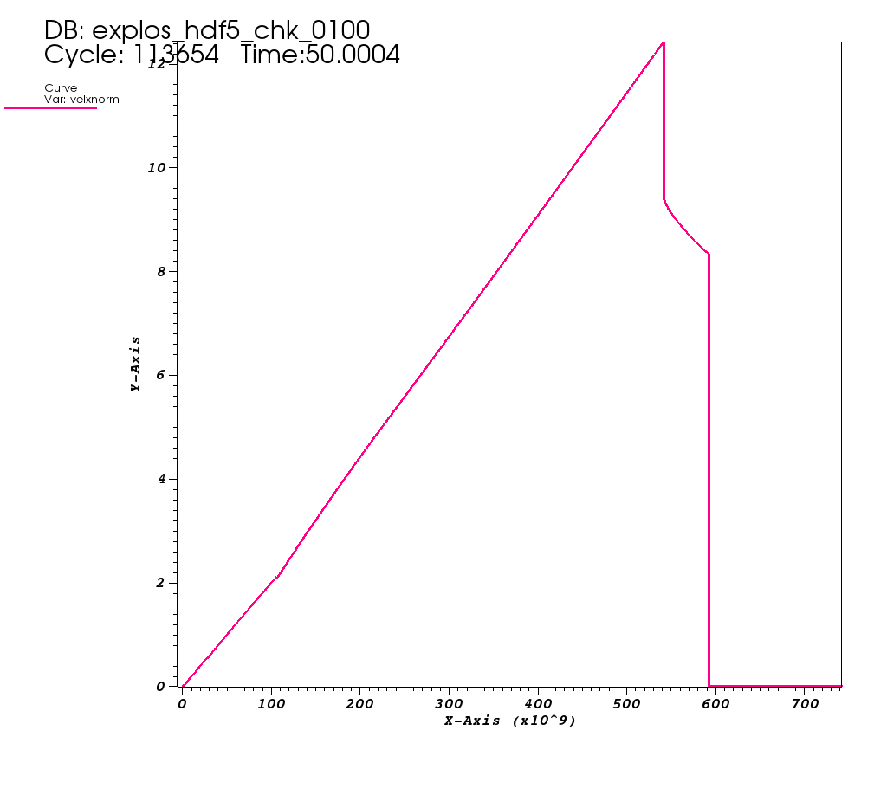
Simulation results
SN
log Density [g/cm³]
SN
(Shell)
Velocity [10,000 km/s]
Shell (sawtooth)
x coordinate is radius relative to center of SN
SN
Shocked
CSM
log Density [g/cm³]
Velocity [10,000 km/s]
Shell
Shell
Shocked
CSM
SN

Slide 12
Synthetic spectra
Use syn++ for spectra
Convert hydrodynamic data to optical depths
Determine velocity of photosphere
  (1) Fixed v at t, determine v at other times based on column density.
    Can be used to predict trends
  (2) Selected based on best fit to observed data
Scale density from sim tmax to desired time (up to 25d), assuming homologous expansion.
Sobolev approximation: find τ(v)
  Ejecta: Density * Group abundance
  Shell: Density only (abundance is free parameter)

Slide 13
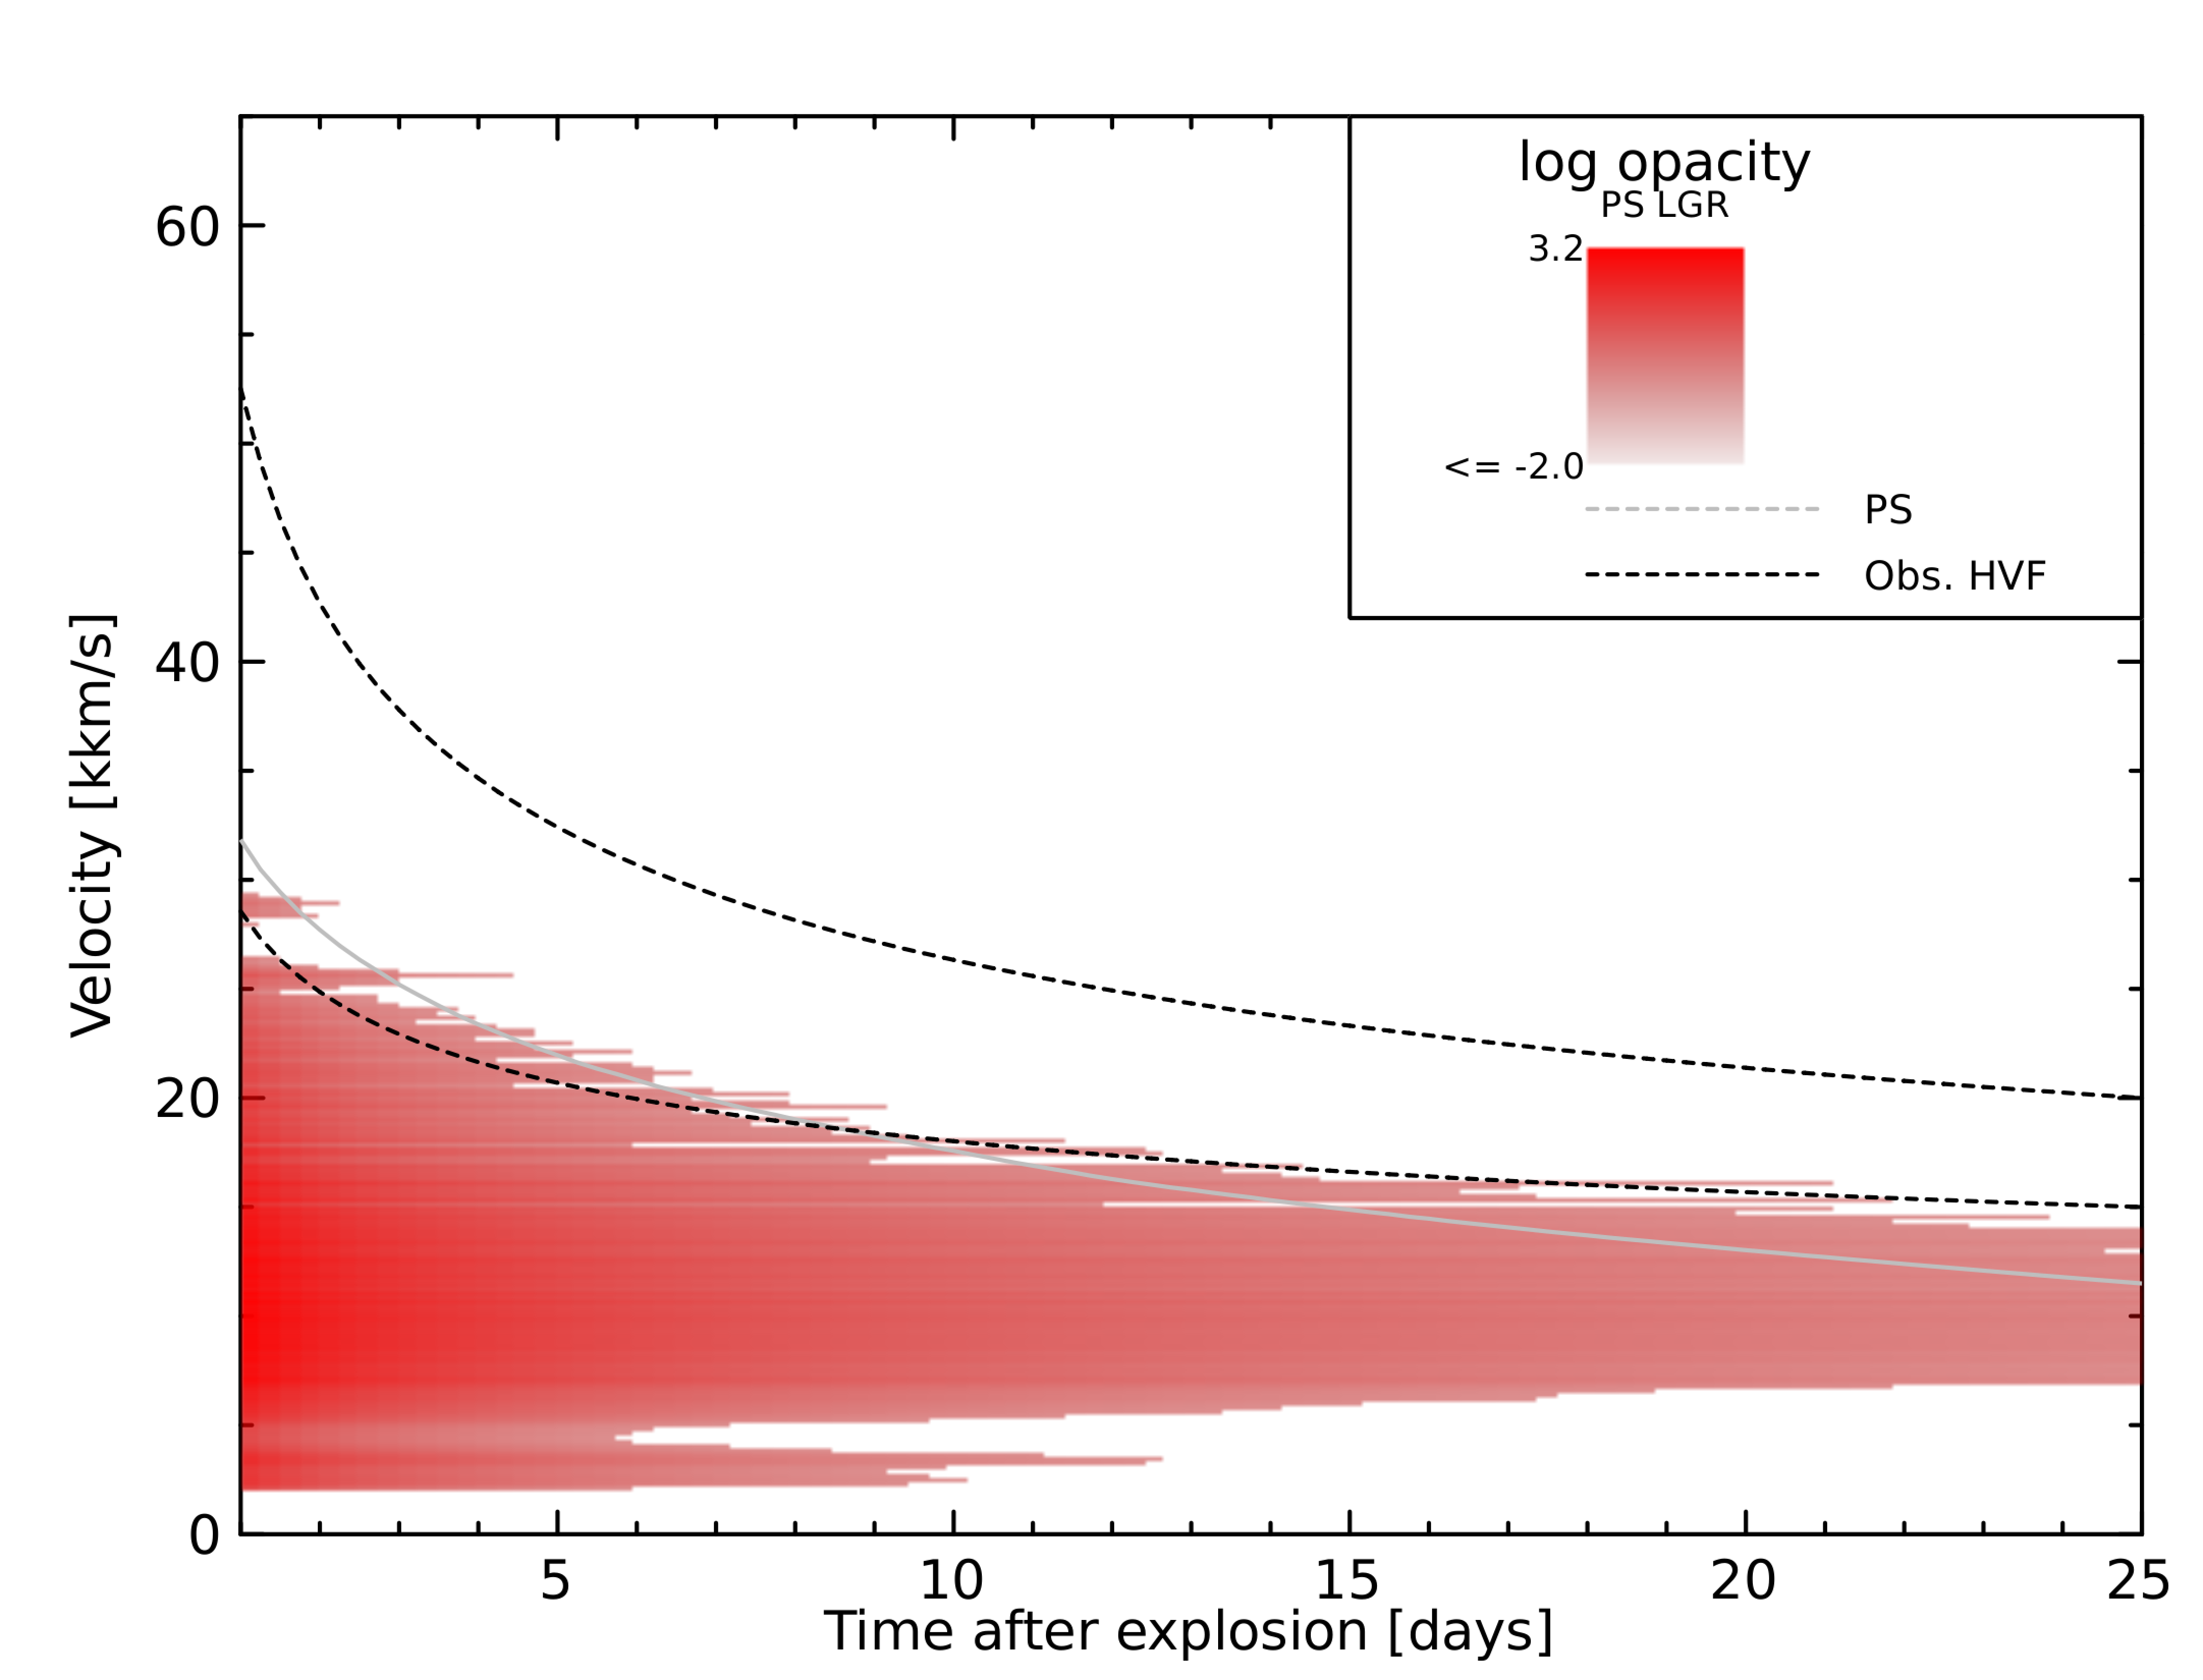
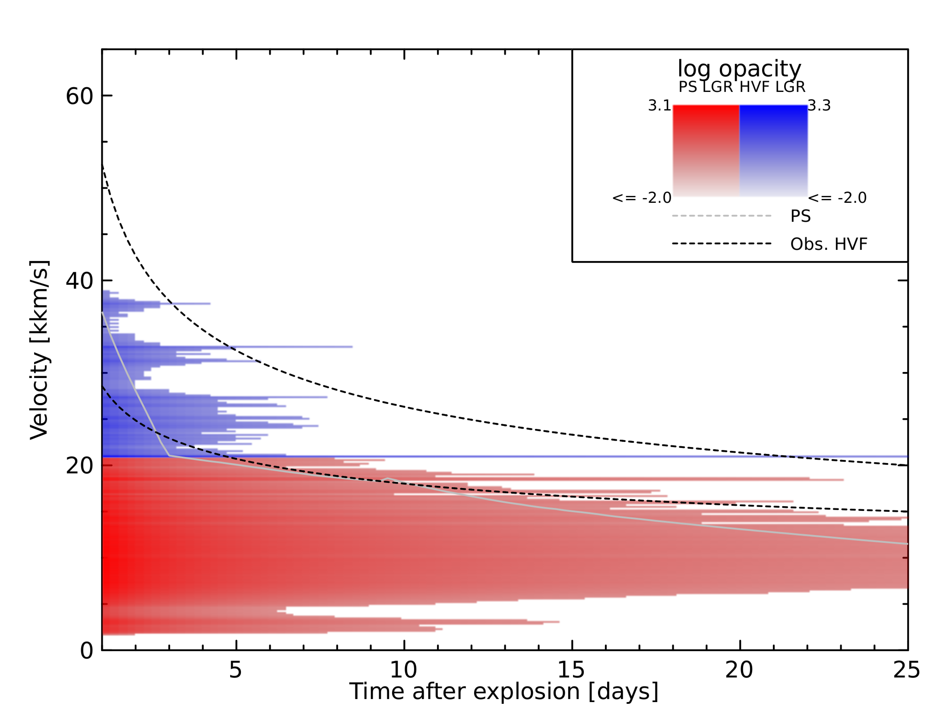
(Ca) Optical Depth
With shell (0.005 Msun)
Normalized to τ = 1
Shell: v = 18.5 kkm/s on d25
Ejecta: v = 11.5 kkm/s on d25
No shell
Normalized to τ = 1
@ 11.5 kkm/s on Day 25

Slide 14
Synthetic spectra
Assume all ions have same temp as photosphere
Ion abundance taken as scalar factor; determined by best fit
Free parameters
  # of days after explosion
  PS velocity
  PS temp
  Ejecta ionization * Ca/Si abundance
  HVF ionization * Ca abundance
For analysis, assume HVF ionization = Ejecta ionization

Slide 15
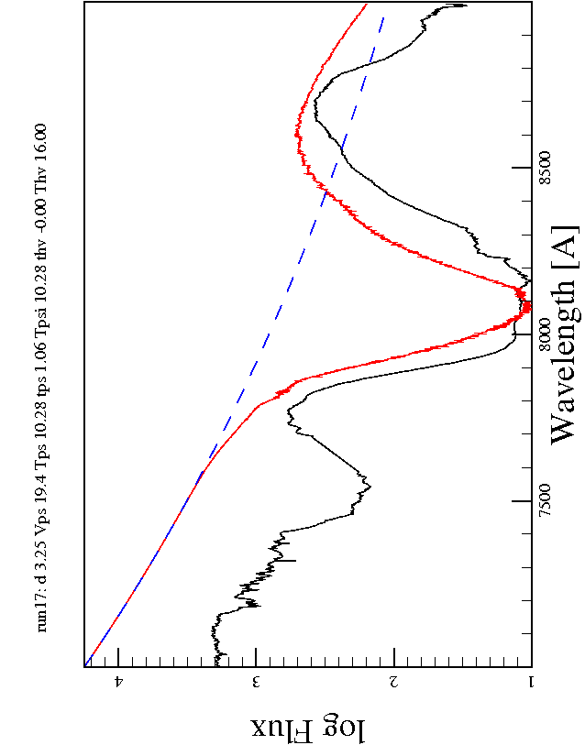
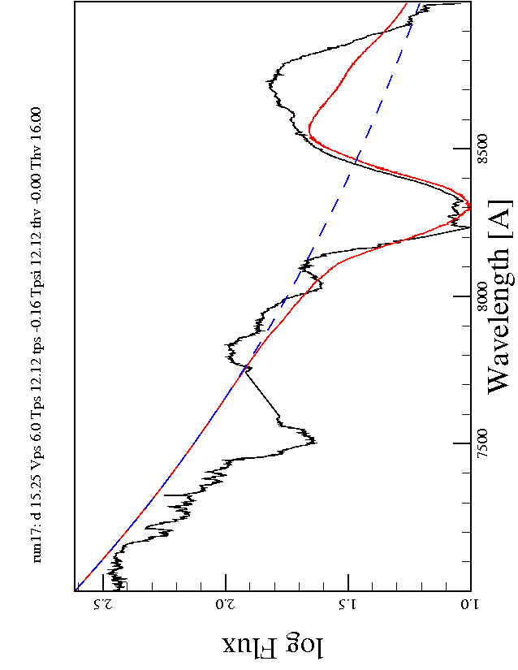
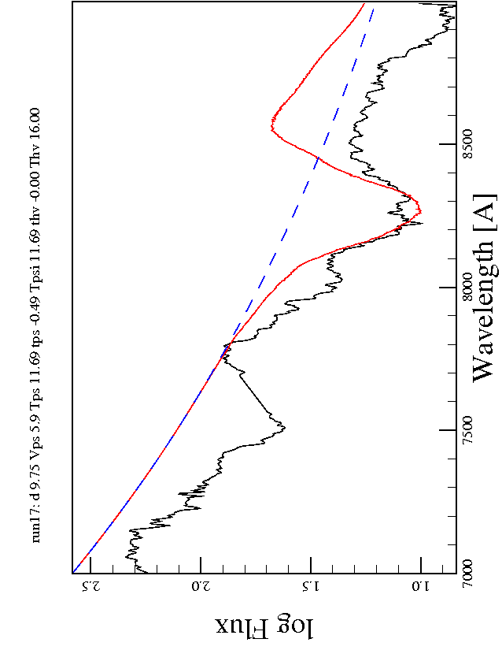
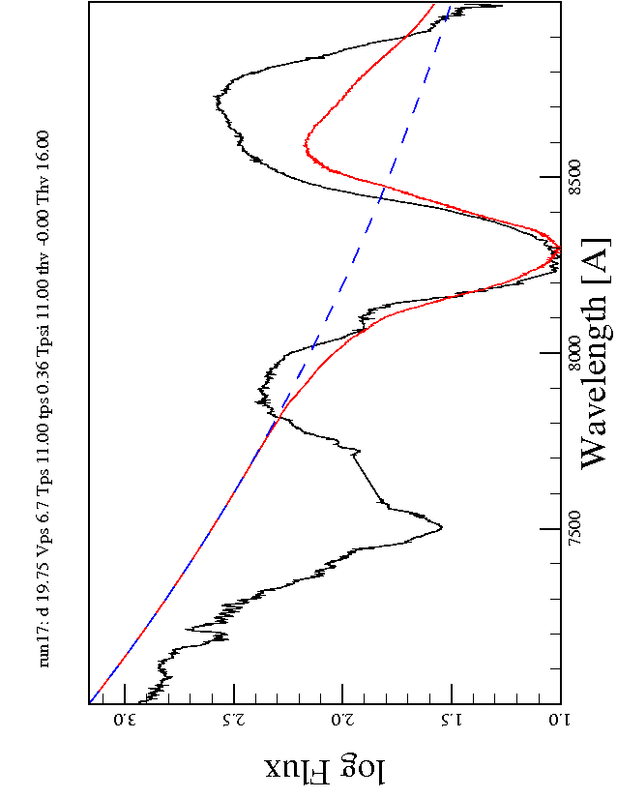
Spectra: No shell
PS
Bmax - 15d
Bmax - 5d
Shell
SN2011fe
Combined
Bmax - 10d
Bmax - 0d
Ca II
OII

Slide 16
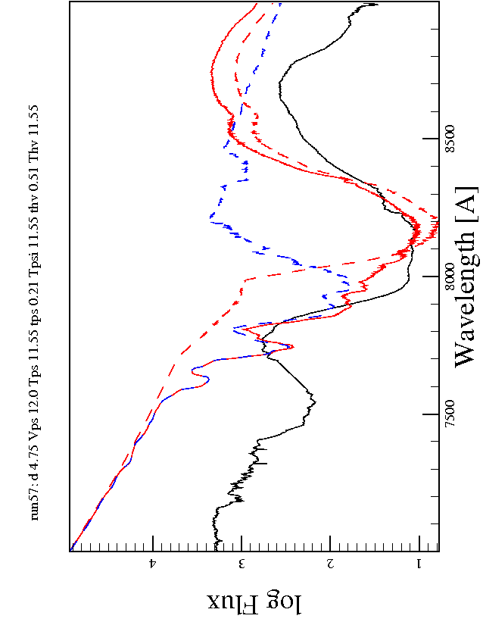
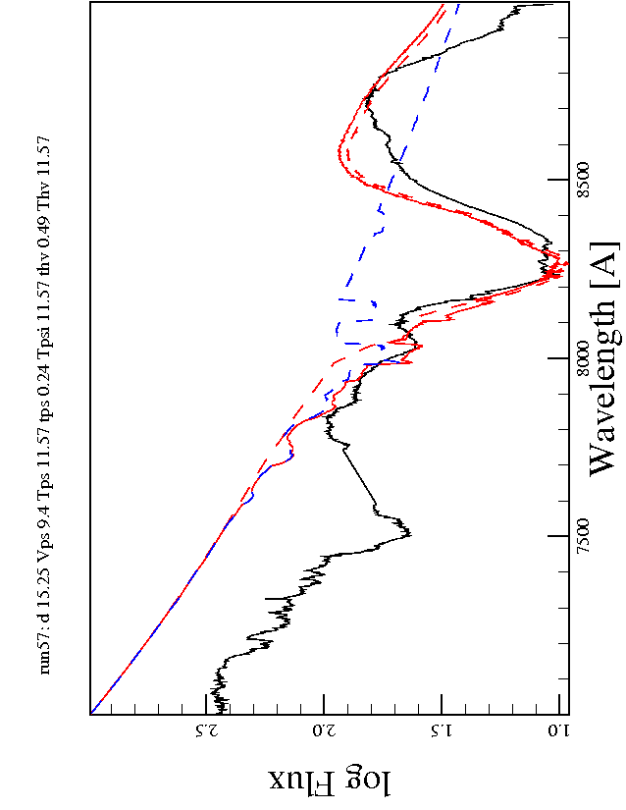
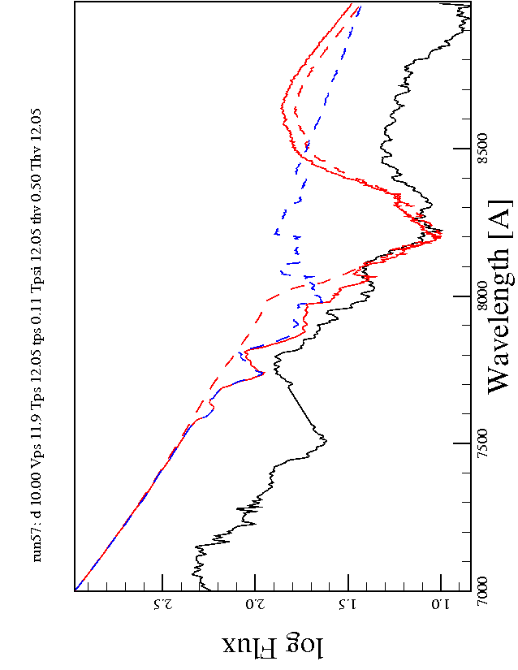
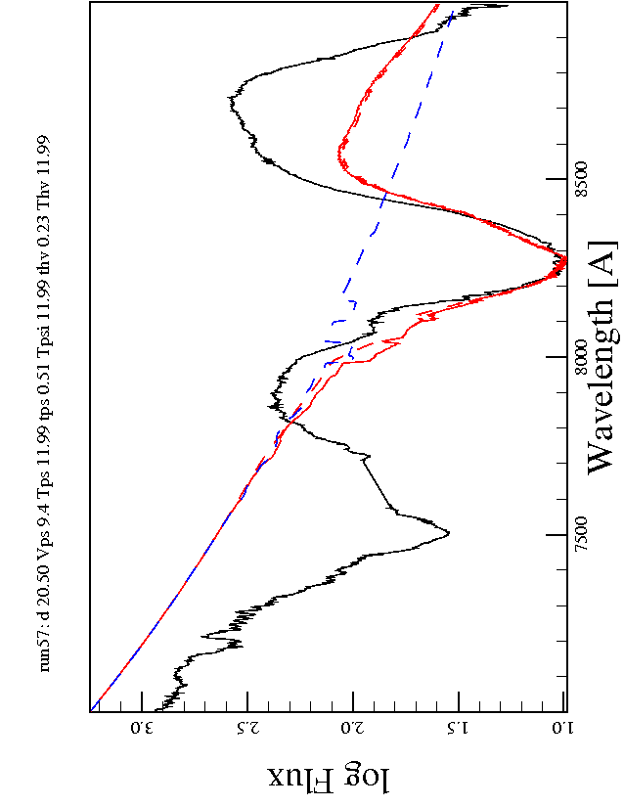
Spectra: 0.005 Msun shell
PS
Bmax - 15d
Bmax - 5d
SN2011fe
Shell
Combined
Bmax - 10d
Bmax - 0d
Ca II
OII

Slide 17
Update from Jan 2014
Prior to Spring 2014
  Summer 2013: Enhanced Helmholtz EOS
    Abandoned work in favor of getting science done for this project
  Fall 2013: Initial shell models 0.1, 0.01, 0.001 Msun, Optical depth profiles
  Presented poster at AAS, January 2014
  Companion interaction / mass stripping
    Needs 2-D or 3-D. Abandoned work in favor of CSM project.
  Supernova shock breakout
    Current focus is HVF.

Slide 18
Update from Jan 2014
Spring 2014
  Run additional shell models
    Found models run in fall 2013 were not initialized correctly (energy was being incorrectly computed for some cells)
    Reran all models + new set with finer gradation in mass
      Was 0.1, 0.01, 0.001 Msun
      Added 0.008, 0.005, 0.012 Msun
      Ran all models with each shell geometry
      Completed simulations in May
  Wind interaction
    Non-wind models seem to fit SN2011fe
    Interaction with ~0.01 Msun material over several weeks would likely result in observable radiation from shock.

Slide 19
Update from Jan 2014
Spring 2014 Summer 2014
  Validate synthetic spectra with delayed detonation models
  “Spectra” generated last fall were optical depth plots for a pencil beam.
  Syn++ native only accepts τ ~ e^-(v/v0)
  Generated power law and exponential profile approximations to density profile from simulation in order to input into syn++.
  Some fit well, others fit very poorly
  Modified syn++ library to accept arbitrary optical depth profile

Slide 20
Update from Jan 2014
Summer / Fall 2014
  Generate spectra from simulation profiles
    Fit to SN2011fe data
    Automated fitting routine (Monte Carlo)
    Entire pipeline from hydrodynamics to spectra now in place
Summer 2014 Fall 2014
  1-D HVF sim paper focusing on matching SN2011fe observations; only Ca II features

Slide 21
Future work
From existing 1-D simulations
  Ca II, Si II features
  Upper limits on H, He, C, O
    Probe source of HVF material, relevant to discussion of double degenerate or surface helium trigger to thermonuclear detonation.
  Comparison to other subcategories of Type Ia SN: unusual features (SN2010kg); Wang HV / Normal; subluminous (SN1991bg); etc.
Questions that are still outstanding:
  Why are HVF features polarized?
  What effects do instabilities (mixing) have on HVF and PS spectra?
  How do asymmetries in explosion or shell affect spectra features?
  2-D simulations of HVF models

Slide 22
Future timeline
Fall 2014
  Continuing analysis of results
    Ca II H&K features – help constrain temperature
  Paper: Ca II (current)
  Generate Si II spectra and fits.
  Paper: Si II
Spring 2014
  Generate H, He, C, O spectra
  Paper: other features (H,He,C,O) – constraints on total abundance

Slide 23
Future Timeline, cont.
Summer 2015
  Run 2-D simulations (spherically symmetric)
  2-D optical depth profile generation
    Easily adapt 1-D code.
  2-D spectra generation software
    Modify syn++?
    Modify TARDIS?
    New code?
Fall 2015
  Generate synthetic spectra from 2-D simulations
    Existing fitting routine can be easily adapted to 2-D
  Paper: Ca & Si features; evaluation of mixing effects.

Slide 24
Future Timeline, cont.
Spring 2016
  Paper: H/He/C/O features, do thresholds differ with 2-D?
Summer/Fall 2016
  Thesis/Graduate
    Shell as source (or not) of HVF and constraints on circumstellar environment

