Slide 1
Why does my code take a week to run?
Optimizing and profiling your code
slides available at http://www.as.utexas.edu/~bwmulligan/GSPS_Profiling.pdf
Brian W. Mulligan
UT Austin
Grad. Student & Post-doc seminar
4 Mar 2016

Slide 2
Hands-on
The best way to learn is to do it.
For this talk, each task / component will be accompanied with examples for you to run / test on your own computer.
Examples in c++ & python

Slide 3
Disclaimer
Some of the information given here may not be valid in non c/c++ based languages (python and java are c/c++ based).
There may be particular tricks or methods that may not apply to other languages.
I work almost exclusively from command line when running / compiling. Using Jupyter or browser based stuff may be a bit different.

Slide 4
Outline
Simple profiling
Common simple optimizations
Advanced profiling

Slide 5
Simple profiling
Use time to measure how long a program takes to run
Use high-precision timing routines to measure individual subroutines or components
Use medium precision timing routines and do something a lot of times

Slide 6
Using time
$time sleep 2
$time multitest
Gives clock time (0:02.04, 0:08.10) required to run, as well as CPU processing load (8.029u)
(sleep doesn't load the CPU)
0.000u 0.001s 0:02.04 0.0% 0+0k 64+0io 1pf+0w
8.029u 0.005s 0:08.10 99.0% 0+0k 32+0io 0pf+0w

Slide 7
Using timers
Python
Import time
start=time.time()
  [code to time here]
runtime=time.time() - start
~millisecond accuracy
c++
#include <ctime>
double time(void)
{
  timespec tTime_Curr;
  clock_gettime(CLOCK_MONOTONIC_RAW,&tTime_Curr);
  return (double)(tTime_Curr.tv_sec + tTime_Curr.tv_nsec * 1.0e-9);
}
double start,runtime;
start = time();
  [code to time]
runtime=time() - start;
~nanosecond accuracy
Templates available:
www.as.utexas.edu/~bwmulligan/timing_template.cpp
www.as.utexas.edu/~bwmulligan/timing_template.py

Slide 8
Hint for testing timing
When working with simple routines, try to avoid using constant inputs
  Compilers / interpreters may automatically optimize the code
Use random number inputs instead.
import random
x = random.random() * random.random()
#include <stdlib.h>
x = rand() / (double)(RAND_MAX);

Slide 9
Optimization: print statements
Get rid of print statements
  Print, printf, cout <<, etc.
Console output is horribly slow. The less output the faster your code will go.
Example:
  Create two for loops, one which performs an operation such as x = exp(random.random()), and one which does the same operation and prints the result every time. Do at 10000 iterations of each loop.
  Compare the execution time of the two loops.

Slide 10
Optimization: loops
Combine consecutive for loops that have the same or similar range
e.g.
for i in range (1,1000):
  x = 1 + a
for i in range (1,1000):
  y = 4.3 * b
for i in range (1,1000):
  z = exp(c)
Example: create the three for loops above, with a,b, and c as random variates. Determine the time to execute the three loops separately, then time them combined into a single loop

Slide 11
Optimization: order of data
When working with large datasets, access the data in the order it is stored.
C based languages store in “row first” order (i.e. a[0][0], a[0][1], and a[0][2] are contiguous in memory, a[0][0] and a[1][0] are separated by the width of a)
Example: create a set of nested loops that fill a large (1024x1024) array with random numbers in [i][j] order, and another in [j][i] order and compare the time to complete the task.
Note: FORTRAN is “column first”.

Slide 12
Optimization: minimize math operations
Floating point operations are expensive, especially divides.
Remove constant sets of operations from inside of loops or blocks of code
i.e.
for i in range(1,1000):
  vol = 4 * math.pi / 3. * r ** 3
Better:
c = 4 * math.pi / 3.
for i in range(1,1000):
  vol = c * r ** 3
Example: Test the above two methods for computing a volume, with radius as a random variate

Slide 13
Optimization:
Don't use ** or pow
The ** or (math.)pow are expensive operations, equivalent to about 10-100 FLOPS
When performing integer power operations, multiply them out.
e.g.
x = pow(z,5) // slow
x = z * z * z * z * z // fast
Example: try the above two methods of computing z⁵

Slide 14
Optimizing:
Don't use python
Equivalent c/c++ program is 100-1000x faster than python.
If the code takes more than 5m to run and is being used often and/or by many people, write it in c/c++ or FORTRAN
If the code is a “one-off” but takes more than 10-15m to run, will probably be better in c/c++ (depends on how much longer it will take you to write c/c++ code).
numba can create a compiled version of a python program; significant speedup running this instead of through python interpreter.

Slide 15
Optimizing:
Don't spin your wheels
Focus on high gain tasks when optimizing.
e.g. Memory access order is way more important than a for loop with 10 iterations and an unnecessary divide.
Look for subroutines that are called a large number of times, large arrays, or for loops that are nested or have many iterations.
Use a profiler to help identify the code to focus your effort on.

Slide 16
Profiling
Report the frequency of usage and/or CPU time used by individual components / modules
Outputs:
  % of total time spent in a given subroutine
  Time spent in a subroutine
  # of calls to a subroutine
  Call history of subroutine

Slide 17
Profiling
Report the frequency of usage and/or CPU time used by individual components / modules
3 forms:
  Event based
    Requires manual change to code; similar to what we've been doing. May not provide call stack
  Sampling
    Depending on method, may not be able to give call stack; may completely miss subroutines called rarely
  Instrumented
    Requires compiling code to include profiling routines.

Slide 18
Profiling
Outputs:
  % of total time spent in a given subroutine
  Time spent in a subroutine
  # of calls to a subroutine
  Call history of subroutine

Slide 19
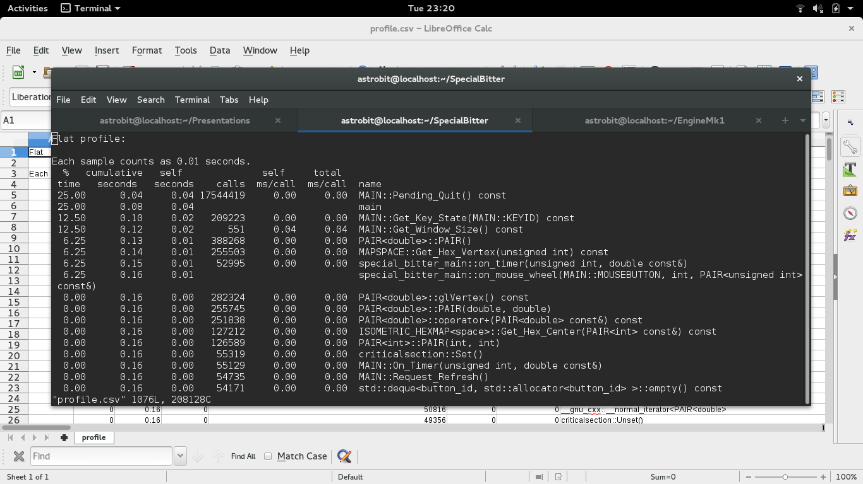
Example (gprof)

Slide 20
How to use profiling data
Look for functions called large # of times and using significant fraction of total time.
  If the subroutine is small, replace function call with code – save f.c. overhead.
  If subroutine is large, apply methods discussed earlier.
Look for functions called few times but using a significant fraction of total time.

Slide 21
How to profile
C++:
  Compile:
    g++ -g program.cpp -o program -pg
  Run:
    run program as usual. Gmon.out will be created.
  Profile:
    gprof program
Python:
  python -m cProfile program.py
Note: gprof and cProfile are “default” profilers. There are many others available that you may like better that may give their output in a more user-friendly way.
Exercise: profile and optimize
  http://www.as.utexas.edu/~bwmulligan/prof_ex.py
  http://www.as.utexas.edu/~bwmulligan/prof_ex.cpp

Slide 22
C++ specific
Pass by reference instead of by value for classes or doubles
  pointer (reference) = 4 bytes (32-bit systems) or 8 bytes (64-bit systems)
  double = 8 bytes
  class = n bytes (n probably >> 8)
Avoid allocating and deallocating memory
  perform new and delete ops as infrequently as possible
use stl (map, vector, string, etc.)
Don't write your own operator = if you don't have to
Avoid casting from int to double and vice versa
arrays that are sized in multiples of 512 (for doubles) or 1024 (for int) can be slightly more efficient

Slide 23
Things to try at home
Compare integer and floating point math.
Compare various math functions (e.g. exp, pow, log, sin, etc.).
Compare matrix operations using manual code, numpy, blas, linpack, or your other favorite linear algebra package.
Compare saving data in memory then dumping to a file vs outputing small blocks to file as you go.

Slide 24
Additional resources
C++ optimization suggestions
  http://www.tantalon.com/pete/cppopt/main.htm
python optimization suggestions
  https://wiki.python.org/moin/PythonSpeed/PerformanceTips
Use numba or numpy
  http://numba.pydata.org/
  http://www.numpy.org/
Profilers
  https://en.wikipedia.org/wiki/List_of_performance_analysis_tools

