Slide 1
Goal:
To understand the full space-time associated with rotating black holes.

Slide 2
Rotating Kerr Black Hole
Mass and spin, but no electrical charge
Assume all mass is in the singularity, no mass anywhere else
(assumption necessary to solve equations)
Find singularity is a ring (not a point)
0 thickness, ∞ density, still infinite tidal forces
Infinite Universes!
(implicitly spread through hyperspace)
Notes:
<number>

Slide 3
Cross-sectional view of rotating Kerr black hole
Event horizons
(one-way membranes)
Surface of infinite redshift
INWARD time-like
space
Ring singularity
Highly curved
normal space
Ergosphere
highly curved
rotating
normal space
tap rotational energy
Space is “flowing” both
inward and around
Fly in, never to return
Notes:
<number>

Slide 4
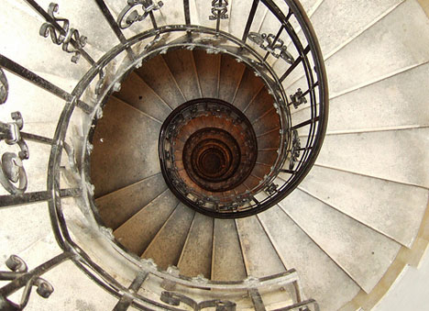
Moving around the ring
One point on ring singularity
In this example, moving side to side is moving through space, but going up and down the stairs is moving through hyperspace
On person goes clockwise around the point on the ring, the other goes counterclockwise. They both successfully go around the ring, but they are no longer in the same space. They can both the at the same point in space, but different points in hyperspace.

Slide 5
Cross-sectional view of rotating Kerr black hole
Event horizons
(one-way membranes)
Surface of infinite redshift
INWARD time-like
space
Ring singularity
Highly curved
normal space
Ergosphere
highly curved
rotating
normal space
tap rotational energy
Space is “flowing” both
inward and around
Fly in, never to return
Notes:
<number>

Slide 6
In the future (from the inside)
Event horizons
(one-way membranes)
Surface of infinite redshift
OUTWARD time-like
space
Ring singularity
Highly curved
normal space
Ergosphere
highly curved
rotating
normal space
tap rotational energy
Space is “flowing” both
inward and around
Flow in time-like region seems to have reversed – we can leave again! But…..
Notes:
<number>

Slide 7
Traversing the event horizons
Inner event horizon
Time
Outer event horizon
As we go down the staircase, we go forward in time, and back and forth in space, but never come back to the same place in hyperspace (the same floor)

Slide 8
One Minute Exam
In the mathematical solution for a rotating black hole:
The surface of infinite redshift is identical to the event horizon.
You can escape the black hole back to the universe from which you entered.
There are exactly two universes.
The space inside the ring singularity entered from above is different that the space inside entered from below.
Notes:
<number>
<number>

Slide 9
Are different universes in Schwarzschild and Kerr solutions to non-rotating and rotating black holes real?
In Real Universe:
Light (at least!) falls into the black hole
Photons are Doppler blue shifted, accelerated to higher energy, =>the energy/mass warps the space and changes the mathematical, hence the physical solution
So, probably not in this case, but stay tuned…
Notes:
<number>

Slide 10
Fifth exam and sky watch, FRIDAY, May 6.
Reading for Exam 5:
Chapter 9 – Sections 9.6.1, 9.6.2, 9.7, 9.8;
Chapter 10 - Sections 10.1-10.4, 10.9;
Chapter 11 - all except Section 11.6 (abbreviated, focus on lectures);
Chapter 12 - all;
Chapter 13 (TBD);
Chapter 14 - all
Notes:
<number>

