Slide 1




Notes:
The first full budget proposal from the Trump administration was released on May 22. This is the first official budget released by the white house that is intended for the 2018 fiscal year. The budget includes 19.1 billion for Nasa, a 100 million or .8% drop from the 2017 allocation, and 6.7 billion for the NSF, a 800 million dollar or 10.7% decrease from the 2017 allocation. NASA and NSF make up the largest fraction of research funding for astronomy and astrophysics in the U.S. The other major agency, the Department of Energy, is also facing a 17% cut to it’s science funding.
This budget has already been the subject of criticism from all professional science organizations as well as members of Congress. Senator John Cornyn of Texas was has noted that President’s budgets are often “Dead on Arrival” and expected that this budget will have a similar fate.

Slide 2
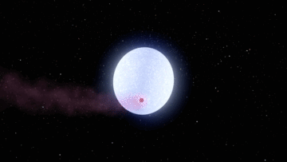

Notes:
The planet is called KELT-9 b. It's a 3 Jupiter-mass planet in a 1.4-day orbit around a 2.5 Solar-mass main sequence star with an effective temperature of 10,000 K. Because the planet is so close to such a hot, bright star, the dayside of the planet has a temperature of about 4600 K (this is a measurement from the depth of the secondary eclipse). This is hotter than many stars (equivalent to a mid-K dwarf), and is so hot that molecules can't exist in the dayside atmosphere. KELT-9 b is therefore in a totally new realm of planetary atmospheres that we've never seen before. The planet experiences UV radiation 700 times more intense than any other known planet. Because of this, the planet's atmosphere should be boiling off into space at a fast rate. The planet's orbit is perpendicular to the star's rotation, carrying it over the star's poles, and its orbit should be precessing (which was my contribution to the project--I calculated how fast the precession should be), and so the planet could stop transiting as soon as 150 years from now. Finally, the star KELT-9 has V=7.6, and so is (barely) the brightest star known to host a transiting giant planet (beating out old favorites HD 209458 and HD 189733), which will make it very good for follow-up observations.

Slide 3
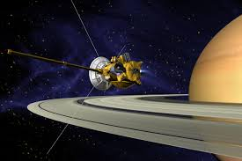

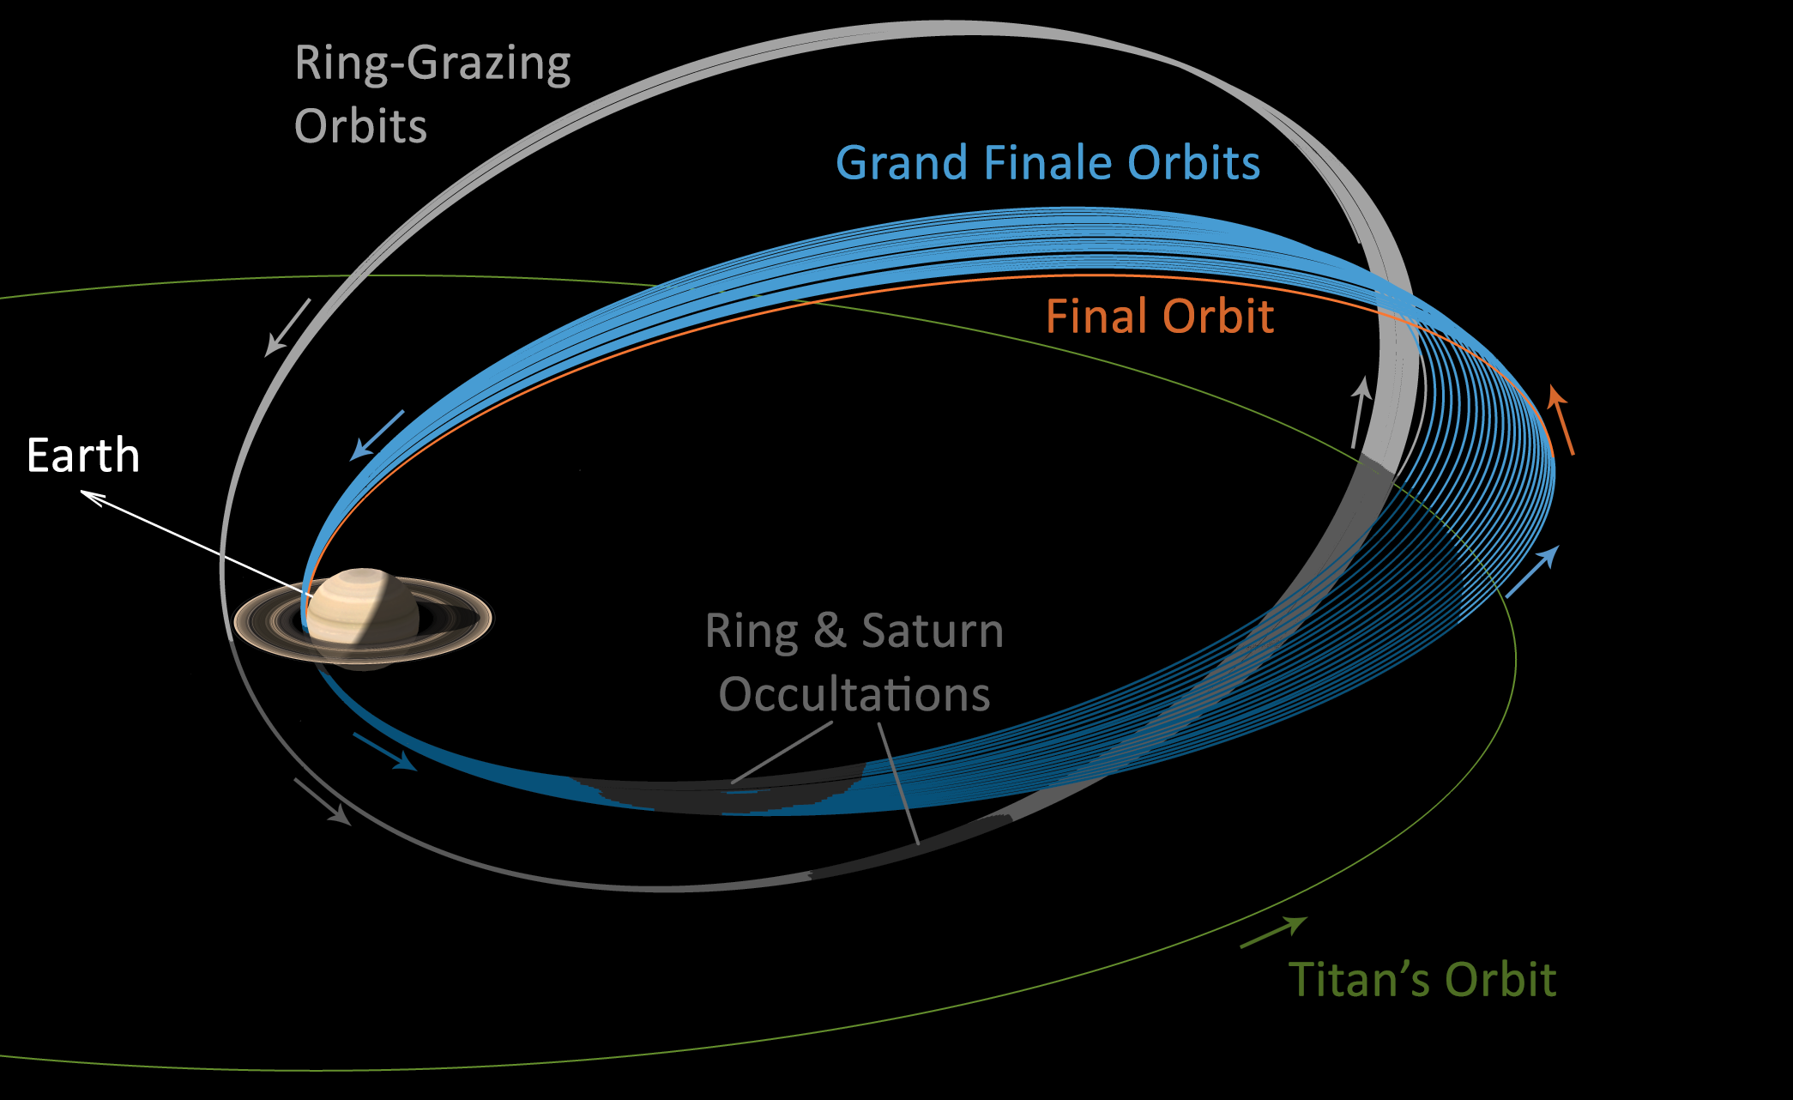
Credit: NASA/JPL-Caltech/Space Science Institute
Notes:
The Cassini spacecraft has begun its last months in its mission around Saturn. In January it took its first plunge between Saturn’s rings and the planet itself, capturing images with unprecedented resolution. Shown here is one of the so called propellors within the rings, which are small gaps caused by moonlets that are only a few km wide. Cassini will continue its mission until September 15, when it will be intentionally driven into the atmosphere of Saturn to be destroyed. This will be done to prevent any possible contamination of Titan or Saturn’s other moons by any bacteria or other organisms that have managed to survive the trip from Earth.

Slide 4

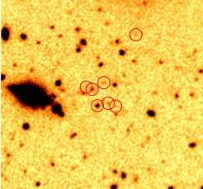
Notes:
Karina Caputi of the Kapteyn Astronomical Institute in the Netherlands led a study looking at nearly 6000 galxies that are about 11 billion light years away, also meaning that this is how the galaxies appeared only 2.5 billion years after the big bang. Their study was looking at how quickly galaxies form stars during that era. Their results largely confirmed the rate of star formation from previous studies, but unexpectedly discovered that some of the unusually bright galaxies fall into two separate groups: a group that forms star faster, closer to 1000 stars per year, and another group that forms stars slower, closer to 10 stars per year. According to the authors, this suggests that star formation is a discrete thing in the early universe, where galaxies only form stars slowly when gas falls in but can kick into high gear when the galaxy interacts with another nearby galaxy or large clump of matter.

