Slide 1
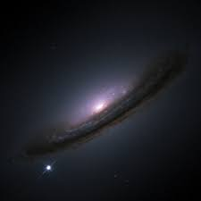
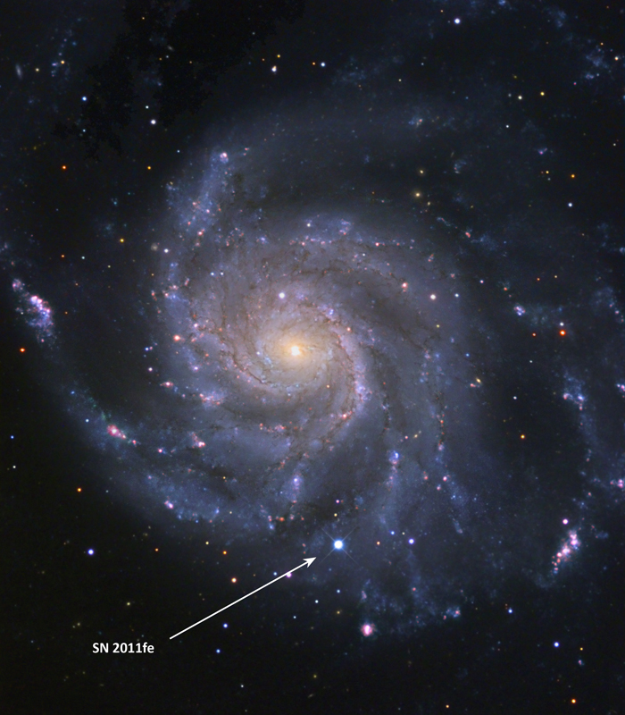
Simulation of High-Velocity Features of Exploding White Dwarfs
Brian W. Mulligan
University of Texas at Austin
Physics Seminar
Trinity University
21 Mar 2017

Slide 2
Overview
What are supernovae?
Why are Type Ia important?
How do we measure them?
Temporal evolution & high-velocity features
Simulation of explosion & interaction
Implications – how the explosion occurs

Slide 3
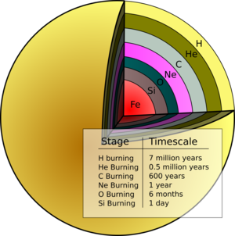
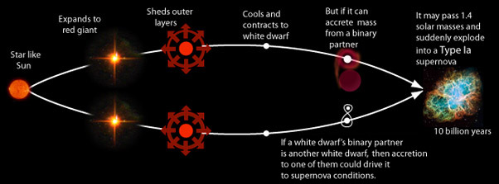
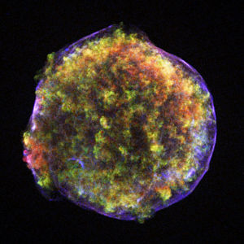
Exploding star (Supernova) Types
Type II, Ib, Ic: Massive Stars
Type Ia: Exploding white dwarfs

Slide 4
Type Ia Supernovae
This talk

Slide 5
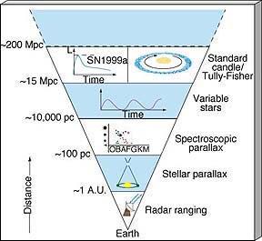

Using SN Ia to measure distances
1.4 x Mass of the Sun
Always the same brightness
100 W
1 m

Slide 6
Using SN Ia to measure distances
1.4 x Mass of the Sun
Always the same brightness
10³⁷ W
10²² m

Slide 7
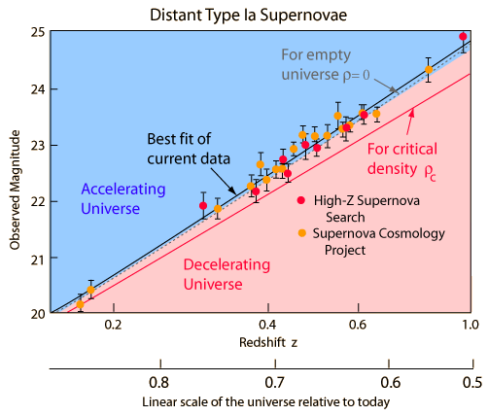
Dark Energy
Brightness
Distance

Slide 8
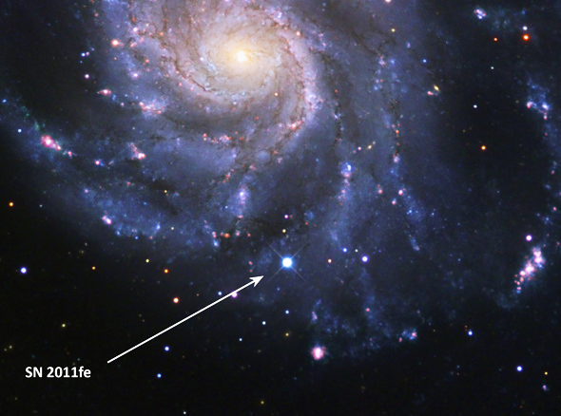
What are SN Ia? (really)
We have never seen Type Ia SN system before the explosion!
White dwarfs are really faint, and we only see SN Ia happen really far away
SN 2011fe – best studied Type Ia SN to date
Pinwheel Galaxy (M101)
2011: year observed
fe: order in that year (161st)

Slide 9
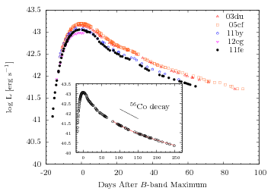
SN 2011fe light curve
10
Brightness (billions of suns)
1
0.1
0.01
~Time of Explosion
(Zheng et al. 2016)

Slide 10
SN 2011fe as a white dwarf
23 August 2011 10:59 pm (CDT)
(Nugent et al. 2012)
10
Explosion (est.):
23 August 2011 10:29 am (CDT)
Brightness (billions of suns)
1
0.1
No detection
23 August 2011 ~2 pm (CDT)
(Bloom et al. 2012)
0.01
(Zheng et al. 2016)
SN 2011fe must be very small (R << Rsun)

Slide 11
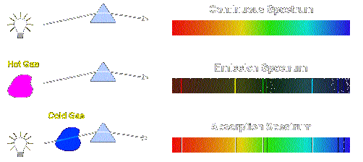
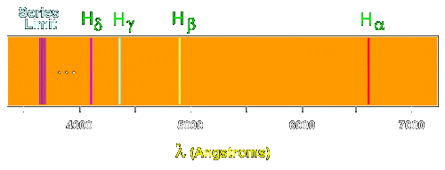
Interpreting Spectra

Slide 12
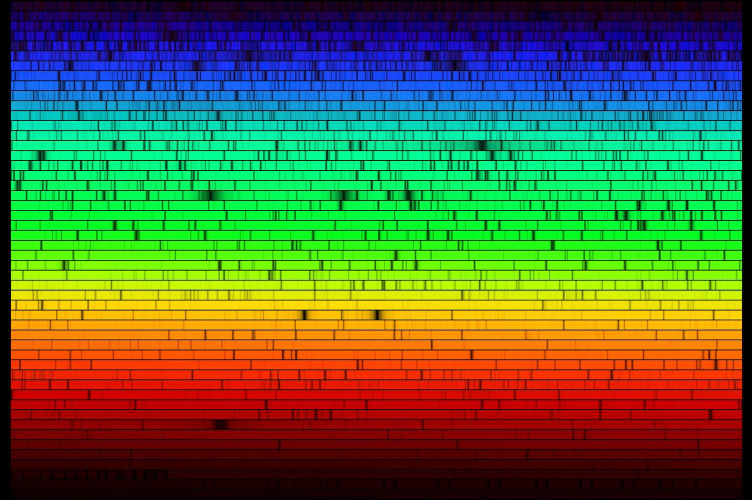
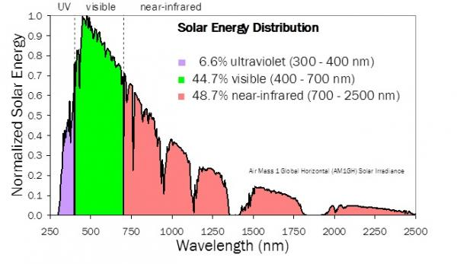
The Solar Spectrum

Slide 13

Redshift / Blueshift

Slide 14
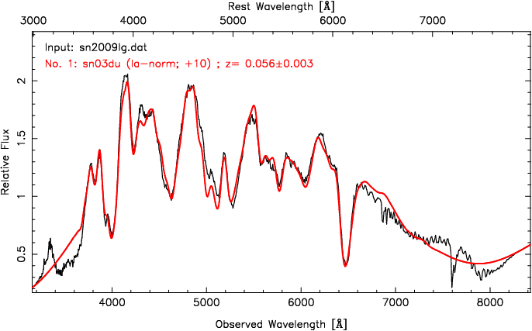
Type Ia Supernova spectrum
Mg
Si
S
Ca
Si
Fe
O
Fe
Ca

Slide 15
Type Ia supernova physics
White dwarf
Carbon & Oxygen
Very dense
~ mass of sun
but the size of Earth
~ 10³⁴ m⁻³
Electron quantum pressure
Electrons so densely packed that Fermi temperature is large
Pressure
Gravity

Slide 16

Type Ia supernova physics
White Dwarf
Carbon & Oxygen
Pressure
Gravity
Mass:
1.4x mass of Sun
Chandrasekhar Limit
Gravity beats electron pressure
Magic happens -
thermonuclear explosion

Slide 17
Type Ia supernova physics
Unburned C/O
O, Ne, Mg
Si, S, Ca
Fe, Co, Ni

Slide 18
Velocity of material
Unburned C/O
O, Ne, Mg
Si, S, Ca
Fe, Co, Ni
10-15,000 km/s
20,000 km/s
Velocity
-20,000 km/s

Slide 19
The times they are a-changin’
1st week: outermost layers
2-4 weeks: middle layers
Months – years: inner layers

Slide 20
1st week
Unburned C/O
O, Mg, Ne
Ca, Si, S
(starting to be visible late in week)
Optically Thick
(Can’t see Fe, Ni, Co)
20,000 km/s
Velocity
-20,000 km/s

Slide 21
2nd week
Unburned C/O
O, Mg, Ne
Ca, Si, S
(starting to be visible late in week)
Optically Thick
(Can’t see Fe, Ni, Co)
20,000 km/s
Velocity
-20,000 km/s

Slide 22
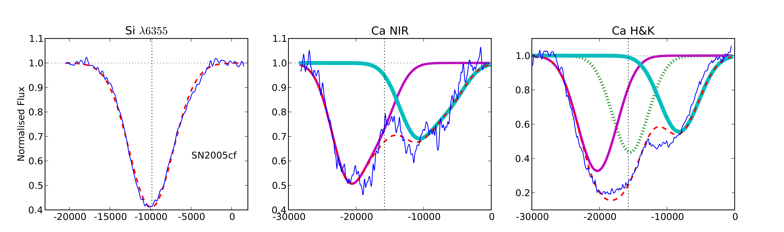
Outermost layers – high velocity
(Childress et al. 2014)
Fast moving stuff (>~20,000 km/s)
Interior stuff (~10,000 km/s)

Slide 23
Unburned C/O
O, Ne, Mg
Si, S, Ca
Fe, Co, Ni
HV material
Ca, and ???

Slide 24
Hydrodynamics
Mulligan & Wheeler 2017
No Shell
(3 models)
High density, high velocity
Shell
Relative Density
Relative Density
Explosion

Slide 25
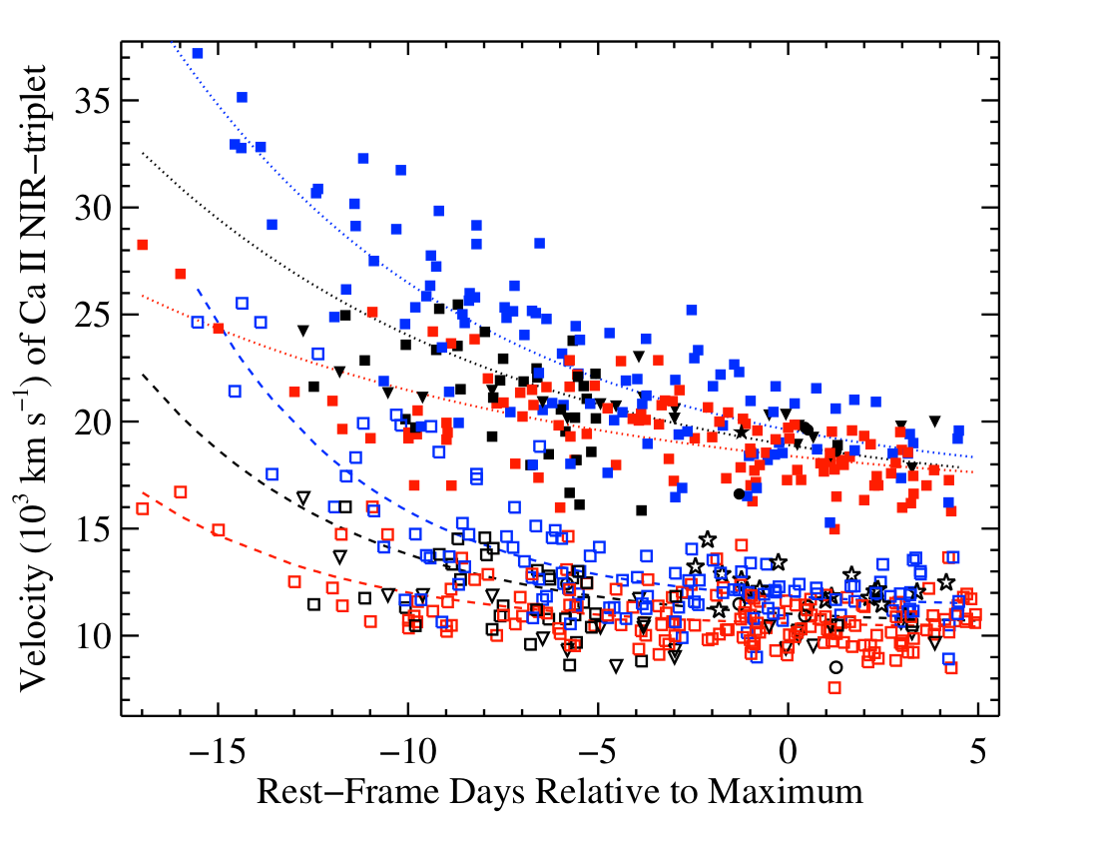
High velocity stuff vs normal stuff
(Silverman et al. 2015)

Slide 26
~2 days after explosion
~5 days after explosion
Red:
Generated
Spectrum
Blue:
Shell
Magenta:
Ejecta
SN2011fe data:
Nugent et al. 2012
Mazali et al. 2014
~14 days after explosion
Mulligan & Wheeler, in prep

Slide 27
Surface explosion?
He shell
Produces Si, Ca on surface

Slide 28
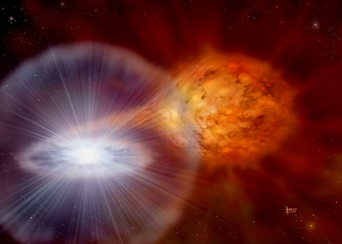
Summary
Type Ia supernova: exploding white dwarfs
  Used to discover Dark Energy
  Never seen one before explosion
  Use spectra after explosion to understand composition, structure
  High velocity features of calcium
  Ca enrichment in outermost layers?
    Suggests surface explosion model

