Slide 1
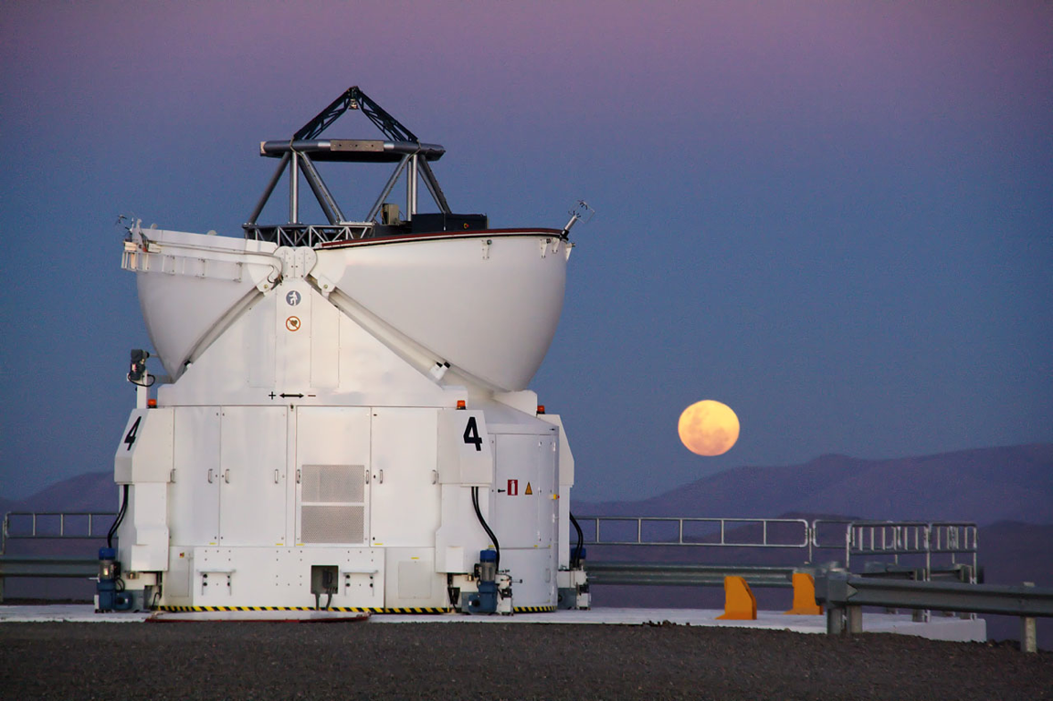

The Tale of the Vampire Star
Henri M.J. Boffin

Slide 2
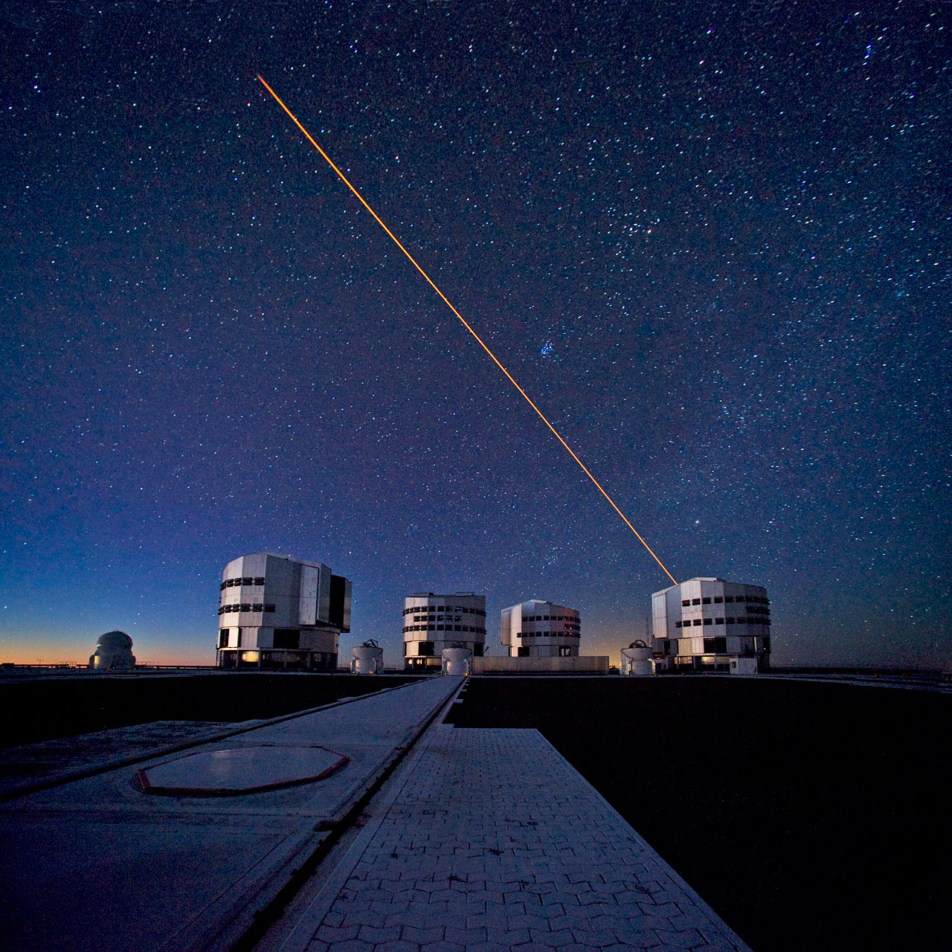
The Very Large Telescope
A Science Machine
Equipped
with latest technology:
Active optics
Adaptive optics
Laser Guide Star
Interferometry

Slide 3

Interferometry: combining waves

Slide 4
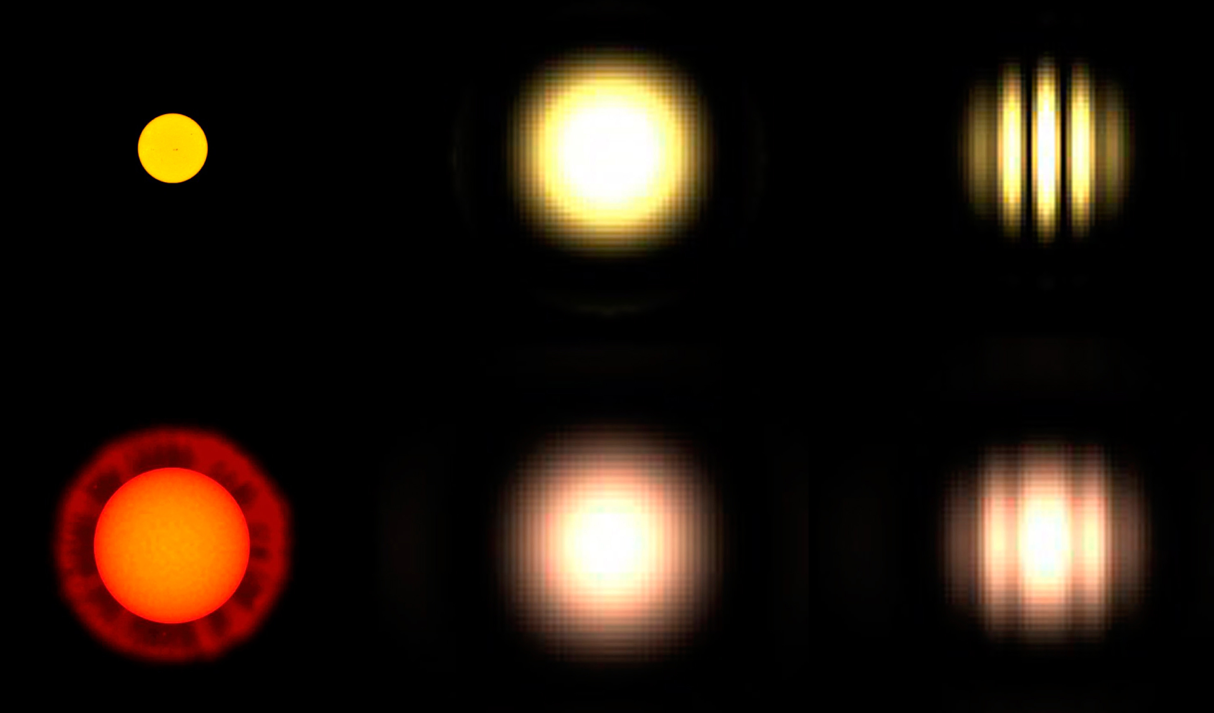
Measuring the radius of stars
Stars of different sizes
Seen through normal telescopes, it is not possible to distinguish them
With interferometry, we can

Slide 5
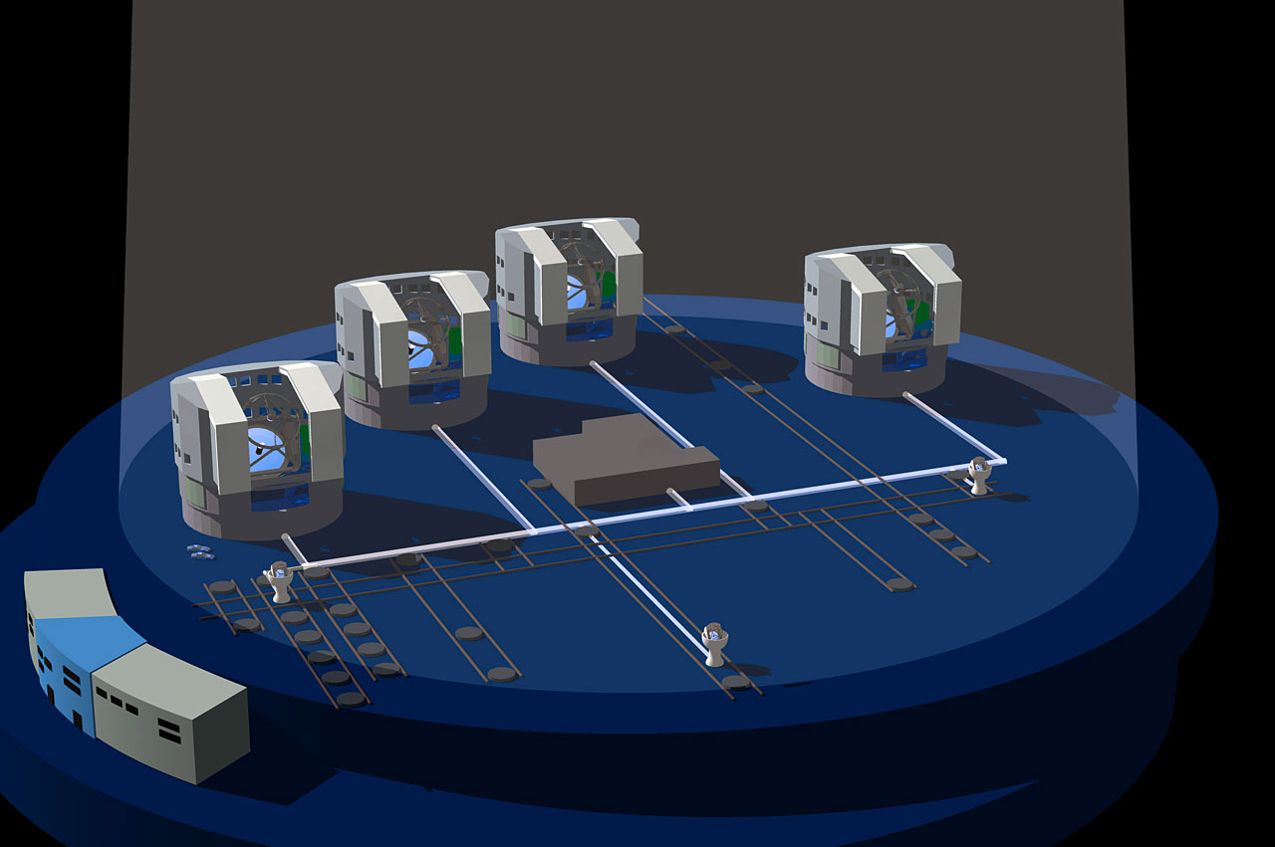
VLT was conceived from start for Interferometry – combining light from telescopes

Slide 6
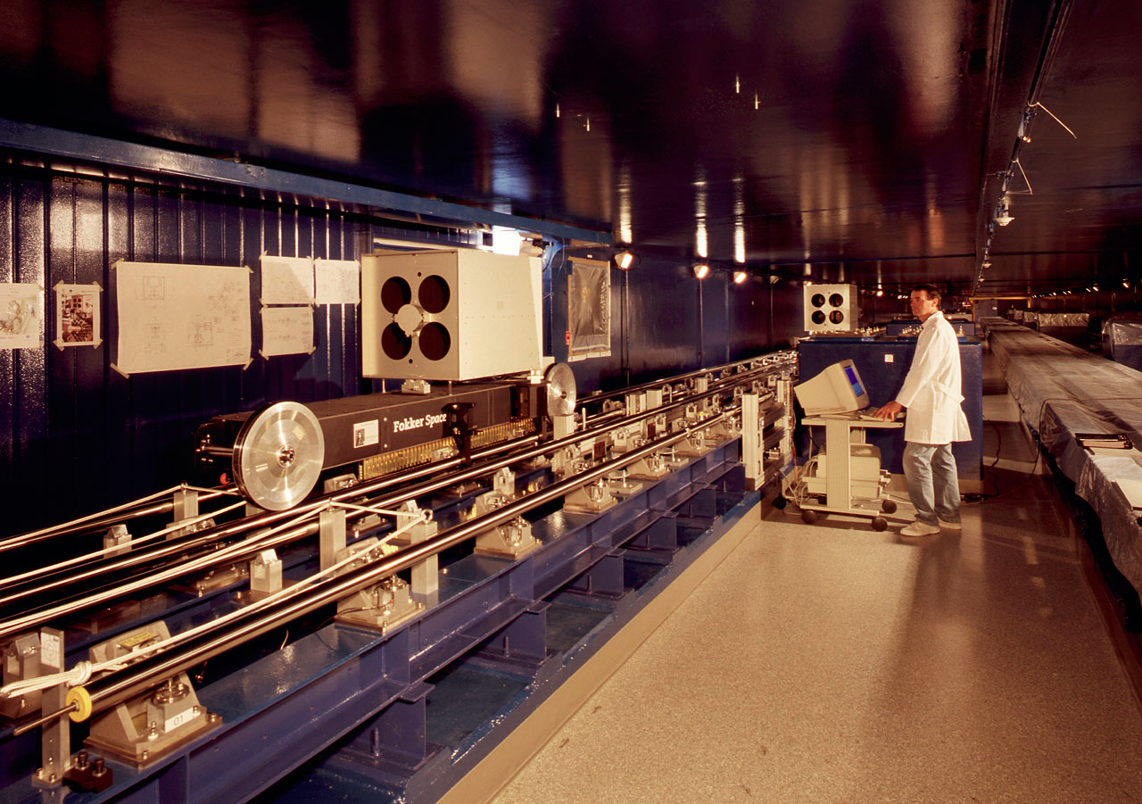
The interferometric laboratory

Slide 7
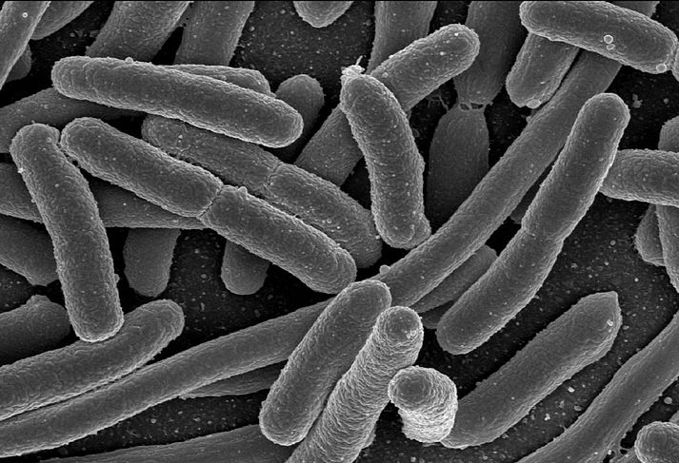

A technological challenge
the light paths must be kept equal to within 1/1000 mm – much less than the width of human hair – over distances of a few hundred metres.
Credit: Rocky Mountain Laboratories, NIAID, NIH
An E. Coli cell is about a micron long, about the precision to which we need to keep the light paths equal!

Slide 8
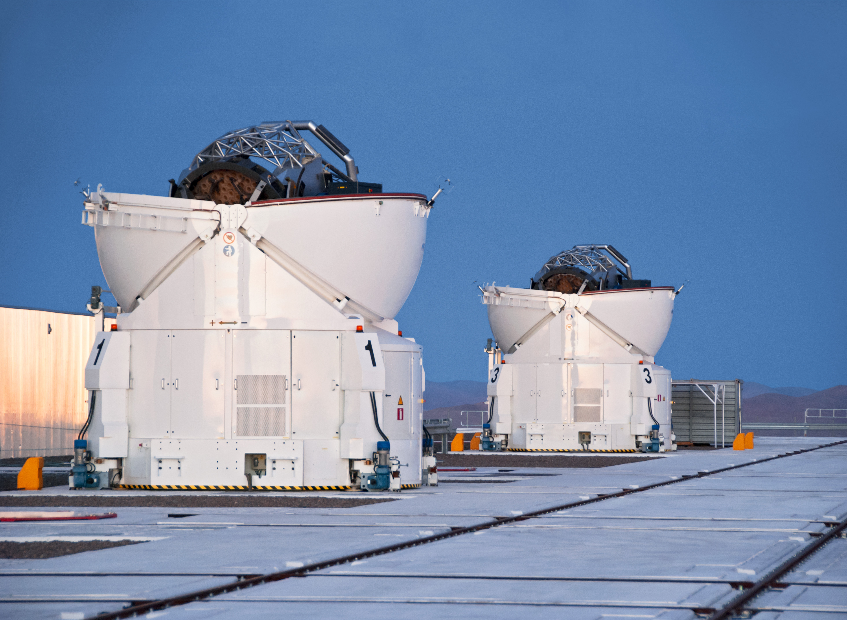

Auxiliary Telescopes
Four 1.8-m telescopes
Built by the Belgian company AMOS
Can move on rails

Slide 9
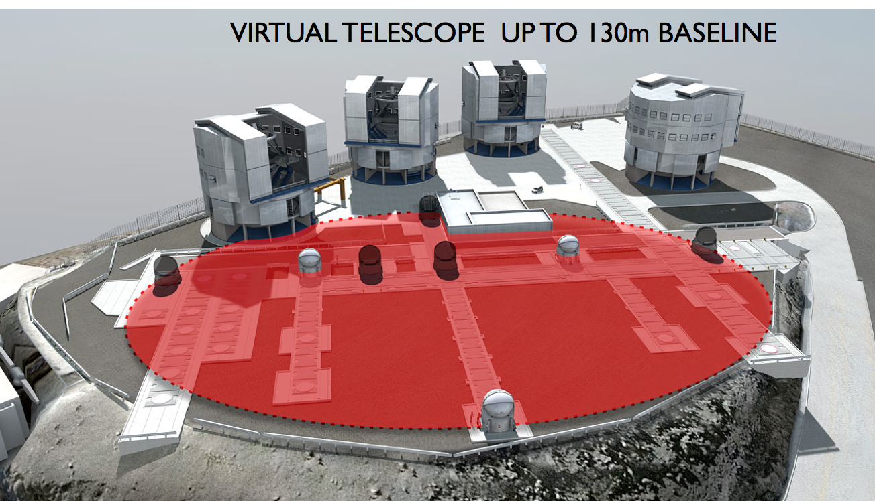
By combining the light from the 4 Auxiliary Telescopes, we have a virtual telescope of the size of the largest separation between the telescopes

Slide 10
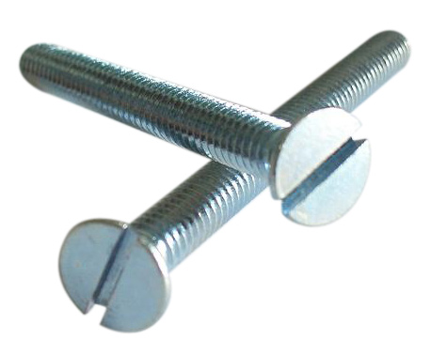
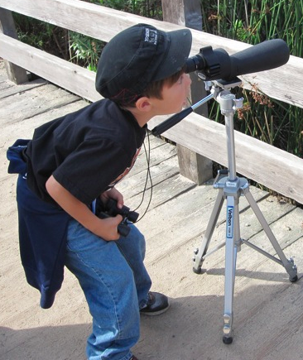
130-m Virtual Telescope
http://www.made-in-china.com
The VLTI provides a spatial resolution of 1 milliarcsecond. This is equivalent to picking out the head of a screw at a distance of 1200 km.
Paranal
1200 KM
An incredible technological achievement!
goexplorenature.com
Santiago

Slide 11
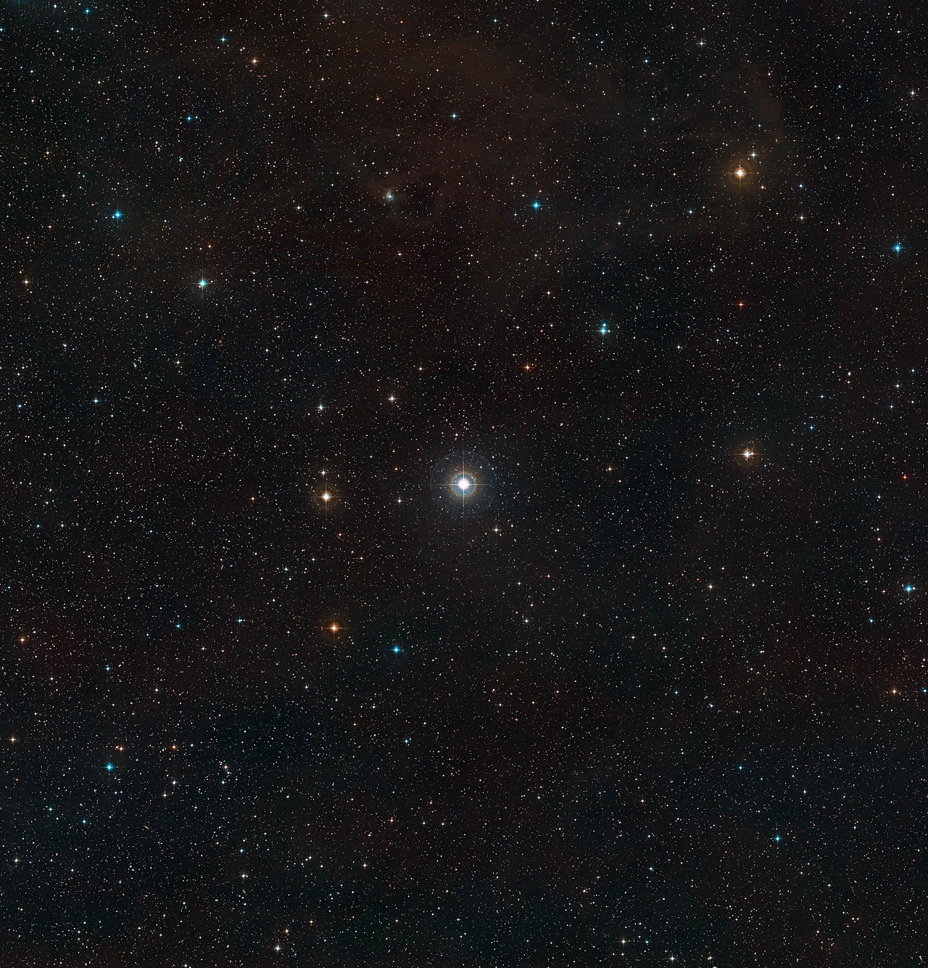
17 Leporis
A star visible with the naked eye

Slide 12
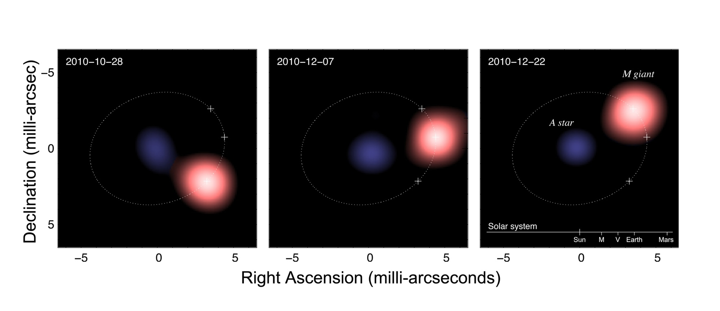
Using Interferometry: It is double!
Observing the system at different epochs, we can see the stars move around each other,
similarly to the Earth moving around the Sun
The VLTI allowed astronomers to measure the sizes of the stars and compute the orbit, from which one can determine the masses of the stars.
Notes:
Separation is similar to distance between Earth and Sun – but the whole system is located 1100 ly away!

Slide 13
1.3 M⊙
2.5 M⊙
The system contains a red giant with 1.3 times the mass of the Sun and a blue star about twice as massive. The two stars orbit around each other in 260 days.

Slide 14
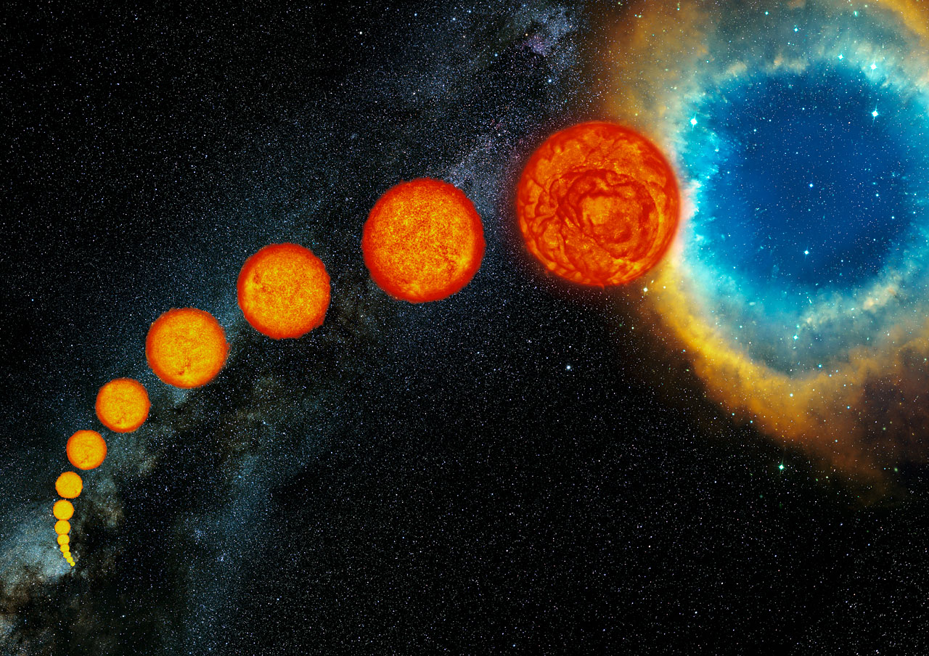
Life of a star
Sun in 5 billion years
The more massive a star, the faster its evolution
Thus, normally, the more massive star is always the more evolved.
Sun now

Slide 15
A mass reversal
Here, however, contrarily to what astronomers expect,
the red giant (i.e. the most evolved star) is the less massive star!
Something dramatic happened!
1.3 M⊙
2.5 M⊙

Slide 16
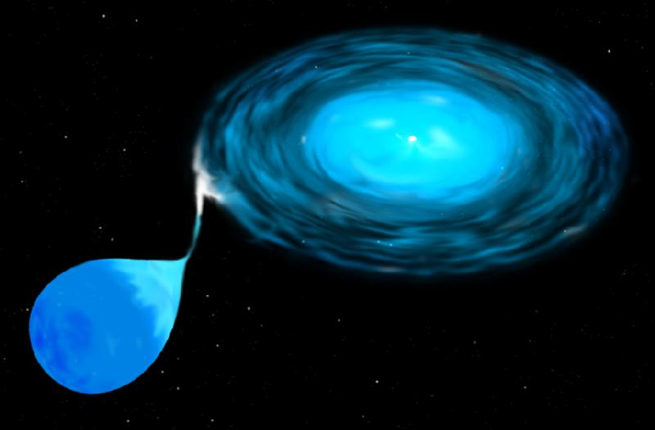
Vampire Star
The star more massive now is the least evolved because it stole the mass from its companion, acting as a vampire!
Credit: STScI

Slide 17
Next time you gaze at the starry night, have a thought for the victims of stellar vampires!
Original research paper:
N. Blind et al., An incisive look at the symbiotic star SS Leporis.
Milli-arcsecond imaging with PIONIER/VLTI,
2011, Astronomy & Astrophysics 536, 55
© H.M.J. Boffin (ES0) – Henri.Boffin AT eso.org
Design by N. Boffin.
All images, except noted, are from ESO’s web site. Please see there for the appropriate credit and copyright.

