Slide 1











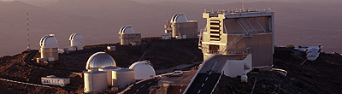
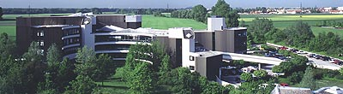
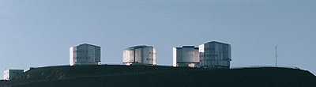
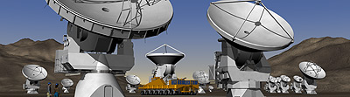
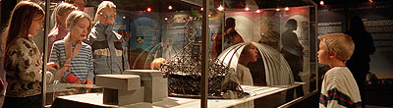
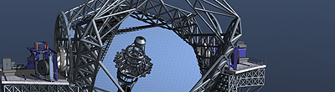
Astronomy and the Media:
A love story?
Henri Boffin (ESO)
hboffin@eso.org
AlphaGalileo | 16.09.2008
Notes:
Bonjour. Je travaille pour l’ESO qui est l’Organisation Europeenne pour l’Astronomie.
Permettez-moi de vous emmener pendant les 20 prochaines minutes dans les etoiles, tout en vous montrant que l’importance de garder ses pieds sur Terre, surtout pour la communication

Slide 2
Why communicate?
Accountability to the public (tax payers) and policy-makers
New projects!
The 1-2% spent on outreach is what will give us the 98% to build the telescope
    Prof. Gilmore, 2008
Local community (Chile) – good relations
Astronomy - among all other sciences
Support government strategy on recruiting the next generation of scientists and engineers
EU dimension
Notes:
On pourrait bien sur se demander pourquoi il faut que l’ESO communique. Apres tout tout le monde aime l’astronomie. Eh bien, il semble qu’etrange que cela paraisse, ce n’est pas vrai. L’astronomie n’est qu’une science parmi d’autres et meme en astronomie, il existe une competitition entre les differents projets. Il est donc utile d’expliquer au public mais aussi aux gouvernements ce que l’on fait avec l’argent et surtout pourquoi c’est important. Il est aussi essentiel de communiquer au Chili pour maintenir d’excellentes relations avec le pays hote. Et comme vous l’avez vu, l’ESO a de nouveaux projets qui necessitent des financements.

Slide 3
The Messenger
Web
Eso-enews
Annual Report
Exhibitions
Events
High-level Visits
Summer schools
EIROforum
Web
Exhibitions
Scientists
Educational community
Policy-makers
Core
Messages
Industry
General Public
Annual Report
Exhibitions
Events
Brochures
Television
Exhibitions
Web
Media
Press Releases
Press Visits
Individual contacts
Notes:
Part of a global strategy
Why the media?
At epoch of web 2.0, do we really need the media?
Cf Europe is spliited -- different cultures, langages --> need multipliers
Eurobarometer

Slide 4
Why We Need the Media
With limited resources, we need amplifying outlets to reach a significant fraction of the targeted audience
Impossible for us to prepare all types of desired communication (material) with different emphasis and levels of complexity
We do not possess the means to provide the material in all the different languages needed
Journalists know their public better than we could try to do!

Slide 5
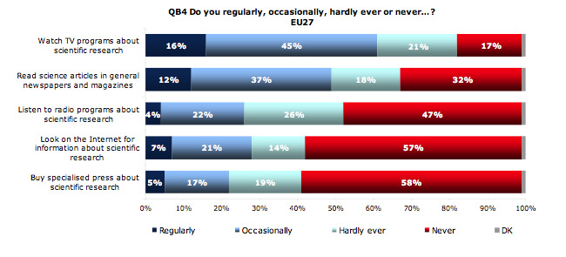
Why we need the media (II)
How do people get informed on science?
TV: 61%
General press: 49%
Radio: 26%
Internet: 28%
Specialised press: 22%
Eurobarometer 2007
Notes:
Television is the most popular medium for information on science
… and most trusted

Slide 6
Raising Public Awareness
The media play a very important role by raising public awareness about science and its results, but
It is doubtful how much the media are really able to teach science to the wide public

Slide 7
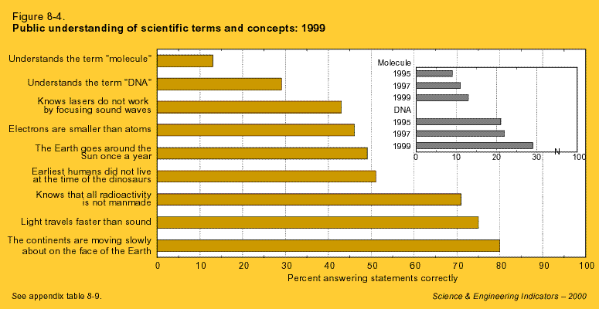

Slide 8
Raising Public Awareness
The media play a very important role by raising public awareness about science and its results, but
It is doubtful how much the media are really able to teach science to the wide public
The scientists must set realistic goals when interacting with the media and the public
Other activities are required to transform the curiosity into knowledge: internet, public events, science centres, …

Slide 9
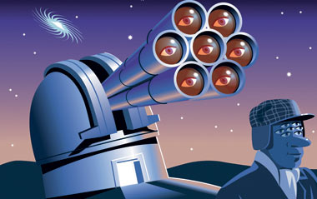

Astronomy
Potentially good for media:
Nice images, wonderful superlative-loaded stories
Link with science fiction
Everyone is born astronomer
Plethora of astronomy magazine demonstrates interest of people
Huge community of amateur astronomers
Planetariums in most cities

Slide 10
Astronomy in the media
A love affair? Yes at first sight
  New York Times online science section has two specific subsections: environment and space&cosmos!
  New Scientist has specific Space section
  BBC Sky at Night : largest running television series (since 1957!)

Slide 11
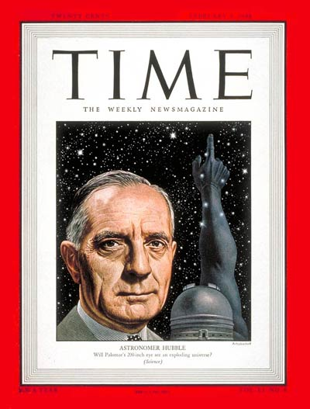
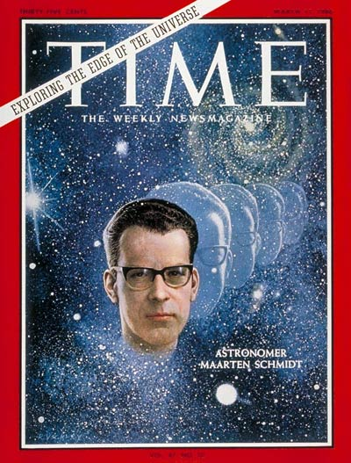
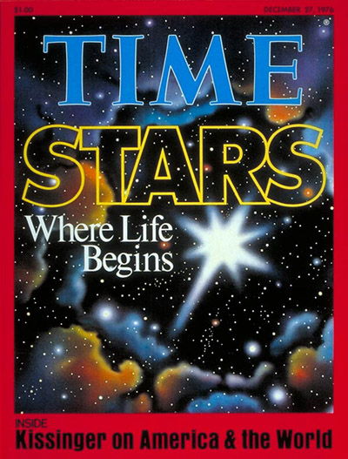
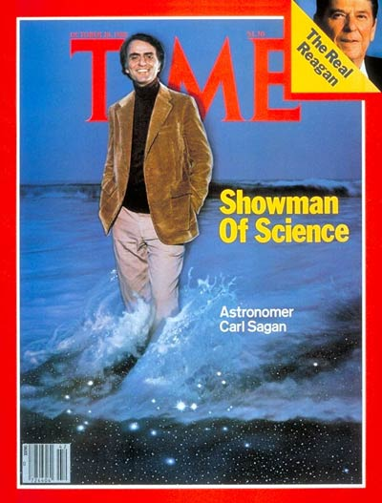
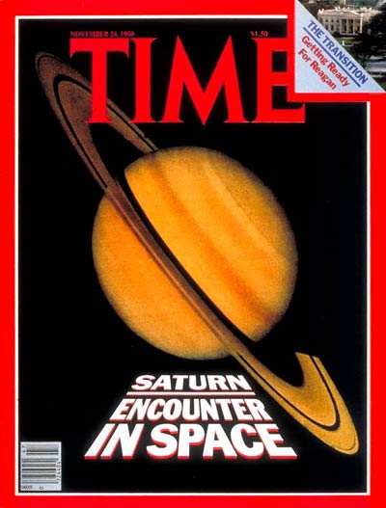
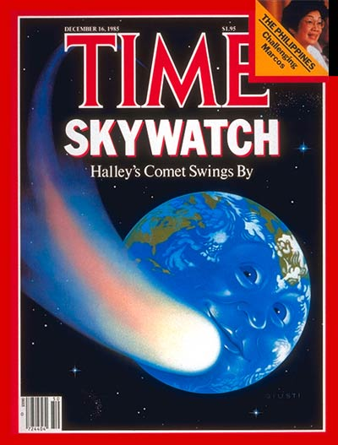
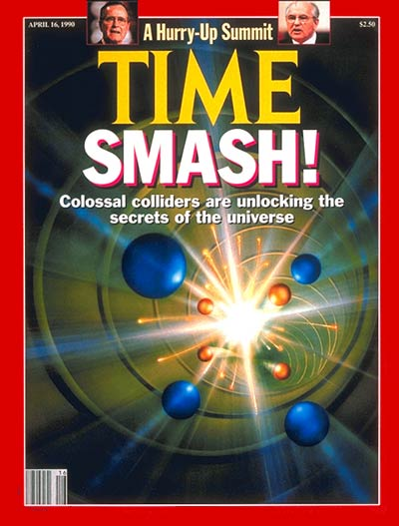
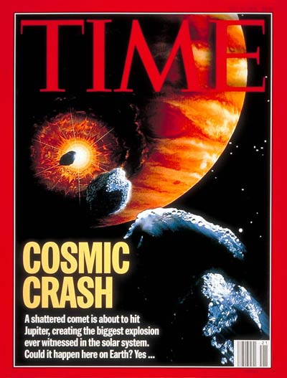
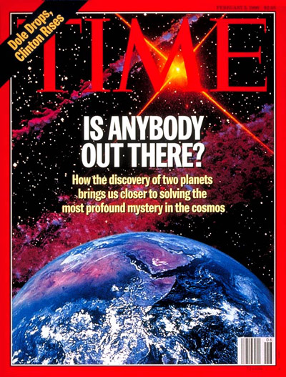
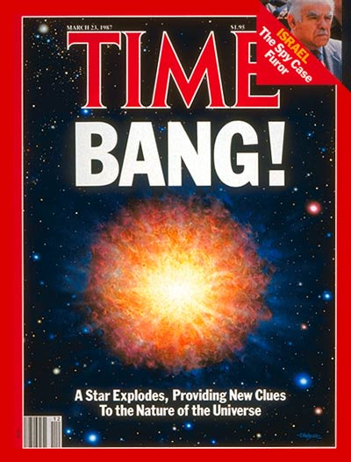
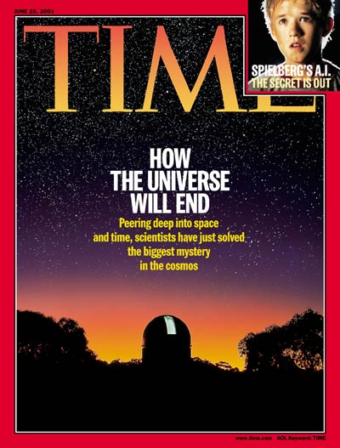
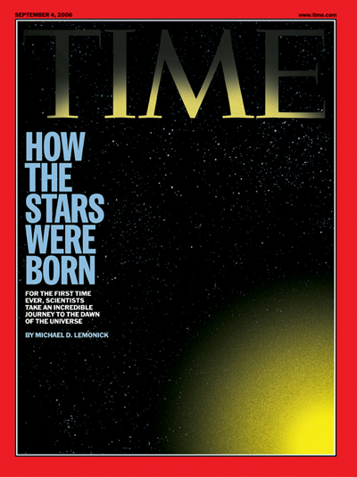
Astronomy does sell!
A Time cover every 5 years or so.
Does not look too bad

Slide 12
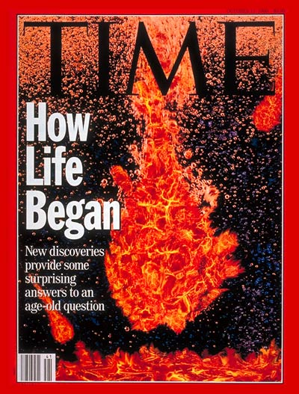
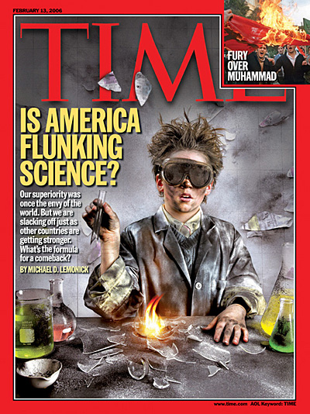
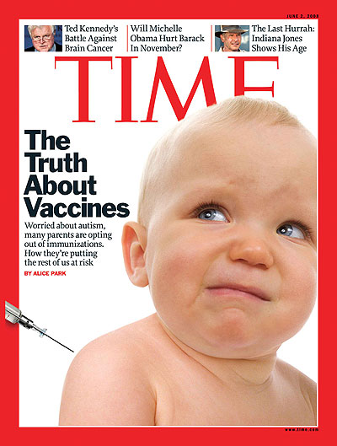
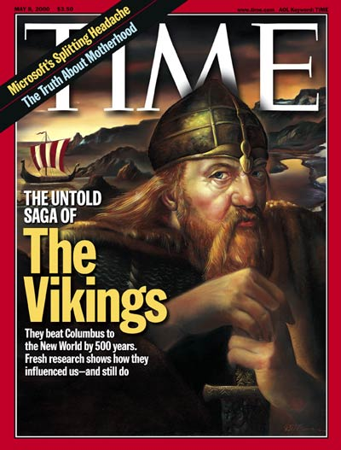
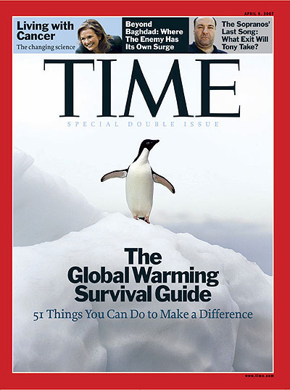
Biology: 4 covers
Chemistry: 9 covers
(mostly before 1965!)
Medicine:
248 covers
31 times more than astronomy!
History: 24 covers
Environment:
60 covers

Slide 13
Time stories
Astronomy 598 articles (179 long)
Astrology 208 78
Archeology 1031 236
Biology 1503 568
Physics 2290 730
Chemistry 2240 802
Environment 7764 3161
Medicine 11814 3169
20 times
Astronomy!

Slide 14
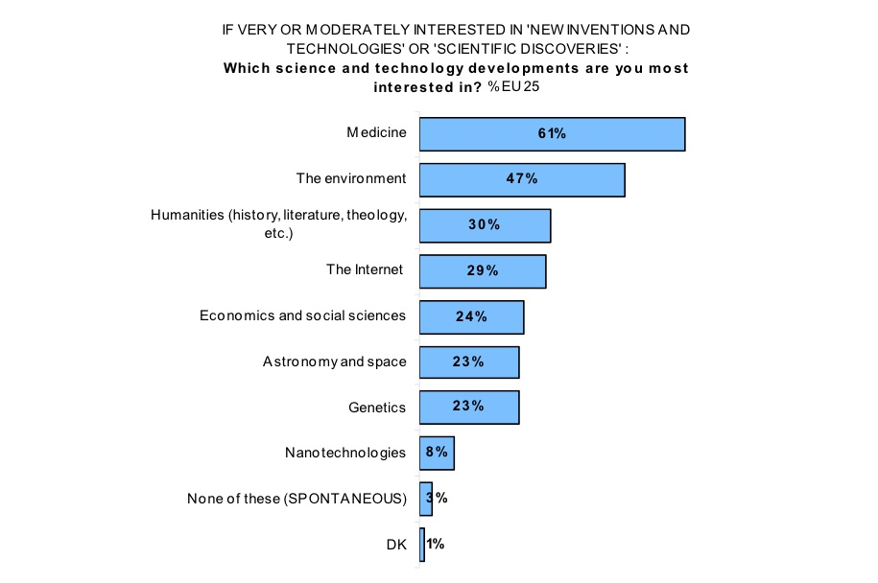
Eurobarometer 2005

Slide 15
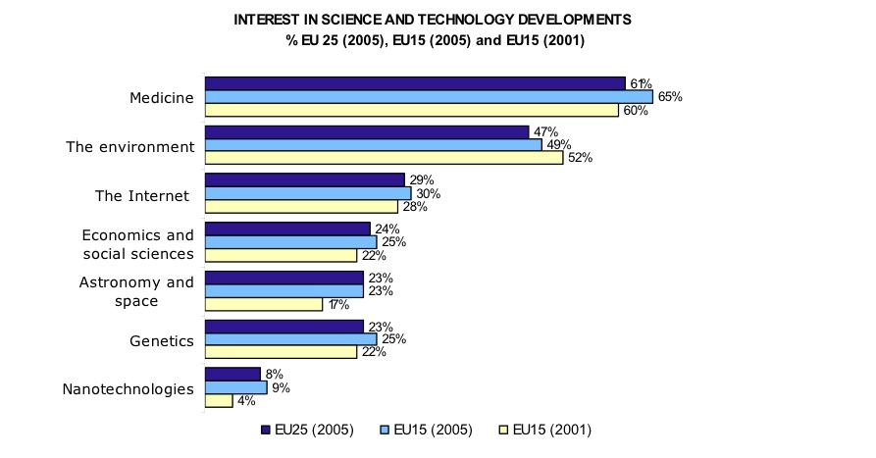
Interest
Increased by 6% in 4 years

Slide 16
The Choice of Themes
Different themes have different chances of being taken over by journalists
Science stories should be (Stein 2000)
  On the leading edge of research
  Involve real people
  Intersection of science and public policy
  Include allegation of malfeasance
Most likely to cause public impact are well-known mysterious and catastrophic subjects, e.g., dark matter, black holes, exoplanets and NEOs on collision course
Or use a superlative: biggest, most distant, closest, brightest, …
Nearly impossible to publish negative results – although they may be scientifically very valid, they do not appear conclusive (enough) to the public

Slide 17
Titles in press releases
Some examples from astronomical press releases distributed by AAS in September and in November 2008
Closest Look Ever at the Edge of A Black Hole
Analysis Begins on Phoenix Lander's Deepest Soil Sample
First Picture of Likely Planet Around Sun-Like Star
Most Dark Matter-Dominated Galaxy in Universe
The Deepest Ultraviolet Image of The Universe Yet
Gemini Releases Historic Discovery image of Planetary "First Family”
Gamma-Ray Burst was Aimed Squarely at Earth

Slide 18
PR Subjects
Astronomical Press releases distributed by AAS in September and November 2008 (total=144)
  Solar System 52
  New Facilities 15
  Exoplanets 12
  Awards, fellowships, contests 10
  Stars, supernovae 10
  Black holes 9
  Press photos 6
  Galaxies 4
  Dark matter 2
  Cosmology 2
NASA (or related): 61
ESA: 17
ESO: 15
80 PRs distributed on AAS list/month

Slide 19
PR Subjects
Astronomical Press releases distributed by Alphagalileo from 20 November 2008 till 20 January 2009
(total=40 out of 400 Science PRs: 10%)
  Solar System 8
  Exoplanets 7
  Stars, supernovae 5
  Cosmology 3
  Awards, fellowships, contests 3
  Press photos 3
  Galaxies 3
  Black holes 2
  History 2
  New Facilities 1
  Others 3
ESA: 8
(excluding Earth’s related)
ESO: 8
STFC: 5
RAS (MNRAS): 3
A&A: 2

Slide 20
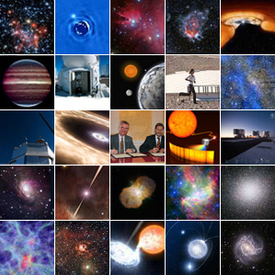
PR Subjects
  Press releases distributed by ESO over 5 years (from 2004 to 2008; total=228)
    Awards, organisation, contests 42
    New Facilities 30
    Press photos 43
    Scientific results 154
      Solar System 52
      Stars, supernovae 38
      Exoplanets 20
      Distant Universe 11
      Gamma-ray bursts 9
      Galaxies 9
      Black holes 7
      Milky Way 6
      Dark matter 2

Slide 21
ESO
ESO Press Releases ~ 50/yr
  Science
  Press Photos
  Instrumentation/Telescopes
  Organisation
ESO telescopes lead to between 650 and 750 refereed papers per year
  For science: Drastic selection

Slide 22
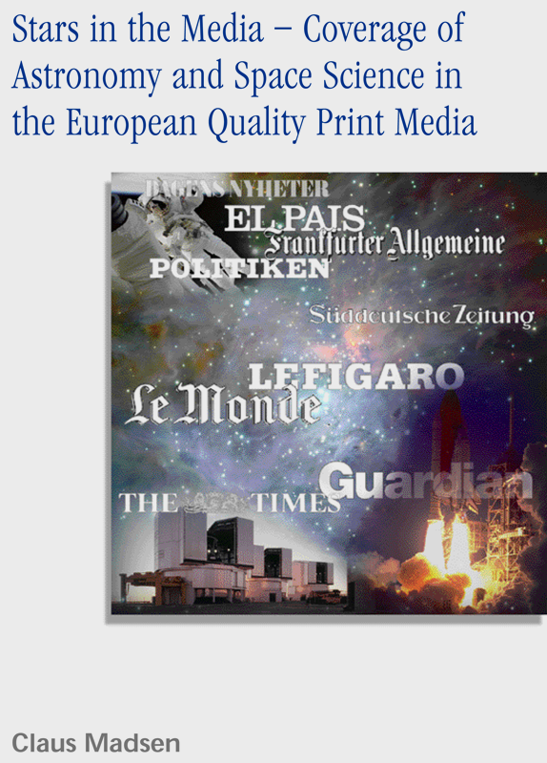
“Stars in the Media” (C. Madsen)
Spring 2001, astronomy and space science,
broadsheet papers in UK, F, D, E, S, DK
Main findings
Choice of topics is influenced by national
(cultural, political) aspects, but the narrative
(story, rhetoric) is rather uniform
The strong influence by scientific press releases is confirmed.
Fundamental research is reported within a
narrow scientific frame
Space coverage is driven by ‘events’ and
focus largely on non-scientific issues and utilitarian aspects
Notes:
C’est un bon moment je crois pour parler d’une etude qui a ete faite par mon collegue Claus Madsen de l’ESO. En 2001, il analyse pendant plusieurs semaines les articles consacres a l’astronomie paraissant dans les journaux les plus importants de differents pays europeens.
Ses resultats sont les suivants:
tout d’abord le choix des sujets depend d’un pays a l’autre, tandis que la facon dont c’est raconte est en fait assez similaire
La reserche fondamentale est decrite dans un cadre assez etroit tandis que la recherche appliquee est surtout discutee en termes d’applications possibles.

Slide 23
“Stars in the Media” (II)
Main findings
In Germany, 67 % of articles describe US science (14 % German science)
In Spain, 85 % of articles describe US science
In Sweden, 71 % of articles describe US science
In the UK, 8 % of articles describe US science, 77 % UK Science
In France, 40% of articles describe F science, 25% US
‘European science’ is virtually absent
Notes:
Les articles recouvrent essentiellement les resultats des Etats-Unis, meme si la fraction depend d’un pays a l’autre.

Slide 24
The Battle to Be Heard
Articles on astrophysics/space currently occupy approx. 0.1% of leading European newspapers
Astronomy and space research are divided ~50-50
There is much more emphasis on health/environment
Science is mostly presented in special sections that are accessed by a small audience
More effort should be invested to show the role of fundamental research for societal development and general culture – this may also attract more interest
C. Madsen, 2001
Notes:
L’espace n’occupe ainsi que un dixieme de pourcent de la place dans les journaux majeurs Europeens. Ce qui est peu! Et c’est reparti a 50-50 entre l’astronomie en tant que telle et la recherche spatiale. De plus la science est presentee dans des pages speciales et souvent avec un impact limite. La dimension culturelle de l’astronomie est souvent ignoree.

Slide 25
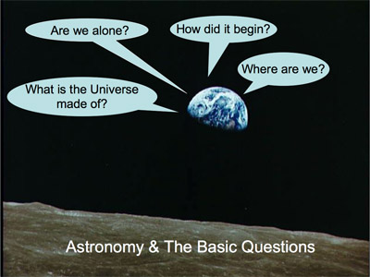
Astronomy…
is after all
humankind’s
boldest attempt
to understand
the world in
which we live.
Notes:
En fait, l’astronomie est vraiment la tentative la plus folle de l’humanite d’essayer de comprendre le monde dans laquelle on vit. Sommes-nous seuls dans l’Univers? Quelle est notre place dans l’Univers? Comment cela a-t-il commence? Comment cela va-t-il finir? De quoi l’Univers est-il fait.
On le voit les questions on des portees culturelles, philosophiques et religieuses evidentes.

Slide 26
Small survey science journalists
how often would you run a story related to astronomy per month?
    1 11%
    2-3 37%
    4-5 19%
    More than 5 33%*
    *(mostly online: “Space is infinite”)

Slide 27
Small survey science journalists
What are the topics most likely to be run?
  (several answers possible)
    None in particular 55%
    Exoplanets 33%
    Solar system 29%
    Cosmology 15%
    Stars and nebulae 11%
    Galaxies 7%

Slide 28
Small survey science journalists
What is most important when selecting the story?
  (several answers possible)
  subject 92%
  availability of a nice image or video 74%
  nationalities of the scientists involved 22%
  names and host institutions of the scientists involved 9%
  institution issuing the press release 0%

Slide 29
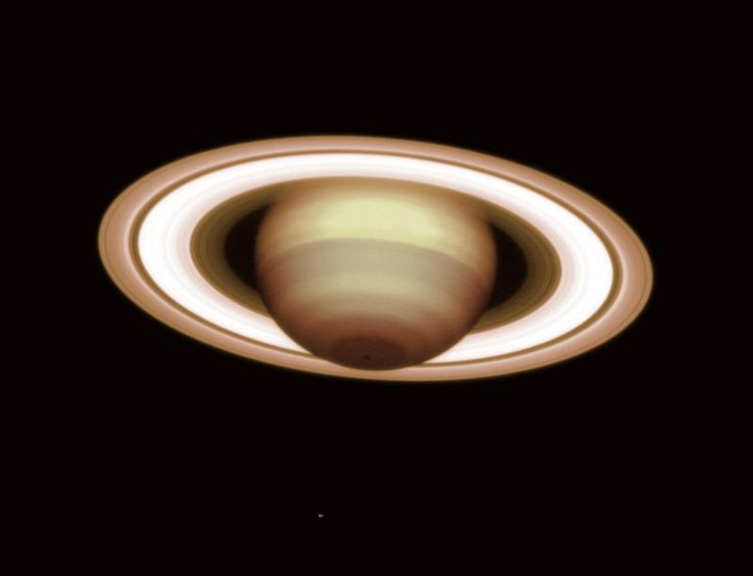
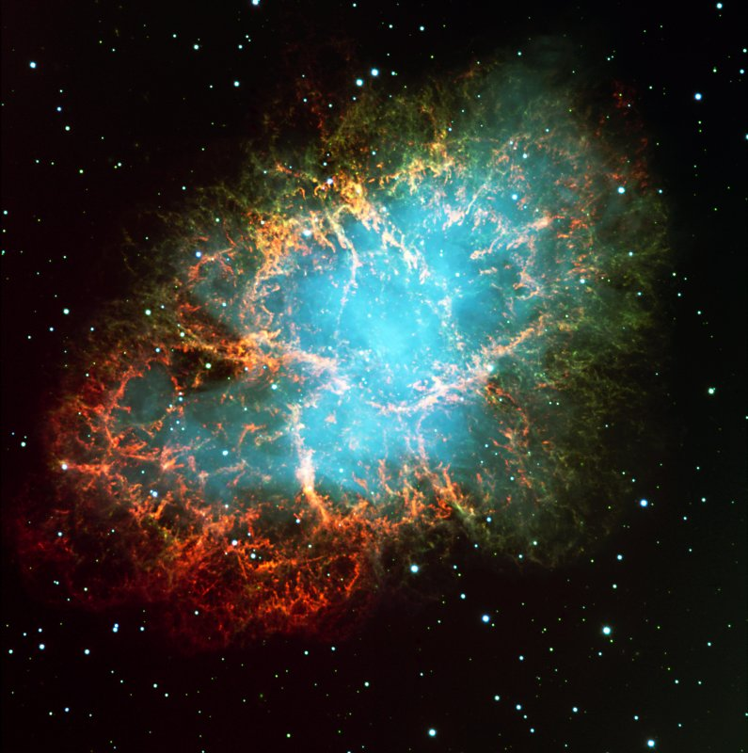
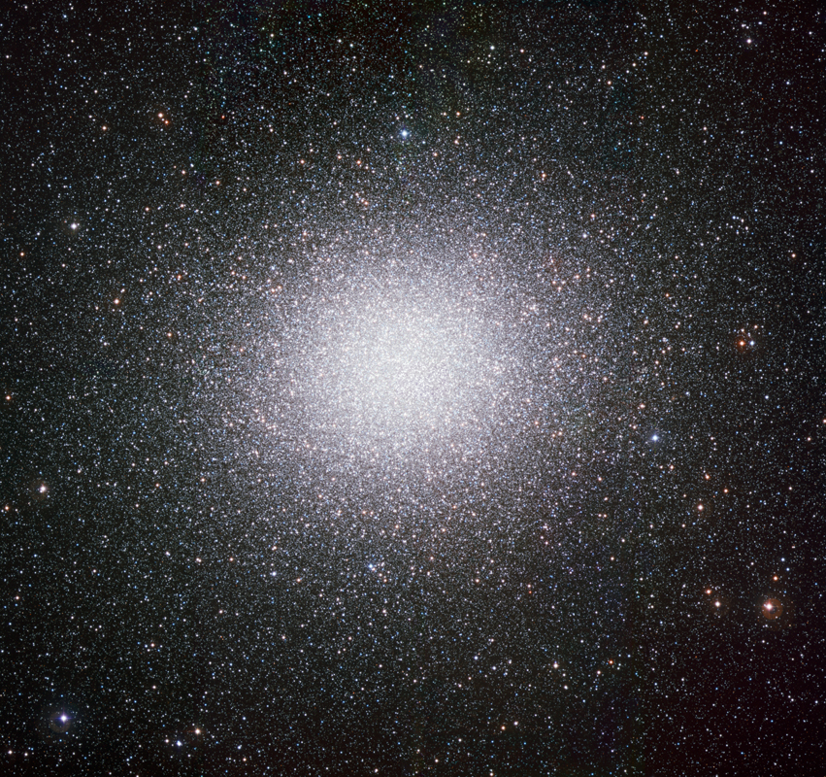
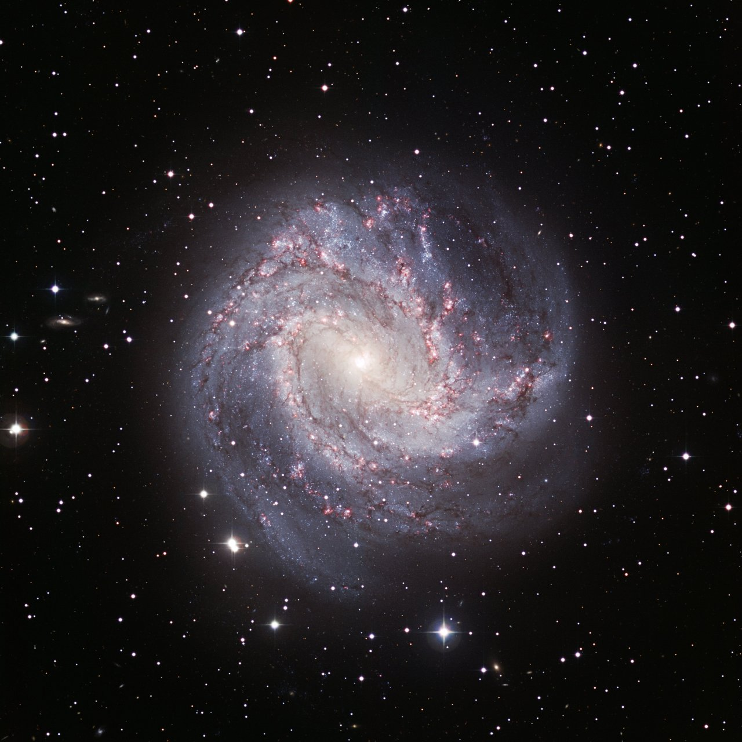
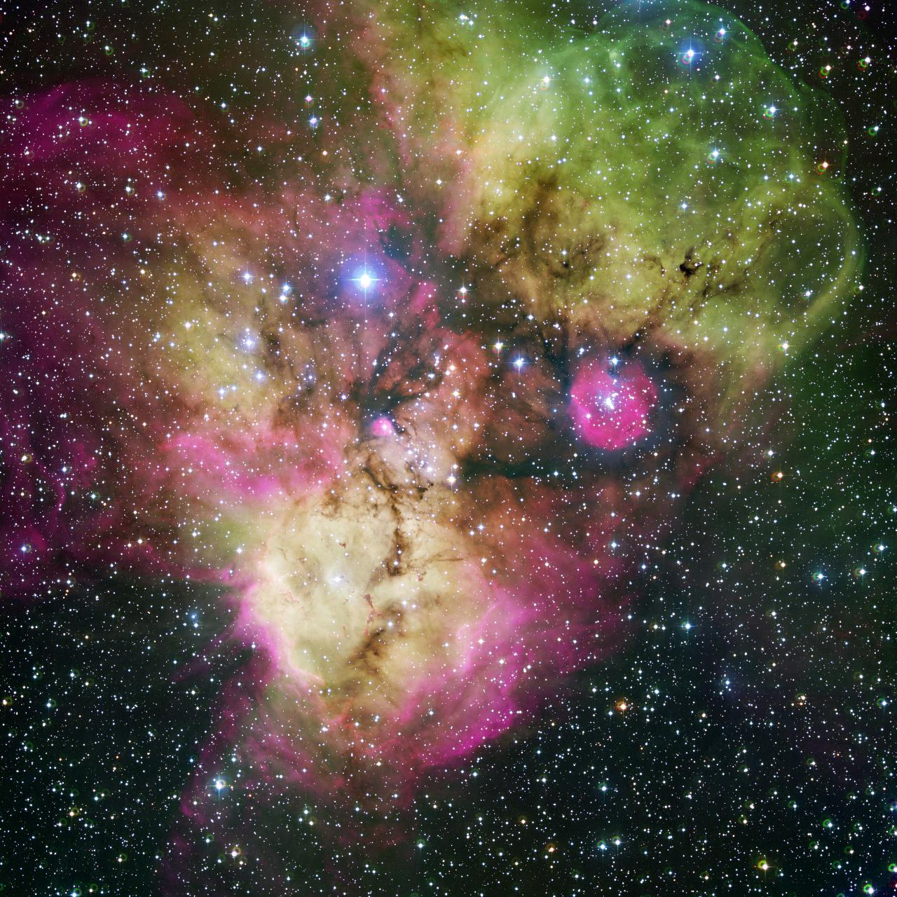
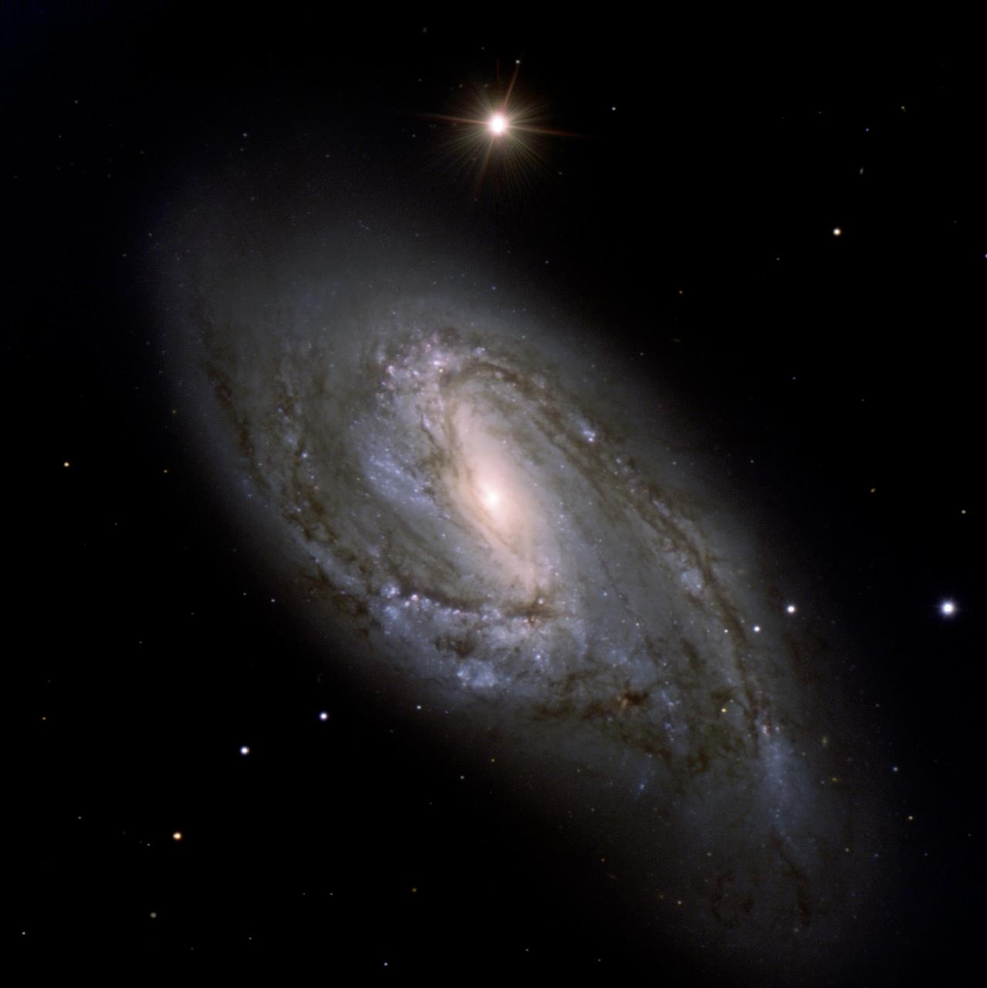
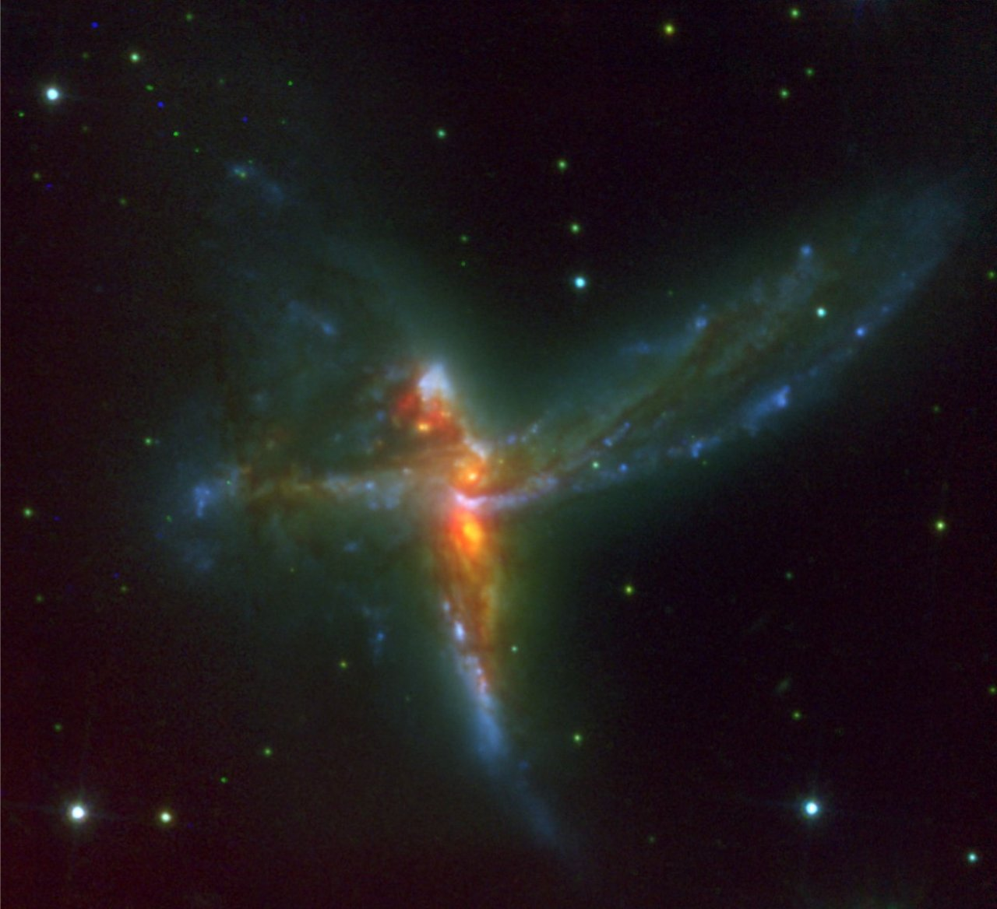
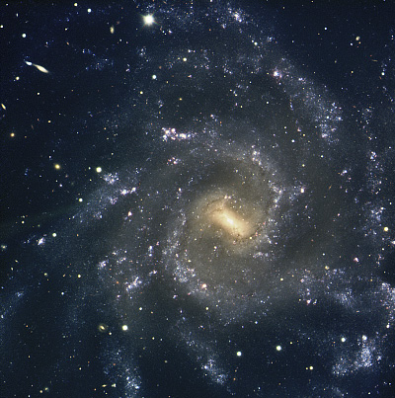
Astronomy lives by images!
Notes:
L”astronomie bien sur vit par l’image et nous les utilisons au maximum pour augmenter notre taux de penetration. Pas seulement des images astronomiques, mais aussi des installations qui sont souvent uniques. Et lorsque aucune photo n’existe, on cree des vues d’artistes. Il n’y a ainsi jamais un communique de presse qui n’ait pas d’image.

Slide 30
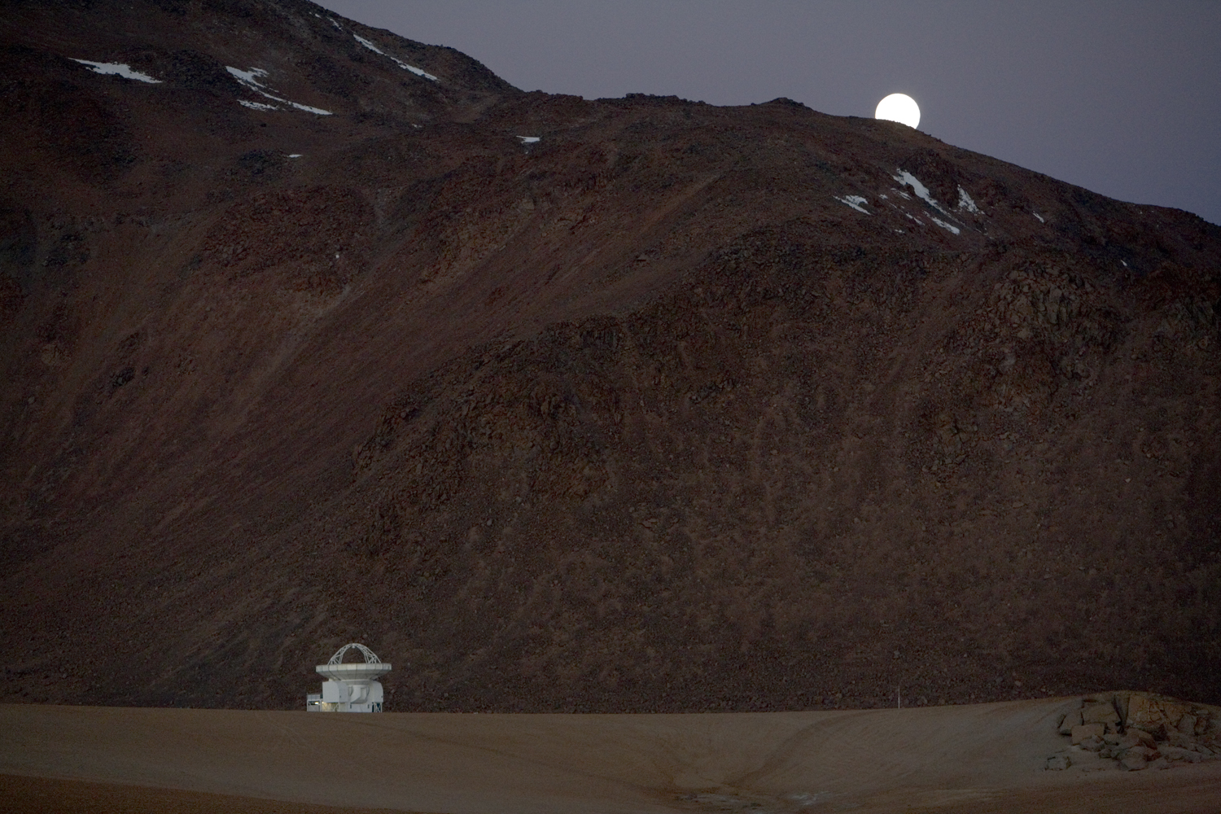
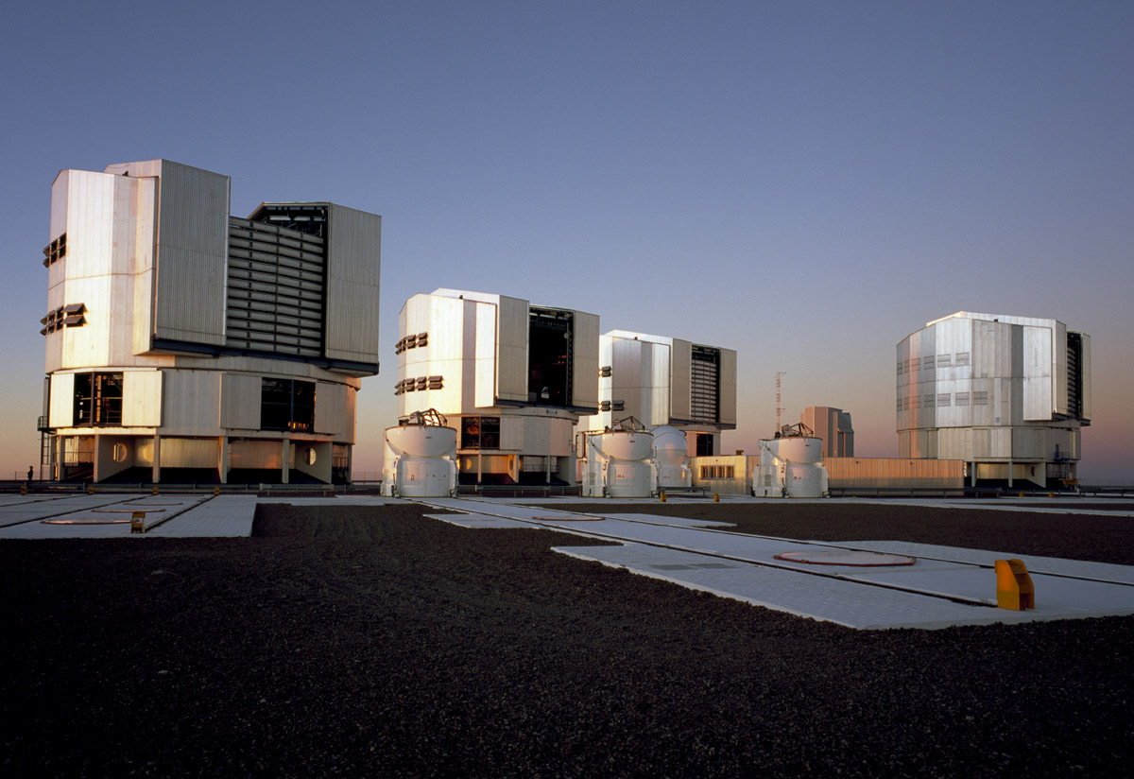
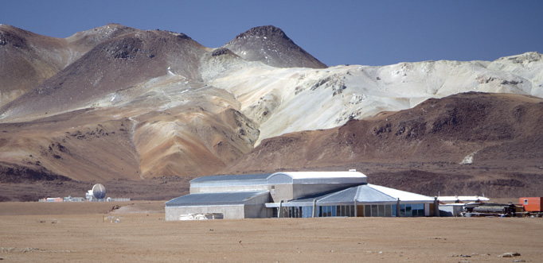
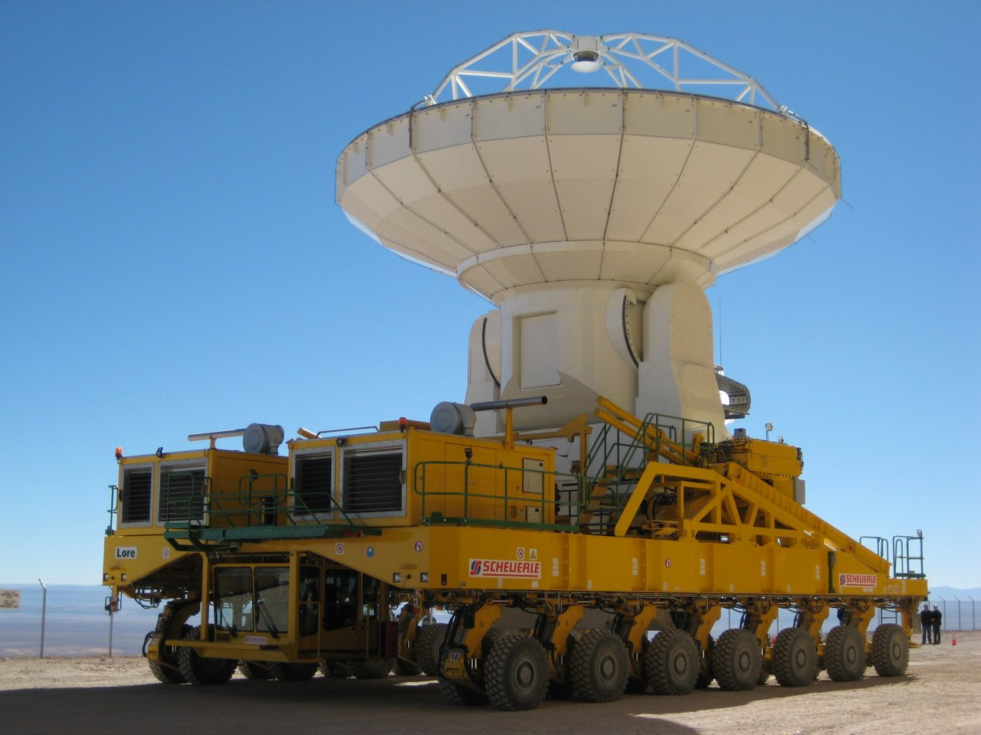
Astronomy lives by images!
Notes:
L”astronomie bien sur vit par l’image et nous les utilisons au maximum pour augmenter notre taux de penetration. Pas seulement des images astronomiques, mais aussi des installations qui sont souvent uniques. Et lorsque aucune photo n’existe, on cree des vues d’artistes. Il n’y a ainsi jamais un communique de presse qui n’ait pas d’image.

Slide 31
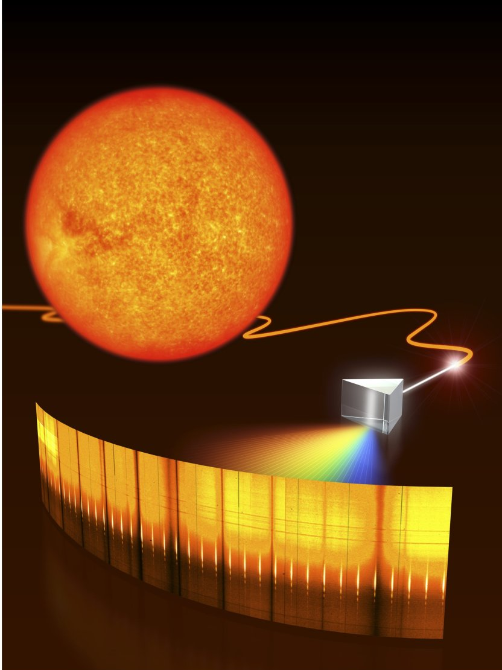
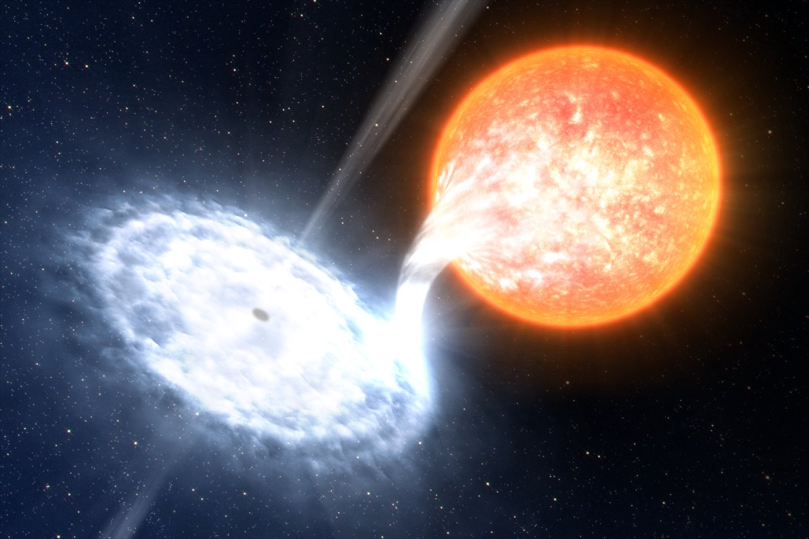
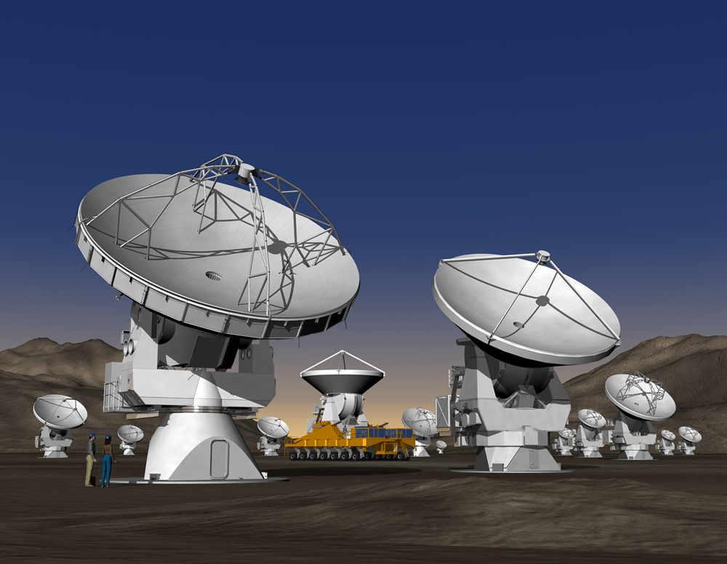
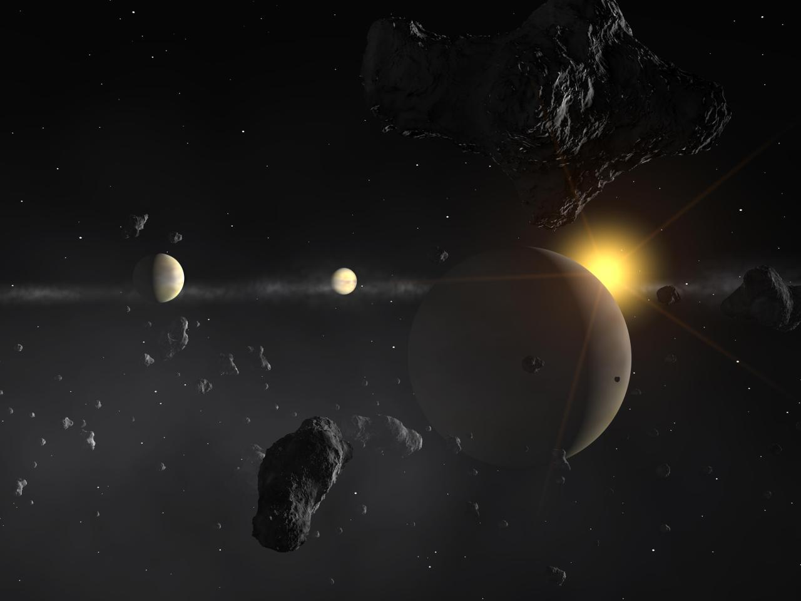
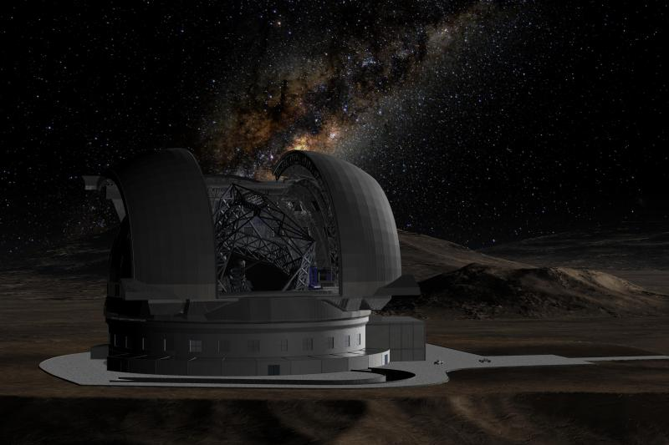
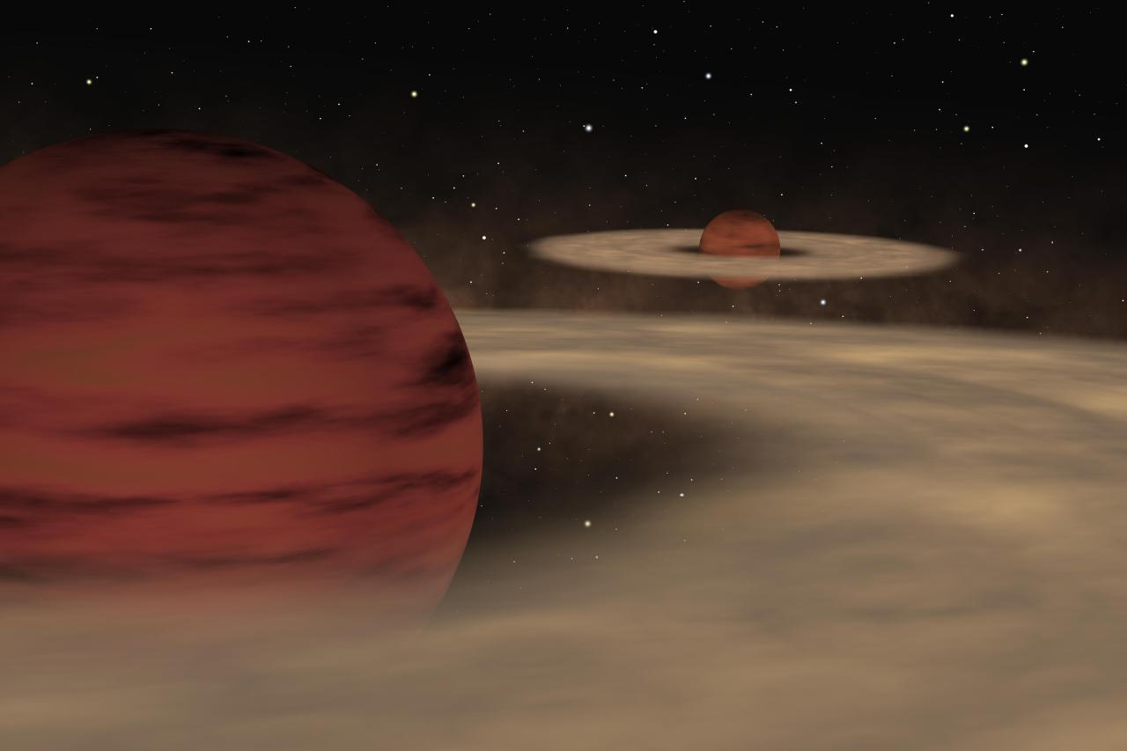
Making images

Slide 32
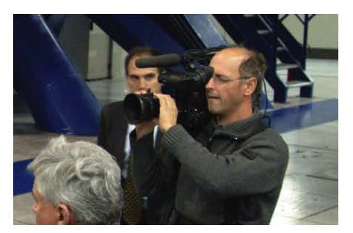




Video News Releases
Associated with important or dramatic PRs
Use Computer Animations
Make interviews of scientists
Broadcast and web quality
Distributed by web and tapes
Distributed with Athenaweb, EBS

Slide 33
Small survey science journalists
Do you find it difficult to run an astronomical story past the chief editor?
    NO 80%
    YES 20%
    “But we don’t make it to the front page!”
    “Astronomy is very favourably seen by Editor in Chief”

Slide 34
Small survey science journalists
Do you think astronomy has the place it deserves in the media?
    YES 62%
    NO 38%
    “Deserves more but won’t get it”
    “At least the breakthroughs are covered”
    “Yes, compared to a lot of other science subjects”
    “Sometimes I'd say that it is too much!”

Slide 35
A love story?

Slide 36

A love story?
A love story!
Definitively!
  Most journalists are keen to cover astronomy
  Most major breakthroughs are covered
  Astronomy gets more than its share in the media

Slide 37



Yearly presence
For ESO, the yearly estimated readership in newspapers and magazines is tens of million people worldwide
In 2007, ESO appeared in at least 100 TV news reports or documentaries, potentially reaching hundreds of millions of viewers
Equivalent advertising value:
> 40 million Euros in a year…
Notes:
Si l’on regarde les statistiques, on peut dire que l’ESO apparait bien dans les media, avec plus de 10 millions de lecteurs et 100 millions de telespectateurs. Si l’on devait estimer cela en terme de cout publicitaire, cela equivaudrait par an a plus de 40 million d’euros ce qui est tres rentable.

Slide 38

A love story!
Definitively!
  Most journalists are keen to cover astronomy
  Most major breakthroughs are covered
  Astronomy gets more than its share in the media
But…
  Astronomy should also be dealt outside of science pages, for its society and cultural aspects
  IYA09 could help in reaching this!

Slide 39

Notes:
Et je vais terminer ainsi. Merci beaucoup.

