Slide 1


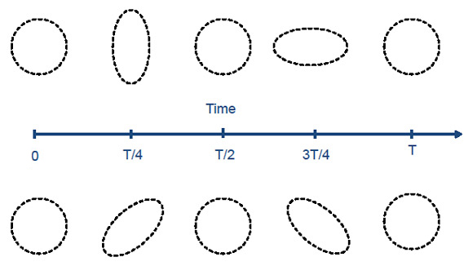
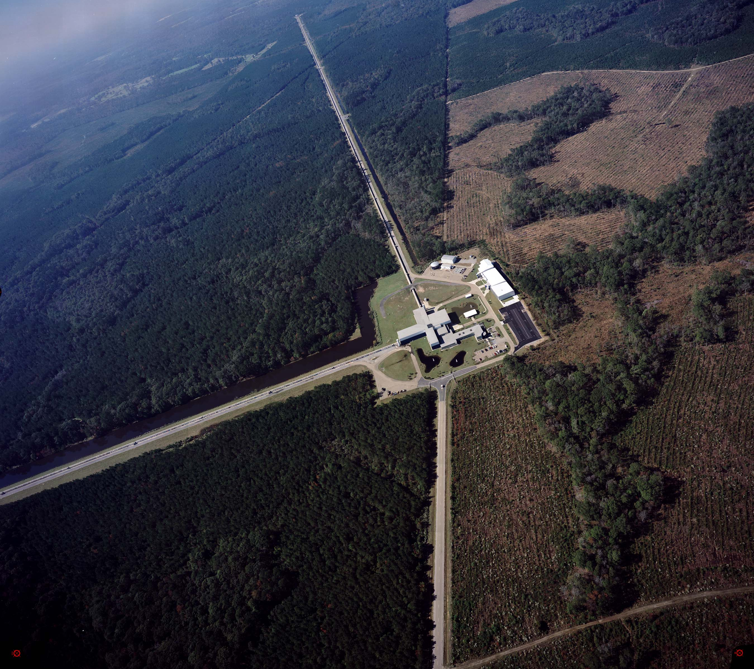
Investigating Binary Black Hole Mergers with Principal Component Analysis
Author: Nicholas Mangini
Faculty Advisors: Professor Laura Cadonati & Dr. James Clark
Goal
Develop an algorithm that uses principle component analysis (PCA) and Bayesian statistics to reconstruct a detected binary black hole (BBH) signal using physically distinct BBH numerical relativistic waveform catalogues
Numerical Relativity Waveform Catalogues
The Experiment
Inject a population of waveforms into 50 Gaussian noise realizations and characterize the performance of the Bayesian model selection and signal reconstruction
Focus on distinguishing between the three NR catalogues (Q-series, HR-series, and RO3-series) at SNR=50
The signals are optimally oriented in this initial study with a fixed mass of 250 M (placed directly overhead the detector and oriented face-on)
Catalogue | Number of Waveforms | Mass Ratio, q | Spin, a | Tilt Angle, Θ
Q | 13 | 1-2.5 | 0.0 | 0.0
HR | 15 | 1-4 | 0.0-0.9 | 0.0
RO3 | 20 | 1.5-4 | 0.4,0.6 | 45°-270°
Background
Gravitational waves (GWs) are ripples in space-time radiated by accelerated mass
Prediction of Einstein’s Theory of General Relativity, indirectly detected by Hulse & Taylor (1974) and perhaps by BICEP2 (2014)
GWs travel at the speed of light carrying away orbital energy from their sources
Sources include core-collapse supernovae, compact body binaries (e.g., pairs of black holes or neutron stars) and pulsars
Principle Component Analysis
Transforms data into a set of orthonormal eigenvectors called principle components (PCs) that span the parameter space
The original data can be reconstructed with a number of PCs less than or equal to the number of original variables ➔ a great data reduction technique
We begin by constructing a matrix H of waveforms, whose columns correspond to each waveform in a catalogue, and factorize so that
U is a matrix of eigenvectors of HH^{T}
V is a matrix of eigenvectors of H^{T}H
S is a diagonal matrix of the square roots of the corresponding eigenvalues of V
H can be reconstructed with a linear combination of any number of PCs from U
β is a coefficient obtained by projecting H onto U
GWs alternately stretch and squeeze space in orthogonal directions measured as strain, h(t), which is a relative change in length ΔL/L
GW detectors like LIGO monitor the distance between a corner station and two end stations
Figure 1. Gravitational waves strain space in two ways, h₊(top) and h_{x} (bottom)
The strain from a galactic supernovae is expected to be of order 10⁻²⁰, corresponding to a change in length of 10⁻¹⁸ m, comparable to the diameter of a proton
The difficulty comes in finding these very small signals in comparatively loud noise
Noise sources include seismic activity, electronic glitches, and thermal noise
Black Hole Evidence Extractor
Algorithm employing Bayes’ theorem to calculate the probability a BBH signal belongs to a specified NR waveform catalogue
The Bayes factors is the ratio of probabilities for each model
M1 and M2 are separate catalogues with different physics
D is the data
If B₁₂ > 1, M₁ is preferred
If B₁₂ < 1, M₂ is preferred
Noise introduces the uncertainty between catalogues at low SNR
To determine the number of PCs, k, to use we calculate the cumulative eigenvalue energy which is a measure of the catalogue variance represented by each PC:
Figure 3. Left: the waveforms in the HR catalog of spinning, non precessing waveforms used in this study. Right: The principle component decomposition of the HR catalog.
Preliminary Results
Catalogue selections works with ~90% success rate in this small sample of waveforms and high SNR
Figure 2. An aerial view of the LIGO detector in Livingston, LA. Each arm is 4 km long.
Binary Black Hole Systems
BBH systems are a promising source for gravitational waves, especially intermediate-mass systems (100 M – 500 M)
GW simulations are obtained by solving Einstein's field equations, which must be done numerically
Much progress has been made recently in simulating BBH mergers using numerical relativity
Simulations for highly asymmetric, spinning systems computationally challenging ➔ lack of accurate physical models for these systems
We attempt to work around this by constructing 'catalogues' of waveforms, each with different physical morphologies and identify which catalogue potentially detected signals belong to
Figure 5. Distribution of Bayes factors for HR waveforms. The boxes denote the interquartile range of the distribution, the red lines indicate the median value and the whiskers show the outliers within 1.5× the interquartile range.
Figure 4. Cumulative eigenvector energy as a function of the number of principal components for the three catalogs in this study. We use the number of PCs that provides 90% of the energy: 2 PCs for set Q, 4 PCs for set HR and 5 PCs for set RO3.
Looking Forward
Ramp up Monte-Carlo study to 1000 different noise realizations and a lower, more realistic SNR
Make the code faster and more efficient
Build larger catalogues to account for more variation in waveform morphologies
Run blind tests where we don’t know what catalogue a particular signal belongs to and attempt to categorize the signal
Generalize BHExtractor to search over total mass, sky location, and inclination

