Slide 1
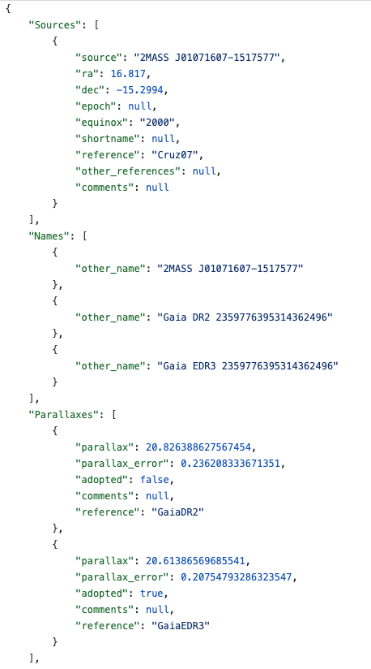
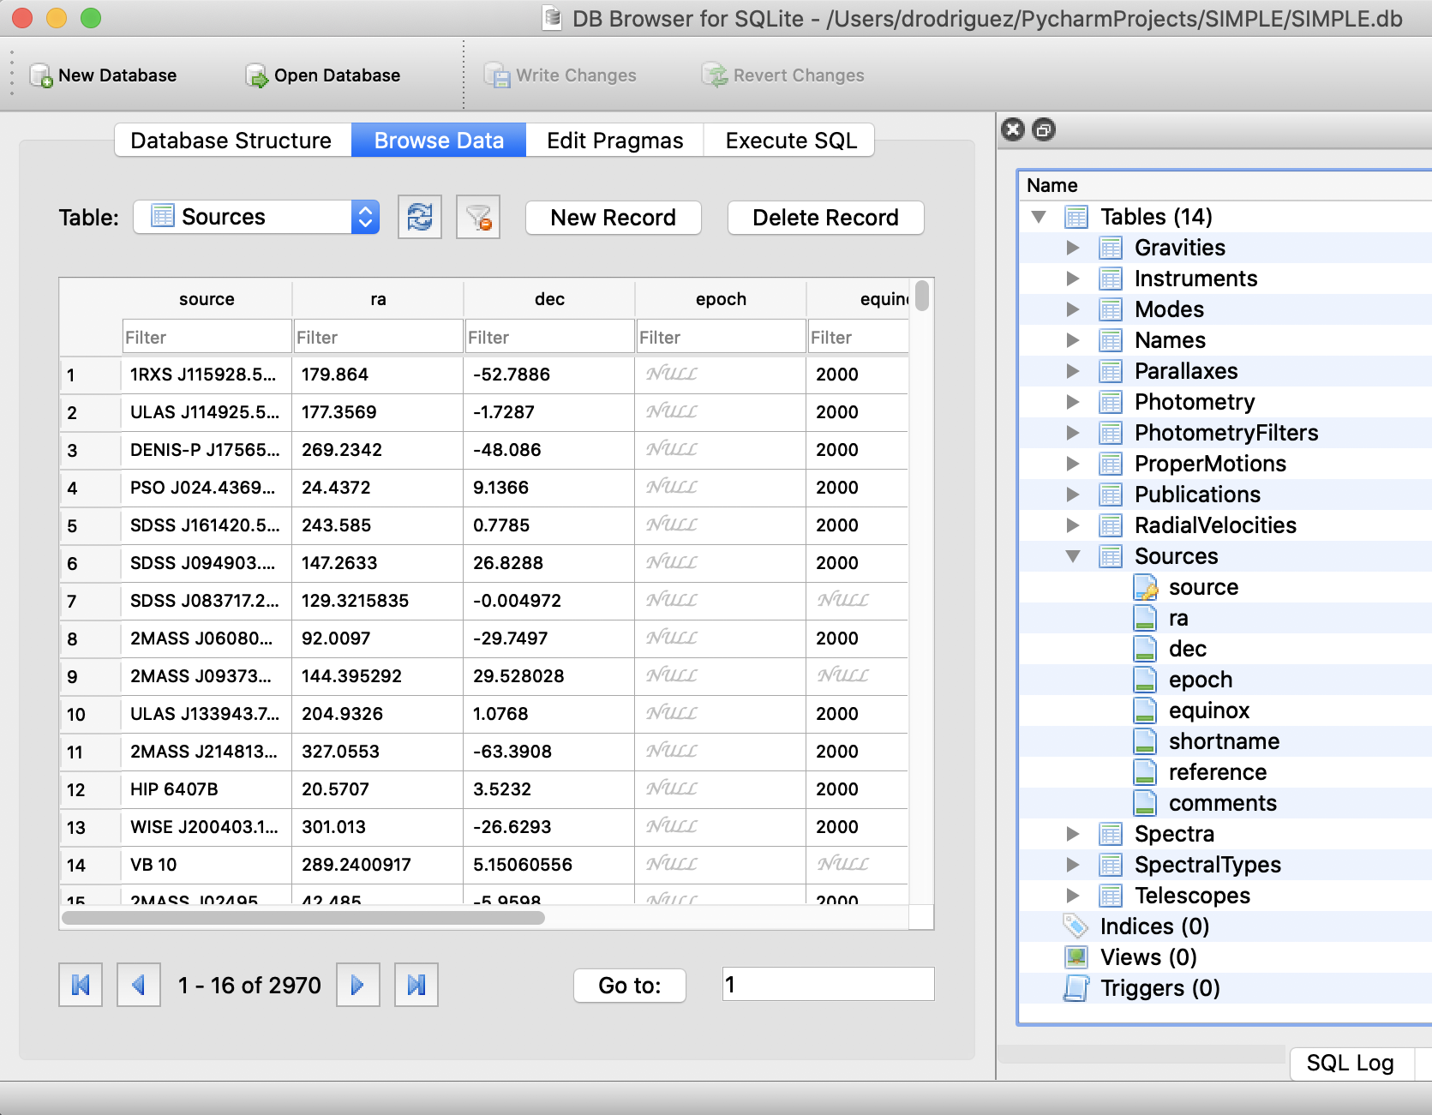
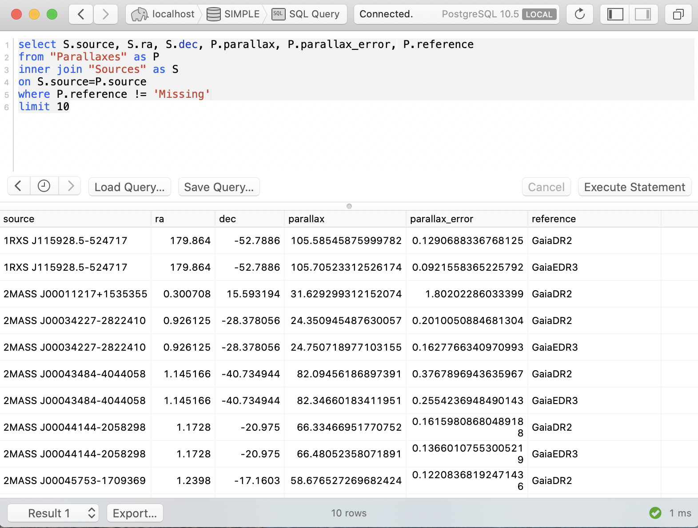
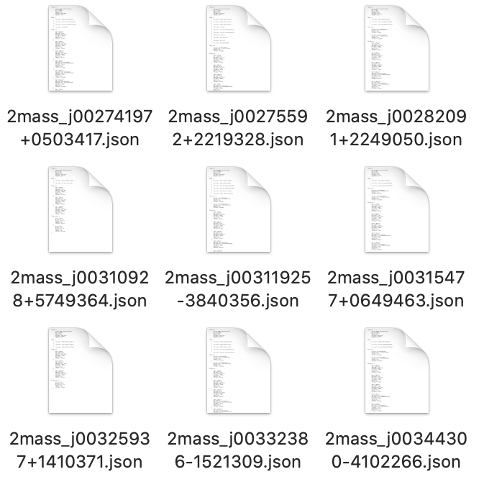
Document store of plain text JSON files
Relational database
Relational database
Document store
astrodbkit2
Examples of handling SIMPLE as a document store, a collection of ASCII JSON files.
Examples of handling SIMPLE as a relational database, using DB Browser for SQLite and

