Slide 1

TITLE : Cyclistic Bike-share Analysis for Targeted Casual-users marketing
Name : Tamojit Roy
Reg. No : 19BCE1156
Guide : Dr. A Sheik Abdullah
Capstone Project (Final Year) – B.Tech CSE [2019-23]

Slide 2

OUTLINE
This research work will mainly revolve around understanding how annual members and casual riders use cyclistic bikes differently. The comparison along with other tasks will later be used to design marketing strategies aimed at converting casual riders to annual members.

Slide 3
IS THE CYCLE INDUSTRY PROFITABLE?
1. It is expected to grow at a robust 5.02 percent CAGR.
2. People all over the world are becoming more and more health-conscious
3. Awareness on cardiovascular fitness, muscle power and flexibility, better-joined mobility, reduced stress levels, increased posture and coordination, bones strengthened and reduced levels of body fat.
4. Increased demand for bicycles across India, driven mostly by congestion, urbanization, and sustainability.
5. The world cycling market, with the demand for traditional and electric cycles as never before, is predicted to be Rs. 4.4 lakh this year's crore.
6. Infrastructure rollout by various governments to support bicycle commuting, shortage of parking space, increasing traffic congestion, and preference for cycles as a relaxing mode of exercise.
7. Impact of COVID-19: Bikes cover short to medium distances due to health safety issues, people in metropolitan areas cycle because owing to the physical differences in standard, they are not able to frequent the gym.
8. Indian bicycles represent a value of 1% from the world market and 15% by volume of the market.

Slide 4


Slide 5
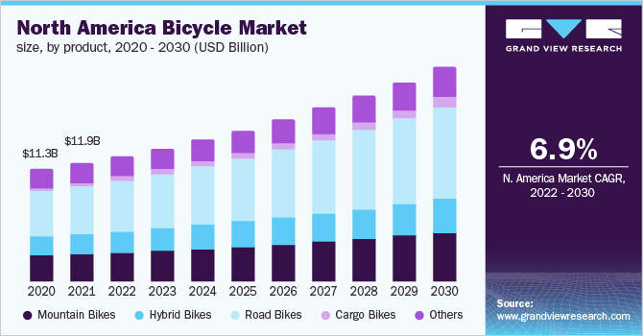

Slide 6
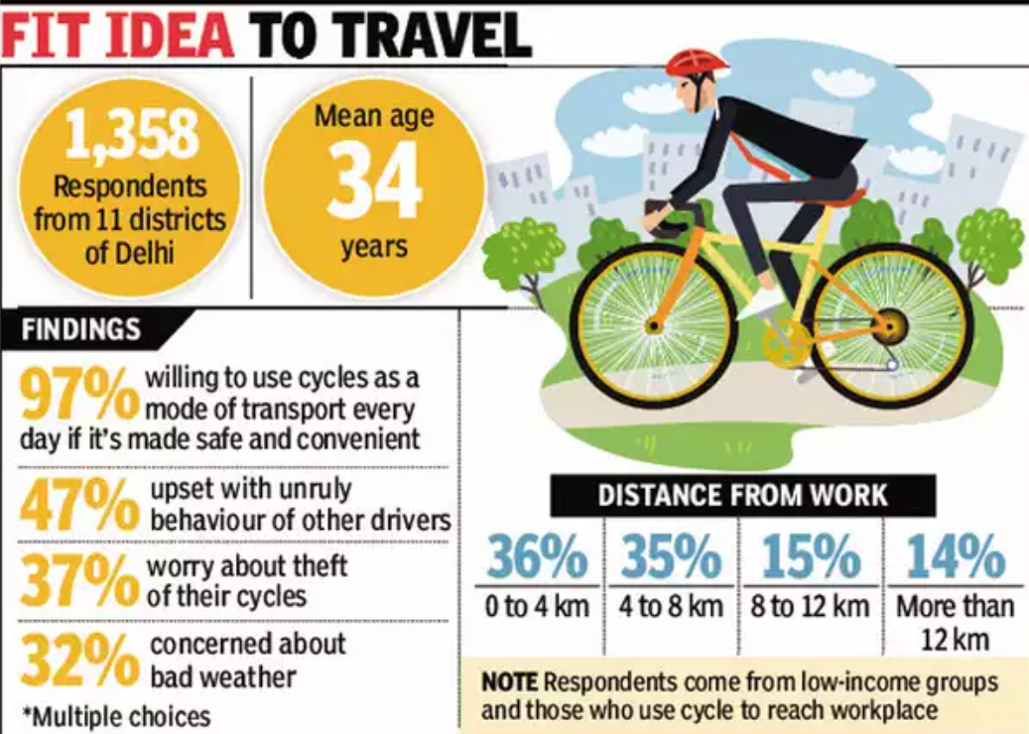

Slide 7
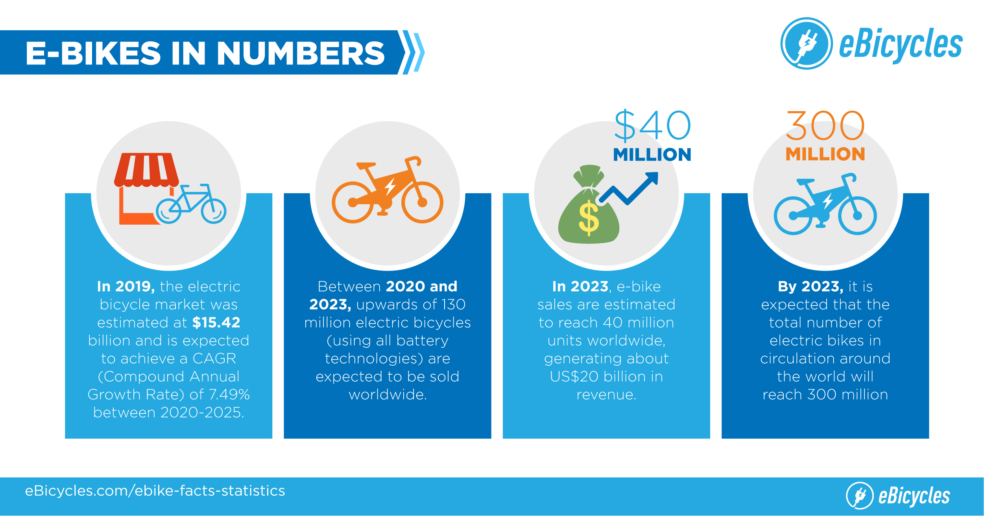

Slide 8
One of the most important days of my life, was when I learned to ride a bicycle.

Slide 9
AREA OF THE PROJECT
Data analytics plays an important role in analyzing and boosting the sales of any company. It has an upper hand when it comes to implementing market plans to target the set of customers who are the most vulnerable by suggesting them various specialized schemes and membership benefits. Hence, it is no doubt one of the most potent tools helpful in boosting the sales of a product. In this research work, I aim to use it to increase the annual membership of cycles for good profits.

Slide 10

BACKGROUND OF THE PROBLEM
Although the age calls for motor-vehicles as the major shareholders of the commute industries, cyclists still continue to have impressive shares in some of the developing heavyweights and developed nations around the world. Some of the countries like Sweden, Denmark, Germany, UK, Japan and even China have a wonderful landscape for cycling. Although some of them are casual riders, quite a many are annual members for the major cycle manufacturing companies all over the world.

Slide 11
PROBLEM STATEMENT
It is no joke that the directors of marketing in these companies believe that the company's future success heavily depends on maximizing the number of annual memberships. Therefore, it is imperative for the teams to understand how casual riders and annual members use Cyclist bikes differently. From these insights, the teams can design a new marketing strategy to convert casual riders into annual members. But first, Cyclist executives must approve the recommendations, so they must be backed up with compelling data insights and professional data visualizations.

Slide 12
QUESTIONS TO ASK
Three questions will guide the future marketing program:
How do annual members and casual riders use Cyclistic bikes differently?
Why would casual riders buy Cyclistic annual memberships?
How can Cyclistic use digital media to influence casual riders to become members?
The goal of this case study is to identify how annual members and casual riders use Cyclistic bikes differently. This comparison along with other tasks will later be used by the marketing department for developing strategies aimed at converting casual riders into members.

Slide 13

STAKEHOLDERS
Primary stakeholders: The director of marketing and Cyclistic executive team.
Secondary stakeholders: Cyclistic marketing analytics team.
Following a step-based approach, the entire project will follow the six-step data analysis process: ask, prepare, process, analyze, share, and act.

Slide 14
BIG CONCEPT
Step-based approach of data crunching will make things simple.

Slide 15
THANKS!
Any questions?
You can find me at tamojit.roy2019@vitstudent.ac.in

