Slide 1

TITLE : Divvy Bike-Share Analysis for Targeted Customer Marketing
Name : Tamojit Roy
Reg. No : 19BCE1156
Guide : Dr. A Sheik Abdullah
Review-3 : Capstone Project (Final Year) – B.Tech CSE [2019-23]

Slide 2
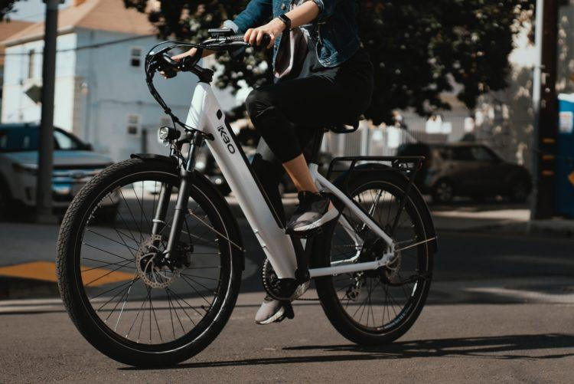
OUTLINE
This research work will mainly revolve around understanding how subscribers and customers of Divvy bike-share service use bikes differently. The comparison along with other tasks will later be used to design marketing strategies aimed at converting customers to subscribers.

Slide 3
I. INTRODUCTION

Slide 4
1. INTRODUCTION
In today's world, a significant lot of people beguiled by their work ethics and cultures need to travel a lot. This poses a serious challenge especially for those who rely on commute services to garner opportunities and those who seek major success in their careers. The competition becomes quite intense in regions with dense but competitive population. Congested spaces pose a murky hindrance to those who are struggling both socially as well as economically, as they have limited options when it comes to choosing commute services. In many cases, they are not aware of various bike-share services which can alleviate their suffering. The bike-share companies, on the other hand are not familiar with the needs of such sections and hence fail to fabricate plans to come up with customer-centric policies and subscriptions for boosting sales and for providing help as well. The first and foremost imperative move is to develop a research work which mainly revolves around understanding how annual members and casual riders use cyclistic bikes differently. The comparison along with other tasks can later be used to design marketing strategies aimed at converting casual riders to annual members.

Slide 5
CONTD.
This research work is focused exactly to address the same problem by taking the instance of Divvy's bike share system. Divvy is a well-known and ubiquitous name and is well reputed to provide bike sharing facilities across Chicago and Evanston. Understanding how subscribers of Divvy bike-sharing trips and the bike-sharing service availing only-customers use the bikes differently for commute purposes, recreational purposes, schooling, marketing, etc. and analyzing the multifarious shadow factors which influence both the user categories in opting for the type of service which they show their inclination towards can prove to be of immense help. This comparison along with other tasks has been used to design marketing strategies aimed towards converting the customers of Divvy bike-sharing trips to the long-term subscribers of the bike-sharing service.

Slide 6
2. PROBLEM STATEMENT
Understanding how subscribers of Divvy bike-sharing trips and the bike-sharing service availing only-customers use the bikes differently for commute purposes, recreational purposes, schooling, marketing, etc. and analyzing the multifarious shadow factors which influence both the user categories in opting for the type of service which they show their inclination towards can be a really challenging task. Figuring this comparison along with other tasks which may later be used to design marketing strategies aimed at converting the customers of Divvy bike-sharing trips to the long-term subscribers of the bike-sharing service is another problem which lacks an efficient way to be addressed.

Slide 7

3. RESEARCH OBJECTIVE
The objective of this research is to extensively analyze and rigorously study every minute behavior of subscribers and customers of the Divvy bike share service in Chicago. Since, in order to understand the two types of users, we should accurately assess and analyze the other composite factors affecting them, it becomes imperative to first of all, dive deep into those shadow-level aspects. Attributes such as trip duration, gender, age, distance between to and from station, locations of the two, etc. are major factors which have a major say in influencing the next-move of the respective types of users of the bike-share system. Having understood precisely these factors, various marketing strategies carved especially towards the user-types can be formed to increase the profits of the company.

Slide 8
4. PROPOSED SYSTEM

Slide 9
4.1 PROPOSED SYSTEM INTRODUCTION
The study is based upon a comprehensive approach which tries to take all possible means for making sense out of data provided. It makes use of multifarious ways of forecasting time-series data. The study is not only limited to forecasting techniques but also aims to display vivid visualizations of the data using popular R libraries, python packages and other external software as well such as Tableau. Not only limited to the schemes mentioned before, this descriptive study targets to formulate schemes, recommendations, plans, personified subscriptions, etc. for the casual users i.e., the customers for converting them into dedicated users i.e. subscribers for boosting sales profits of the bike-share service providing company.

Slide 10
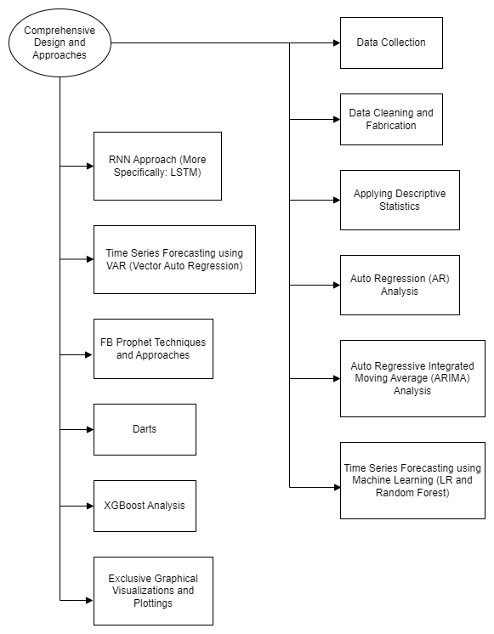
4.2 PROPOSED SYSTEM DIAGRAM

Slide 11
4.3 LIST OF MODULES
Data Collection
Data Cleaning and Fabrication
Applying Descriptive Statistics
Auto Regression (AR) Analysis
Auto Regressive Integrated Moving Average (ARIMA) Analysis
Time Series Forecasting using Machine Learning (LR and Random Forest)
RNN Approach (More Specifically: LSTM)
Time Series Forecasting using VAR (Vector Auto Regression)
FB Prophet Techniques and Approaches
Darts
XGBoost Analysis
Exclusive Graphical Visualizations and Plottings

Slide 12
4.4 EXPLANATION OF ALL MODULES
1. Data Collection and Cleaning:
Process starts with searching for and downloading the dataset of Divvy Trips from the Chicago Data Portal, including it in our workflow if all the constraints comply.
The ROCCC approach is used to determine the credibility of the data.
The coding and data analysis is done predominantly in R and Python.
The first step involves the importing of data, cleaning the data, and sampling the data as we have limited computing power.
For data cleaning we use R Language.
We first loaded all the necessary packages for doing so, followed by sampling.
We added new columns: Date, Year, Month, Day and Day of the Week.
We then checked the data for errors.
We cleaned the column names and checked for duplicate records in rows.

Slide 13
CONTD.
The exporting of the cleaned data to a new file is followed by updating the working directory to the script path.
After that, we started the descriptive analysis, in which saw the average ride time by each day for Subscribers vs Customers.
We sorted the days of the week, analyzed the ridership data by type and weekday, and visualized the number of rides by rider type.
We visualized the average duration of ride by rider type.
2. Descriptive Analysis:
We also performed a number of statistical techniques to know some more insights.
We also trained and tested the data many times.
Each time with a different technique and approach and predicted the outcomes.
Suitable metrics include statistical schemes like MSE, RMSE, etc.

Slide 14
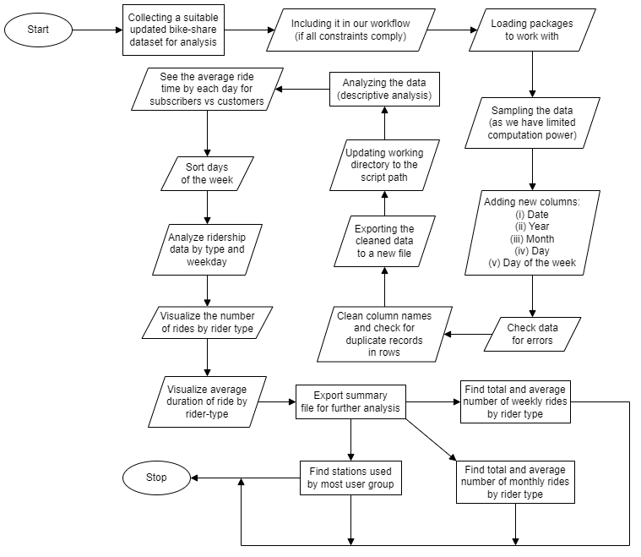
CONTD.

Slide 15
CONTD.
3. Auto Regression (AR) Analysis:
An AR analysis was performed on the dataset.
In AR, we have some inputs and we multiply it with some weights and get the outputs as a continuous value.
In this analysis, we had tried to predict the future trip durations or the trip durations beyond the sample of data which we have actually taken into consideration.
After doing the basic imports we did other things.
We read the previously cleansed dataset and extracted only the necessary parameter.
We then checked our data for stationarity.
After performing the tests, we concluded that the data was stationary.
For the training and testing purpose, we reserved some percentage of the data for training on the model.
After training the model, we checked the parameters of the model and its summary.
After we were done with making the predictions, we plotted the results in graphical format.

Slide 16
CONTD.
4. Auto Regressive Integrated Moving Average (ARIMA) Analysis:
In ARMA, we took into consideration the previous values of our data in addition to the previous errors which becomes our inputs for reaching the output or future values.
The ACF (Auto Correlation Function) and PACF (Partial Auto Correlation Function) have a role to play in ARMA.
The inputs are the past trip durations, each of which came with the start time of the bike share trip.
We imported the modules and read the data.
We ran ADF test.
After performing the test, we concluded that the data was stationary.
After getting the best mode, we splitted the dataset into training and testing.
After we were done with making the predictions, we plotted the results in graphical format.
We calculated the error in our predictions by making use of RMSE value.

Slide 17
CONTD.
5. Time Series Forecasting using Machine Learning (LR and Random Forest):
Two ML models namely Random Forest and Linear Regression were used to make predictions.
We read the data and imported necessary modules.
We created 3 additional columns in our dataset by shifting the values from the original trip_duration column by one row, successively for each of the successive columns.
After a slight data preprocessing, and splitting the dataset into training and testing sets, we fitted the 2 models onto the training data.
We predicted the results by using the test set for both Random Forest and Linear Regression as well and plotted the results in 2 separate graphs, one for each of the models.
To compare the accuracy of the predictions made by the two models, we calculated the MSE for each.
We did the conclusion.

Slide 18
CONTD.
6. RNN Approach (More Specifically: LSTM):
A RNN is a form of ANN that is commonly used to make predictions on data where there normally involves a sequence.
All the important components were imported and read the data.
We hadn't checked for the stationarity in our data, because technically RNN can work with non-stationary data as well and do not require the data to be stationary.
We splitted the dataset into training and testing sets.
We preprocessed the data using a MinMaxScaler for converting the data into a scale of 0 to 1.
We finally created the model after calling the Sequential, Dense and LSTM classes from keras.
We added an LSTM layer with a 100 neurons, and the activation function as the RELU activation function.
We finally compiled the model using the Adam optimizer and MSE as the loss function.

Slide 19
CONTD.
We fitted the model for 50 epochs.
After training the model, we computed the loss for each epoch, and we also plotted it.
We made predictions on the testing set and converted it back into the original scale and performed the Inverse Transform upon the test predictions and appended those predictions to our original test set.
To put a number to see how good the predictions were we used RMSE.

Slide 20
CONTD.
7. Time Series Forecasting using VAR (Vector Auto Regression):
In VAR we assume that there are two time series which have a correlation.
We read the data and imported the important packages.
We plotted the 8 parameters into 8 different graphs.
We checked whether there was any correlation between 2 suitable parameters or columns of the dataset through Granger Causality Test.
To fit the model we used the VARMAX class in which we fed the training data.
For making the forecasts from the point where the training data ends, we specified the number of forecasts as 7600.
We also calculated the mean of all the predictions.
We computed the mean values of each of the time series values and the RMSE for comparing the errors corresponding to each series.

Slide 21
CONTD.
8. FB Prophet Techniques and Approaches:
Prophet is an open-source software released by Facebook's Core Data Science Team.
Prophet uses an additive model to fit the non-linear trends with yearly, weekly and daily seasonality, plus holiday effects.
We imported the necessary packages and the dataset.
We splitted the dataset into training and testing sets and started making predictions.
We made the predictions using the predict function and saved the predictions into the forecast dataframe.
We observed the values like yhat, yhat_lower and yhat_upper, which were actually our values of interest to make the plots.
Then, using the built-in FB Prophet visualizations through the plot_plotly function after feeding the model and the forecasted values we obtained the great visualization.
We got an interactive plot where we had the option to set the plot to display as per 1-week data, 1-month data, 6-months data, 1-year data, and the whole trend as well.

Slide 22
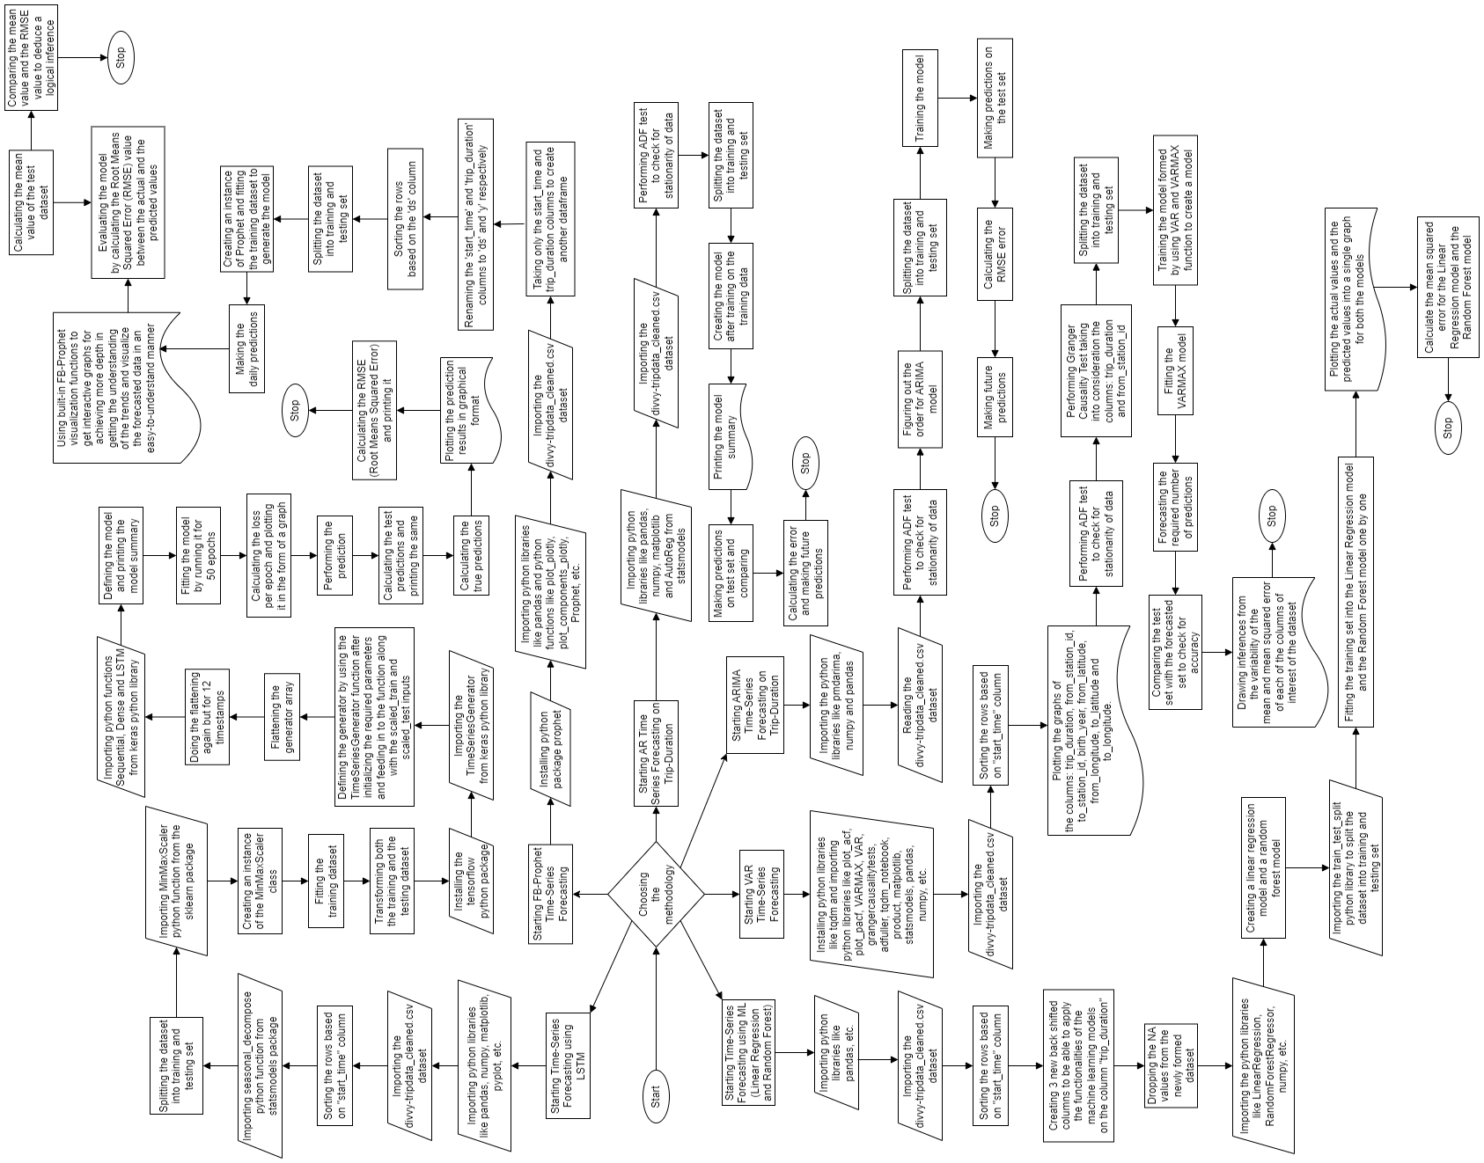
CONTD.
Read this way

Slide 23
CONTD.
9. Darts:
Darts is a very useful python library providing many useful tools to perform many data analytics operations and also time forecasting functionalities.
We installed the darts package.
We imported the modules and read the data.
We splitted the series into training and validation sets and plotted them.
We performed many other operations.
We calculated the MAPE for the combined naive drift and for each of the models: ExponentialSmoothing, Prophet, AutoARIMA, Theta.
We then searched for the best theta parameter, by trying 50 different values.
We calculated the MAPE of the best theta model.
Plotted the combined graph of the best theta model prediction, calculated the MAPE and the MAPE over all historical forecasts and drawing the Industrial error scores histogram.

Slide 24
CONTD.
We plotted the historical forecast theta data with the original data.
We plotted residuals analysis over the best theta model residuals.
We created an instance of the ExponentialSmoothing class named model_es.
We fitted the training data before doing the probabilistic forecast for 500 samples.
We then formed an ensemble model using forecasting models like NaiveSeasonal(6), NaiveSeasonal(12) and NaiveDrift.
We fitted the ensemble model with training data and predicting for 120 values.
We plotted the ensemble forecast graph.
We calculated the MAPE for the ensemble prediction.
We drew the ensemble forecast graph.
We calculated the MAPE for the historical ensemble prediction.

Slide 25
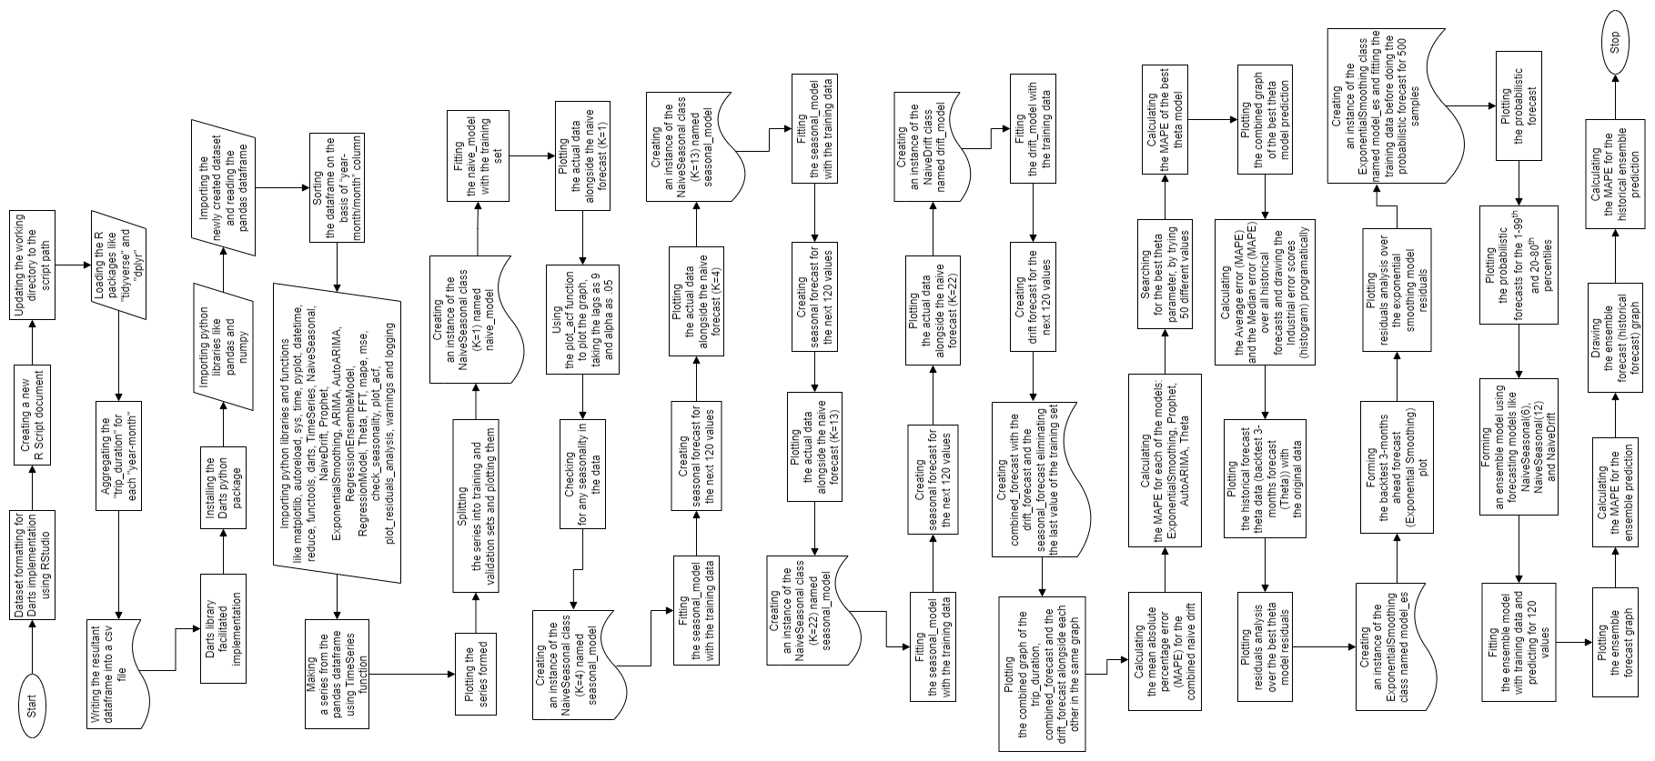
CONTD.
Read this way

Slide 26
CONTD.
10. XGBoost Analysis:
XGBoost is a scalable, distributed gradient-boosted decision tree (GBDT) machine learning library.
We imported the modules and read the data.
We splitting the dataset into training and testing sets with a suitable fragmentation.
We created time series features based on time series index.
We visualized the feature/target relationship, created the model using the XGBoostRegressor function and fitted it.
We plotting the Truth Data and the Prediction for the specific week of data.
Then finally calculated the RMSE score and the error.

Slide 27
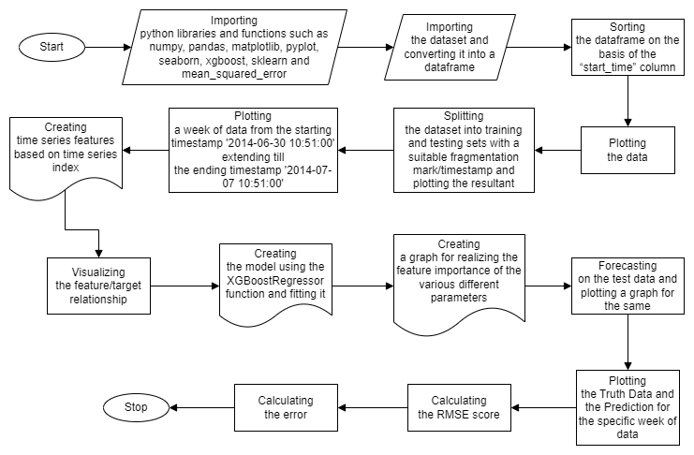
CONTD.

Slide 28
CONTD.
11. Exclusive Graphical Visualizations and Plottings:
Some of the visualizations were achieved with the help of RStudio, whereas some others with basic MS Excel tips and tricks.
Using RStudio and ggplot library, we obtained the graphs for the number of rides taken by each of the category of the service-users for each day of the week for the sampled data.
Another RStudio graph obtained showed the average trip duration of the customers and the subscribers on different days of the week.
We tried to graphically show the most popular bike stations based upon the number of rides associated with each for both the subscribers and the customers separately.

Slide 29
5. IMPLEMENTATION (TILL NOW)
Text goes here.

Slide 30
6. WHAT IS TO BE DONE NEXT

Slide 31
TO BE DONE
1. Devising a new state-of-the-art algorithm to combine all the novel approaches
2. Tableau visualizations
3. Results discretion
4. Recommendation and schemes formulation
5. Conclusion of the entire study

Slide 32
VI. GUIDE APPROVAL MAIL SNAPSHOT

Slide 33
APPROVAL SNAPSHOT

Slide 34
VIII. REFERENCES
[1] Md Doulotuzzaman Xames, Jannatul Shefa, Ferdous Sarwar, "Bicycle industry as a post‑pandemic green recovery driver in an emerging economy: a SWOT analysis", Springer-Verlag GmbH Germany, part of Springer Nature 2022 (Environmental Science and Pollution Research), July 2022.
[2] Weiwei Jiang, "Bike sharing usage prediction with deep learning: a survey", Springer-Verlag London Ltd., part of Springer Nature 2022, Neural Computing and Applications (2022) 34:15369–15385, June 2022.
[3] Suzana Regina Moro, Paulo Augusto Cauchick-Miguel, "An Analysis of a Bike-Sharing System from a Business Model Perspective", Brazilian Journal of Operations & Production Management, Vol. 19, No. 2, e20221400, 2022, ISSN 2237-8960 (Online), June 2022.
[4] Yuanyuan Guo, Linchuan Yang, Yang Chen, "Bike Share Usage and the Built Environment: A Review", Frontiers in Public Health (www.frontiersin.org), Volume 10, Article 848169, February 2022.

Slide 35
[5] Songhua Hu, Mingyang Chen, Yuan Jiang, Wei Sun, Chenfeng Xiong, "Examining factors associated with bike-and-ride (BnR) activities around metro stations in large-scale dockless bikesharing systems", Journal of Transport Geography 98 (2022) 103271, Elsevier Ltd., December 2021.
[6] Hanning Song, Gaofeng Yin, Xihong Wan, Min Guo, Zhancai Xie, Jiafeng Gu, "Increasing Bike-Sharing Users’ Willingness to Pay — A Study of China Based on Perceived Value Theory and Structural Equation Model", Frontiers in Psychology (www.frontiersin.org), Volume 12 | Article 747462, January 2022.
[7] Xiaonan Zhang, Jianjun Wang, Xueqin Long, Weijia Li, "Understanding the intention to use bike-sharing system: A case study in Xi’an, China", PLoS ONE 16(12): e0258790, December 2021.
[8] Puneeth B. R., Nethravathi P. S., "Bicycle Industry in India and its Challenges – A Case Study", International Journal of Case Studies in Business, IT, and Education (IJCSBE), 5(2), 62-74, ISSN: 2581-6942, Vol. 5, No. 2, August 2021.
[9] Vitória Albuquerque, Miguel Sales Dias, Fernando Bacao, "Machine Learning Approaches to Bike-Sharing Systems: A Systematic Literature Review", International Journal of Geo-Information, ISPRS Int. J. Geo-Inf. 2021, 10, 62, February 2021.

Slide 36
[10] Anil Jain, Nirmala Joshi, Anand J Mayee, "Factors motivating buying behavior of female two wheeler users in the district of Palghar", Journal of Management Research and Analysis, October-December, 2020;7(4):154-158, December 2020.
[11] S. Diwakar Raj, Dr. N. Kannan, "Factors Influencing Purchase of Two Wheeler - A Study with Reference to Chennai City", International Journal of Management, 11(12), 2020, pp 2977-2982, ISSN Print: 0976-6502 and ISSN Online: 0976-6510, December 2020.
[12] Gyugeun Yoon, Joseph Y.J. Chow, "Unlimited-ride bike-share pass pricing revenue management for casual riders using only public data", International Journal of Transportation Science and Technology 9 (2020) 159–169, January 2020.
[13] Leonardo Caggiani, Rosalia Camporeale, Branka Dimitrijević, Milorad Vidović, "An approach to modeling bike-sharing systems based on spatial equity concept", AIIT 2nd International Congress on Transport Infrastructure and Systems in a changing world (TIS ROMA 2019), 23rd-24th September 2019, Rome, Italy, Elsevier B.V., 2020.
[14] Mohammed Hamad Almannaa, "Optimizing Bike Sharing Systems: Dynamic Prediction Using Machine Learning and Statistical Techniques and Rebalancing", DOI: 10.13140/RG.2.2.26034.43202, Thesis for: PhD, Advisor: Hesham Rakha, Project: Bike Research, April 2019.

Slide 37
[15] Elisabete Arsenio, Elisabete Arsenio, Sofia Azeredo Lopes, Helena Iglésias Pereira, "Assessing the market potential of electric bicycles and ICT for low carbon school travel: a case study in the Smart City of ÁGUEDA", European Transport Research Review (2018) 10: 13, Springer, January 2018.
[16] Miriam Ricci, "Bike sharing: A review of evidence on impacts and processes of implementation and operation", Research in Transportation Business & Management 15 (2015) 28–38, Elsevier Ltd., April 2015.
[17] Angela Au, "Social Media Strategies Used in Marketing Custom Bicycle Framebuilding Companies", Doctoral Study - Walden University ScholarWorks (Walden Dissertations and Doctoral Studies Collection), November 2015.
[18] Inês Frade, Anabela Ribeiro, "Bicycle sharing systems demand", EWGT2013 – 16th Meeting of the EURO Working Group on Transportation, Procedia - Social and Behavioral Sciences 111 ( 2014 ) 518 – 527, Elsevier Ltd., February 2014.
[19] Darren Buck, Ralph Buehler, Patricia Happ, Bradley Rawls, Payton Chung, Natalie Borecki, "Are Bikeshare Users Different from Regular Cyclists? A First Look at Short-Term Users, Annual Members, and Area Cyclists in the Washington, DC Region", Transportation Research Record Journal of the Transportation Research Board 2387(-1):112-119, DOI: 10.3141/2387-13, December 2013.

Slide 38
[20] Carlos M. Vallez, Mario Castro, David Contreras, "Challenges and Opportunities in Dock-Based Bike-Sharing Rebalancing: A Systematic Review", Sustainability 2021, 13, 1829. https://doi.org/10.3390/su13041829, MDPI, February 2021.

Slide 39
THANKS!
Any questions?
You can find me at tamojit.roy2019@vitstudent.ac.in

