Slide 1
Fake News Detection using Machine Learning Algorithms
Research Paper

Slide 2
Authors
Tamojit Roy (19BCE1156)
Akash Patra (19BCE1743)

Slide 3
Abstract
The recent boom in the number of fake news articles can be attributed to the increasing prejudice and public opinion differences between people around the world and biased media. In addition, the ever-increasing number of media outlets and the influx of information and news articles paves the way for fake news intrusions into untouched facts. Together they lead to the formation of deviant or sometimes biased news. This can be harmful to those who read them and affect them in the wrong way. This can even instigate war and even other inhuman and unwanted crimes which might lead to the destruction and even elimination of the population in good numbers. So this fake news must be detected at all costs and make the common people aware about this. This work proposes a new approach for detecting fake news in datasets using some of the most widely used algorithms of machine learning such as SVM, Logistic Regression, Naïve Bayes. The results obtained by applying feature extraction models, CountVectorizer, and term frequency-inverse document frequency (TFIDF) to measurements such as accuracy, precision, recall, and F1 score are also differentiated. This work demonstrates an easier approach to the fake news detection which is simple to understand and replicate for any researcher who might take an interest to work in this field. This work simplifies the work of the detector by using good feature extraction models CountVectorizer and TFIDF. This work will definitely help any future scholar or researcher to proceed in this domain and work further.

Slide 4
Motivation
Pivotal in curbing the spread of false information
Useful and trustful means to classify true and false news
Ranking improvements
Classification of fake news articles
Comparison of fakeness of ambiguous keywords in articles

Slide 5
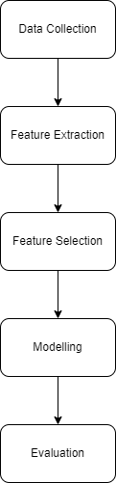
Flow Chart

Slide 6
Proposed Work

Slide 7
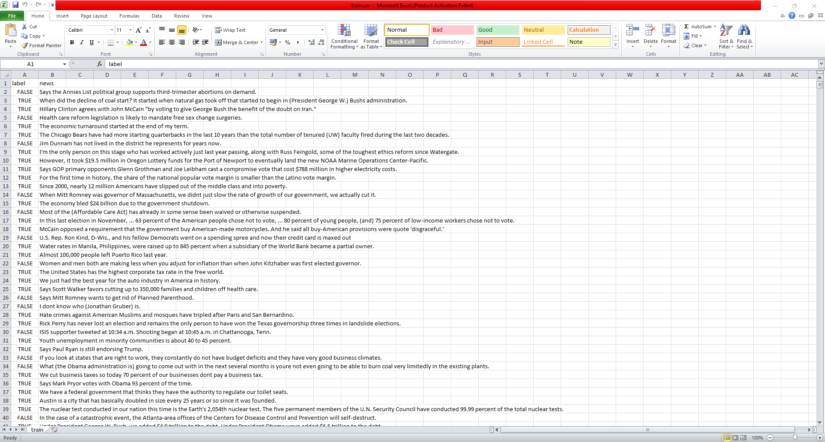
Data Collection
Notes:
William Yang Wang's Liar, Fire Liar Pants. The dataset in this repository is already divided into training sets, validation sets and test sets. The dataset contains 12,836 short statements labeled by truth, subject, context / location, speaker, state, party, and history.

Slide 8
Data Preprocessing
In the proposed system, the 6-label classification problem is transformed into a binary classification problem with labels such as True and False. We converted the label using the following mapping.
pants-fire - False
false - False
barely-true - False
half-true - True
mostly-true - True
true - True
After preprocessing, we got three clean files:
train.csv
valid.csv
test.csv

Slide 9
Feature Extraction
Count Vectorizer
Tfidf Vectorizer
Notes:
To make the machine learning models gain insights from the news headlines, two approaches of feature extraction were used.

Slide 10
Modelling
Logistic Regression
Naïve Bayes
SVM Classifier
Random Forest Classifier
Voting Classifier
Notes:
In this step, we will be using some of the machine learning models for training the model using the feature extracted data. The machine learning models such as Naïve Bayes, Logistic Regression, SVM and Random Forest will be made use of for this purpose.

Slide 11
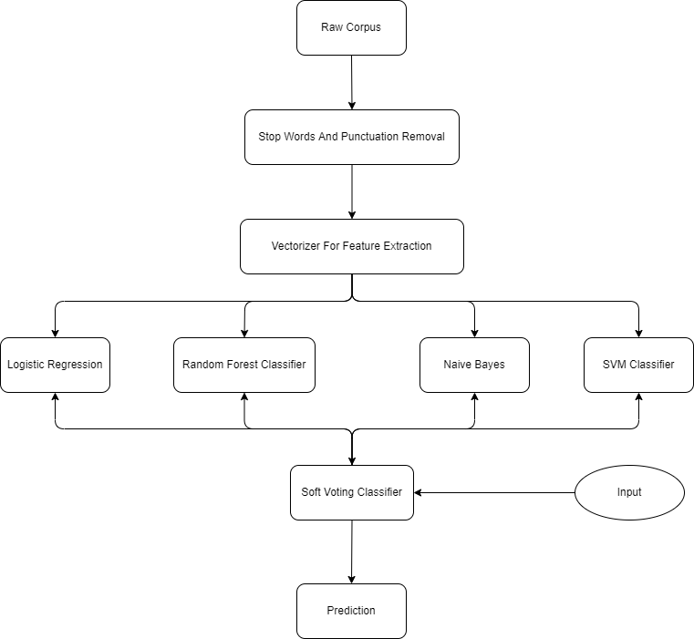
Architecture

Slide 12
Performance Comparison

Slide 13
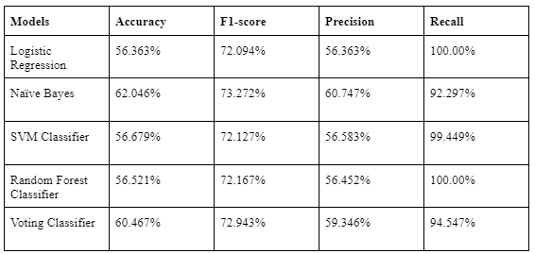
For CountVectorizer

Slide 14
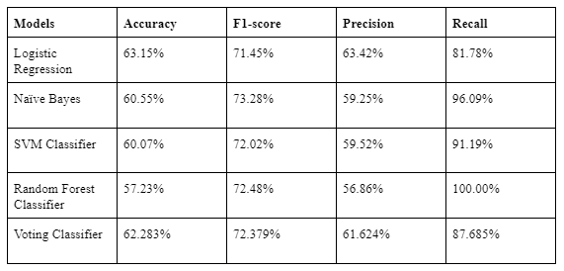
For TfidfVectorizer
Notes:
Therefore, from these results, we can conclude that TfidfVectorizer is superior to CountVectorizer in terms of feature extraction.

Slide 15
Conclusion
Though there are a lot of existing works on fake news detection systems, there is plenty of space for further experimentation. The discovery of new knowledge on the type of fake news will pave a path and open opportunities for new and more accurate models. In this paper, to the best of our knowledge, we have used most of the popular machine learning algorithms and compared them. Moreover, the Count Vectorizer and TFIDF Vectorizer methods for feature extraction provided us with satisfactory results. In this paper, our main aim was to improve the accuracy and other performance metrics to the best of our caliber.

Slide 16
Thank You

