Slide 1
Adult Income Survey Story Telling project
Doosoo Yoon
2022.09.19

Slide 2
Introduction – Adult Income Survey
Data
The 1994 Census bureau database by Ronny Kohavi and Barry Becker
Notable features:
Categorical: Workclass, education, marital
Continuous: Age, hours-per-week
What we expect by exploring some features of dataset:
A person makes over $50K per year or not.
Do education level and/or gender affect the income?

Slide 3
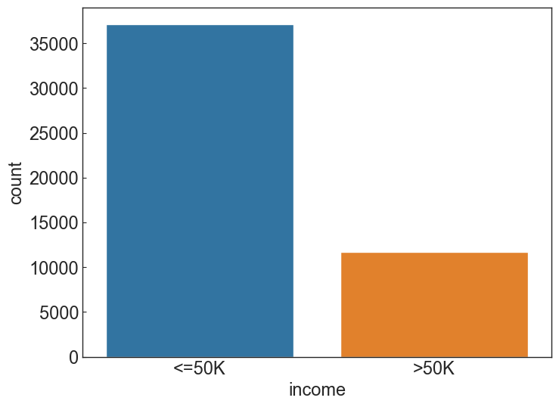
Income Groups
Not balanced dataset:
76% → low income group

Slide 4
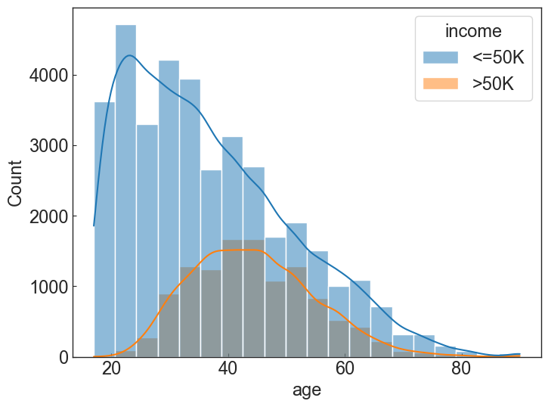
Income distributions w/ Age
“Age” is not symmetric for the low income group
Younger adults are dominant at the low income group.
The peak ”age” in the high income group is about mid-40s.

Slide 5
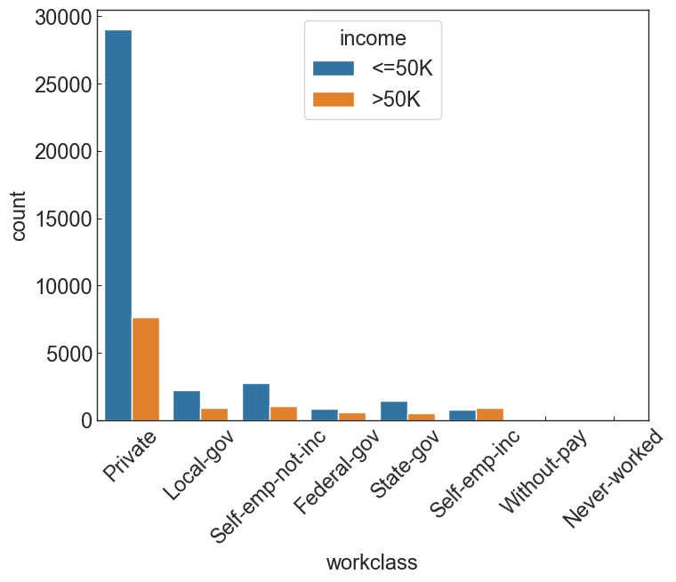
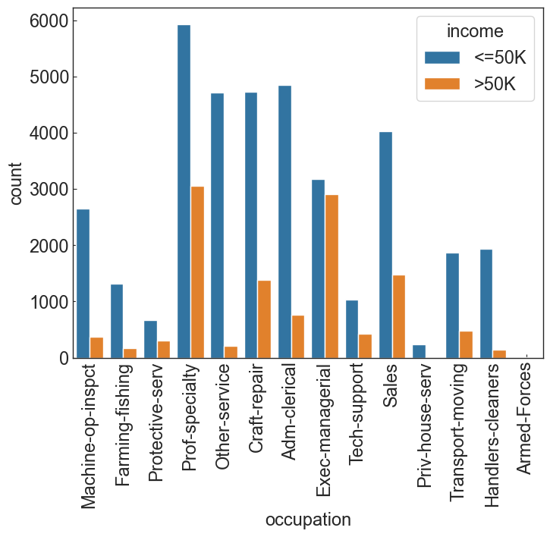
Count of Work-Class and Occupation

Slide 6
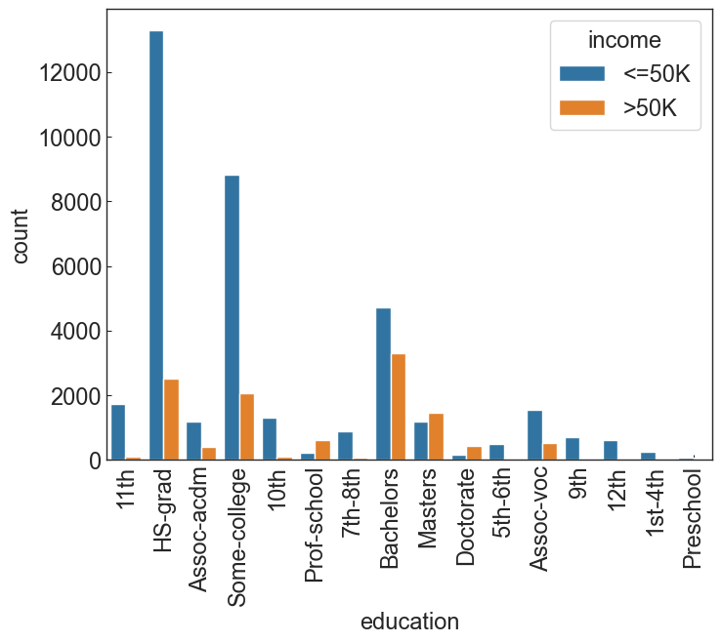
Education for two Income classes
Most low income people fall into the HS-grad.
Higher proportion of the high income group for higher education level (e.g., Bachelors, Masters, Doctorate)
Higher education → Better Earning

Slide 7
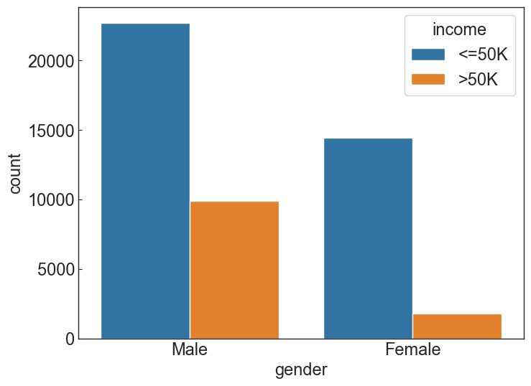
Gender for two income classes
Male: 20% of men earn more than $50K.
Female: only 4% of women earn more than $50K.
Male group has more chance to have high income than female group.

Slide 8
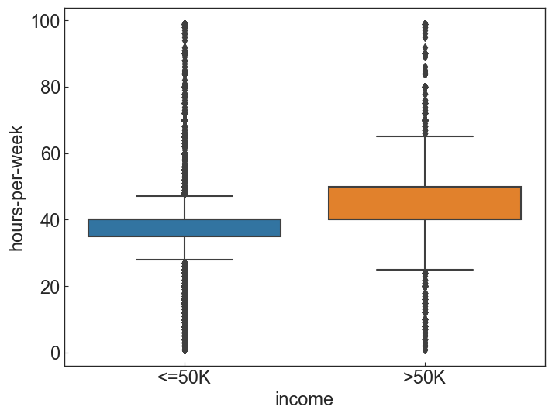
Working Hours
The working hour is more flexible for higher income group (i.e., broader box IQR range.)
More Outliers present in the low income group.

Slide 9
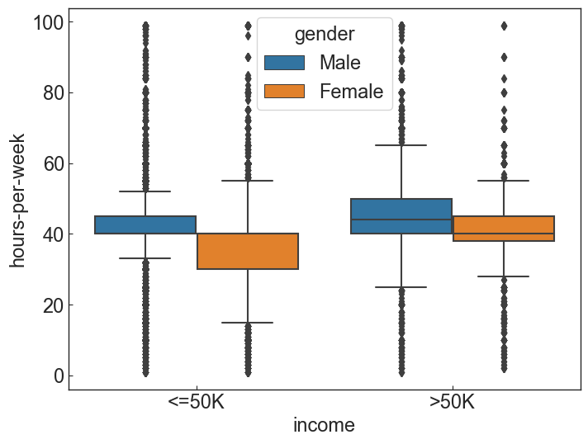
Work-hour flexibility by gender
Females have more flexible working hours in the low income group.
Males have more flexible working hours in the high income group.

Slide 10
Conclusion
What we expect by exploring some features of dataset:
A person makes over $50K per year or not.
Do education level and/or gender affect the income?
Large proportion of people having degree doctorate, prof-school, masters are making salary more than 50K. → Higher education provide better earning chance.
Females are rarely earning more than $50K, compared to males.
Likely it is related to the flexibility of working hours.
Income group who earns >$50k have flexible working hours.
Males are more flexible in working hours in the high income group, but not females.

