Slide 1

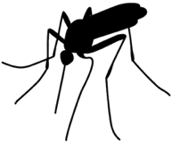
West Nile Virus Prediction
Doosoo Yoon Data Science Team 2022.12.07

Slide 2
Problem Identification
How can the City of Chicago predict an outbreak of West Nile Virus (WNV), which is known to be spread through infected mosquitos, using weather conditions, and thus mitigate its spread next year effectively by controlling the number of mosquitos with spray?
Data:
Main data – WNV test results and the number of trapped mosquitos in Chicago (2007 – 2013)
Spray data – Date and location for spray efforts to kill mosquitos
Weather data – Dataset from NOAA of the weather condition (2007 – 2014)

Slide 3
Problem Identification
How can the City of Chicago predict an outbreak of West Nile Virus (WNV), which is known to be spread through infected mosquitos, using weather conditions, and thus mitigate its spread next year effectively by controlling the number of mosquitos with spray?
Data:
Main data – WNV test results and the number of trapped mosquitos in Chicago (2007 – 2013)
Spray data – Date and location for spray efforts to kill mosquitos
Weather data – Dataset from NOAA of the weather condition (2007 – 2014)

Slide 4
Recommendation
The data shows that
the virus actively prevailed on August in the City of Chicago.
→ Careful tracking of mosquito number is demanded during the summer.
spray works in reducing the number of mosquitos and the presence the virus.
Given the weather dataset, we evaluate 5 different models and find that
the Random Forest model is the best one for this project.
wet and warm air are critical condition for the spread of the virus.
We suggest that the City of Chicago utilize our best model to predict the prevalence of the virus from the weather condition and plan the strategic spray to prevent from the virus spread effectively.

Slide 5
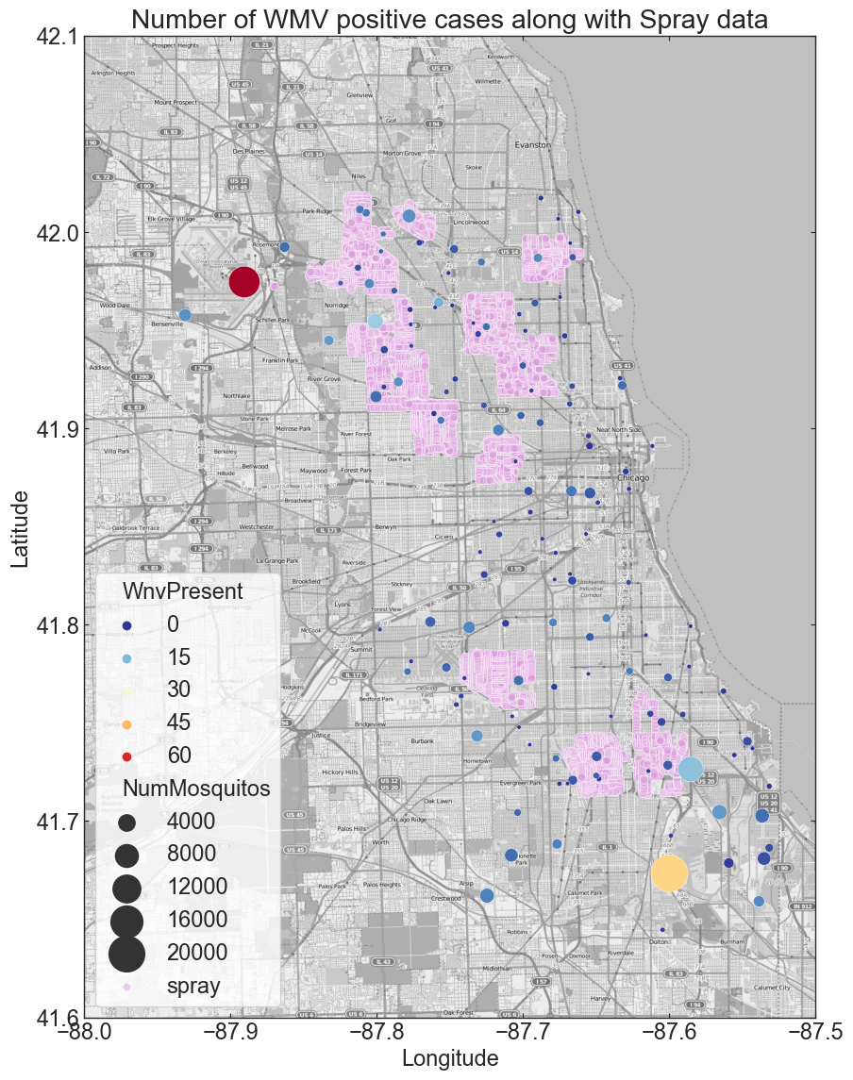
Outbreak of WNV
Mosquitos dwell broadly in the city of Chicago.
The largest WNV-positive case occurs at the place where the cumulative number of mosquitos is largest.
Spray is effective to mosquito control.

Slide 6
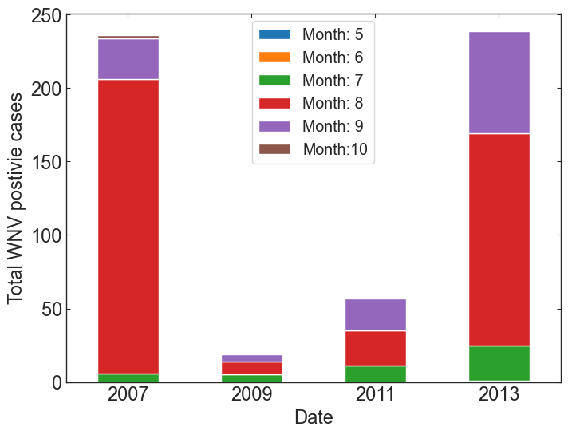
Outbreak of WNV
Mosquitos dwell broadly in the city of Chicago.
The largest WNV-positive case occurs at the place where the cumulative number of mosquitos is largest.
Spray is effective to mosquito control.

Slide 7
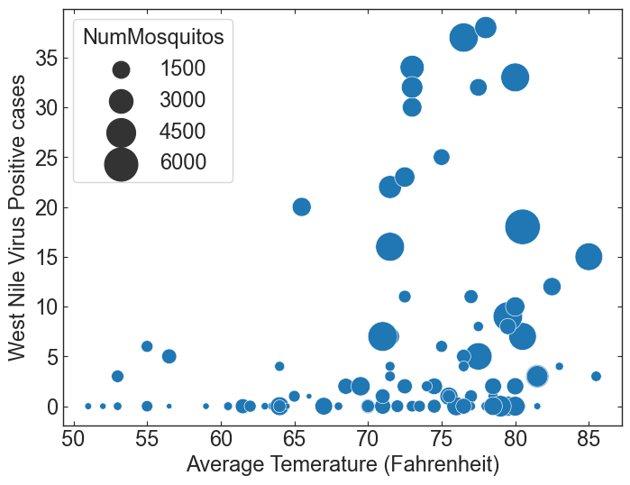
Temperature vs. Mosquitos & WNV
Average Temperature: 70 ~ 80 degrees → more mosquitos → more WNV

Slide 8
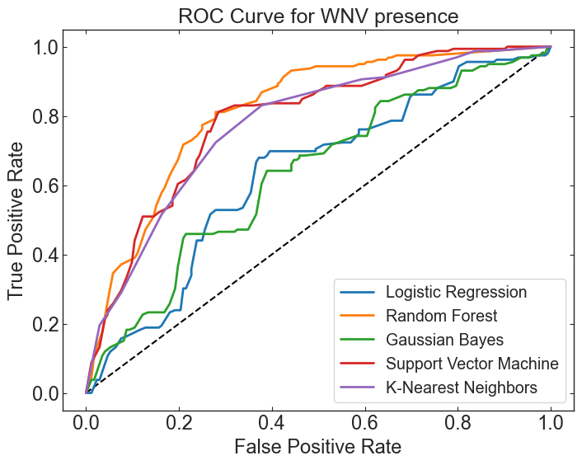
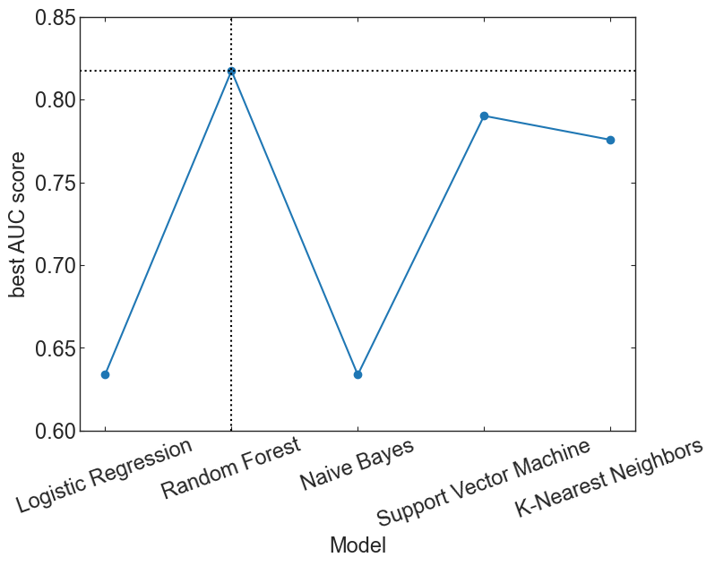
Modeling Result
Best model: Random Forest (AUC score: 0.82)

Slide 9
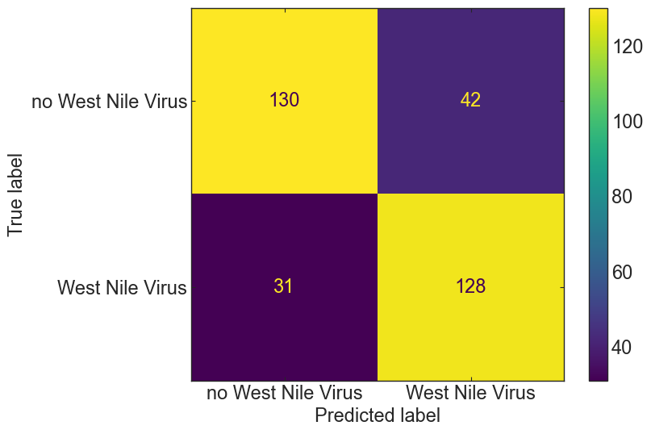
Modeling Result
Best model: Random Forest (AUC score: 0.82)

Slide 10
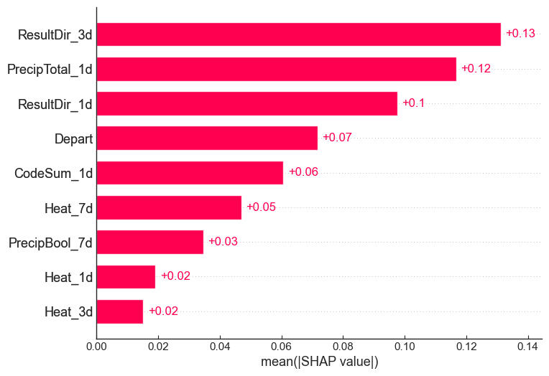
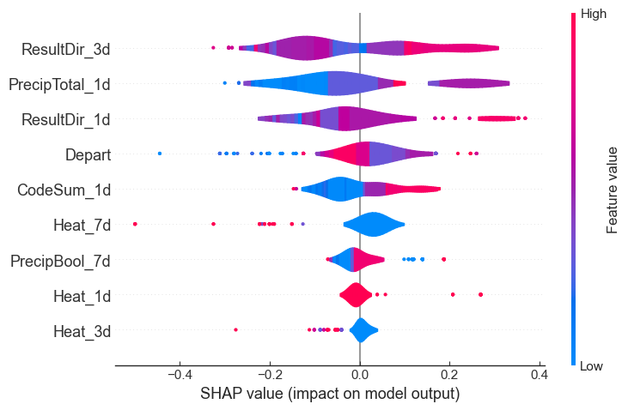
Importance of Features
Wind direction and precipitation factors contribute significantly to the prediction of WNV.

Slide 11
Take away
Spray works in reducing the number of mosquitos and the presence the virus.
When does the city of Chicago apply the spray to minimize the outbreak of the virus?
To help the city predict the presence of WNV from the weather condition, we benchmark 5 different models, in which
the Random Forest model is the best one for this project.
wet and warm air are critical condition for the spread of the virus.
We suggest that the City of Chicago utilize our best model to predict the prevalence of the virus from the weather condition and plan the strategic spray to prevent from the virus spread effectively.

Slide 12
Thank you !

