Slide 1

Web Traffic Time Series Forecasting
Doosoo Yoon Data Science Team 2023.01.15

Slide 2
Problem Identification
How can the internet servers, such as Google, Facebook, and Yahoo, improve their capability in handling traffic control by means of time series analysis, forecasting an accurate prediction of future views for the next 60 days?
Data:
Main data – train.csv
145k rows each of which represents a different Wikipedia page
804 columns: article title + daily traffic on the particular Wikipedia page from
2015-07-01 to 2017-09-10
Page title: language / type of access / agent

Slide 3
Problem Identification
How can the internet servers, such as Google, Facebook, and Yahoo, improve their capability in handling traffic control by means of time series analysis, forecasting an accurate prediction of future views for the next 60 days?
Data:
Main data – train.csv
145k rows each of which represents a different Wikipedia page
804 columns: article title + daily traffic on the particular Wikipedia page from
2015-07-01 to 2017-09-10
Page title: language / type of access / agent

Slide 4
Recommendation
The data shows that
the number of pages written in English is the largest
although the mobile-web-accessible pages are slightly more than the desktop-accessible pages, the daily traffic for the desktop-accessible pages are still popular.
the daily traffic of English wiki pages is an order of magnitude busier than that of any other pages.
We performed three different models for forecasting the future web traffic:
SARIMA, Prophet by Facebook, LSTM (← best performance)
We suggest that the internet servers make use of our best model, LSTM, to predict the traffic of web pages to avoid any mishaps such as server shutdown or slowdown.

Slide 5
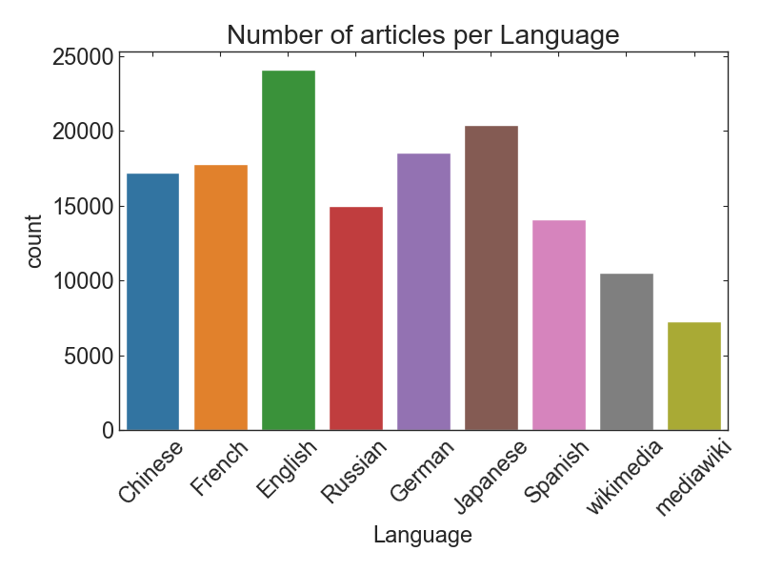
Number of Articles per language
English Wiki pages are dominant.
The number of Spanish Wiki pages is the smallest although Spanish is one of the most spoken languages.

Slide 6
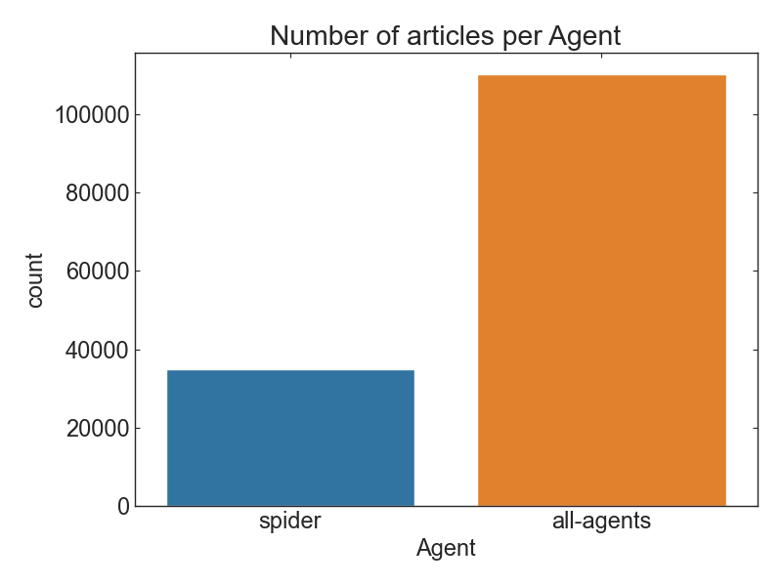
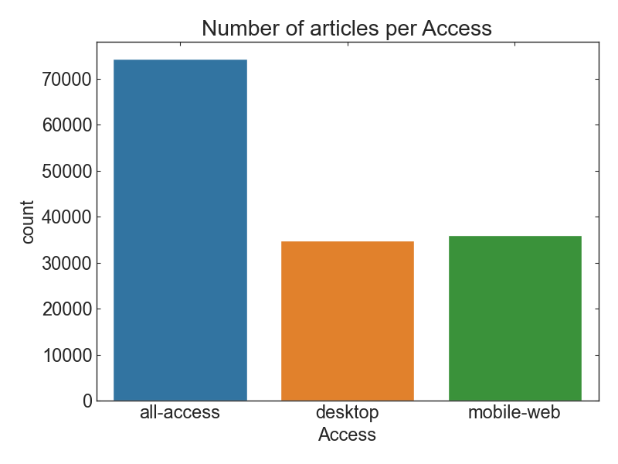
Number of Articles per Agent/Access
Non-spider pages are more than spider counterparts.
The number of Mobile-web-accessible pages is slightly more than desktop-accessible pages.

Slide 7
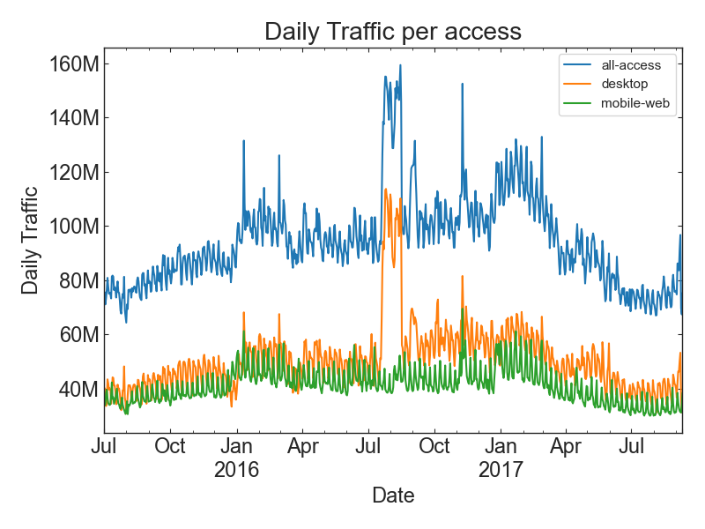
Number of Articles per Agent/Access
Non-spider pages are more than spider counterparts.
The number of Mobile-web-accessible pages is slightly more than desktop-accessible pages.
→ However, desktop-access has still more traffic than mobile-access.

Slide 8
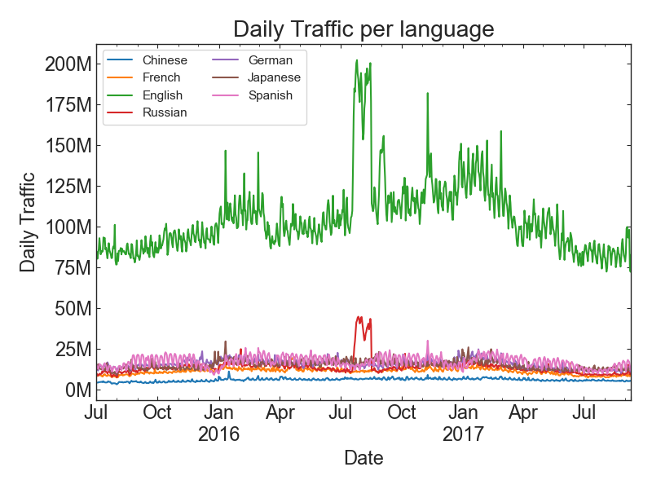
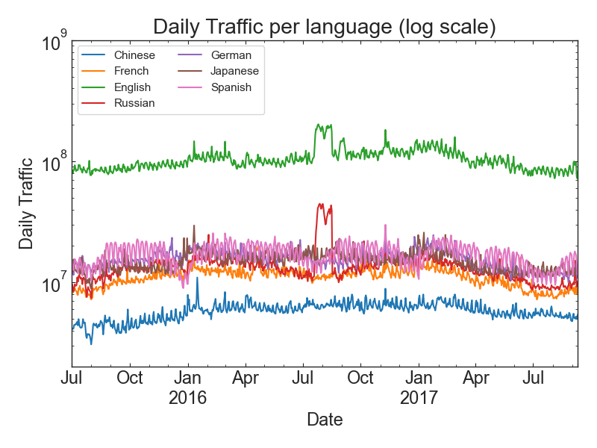
Daily Traffic per language
The average daily traffic of English Wiki pages are an order of magnitude busier than any other pages.
Similar pattern between English and Russian pages
Spanish pages have relatively high traffic although it has small number of articles.

Slide 9
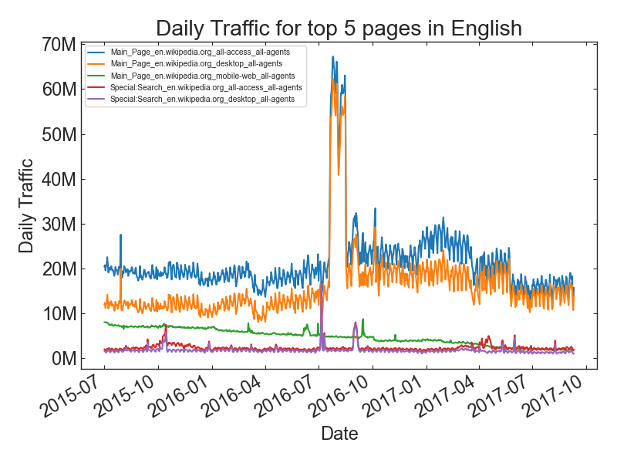
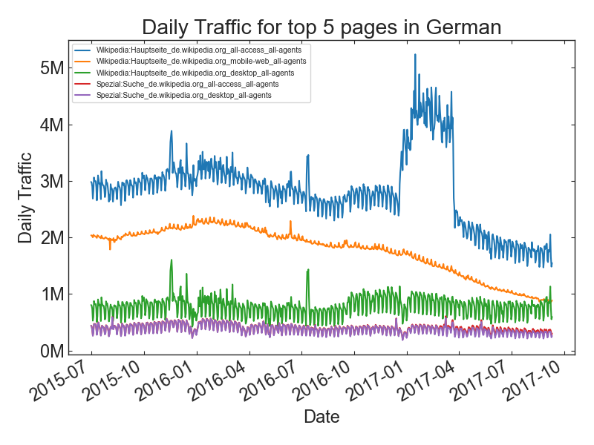
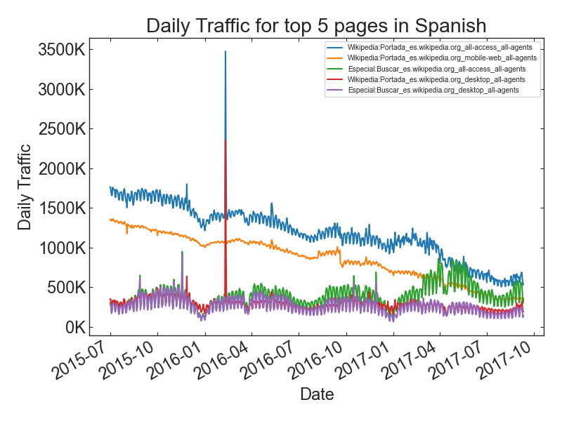
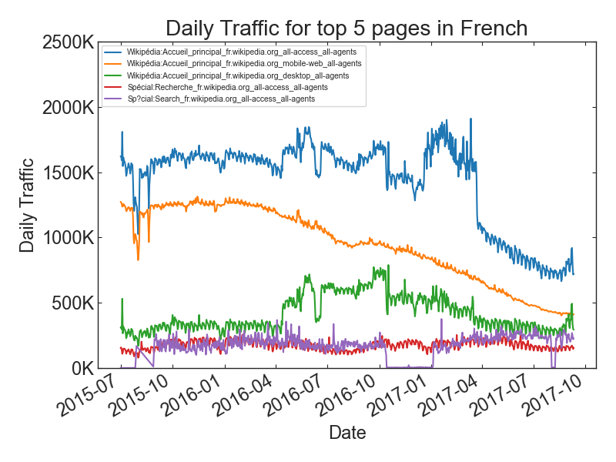
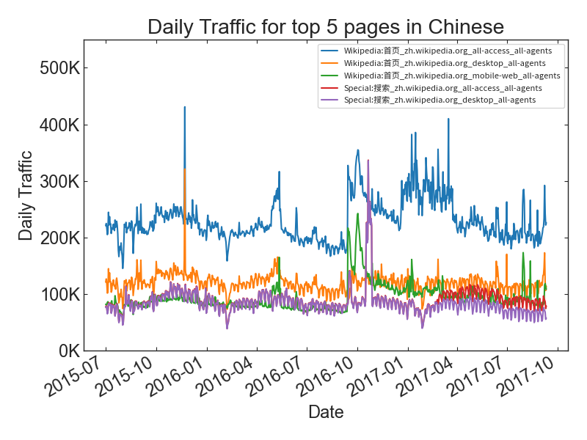
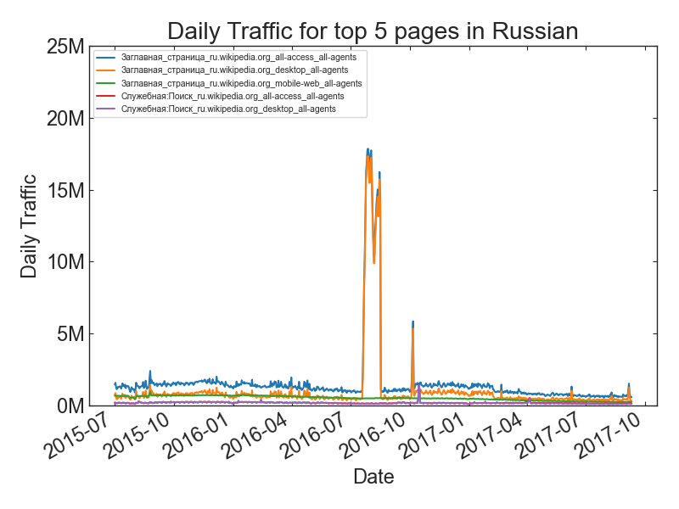
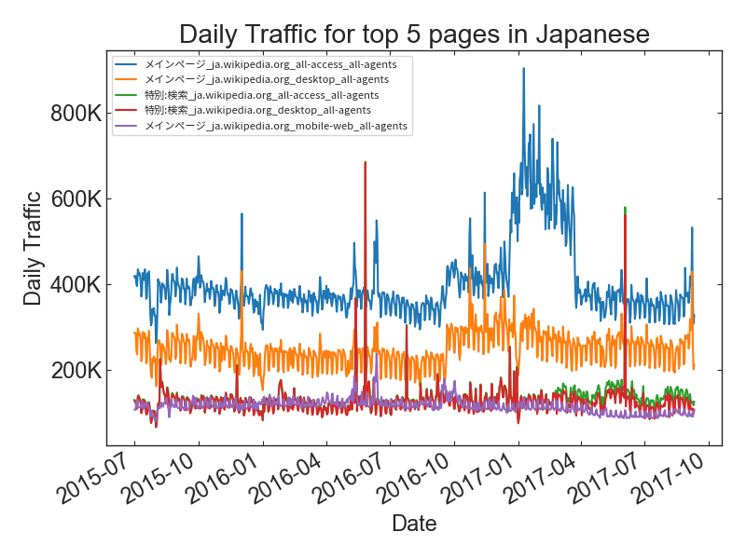
Top 5 popular pages per language

Slide 10
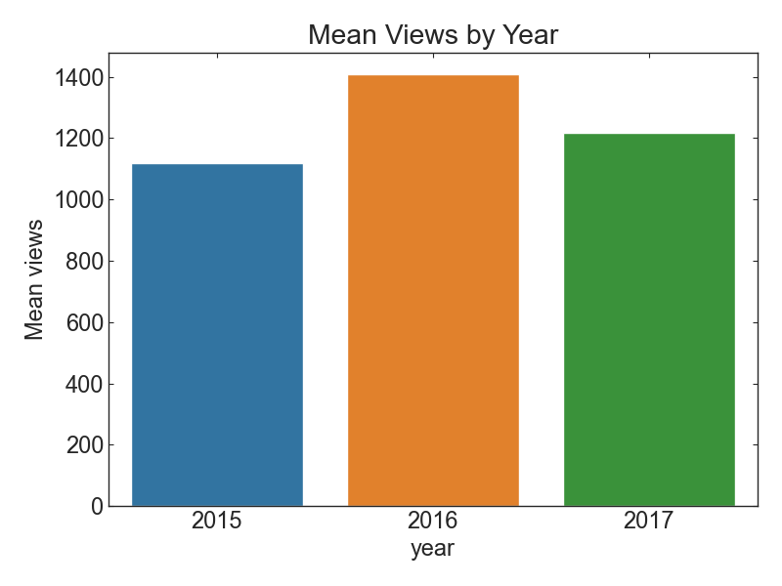
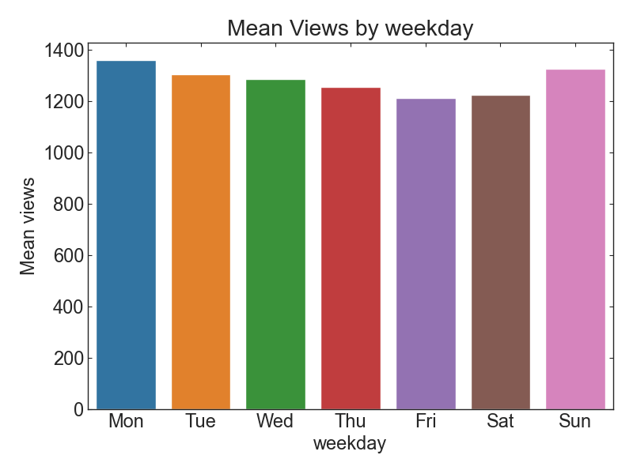
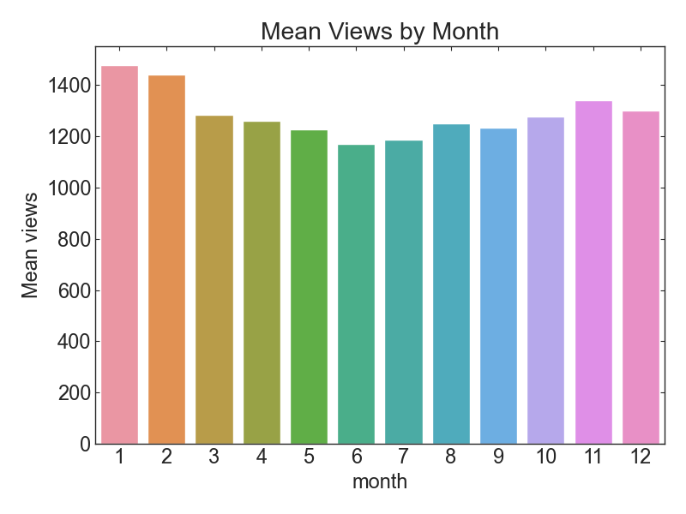
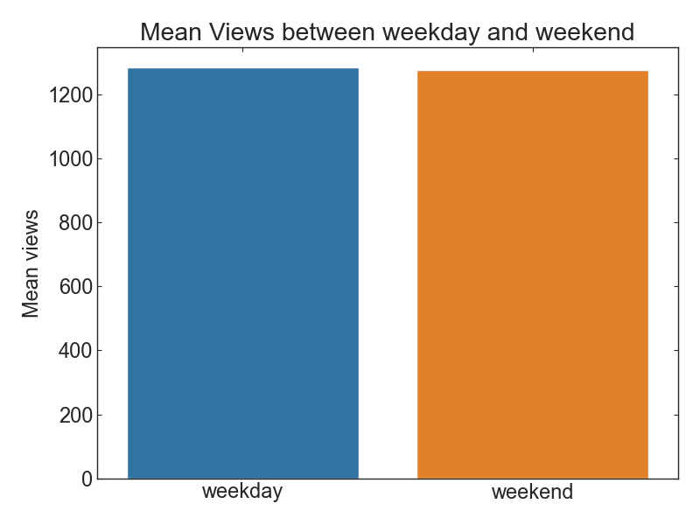
Average Views

Slide 11
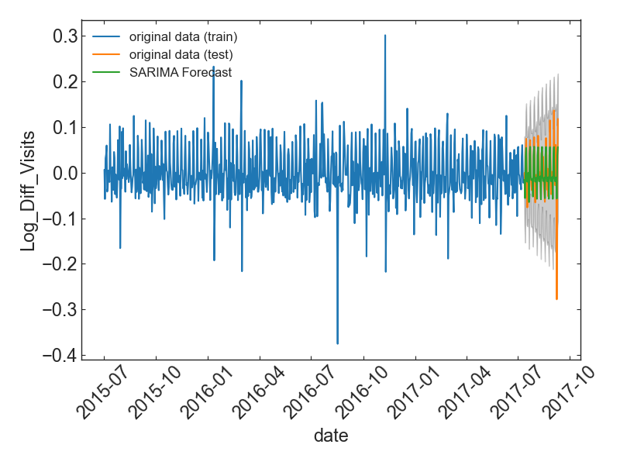
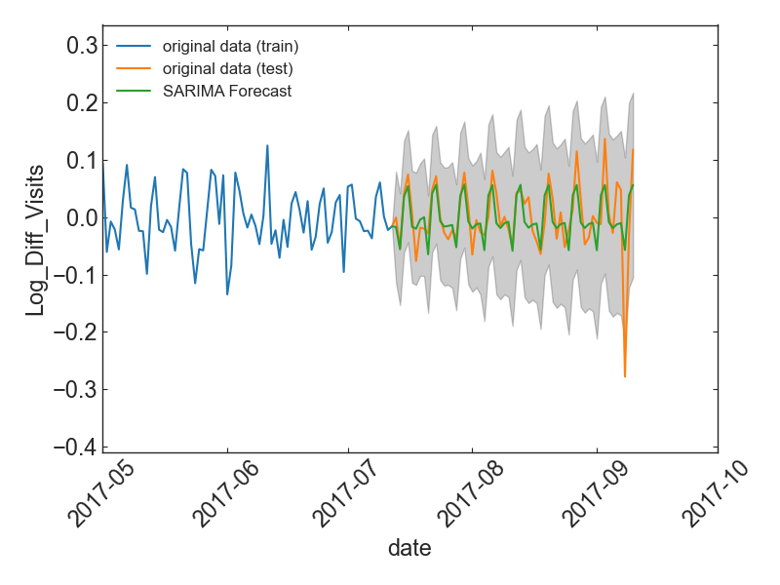
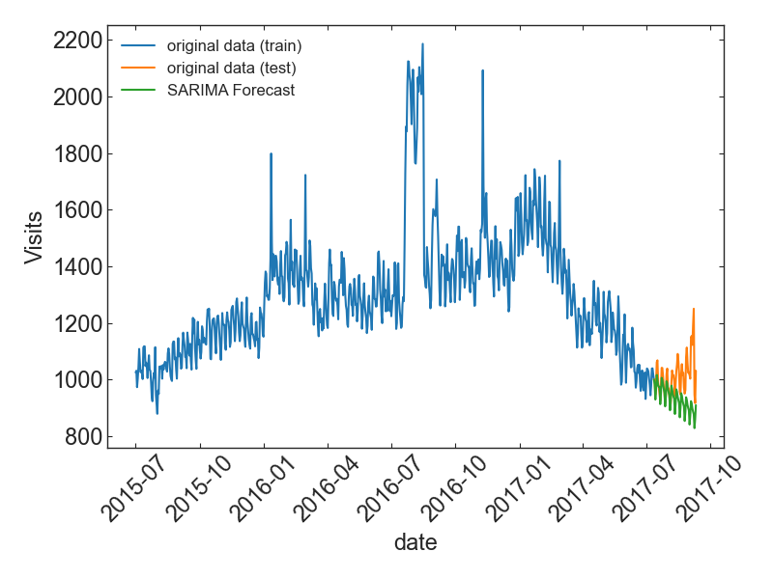
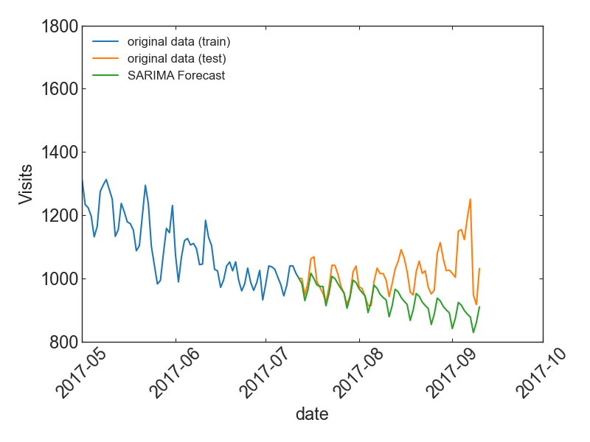
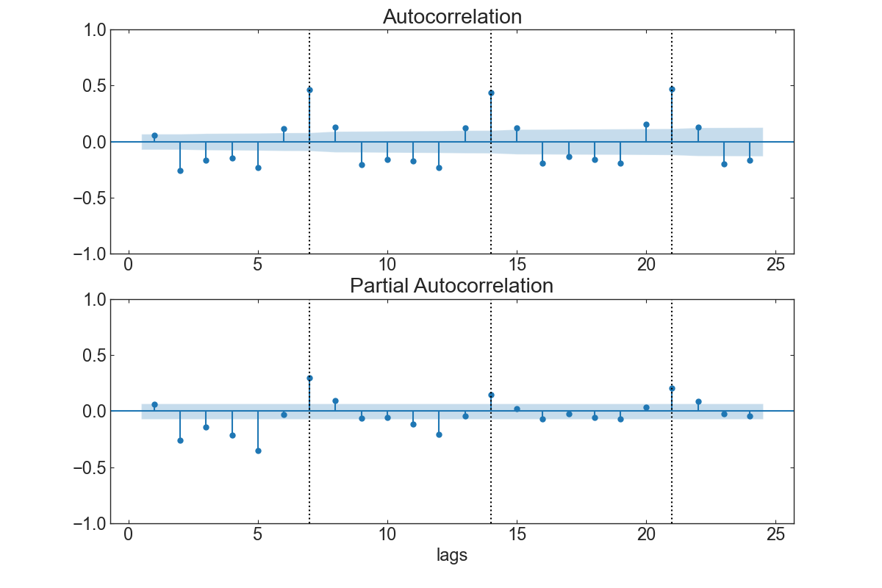
Model: SARIMA
Strong week seasonality (m=7)
Stationarity test → Log & Difference

Slide 12
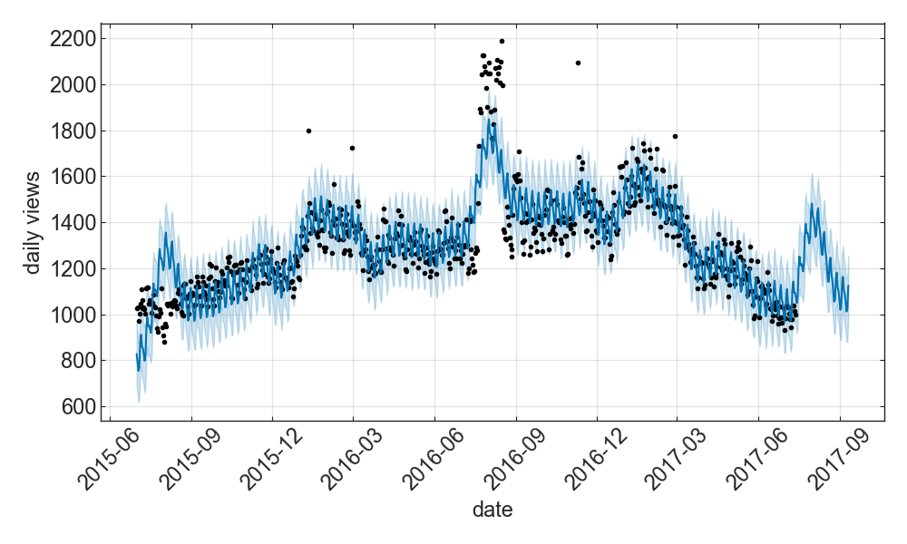
Model: Prophet
Prophet automatically detects abrupt changes in the trajectories of time series.
Unexpected bump is predicted in August 2017.

Slide 13
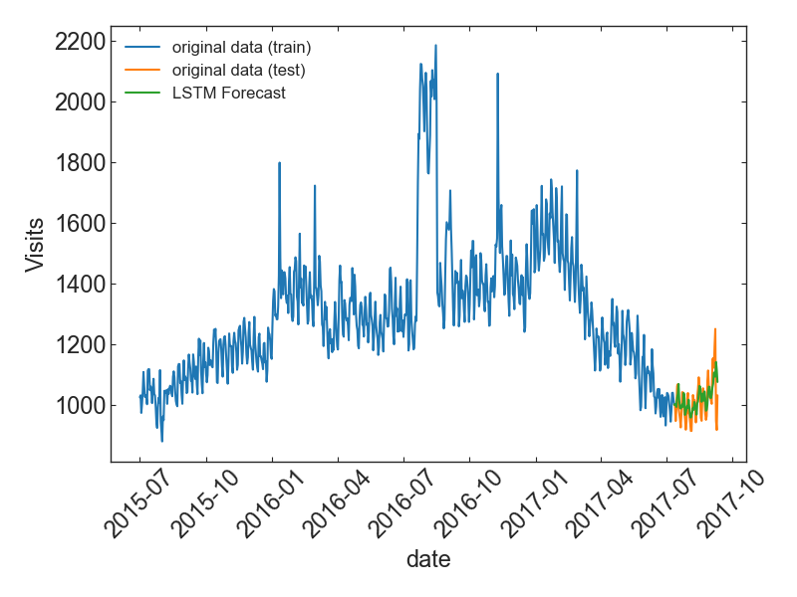
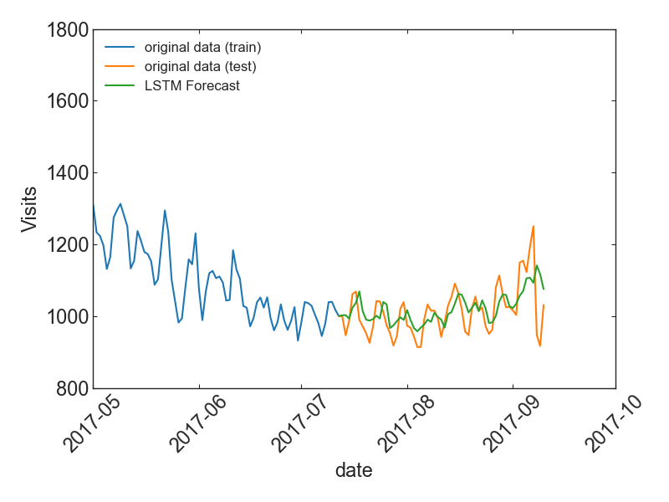
Model: LSTM
Long Short-Term Memory (LSTM): Feedback connections by a recurrent neural network.
Look back = 10 days

Slide 14
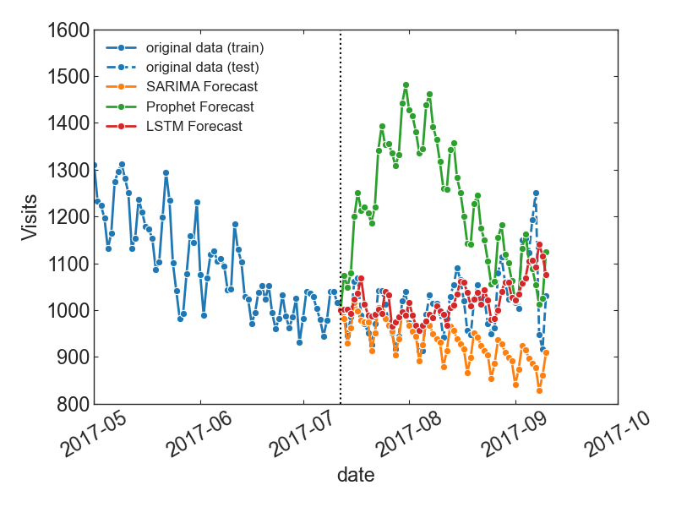
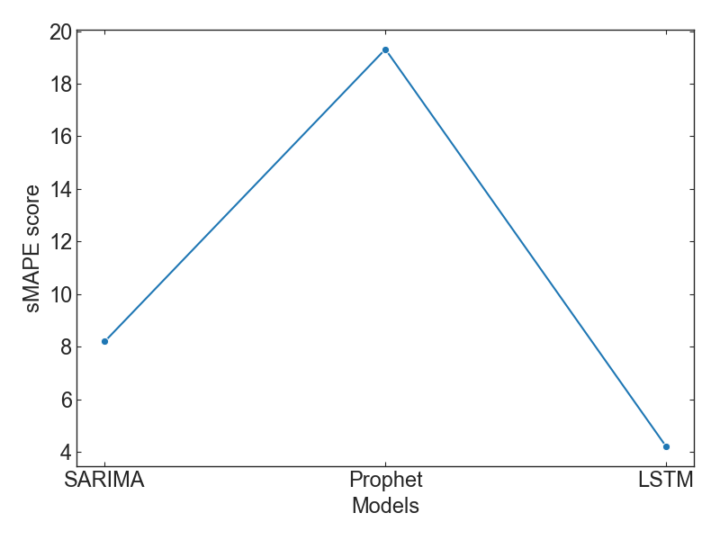
Model Comparison
Best Model: LSTM (smallest sMAPE error)

Slide 15
Take away
The data shows that
English Wikipedia pages are the largest for both number of articles and the average daily traffic.
although the mobile-web-accessible pages are slightly more than the desktop-accessible pages, the daily traffic for the desktop-accessible pages are still popular.
the total average traffic has a strong week seasonality.
Three different models for forecasting the future web traffic:
SARIMA, Prophet by Facebook, LSTM (← best performance)
We suggest that the internet servers make use of our best model, LSTM, to predict the traffic of web pages to avoid any mishaps such as server shutdown or slowdown.

Slide 16
Thank you !

