Slide 1
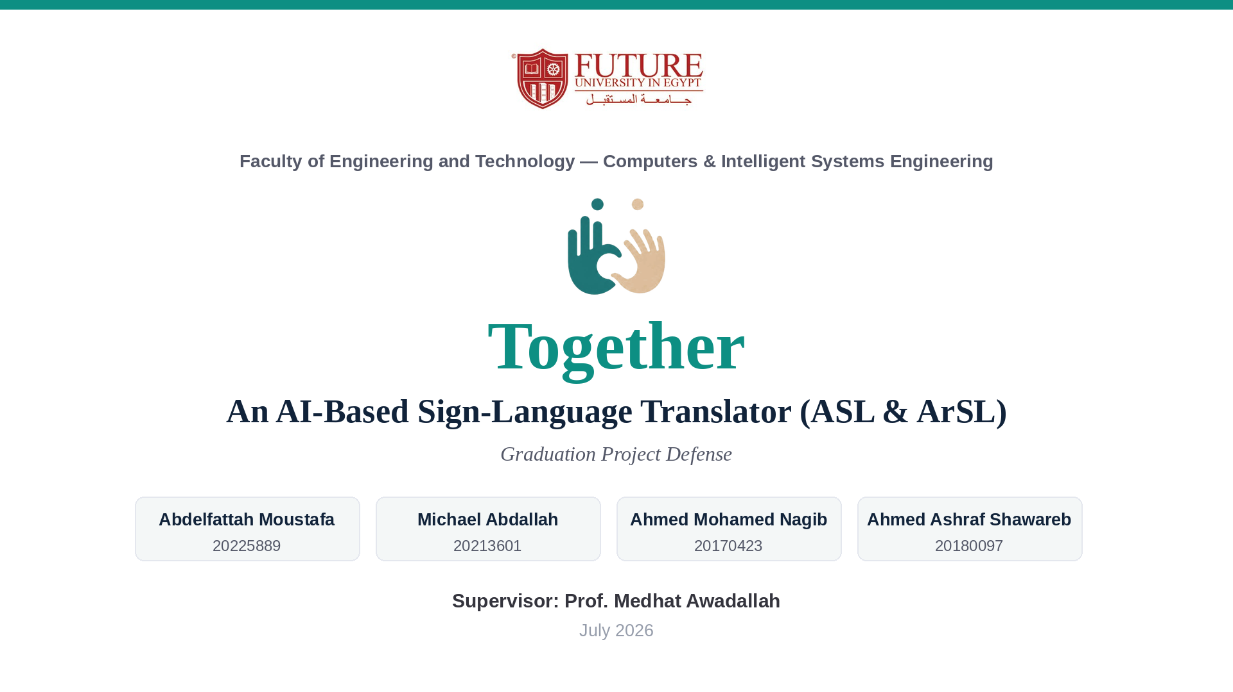
Notes:
[Speaker 1 — 40s] Good morning. We are the Together team, and this is our graduation project: an AI-based sign-language translator for American and Arabic Sign Language. Over the next thirty minutes the four of us will walk you through the problem, the two recognition models we trained, the full web platform we built, and the evaluation — and then we will show you the system running live.

Slide 2
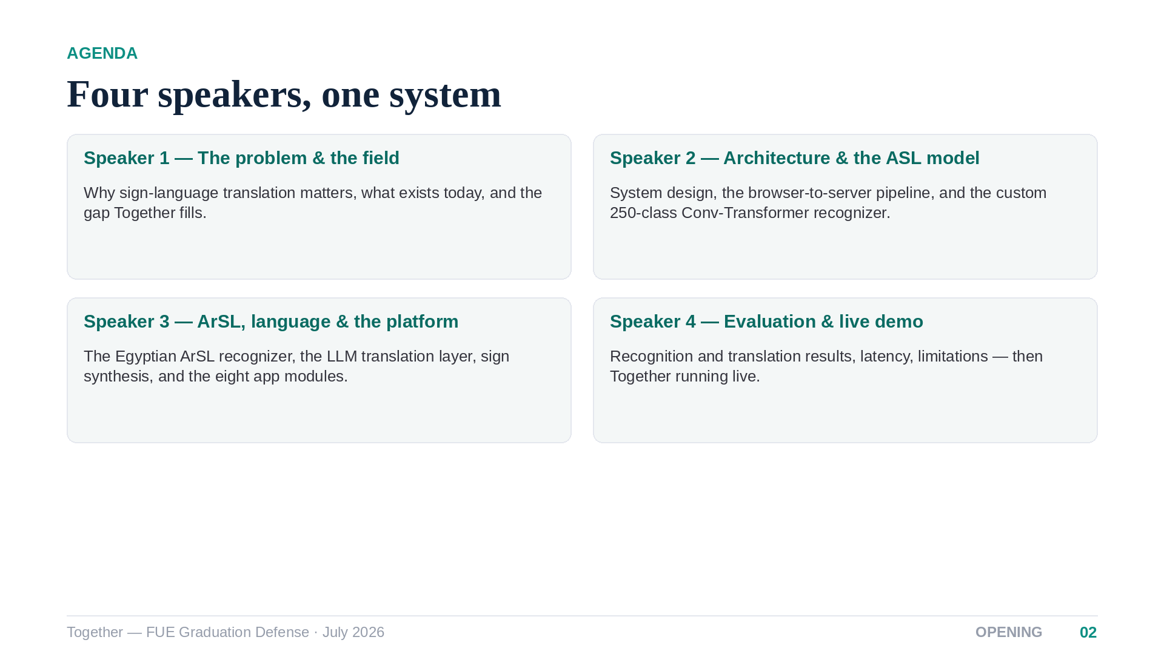
Notes:
[Speaker 1 — 30s] A quick roadmap. I will open with the problem and the research landscape. My colleagues then cover the system architecture and the ASL model, the Arabic model and the application itself, and finally the full evaluation. We close with a live demonstration and your questions.

Slide 3
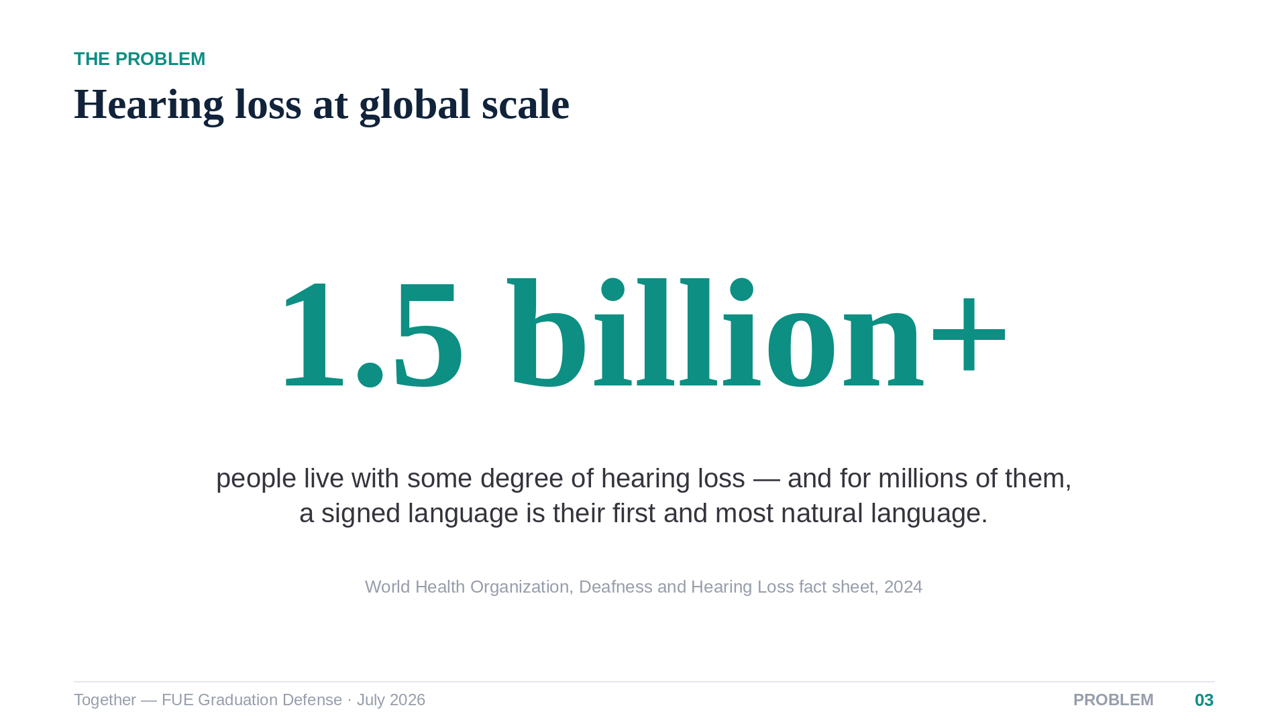
Notes:
[Speaker 1 — 40s] The scale of this problem is easy to underestimate. The WHO counts more than one and a half billion people with some degree of hearing loss, and the number is growing. For millions of Deaf people the natural language is a signed one — ASL, or here in Egypt, Egyptian Arabic Sign Language. The barrier they face daily is not a disability problem; it is a translation problem.

Slide 4
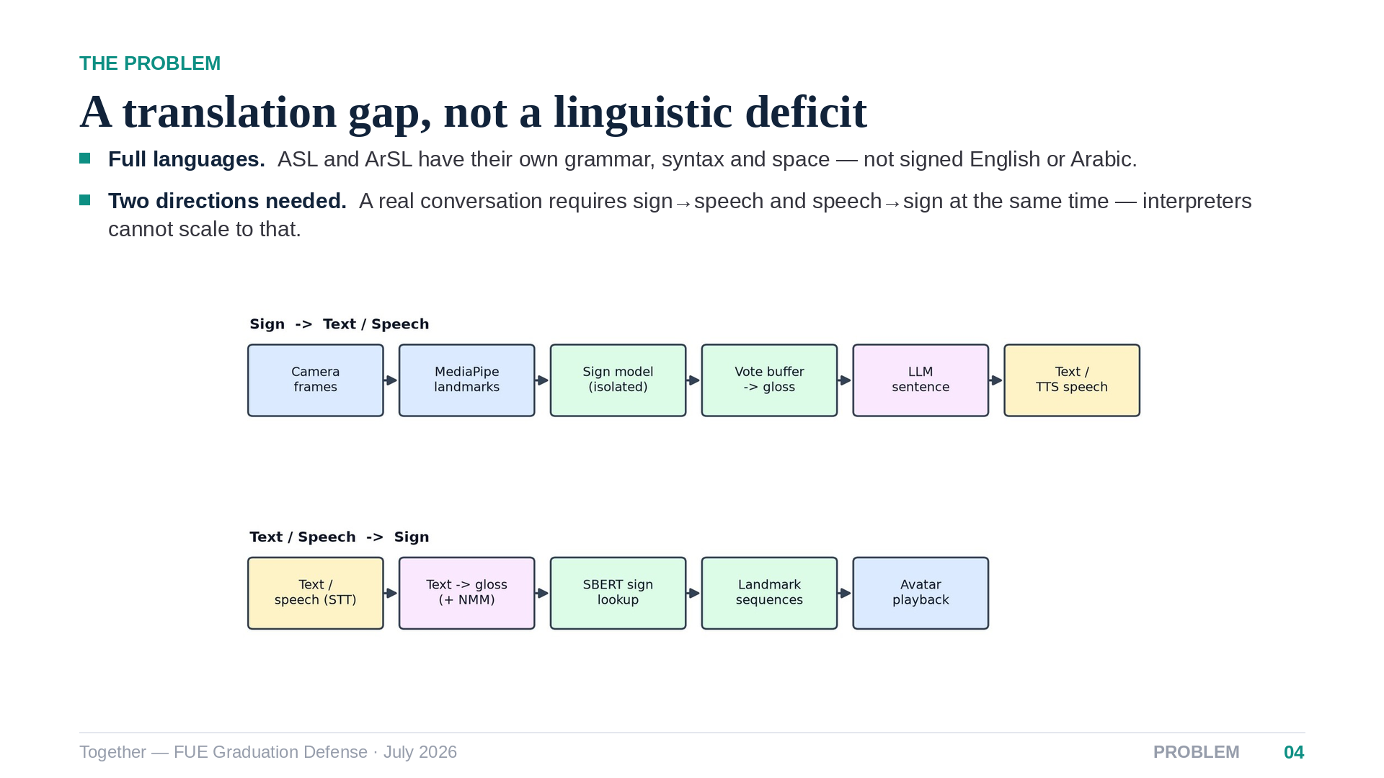
Notes:
[Speaker 1 — 45s] Sign languages are complete natural languages — Stokoe established this back in 1960. They are not word-for-word codes of spoken language, which is exactly why translation is hard. And a real conversation needs both directions at once: the Deaf participant must be understood, and must understand back. That bidirectional loop, shown here, is the design target of the whole project.

Slide 5
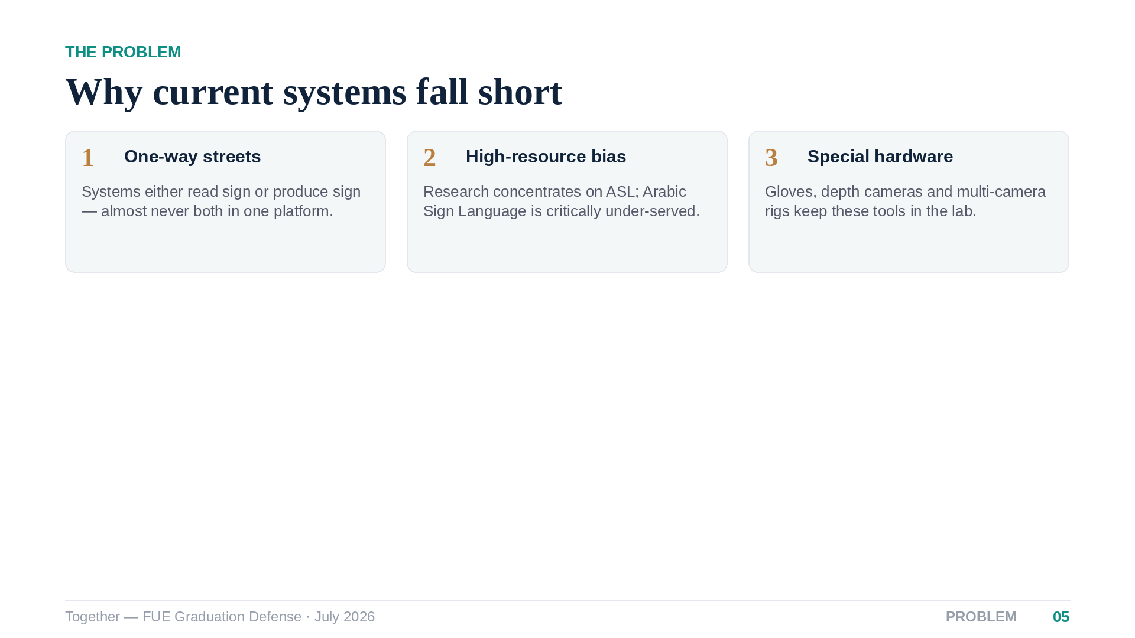
Notes:
[Speaker 1 — 35s] Surveying the field, deployed systems stumble on three hurdles. They are one-directional. They target high-resource languages, leaving ArSL behind. And they lean on hardware — gloves, depth cameras, calibrated rigs — that no Deaf person carries around. These three failures define our requirements.

Slide 6
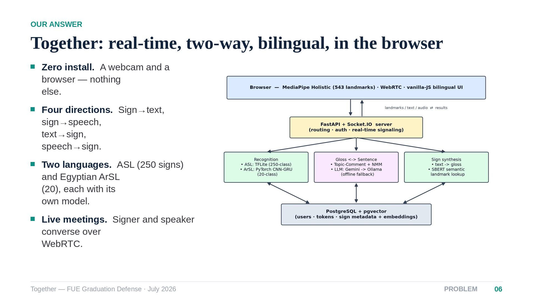
Notes:
[Speaker 1 — 45s] Together is our answer: a real-time, bidirectional, bilingual translator that runs entirely in a standard browser. MediaPipe extracts a skeleton of landmarks client-side, our models classify signs on the server, and a language model turns sign grammar into fluent sentences. The same machinery runs in reverse to animate an avatar, and a live meeting mode runs both directions concurrently.

Slide 7
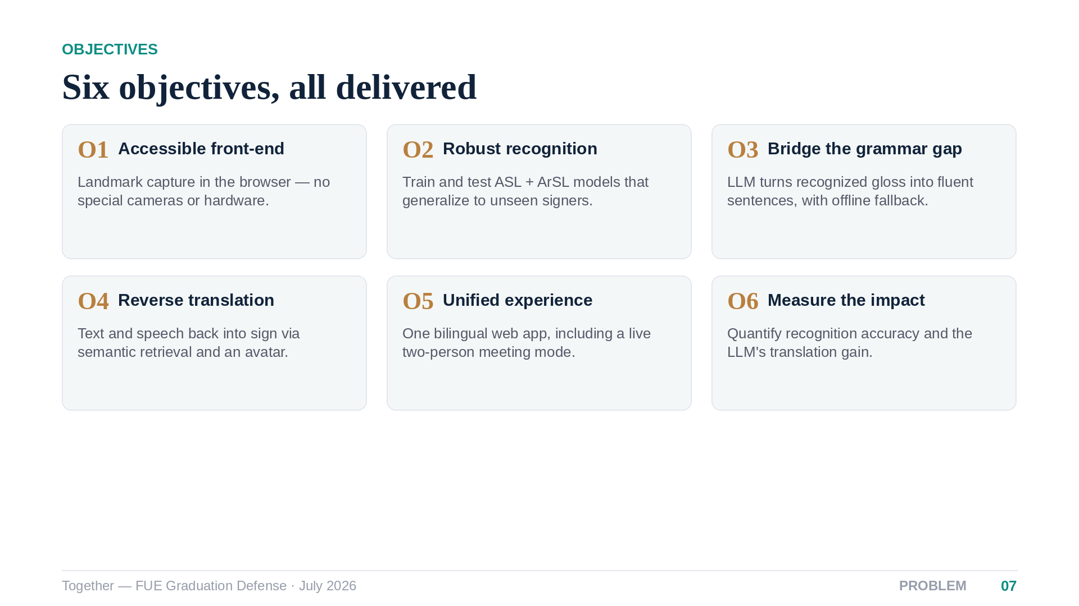
Notes:
[Speaker 1 — 35s] We set six objectives at the start of the year, and every one of them is delivered in the system you will see today. Keep objective six in mind — measuring how much the language model actually improves translation — because it shapes the whole evaluation chapter at the end.

Slide 8
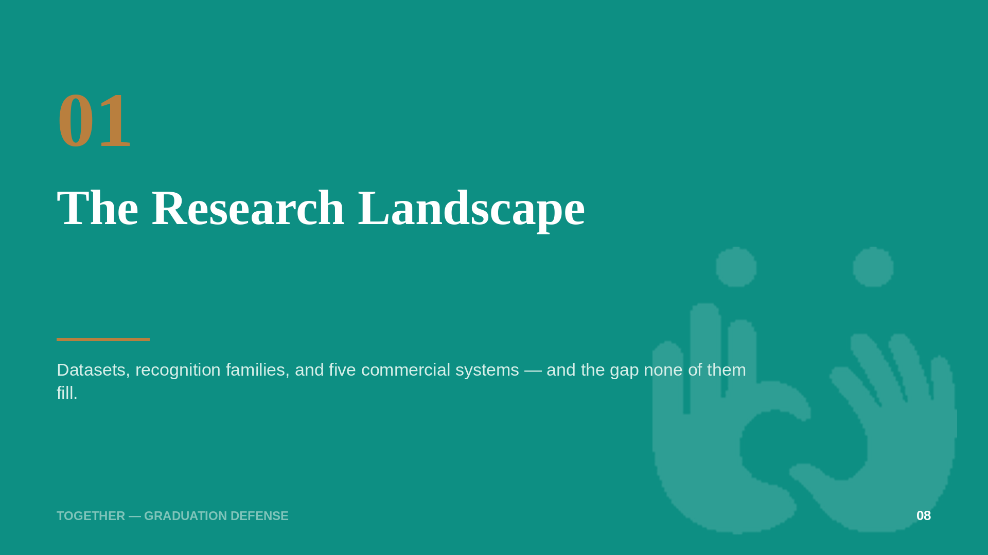
Notes:
[Speaker 1 — 10s] Let me place Together in the research landscape first.

Slide 9
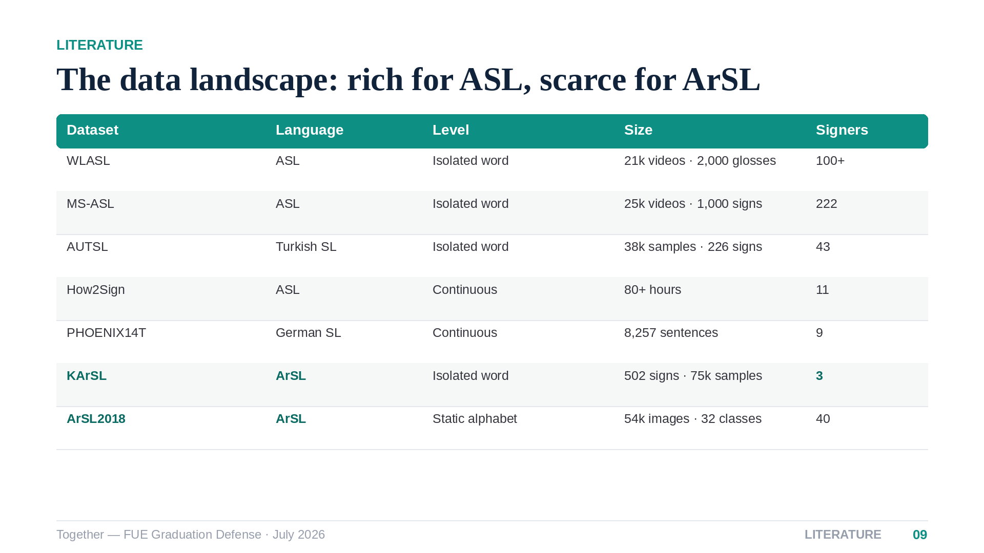
Notes:
[Speaker 1 — 45s] The data tells the story. English ASL has tens of thousands of videos across hundreds of signers. Arabic has KArSL — large but recorded from only three signers — and alphabet-level image datasets. There is no large word-level Egyptian corpus, and no continuous ArSL corpus at all. Any honest Arabic system must be designed for data scarcity, and ours is.

Slide 10
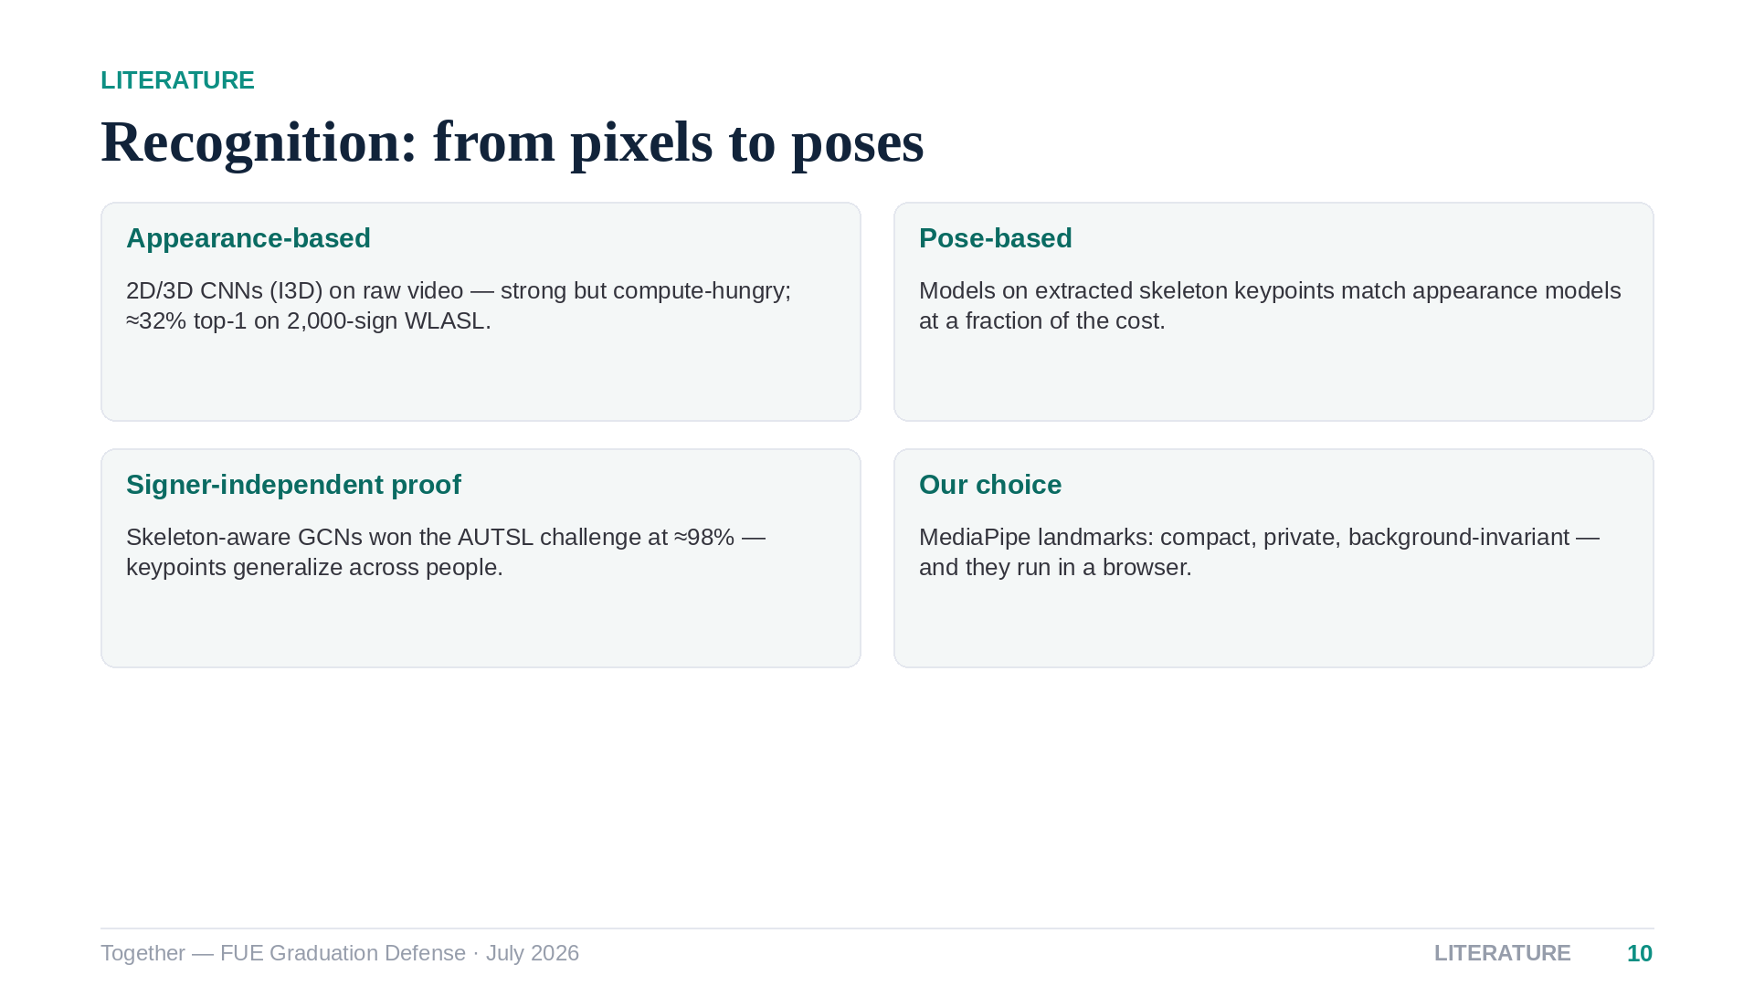
Notes:
[Speaker 1 — 45s] Recognition research splits into appearance models on raw video and pose models on extracted keypoints. On large vocabularies raw-video models are expensive and fragile, while keypoint models proved they generalize across signers — the AUTSL challenge was won by a skeleton model at ninety-eight percent. That is why Together is landmark-based end to end: cheaper, more private, and it runs in a browser.

Slide 11
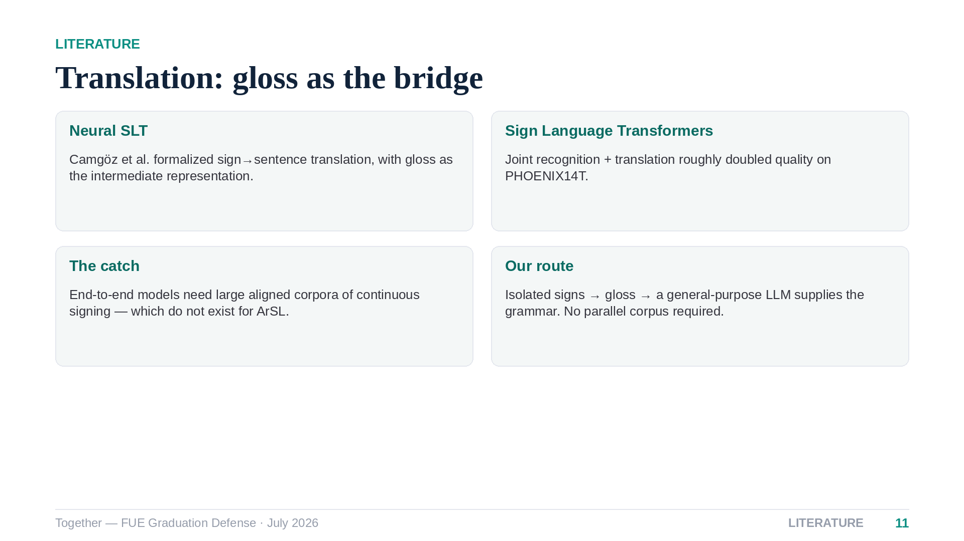
Notes:
[Speaker 1 — 45s] For full translation, the milestone work of Camgöz and colleagues used gloss — the written shorthand of sign language — as a bridge between video and sentences. Their transformers are powerful but need thousands of aligned sentences, a resource Arabic simply does not have. Our route keeps the gloss bridge but replaces the trained decoder with a general-purpose LLM — no parallel corpus required. The meeting pipeline shown here is where that choice pays off.

Slide 12
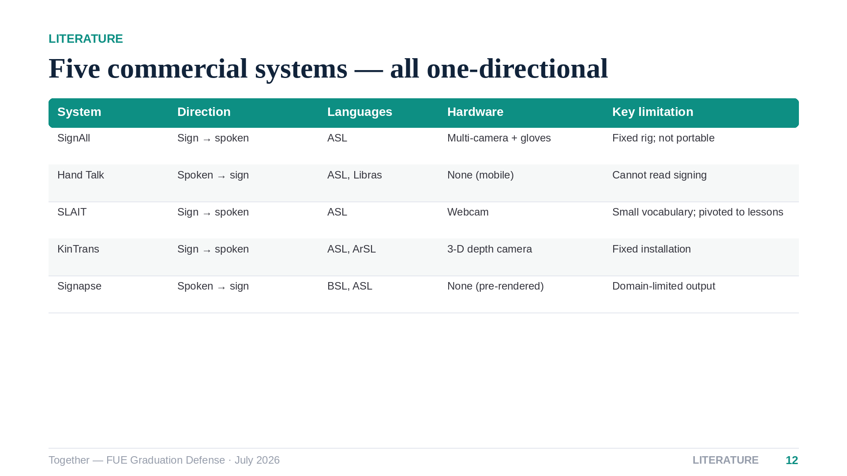
Notes:
[Speaker 1 — 45s] Five commercial systems frame the market. Notice the direction column: every single one is one-directional. SignAll needs a camera rig and gloves. KinTrans supports Arabic but requires a depth camera bolted to a counter. SLAIT is closest to us — browser and webcam — but reads sign only, with a small vocabulary. Nobody closes the conversational loop.

Slide 13
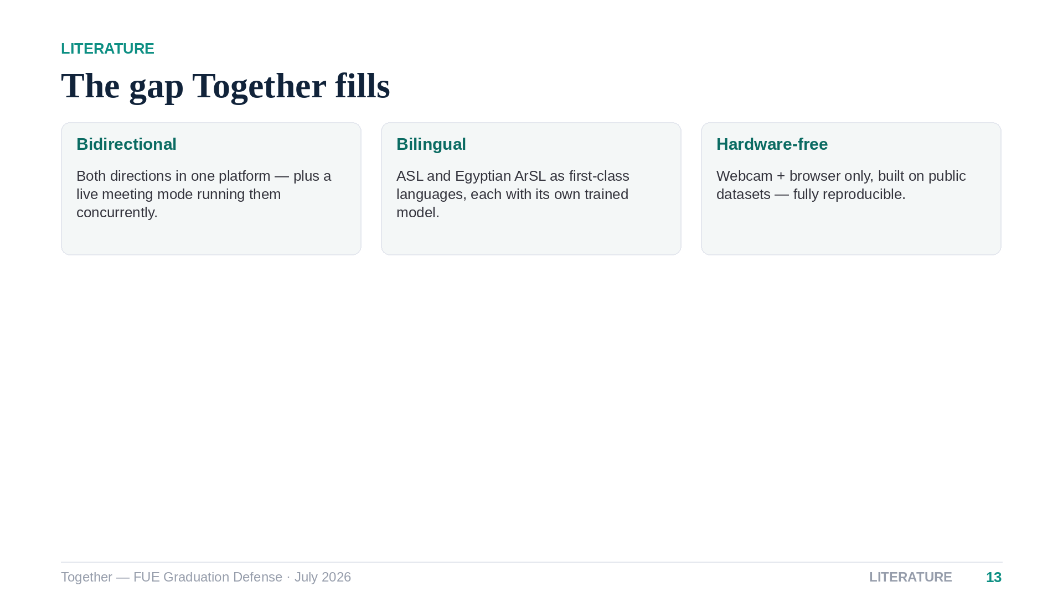
Notes:
[Speaker 1 — 30s] So the gap is precise: no existing system is bidirectional, bilingual and hardware-free at the same time. That triple is exactly what Together delivers, and it is reproducible from public datasets. I will hand over to my colleague to show you how the system is built.

Slide 14
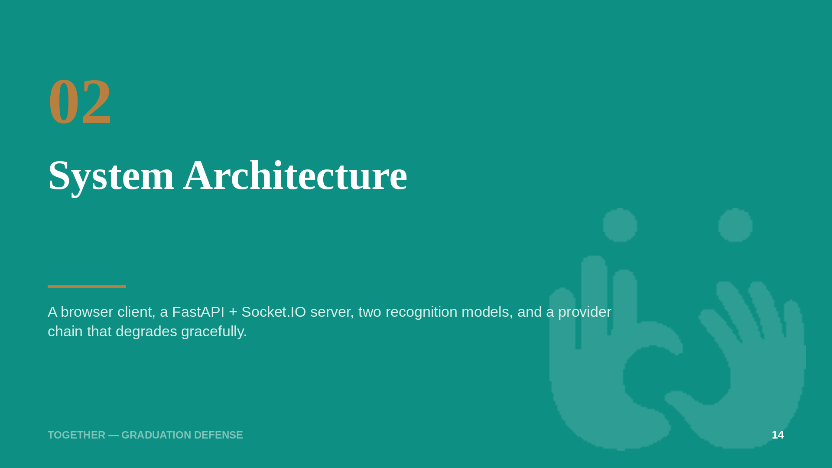
Notes:
[Speaker 2 — 10s] Thank you. Let me open the hood.

Slide 15
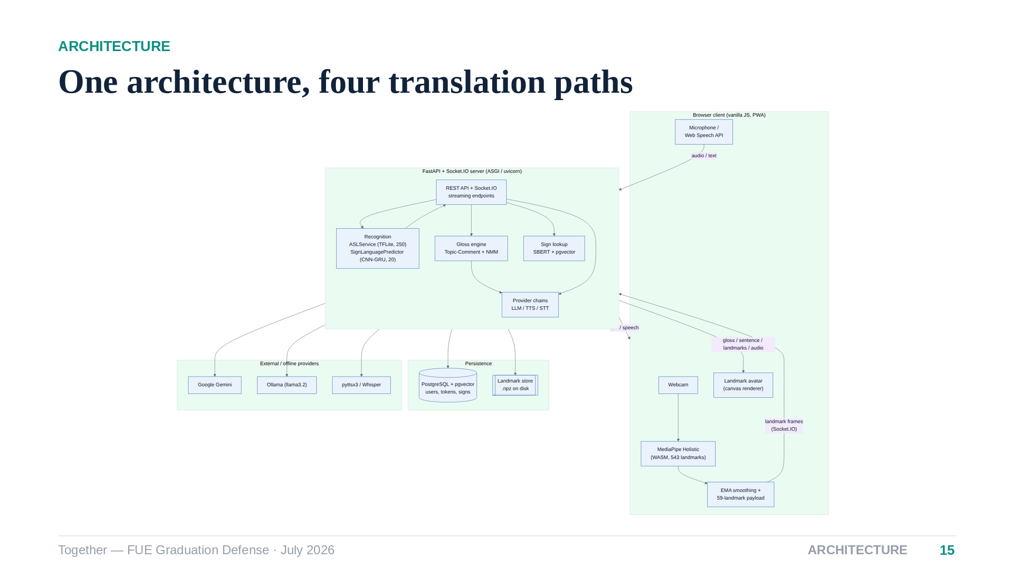
Notes:
[Speaker 2 — 60s] This is the whole system on one slide. In the browser, MediaPipe Holistic extracts 543 pose, face and hand landmarks per frame — raw video never leaves the device, which is our privacy stance. Landmarks stream over Socket.IO to a FastAPI server hosting two recognizers: a TFLite model for ASL and a PyTorch model for Arabic. A gloss engine and provider chain handle language, PostgreSQL with pgvector handles semantic sign lookup, and everything cloud has a local fallback — Gemini falls back to Ollama, cloud TTS to local synthesis.

Slide 16
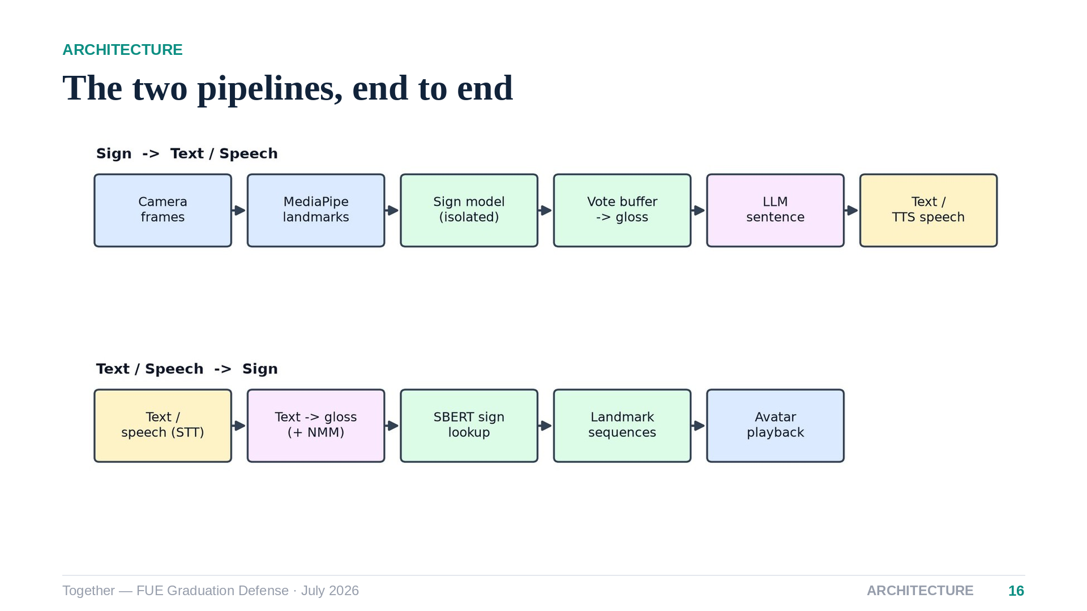
Notes:
[Speaker 2 — 40s] Reading the top row left to right: camera frames become landmarks, landmarks become isolated sign predictions, a voting buffer stabilizes them into gloss, and the LLM composes a sentence which we can also speak aloud. The bottom row is the mirror: text or transcribed speech is glossed, each token is matched to a stored sign by semantic search, and the avatar plays the landmark sequences back.

Slide 17
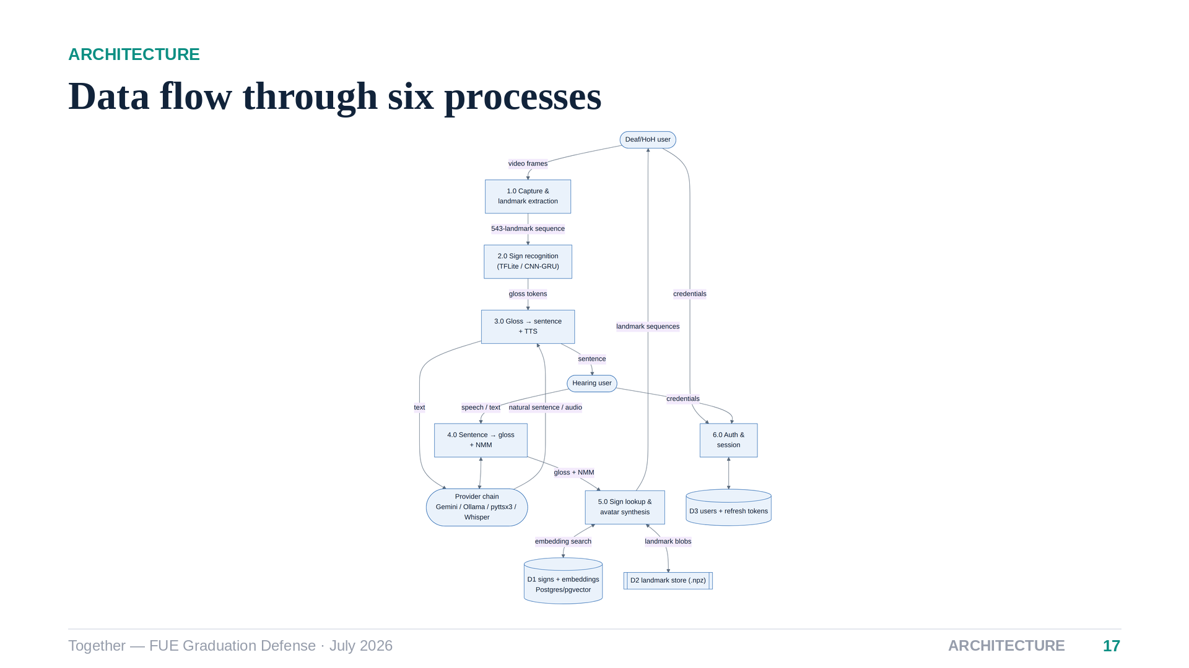
Notes:
[Speaker 2 — 35s] The level-one data-flow diagram decomposes that into six processes — capture, recognition, sentence formation, glossing, sign lookup, and authentication — with three stores: the sign database with its embeddings, the landmark files on disk, and the user store. Every arrow here exists as a concrete API route or socket event in the codebase.

Slide 18
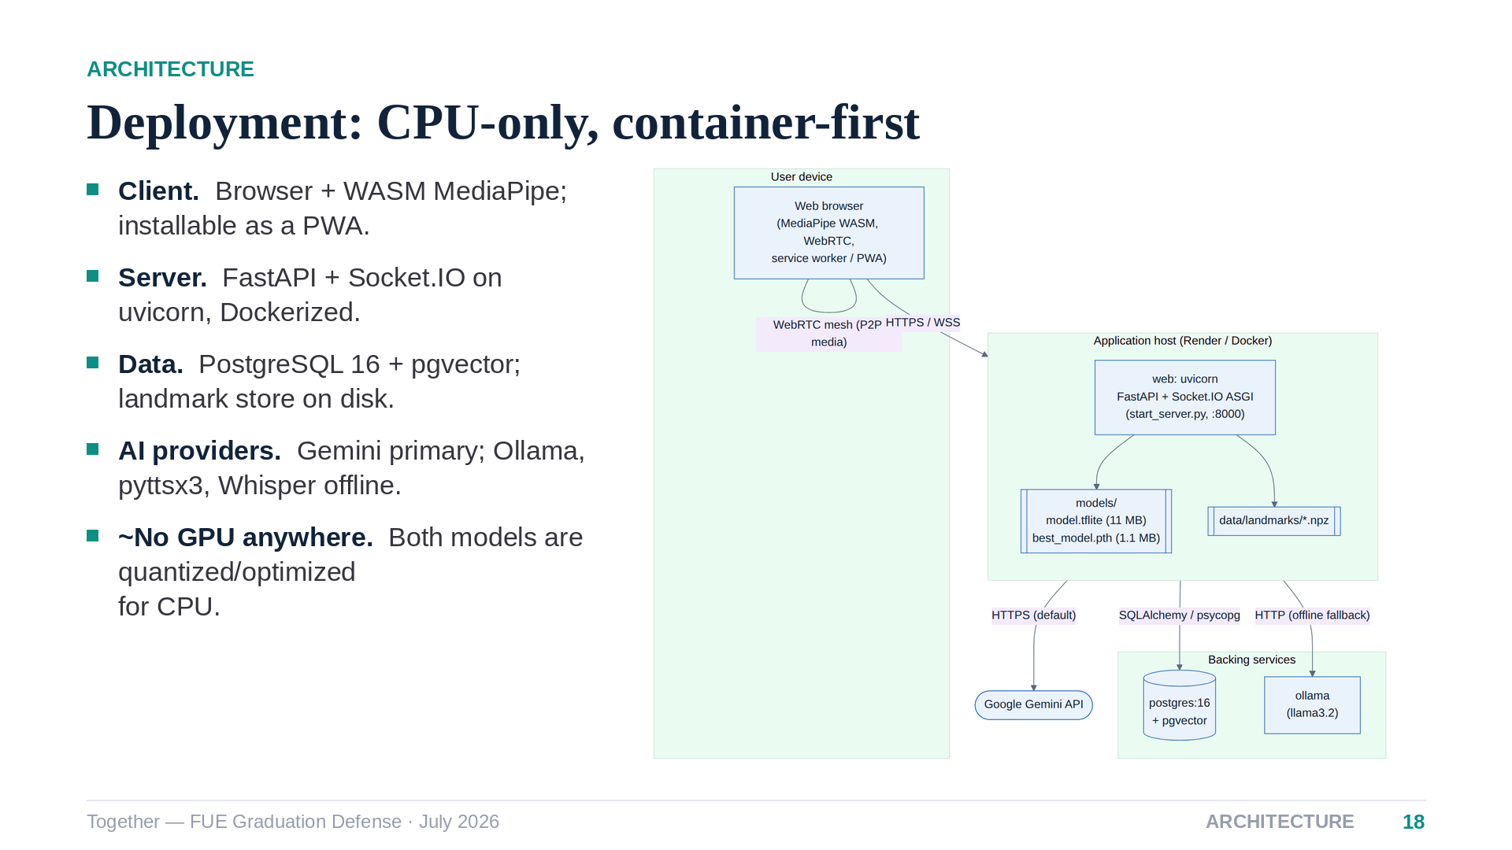
Notes:
[Speaker 2 — 40s] Deployment is deliberately boring: one container for the web service, Postgres with the vector extension, and an optional local Ollama. There is no GPU in this diagram on purpose — both recognizers are optimized to run on commodity CPU, which is what makes the system deployable on student-budget infrastructure.

Slide 19
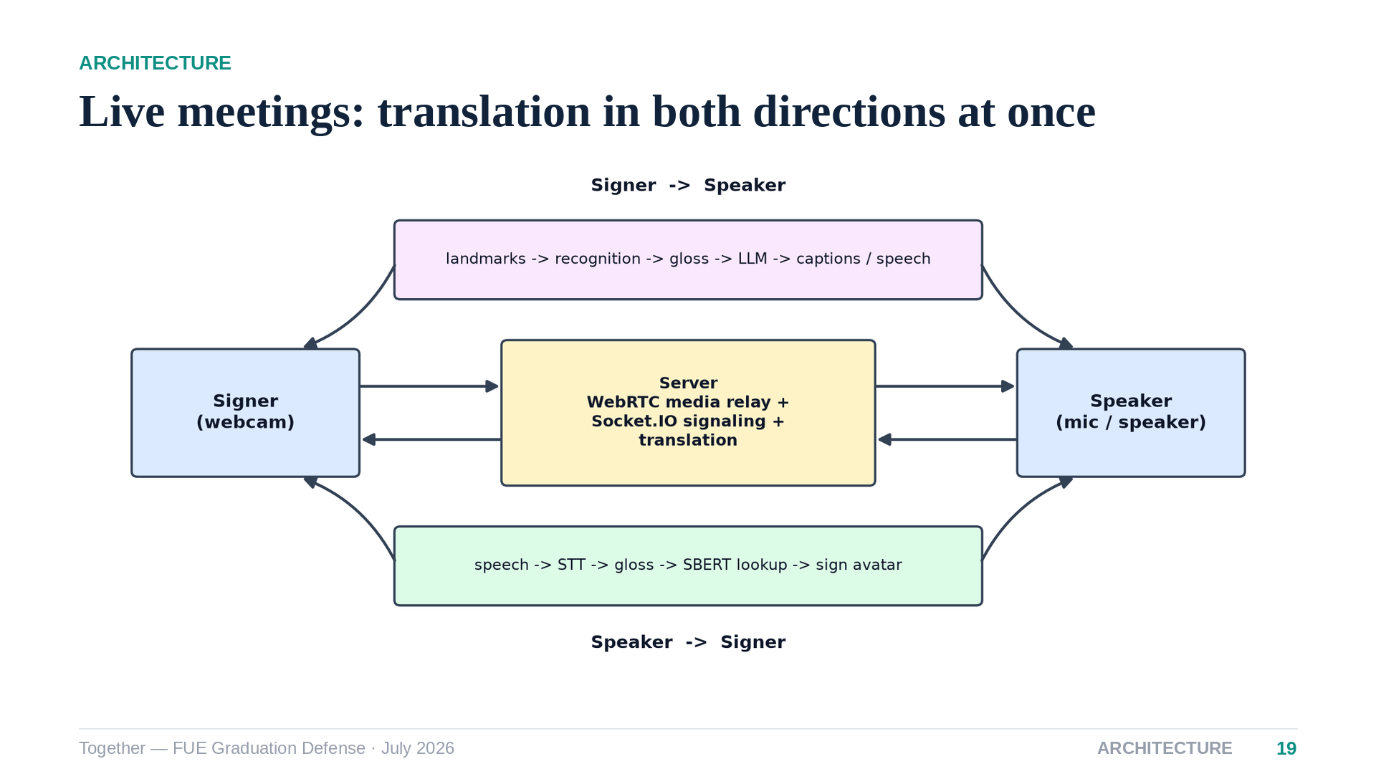
Notes:
[Speaker 2 — 40s] The meeting mode is where everything composes. Two participants exchange audio and video peer-to-peer over WebRTC — media never transits our server; Socket.IO only does signalling. The signer's landmarks run through recognition and reach the speaker as live captions and speech; the speaker's voice is transcribed, glossed and rendered as an avatar for the signer. Two pipelines, one per participant, running concurrently.

Slide 20
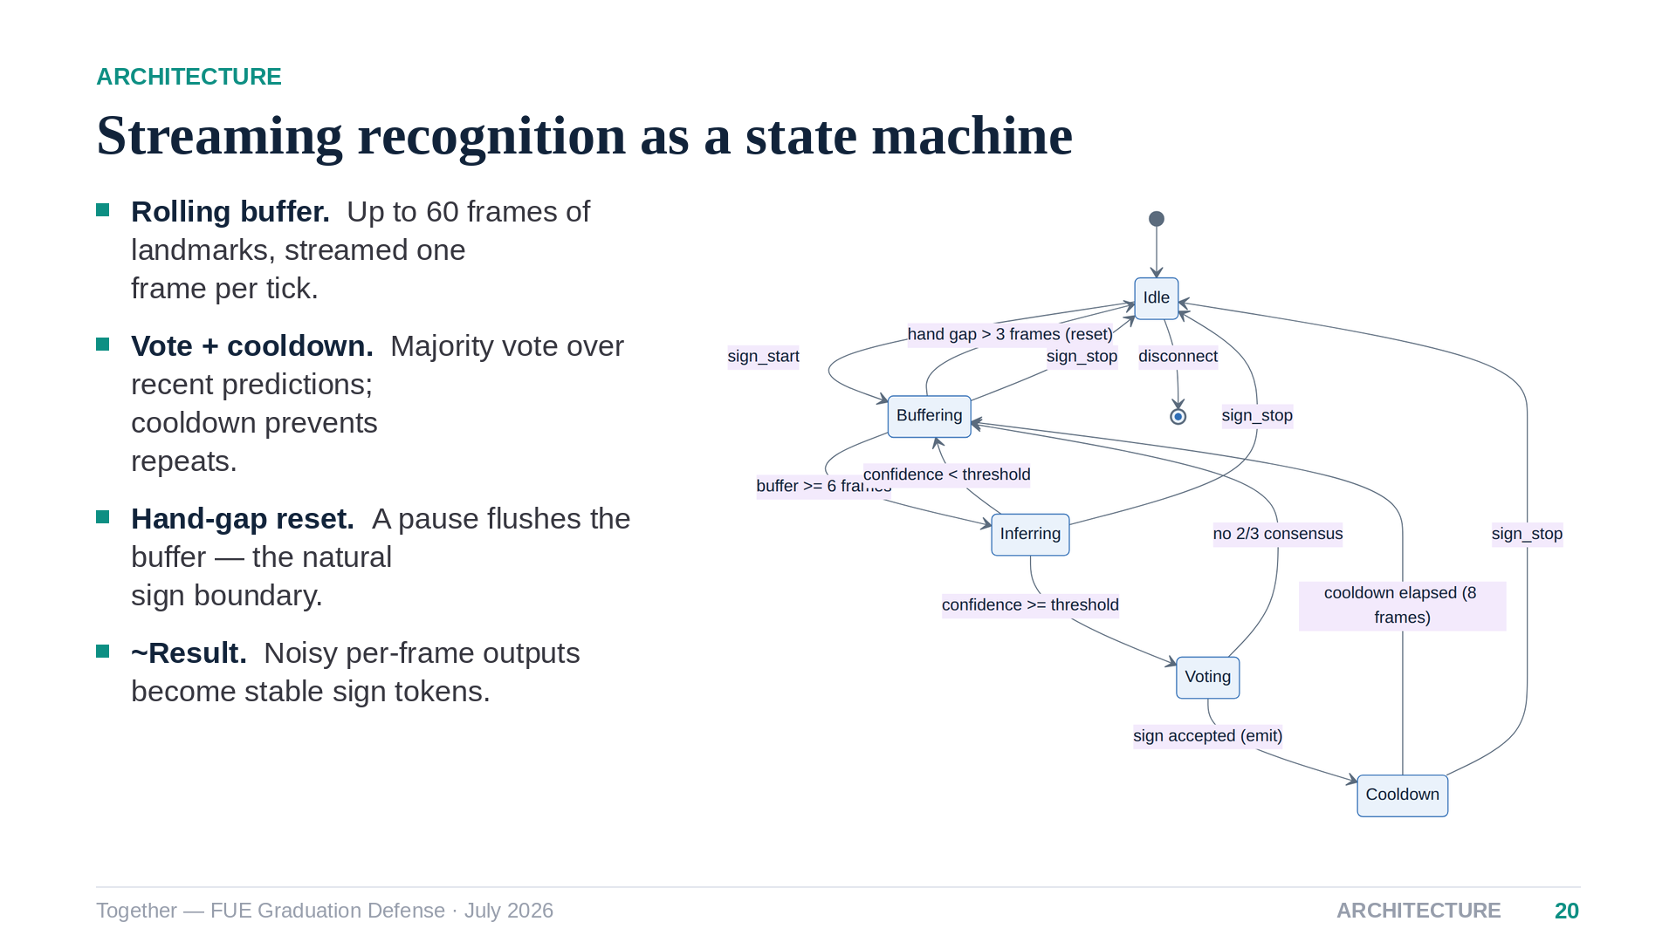
Notes:
[Speaker 2 — 40s] Real-time recognition is a small state machine. Frames fill a rolling buffer; inference runs in a worker thread; a prediction only survives if it wins a majority vote and clears a confidence gate, then a cooldown stops it from repeating. When the hands drop, the buffer flushes — that pause is the natural boundary between signs. This is what makes the demo feel stable rather than jittery.

Slide 21
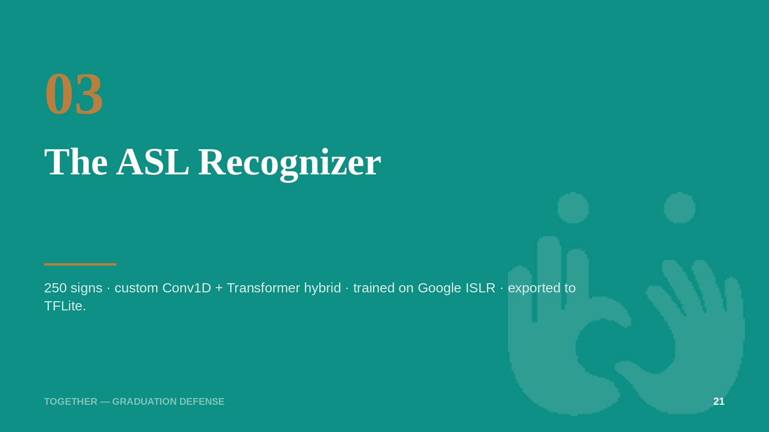
Notes:
[Speaker 2 — 10s] Now the first of our two models — the large one.

Slide 22
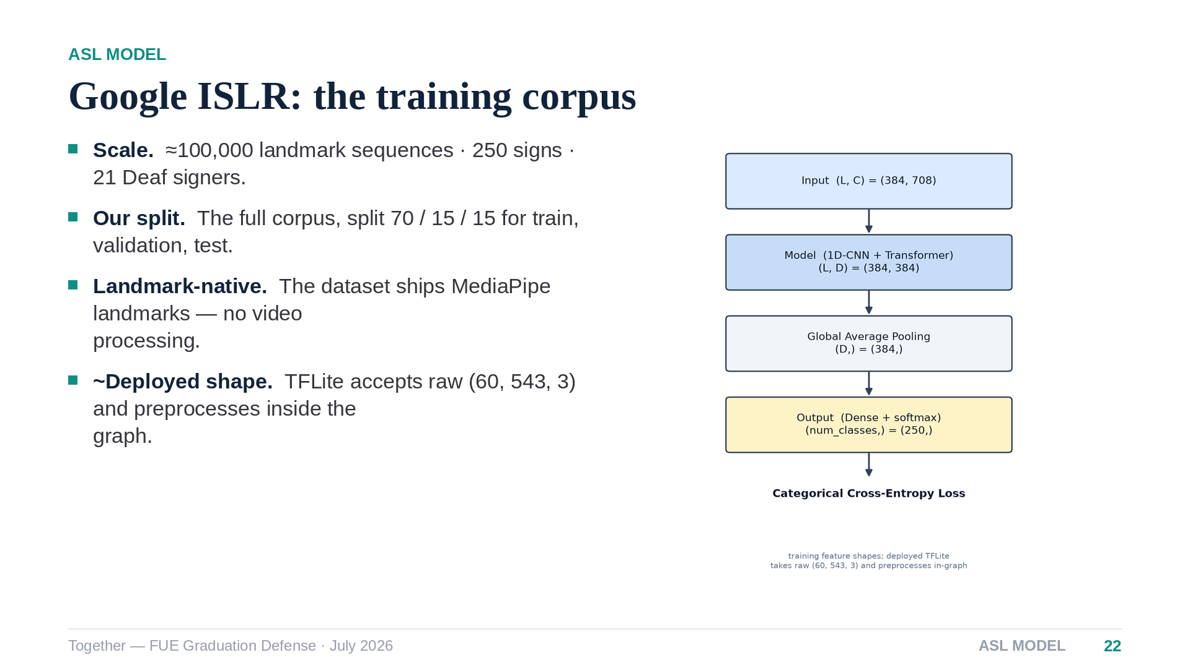
Notes:
[Speaker 2 — 40s] The ASL model trains on Google's Isolated Sign Language Recognition corpus — about a hundred thousand sequences signed by twenty-one Deaf adults. We train on the full corpus under a seventy-fifteen-fifteen split. Note the deployment detail on the right: the exported TFLite graph takes raw landmarks and performs all preprocessing internally, so the browser sends coordinates and nothing else.

Slide 23
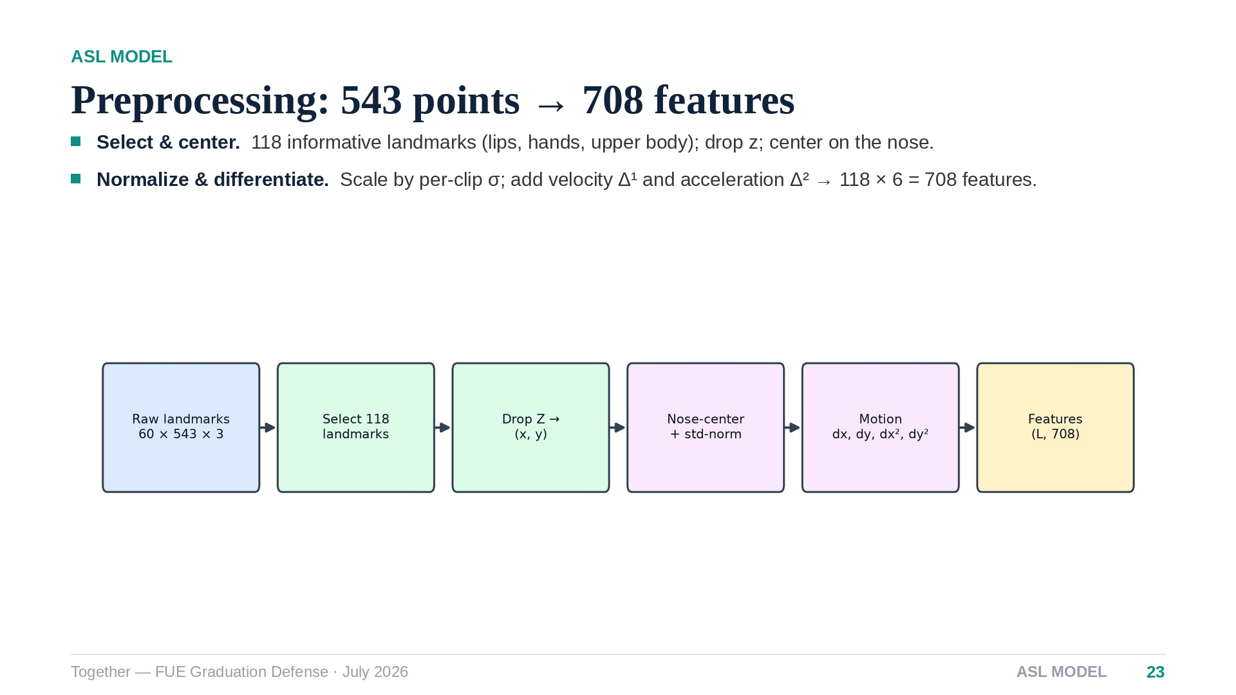
Notes:
[Speaker 2 — 45s] Preprocessing distills the 543 raw points down to the 118 that carry signing information — lips, both hands, upper body. We drop depth, center on the nose, and normalize by the clip's standard deviation so distance from the camera cancels out. Then we append first- and second-order motion — velocity and acceleration — giving 708 features per frame. Motion features matter because a sign is a trajectory, not a pose.

Slide 24
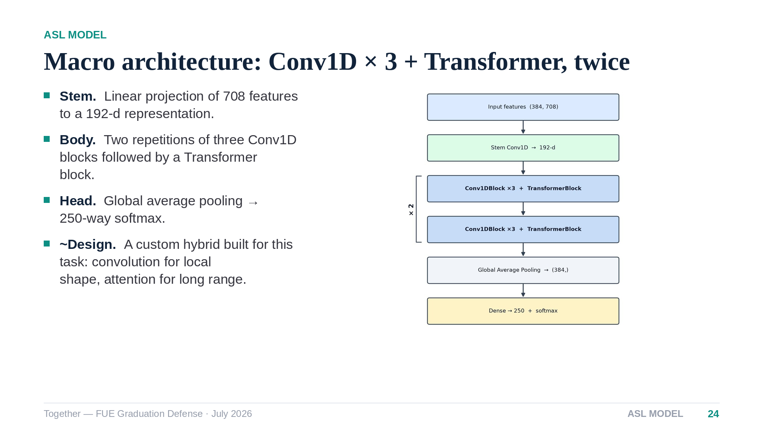
Notes:
[Speaker 2 — 40s] The architecture is our own convolution-plus-transformer hybrid: convolutions capture local hand-shape transitions, attention captures the long-range structure of a sign, and we alternate them — three convolution blocks then a transformer block, repeated twice — before pooling into a 250-way classifier.

Slide 25
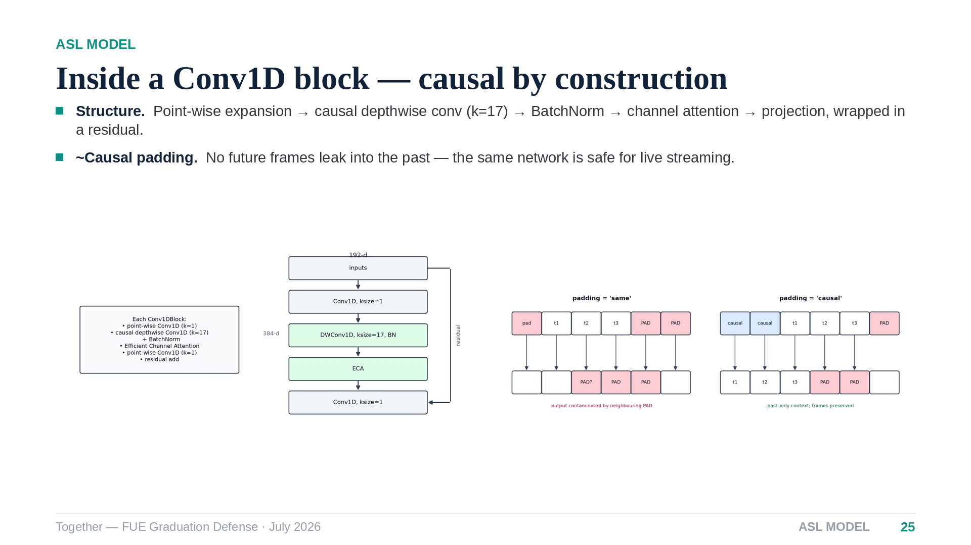
Notes:
[Speaker 2 — 45s] Each convolution block is an inverted bottleneck: a point-wise expansion, a depthwise convolution with a wide kernel of seventeen frames, channel attention, and a residual connection. The detail worth defending is causal padding — shown lower right — which guarantees the model never looks at future frames. That is what lets the same network run on a live stream without behavioral drift.

Slide 26
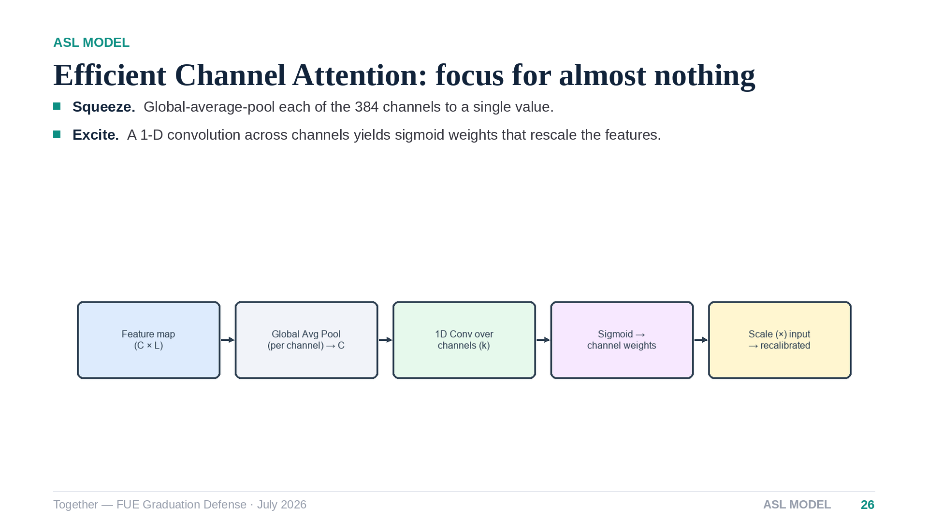
Notes:
[Speaker 2 — 30s] Efficient Channel Attention is a five-line idea: pool each channel to one number, run a tiny one-dimensional convolution across channels, and use the sigmoid output to reweight them. It costs a few hundred parameters and consistently sharpens which feature channels the network trusts at each moment.

Slide 27
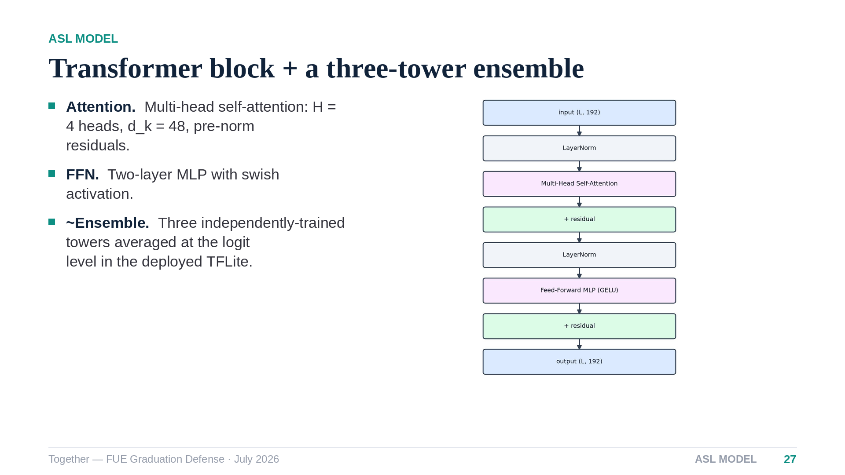
Notes:
[Speaker 2 — 35s] The transformer block is the standard pre-norm design — four heads of dimension forty-eight with a feed-forward network. One deployment choice: the shipped TFLite file is actually a three-tower ensemble, three independently trained copies averaged at the logit level. It buys robustness at inference time for zero extra engineering in the client.

Slide 28
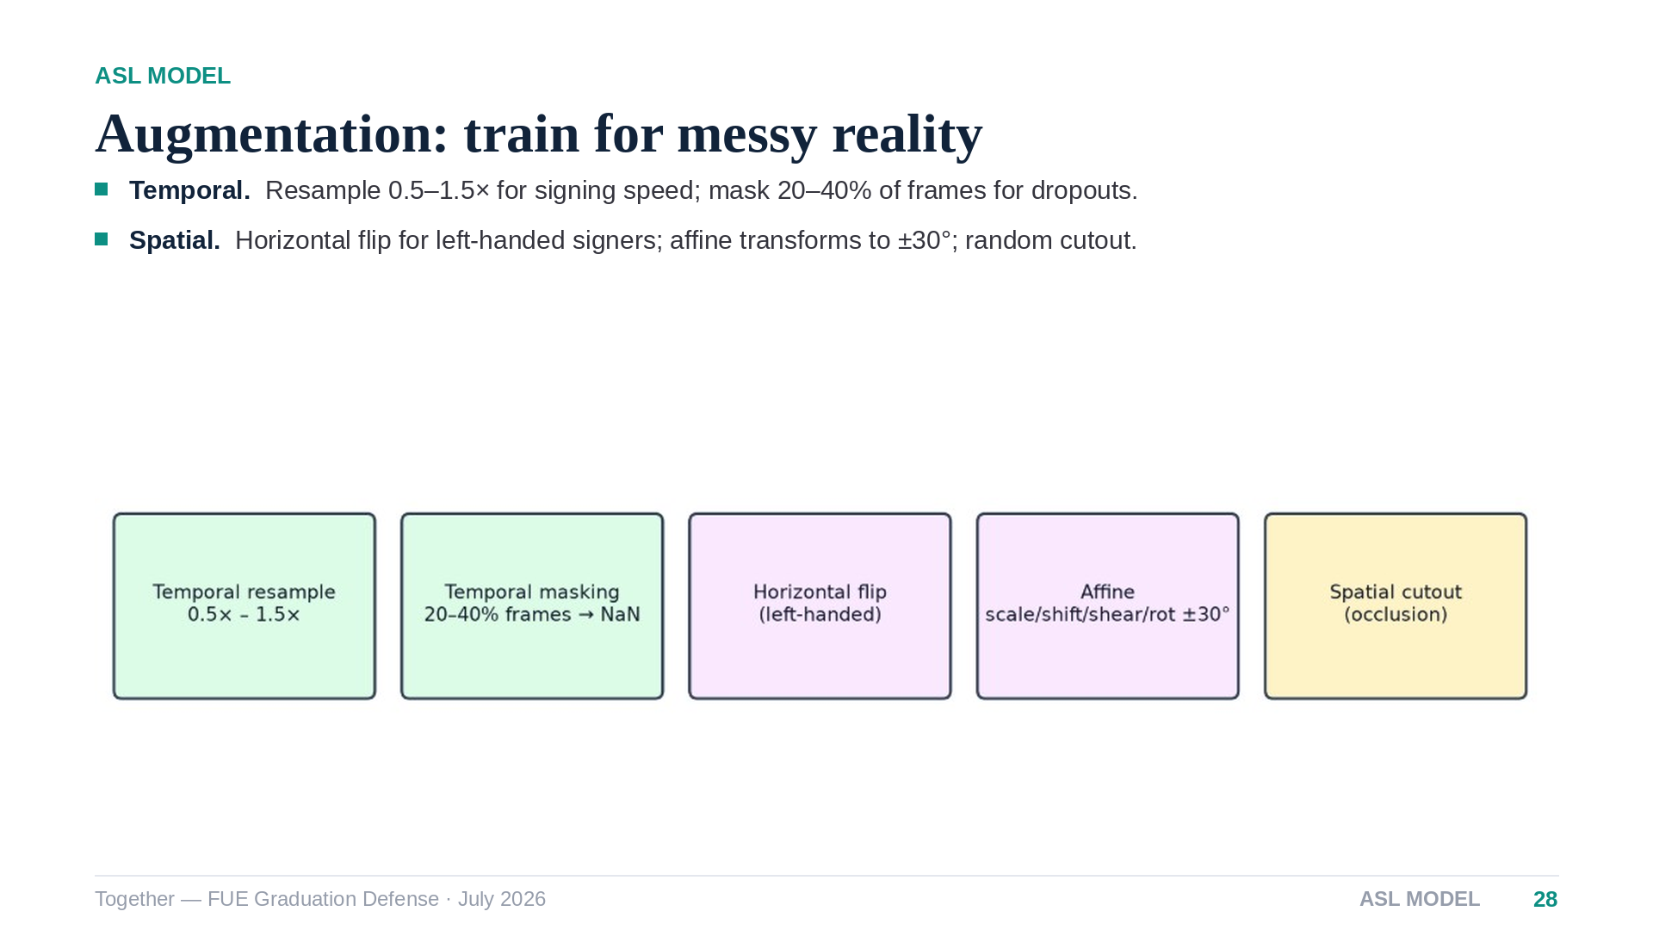
Notes:
[Speaker 2 — 35s] Augmentation is where generalization is won. Temporal resampling simulates fast and slow signers; frame masking simulates tracking dropouts; horizontal flips cover left-handed signers; affine jitter and cutout simulate camera angle and occlusion. Every effect we expect from a real webcam is manufactured during training.

Slide 29
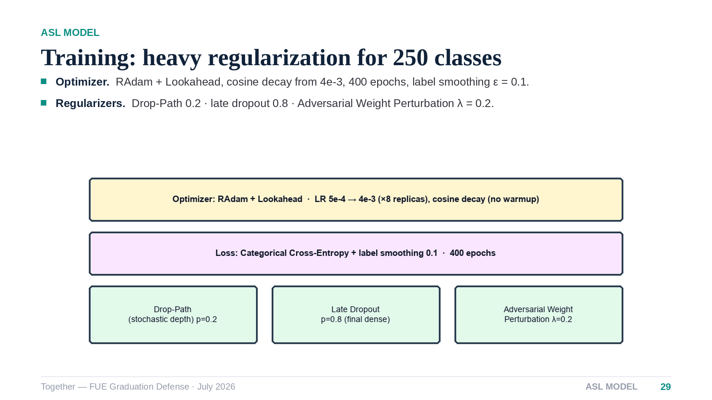
Notes:
[Speaker 2 — 40s] Training runs four hundred epochs with RAdam wrapped in Lookahead under a cosine schedule, and cross-entropy with label smoothing. Against overfitting on 250 classes we stack three regularizers: stochastic depth, a very aggressive dropout on the final layer, and adversarial weight perturbation, which optimizes the loss under small worst-case weight shifts.

Slide 30
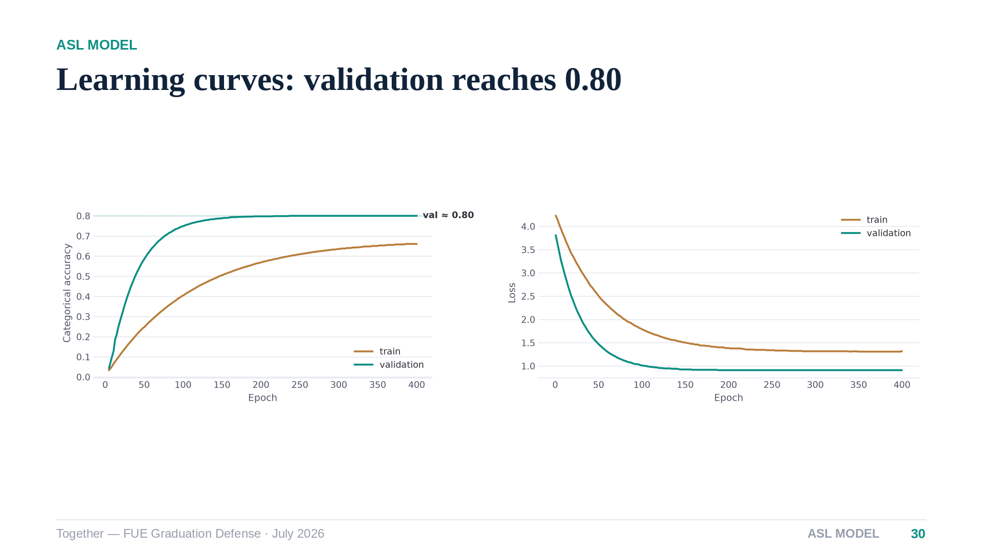
Notes:
[Speaker 2 — 40s] The curves tell a healthy story: validation accuracy climbs to about eighty percent and plateaus with no divergence between the curves. If validation above training looks odd — that is expected here, because the heavy augmentation and regularization are active only on the training pass. Speaker three will take it from here with the Arabic model.

Slide 31
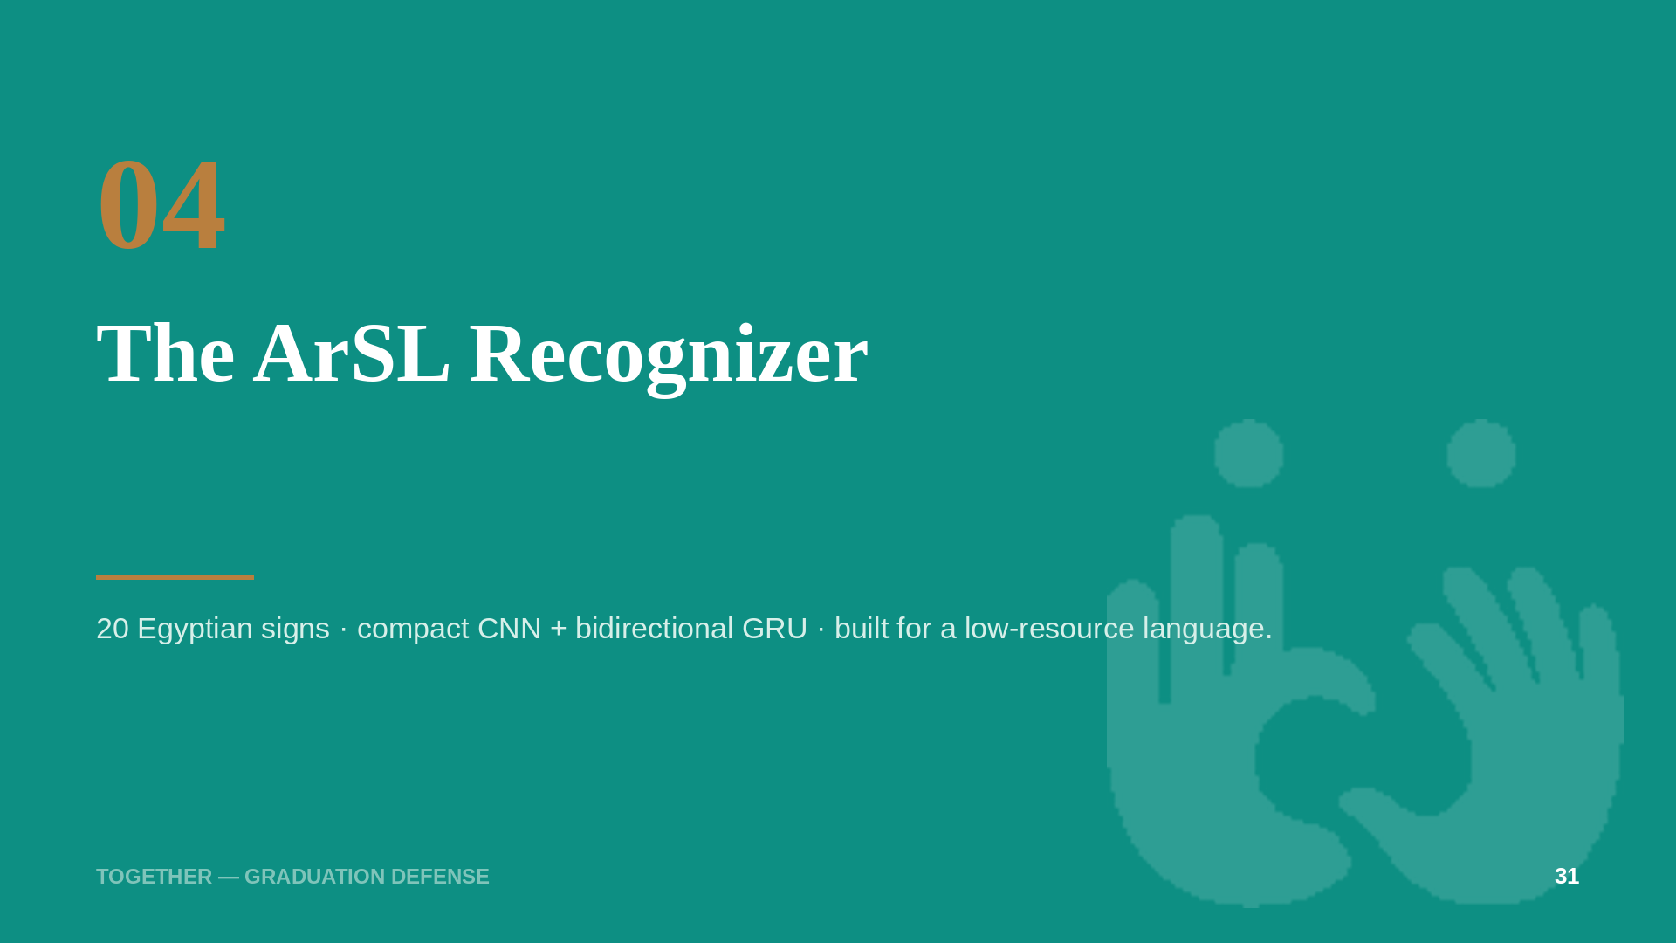
Notes:
[Speaker 3 — 10s] Thank you. The Arabic model had the opposite problem: not too many classes — too little data.

Slide 32
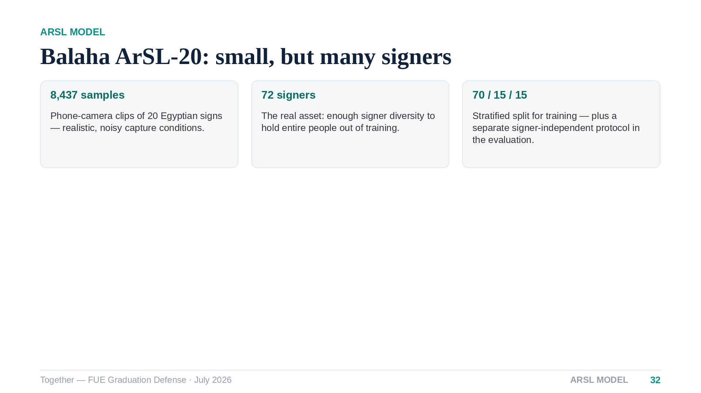
Notes:
[Speaker 3 — 40s] Our Arabic corpus is the Balaha twenty-word dataset: eight and a half thousand phone-camera clips. Twenty signs is small — but seventy-two different signers is the valuable part, because it lets us later hold entire signers out of training and measure honest generalization. The architecture must respect the data budget: a transformer here would simply memorize.

Slide 33
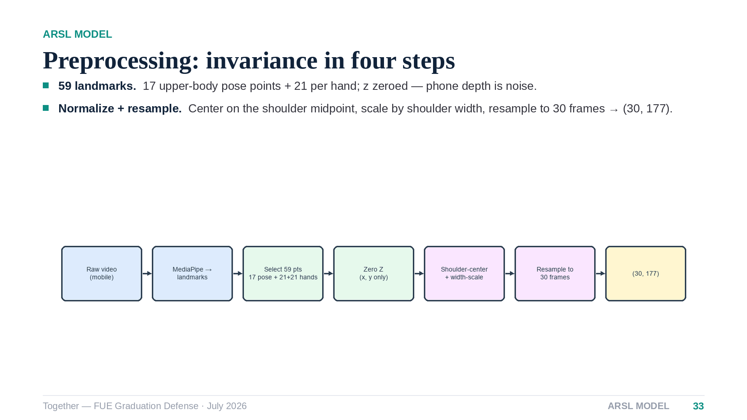
Notes:
[Speaker 3 — 35s] Preprocessing keeps fifty-nine landmarks — upper body and both hands — and zeroes the depth axis, which is unreliable across phone cameras. Centering on the shoulder midpoint and scaling by shoulder width buys position and size invariance, and every clip is resampled to exactly thirty frames, so the network always sees a thirty-by-one-seventy-seven tensor.

Slide 34
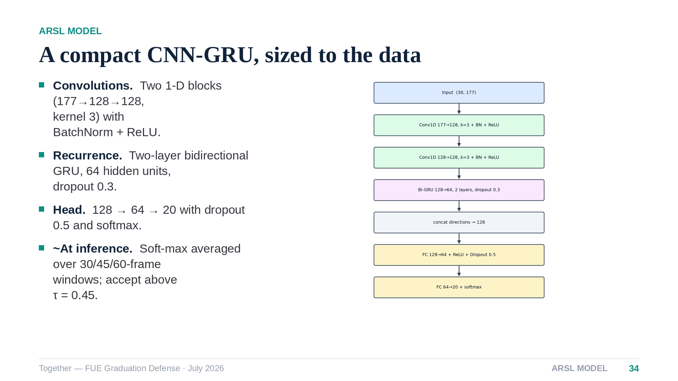
Notes:
[Speaker 3 — 40s] The model is a deliberately compact hybrid: two small convolution blocks learn local motion patterns, and a two-layer bidirectional GRU models the temporal order. At inference we run three temporal windows — thirty, forty-five and sixty frames — and average their probabilities before a confidence gate, which smooths out any single bad window.

Slide 35
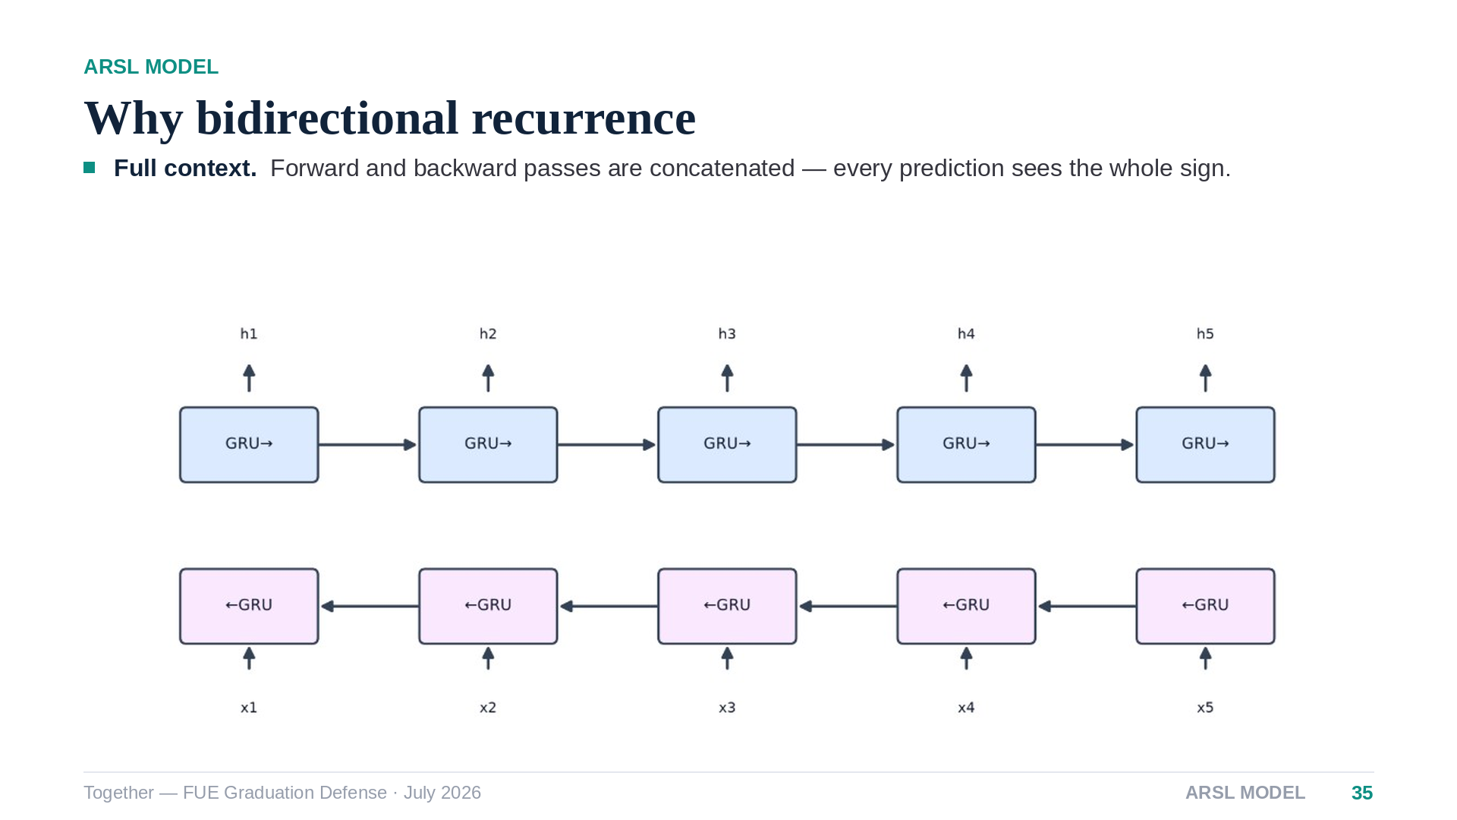
Notes:
[Speaker 3 — 30s] The GRU reads each sequence in both directions and concatenates the two hidden states, so the decision at the end of a sign is informed by its beginning and vice versa. For isolated signs — where we always have the full clip in the buffer — bidirectionality is free accuracy.

Slide 36
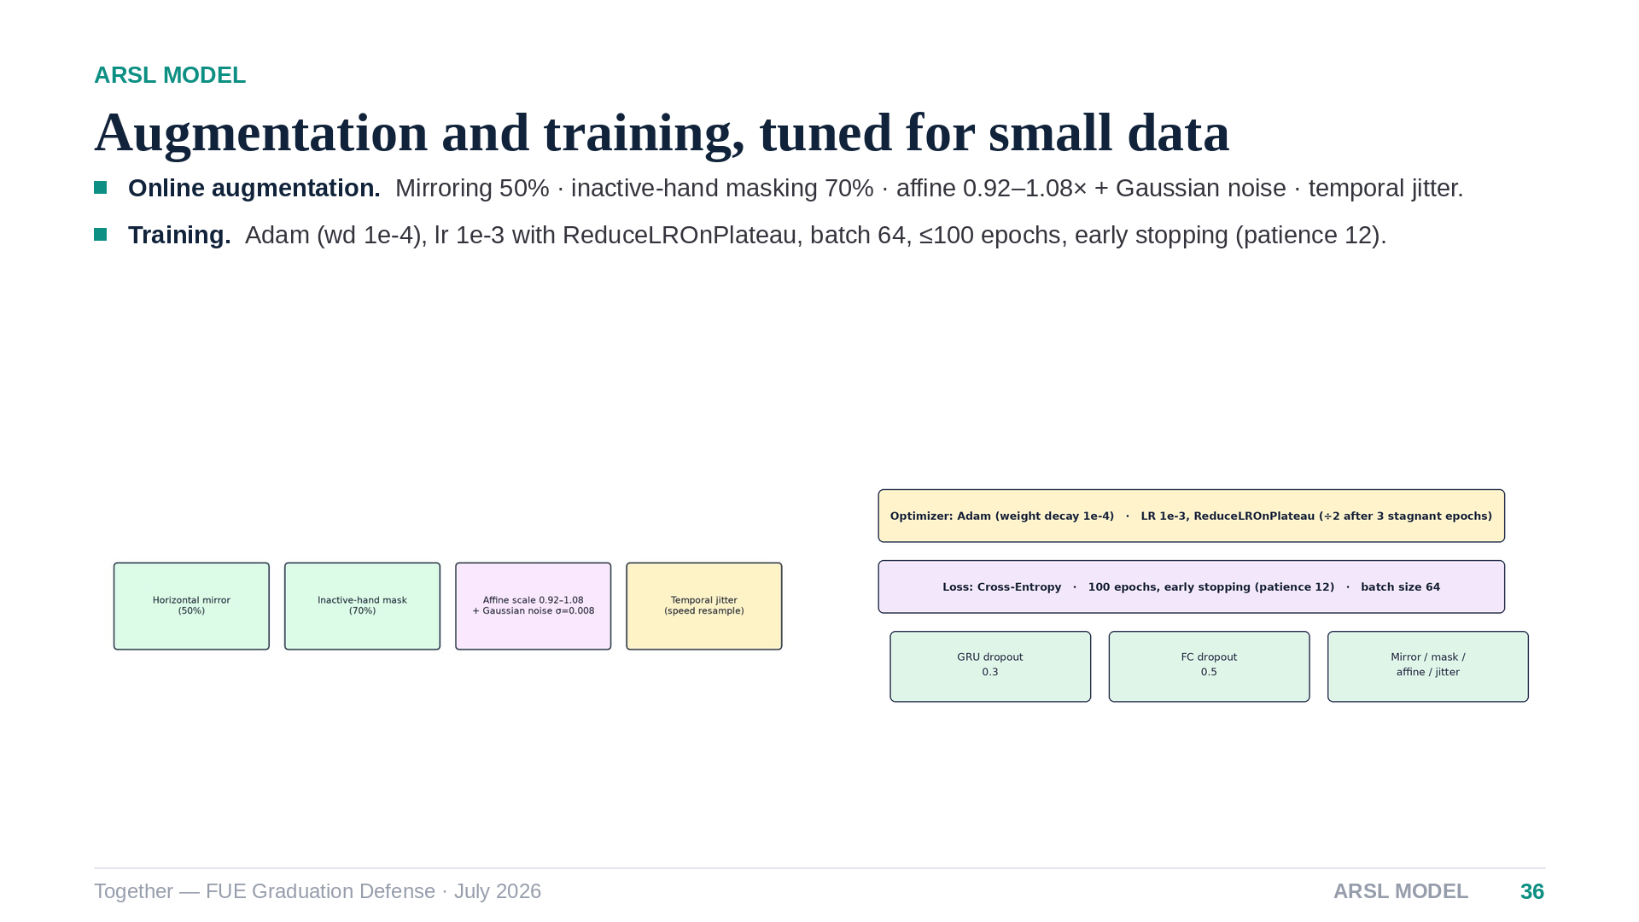
Notes:
[Speaker 3 — 35s] Augmentation mirrors half the samples, masks the inactive hand — because one-handed signs should not depend on where the idle hand rests — and adds affine scaling with a little noise plus temporal jitter. Training is plain Adam with a plateau scheduler and early stopping; the model converges in well under a hundred epochs.

Slide 37
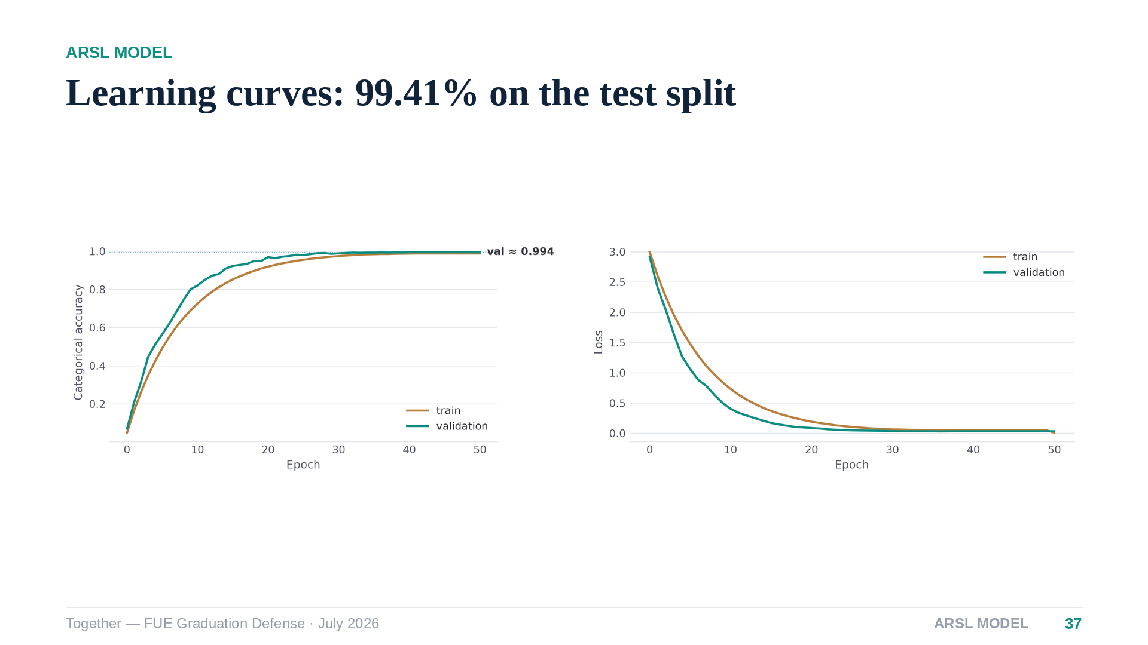
Notes:
[Speaker 3 — 30s] On its own test split the model converges fast and lands at ninety-nine point four percent. Hold your skepticism — a stratified split shares signers across partitions, so speaker four will show the honest signer-independent number later. Even there, this small model holds up remarkably well.

Slide 38
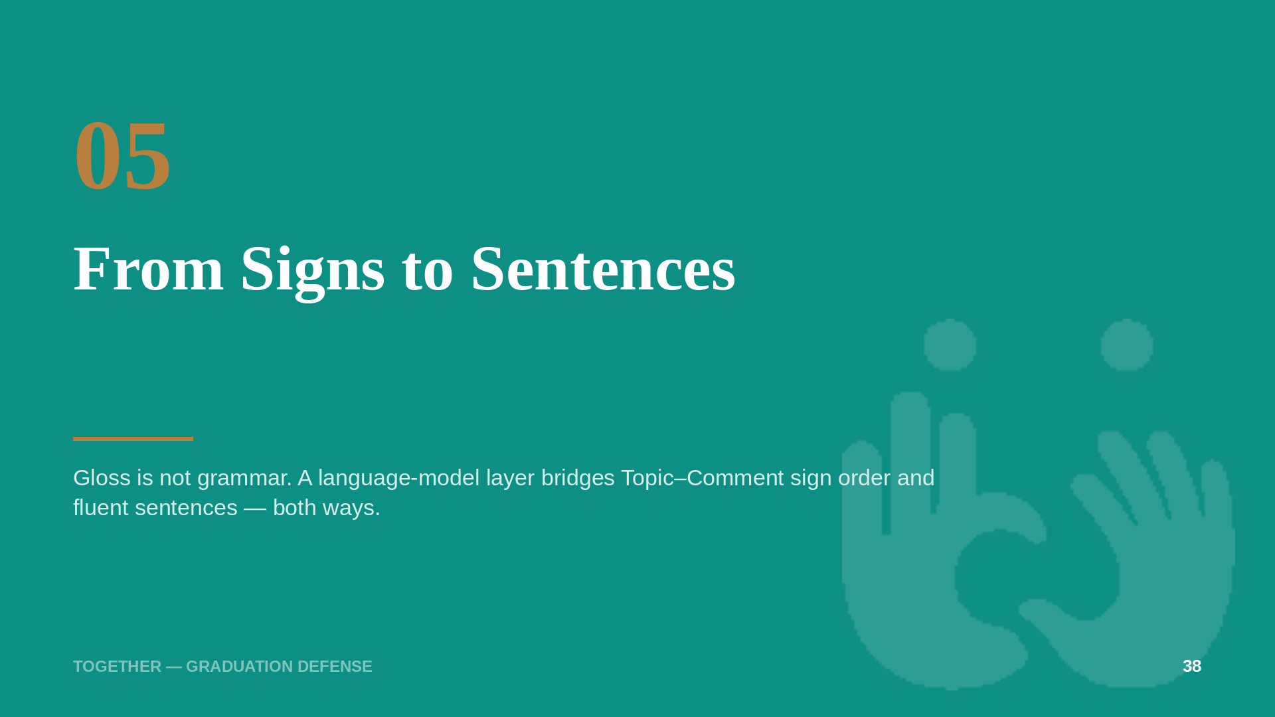
Notes:
[Speaker 3 — 10s] Recognition gives us words. Language is the next problem.

Slide 39
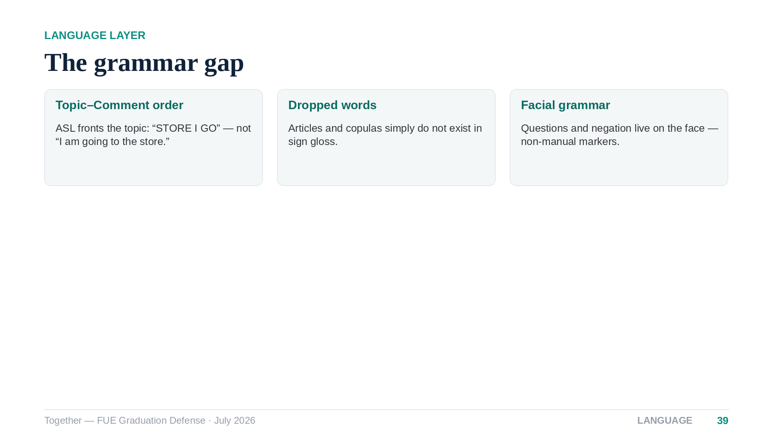
Notes:
[Speaker 3 — 40s] Sign languages order information Topic-first: the gloss for “I am going to the store” is literally STORE — I — GO, with no articles and no copulas. And a third of the grammar is not on the hands at all: raised eyebrows mark yes-no questions, furrowed brows mark wh-questions. Concatenating recognized words can never produce a fluent sentence — something must supply the grammar.

Slide 40
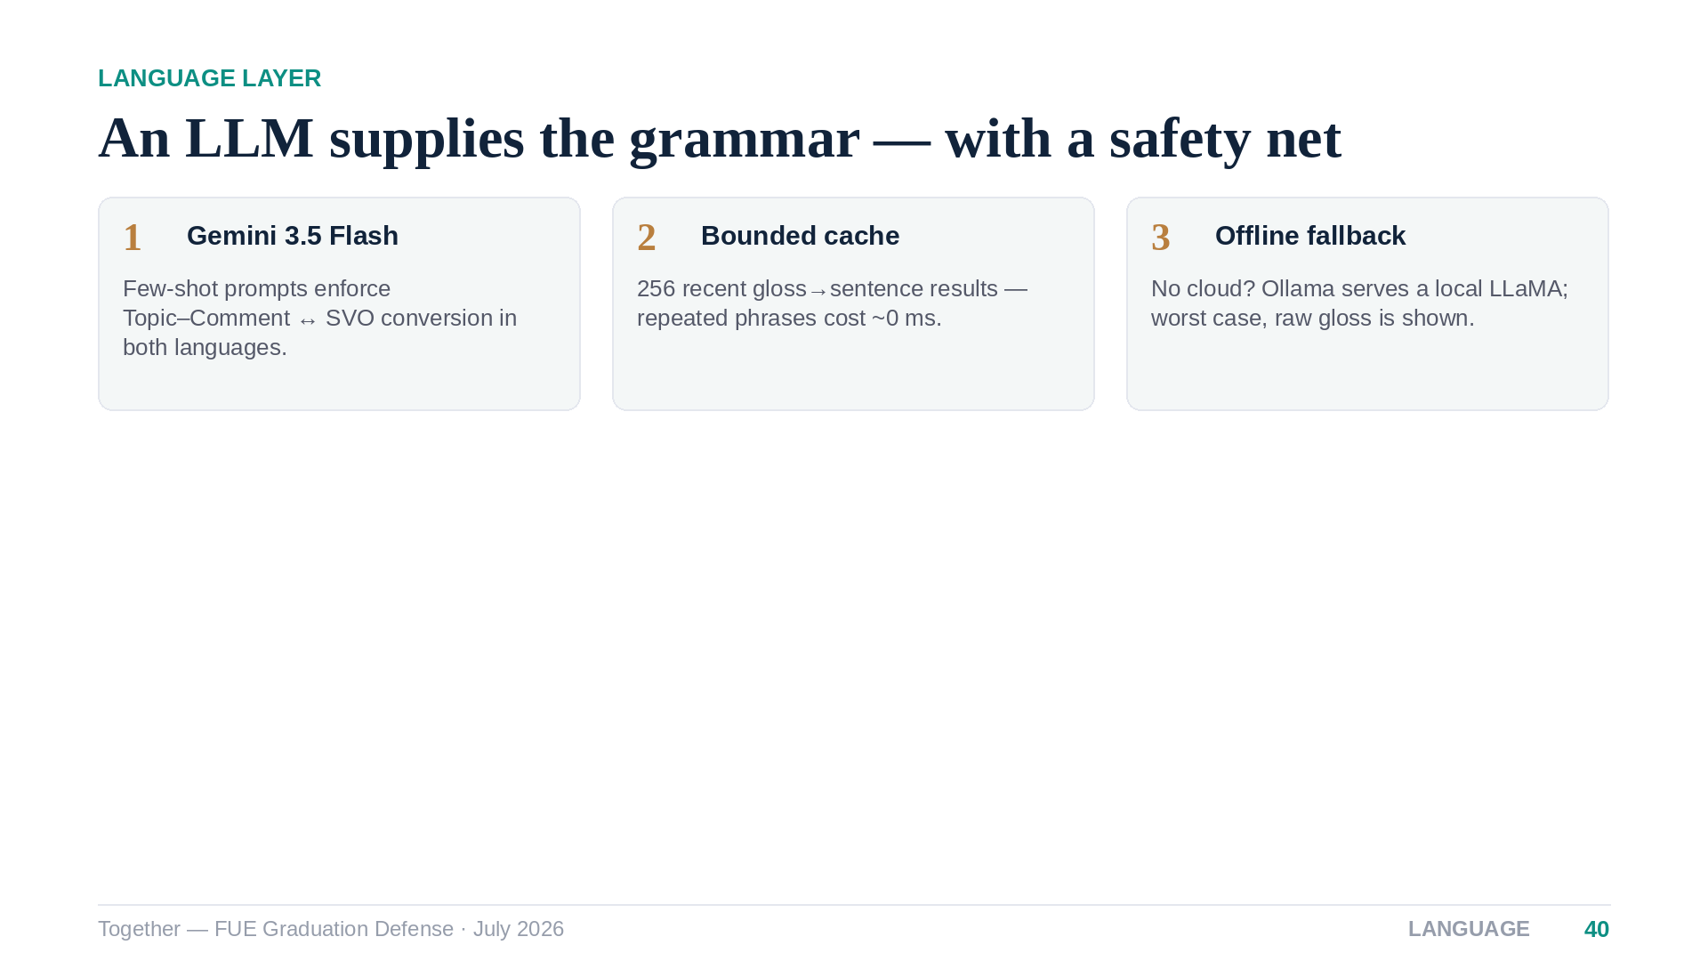
Notes:
[Speaker 3 — 40s] We hand the gloss to a large language model with few-shot examples that teach the reordering. Three engineering guarantees make this production-grade: a bounded cache so conversation phrases stop costing round-trips, an automatic fallback to a local model when the cloud is unreachable, and a final fallback to raw gloss — the feature degrades, it never dies.

Slide 41
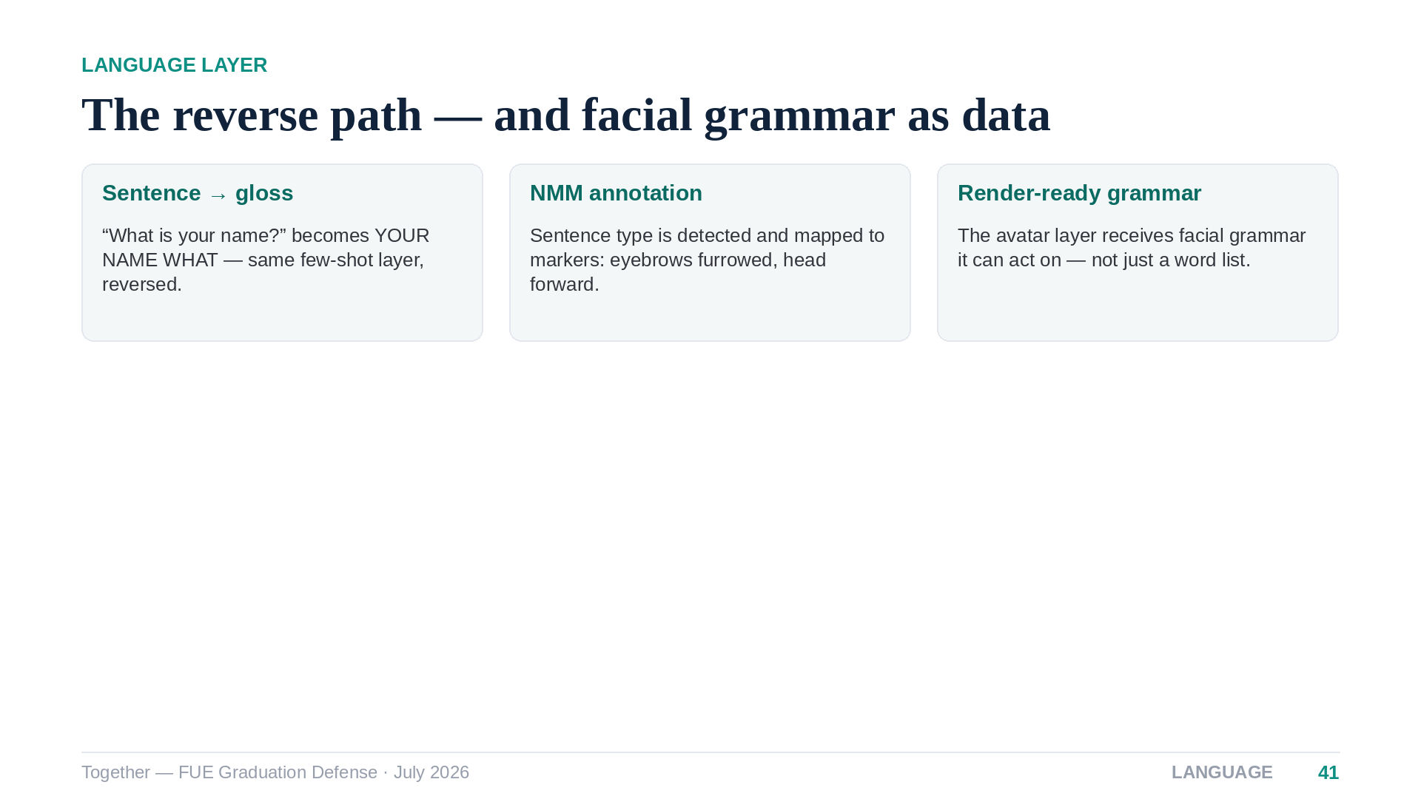
Notes:
[Speaker 3 — 35s] The same layer runs in reverse for text-to-sign: sentences become gloss tokens, and we annotate the non-manual markers — the system knows a wh-question should carry furrowed brows across its span. Those annotations ship with the animation data, so facial grammar is represented explicitly rather than lost.

Slide 42
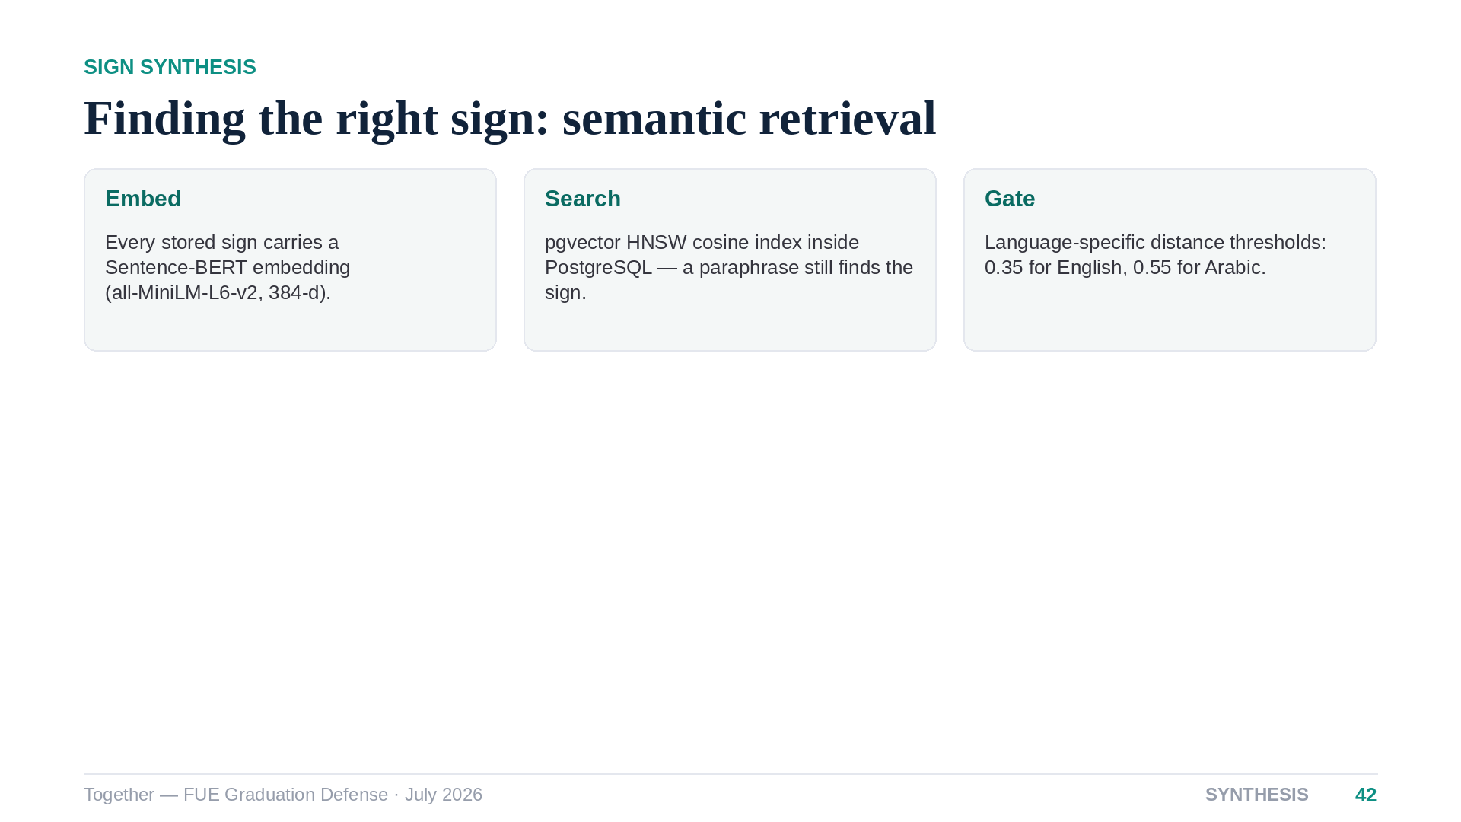
Notes:
[Speaker 3 — 35s] To animate a word we search semantically, not by string match. Every sign in the database has a sentence-embedding; the query is embedded and matched by cosine distance inside Postgres itself, using an HNSW index. Ask for “home” and the sign for “house” answers. A distance gate per language keeps bad matches out.

Slide 43
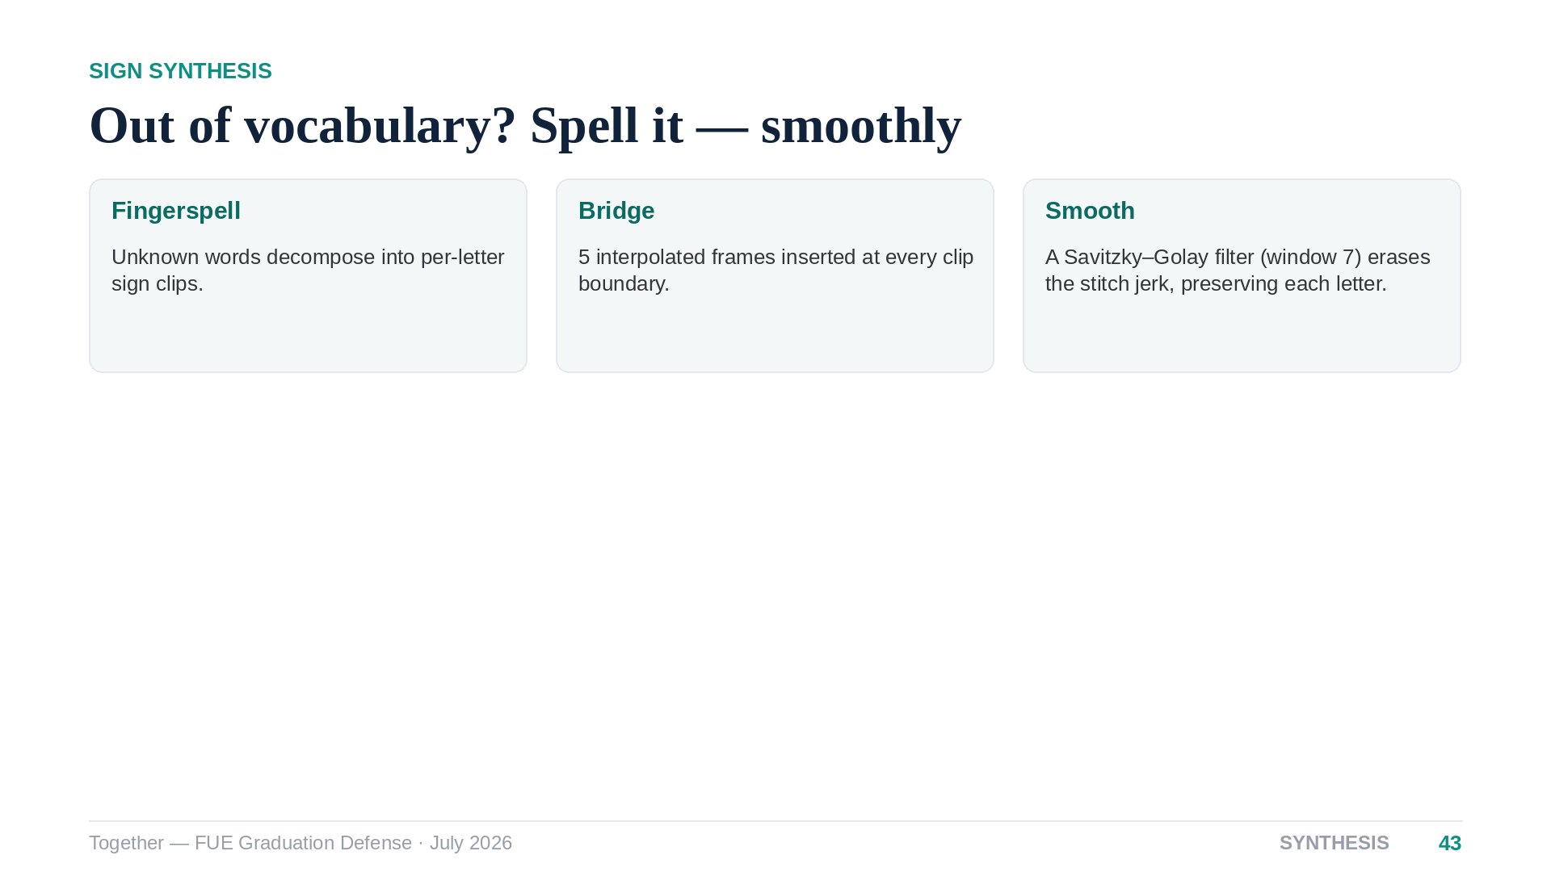
Notes:
[Speaker 3 — 30s] When a word has no dedicated sign, we synthesize it: fingerspell letter by letter, insert short interpolated bridges between clips, and run a Savitzky-Golay filter over each boundary so the concatenation reads as one continuous motion instead of a slideshow of letters.

Slide 44
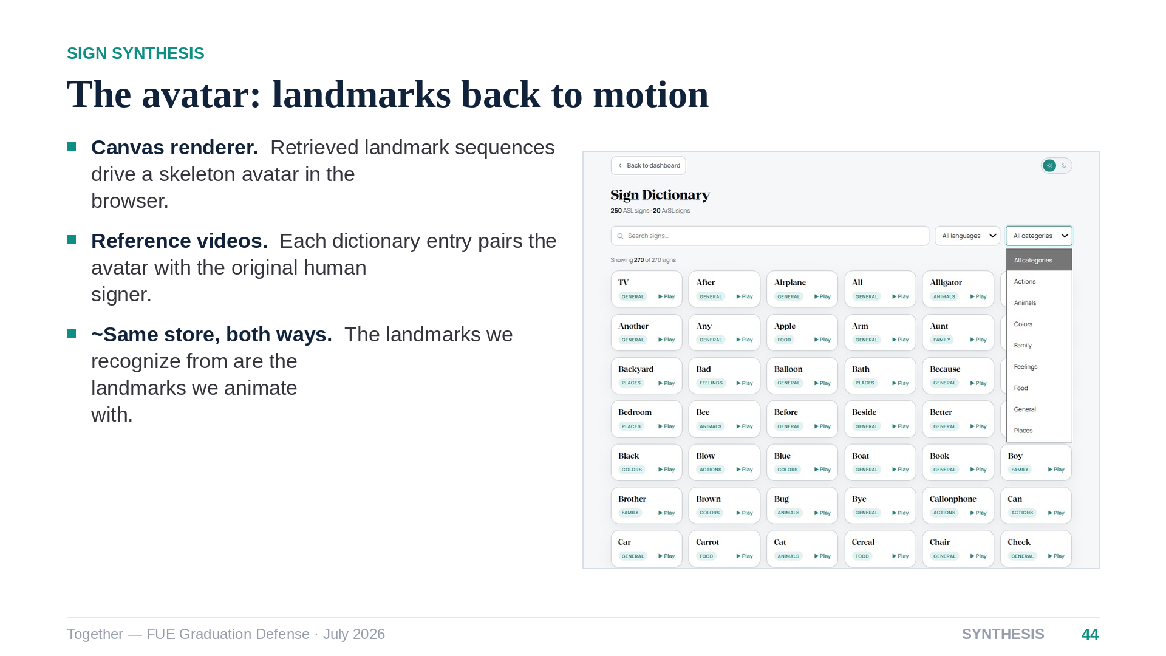
Notes:
[Speaker 3 — 35s] The avatar is a canvas renderer that replays those landmark sequences as a moving skeleton — here inside the dictionary, side by side with the original human recording so learners can compare. One elegant property: the exact representation we recognize from is the representation we animate with. Now let me show you the product this all lives in.

Slide 45
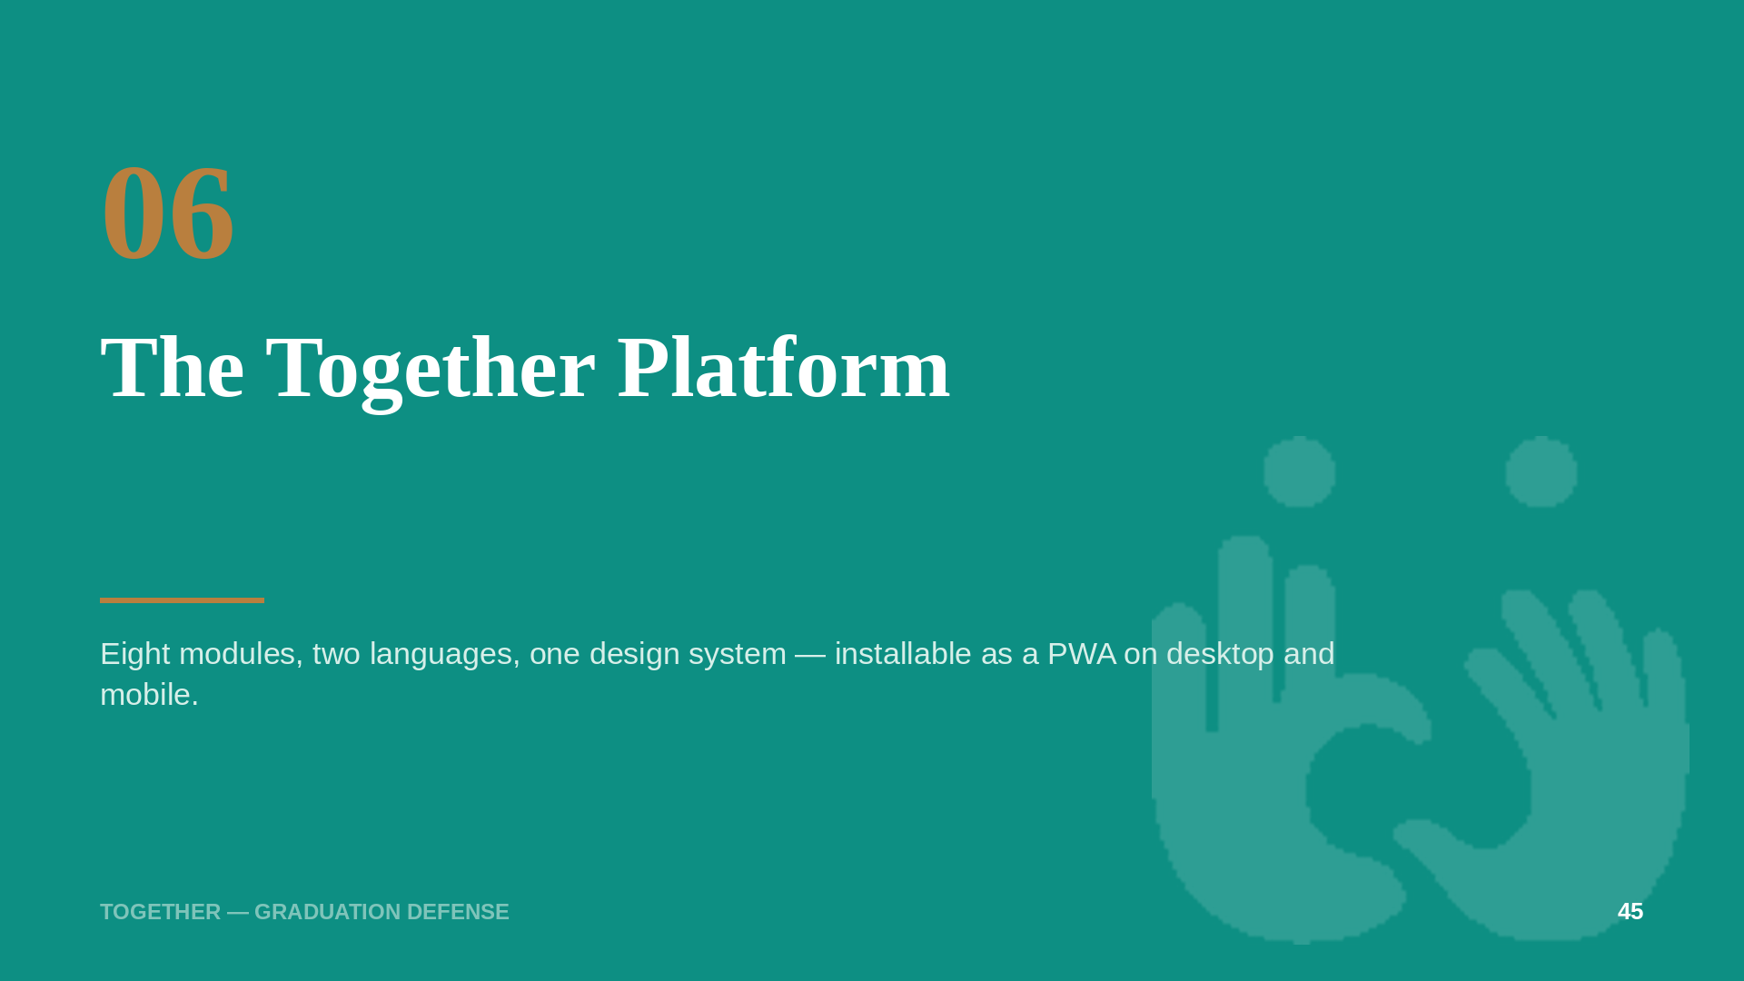
Notes:
[Speaker 3 — 10s] Everything so far ships inside one bilingual web application.

Slide 46
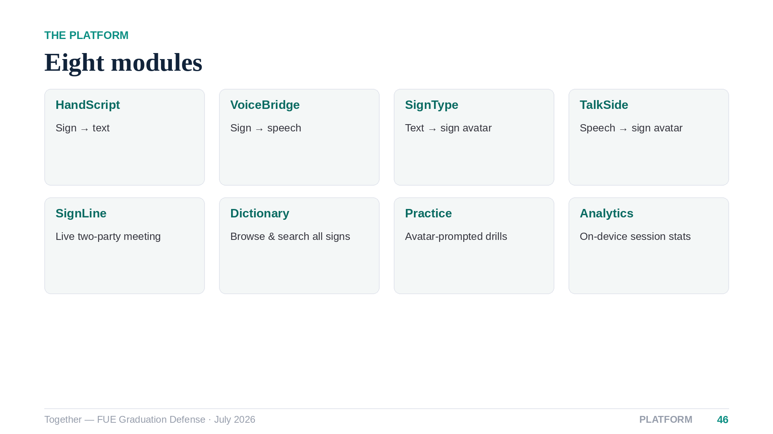
Notes:
[Speaker 3 — 30s] Five translation modules cover every direction plus the live meeting, and three companion modules — Dictionary, Practice and Analytics — turn the platform into a learning tool as well as a translator. All eight share one real-time dashboard and one design system.

Slide 47
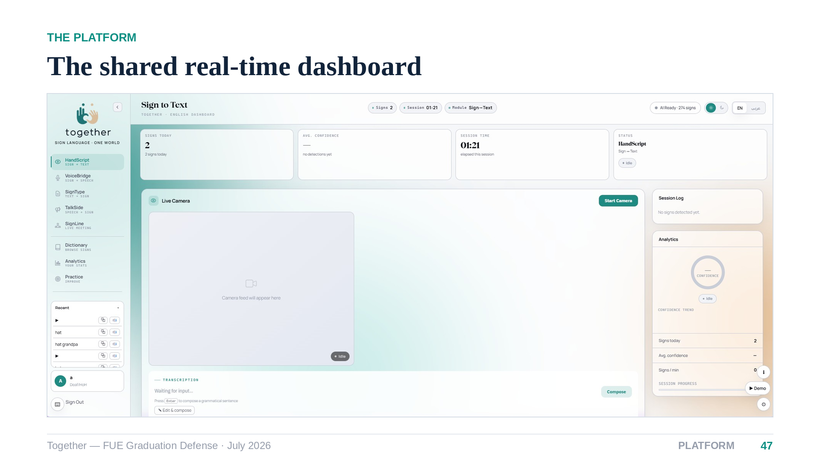
Notes:
[Speaker 3 — 35s] This is HandScript translating live: camera panel with start-stop, recognized signs streaming into the session log, a confidence ring updating per inference, and the transcription panel where accumulated gloss becomes a sentence — automatically on a pause, or on demand. The status cards along the top track today's signs, average confidence and session time.

Slide 48
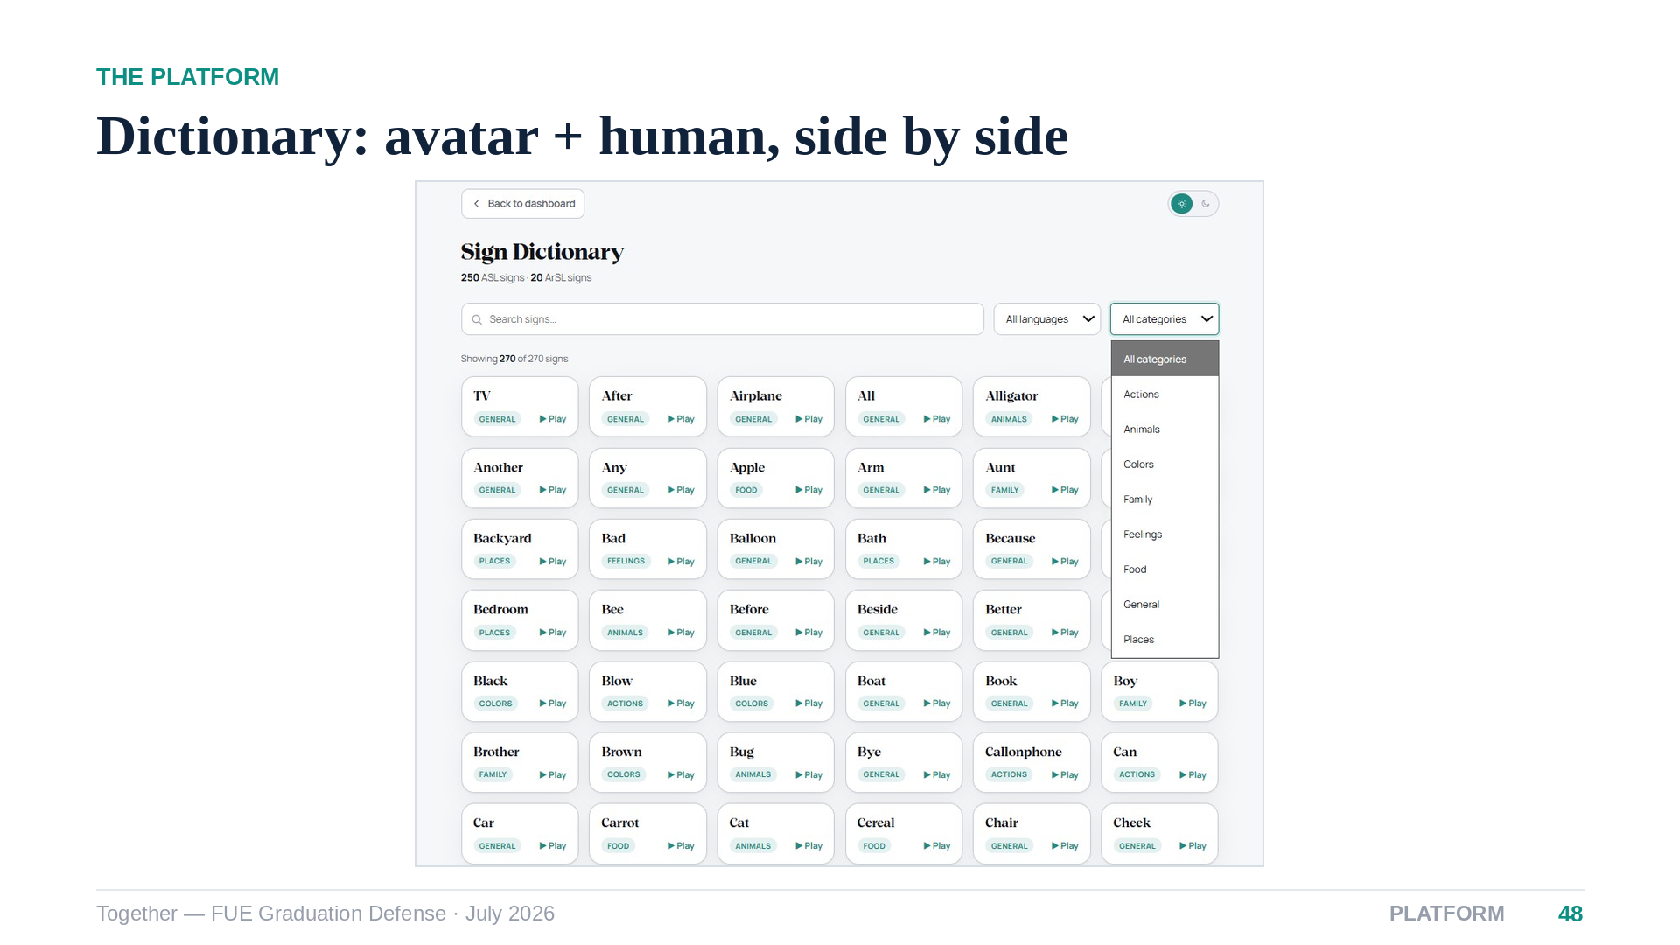
Notes:
[Speaker 3 — 25s] The Dictionary exposes the whole vocabulary with category filters and semantic search — a paraphrase still lands on the right entry. Every sign renders as the avatar and, where available, the original signer video, which learners told us is the combination they actually want.

Slide 49
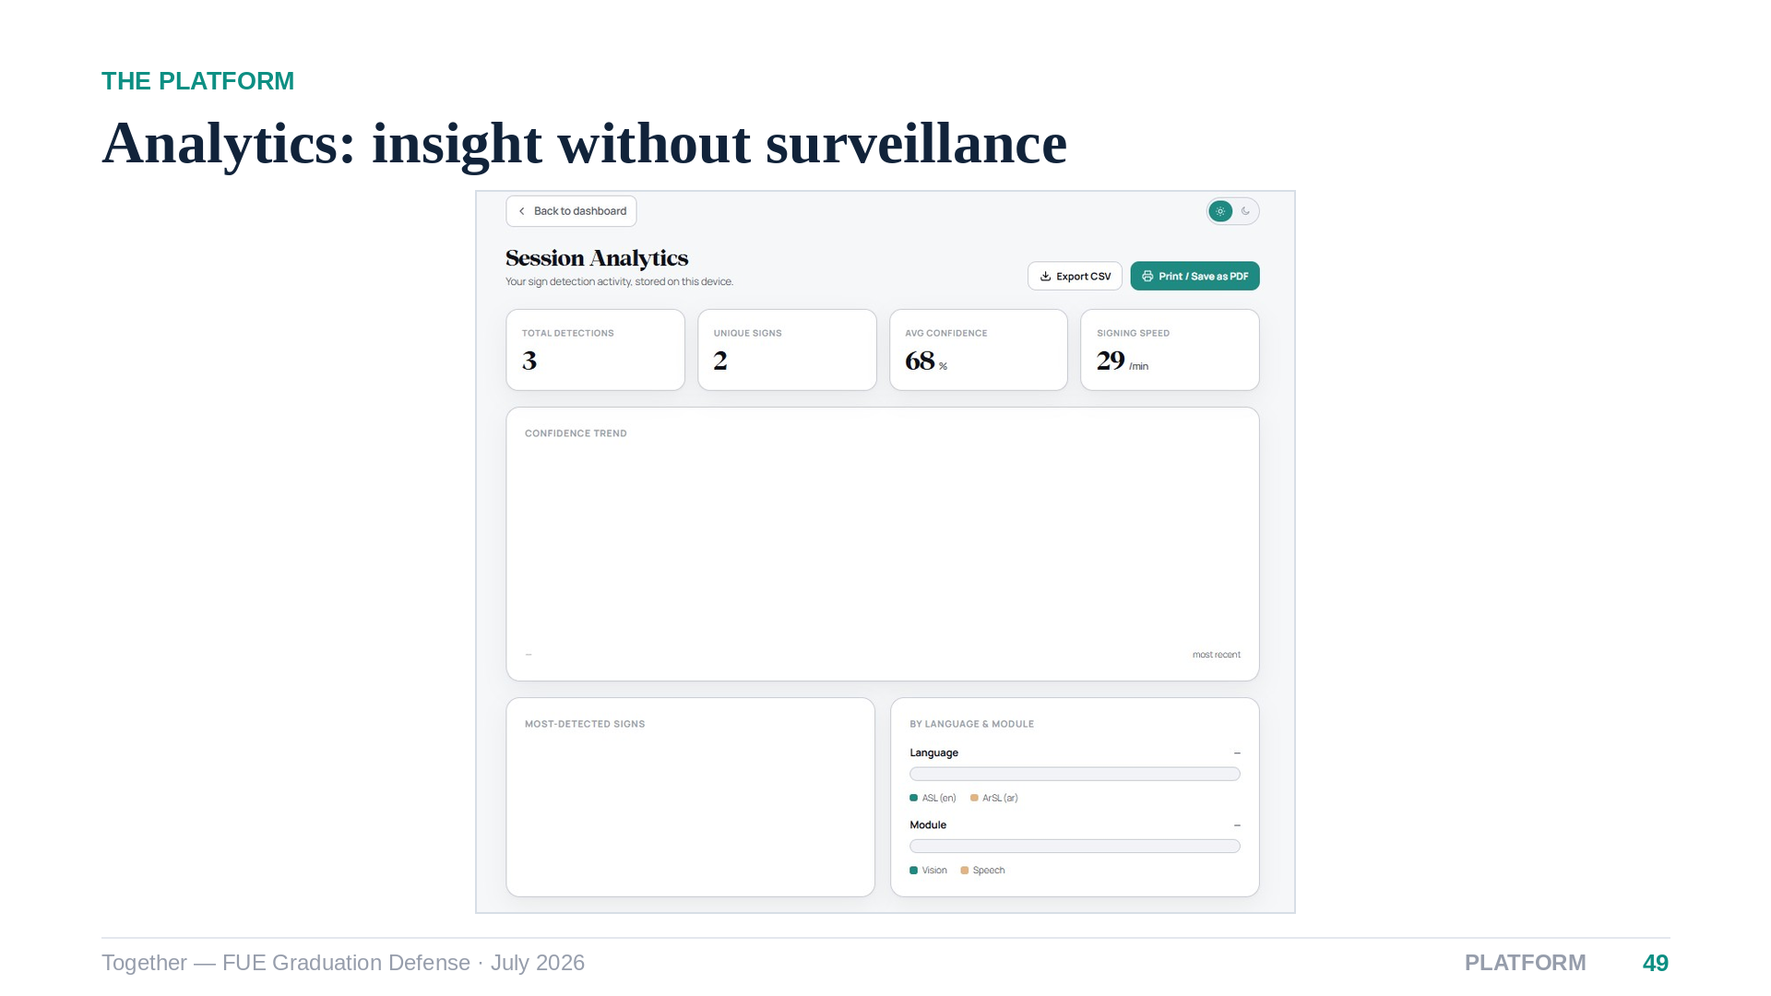
Notes:
[Speaker 3 — 25s] Analytics summarizes detections, unique signs, confidence trends and signing speed — computed entirely on the device, consistent with our privacy rule that only landmarks ever leave the browser. Sessions export to CSV or print to PDF.

Slide 50
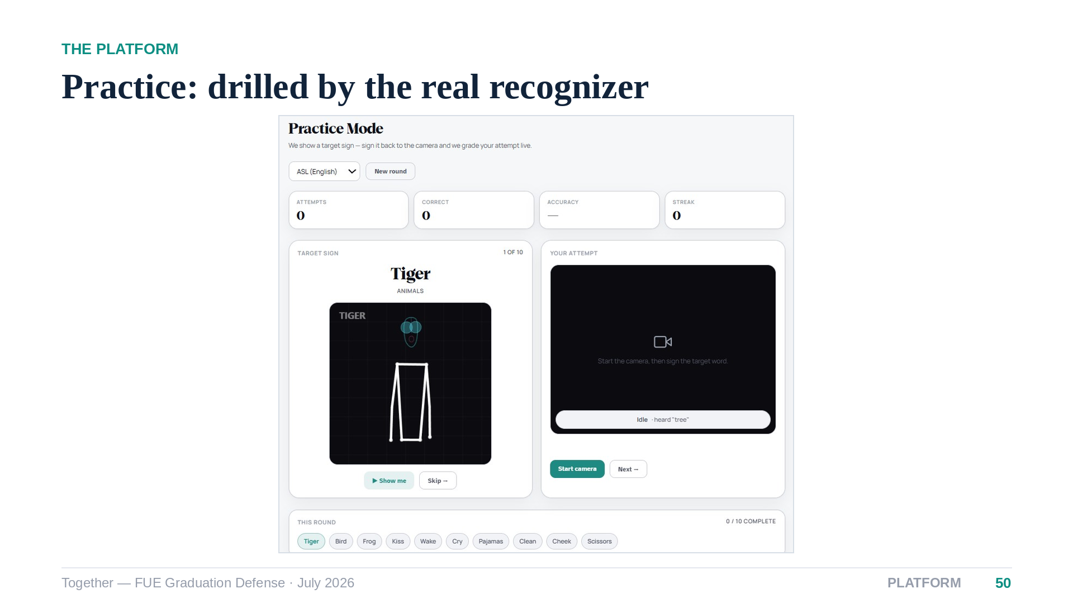
Notes:
[Speaker 3 — 25s] Practice runs ten-sign rounds: the avatar demonstrates, the learner attempts, and the very same recognition pipeline that powers translation judges the attempt with live feedback. You are graded by the production system, not a toy.

Slide 51

Notes:
[Speaker 3 — 25s] The Arabic experience is not a translated skin — it is a true right-to-left mirror of the entire interface, down to charts and the avatar panel, with no English leaking through. The same views adapt to mobile, where Together installs as a progressive web app.

Slide 52

Notes:
[Speaker 3 — 35s] Security is thesis-grade, not an afterthought: Argon2id hashing, rotating refresh tokens, sliding-window rate limits, and registration verified by a WhatsApp one-time password. And the deepest privacy property is architectural — the server never receives video, only landmark coordinates. Speaker four will now put numbers on all of this.

Slide 53

Notes:
[Speaker 4 — 10s] Thank you. Let us put every claim under a number.

Slide 54

Notes:
[Speaker 4 — 35s] Our methodology rests on four families of evidence. The one I want to highlight is generalization: models are easy to flatter with a random split, so we tested the ASL model on an entirely different corpus, and the Arabic model on signers it had never seen. And translation quality is always measured against the raw-gloss baseline, so the language model's contribution is isolated, not asserted.

Slide 55

Notes:
[Speaker 4 — 45s] Here are the four headline numbers. ASL: eighty percent on its own test distribution, and sixty-two point four when we take the same model to SignASL — a different corpus, different signers, different recording conditions. That drop is expected; still recognizing the majority of two hundred and fifty signs on a foreign corpus is evidence of real sign representations. ArSL: ninety-nine point four in-distribution, and eighty-eight percent on held-out signers — the honest number, and a strong one for phone-camera video.

Slide 56

Notes:
[Speaker 4 — 30s] The full metric tables. Macro precision and recall track accuracy closely in both models, which tells you performance is balanced across classes rather than carried by a few easy signs. Top-five accuracy of ninety-five percent for ASL matters in practice: the right sign is almost always among the top candidates feeding our voting buffer.

Slide 57

Notes:
[Speaker 4 — 30s] The full twenty-by-twenty confusion matrix for Arabic is almost perfectly diagonal — the handful of off-diagonal cells are single confusions between visually adjacent signs. There is no systematic failure mode here; at this vocabulary size the model is essentially solved in-distribution.

Slide 58

Notes:
[Speaker 4 — 45s] For ASL we ranked misclassifications by the model's confidence in the wrong sign, from a re-run of the cross-dataset evaluation. Look at what confuses it: listen and hear. Cut and scissors — in both directions. Chin and thirsty, both articulated at the chin. These are signs that genuinely look alike; the model's errors are the errors a human learner makes, which is exactly what a credible recognizer's failure profile should look like.

Slide 59

Notes:
[Speaker 4 — 40s] Now objective six: does the language model actually help? Character-level F-score against human references: for English, raw gloss scores 0.54 and the LLM lifts it to 0.91. For Arabic, 0.34 to 0.59. Both gains are large and consistent — and the Arabic numbers are structurally lower not because that system is worse, but because Arabic morphology spreads correct meaning across many surface forms that overlap metrics penalize.

Slide 60

Notes:
[Speaker 4 — 35s] The BLEU profiles make the mechanism visible. Raw gloss holds some unigram credit — the content words are there — but collapses toward zero at four-grams: gloss has words, not phrasing. With the LLM the curves stay high across all n-gram orders: BLEU-4 of 0.81 for English and 0.42 for Arabic, against baselines of 0.04 and 0.03. A twenty-fold improvement in fluent phrasing.

Slide 61

Notes:
[Speaker 4 — 35s] Decomposing chrF nails down what the LLM adds. Raw gloss already has decent precision — its words are correct — but poor recall: everything grammatical is missing. The long arrows are recall: for English from 0.52 to 0.91. The language model is not polishing word choice; it is supplying the function words and morphology — the grammar — that gloss by definition lacks.

Slide 62

Notes:
[Speaker 4 — 35s] Latency: the ASL ensemble answers in about forty-three milliseconds and the quantized Arabic model in four — INT8 quantization bought a 1.78-times speedup with no measurable accuracy change. The gloss cache removes repeated LLM round-trips entirely. All of it on CPU: the demo you are about to see runs on hardware like this podium laptop.

Slide 63

Notes:
[Speaker 4 — 40s] Four limitations, stated plainly. We recognize isolated signs, not continuous signing. The ASL in-distribution split shares signers, which is why we lean on the cross-dataset number. The Arabic vocabulary is twenty words. And our translation reference set is small, so we weight chrF over BLEU. We would rather you hear these from us than find them yourselves.

Slide 64

Notes:
[Speaker 4 — 25s] None of these is a dead end — each maps to a concrete next step, and the landmark-based architecture carries over unchanged to all four. That is, in our view, the mark of a good foundation.

Slide 65

Notes:
[Speaker 4 — 40s] Our contributions, in order of what we believe matters: the first system in this space that is bidirectional, bilingual and hardware-free at once; a working Egyptian sign recognizer validated on held-out signers; the demonstration that a general-purpose LLM can replace the parallel corpora this field usually requires; and a blueprint anyone can reproduce from public data on commodity hardware.

Slide 66

Notes:
[Speaker 4 — 25s] Future work follows directly: continuous signing, a larger consented Arabic corpus, signer-independent ASL evaluation, a study with the Deaf community, fully on-device recognition, and new languages — the architecture has already shown it generalizes across two very different ones.

Slide 67

Notes:
[Speaker 4 — 25s] Our thesis closes with this sentence, and we stand behind every word of it: an accessible, bidirectional, bilingual sign-language translator is achievable today. Not in a lab — in a browser. Let us show you.

Slide 68

Notes:
[Speaker 4 — 4-5 min] Demo runbook: start on the English dashboard, sign two or three ASL signs, let the vote buffer commit them, and trigger sentence formation — then play the spoken output. Switch to SignType and type a sentence for the avatar. Flip the language toggle to show the full Arabic right-to-left interface and recognize one ArSL sign. If time allows, open SignLine on the second laptop and hold a two-way exchange. Fallback if the network misbehaves: the offline chain — Ollama and local TTS — keeps every step functional.

Slide 69

Notes:
[All — Q&A] Thank you for your attention. We are happy to take questions in any order — each of us will field the section they presented. The backup slide that follows holds the full hyperparameter tables if the committee wants exact training configurations.

Slide 70

Notes:
[Backup — not presented] Complete training configurations for both models, kept for committee questions. Everything here matches Chapter 4 of the thesis exactly; if asked about any single value, the relevant thesis section is 4.2.4 for ASL and 4.3.4 for ArSL.

