Slide 1


Department of CSE
Raghu institution of technology
Smart Inventory System
Real-Time Inventory and Stock Management for Grocery Stores
Project Guide
Mr. K Vijay,
Assistant Professor,
Raghu Institute Of Technology
Yogi Raj
Sudheer
Bhavika
Raj Kumar
Project Review -1

Slide 2

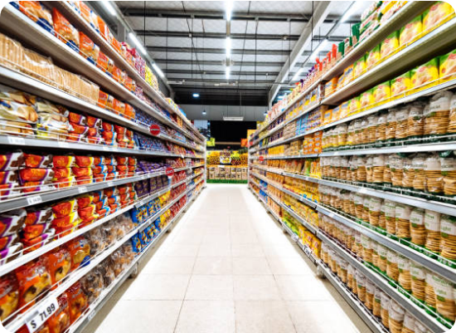
The Problem
Challenges in Local Retail
•
Manual Tracking: Prone to human errors and inaccuracies.
•
Stockouts & Overstocking: Inability to predict demand leads to lost sales or wasted capital.
•
Wastage: Perishable items expire unnoticed due to poor batch tracking.
•
Lack of Insights: No real-time data to make informed purchasing decisions.

Slide 3
The Solution
A modern, web-based platform designed to automate operations, track inventory in real-time, and connect directly with suppliers.

Slide 4
Table of contents
01
04
02
05
03
06
System Analysis
Introduction
Proposed System
Objectives
Goals , and expected outcome
System Design
Literature Survey
Existing work survey
And gaps
Technology Stack

Slide 5





INTRODUCTION
PROBLEMS
Problem Statement
Traditional inventory management in Kirana shops relies on manual tracking or outdated systems, leading to inaccurate stock counts, stock-outs, overstocking, and lack of real-time visibility.

Slide 6

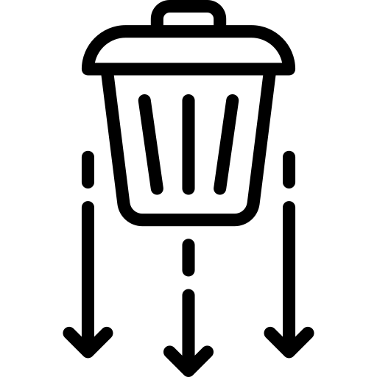


OBJECTIVES
2
3
Track inventory levels in real time
Reduce manual errors and wastage
What we aim to achieve.
1
4
Automatically update stock during sales
Provide a live dashboard for store owners

Slide 7
Goals (EXPECTED OUTCOMES based on your features)
Improved inventory accuracy
Demand forecasting using historical sales data (future enhancement)
1º
5º
Mercury is the closest planet to the Sun
GOAL
2º
Faster decision-making
4º
Despite being red, Mars is a cold place
Scalable base for future features
And
Cloud deployment
3º
Reduce Stock looses

Slide 8
Literature Survey
What Others Have Done
Inventory & sales data storage
Summary of Existing Solutions / Research:
Existing inventory management systems focus on basic stock maintenance, billing, and sales records. Most research papers propose centralized inventory databases with periodic updates and report generation.
1
2
Sales and stock record maintenance
Inventory reports and summaries
3
4
Automatic replenishment

Slide 9

Gaps / Limitations in existing work
1
Complex system design not suitable for small Kirana shops.
2
No predictive analysis for low-stock or demand trends.
3
Limited user-friendly dashboards for quick decision-making
4
No cloud-ready architecture for scalability

Slide 10

Enhancements Over Existing System
1
Simplified UI & workflow for Kirana shop owners
2
Visual live dashboard for instant understanding
3
Low-stock alerts and analytics-ready design
4
Cloud-ready architecture for scalability

Slide 11




System Analysis
User (Browser)
React Dashboard
Proposed System Overview
Web-based inventory management system for Kirana shops
Real-time stock tracking with automatic updates
Live dashboard for instant inventory visibility
Spring Boot API’s
PostgreSQL Database

Slide 12



System Analysis
Software Requirement
1. Frontend: React.js
2. Backend: Spring Boot
3. PostgreSQL
4. ORM: JPA / Hibernate
5. OS: Windows / Linux
6. Browser: Chrome/Firefox
7. AWS

Slide 13
SYSTEM DESIGN
Software Requirement
CLIENT TIRE
APPLICATION TIRE
DATA TIRE
React Frontend
Port:3000
JavaScript/JSX
Spring boot backend
Port: 8080
Rest API
PostgreSQL
Database
Port: 5432
Security Layer
Jwt Token Validation
Core tables
Screen 1
Purchase Management
Screen 2
Billing
Or
Point of Sale
http / Rest
JDBC
1. Retailers
2. Suppliers
3. Customers
4. Items
5. Purchase Orders
6. Sales
7. Sale items
8. Inventory transactions
9. Supplier payments
API ,Json
Rest Controller
Queries
Screen 3
Stock Monitoring
Screen 4
Report
Or history
Service Layer
Business logic layer
Views:
Repository Layer
Low stock items
Pending supplier payments
Daily sales report

Slide 14






Technology Stack
React JS
Spring Boot
PostgreSQL
AWS
Frontend: Responsive and dynamic user interface.
Backend: Robust and scalable server-side logic.
Database: Reliable structured data storage.
Cloud: Secure hosting and deployment infrastructure.

Slide 15
"Minimizes stockouts, eliminates human errors, and enhances customer satisfaction through automation."
— Project Goal

Slide 16
Questions?
Thank you for your attention.
Smart Inventory System Team

