Slide 1
Setting up a Spatial Data Infrastructure (SDI) with Open Source Software using OSGeoLive
Astrid Emde, Angelos Tzotzos, Nicolas Roelandt
FOSS4G 2019 Bucharest

Slide 2

SDI Workshop
What is a Spatial Data Infrastructure (SDI)
Components of an SDI
Data
Services & OGC Standards
Clients
Metadata
Get to know OSGeo Software

Slide 3

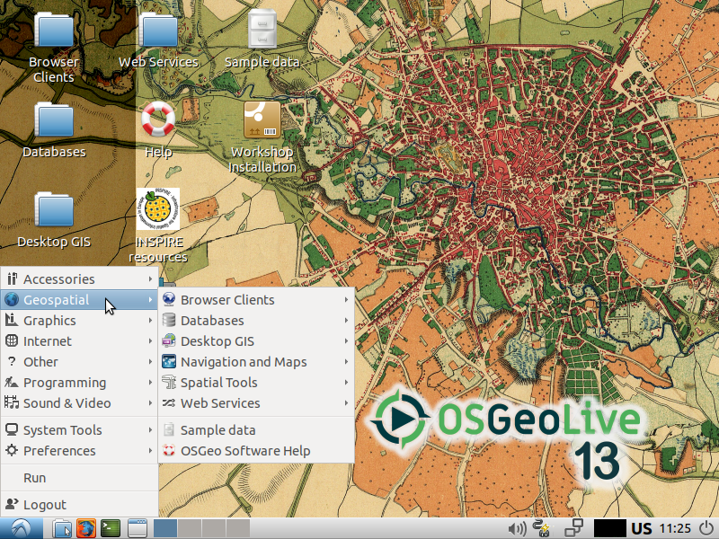
Workshop with OSGeoLive
OSGeoLive 13.0
(August 2019)
OSGeoLive
http://live.osgeo.org
Download Data & Presentation
http://trac.osgeo.org/osgeolive/wiki/Live_GIS_Workshop_Install

Slide 4
What is a SDI?

Slide 5

What is an SDI?
A spatial data infrastructure (SDI) is a data infrastructure implementing a framework of geographic data, metadata, users and tools that are interactively connected in order to use spatial data in an efficient and flexible way. Another definition is "the technology, policies, standards, human resources, and related activities necessary to acquire, process, distribute, use, maintain, and preserve spatial data".
Zitat: Wikipedia https://en.wikipedia.org/wiki/Spatial_data_infrastructure

Slide 6
SDI
Data infrastructure that provides geographic data and metadata
Data network to exchange data
Data producer and data user are connected via a physical network f.e internet / intranet
it is accessible for several users
Users can use different tools for different processes
It helps you to make data accessible, maintainable and findable throughout your organization
Increases efficiency and flexibility

Slide 7




Communication with the Clients
Clients
centralized
Data storage
Clients
Server
Service
From Geodatendienste im Internet (3. Auflage, KSt. GDI-DE)
http://www.geoportal.de/SharedDocs/Downloads/DE/GDI-DE/Flyer-Broschueren/Leitfaden-Geodienste-im%20Internet.pdf?__blob=publicationFile
Notes:
GDI als Netzwerk zum Austausch von Geodaten
* Verwaltungs- und Fachübergreifende Geodatenangebote
--> Verknüpfung von Geodaten-Produzenten, Dienstleistern und Geodatennutzer
--> Bereitstellung raumbezogener Informationen für alle Nutzer
* Systematische Strukturierung und Koordinierung von Geodaten
GDI-Elemente:
* Geodaten mit Metadaten (Beschreibung)
* Geodatendienste
* Datennetze

Slide 8
Data storage
file system
database
Spatial Services
Provide data access
OGC Services
WMS Web Map Service
WFS Web Feature Service
WCS Web Coverage Service
WMC Web Map Context
WPS Web Processing Service
CSW Catalog Service Web
& more
Client
Search / View /
Download Data
Browser
Desktop GIS
Edit data
editors f.e. Desktop GIS
command line tools
scripts
Exercise 1: Please assign Open Source Software to the components of a SDI. See https://live.osgeo.org

Slide 9
Data storage
file system
database
ESRI Shape
OGC GeoPackage
PostgreSQL/PostGIS...
Spatial Services
Provide data access
OGC Services
MapServer
GeoServer
deegree
QGIS Server
PyWPS
GeoNetwork
pycsw
Client
Search / View /
Download Data
Browser: Mapbender,
OpenLayer,
Leaflet, Cesium
DesktopGIS: QGIS,
GRASS GIS, Saga,
OpenJump, gvSig,
Marble
Edit data
editors f.e. Desktop GIS
QGIS, gvSIG, uDIG,
Saga, GRASS, OpenJump
command line tools
ogr2ogr gdal shp2pgsql
scripts f.e. python

Slide 10
Data - Status
Users work with different data
Different formats
Different tools to view and edit
Data can is spread and copied
Data can have different versions that are in use

Slide 11
Data
Goals
Central data storage
Editing does not have to take place always in the central data storage, but define how to exchange
Easy import & export of data
Flexible visualisation with different tools
Data storage with defined access
Data storage with authentification/authorisation and multi user access
Data history

Slide 12
Data
Goals
First Goal: centralized data storage

Slide 13

Database

Slide 14


PostgreSQL & PostGIS
<
https://live.osgeo.org/de/overview/overview.html

Slide 15
PostgreSQL
Supported by several other programs and programming languages
Fast, powerful, reliable, robust, easy to maintain
PostGIS is an extension for PostgreSQL
Let PostGIS do the work - not your Desktop GIS
Follows standard - OGC Simple Feature Spezification for SQL and OGC ISO SQL/MM Spezification
Provides many spatial functions
Control access to your data

Slide 16

Exercise 2: Create Database in PostgreSQL
Open Database Client pgAdmin III
Create database: context menu on database → new database → name foss4g
Load postgis Extension
  Context menu on database foss4g → new object → new extension → name: postgis

Slide 17
Data
Goals
First Goal: centralized data storage
Second Goal: Easy import & export of data
Third Goal: Flexible visualisation with different tools

Slide 18
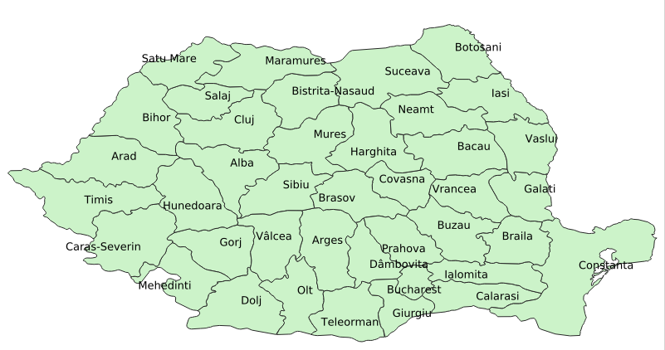

Exercise 3: Load Natural Earth data (Shapes) in Desktop GIS QGIS
/home/user/data/natural_earth2/ne_10m_admin_1_states_provinces_shp.shp
Provinces of Romania
Filter show only admin = 'Romania'
Label with column [name]

Slide 19

Data import from QGIS to PostgreSQL
You can import Shape to PostgreSQL via
  QGIS DB Manager
  or
  shp2pgsql
  ogr2ogr
  python
  ...

Slide 20

Create a new PostgreSQL Connection in QGIS

Slide 21

QGIS DB Manager
Easy Import / Export
Supports many data formats
Visualize your data
Show &
edit table structure
Create index
Vacuum / Analyze

Slide 22

QGIS DB Manager Import

Slide 23
Exercise 4: Import & Export
Import provinces from Natural Earth data (only Romania)
Import populated places from Natural Earth data (only Romania)
Add the table from your database to your QGIS project (drag & drop)
Export: Save populated places as geopackage via DB Manager or via QGIS save as...

Slide 24
Data
Goals
First Goal: centralized data storage
Second Goal: Easy import & export of data
Third Goal: Flexible visualisation with different tools
Fourth Goal: Defined access to data

Slide 25
PostgreSQL roles
PostgreSQL has roles
  groups
  User with login
You can give access to databases, schema, tables, views … to roles
Write or read access

Slide 26
Create roles in PostgreSQL
Create role, create login role
Give read access to table places
Give write access to table countries

Slide 27
Exercise 5: Control data access
Create a role workshop_read and workshop_writer
Create a login role robert with a password and add to workshop_reader
Create a new login role wilma and add wilma to the workshop_writer role
Grant read access to table places to your new role workshop_reader
Grant write access to table countries to your new role workshop_writer
Try to access and edit via QGIS

Slide 28
Exercise 5: Control data access Solution
CREATE ROLE workshop_reader;
CREATE ROLE workshop_writer;
CREATE ROLE robert WITH LOGIN PASSWORD 'foss4g';
GRANT workshop_reader TO robert;
CREATE ROLE wilma WITH LOGIN PASSWORD 'foss4g';
GRANT workshop_writer TO wilma;

Slide 29
Exercise 5: Control data access Solution
GRANT SELECT ON places to workshop_reader;
-- change to user robert
Select * from places;
GRANT ALL ON countries to workshop_writer;
GRANT USAGE ON SEQUENCE countries_gid_seq TO workshop_writer;
-- change to user wilma
Select * from countries;
Update countries set name = 'TEST' WHERE name = 'Romania';

Slide 30
Data storage
file system
database
Spatial Services
Provide data access
OGC Services
WMS Web Map Service
WFS Web Feature Service
WCS Web Coverage Service
WMC Web Map Context
WPS Web Processing Service
CSW Catalog Service Web
& more
Client
Search / View /
Download Data
Browser
Desktop GIS
Edit data
editors f.e. Desktop GIS
command line tools
scripts

Slide 31
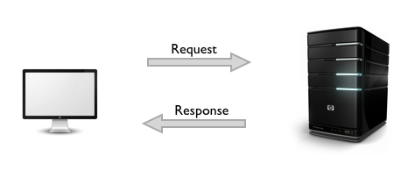
Services

Slide 32
Provide Data via OGC Services
Goals
Provide Data in the web - Intra- or Internet
Provide data via standards that many tools support
Provide INSPIRE conform Services in Europe
OGC WMS Web Map Service – show data and get information (advantage: styling is already defined)
OGC WFS Web Feature Service - download service, provide data, edit data

Slide 33
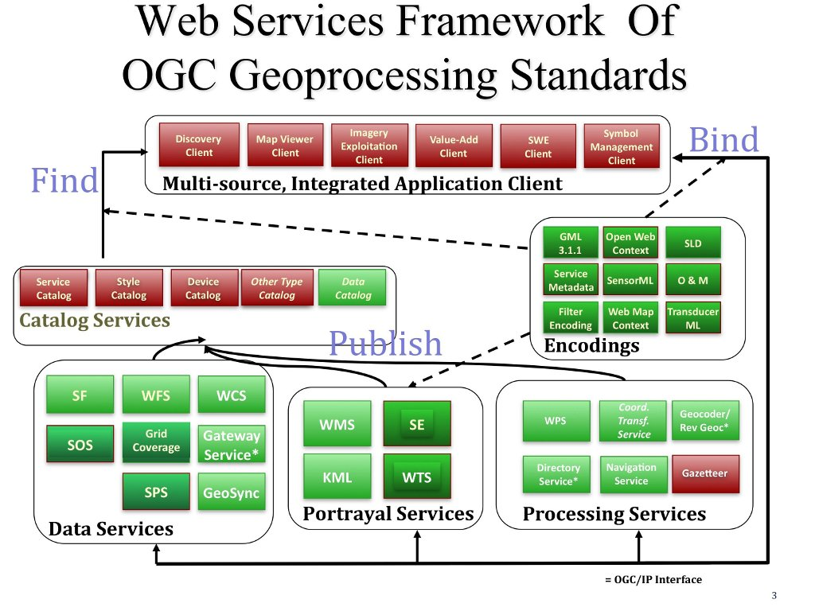
https://live.osgeo.org/archive/10.5/en/standards/standards.html

Slide 34
OSGeo Software with OGC WMS Support
MapServer
GeoServer
QGIS Server
deegree
MapProxy
OGC WMS – map service, provide maps as raster, information as html, plain text, GML

Slide 35
OSGeo Software with OGC WFS Support
MapServer
GeoServer
QGIS Server
deegree
MapProxy
OGC WFS – feature service, data access f.e. via GML

Slide 36
Provide Data via OGC Services
Goals
First Goal: Provide Data in the web - Intra- or Internet
Provide data via standards that many tools support
OGC WMS Web Map Service – show data and get information (styling is already defined)

Slide 37
WMS example with QGIS Server
Publish your data via QGIS Server as WMS
Menu → Project → Project properties → OWS Server
Name and title, extent, layer access
(make sure you saved the password for your database access)
http://localhost/cgi-bin/qgis_mapserv.fcgi?map=/home/user/service_wms.qgz&SERVICE=WMS&VERSION=1.3.0&REQUEST=GetCapabilities

Slide 38
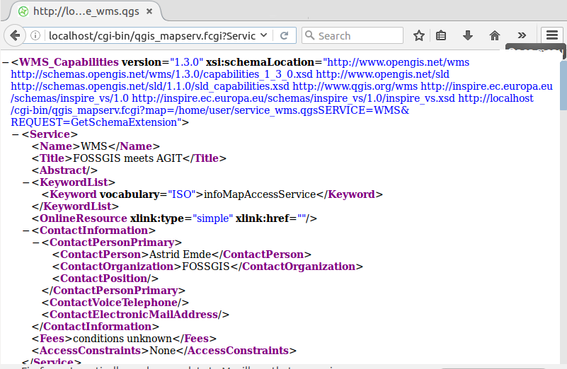
WMS Capabilities Document

Slide 39
Exercise 6: WMS example with QGIS Server
Publish your data via QGIS Server as WMS
Create a WMS with two layers countries and places – style them nicely with labeling
Save your project at: /home/user/service_wms.qgs
Load your WMS in an empty QGIS project

Slide 40
Exercise 7: Load external Services to QGIS
http://localhost/cgi-bin/qgis_mapserv.fcgi?map=/usr/local/share/qgis/QGIS-NaturalEarth-Example.qgz&SERVICE=WMS&VERSION=1.3.0&REQUEST=GetCapabilities
http://osm-demo.wheregroup.com/service?REQUEST=GetCapabilities&Service=WMS&Version=1.3.0
Romania http://geo-spatial.org/geoserver/ows?service=wms&version=1.3.0&REQUEST=getCapabilities
Find a WMS Server for you needs
https://inspire-geoportal.ec.europa.eu/

Slide 41
How to spread your service in the web?
Refer to your GetCapabilities-Urls
Add your GetCapabilities & Metadata in a Metadata catalog
Offer your WMS in WebGIS Client in a ready to use application f.e. OpenLayers, Leaflet, Mapbender, GeoMoose, MapStore, QGIS Map Client

Slide 42
Provide Services with Leaflet
// define rectangle geographical bounds
var bounds = [[43.700,20.000 ], [ 48.300,29.700]];
// create an orange rectangle L.rectangle(bounds, {color: "#ff7800", weight: 1}).addTo(map);
// zoom the map to the rectangle bounds
map.fitBounds(bounds);

Slide 43
Exercise 8: Leaflet
// define rectangle geographical bounds
var bounds = [[43.700,20.000 ], [ 48.300,29.700]];
// create an orange rectangle L.rectangle(bounds, {color: "#ff7800", weight: 1}).addTo(map);
// zoom the map to the rectangle bounds
map.fitBounds(bounds);

Slide 44
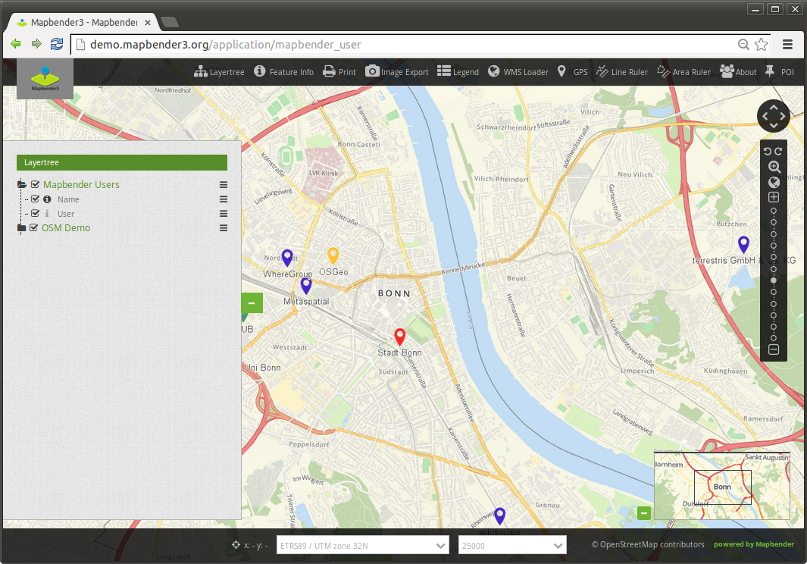
Provide Services in a Geoportal f.e. Mapbender
http://localhost/mapbender/
Login via: root / root
Provide Applications
for different needs

Slide 45
Publish WMS in Mapbender
Menu → New DataSource
Load GetCapabilities Url

Slide 46
Exercise 9: Load WMS in Mapbender
Load your QGIS WMS and some other WMS in Mapbender

Slide 47
Exercise 10: Create a new Application in Mapbender
Your application should start with the extent of Bucharest
Copy Application mapbender_user and rename it to FOSS4G
Switch to Layout → map-Element and set SRS EPSG:4326
Modify MAX EXTENT to Romania lower left 20.1139 43.5602 – upper right 29.8267 48.3647
Modify Start Extent Bucharest lower left 26.0985 44.4329 upper right 26.1064 44.4399

Slide 48
Exercise 11: Add Services to your application
Your application should show your QGIS WMS and some other external WMS
Go to Tab Layerset
Add WMS via +

Slide 49
Metadata Catalog to find your data
Goals
Your user should find your data
Provide a catalog for you data

Slide 50
Provide Metadata for your data and Services
Metadata should be provides & has to be up-to-date
OGC Catalogue Service Web (CSW)
GeoNetwork, GeoNode, pycsw, Metador
f.e Germany: GDI-DE & 16 Catalogues for provinces
f.e. Greek http://geodata.gov.gr/
INSPIRE
https://inspire.ec.europa.eu/INSPIRE-in-your-Country/DE
https://inspire.ec.europa.eu/INSPIRE-in-your-Country/RO

Slide 51
Exercise 11: Search in the Romanian Metadata Catalog for a Service
https://inspire.ec.europa.eu/INSPIRE-in-your-Country/RO

Slide 52
Exercise 11: Add your new QGIS WMS to GeoNode or GeoNetwork
Open GeoNode
Login: admin/admin
Add a new Metadata entry for you WMS
Follow the quickstart
https://live.osgeo.org/en/quickstart/geonode_quickstart.html

Slide 53
Wrap things up
Central data storage in a database offers lot of advantages
Data Sharing via Services is easy and supported by many programs
Offering ready-to-use applications covers the needs of many not advanced users
Metadata helps you to find the data you need
Metadata should be up-to-date
A SDI is a profit for all involved parties

