Slide 1

A new component framework for developing web map applications

Slide 2

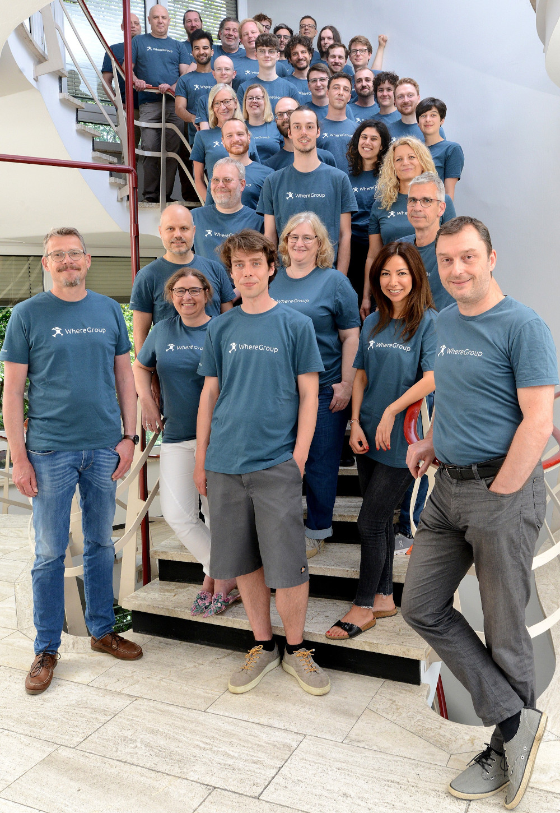
WhereGroup
WhereGroup GmbH
40+ employees - developers, consultants & geospatial experts
Working with & supporting Open Source Geospatial Software for more than 15
years
Berlin | Bonn | Freiburg | Hamburg
We are hiring!

Slide 3
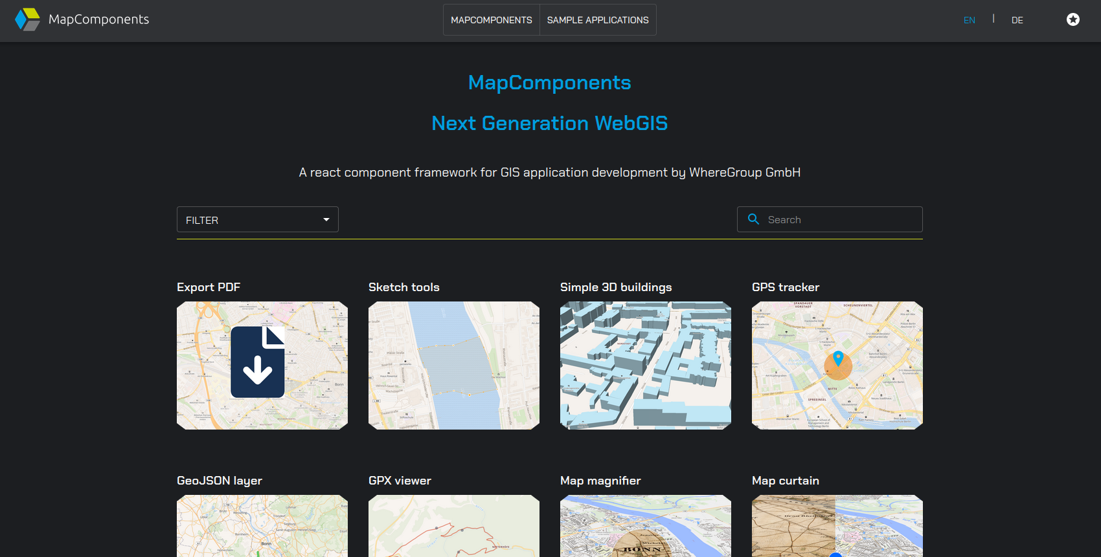
MapComponents, a new component framework for developing web map applications
MapComponents is a modular React component framework for declarative GIS application development
MIT licensed
https://www.mapcomponents.org
https://github.com/mapcomponents

Slide 4




MapComponents is built upon and extents React
+
...
https://reactjs.org/

Slide 5
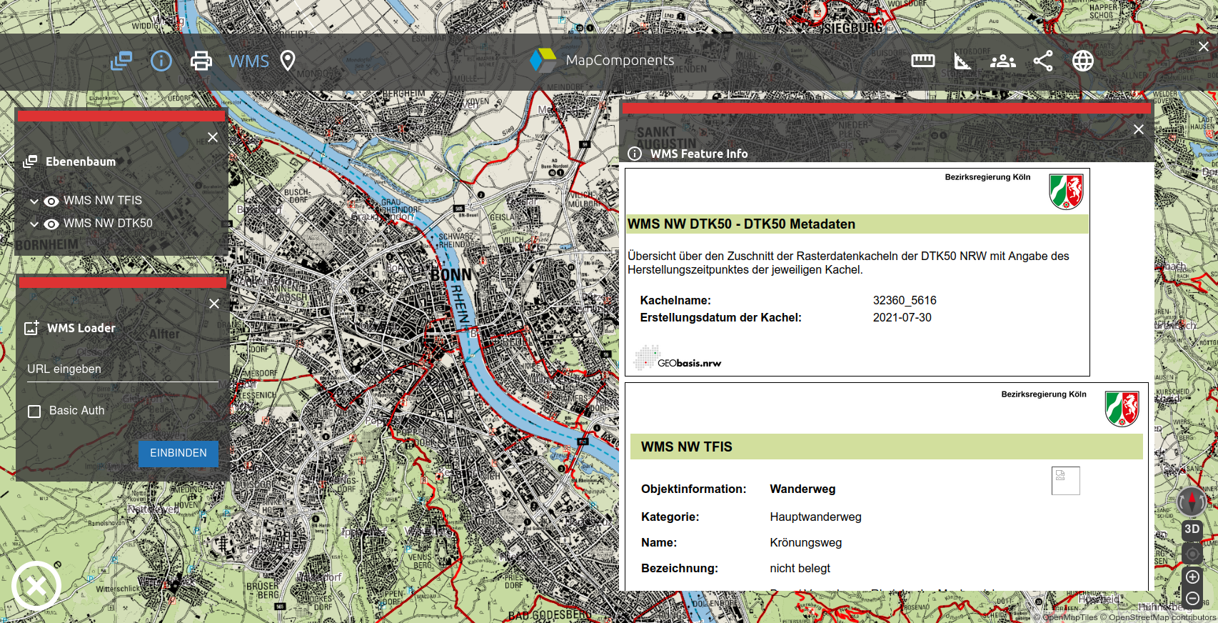
Application Example: WebGIS
Asd
asd
https://www.mapcomponents.org/en/demo/AppWebGis/dashboard

Slide 6
Application Example: Dashboard
https://www.mapcomponents.org/en/demo/AppRunningContest/dashboard

Slide 7
Component Example: Magnifier
https://www.mapcomponents.org/en/demo/MlLayerMagnify/mapcomponents-mllayermagnify--example-config

Slide 8
Use the Storybook to interactively explore the components
https://mapcomponents.github.io/react-map-components-maplibre/?path=/story/mapcomponents-mlgeojsonlayer--default-paint-overrides

Slide 9
Current state and goals
Very active development
Used for several customer projects already
Recently migrated to TypeScript
Server-side components for backend services

Slide 10

A modular React component framework for declarative GIS application development
https://www.mapcomponents.org
https://github.com/mapcomponents
https://twitter.com/MapComponents
Play around at https://codesandbox.io/s/base-template-n0vp9

